Slide 1
GIT Training
EM&M GIT website
http://emm-git1.sys.comcast.net/
GIT information and User Guide
http://emm-git1.sys.comcast.net/CEMP-227392710-050814-1337-42.pdf

Slide 2
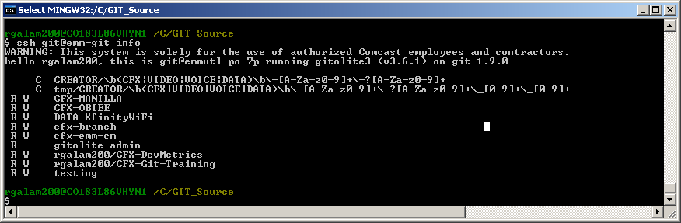
1. Create a directory on your laptop to add git repos into. Example c:\Git_Source
2. Go into explorer and find the Git_Source Directory
3. Right click and select “Git Bash”
4. Type: ssh git@emm-git info
This will give you a listing of all repos you can see. We are going to work with the “rgalam200/CFX-Git-Training” Repo

Slide 3
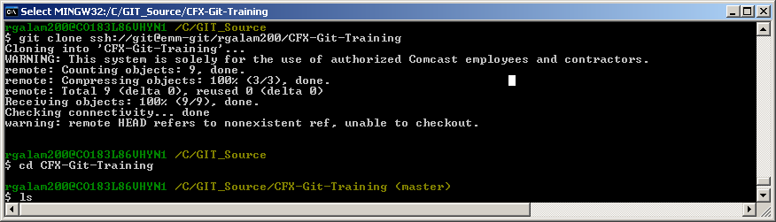
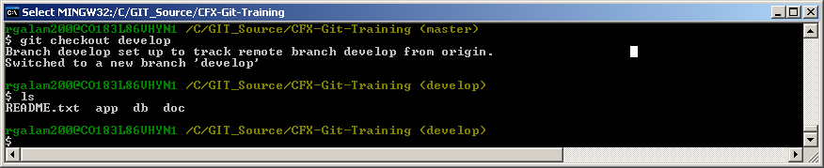
Clone the CFX-Git-Training Repo down to your local drive
git clone emm-git:rgalam200/CFX-Git-Training
2. cd into the new directory that has been created
3. Type: ls -- You see that it is empty
4. You are in the master branch as a default
rgalam200@C0183L86VNYN1 /C/GIT_Source/CFX-Git-Training <master>
Change to the develop branch: git checkout develop
rgalam200@C0183L86VNYN1 /C/GIT_Source/CFX-Git-Training <develop>
6. Type: ls -- The directories are now present

Slide 4
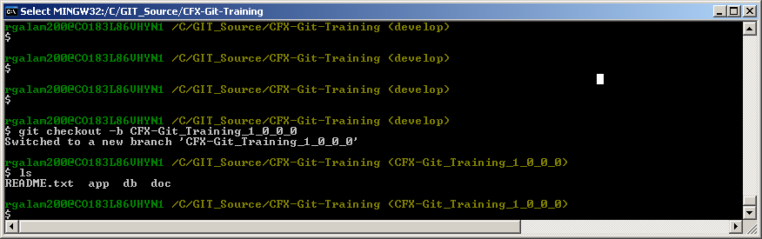
1. Create a new Branch called CFX-Git-Training_1_0_0_0
git checkout –b CFX-Git-Training_1_0_0_0
Now you are in the new branch.
rgalam200@C0183L86VNYN1 /C/GIT_Source/CFX-Git-Training <CFX-Git-Training_1_0_0_0>
** Create the following branches for training: (git checkout –b <Branch Name Below>.
Lakshmi: CFX-Git-Training_1_0_0_1
Aninyda: CFX-Git-Training_1_0_0_2
Rajib: CFX-Git-Training_1_0_0_3
Jason: CFX-Git-Training_1_0_0_4

Slide 5
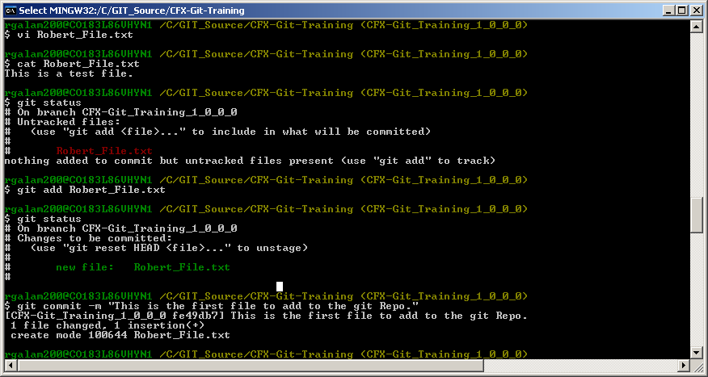
Create a test File
Check status:
git status -- This shows above that you have a new file in Red
Add the file to your local Repo
git add <Your_Name>_File.txt
Check status:
git status -- This shows above you need to commit the file in Green
Commit the File to the Repo (This command will commit all changes):
git commit –m “Description of Change”

Slide 6
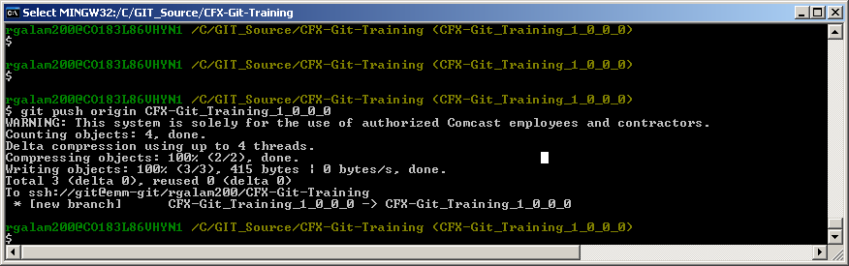
Push your new branch up to the main git server
git push origin CFX-Git-Training_1_0_0_0
Lakshmi: CFX-Git-Training_1_0_0_1
Aninyda: CFX-Git-Training_1_0_0_2
Rajib: CFX-Git-Training_1_0_0_3
Jason: CFX-Git-Training_1_0_0_4

Slide 7
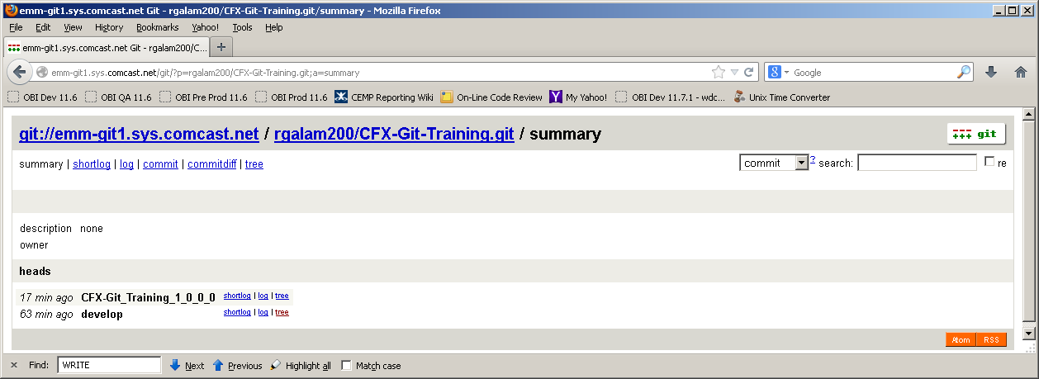
The new Branch (Head) can now be seen on the Git Server

Slide 8
GIT Commands and Notes
Git Repository:
http://emm-git1.sys.comcast.net/
To setup username to the git repository:
git commit --global user.name "<Your Name>"
Example: git commit --global user.name "Robert Galambos"
To set up email to the repository:
git commit --global user.email <email address>
Example: git commit --global user.email robert_galambos@cable.comcast.com
GIT CLONE:
git clone <URL>/<Project>
Example: git clone ssh://git@emm-git/CFX_MANILLA
GIT CLONE BRANCH:
git clone -b <branch name> <URL>:<project name>
git clone -b develop emm-git:CFX-OBIEE
GIT SHOW INFORMATION ON REPO:
NOTE: execute command from inside local repo
git remote show origin
To create an empty Repository (Does not exist in server repository):
git clone git@emm-git:/rgalam200/CFX-TestRepo_1_0_0_0
Add OWNERS/READERS/WRITERS to Repo
ssh git@emm-git perms CFX-RealTimeEntitlement + OWNERS rgalam200
ssh git@emm-git perms CFX-RealTimeEntitlement + WRITERS <Developer NTLogin>
GIT Repository Information:
ssh git@emm-git info
GIT Repository Help:
ssh git@emm-git help
also git --help

Slide 9
GIT Commands and Notes
To see Graph log
git log --graph
To create remote alias to git repository:
git remote add origin <URL>:<Project>
Example: git remote add origin git@emm-git:CFX_MANILLA.git
To show what remote alias' have been set up:
git remote -v
To remove a remote alias:
git remote rm origin
To push the CFX_MANILLA information to repository
git push origin <BRANCH>
To add and commit a file to git:
create file
git add -- Sets a save point, but not commited
git status -- shows the status of the local git directory
git commit -- commit the change will bring up a comment file
git commit -m "Change Description" commit the change without comment file
NOTE: To do a add and commit:
git commit -a -m 'Change Description'
To remove a file:
git rm <filename>
To see the log:
git log -- Shows what has happen in the git directory
Show branches:
git branch

Slide 10
GIT Commands and Notes
To create new branch:
git checkout -b test_branch
To change to another branch:
git checkout master
git checkout test_branch
To merge Branch into master (multiple steps):
git checkout <master>
git merge <branch>
To merge Branch into master (one step):
git merge --no-ff test_branch
To remove Branch:
git branch -d test_branch
To refresh your local copy of the project:
Go to directory
git pull
Tutorial on Add, commit, push pull:
touch README file
Change README file
git status
git add README
git status
git commit -m "Added text to readme file"
git push origin master
To add all files in a directory:
git add .

Slide 11
GIT Commands and Notes
To Tag something in git:
Create a file
git tag -- shows no tags
git tag v0 -- adds a tag
git tag -- shows a tag v0
change file
git add -- save point for file
git commit -- commit change to local git
git tag v1 -- Adds a new tab
git tag -- shows tag v0 and v1
git checkout v0 -- to go back to version 0
git checkout v1 -- to go to version 1
Adding a READERS to the Repo:
Example:ssh git@host perms foo + READERS user1
ssh git@emm-git perms CFX-OBIEE + READERS awalla5075k
Show Readers:
ssh git@emm-git perms -l CFX-OBIE

