Slide 1
Digital Commons

Slide 2
Welcome to Digital Commons
ILR now joins a community at the forefront of scholarly communications
View the repository at:
  http://digitalcommons.ilr.cornell.edu

Slide 3
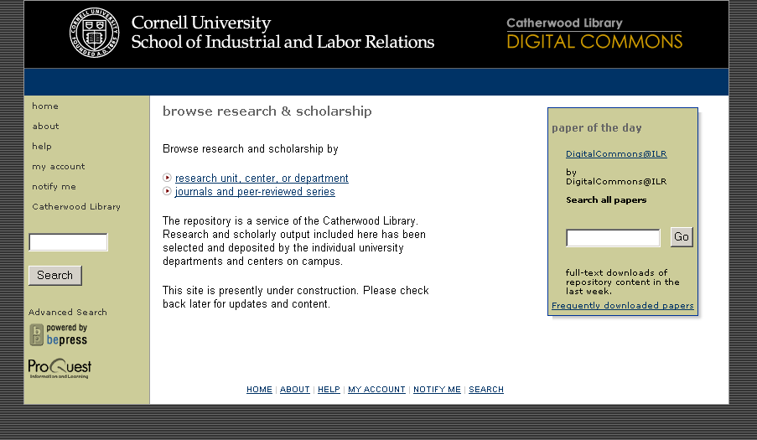
Repository Home Page

Slide 4
Institutional Repositories
Institutional Repositories (IR): “Digital collections that preserve and provide access to the intellectual output of an institution.”*
* Raym Crow The case for institutional repositories: a SPARC position paper. 2002.
IRs might contain:
  Pre-prints (pre-refereed papers) or Post-prints (post-refereed papers)
  Undergraduate senior or honor theses
  Non-static resources (e.g., sound and video files)
  Conference papers
  Book chapters
  Reports
  Journals
  Presentations
  Etc.

Slide 5
Purpose of IRs
Institutional Repositories serve three constituencies:
  The University or College
  The Faculty
  The Broader Research Community

Slide 6
The University
Facilitates information liberation - an ability to offer rich content that has historically been hard to share
Can manage and showcase institutional information assets (articles, working papers, etc.) under one site
Facilitates worldwide readership leading to an increase in the profile and prestige of the institution
Can stake or further a leadership claim in a specific subject area
Demonstrates to funding bodies (e.g., institutes and centres) the breadth and depth of output from a university
Institution viewed as forward thinking and contributing toward publishing paradigm shift
Key Uses:
  Competitive / Comparative Tool
  Faculty / Graduate Recruitment Tool

Slide 7
Faculty Benefits
Wide dissemination of content
  Papers are more visible
  Papers are cited more
Facilitates rapid dissemination of ideas
Creates ease of access for peer group
Produces a community of faculty actively engaged with a worldwide audience of fellow researchers

Slide 8
The Broader Research Community
‘Frees up’ the communication process through the ability to view material that was previously unavailable or difficult to find.
Improves access to content for individuals who may not have had access
Speeds innovation due to free information sharing

Slide 9
Populating IRs
Electronic Theses & Dissertations
  ProQuest has populated in Digital Commons
Senior theses and similar non-published works make excellent candidates for an IR
Journal Articles (preprint & post-print)
  Develop a policy requiring IR publishing of articles, where acceptable to journal publisher

Slide 10
Common Faculty Concerns
Concerned about getting published/tenure
  Journals do not consider IR preprints “prior submissions” - Elsevier as example
  Most journals (84%+) will allow preprints to stay up after publication
Don’t want others to “steal” an idea from the repository
  Publishing in IR establishes precedence of the idea
  Like-minded others may become supporters or collaborators
Too busy to participate
  Posting is easy, and takes less than 2 minutes
  Adjust your workflow to utilize administrative staff as needed

Slide 11
Digital Commons Reaches Out
Confirmation email to Authors
  Authors receive an email when the paper is posted that provides the URL for distribution
Monthly email to Authors
  Provides usage, link to paper (for distribution), and link/email to series to submit additional work
Audience Notification
  System can email interested audience of papers added
  Prior to notification, system will notify authors/administrators of forthcoming announcement, and encourage additional submissions

Slide 12
Typical Site Structure
Can bundle multiple repositories together as a consortium
Consortium Repository
Institutional Repository
The “site,” containing all series and objects
The department sponsoring the series (e.g. School of Business)
Community
Publication Series
Collection of Objects - designed either as an open (unstructured) series or a journal (structured) series.
Structural elements added to a series defined as a journal
Volume/Issue
Objects
The fundamental “document” that an end user retrieves and uses – can be papers, images, music, video, etc.
Metadata
Document
Supplemental Files

Slide 13
Digital Commons Sites
The Berkeley Electronic Press technology has been implemented at a number of sites including:
  California Digital Library (http://repositories.cdlib.org/escholarship/)
  Florida State University
  New England Law Library Repository, including University of Connecticut, Cornell and Yale (http://lsr.nellco.org)
  University of Pennsylvania
  Boston College
  Dickinson College
  Carleton College
  Trinity University (Texas)
  Middlebury College
  University of New Brunswick
  Stevens Institute of Technology
  Pace University
  Cornell – School of Industrial & Labor Relations
  University of Texas at El Paso
  Thomas Jefferson University
Visit http://www.umi.com/umi/digitalcommons for links to Digital Commons sites

Slide 14
What Do I Do Next?
Faculty Members
  View the site at: http://digitalcommons.ilr.cornell.edu
  Click on “My Account” and follow instructions to sign up
  Contact the Library to arrange submission of materials
Librarians
  View and Register on the Site
  Engage Faculty Members in Discussing Potential Content

Slide 15
Enjoy! We’re Here To Help
ProQuest Technical Support
  tsupport@il.proquest.com
  800.889.3358
  Martha Salyer, Digital Commons Team Lead
Jeff Riedel – Program Manager
  jeff.riedel@il.proquest.com
  800.521.0600 x3774

