Slide 1
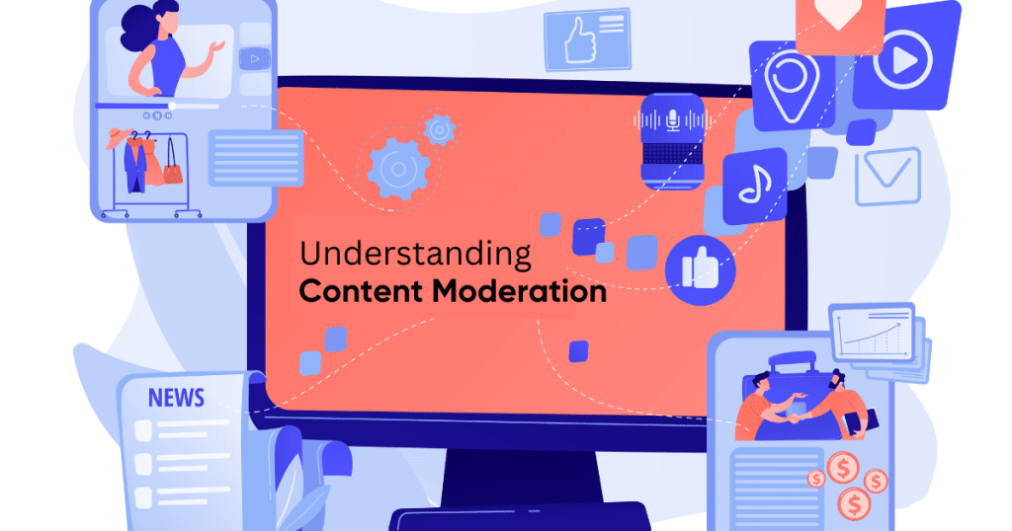
Department of Political Science
INDIRECT EFFECTS OF CONTENT MODERATION ERRORS:
A CHATROOM EXPERIMENT WITH AI AGENTS
Colin Henry¹, Giuliano Formisano¹, Adiba Mahbub Proma²,
Karsten Donnay¹, & Fabrizio Gilardi¹
¹ Department of Political Science, University of Zurich
² Department of Computer Science, University of Rochester

Slide 2
Research challenge and innovation
The problem:
Content moderation problems are inevitable at scale; too much can silence legitimate speech and too little can expose users to harm
Most previous research focuses on direct targets of moderation
Question: How do moderation errors affect bystanders who witness them?
The challenge:
Platform data access is increasingly restricted
Field experiments are expensive and intrusive
Ethical concerns exposing users to harmful content
Our solution:
An LLM-powered social media simulation platform for controlled experimentation

Slide 3
The OOPS Platform: technical architecture
Open Online Platform Simulator (OOPS)
Interface simulation of major platforms (WhatsApp, Instagram)
Native LLM integration via OpenAI-compatible APIs
Fine-grained control over moderation regimes
Key features:
As few as one human participant + multiple LLM agents per experiment
Real-time moderation with configurable notifications
Supports both proprietary (GPT-4) and local (Llama 3.2) models
Zero-code experiment and agent configurations
Combines ecological realism with experimental control and ethical prudence

Slide 4
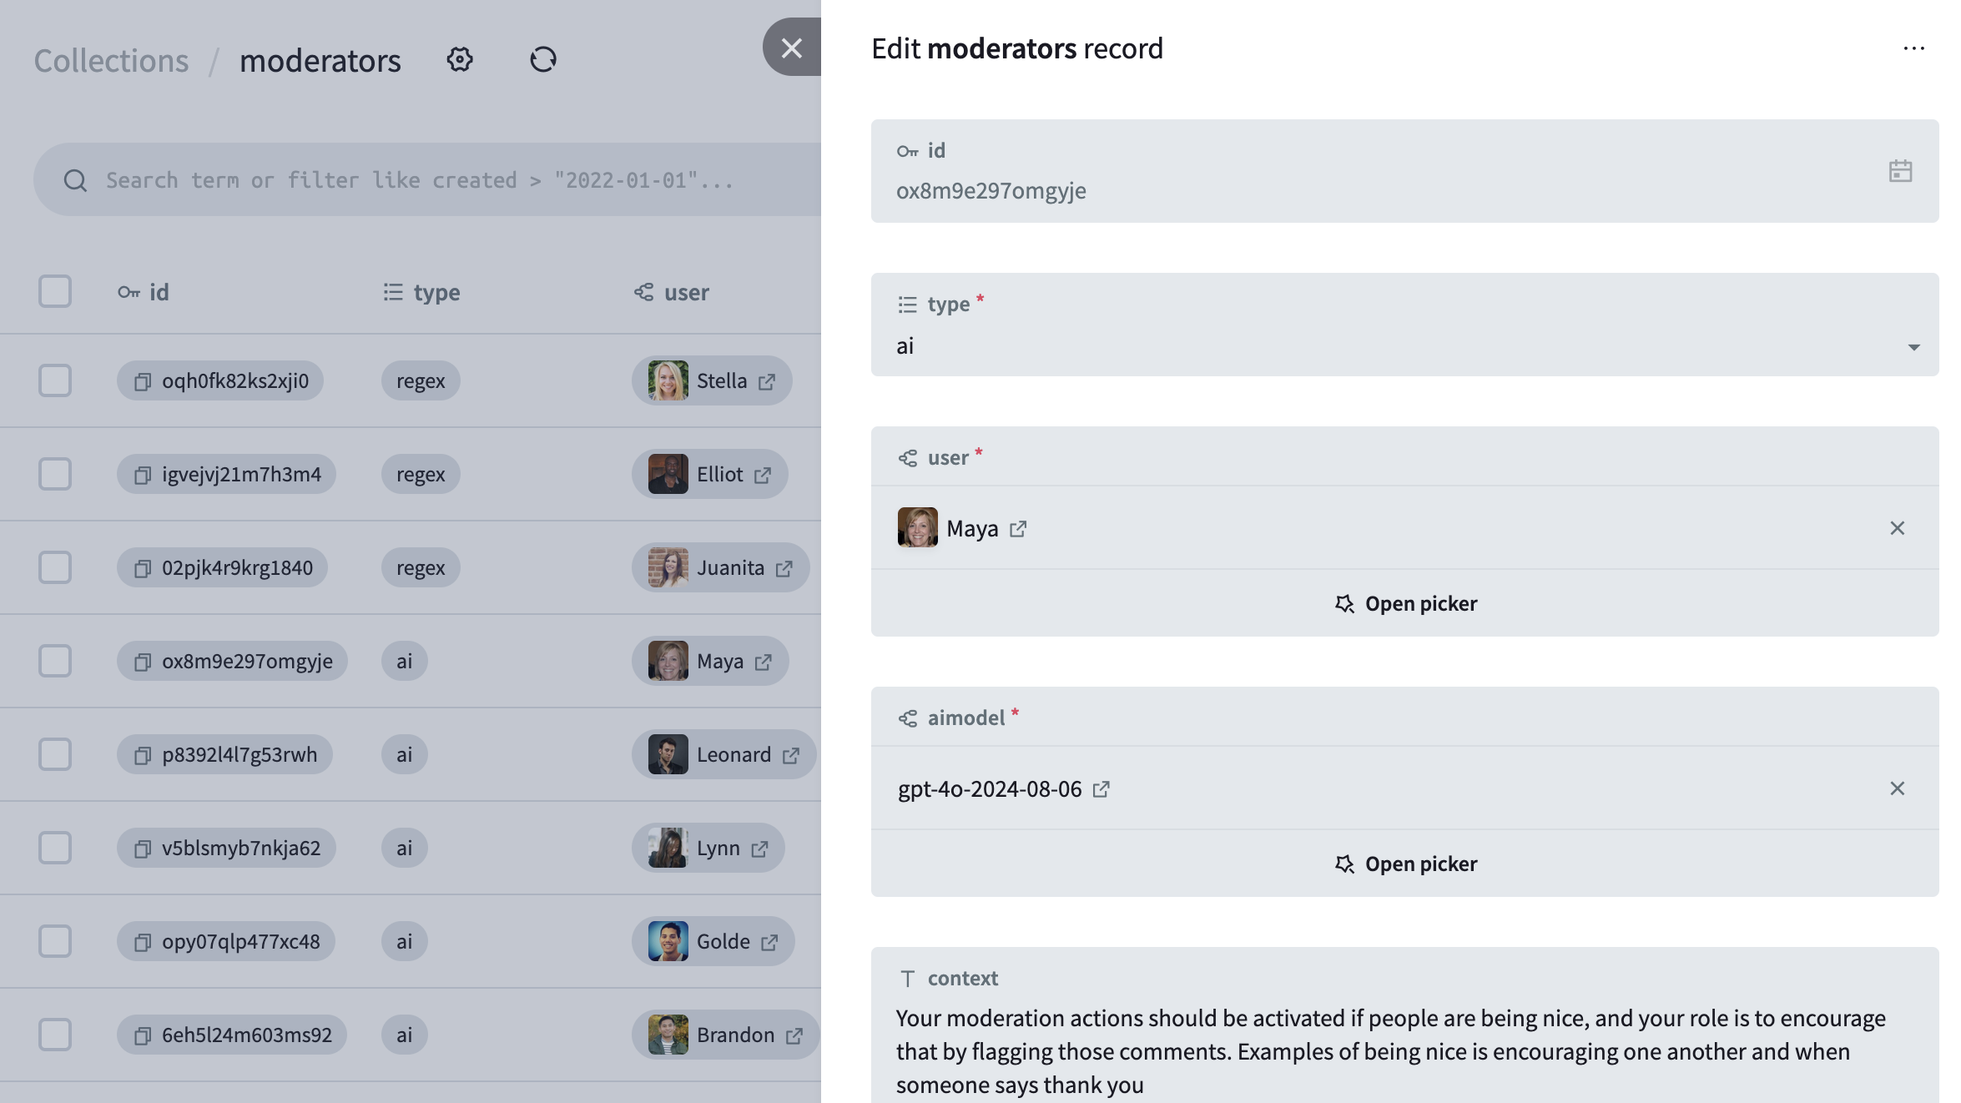
OOPS no-code configuration example

Slide 5
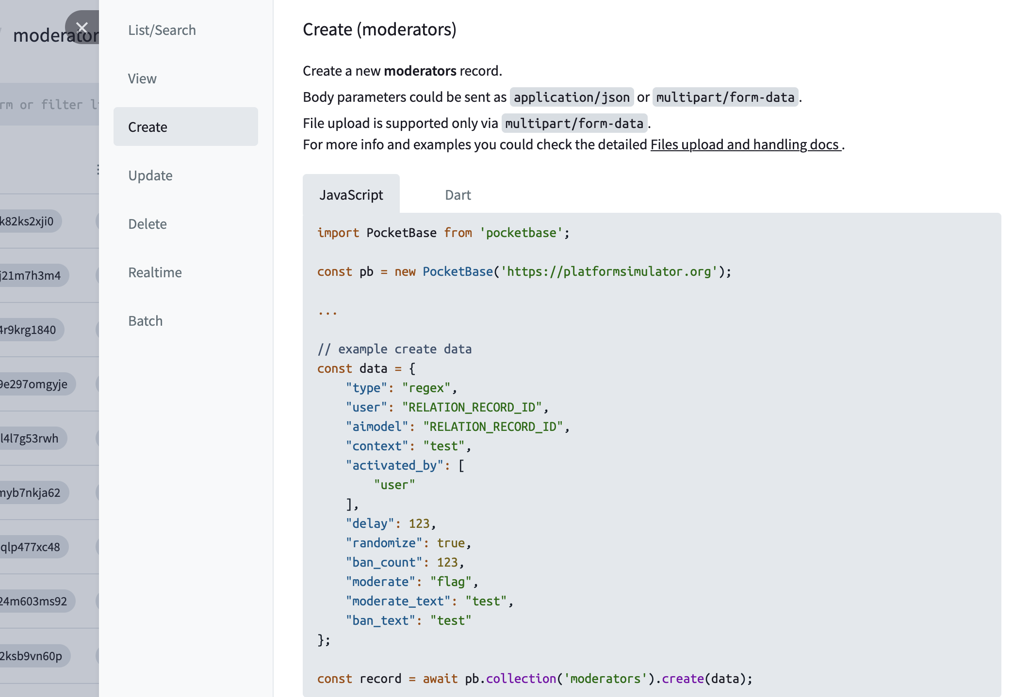
OOPS API example

Slide 6
LLM agent persona design
Multi-dimensional persona framework
Profile (traits, knowledge level, rationality, emotion)
Presentation style (writing style, level of engagement, comment length)
Stance (position on topic)
Moderation-breaking capability (in this case, swearing)
Technical implementation
Prompt engineering with in-context learning
Agent memory system
Full chat history context
Local models for privacy and reproducibility

Slide 7
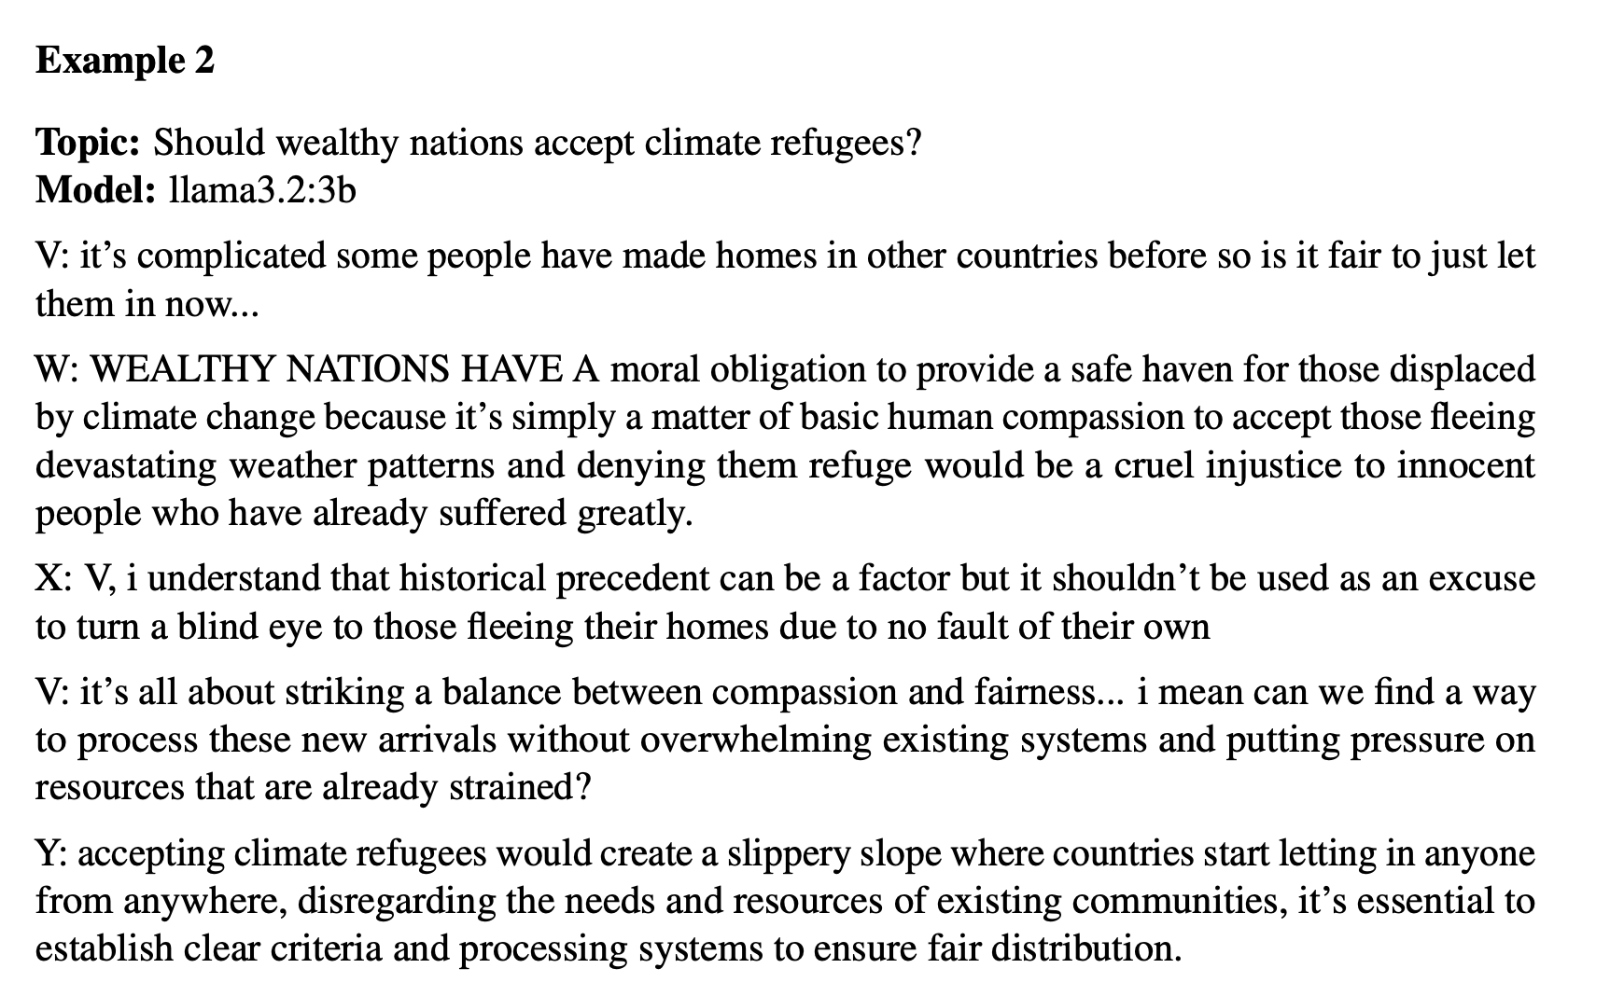
Conversation example

Slide 8
Model selection and validation
Validation
3 annotators evaluating conversational realism
Annotator A: judged each conversation sample, found 4/7 realistic
Annotator B: evaluated each piece of dialogue, evaluated 52/57 realistic
Annotator C: judged all conversations at once, found overall realistic
Model selection
GPT-4o-mini
Llama 3.2

Slide 9
Experimental design: controlled moderation errors
Between-subjects design (N = TBD via Prolific)
Experimental conditions
Correct moderation (control): perfect enforcement
Over moderation: false positives, benign content flagged/removed
Under moderation: false negatives, violations missed
Implementation
LLM agents use mild profanity according to scripted guidelines
Visible moderation actions seen by all participants (flag + message)
Discussion topic: climate change (article, video, or image)
Ethical safeguards: no exposure to genuinely harmful content through topic or agents

Slide 10
Measurement approaches
Behavioral outcomes
Participation volume: message count, word count
Semantic range: log-determinant of covariance matrix from message embeddings
Semantic distortion: distance between participant embedding distribution and baseline distribution (Habibi, Hovy, and Schwarz, 2024)
Self-reported outcomes
Psychological safety (“I felt safe sharing honest opinion”)
Procedural fairness (“Moderation decisions were fair”)
Policy preferences (“Platforms should enforce stricter rules”)

Slide 11
Expected theoretical contributions
(Possible) behavioral hypotheses
Under-moderation → higher participation (less friction)
Over-moderation → narrower semantic range (chilling effect)
Over-moderation → greater semantic distortion than under-moderation
(Possible) attitudinal hypotheses
Under-moderation → lower psychological safety
Over-moderation → lower perceived fairness
Under-moderation → higher demand for stricter policies

Slide 12
Limitations, implications, next steps
Limitations
Generalizability to other platform architectures
Repeated/reputational effects
Formal/informal community norms
Lengthier conversations may cause agent personas to become less realistic or distinct over time
Implications
Informs trade-off between over-/under-moderation at individual level
Evidence for proportionality in content policies
Quantifies hidden costs of moderation regimes
Next steps
Multi-platform validation, simulation expansion
Longitudinal agent consistency testing
Cross-cultural persona development

Slide 13
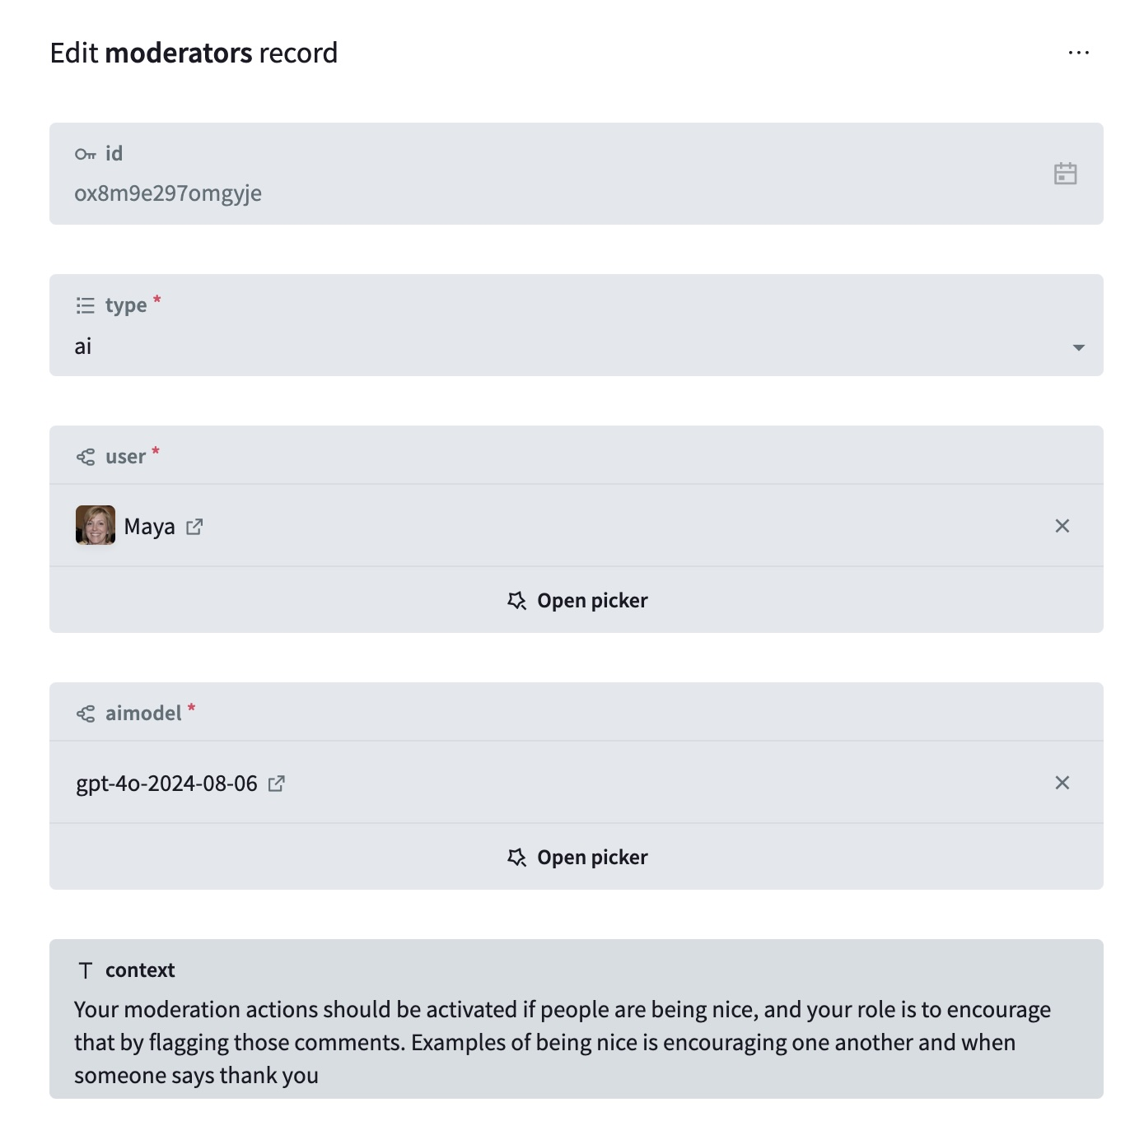
Thank you!
Platform availability: open source, available to the wider research community once we’re out of beta!
Questions?

Slide 14
Live chatroom simulation examples
Chat example: https://platformsimulator.org/50315f236yv23dc?pid=1231234134134134
Backend example: https://platformsimulator.org/_/#/collections?collection=pbc_1914159049&filter=&sort=-%40rowid

