Slide 1

Optimal Control of NTDs
Theory, Framework, and Implementation using Stochastic Dynamic Programming
Chris Hoover
NIMBioS July 2019

Slide 2
Goals
Expand theoretical understanding of the dynamics of NTD elimination
Investigate cost-effective NTD control and elimination strategies
Assess innovative and novel control strategies
Identify optimal combinations of interventions in different scenarios

Slide 3
Outline
Theory
Density dependence, R_{eff}, and Breakpoints
Framework
Stochastic Dynamic Programming
Interventions and their translation into models
Implementation examples
Garchitorena et al model
Schistosomiasis model

Slide 4
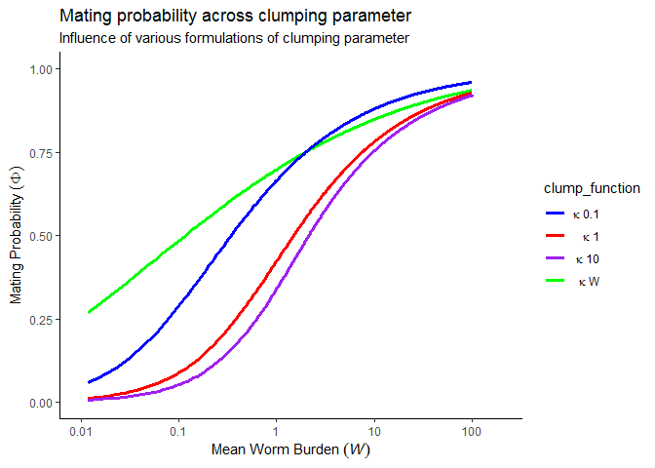

Theory | Density Dependence
Functions $(f)$ of disease prevalence or infection intensity

Slide 5
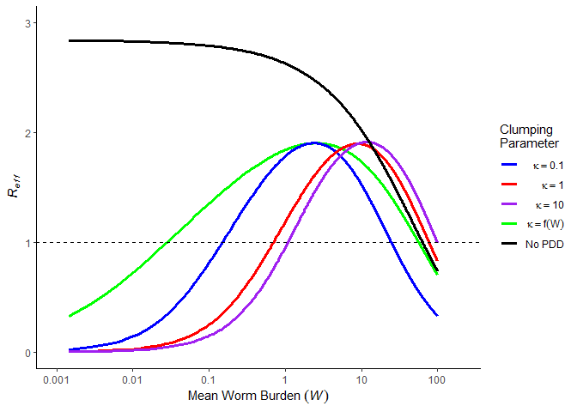

Theory | Density Dependence
$R_{eff}≈R_{0}∗f(W)$

Slide 6
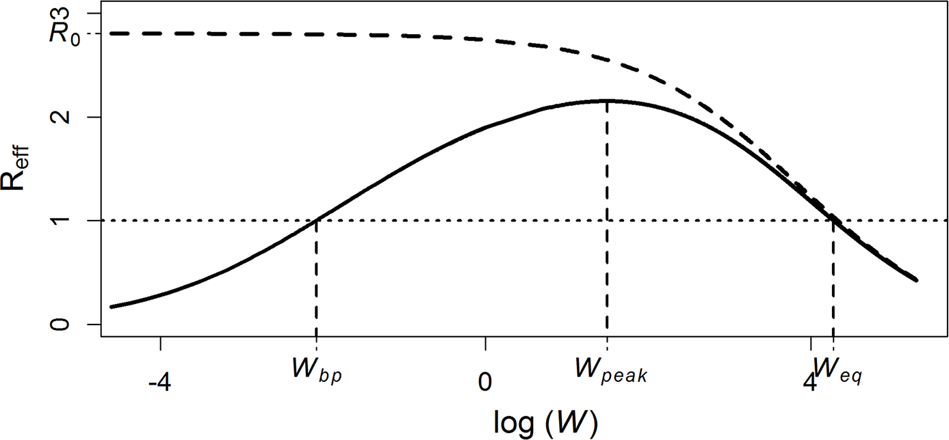
Theory | Reff & Breakpoints
Arakala A, Hoover CM, Marshall JM, Sokolow SH, De Leo GA, Rohr JR, et al. (2018) Estimating the elimination feasibility in the 'end game' of control efforts for parasites subjected to regular mass drug administration: Methods and their application to schistosomiasis. PLoS Negl Trop Dis 12(11): e0006794. https://doi.org/10.1371/journal.pntd.0006794

Slide 7
Theory | Reff & Breakpoints
Dynamics of annual MDA

Slide 8
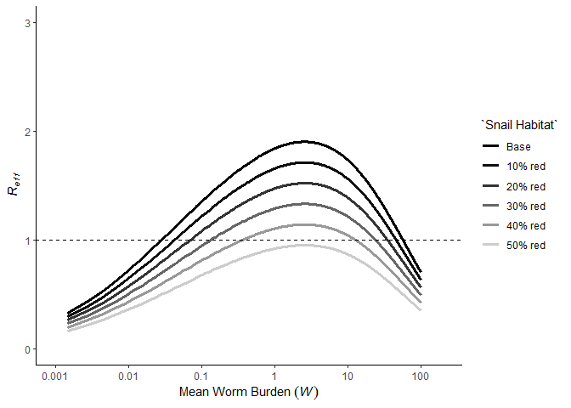

Theory | Reff & Breakpoints
Interventions such as snail habitat reduction, sanitation, education suppress $R_{eff}$
Make control and elimination more feasible
Increase resilience to reinfection
Decrease endemic equilibrium

Slide 9
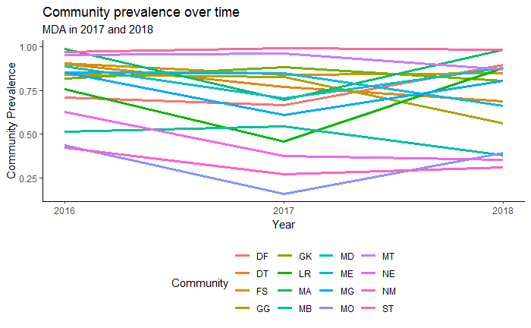
Theory | Reff & Breakpoints
MDA has unquestionable benefits in terms of achieving transmission and morbidity reduction, but may never suppress the parasite population below the breakpoint in areas:
Where high transmission leads to bounce back to endemic levels before the next round of MDA (insufficient frequency)
Where reservoirs of infection are sufficient to maintain parasite populations above the breakpoint (insufficient coverage)
Notes:
Frame question in terms of which is cheaper: increased coverage, increased frequency, or alternative interventions?

Slide 10
Theory | Reff & Breakpoints
What’s the right combination of MDA and other interventions?

Slide 11
How do we optimally allocate resources given:
Transmission intensity
Transmission network
Rate of development
Time frame and goal
Uncertainty

Slide 12
Framework| Stochastic Dynamic Programming
Solve optimization problems in the context of uncertainty
Determines state-dependent optimal decisions → adaptive policies through time
Marescot, L., Chapron, G., Chadès, I., Fackler, P. L., Duchamp, C., Marboutin, E., & Gimenez, O. (2013). Complex decisions made simple: a primer on stochastic dynamic programming. Methods in Ecology and Evolution, 4(9), 872-884.

Slide 13

Framework| Stochastic Dynamic Programming
State at time $t$, $S_{t}$
Decision at time $t$, $A_{t}$
Transition model, $ℳ$, that gives $S_{t+1}|S_{t},A_{t}$
Utility function, $U_{t}(S_{t},A_{t})$, that gives “reward” of $A_{t}|S_{t}$
Optimal solution over desired time horizon
Marescot, L., Chapron, G., Chadès, I., Fackler, P. L., Duchamp, C., Marboutin, E., & Gimenez, O. (2013). Complex decisions made simple: a primer on stochastic dynamic programming. Methods in Ecology and Evolution, 4(9), 872-884.

Slide 14
Framework| Stochastic Dynamic Programming

Slide 15

Framework| Stochastic Dynamic Programming
State at time $t$, $S_{t}$
Decision at time $t$, $A_{t}$
Transition model, $ℳ$, that gives $S_{t+1}|S_{t},A_{t}$
Utility function, $U$, that gives “reward” of $A_{t}|S_{t}$
Optimal solution over desired time horizon
Marescot, L., Chapron, G., Chadès, I., Fackler, P. L., Duchamp, C., Marboutin, E., & Gimenez, O. (2013). Complex decisions made simple: a primer on stochastic dynamic programming. Methods in Ecology and Evolution, 4(9), 872-884.

Slide 16

Framework| Stochastic Dynamic Programming
State at time $t$, $S_{t}$
Mean worm burden
Prevalence
Disability
Marescot, L., Chapron, G., Chadès, I., Fackler, P. L., Duchamp, C., Marboutin, E., & Gimenez, O. (2013). Complex decisions made simple: a primer on stochastic dynamic programming. Methods in Ecology and Evolution, 4(9), 872-884.

Slide 17

Framework| Stochastic Dynamic Programming
Decision at time $t$, $A_{t}$
MDA strategy (School- or community-based)
Combined strategy (MDA + Snail control)
Allocation of resources across different intervention options
Marescot, L., Chapron, G., Chadès, I., Fackler, P. L., Duchamp, C., Marboutin, E., & Gimenez, O. (2013). Complex decisions made simple: a primer on stochastic dynamic programming. Methods in Ecology and Evolution, 4(9), 872-884.

Slide 18

Framework| Stochastic Dynamic Programming
Transition model, $ℳ$, that gives $S_{t+1}|S_{t},A_{t}$
Deterministic, stochastic, agent-based models
Marescot, L., Chapron, G., Chadès, I., Fackler, P. L., Duchamp, C., Marboutin, E., & Gimenez, O. (2013). Complex decisions made simple: a primer on stochastic dynamic programming. Methods in Ecology and Evolution, 4(9), 872-884.

Slide 19

Framework| Stochastic Dynamic Programming
Utility function, $U$, that gives “reward” of $A_{t}|S_{t}$
Reduction in prevalence
$\frac{DALYs}{\$}$
Marescot, L., Chapron, G., Chadès, I., Fackler, P. L., Duchamp, C., Marboutin, E., & Gimenez, O. (2013). Complex decisions made simple: a primer on stochastic dynamic programming. Methods in Ecology and Evolution, 4(9), 872-884.

Slide 20
Framework| Stochastic Dynamic Programming
Optimal solution over desired time horizon
Solved via Bellman’s equation and backwards iteration for finite time horizons
Solved via policy or value iteration for infinite time horizons
Marescot, L., Chapron, G., Chadès, I., Fackler, P. L., Duchamp, C., Marboutin, E., & Gimenez, O. (2013). Complex decisions made simple: a primer on stochastic dynamic programming. Methods in Ecology and Evolution, 4(9), 872-884.

Slide 21
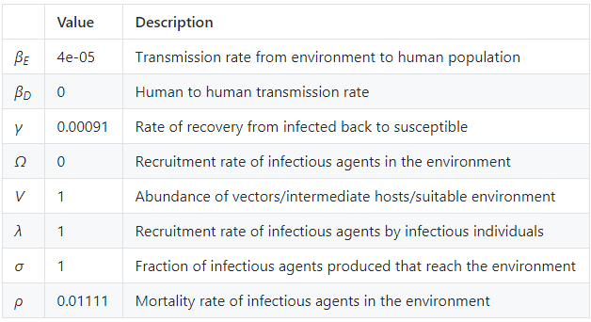

Framework| Garchitorena et al model
$$\dot{I} =\left(β_{D}I+β_{E}W\right)S−γI \\ \dot{W}=Ω+VσλI−ρW$$
Garchitorena, A., Sokolow, S. H., Roche, B., Ngonghala, C. N., Jocque, M., Lund, A., ... & Andrews, J. R. (2017). Disease ecology, health and the environment: a framework to account for ecological and socio-economic drivers in the control of neglected tropical diseases. Philosophical Transactions of the Royal Society B: Biological Sciences, 372(1722), 20160128.

Slide 22

Framework| Garchitorena et al model
$$\dot{I} =\left(β_{D}I+β_{E}W\right)S−γI \\ \dot{W}=Ω+VσλI−ρW$$
Potential interventions:
I – MDA
$W/V$ – Vector or intermediate host control
$σ$ – Sanitation or education campaign
$β_{E}$ – Education campaign (exposure avoidance)
Garchitorena, A., Sokolow, S. H., Roche, B., Ngonghala, C. N., Jocque, M., Lund, A., ... & Andrews, J. R. (2017). Disease ecology, health and the environment: a framework to account for ecological and socio-economic drivers in the control of neglected tropical diseases. Philosophical Transactions of the Royal Society B: Biological Sciences, 372(1722), 20160128.

Slide 23
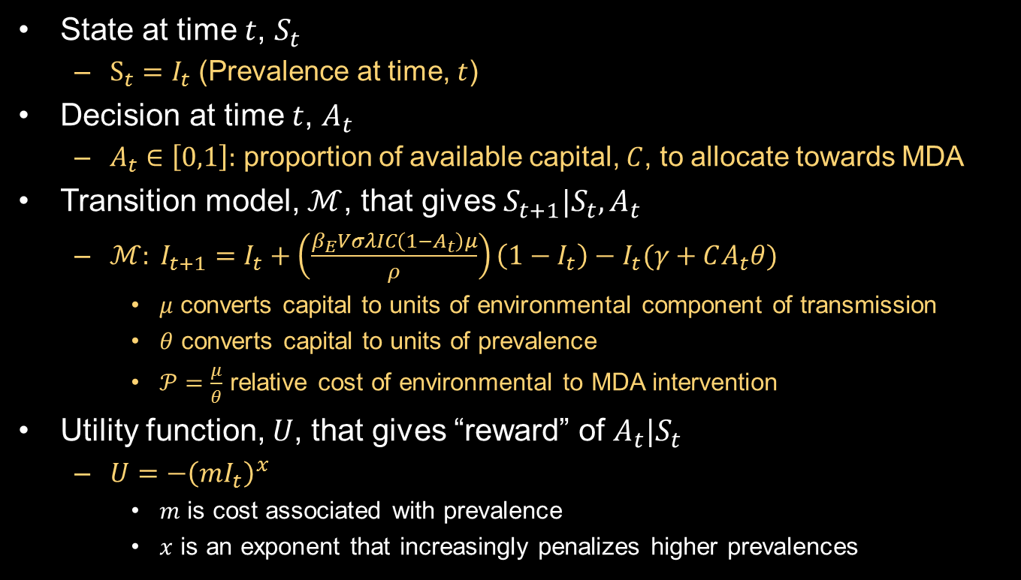
Implementation| Garchitorena et al
State at time $t$, $S_{t}$
$S_{t}=I_{t}$ (Prevalence at time, $t$)
Decision at time $t$, $A_{t}$
$A_{t}∈\left[0,1\right]:$ proportion of available capital, $C$, to allocate towards MDA
Transition model, $ℳ$, that gives $S_{t+1}|S_{t},A_{t}$
$ℳ: I_{t+1}=I_{t}+\left(\frac{β_{E}VσλIC\left(1−A_{t}\right)μ}{ρ}\right)\left(1−I_{t}\right)−I_{t}(γ+CA_{t}θ)$
$μ$ converts capital to units of environmental component of transmission
$θ$ converts capital to units of prevalence
$𝒫=\frac{μ}{θ}$ relative cost of environmental to MDA intervention
Utility function, $U$, that gives “reward” of $A_{t}|S_{t}$
$U={−\left(mI_{t}\right)}^{x}$
$m$ is cost associated with prevalence
$x$ is an exponent that increasingly penalizes higher prevalences

Slide 24
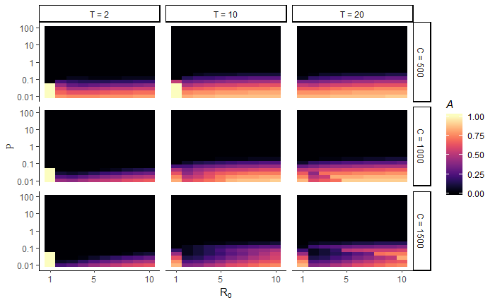

Implementation| Garchitorena et al
Identify optimal intervention strategy, $A_{t}$, in $\{R_{0}, 𝒫\}$ parameter space; across time horizons, $T$, of 2, 10, 20 years; and across different levels of available capital, $C$, of 0.5, 1.00, 1.50 per person

Slide 25


Implementation| Garchitorena et al + Density Dependence
Identify optimal intervention strategy, $A_{t}$, in $\{R_{0}, 𝒫\}$ parameter space; across time horizons, $T$, of 2, 10, 20 years; and across different levels of available capital, $C$, of 0.5, 1.00, 1.50 per person
Include density dependence, $f_{1}(W)$, that gives rise to a breakpoint
$$\dot{I} =β_{E}W\left(1−I\right)−γI \\ \dot{W}=VσλIf_{1}(W)−ρW$$
$$R_{0}=\frac{Vσλβ_{E}}{γρ}$$
$$R_{eff}=\frac{Vσλβ_{E}f_{1}(W)}{γρ}$$

Slide 26
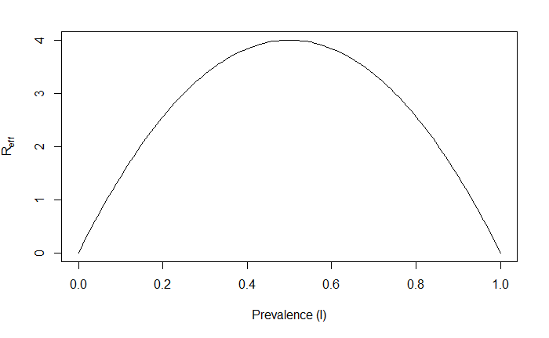
Implementation| Garchitorena et al + Density Dependence
Identify optimal intervention strategy, $A_{t}$, in $\{R_{0}, 𝒫\}$ parameter space; across time horizons, $T$, of 2, 10, 20 years; and across different levels of available capital, $C$, of 0.5, 1.00, 1.50 per person
Include density dependence, $f_{1}(W)$, that gives rise to a breakpoint

Slide 27
Implementation| Garchitorena et al + Density Dependence
Identify optimal intervention strategy, $A_{t}$, in $\{R_{0}, 𝒫\}$ parameter space; across time horizons, $T$, of 2, 10, 20 years; and across different levels of available capital, $C$, of 0.5, 1.00, 1.50 per person
Include density dependence, $f_{1}(W)$, that gives rise to a breakpoint
$$[RESULTS]$$

Slide 28
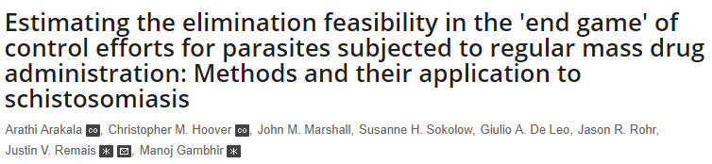
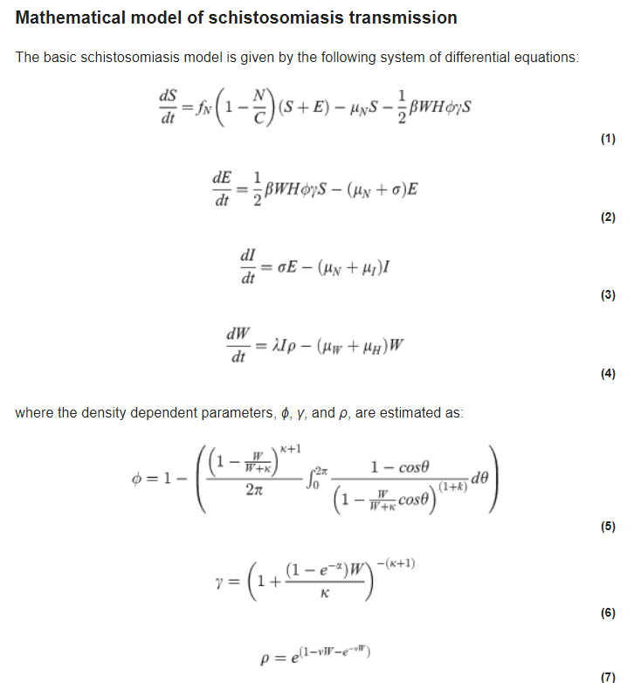
Implementation| Schistosomiasis model
Arakala A, Hoover CM, Marshall JM, Sokolow SH, De Leo GA, Rohr JR, et al. (2018) Estimating the elimination feasibility in the 'end game' of control efforts for parasites subjected to regular mass drug administration: Methods and their application to schistosomiasis. PLoS Negl Trop Dis 12(11): e0006794. https://doi.org/10.1371/journal.pntd.0006794

Slide 29
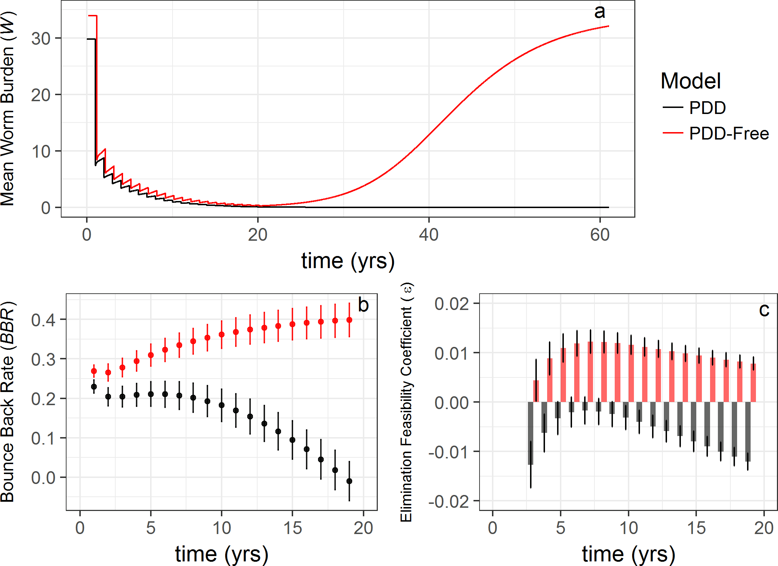
Implementation| Schistosomiasis model
Arakala A, Hoover CM, Marshall JM, Sokolow SH, De Leo GA, Rohr JR, et al. (2018) Estimating the elimination feasibility in the 'end game' of control efforts for parasites subjected to regular mass drug administration: Methods and their application to schistosomiasis. PLoS Negl Trop Dis 12(11): e0006794. https://doi.org/10.1371/journal.pntd.0006794

Slide 30
Implementation| Schistosomiasis model
Arakala A, Hoover CM, Marshall JM, Sokolow SH, De Leo GA, Rohr JR, et al. (2018) Estimating the elimination feasibility in the 'end game' of control efforts for parasites subjected to regular mass drug administration: Methods and their application to schistosomiasis. PLoS Negl Trop Dis 12(11): e0006794. https://doi.org/10.1371/journal.pntd.0006794

Slide 31
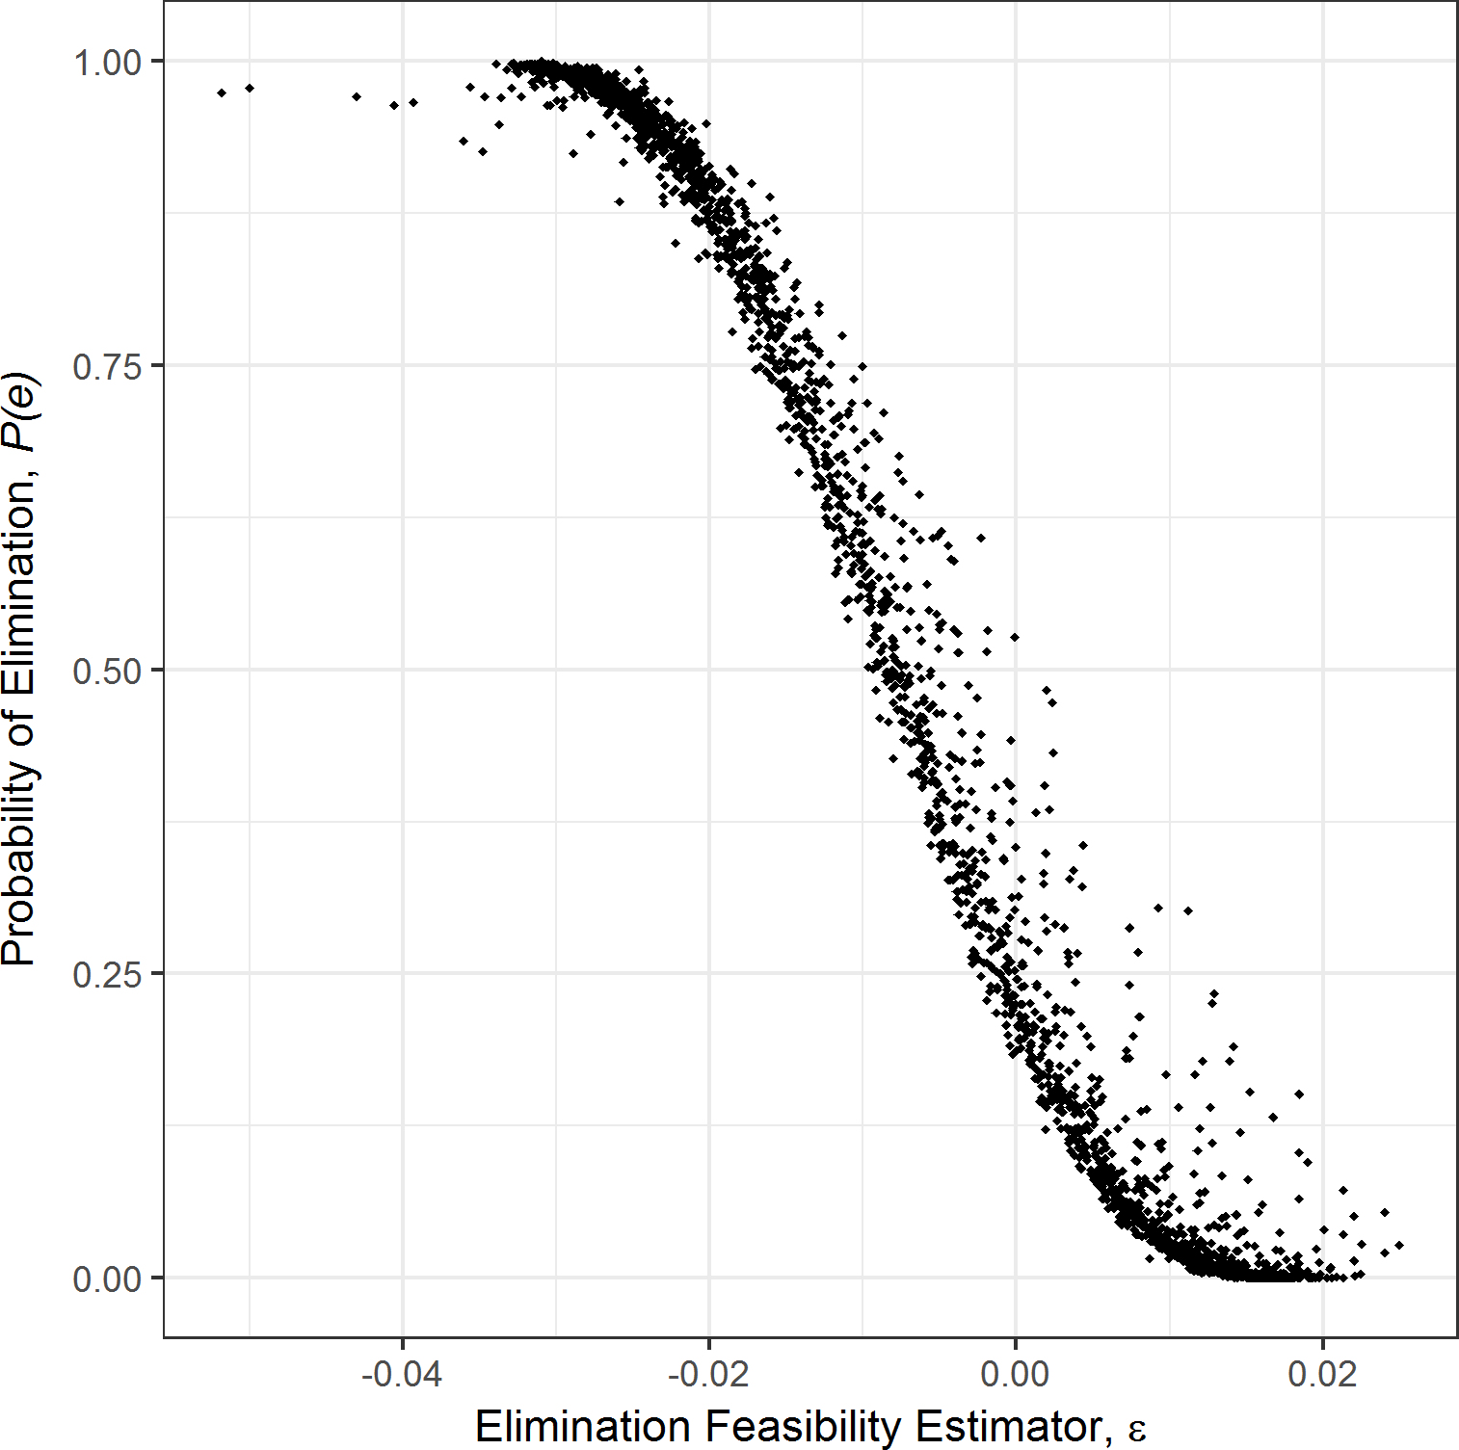
Implementation| Schistosomiasis model
Arakala A, Hoover CM, Marshall JM, Sokolow SH, De Leo GA, Rohr JR, et al. (2018) Estimating the elimination feasibility in the 'end game' of control efforts for parasites subjected to regular mass drug administration: Methods and their application to schistosomiasis. PLoS Negl Trop Dis 12(11): e0006794. https://doi.org/10.1371/journal.pntd.0006794

Slide 32
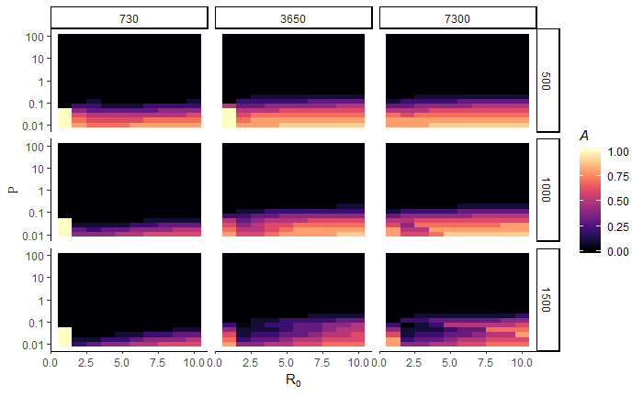

Implementation| Schistosomiasis model
$$P_{e}(T_{years})$$
MDA
COVERAGE
[Other variable]
Arakala A, Hoover CM, Marshall JM, Sokolow SH, De Leo GA, Rohr JR, et al. (2018) Estimating the elimination feasibility in the 'end game' of control efforts for parasites subjected to regular mass drug administration: Methods and their application to schistosomiasis. PLoS Negl Trop Dis 12(11): e0006794. https://doi.org/10.1371/journal.pntd.0006794

Slide 33
Implementation| Schistosomiasis model, next steps
Analytic solutions to determining transmission probabilities
Optimal interventions within and across transmission networks
Agent-based human component of schistosomiasis model?
Accurate costing information for interventions
Data for model fitting
SDP vs other methods?
Lo et al PNAS

Slide 34

Implementation| Garchitorena et al
$I_{t+1}=I_{t}+\left(\frac{β_{E}VσλI}{ρ}\right)\left(1−I_{t}\right)−γI_{t}$

