Slide 1

Optimal Control of Schistosomiasis
Influence of density dependence and framework for investigation
Chris Hoover
NIMBioS July 2019

Slide 2

Goals
Expand theoretical understanding of the dynamics of NTD elimination
Investigate cost-effective NTD control and elimination strategies
Identify optimal combinations of interventions in different scenarios
Assess innovative and novel control strategies

Slide 3
Goals for today and tomorrow
Present frameworks (models) for investigation
Brainstorm and refine
Outline of analyses to conduct in coming months

Slide 4
Outline
Theory
Density dependence, R_{eff}, and Breakpoints
Framework & Implementation
Interventions and their translation into models
Probability of elimination and other objectives

Slide 5
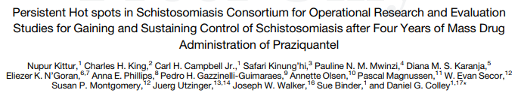
Background
Persistent hotspots in SCORE

Slide 6
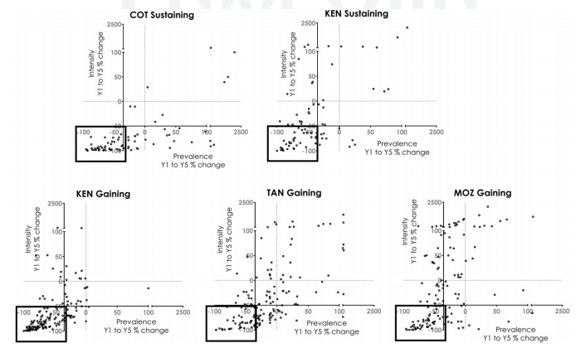
Background
Persistent hotspots in SCORE

Slide 7
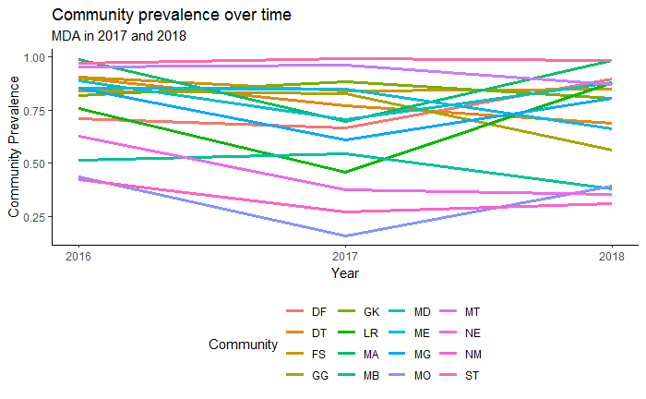
Background
Rapid rebounds in prevalence in Senegal

Slide 8
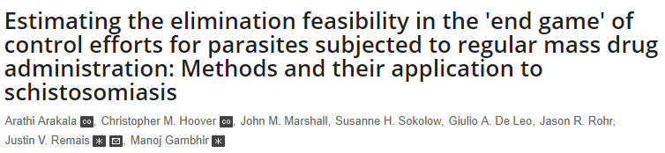
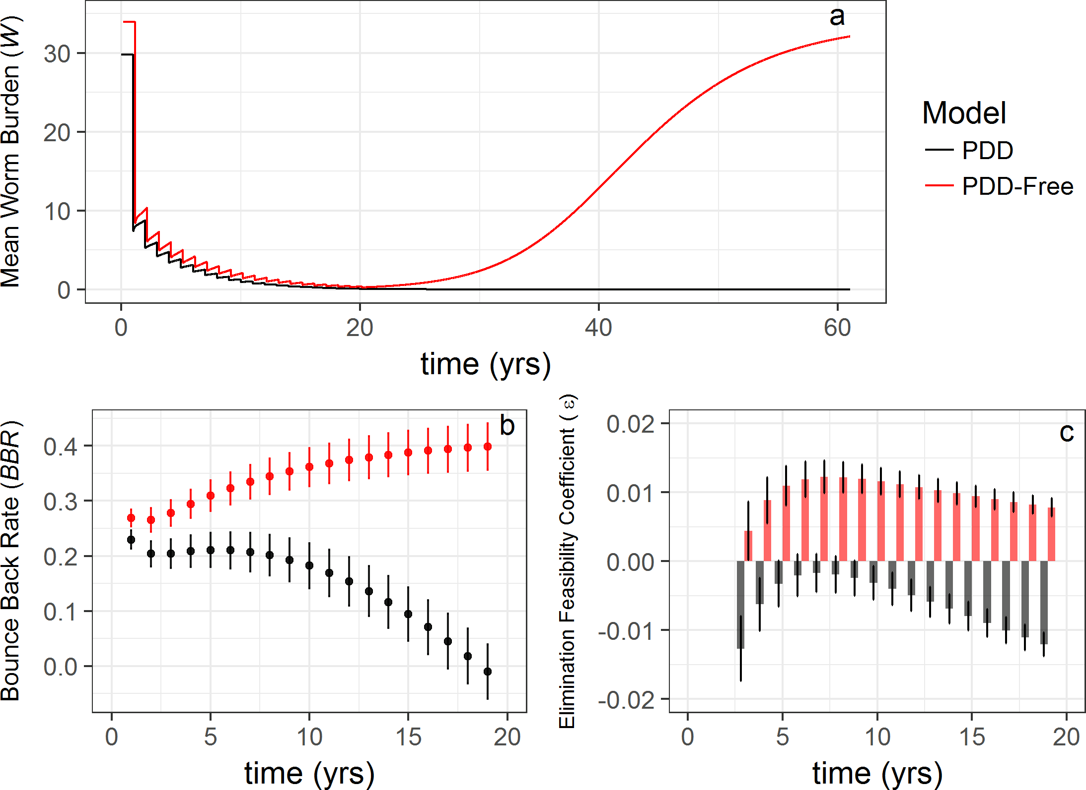
Theory | Density Dependence, Reff & Breakpoints
Arakala A, Hoover CM, Marshall JM, Sokolow SH, De Leo GA, Rohr JR, et al. (2018) Estimating the elimination feasibility in the 'end game' of control efforts for parasites subjected to regular mass drug administration: Methods and their application to schistosomiasis. PLoS Negl Trop Dis 12(11): e0006794. https://doi.org/10.1371/journal.pntd.0006794

Slide 9
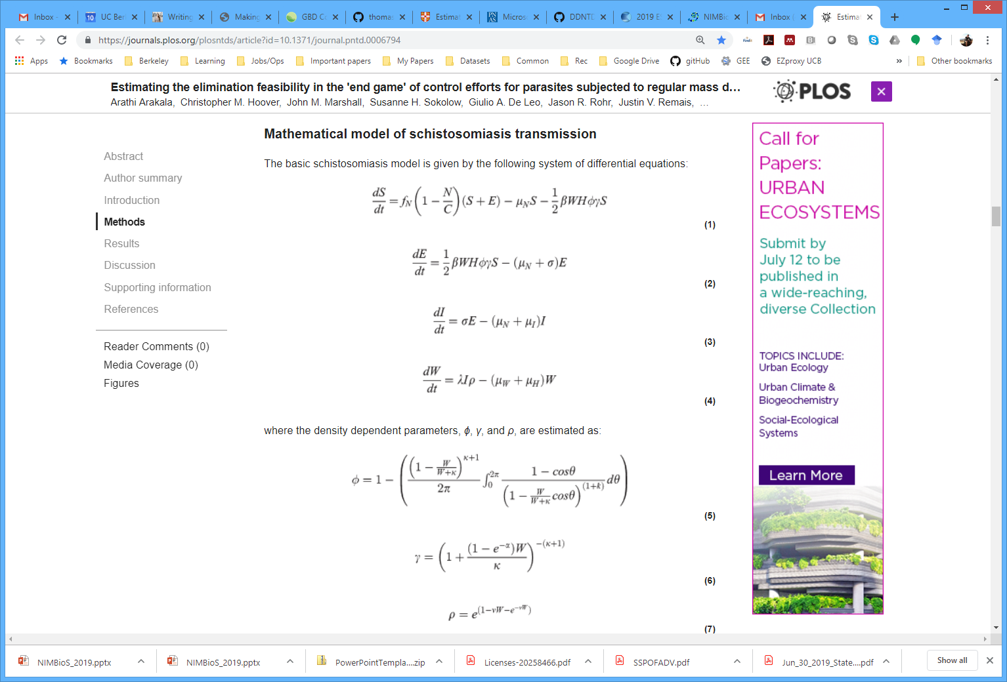
Theory | Density Dependence, Reff & Breakpoints
Arakala A, Hoover CM, Marshall JM, Sokolow SH, De Leo GA, Rohr JR, et al. (2018) Estimating the elimination feasibility in the 'end game' of control efforts for parasites subjected to regular mass drug administration: Methods and their application to schistosomiasis. PLoS Negl Trop Dis 12(11): e0006794. https://doi.org/10.1371/journal.pntd.0006794

Slide 10
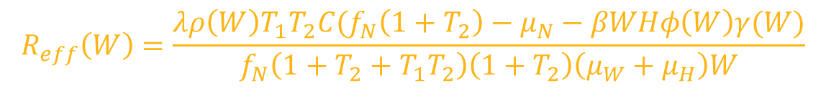
Theory | Density Dependence, Reff & Breakpoints
$$R_{eff}\left(W\right)=\frac{λρ\left(W\right)T_{1}T_{2}C(f_{N}\left(1+T_{2}\right)−μ_{N}−βWHφ\left(W\right)γ(W)}{f_{N}\left(1+T_{2}+T_{1}T_{2}\right)\left(1+T_{2}\right)\left(μ_{W}+μ_{H}\right)W}$$
Arakala A, Hoover CM, Marshall JM, Sokolow SH, De Leo GA, Rohr JR, et al. (2018) Estimating the elimination feasibility in the 'end game' of control efforts for parasites subjected to regular mass drug administration: Methods and their application to schistosomiasis. PLoS Negl Trop Dis 12(11): e0006794. https://doi.org/10.1371/journal.pntd.0006794

Slide 11
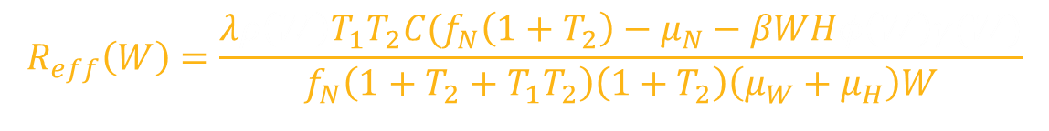

Theory | Density Dependence, Reff & Breakpoints
$$R_{eff}\left(W\right)=\frac{{λρ\left(W\right)T}_{1}T_{2}C(f_{N}\left(1+T_{2}\right)−μ_{N}−βWHφ\left(W\right)γ(W)}{f_{N}\left(1+T_{2}+T_{1}T_{2}\right)\left(1+T_{2}\right)\left(μ_{W}+μ_{H}\right)W}$$
Density dependence functions, $f(W)$
Arakala A, Hoover CM, Marshall JM, Sokolow SH, De Leo GA, Rohr JR, et al. (2018) Estimating the elimination feasibility in the 'end game' of control efforts for parasites subjected to regular mass drug administration: Methods and their application to schistosomiasis. PLoS Negl Trop Dis 12(11): e0006794. https://doi.org/10.1371/journal.pntd.0006794

Slide 12
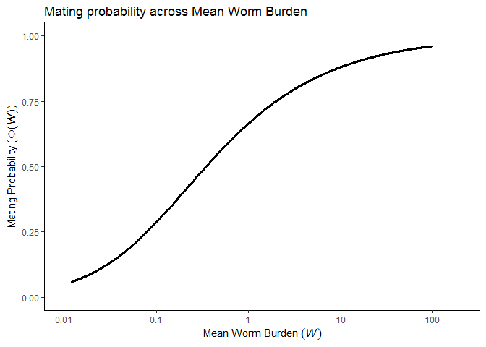
Theory | Density Dependence, Reff & Breakpoints
Functions of disease prevalence or infection intensity
Positive Density Dependence (PDD) – decreased transmission with decreasing prevalence/intensity

Slide 13
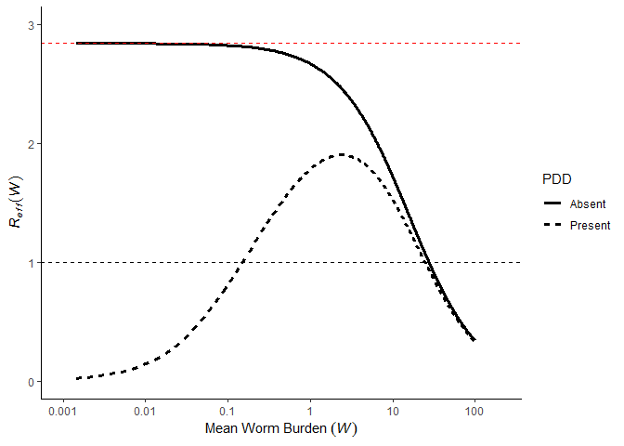



Theory | Density Dependence, Reff & Breakpoints
$$R_{eff}(W)≈R_{0}∗f(W)$$
$$R_{0}$$
Breakpoint, $W_{bp}$

Slide 14

Theory | Density Dependence, Reff & Breakpoints
$$R_{eff}\left(W\right)=\frac{{λρ\left(W\right)T}_{1}T_{2}C(f_{N}\left(1+T_{2}\right)−μ_{N}−βWHφ\left(W\right)γ(W)}{f_{N}\left(1+T_{2}+T_{1}T_{2}\right)\left(1+T_{2}\right)\left(μ_{W}+μ_{H}\right)W}$$
Density dependence functions, $f(W)$
$W_{bp}$ estimable by solving for $W$ when $R_{eff}=1$
MDA changes $R_{eff}$ by reducing $W$
Arakala A, Hoover CM, Marshall JM, Sokolow SH, De Leo GA, Rohr JR, et al. (2018) Estimating the elimination feasibility in the 'end game' of control efforts for parasites subjected to regular mass drug administration: Methods and their application to schistosomiasis. PLoS Negl Trop Dis 12(11): e0006794. https://doi.org/10.1371/journal.pntd.0006794

Slide 15


Theory | Density Dependence, Reff & Breakpoints
Goal: reduce $W$ below $W_{bp}$
Insufficient coverage or frequency often prevents this
Breakpoint, $W_{bp}$

Slide 16
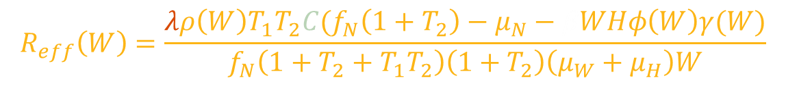
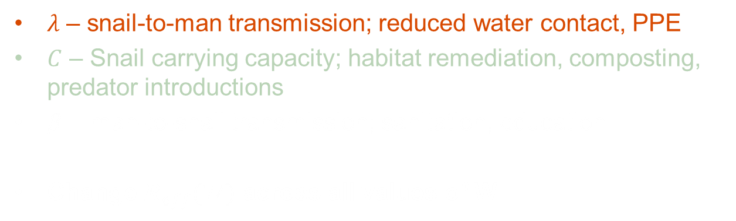
Framework| Modeling Interventions
$$R_{eff}\left(W\right)=\frac{λρ\left(W\right)T_{1}T_{2}C(f_{N}\left(1+T_{2}\right)−μ_{N}−βWHφ\left(W\right)γ(W)}{f_{N}\left(1+T_{2}+T_{1}T_{2}\right)\left(1+T_{2}\right)\left(μ_{W}+μ_{H}\right)W}$$
$λ$ – snail-to-man transmission; reduced water contact, PPE
$C$ – Snail carrying capacity; habitat remediation, composting, predator introductions
$β$ – man-to-snail transmission; sanitation, education
Change $R_{eff}(W)$ across all values of W

Slide 17
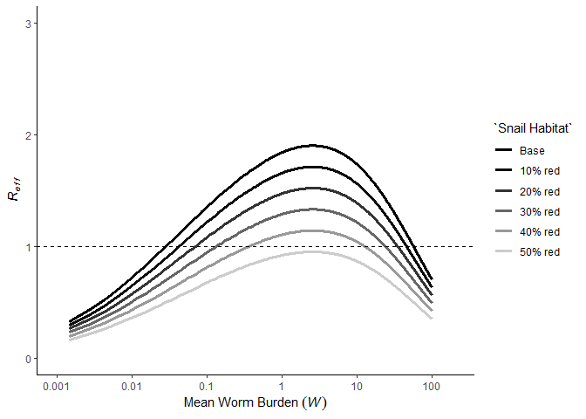


Framework| Modeling Interventions
Interventions such as snail habitat reduction, sanitation, education suppress $R_{eff}$
Make control and elimination more feasible
Increase resilience to reinfection
Decrease endemic equilibrium
Breakpoint, $W_{bp}$

Slide 18
Framework| Modeling Interventions
What’s the right combination of MDA and other interventions?

Slide 19
Framework| Modeling Interventions
Stochastic model using adaptiveTau R package (tau leaping algorithm for stochastic events)

Slide 20
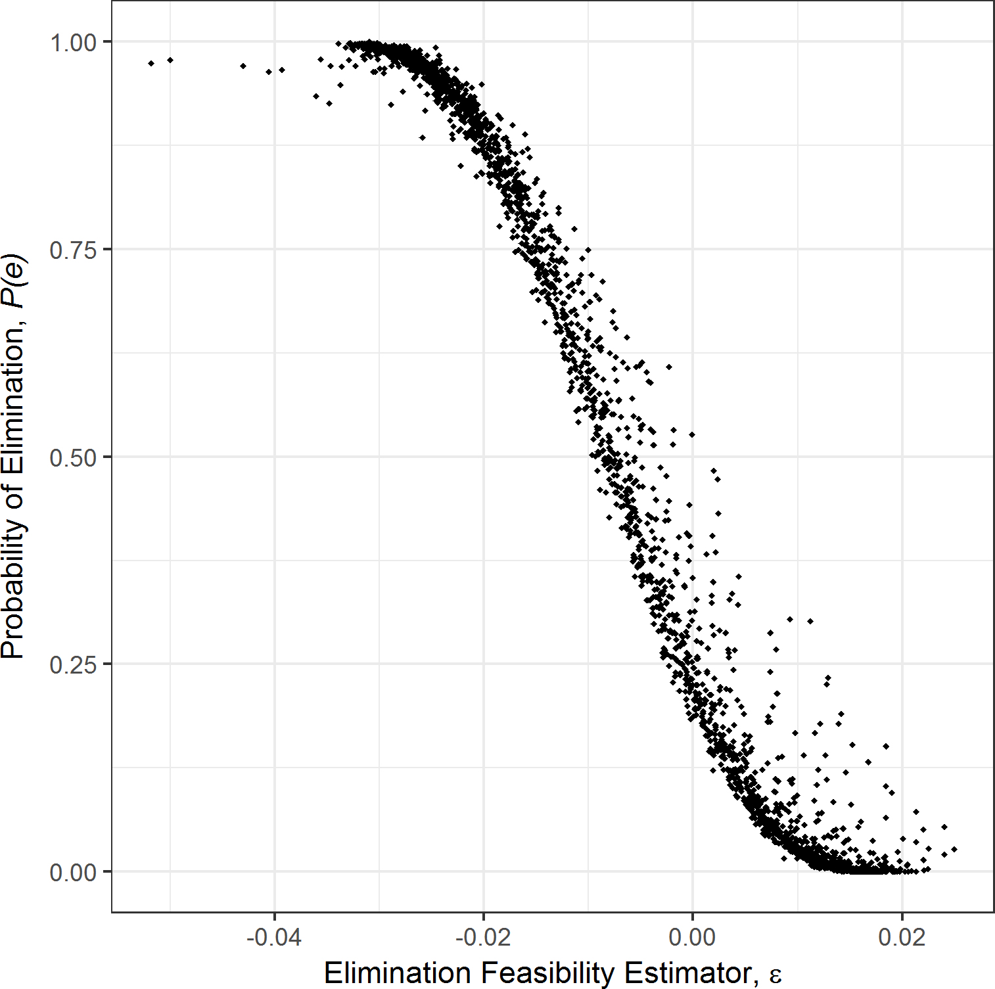

Implementation| Modeling Interventions
$P(e)$ estimated from 100 simulations across 20 trials
Arakala A, Hoover CM, Marshall JM, Sokolow SH, De Leo GA, Rohr JR, et al. (2018) Estimating the elimination feasibility in the 'end game' of control efforts for parasites subjected to regular mass drug administration: Methods and their application to schistosomiasis. PLoS Negl Trop Dis 12(11): e0006794. https://doi.org/10.1371/journal.pntd.0006794

Slide 21
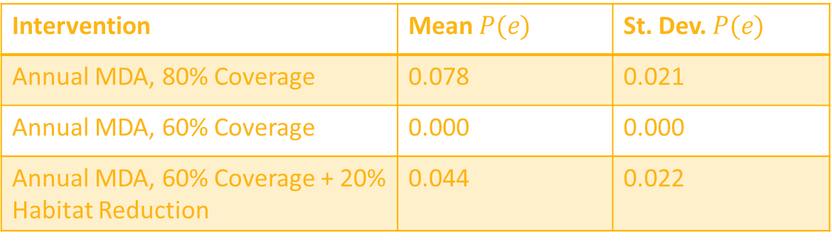
Implementation| Modeling Interventions
$P(e)$ estimated from 100 simulations across 20 trials
Intervention | Mean $P(e)$ | St. Dev. $P(e)$
Annual MDA, 80% Coverage | 0.078 | 0.021
Annual MDA, 60% Coverage | 0.000 | 0.000
Annual MDA, 60% Coverage + 20% Habitat Reduction | 0.044 | 0.022
Arakala A, Hoover CM, Marshall JM, Sokolow SH, De Leo GA, Rohr JR, et al. (2018) Estimating the elimination feasibility in the 'end game' of control efforts for parasites subjected to regular mass drug administration: Methods and their application to schistosomiasis. PLoS Negl Trop Dis 12(11): e0006794. https://doi.org/10.1371/journal.pntd.0006794

Slide 22

Implementation| Schistosomiasis model, next steps
Reduce computational intensity, maintain stochastic component
Solved with Stochastic Dynamic Programming?
Optimal interventions within and across transmission networks, with seasonality
Agent-based human component of schistosomiasis model?
Age structure and individual variability
Accurate costing information for interventions
Exploring across large decision space (i.e. multiple potential interventions implemented in different quantities at different times)
Data for model fitting
Which scenario(s) to focus on?
Lo et al PNAS
Objective function?
DALYs/$
$W<W_{bp}$
$P(e)$

Slide 24
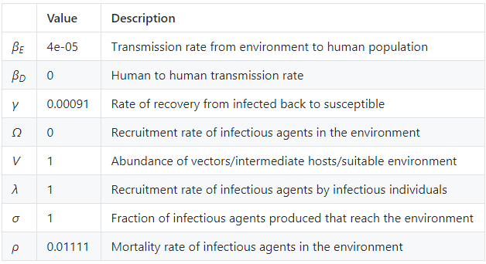

Framework| Garchitorena et al model
$$\dot{I} =\left(β_{D}I+β_{E}W\right)S−γI \\ \dot{W}=Ω+VσλI−ρW$$
Garchitorena, A., Sokolow, S. H., Roche, B., Ngonghala, C. N., Jocque, M., Lund, A., ... & Andrews, J. R. (2017). Disease ecology, health and the environment: a framework to account for ecological and socio-economic drivers in the control of neglected tropical diseases. Philosophical Transactions of the Royal Society B: Biological Sciences, 372(1722), 20160128.

Slide 25

Framework| Garchitorena et al model
$$\dot{I} =\left(β_{D}I+β_{E}W\right)S−γI \\ \dot{W}=Ω+VσλI−ρW$$
Potential interventions:
I – MDA
$W/V$ – Vector or intermediate host control
$σ$ – Sanitation or education campaign
$β_{E}$ – Education campaign (exposure avoidance)
Garchitorena, A., Sokolow, S. H., Roche, B., Ngonghala, C. N., Jocque, M., Lund, A., ... & Andrews, J. R. (2017). Disease ecology, health and the environment: a framework to account for ecological and socio-economic drivers in the control of neglected tropical diseases. Philosophical Transactions of the Royal Society B: Biological Sciences, 372(1722), 20160128.

Slide 26
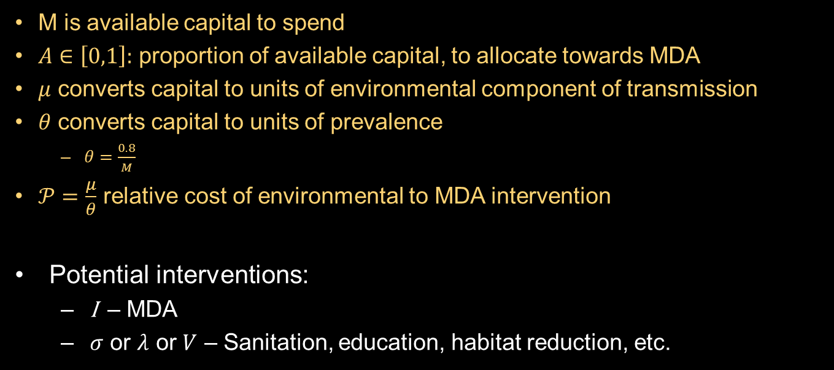

Framework| Garchitorena et al model
$$\dot{I} =β_{E}W\left(1−I\right)−(γ+MAθ)I \\ \dot{W}=VσλI(M\left(1−A\right)μ)−ρW$$
M is available capital to spend
$A∈\left[0,1\right]:$ proportion of available capital, to allocate towards MDA
$μ$ converts capital to units of environmental component of transmission
$θ$ converts capital to units of prevalence
$θ=\frac{0.8}{M}$
$𝒫=\frac{μ}{θ}$ relative cost of environmental to MDA intervention
Potential interventions:
I – MDA
$σ$ or $λ$ or $V$ – Sanitation, education, habitat reduction, etc.

Slide 27
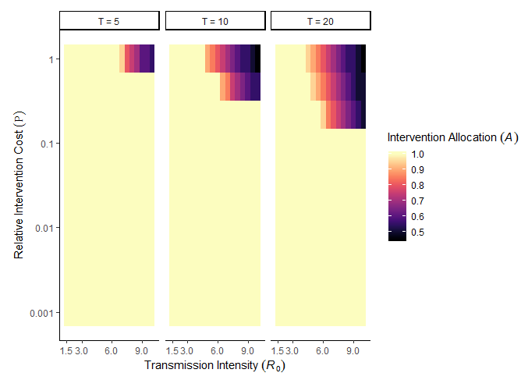

Implementation| Garchitorena et al
Identify optimal intervention strategy, $A$, in $\{R_{0}, 𝒫\}$ parameter space; across time horizons, $T$, of 5, 10, 20 years

Slide 28


Implementation| Garchitorena et al + Density Dependence
Identify optimal intervention strategy, $A$, in $\{R_{0}, 𝒫\}$ parameter space; across time horizons, $T$, of 5, 10, 20 years
Include density dependence, $f_{1}(W)$, that gives rise to a breakpoint
$$\dot{I} =β_{E}W\left(1−I\right)−γI \\ \dot{W}=VσλIf_{1}\left(W\right)−ρW$$
$$f_{1}\left(W\right)=ζI(1−I)$$
$$R_{0}=\frac{Vσλβ_{E}}{γρ}$$
$$R_{eff}=\frac{Vσλβ_{E}f_{1}(W)}{γρ}$$

Slide 29
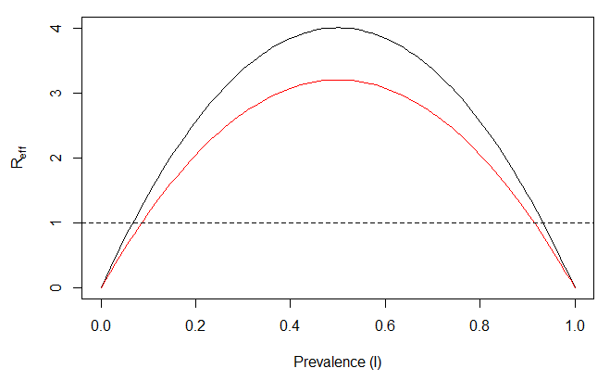
Implementation| Garchitorena et al + Density Dependence
Identify optimal intervention strategy, $A$, in $\{R_{0}, 𝒫\}$ parameter space; across time horizons, $T$, of 5, 10, 20 years
Include density dependence, $f_{1}(W)$, that gives rise to a breakpoint

Slide 30
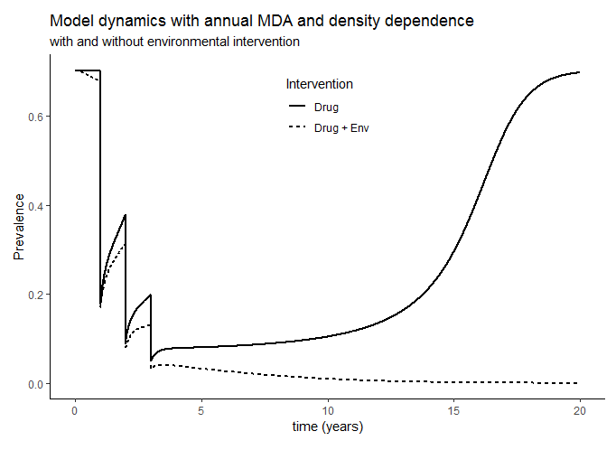
Implementation| Garchitorena et al + Density Dependence
Identify optimal intervention strategy, $A$, in $\{R_{0}, 𝒫\}$ parameter space; across time horizons, $T$, of 5, 10, 20 years
Include density dependence, $f_{1}(W)$, that gives rise to a breakpoint

Slide 31
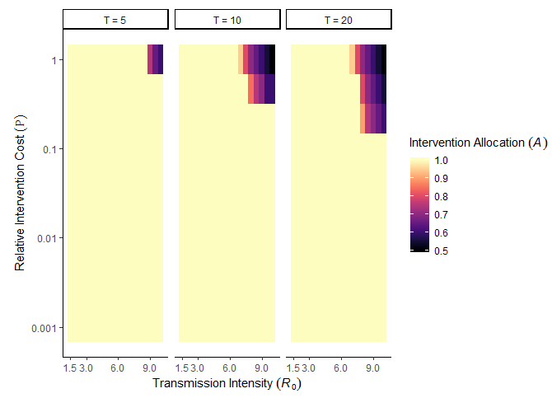
Implementation| Garchitorena et al + Density Dependence
Identify optimal intervention strategy, $A$, in $\{R_{0}, 𝒫\}$ parameter space; across time horizons, $T$, of 5, 10, 20 years
Include density dependence, $f_{1}(W)$, that gives rise to a breakpoint

Slide 32

Next Steps| Garchitorena et al
Systematic noncompliance in MDA treatment
Stochasticity
Network structure
Non-linearities in transmission
Economic component
Solved within formalized optimal control framework (SDP)
Estimating breakpoints
$R_{eff}=R_{0}×f(W)$
$1=R_{0}×f(W_{bp})$
$f^{−1}\left(\frac{1}{R_{0}}\right)=W_{bp}$

Slide 33
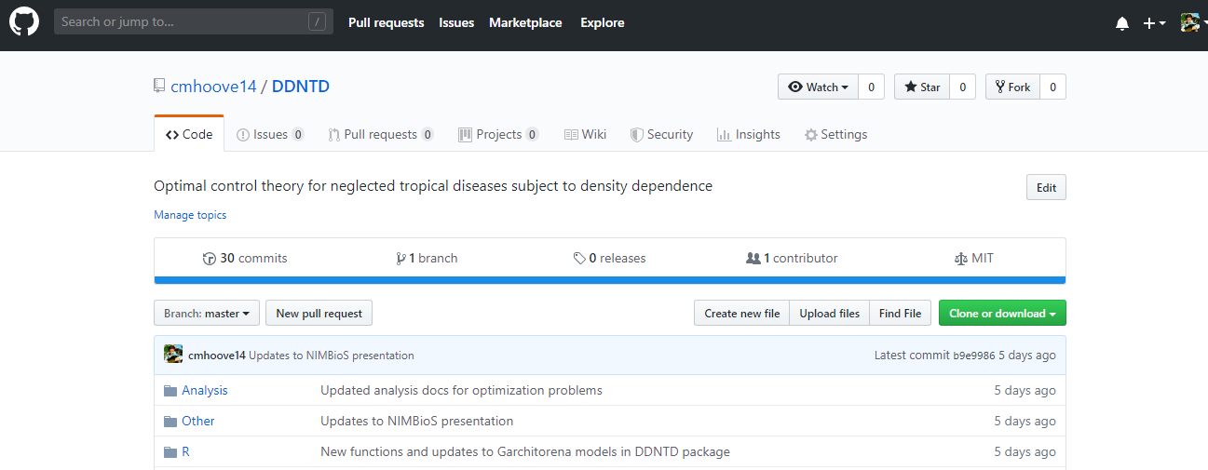
Implementation| Models
Easily distributable and reproducible analyses and methods
https://github.com/cmhoove14/DDNTD
devtools::install_github(cmhoove14/DDNTD)

Slide 34
Framework| Stochastic Dynamic Programming
Solve optimization problems in the context of uncertainty
Determines state-dependent optimal decisions → adaptive policies through time
Marescot, L., Chapron, G., Chadès, I., Fackler, P. L., Duchamp, C., Marboutin, E., & Gimenez, O. (2013). Complex decisions made simple: a primer on stochastic dynamic programming. Methods in Ecology and Evolution, 4(9), 872-884.

Slide 35

Framework| Stochastic Dynamic Programming
State at time $t$, $S_{t}$
Decision at time $t$, $A_{t}$
Transition model, $ℳ$, that gives $S_{t+1}|S_{t},A_{t}$
Utility function, $U_{t}(S_{t},A_{t})$, that gives “reward” of $A_{t}|S_{t}$
Optimal solution over desired time horizon
Marescot, L., Chapron, G., Chadès, I., Fackler, P. L., Duchamp, C., Marboutin, E., & Gimenez, O. (2013). Complex decisions made simple: a primer on stochastic dynamic programming. Methods in Ecology and Evolution, 4(9), 872-884.

Slide 36

Framework| Stochastic Dynamic Programming
State at time $t$, $S_{t}$
Mean worm burden
Prevalence
Disability
Marescot, L., Chapron, G., Chadès, I., Fackler, P. L., Duchamp, C., Marboutin, E., & Gimenez, O. (2013). Complex decisions made simple: a primer on stochastic dynamic programming. Methods in Ecology and Evolution, 4(9), 872-884.

Slide 37

Framework| Stochastic Dynamic Programming
Decision at time $t$, $A_{t}$
MDA strategy (School- or community-based)
Combined strategy (MDA + Snail control)
Allocation of resources across different intervention options
Marescot, L., Chapron, G., Chadès, I., Fackler, P. L., Duchamp, C., Marboutin, E., & Gimenez, O. (2013). Complex decisions made simple: a primer on stochastic dynamic programming. Methods in Ecology and Evolution, 4(9), 872-884.

Slide 38

Framework| Stochastic Dynamic Programming
Transition model, $ℳ$, that gives $S_{t+1}|S_{t},A_{t}$
Deterministic, stochastic, agent-based models
Marescot, L., Chapron, G., Chadès, I., Fackler, P. L., Duchamp, C., Marboutin, E., & Gimenez, O. (2013). Complex decisions made simple: a primer on stochastic dynamic programming. Methods in Ecology and Evolution, 4(9), 872-884.

Slide 39

Framework| Stochastic Dynamic Programming
Utility function, $U_{t}(S_{t},A_{t})$, that gives “reward” of $A_{t}|S_{t}$
Reduction in prevalence
$\frac{DALYs}{\$}$
Marescot, L., Chapron, G., Chadès, I., Fackler, P. L., Duchamp, C., Marboutin, E., & Gimenez, O. (2013). Complex decisions made simple: a primer on stochastic dynamic programming. Methods in Ecology and Evolution, 4(9), 872-884.

Slide 40
Framework| Stochastic Dynamic Programming
Optimal solution over desired time horizon
Solved via Bellman’s equation and backwards iteration for finite time horizons
Solved via policy or value iteration for infinite time horizons
Marescot, L., Chapron, G., Chadès, I., Fackler, P. L., Duchamp, C., Marboutin, E., & Gimenez, O. (2013). Complex decisions made simple: a primer on stochastic dynamic programming. Methods in Ecology and Evolution, 4(9), 872-884.

Slide 41
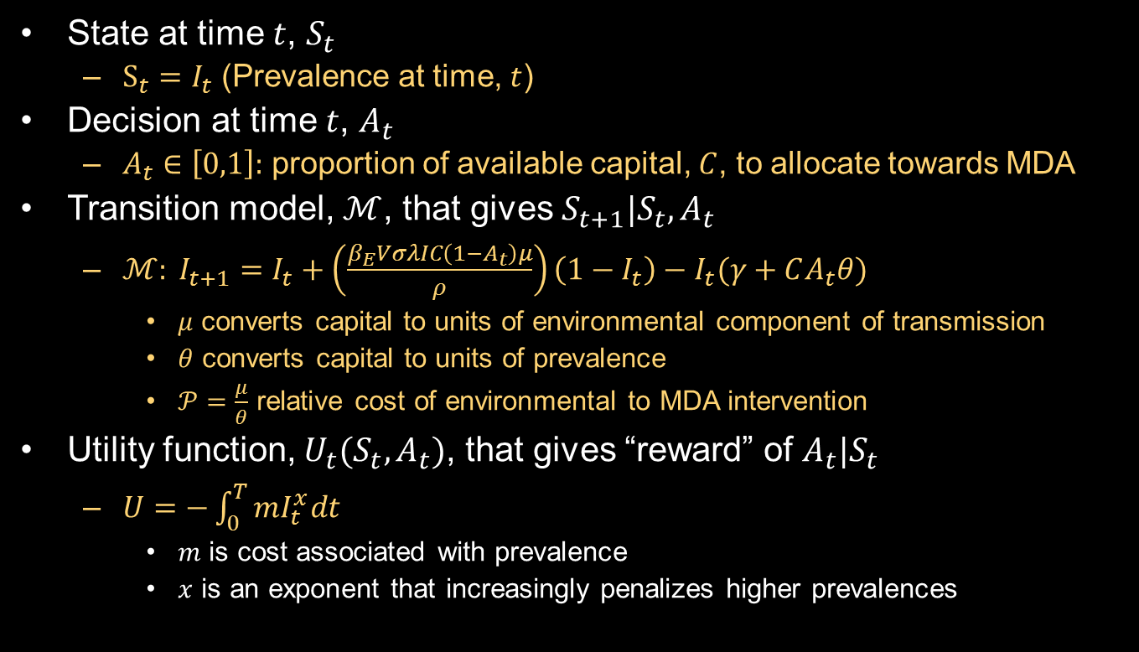
Implementation| Garchitorena et al
State at time $t$, $S_{t}$
$S_{t}=I_{t}$ (Prevalence at time, $t$)
Decision at time $t$, $A_{t}$
$A_{t}∈\left[0,1\right]:$ proportion of available capital, $C$, to allocate towards MDA
Transition model, $ℳ$, that gives $S_{t+1}|S_{t},A_{t}$
$ℳ: I_{t+1}=I_{t}+\left(\frac{β_{E}VσλIC\left(1−A_{t}\right)μ}{ρ}\right)\left(1−I_{t}\right)−I_{t}(γ+CA_{t}θ)$
$μ$ converts capital to units of environmental component of transmission
$θ$ converts capital to units of prevalence
$𝒫=\frac{μ}{θ}$ relative cost of environmental to MDA intervention
Utility function, $U_{t}(S_{t},A_{t})$, that gives “reward” of $A_{t}|S_{t}$
$U=−\int_{0}^{T}{mI_{t}^{x}dt}$
$m$ is cost associated with prevalence
$x$ is an exponent that increasingly penalizes higher prevalences

Slide 42
How do we optimally allocate resources given:
Transmission intensity
Transmission network
Rate of development
Time frame and goal
Uncertainty

Slide 43
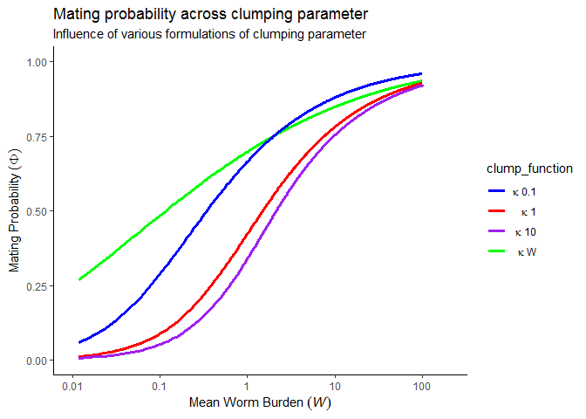

Theory | Density Dependence
Functions $(f)$ of disease prevalence or infection intensity

Slide 44
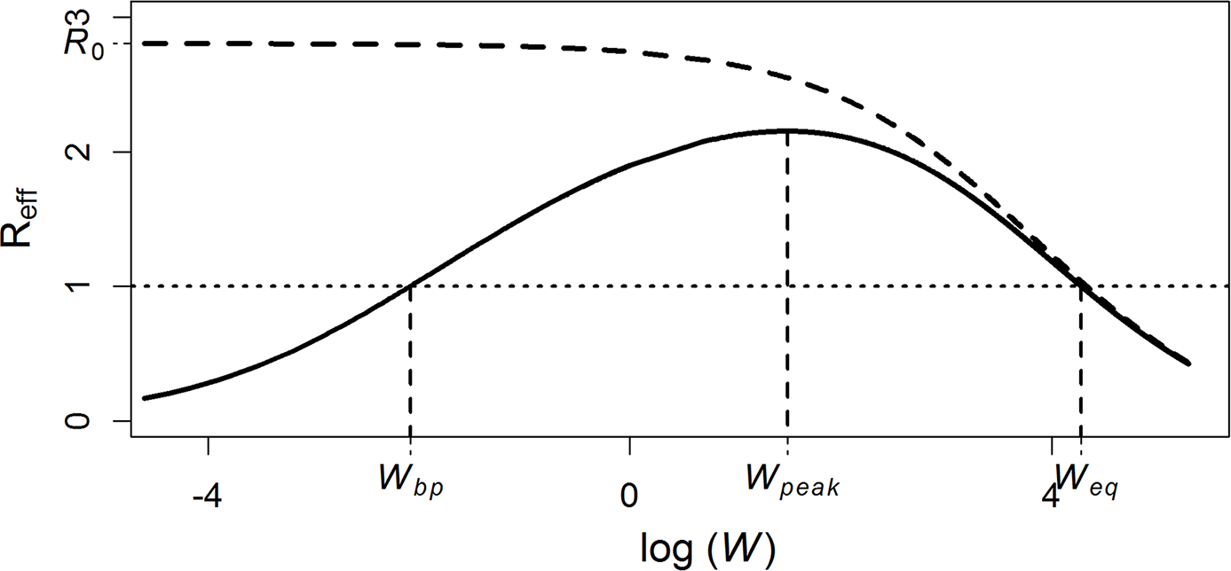
Theory | Reff & Breakpoints
Arakala A, Hoover CM, Marshall JM, Sokolow SH, De Leo GA, Rohr JR, et al. (2018) Estimating the elimination feasibility in the 'end game' of control efforts for parasites subjected to regular mass drug administration: Methods and their application to schistosomiasis. PLoS Negl Trop Dis 12(11): e0006794. https://doi.org/10.1371/journal.pntd.0006794

Slide 45
Theory | Reff & Breakpoints
MDA has unquestionable benefits in terms of achieving transmission and morbidity reduction, but may never suppress the parasite population below the breakpoint in areas:
Where high transmission leads to bounce back to endemic levels before the next round of MDA (insufficient frequency)
Where reservoirs of infection are sufficient to maintain parasite populations above the breakpoint (insufficient coverage)
Notes:
Frame question in terms of which is cheaper: increased coverage, increased frequency, or alternative interventions?

Slide 46
Implementation| Schistosomiasis model
Arakala A, Hoover CM, Marshall JM, Sokolow SH, De Leo GA, Rohr JR, et al. (2018) Estimating the elimination feasibility in the 'end game' of control efforts for parasites subjected to regular mass drug administration: Methods and their application to schistosomiasis. PLoS Negl Trop Dis 12(11): e0006794. https://doi.org/10.1371/journal.pntd.0006794

Slide 47
Implementation| Schistosomiasis model
Arakala A, Hoover CM, Marshall JM, Sokolow SH, De Leo GA, Rohr JR, et al. (2018) Estimating the elimination feasibility in the 'end game' of control efforts for parasites subjected to regular mass drug administration: Methods and their application to schistosomiasis. PLoS Negl Trop Dis 12(11): e0006794. https://doi.org/10.1371/journal.pntd.0006794

Slide 48
Implementation| Schistosomiasis model
Arakala A, Hoover CM, Marshall JM, Sokolow SH, De Leo GA, Rohr JR, et al. (2018) Estimating the elimination feasibility in the 'end game' of control efforts for parasites subjected to regular mass drug administration: Methods and their application to schistosomiasis. PLoS Negl Trop Dis 12(11): e0006794. https://doi.org/10.1371/journal.pntd.0006794

Slide 49
Implementation| Schistosomiasis model, next steps
Analytic solutions to determining transmission probabilities
Optimal interventions within and across transmission networks
Agent-based human component of schistosomiasis model?
Accurate costing information for interventions
Exploring across large decision space (i.e. multiple potential interventions implemented in different quantities at different times)
Data for model fitting
SDP vs other methods?
Lo et al PNAS

Slide 50
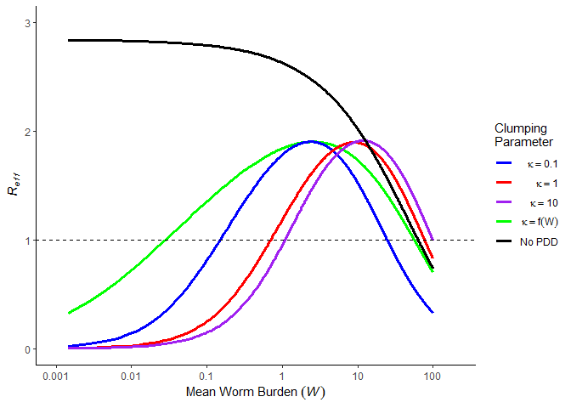

Theory | Density Dependence
$R_{eff}≈R_{0}∗f(W)$

