Slide 1

Optimal Control of Schistosomiasis
Influence of density dependence and framework for investigation
Chris Hoover
NIMBioS July 2019

Slide 2

Goals
Expand theoretical understanding of the dynamics of NTD elimination
Investigate cost-effective NTD control and elimination strategies
Identify optimal combinations of interventions in different scenarios
Assess innovative and novel control strategies

Slide 3
Outline
Theory
Density dependence, R_{eff}, and Breakpoints
Framework & Implementation
Interventions and their translation into models
Probability of elimination and other objectives

Slide 4
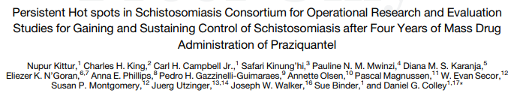
Background
Persistent hotspots in SCORE

Slide 5
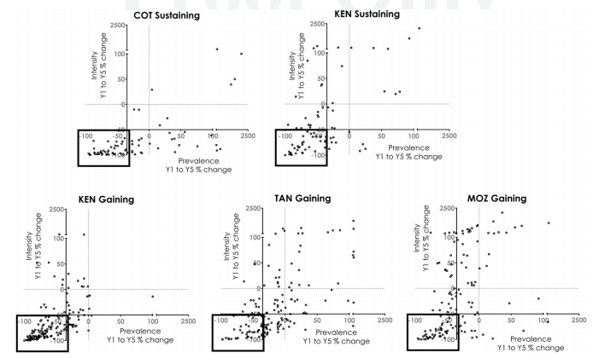
Background
Persistent hotspots in SCORE

Slide 6
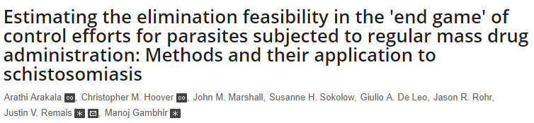
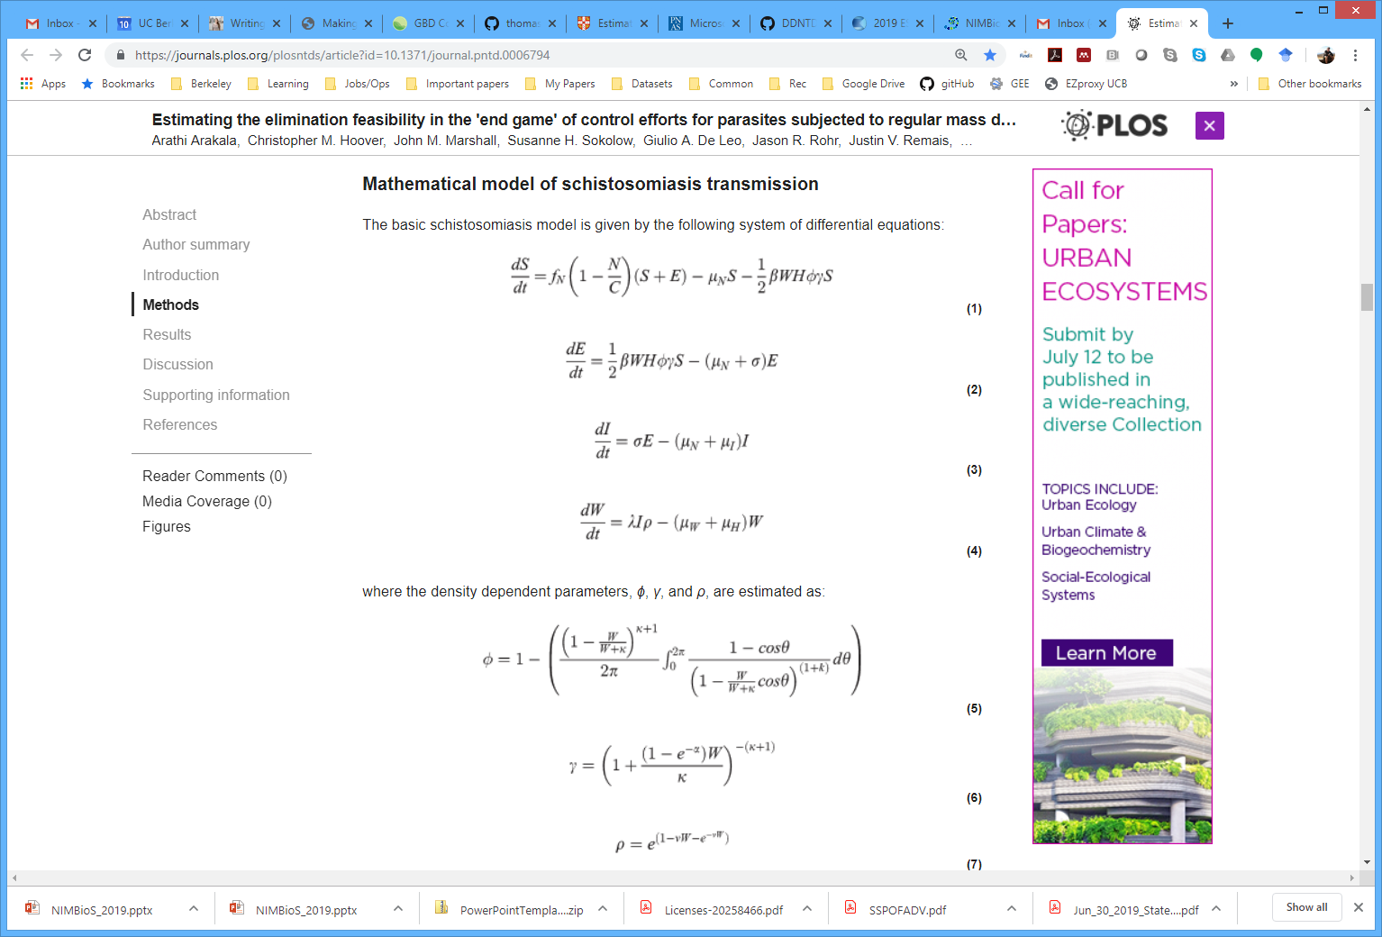
Theory | Density Dependence, Reff & Breakpoints
Arakala A, Hoover CM, Marshall JM, Sokolow SH, De Leo GA, Rohr JR, et al. (2018) Estimating the elimination feasibility in the 'end game' of control efforts for parasites subjected to regular mass drug administration: Methods and their application to schistosomiasis. PLoS Negl Trop Dis 12(11): e0006794. https://doi.org/10.1371/journal.pntd.0006794

Slide 7
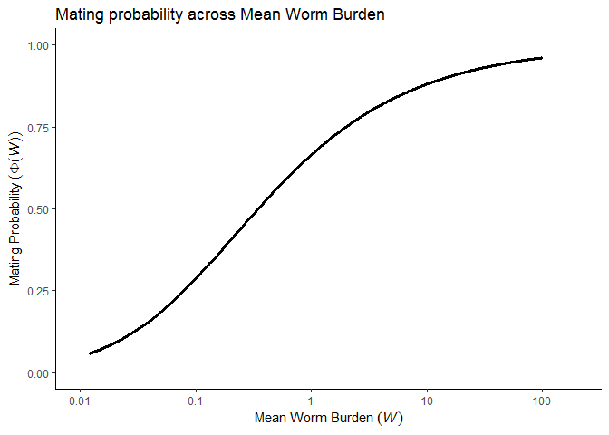

Theory | Density Dependence, Reff & Breakpoints
Functions $(f)$ of disease prevalence or infection intensity

Slide 8
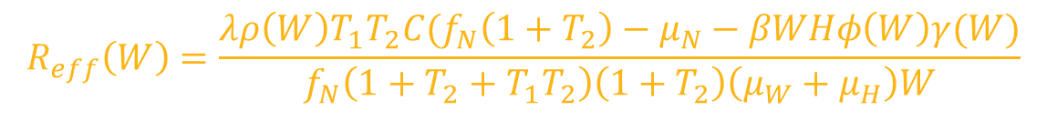
Theory | Density Dependence, Reff & Breakpoints
$$R_{eff}\left(W\right)=\frac{λρ\left(W\right)T_{1}T_{2}C(f_{N}\left(1+T_{2}\right)−μ_{N}−βWHφ\left(W\right)γ(W)}{f_{N}\left(1+T_{2}+T_{1}T_{2}\right)\left(1+T_{2}\right)\left(μ_{W}+μ_{H}\right)W}$$
Arakala A, Hoover CM, Marshall JM, Sokolow SH, De Leo GA, Rohr JR, et al. (2018) Estimating the elimination feasibility in the 'end game' of control efforts for parasites subjected to regular mass drug administration: Methods and their application to schistosomiasis. PLoS Negl Trop Dis 12(11): e0006794. https://doi.org/10.1371/journal.pntd.0006794

Slide 9
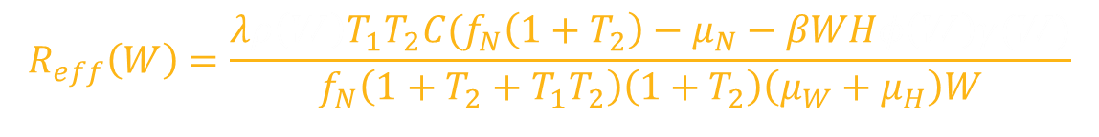

Theory | Density Dependence, Reff & Breakpoints
$$R_{eff}\left(W\right)=\frac{{λρ\left(W\right)T}_{1}T_{2}C(f_{N}\left(1+T_{2}\right)−μ_{N}−βWHφ\left(W\right)γ(W)}{f_{N}\left(1+T_{2}+T_{1}T_{2}\right)\left(1+T_{2}\right)\left(μ_{W}+μ_{H}\right)W}$$
Density dependence functions, $f(W)$
$W_{bp}$ estimable by solving for $W$ when $R_{eff}=1$
MDA changes $R_{eff}$ by reducing $W$
Arakala A, Hoover CM, Marshall JM, Sokolow SH, De Leo GA, Rohr JR, et al. (2018) Estimating the elimination feasibility in the 'end game' of control efforts for parasites subjected to regular mass drug administration: Methods and their application to schistosomiasis. PLoS Negl Trop Dis 12(11): e0006794. https://doi.org/10.1371/journal.pntd.0006794

Slide 10
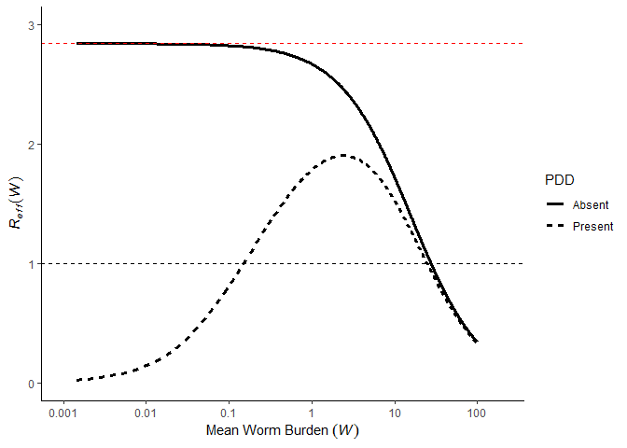



Theory | Density Dependence, Reff & Breakpoints
$$R_{eff}(W)≈R_{0}∗f(W)$$
$$R_{0}$$
Breakpoint, $W_{bp}$

Slide 11

Theory | Density Dependence, Reff & Breakpoints
Dynamics of annual MDA
Breakpoint, $W_{bp}$

Slide 12
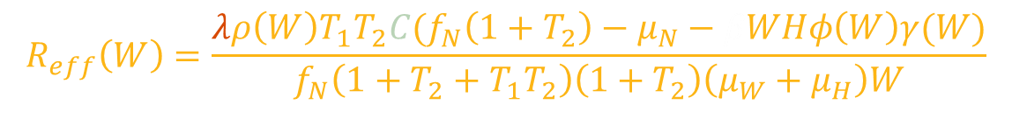
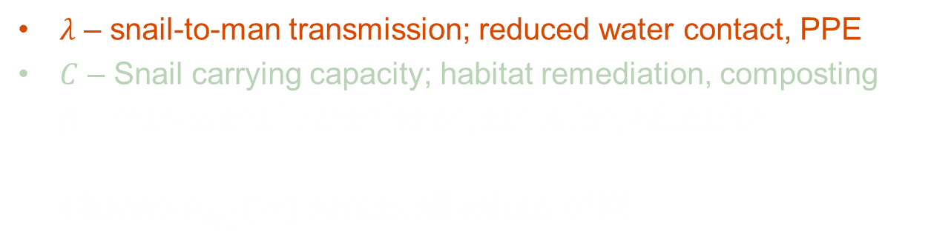
Framework| Modeling Interventions
$$R_{eff}\left(W\right)=\frac{λρ\left(W\right)T_{1}T_{2}C(f_{N}\left(1+T_{2}\right)−μ_{N}−βWHφ\left(W\right)γ(W)}{f_{N}\left(1+T_{2}+T_{1}T_{2}\right)\left(1+T_{2}\right)\left(μ_{W}+μ_{H}\right)W}$$
$λ$ – snail-to-man transmission; reduced water contact, PPE
$C$ – Snail carrying capacity; habitat remediation, composting
$β$ – man-to-snail transmission; sanitation, education
Change $R_{eff}(W)$ across all values of W

Slide 13
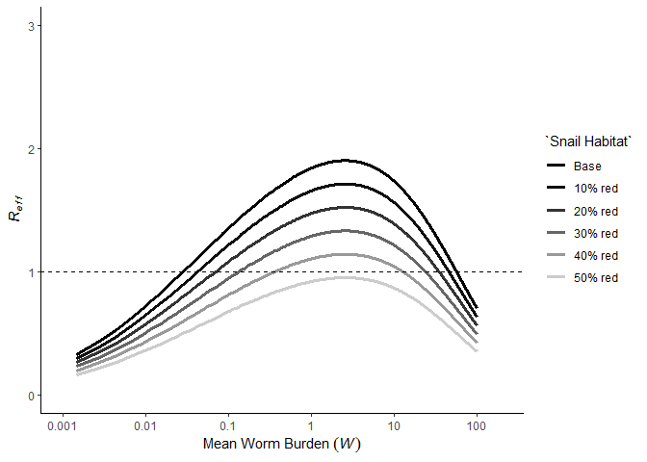


Framework| Modeling Interventions
Interventions such as snail habitat reduction, sanitation, education suppress $R_{eff}$
Make control and elimination more feasible
Increase resilience to reinfection
Decrease endemic equilibrium
Breakpoint, $W_{bp}$

Slide 14
Framework| Modeling Interventions
What’s the right combination of MDA and other interventions?

Slide 15
Framework| Modeling Interventions
Stochastic model using adaptiveTau R package (tau leaping algorithm for stochastic events)

Slide 16
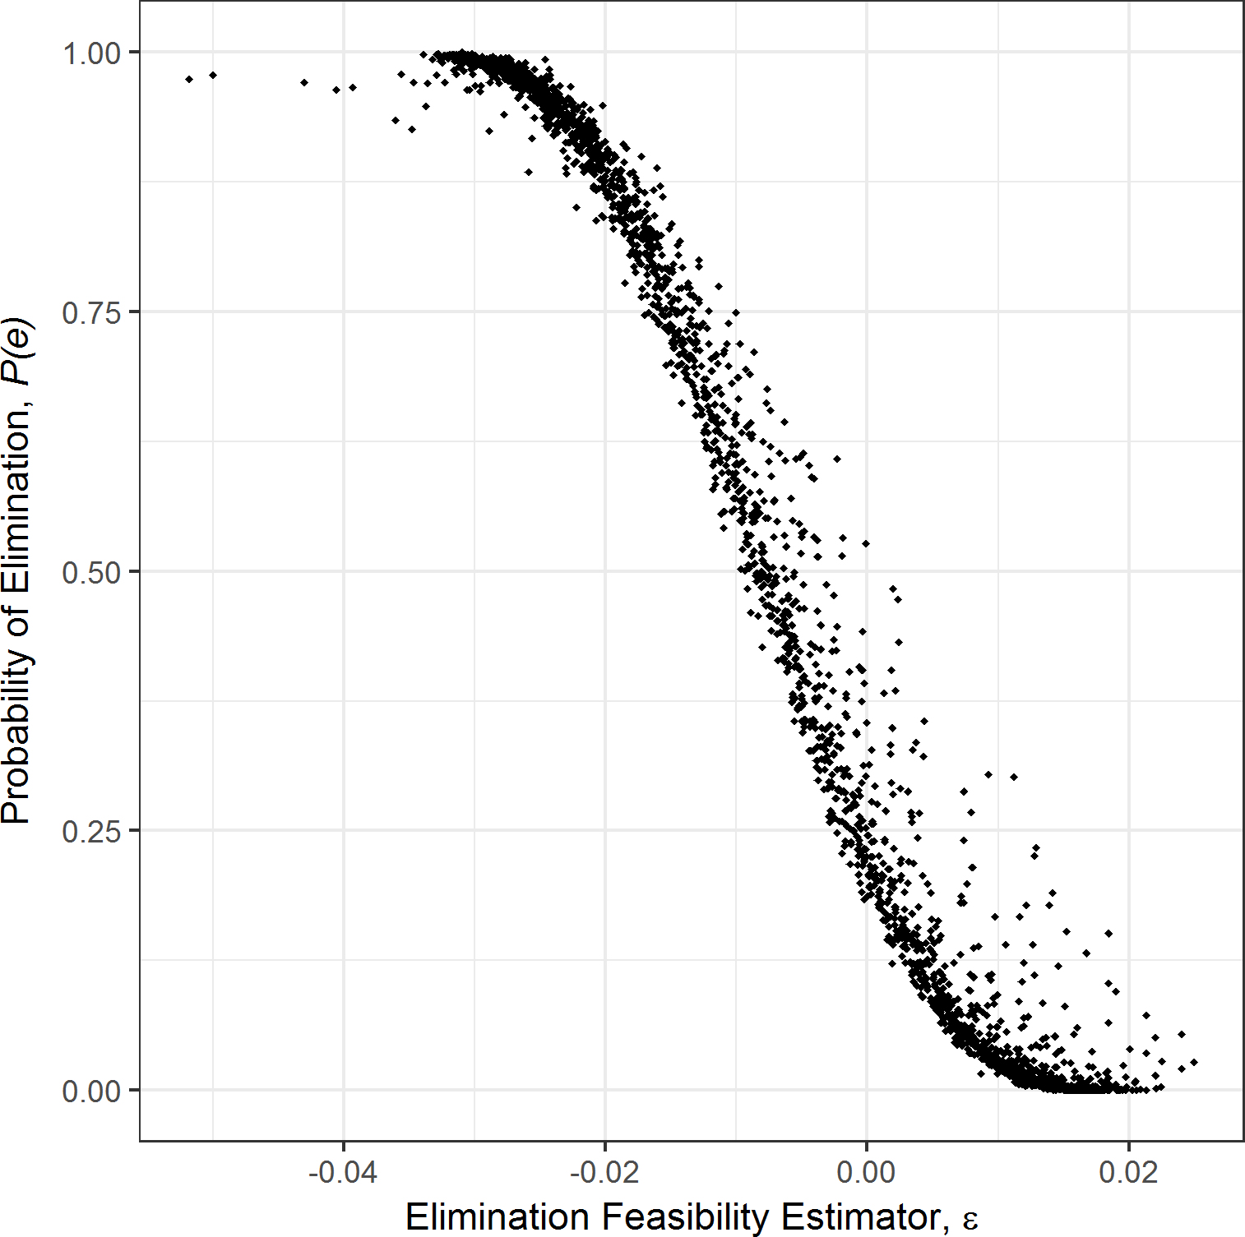

Implementation| Modeling Interventions
$P(e)$ estimated from 100 simulations across 20 trials
Arakala A, Hoover CM, Marshall JM, Sokolow SH, De Leo GA, Rohr JR, et al. (2018) Estimating the elimination feasibility in the 'end game' of control efforts for parasites subjected to regular mass drug administration: Methods and their application to schistosomiasis. PLoS Negl Trop Dis 12(11): e0006794. https://doi.org/10.1371/journal.pntd.0006794

Slide 17
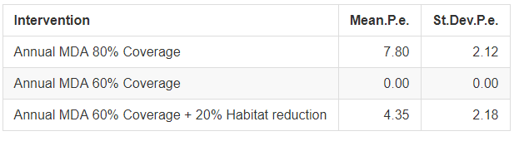
Implementation| Modeling Interventions
$P(e)$ estimated from 100 simulations across 20 trials
Arakala A, Hoover CM, Marshall JM, Sokolow SH, De Leo GA, Rohr JR, et al. (2018) Estimating the elimination feasibility in the 'end game' of control efforts for parasites subjected to regular mass drug administration: Methods and their application to schistosomiasis. PLoS Negl Trop Dis 12(11): e0006794. https://doi.org/10.1371/journal.pntd.0006794

Slide 18
Implementation| Schistosomiasis model, next steps
Analyze with Stochastic Dynamic Programming?
Optimal interventions within and across transmission networks, with seasonality
Agent-based human component of schistosomiasis model?
Accurate costing information for interventions
Exploring across large decision space (i.e. multiple potential interventions implemented in different quantities at different times)
Data for model fitting
Which scenario(s) to focus on?
Lo et al PNAS

Slide 20
Framework| Stochastic Dynamic Programming
Solve optimization problems in the context of uncertainty
Determines state-dependent optimal decisions → adaptive policies through time
Marescot, L., Chapron, G., Chadès, I., Fackler, P. L., Duchamp, C., Marboutin, E., & Gimenez, O. (2013). Complex decisions made simple: a primer on stochastic dynamic programming. Methods in Ecology and Evolution, 4(9), 872-884.

Slide 21

Framework| Stochastic Dynamic Programming
State at time $t$, $S_{t}$
Decision at time $t$, $A_{t}$
Transition model, $ℳ$, that gives $S_{t+1}|S_{t},A_{t}$
Utility function, $U_{t}(S_{t},A_{t})$, that gives “reward” of $A_{t}|S_{t}$
Optimal solution over desired time horizon
Marescot, L., Chapron, G., Chadès, I., Fackler, P. L., Duchamp, C., Marboutin, E., & Gimenez, O. (2013). Complex decisions made simple: a primer on stochastic dynamic programming. Methods in Ecology and Evolution, 4(9), 872-884.

Slide 22
Framework| Stochastic Dynamic Programming
State at time $t$, $S_{t}$
Decision at time $t$, $A_{t}$
Transition model, $ℳ$, that gives $S_{t+1}|S_{t},A_{t}$
Utility function, $U_{t}(S_{t},A_{t})$, that gives “reward” of $A_{t}|S_{t}$
Optimal solution over desired time horizon
Marescot, L., Chapron, G., Chadès, I., Fackler, P. L., Duchamp, C., Marboutin, E., & Gimenez, O. (2013). Complex decisions made simple: a primer on stochastic dynamic programming. Methods in Ecology and Evolution, 4(9), 872-884.

Slide 23

Framework| Stochastic Dynamic Programming
State at time $t$, $S_{t}$
Mean worm burden
Prevalence
Disability
Marescot, L., Chapron, G., Chadès, I., Fackler, P. L., Duchamp, C., Marboutin, E., & Gimenez, O. (2013). Complex decisions made simple: a primer on stochastic dynamic programming. Methods in Ecology and Evolution, 4(9), 872-884.

Slide 24

Framework| Stochastic Dynamic Programming
Decision at time $t$, $A_{t}$
MDA strategy (School- or community-based)
Combined strategy (MDA + Snail control)
Allocation of resources across different intervention options
Marescot, L., Chapron, G., Chadès, I., Fackler, P. L., Duchamp, C., Marboutin, E., & Gimenez, O. (2013). Complex decisions made simple: a primer on stochastic dynamic programming. Methods in Ecology and Evolution, 4(9), 872-884.

Slide 25

Framework| Stochastic Dynamic Programming
Transition model, $ℳ$, that gives $S_{t+1}|S_{t},A_{t}$
Deterministic, stochastic, agent-based models
Marescot, L., Chapron, G., Chadès, I., Fackler, P. L., Duchamp, C., Marboutin, E., & Gimenez, O. (2013). Complex decisions made simple: a primer on stochastic dynamic programming. Methods in Ecology and Evolution, 4(9), 872-884.

Slide 26

Framework| Stochastic Dynamic Programming
Utility function, $U_{t}(S_{t},A_{t})$, that gives “reward” of $A_{t}|S_{t}$
Reduction in prevalence
$\frac{DALYs}{\$}$
Marescot, L., Chapron, G., Chadès, I., Fackler, P. L., Duchamp, C., Marboutin, E., & Gimenez, O. (2013). Complex decisions made simple: a primer on stochastic dynamic programming. Methods in Ecology and Evolution, 4(9), 872-884.

Slide 27
Framework| Stochastic Dynamic Programming
Optimal solution over desired time horizon
Solved via Bellman’s equation and backwards iteration for finite time horizons
Solved via policy or value iteration for infinite time horizons
Marescot, L., Chapron, G., Chadès, I., Fackler, P. L., Duchamp, C., Marboutin, E., & Gimenez, O. (2013). Complex decisions made simple: a primer on stochastic dynamic programming. Methods in Ecology and Evolution, 4(9), 872-884.

Slide 28
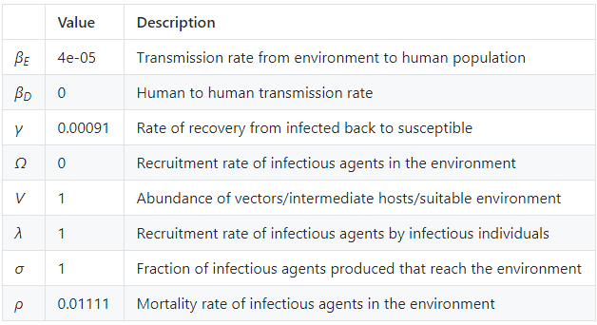

Framework| Garchitorena et al model
$$\dot{I} =\left(β_{D}I+β_{E}W\right)S−γI \\ \dot{W}=Ω+VσλI−ρW$$
Garchitorena, A., Sokolow, S. H., Roche, B., Ngonghala, C. N., Jocque, M., Lund, A., ... & Andrews, J. R. (2017). Disease ecology, health and the environment: a framework to account for ecological and socio-economic drivers in the control of neglected tropical diseases. Philosophical Transactions of the Royal Society B: Biological Sciences, 372(1722), 20160128.

Slide 29

Framework| Garchitorena et al model
$$\dot{I} =\left(β_{D}I+β_{E}W\right)S−γI \\ \dot{W}=Ω+VσλI−ρW$$
Potential interventions:
I – MDA
$W/V$ – Vector or intermediate host control
$σ$ – Sanitation or education campaign
$β_{E}$ – Education campaign (exposure avoidance)
Garchitorena, A., Sokolow, S. H., Roche, B., Ngonghala, C. N., Jocque, M., Lund, A., ... & Andrews, J. R. (2017). Disease ecology, health and the environment: a framework to account for ecological and socio-economic drivers in the control of neglected tropical diseases. Philosophical Transactions of the Royal Society B: Biological Sciences, 372(1722), 20160128.

Slide 30
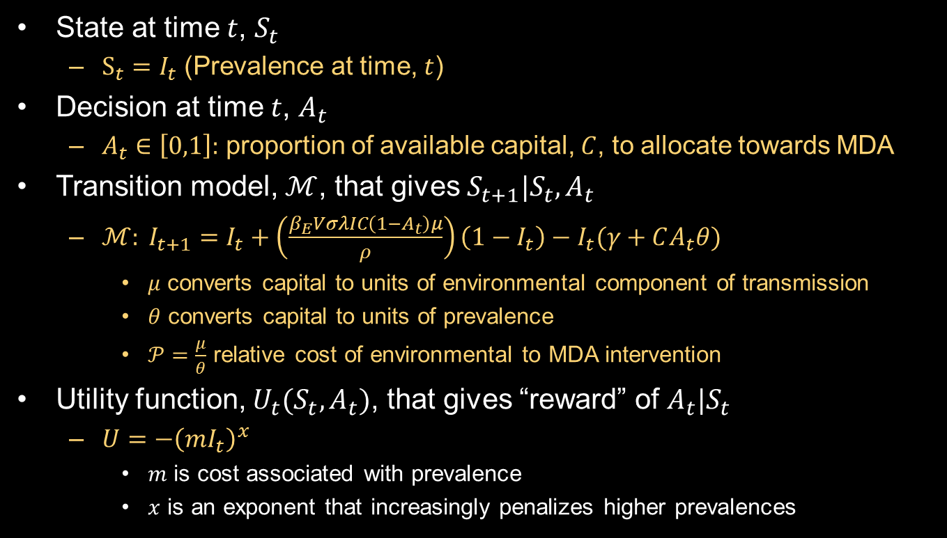
Implementation| Garchitorena et al
State at time $t$, $S_{t}$
$S_{t}=I_{t}$ (Prevalence at time, $t$)
Decision at time $t$, $A_{t}$
$A_{t}∈\left[0,1\right]:$ proportion of available capital, $C$, to allocate towards MDA
Transition model, $ℳ$, that gives $S_{t+1}|S_{t},A_{t}$
$ℳ: I_{t+1}=I_{t}+\left(\frac{β_{E}VσλIC\left(1−A_{t}\right)μ}{ρ}\right)\left(1−I_{t}\right)−I_{t}(γ+CA_{t}θ)$
$μ$ converts capital to units of environmental component of transmission
$θ$ converts capital to units of prevalence
$𝒫=\frac{μ}{θ}$ relative cost of environmental to MDA intervention
Utility function, $U_{t}(S_{t},A_{t})$, that gives “reward” of $A_{t}|S_{t}$
$U={−\left(mI_{t}\right)}^{x}$
$m$ is cost associated with prevalence
$x$ is an exponent that increasingly penalizes higher prevalences

Slide 31
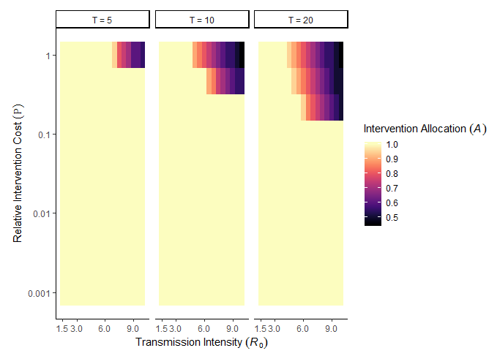

Implementation| Garchitorena et al
Identify optimal intervention strategy, $A_{t}$, in $\{R_{0}, 𝒫\}$ parameter space; across time horizons, $T$, of 5, 10, 20 years

Slide 32


Implementation| Garchitorena et al + Density Dependence
Identify optimal intervention strategy, $A_{t}$, in $\{R_{0}, 𝒫\}$ parameter space; across time horizons, $T$, of 5, 10, 20 years
Include density dependence, $f_{1}(W)$, that gives rise to a breakpoint
$$\dot{I} =β_{E}W\left(1−I\right)−γI \\ \dot{W}=VσλIf_{1}(W)−ρW$$
$$R_{0}=\frac{Vσλβ_{E}}{γρ}$$
$$R_{eff}=\frac{Vσλβ_{E}f_{1}(W)}{γρ}$$

Slide 33
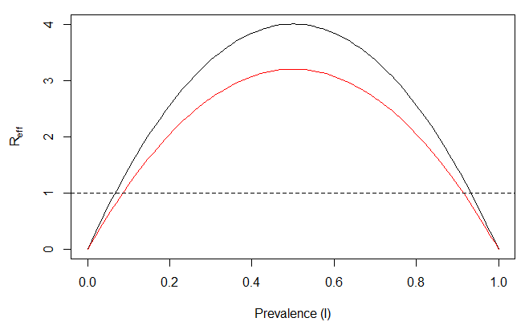
Implementation| Garchitorena et al + Density Dependence
Identify optimal intervention strategy, $A_{t}$, in $\{R_{0}, 𝒫\}$ parameter space; across time horizons, $T$, of 5, 10, 20 years
Include density dependence, $f_{1}(W)$, that gives rise to a breakpoint

Slide 34
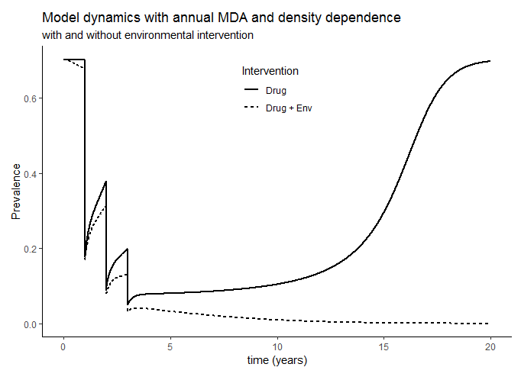
Implementation| Garchitorena et al + Density Dependence
Identify optimal intervention strategy, $A_{t}$, in $\{R_{0}, 𝒫\}$ parameter space; across time horizons, $T$, of 5, 10, 20 years
Include density dependence, $f_{1}(W)$, that gives rise to a breakpoint

Slide 35
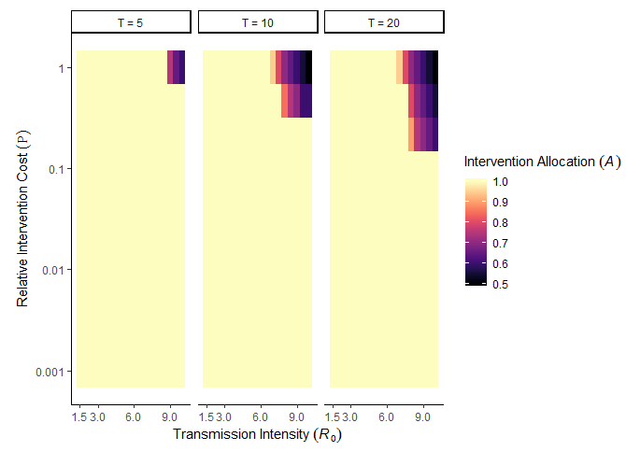
Implementation| Garchitorena et al + Density Dependence
Identify optimal intervention strategy, $A_{t}$, in $\{R_{0}, 𝒫\}$ parameter space; across time horizons, $T$, of 5, 10, 20 years
Include density dependence, $f_{1}(W)$, that gives rise to a breakpoint

Slide 36
Next Steps| Garchitorena et al
Systematic noncompliance in MDA treatment
Stochasticity
Network structure
Solved within formalized optimal control framework (SDP)

Slide 37
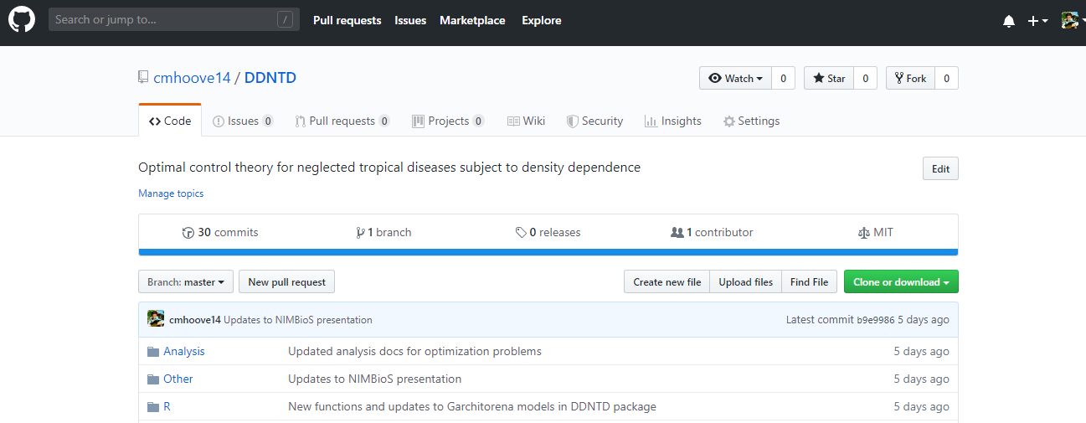
Implementation| Schistosomiasis model, next steps
Easily distributable and reproducible analyses and methods
https://github.com/cmhoove14/DDNTD

Slide 38
How do we optimally allocate resources given:
Transmission intensity
Transmission network
Rate of development
Time frame and goal
Uncertainty

Slide 39
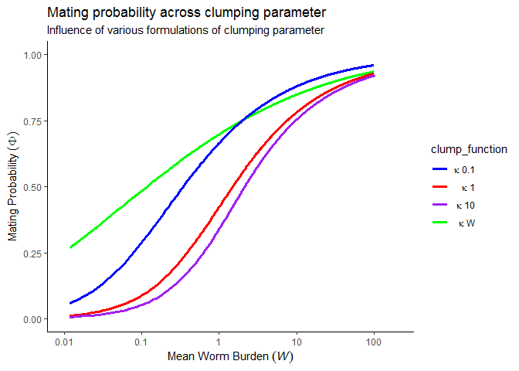

Theory | Density Dependence
Functions $(f)$ of disease prevalence or infection intensity

Slide 40
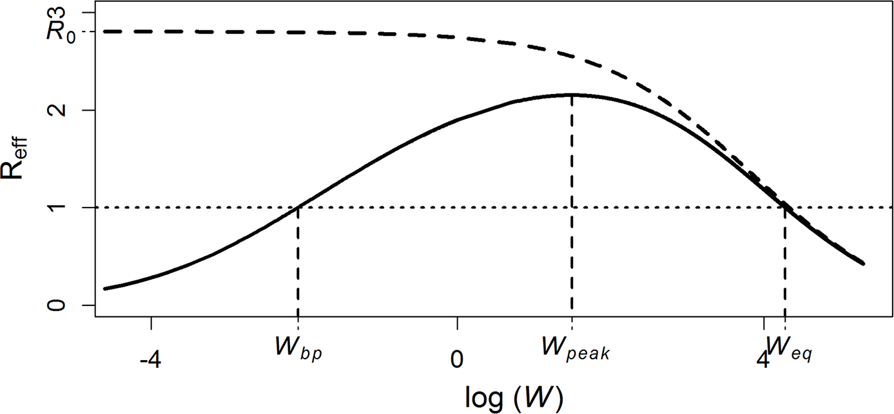
Theory | Reff & Breakpoints
Arakala A, Hoover CM, Marshall JM, Sokolow SH, De Leo GA, Rohr JR, et al. (2018) Estimating the elimination feasibility in the 'end game' of control efforts for parasites subjected to regular mass drug administration: Methods and their application to schistosomiasis. PLoS Negl Trop Dis 12(11): e0006794. https://doi.org/10.1371/journal.pntd.0006794

Slide 41
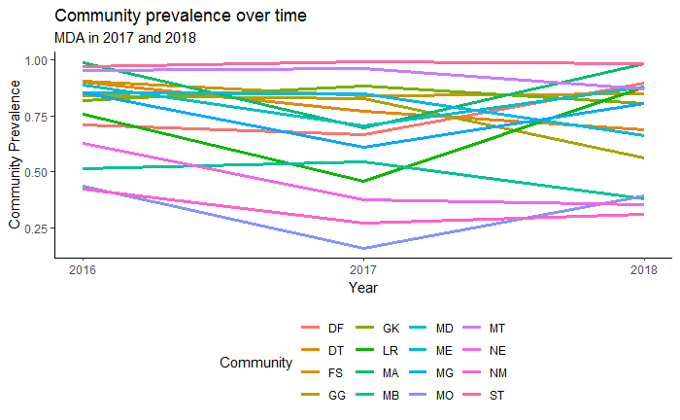
Theory | Reff & Breakpoints
MDA has unquestionable benefits in terms of achieving transmission and morbidity reduction, but may never suppress the parasite population below the breakpoint in areas:
Where high transmission leads to bounce back to endemic levels before the next round of MDA (insufficient frequency)
Where reservoirs of infection are sufficient to maintain parasite populations above the breakpoint (insufficient coverage)
Notes:
Frame question in terms of which is cheaper: increased coverage, increased frequency, or alternative interventions?

Slide 42
Implementation| Schistosomiasis model
Arakala A, Hoover CM, Marshall JM, Sokolow SH, De Leo GA, Rohr JR, et al. (2018) Estimating the elimination feasibility in the 'end game' of control efforts for parasites subjected to regular mass drug administration: Methods and their application to schistosomiasis. PLoS Negl Trop Dis 12(11): e0006794. https://doi.org/10.1371/journal.pntd.0006794

Slide 43
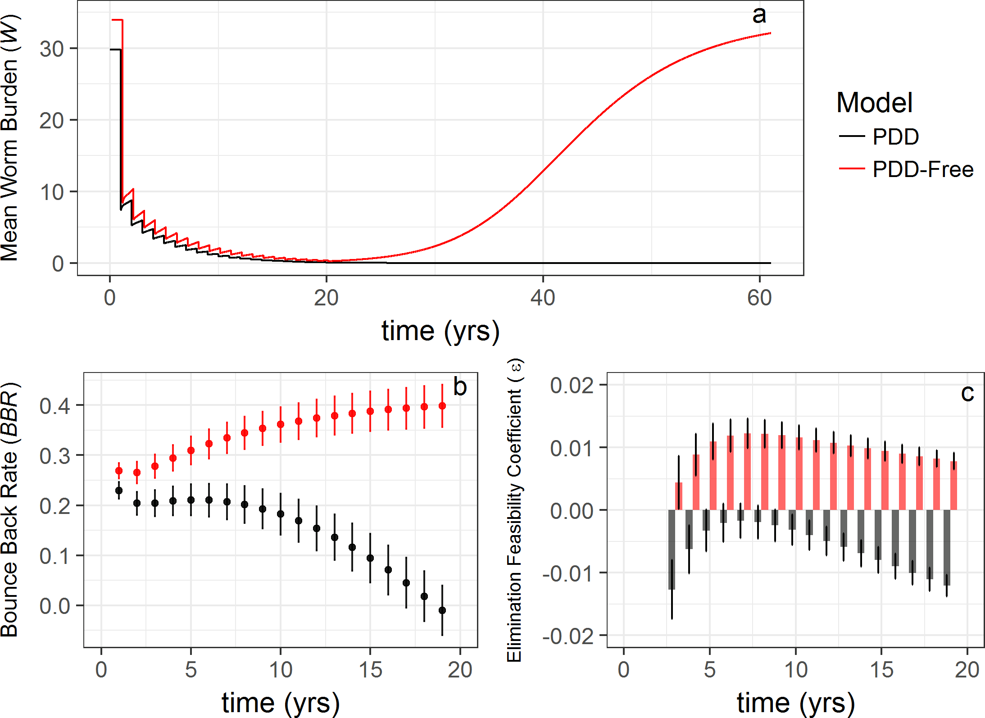
Implementation| Schistosomiasis model
Arakala A, Hoover CM, Marshall JM, Sokolow SH, De Leo GA, Rohr JR, et al. (2018) Estimating the elimination feasibility in the 'end game' of control efforts for parasites subjected to regular mass drug administration: Methods and their application to schistosomiasis. PLoS Negl Trop Dis 12(11): e0006794. https://doi.org/10.1371/journal.pntd.0006794

Slide 44
Implementation| Schistosomiasis model
Arakala A, Hoover CM, Marshall JM, Sokolow SH, De Leo GA, Rohr JR, et al. (2018) Estimating the elimination feasibility in the 'end game' of control efforts for parasites subjected to regular mass drug administration: Methods and their application to schistosomiasis. PLoS Negl Trop Dis 12(11): e0006794. https://doi.org/10.1371/journal.pntd.0006794

Slide 45
Implementation| Schistosomiasis model, next steps
Analytic solutions to determining transmission probabilities
Optimal interventions within and across transmission networks
Agent-based human component of schistosomiasis model?
Accurate costing information for interventions
Exploring across large decision space (i.e. multiple potential interventions implemented in different quantities at different times)
Data for model fitting
SDP vs other methods?
Lo et al PNAS

Slide 46
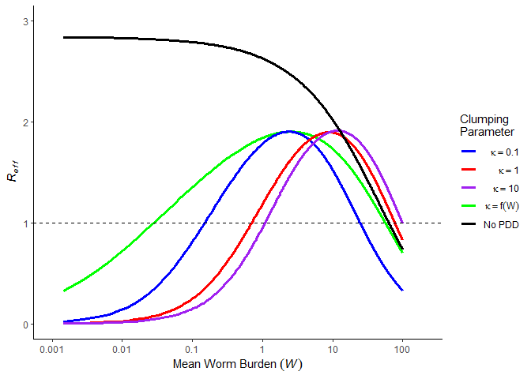

Theory | Density Dependence
$R_{eff}≈R_{0}∗f(W)$

