Slide 1

Optimal Control of NTDs
Theory, Framework, and Implementation using Stochastic Dynamic Programming
Chris Hoover
NIMBioS July 2019

Slide 2
Outline
Theory
Density dependence, R_{eff}, and Breakpoints
Framework
Systems, decisions, and utility
Implementation examples
Garchitorena et al model
Schistosomiasis model

Slide 3
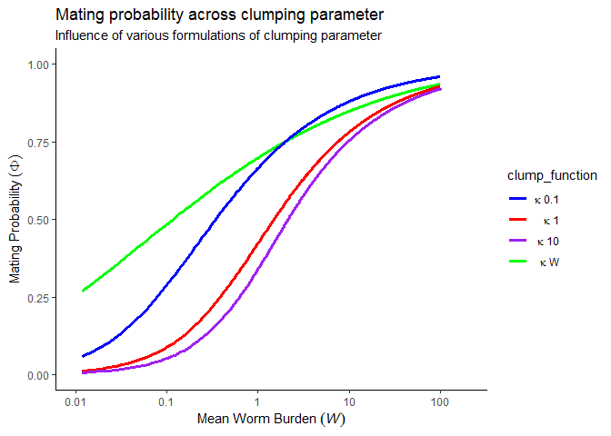
Theory | Density Dependence

Slide 4
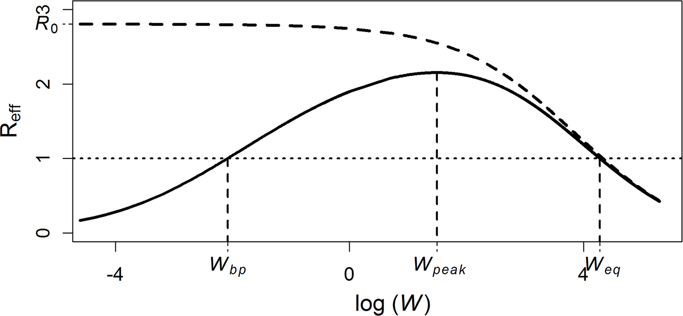
Theory | Reff & Breakpoints
Arakala A, Hoover CM, Marshall JM, Sokolow SH, De Leo GA, Rohr JR, et al. (2018) Estimating the elimination feasibility in the 'end game' of control efforts for parasites subjected to regular mass drug administration: Methods and their application to schistosomiasis. PLoS Negl Trop Dis 12(11): e0006794. https://doi.org/10.1371/journal.pntd.0006794

Slide 5
Theory | Reff & Breakpoints
Annual MDA fails to achieve elimination except at extremely ambitious levels of coverage (>90%)

Slide 6
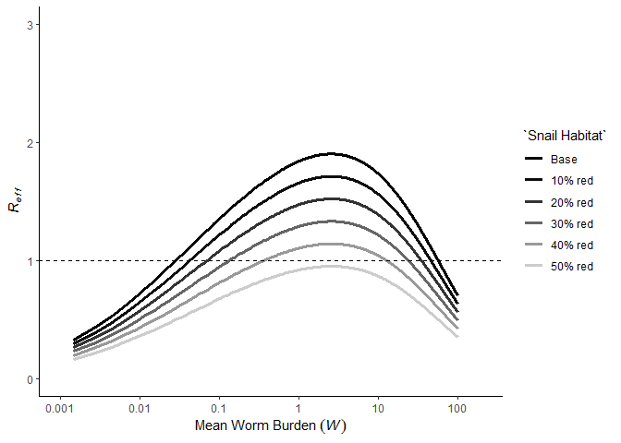

Theory | Reff & Breakpoints
Interventions that affect model parameters (snail habitat suitability, sanitation, education) suppress $R_{eff}$
Make control and elimination more feasible
Increase resilience to reinfection
Decrease endemic equilibrium

Slide 7
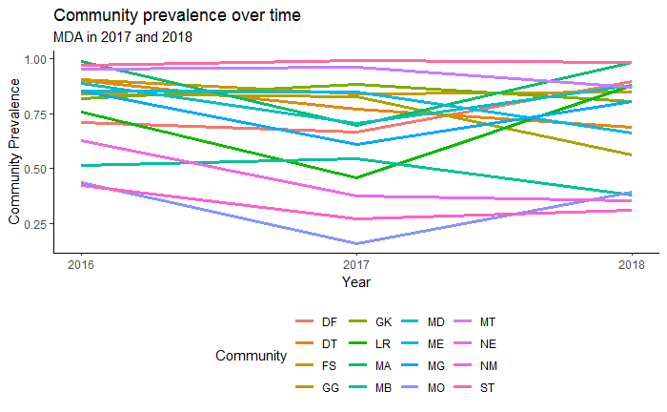
Theory | Reff & Breakpoints
Cannot question the benefits of MDA in terms of transmission reduction and most importantly reductions in morbidity, but MDA falls short in some areas due to high transmission, reservoirs of infection (missed segments of the population, environmental reservoirs)

Slide 8
How do we optimally allocate resources given:
Transmission intensity
Transmission network
Rate of development
Time frame and goal
Uncertainty

Slide 9

Framework| Stochastic Dynamic Programming
State at time $t$, $S_{t}$
Decision at time $t$, $A_{t}$
Transition model, $ℳ$, that gives $S_{t+1}|S_{t},A_{t}$
Utility function, $U$, that gives “reward” of $A_{t}|S_{t}$
Optimal solution over desired time horizon
Marescot, L., Chapron, G., Chadès, I., Fackler, P. L., Duchamp, C., Marboutin, E., & Gimenez, O. (2013). Complex decisions made simple: a primer on stochastic dynamic programming. Methods in Ecology and Evolution, 4(9), 872-884.

Slide 10

Framework| Stochastic Dynamic Programming
State at time $t$, $S_{t}$
Mean worm burden
Prevalence
Disability
Marescot, L., Chapron, G., Chadès, I., Fackler, P. L., Duchamp, C., Marboutin, E., & Gimenez, O. (2013). Complex decisions made simple: a primer on stochastic dynamic programming. Methods in Ecology and Evolution, 4(9), 872-884.

Slide 11

Framework| Stochastic Dynamic Programming
Decision at time $t$, $A_{t}$
MDA strategy (School- or community-based)
Combined strategy (MDA + Snail control)
Allocation of resources across different intervention options
Marescot, L., Chapron, G., Chadès, I., Fackler, P. L., Duchamp, C., Marboutin, E., & Gimenez, O. (2013). Complex decisions made simple: a primer on stochastic dynamic programming. Methods in Ecology and Evolution, 4(9), 872-884.

Slide 12

Framework| Stochastic Dynamic Programming
Transition model, $ℳ$, that gives $S_{t+1}|S_{t},A_{t}$
Deterministic, stochastic, agent-based models
Marescot, L., Chapron, G., Chadès, I., Fackler, P. L., Duchamp, C., Marboutin, E., & Gimenez, O. (2013). Complex decisions made simple: a primer on stochastic dynamic programming. Methods in Ecology and Evolution, 4(9), 872-884.

Slide 13

Framework| Stochastic Dynamic Programming
Utility function, $U$, that gives “reward” of $A_{t}|S_{t}$
Reduction in prevalence
$\frac{DALYs}{\$}$
Marescot, L., Chapron, G., Chadès, I., Fackler, P. L., Duchamp, C., Marboutin, E., & Gimenez, O. (2013). Complex decisions made simple: a primer on stochastic dynamic programming. Methods in Ecology and Evolution, 4(9), 872-884.

Slide 14
Framework| Stochastic Dynamic Programming
Optimal solution over desired time horizon
Solved via Bellman’s equation and backwards iteration for finite time horizons
Solved via policy or value iteration for infinite time horizons
Marescot, L., Chapron, G., Chadès, I., Fackler, P. L., Duchamp, C., Marboutin, E., & Gimenez, O. (2013). Complex decisions made simple: a primer on stochastic dynamic programming. Methods in Ecology and Evolution, 4(9), 872-884.

Slide 15


Implementation| Garchitorena et al
$$\dot{I} =\left(β_{D}I+β_{E}W\right)S−γI \\ \dot{W}=Ω+VσλI−ρW$$
Assume all transmission is environment-human ($β_{D}=0$)
Assume no exogenous propagule production ($Ω=0$)
Model prevalence with no recovered ($R$) state ($S=1−I$)
$$\dot{I} =β_{E}W\left(1−I\right)−γI \\ \dot{W}=VσλI−ρW$$
$$R_{0}=\frac{Vσλβ_{E}}{γρ}$$
Garchitorena, A., Sokolow, S. H., Roche, B., Ngonghala, C. N., Jocque, M., Lund, A., ... & Andrews, J. R. (2017). Disease ecology, health and the environment: a framework to account for ecological and socio-economic drivers in the control of neglected tropical diseases. Philosophical Transactions of the Royal Society B: Biological Sciences, 372(1722), 20160128.

Slide 16
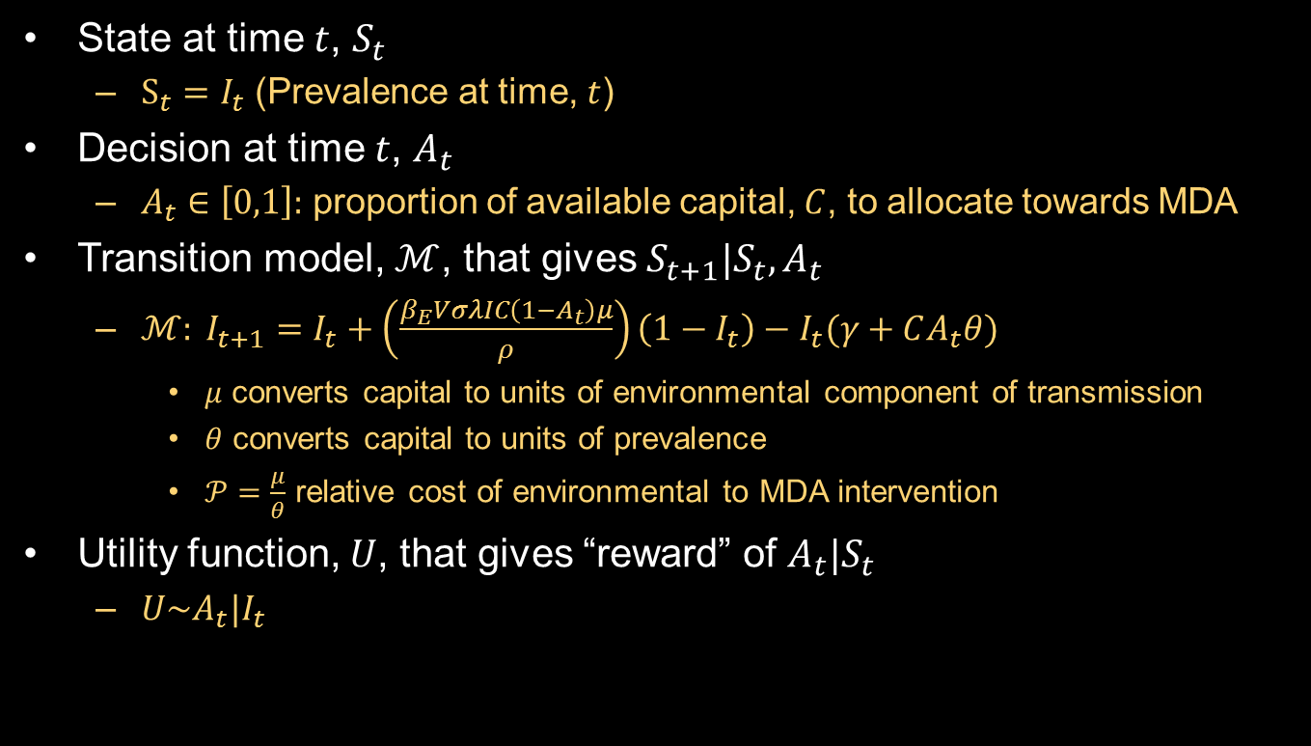
Implementation| Garchitorena et al
State at time $t$, $S_{t}$
$S_{t}=I_{t}$ (Prevalence at time, $t$)
Decision at time $t$, $A_{t}$
$A_{t}∈\left[0,1\right]:$ proportion of available capital, $C$, to allocate towards MDA
Transition model, $ℳ$, that gives $S_{t+1}|S_{t},A_{t}$
$ℳ: I_{t+1}=I_{t}+\left(\frac{β_{E}VσλIC\left(1−A_{t}\right)μ}{ρ}\right)\left(1−I_{t}\right)−I_{t}(γ+CA_{t}θ)$
$μ$ converts capital to units of environmental component of transmission
$θ$ converts capital to units of prevalence
$𝒫=\frac{μ}{θ}$ relative cost of environmental to MDA intervention
Utility function, $U$, that gives “reward” of $A_{t}|S_{t}$
$U\sim A_{t}|I_{t}$

Slide 17

Implementation| Garchitorena et al
Identify optimal solutions in $\{R_{0}, 𝒫\}$ parameter space and across time horizons, $T$, of 5, 10, 20, Inf
[RESULTS]

Slide 18


Implementation| Garchitorena et al + Density Dependence
Identify optimal solutions in $\{R_{0}, 𝒫\}$ parameter space and across time horizons, $T$, of 5, 10, 20, Inf
Include density dependence, $f_{1}(W)$, that gives rise to a breakpoint
$$\dot{I} =β_{E}f_{1}(W)W\left(1−I\right)−γI \\ \dot{W}=VσλI−ρW$$
$$R_{0}=\frac{Vσλβ_{E}}{γρ}$$
$$R_{eff}=\frac{Vσλβ_{E}f_{1}(W)}{γρ}$$

Slide 19
Implementation| Garchitorena et al + Density Dependence
Identify optimal solutions in $\{R_{0}, 𝒫\}$ parameter space and across time horizons, $T$, of 5, 10, 20, Inf
Include density dependence, $f_{1}(W)$, that gives rise to a breakpoint
[RESULTS]

Slide 20

Implementation| Garchitorena et al
$I_{t+1}=I_{t}+\left(\frac{β_{E}VσλI}{ρ}\right)\left(1−I_{t}\right)−γI_{t}$

