Slide 1
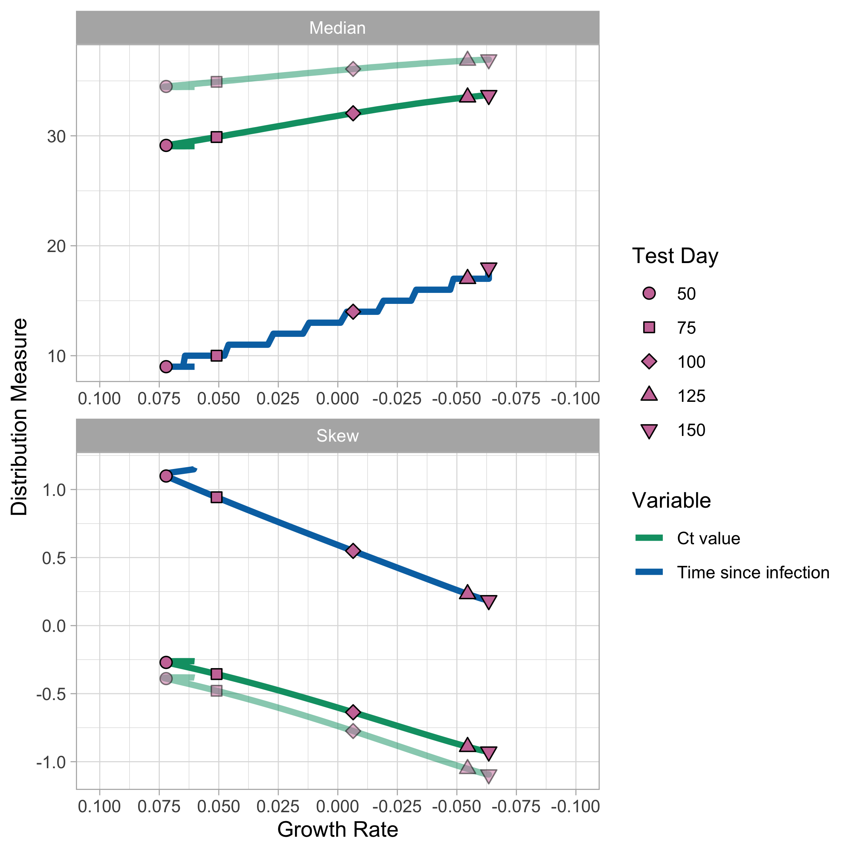
Observation Model
Observation Model

