Slide 1
REGRESSION ANALYSIS

Slide 2
Agenda
Understanding Regression Analysis
The Process of Conducting a Regression Analysis
Example in SPSS

Slide 3
Understanding Regression Analysis
Importance of regression analysis
Regression analysis is one of the most important methods in quantitative market research.
Marketing and strategy departments of major companies use regression analysis regularly for decision-making
Regression analysis can:
Indicate if independent variables have a significant relationship with a dependent variable.
Indicate the relative strength of different independent variables’ effects on a dependent variable.
Make predictions.
In this lecture we introduce linear regression (OLS)

Slide 4
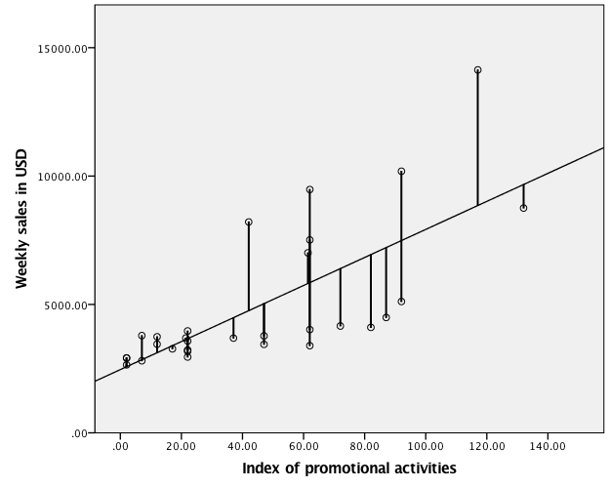
The Regression Analysis Estimates a Line Using the Observations
The regression estimation procedure attempts to fit a best possible line. This line is optimal if the squared distances to all observation points are minimized. Thereby:
Positive and negative deviances don’t balance each other
Bigger deviances are weighted disproportionately high
If the assumptions of the regression are harmed, the line might not be the true line!

Slide 5
Understanding Regression Analysis
Notation:
y = α + β₁x₁ + e
Y dependent variable
α Intercept
β₁ Regression parameter
x₁ Independent variable
e Error or residual
For multiple regression:
y = α + β₁x₁ + β₂x₂ + β₃x₃ + e
Predicted (or estimated) value

Slide 6
The Process of Conducting a Regression Analysis
1.
Check the regression analysis data requirements
2.
Specify and estimate the regression model
3.
Test the regression analysis assumptions
4.
Interpret the regression results
5.
Validate the regression results
6.
Use the regression model

Slide 7
Regression Analysis Principles of Hypothesis Testing
1.
Check the regression analysis data requirements
Sample size
Formal power analysis (e.g. using G*power)
Green’s (1991) rule of thumb: 104+k where k is the number of independent variables
Variables need to vary
Scale type of the dependent variable: interval or ratio scaled
Collinearity
Collinearity is a data issue that arises if two independent variables are highly correlated.
The VIF or Variance Inflation Factor can indicate collinearity. Values over 10 indicate collinearity.
If collinearity is present either use factor analysis, re-specify the regression model, or simply accept the collinearity (noting its presence).

Slide 8
Regression Analysis Principles of Hypothesis Testing
2.
Specify and estimate the regression model
The goal is to build a simple yet complete model. Some suggestions
If independent variables have overlap then focus on the most important or distinct variable.
If you need to use a model for different circumstances, ensure the independent variables are the same to allow comparison.
Consider the type of advice you want to give.
Consider the sample sizes and rules of thumb. Smaller datasets require fewer independent variables
If variables are ordinal, try to use dummy variables.

Slide 9
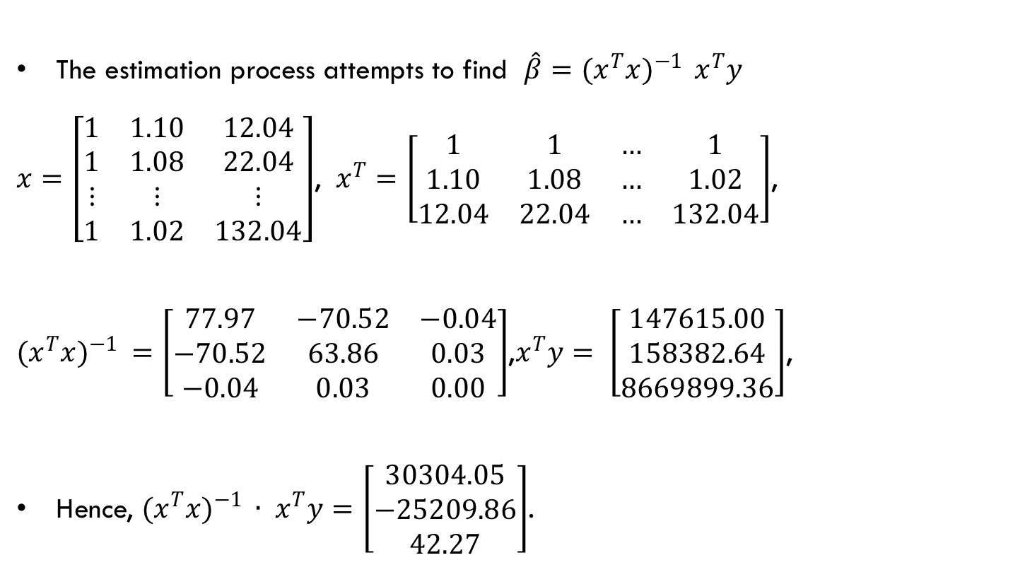
Regression Analysis Principles of Hypothesis Testing
3.
Model estimation
The estimation process attempts to find $\hat{β}=(x^{T}x)^{−1 } x^{T}y$
$x=\left[\begin{matrix}1 & 1.10 & 12.04 \\ 1 & 1.08 & 22.04 \\ ⋮ & ⋮ & ⋮ \\ 1 & 1.02 & 132.04\end{matrix}\right]$, $x^{T}=\left[\begin{matrix}1 & 1 & … & 1 \\ 1.10 & 1.08 & … & 1.02 \\ 12.04 & 22.04 & … & 132.04\end{matrix}\right]$,
$(x^{T}x)^{−1 }=\left[\begin{matrix}77.97 & −70.52 & −0.04 \\ −70.52 & 63.86 & 0.03 \\ −0.04 & 0.03 & 0.00\end{matrix}\right]$,$x^{T}y= \left[\begin{matrix}147615.00 \\ 158382.64 \\ 8669899.36\end{matrix}\right]$,
Hence, $(x^{T}x)^{−1 }∙ x^{T}y=\left[\begin{matrix}30304.05 \\ −25209.86 \\ 42.27\end{matrix}\right]$.

Slide 10
Regression Analysis Principles of Hypothesis Testing
4.
Test the regression analysis assumptions
The critical assumptions are:
1. The regression model can be expressed linearly,
2. The regression model’s expected mean error is zero,
3. The errors’ variance is constant (homoscedasticity), and
4. The errors are independent (no autocorrelation).
An optional assumption (to determine significance of parameters):
5. The errors need to be approximately normally distributed.

Slide 11
Regression Analysis Linearity
Linearity is an assumption that asks if we can write the regression model as y = α + β₁x₁ + .. + β_{z}x_{z+} e
A separate issue is if the relationship between y and x is best expressed as a linear relationship. If not, we can use transformations:
x²
Log (x)
After such transformations the model is still linear!

Slide 12
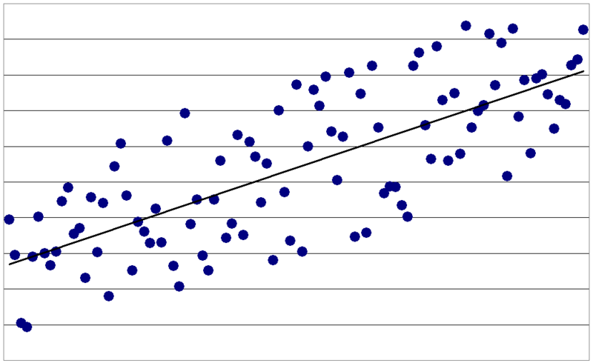
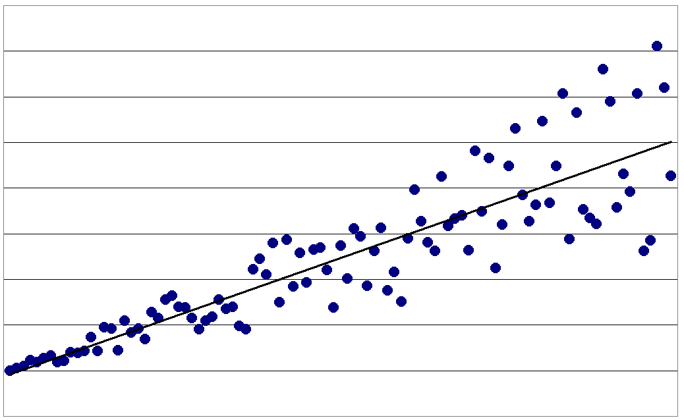
Regression Analysis Homoskedasticity
Homoskedastic distribution
Is the variance constant or de(in) creasing as a function of one or more independent variable(s)?
Heteroskedastic distribution

Slide 13
Regression Analysis Are the Errors Independent?
Primarily relevant for time series: Does one observation influence another?
Satisfaction of same group of customers asked monthly
Success of new products launched after one another
Use the Durbin-Watson test after ranking the observations on a time dimension. The test can have four conclusions:
The errors may be positively related (called positive autocorrelation).
If positive errors are commonly followed by negative errors and negative errors by positive errors, we have negative autocorrelation.
If no systematic pattern of errors occurs, we have no autocorrelation. This absence of autocorrelation is required to estimate standard (OLS) regression models.
The D-W values may fall between the lower and upper critical value. If this occur, the test is inconclusive.

Slide 14
Regression Analysis Are the Residuals Approximately Normally Distributed?
This optional assumption can be visualized using a histogram of the residuals.
Also conduct a Shapiro-Wilk test on the residuals

Slide 15
Regression Analysis Principles of Hypothesis Testing
4.
Interpret the regression results
Overall Model Fit
F-test
R²

Slide 16
Regression Analysis Overall Model Fit
Model fit measures: R² and adjusted R²
N=Sample, K=Number of variables

Slide 17
Regression Analysis Effects of Individual Variables
The effects of individual variables:
Consider the significance of the parameter of each variable (not the intercept) in turn. The hypothesis tested for each variable is
H₀: β₁ = 0 (line is horizontal)
H₁: β₁ ≠ 0 (regression line is not horizontal)
If the Sig. column in SPSS indicates a value below .05 we consider this to be significant.
For significant variables also consider:
The sign
The βs. (direction of the regression line)
Unstandardized: expresses the effect of a one-unit change in the independent variable on the dependent.
The standardized effect: the effect relative to the other variables. Standardized effects can be compared but not for dummy variables
Significance?
(p-value)
Direction? (sign)
Size? (β vs. standardized β)

Slide 18
Regression Analysis Principles of Hypothesis Testing
5.
Validate the regression model
Split-sample validation
Split the sample in 70% (estimation sample) and 30% (validation sample) randomly and re-run the model
Cross-validation
Control variables
In many situations you have additional, unused, variables that may be relevant. You can add these to observe if the core model results change (or are stable).

Slide 19
Regression Analysis Principles of Hypothesis Testing
6.
Use the regression model
Using the regression model is the final and key step. Use involves prediction of effects or interpreting effects (see previous steps).
Prediction: consider the following model and results:
y = α + β₁x₁ + β₂x₂ + e
What is our predicted outcome if we set the price to 1.10 USD and the level of promotional activities to 50?
29,011.585 – 24,003.037 · 1.10 USD + 44.227 · 50 promotional activities = 4,819.594 USD sales per week

Slide 20
Regression Analysis Example using SPSS
Please use the Oddjob Airways dataset
The task is to identify variables relating to commitment to Oddjob Airways.
Management identified a shortlist as follows:
Oddjob Airways gives you a sense of safety (s9),
The condition of Oddjob Airways’ aircraft is immaculate (s10),
Oddjob Airways also pays attention to its service delivery’s details. (s19),
Oddjob Airways makes traveling uncomplicated (s21), and
Oddjob Airways offers great value for money (s23).
And the request was to control for the respondent’s status (status), age (age), and gender (gender).

Slide 21
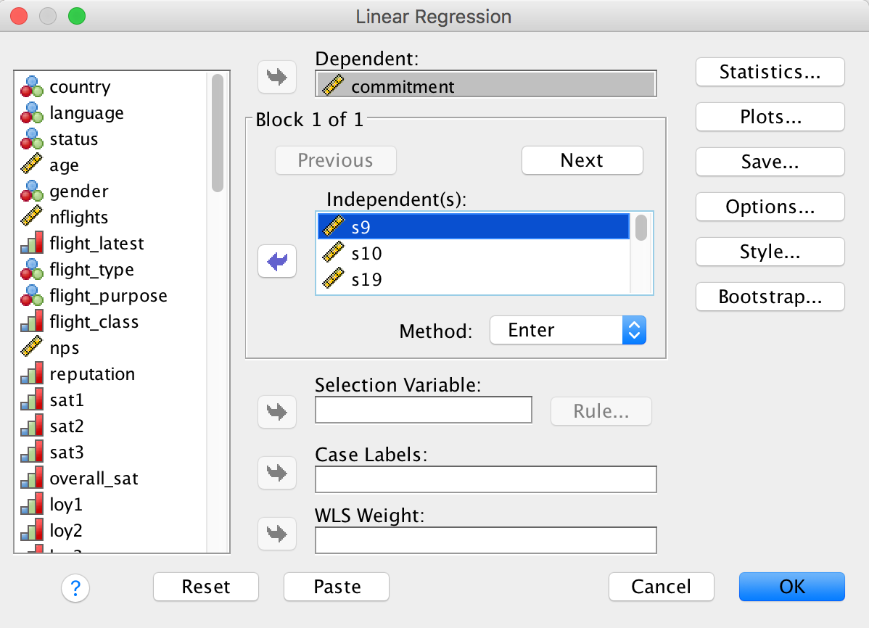
Regression Analysis Example using SPSS
Add Commitment to the Dependent: box
Click to Statistics
Add the list of independent variables from the previous slide

Slide 22
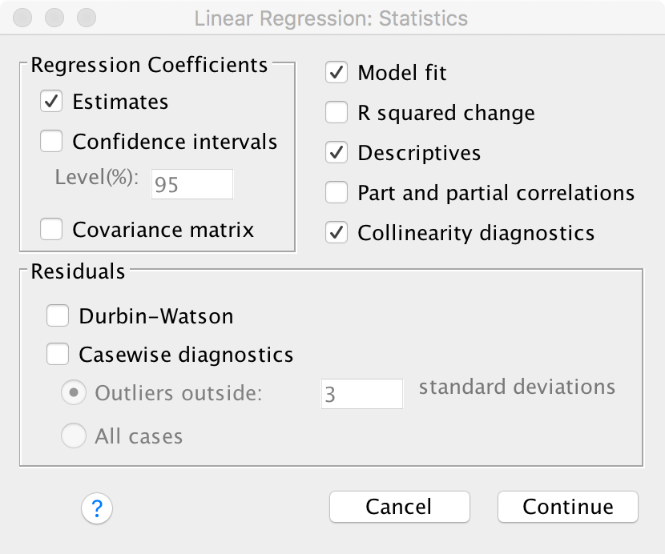
Regression Analysis Example using SPSS
Add Commitment to the Dependent: box
Click to Statistics
Tick Model fit, Descriptives, and Collinearity diagnostics
Add the list of independent variables from the previous slide
Also click on save (see next slide)

Slide 23
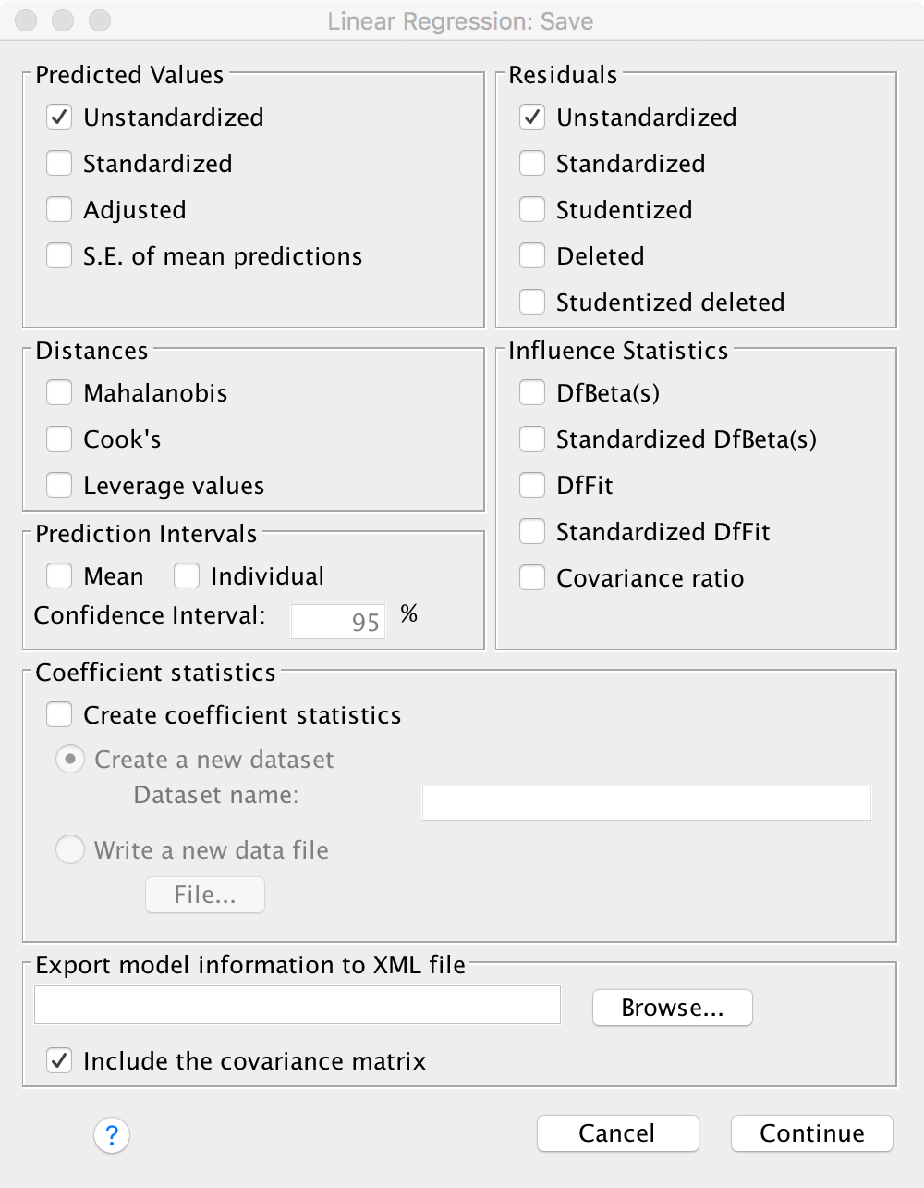
Regression Analysis Example using SPSS
Tick Unstandardized
Also tick unstandardized

Slide 24
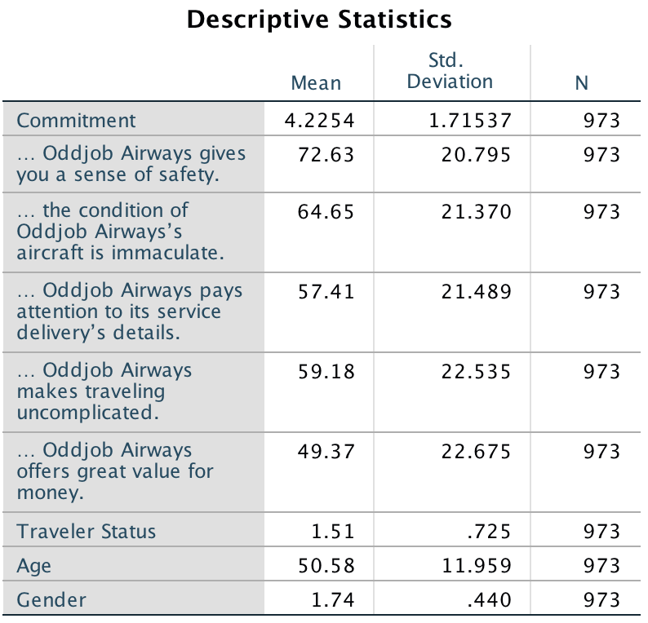
Regression Analysis Example using SPSS
Sample size, which is greater than 104+k
Some variance

Slide 25
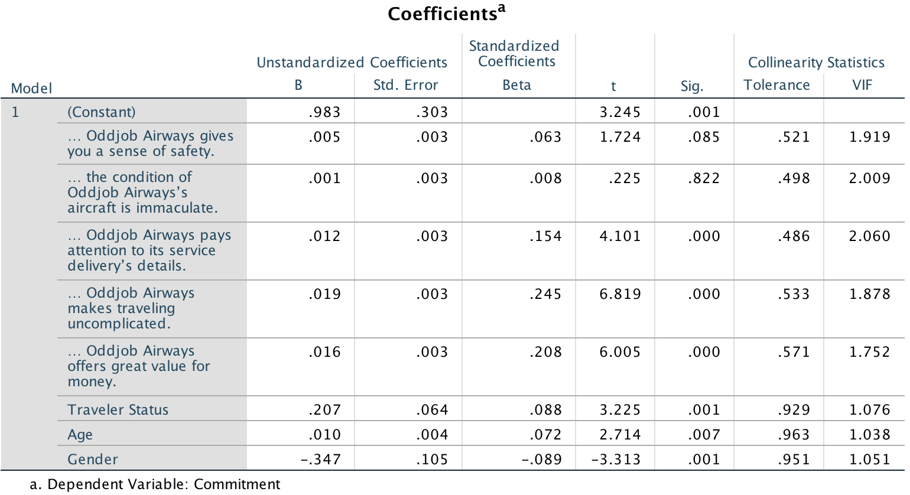
Regression Analysis Example using SPSS
Collinearity diagnostics all show VIF’s lower than the conservative threshold of 5.

Slide 26
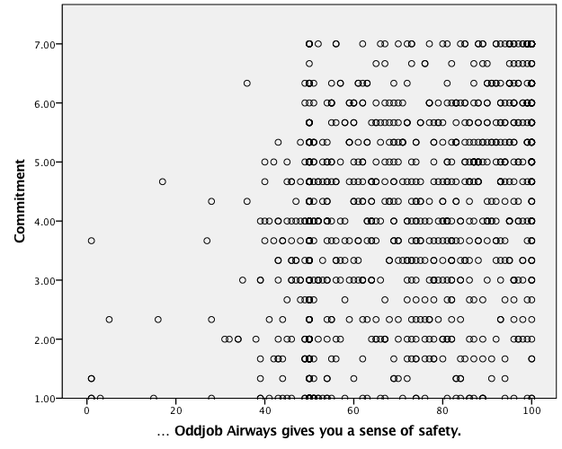
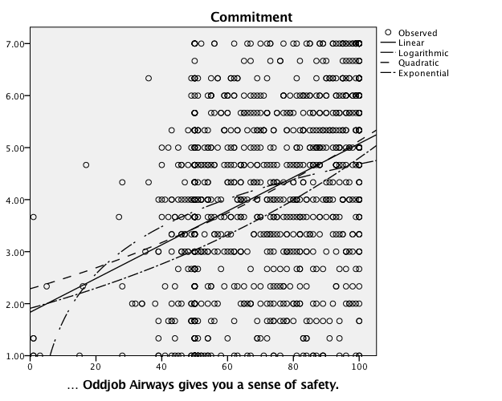
Regression Analysis Example using SPSS
No clear conclusion, which is typical
Linearity: make scatterplots of the independent variables against the dependent. Remember, this is to understand the form of the relationship, you are not testing the linearity assumption!
To get more detail, Curve Estimation may help. Only use nonlinear specifications if alternatives are much better.
You can also conduct Ramsey’s RESET test after saving the squared and third power transformations of the predicted values. You can then add these to a separate regression model to assess the R² increase.
Hard to draw a conclusion. Hence a linear line is the best option

Slide 27
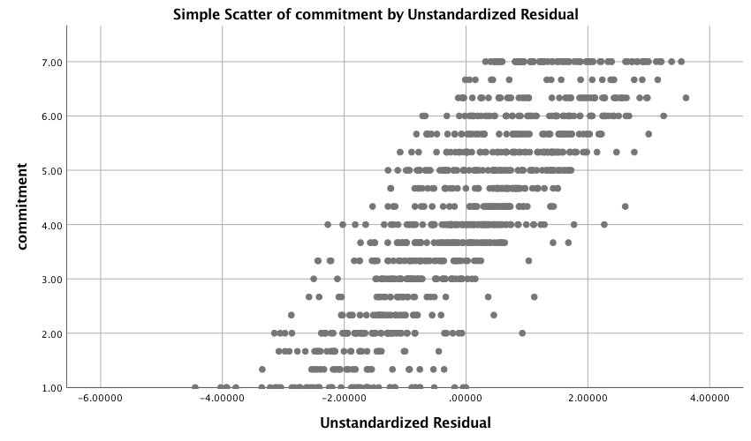
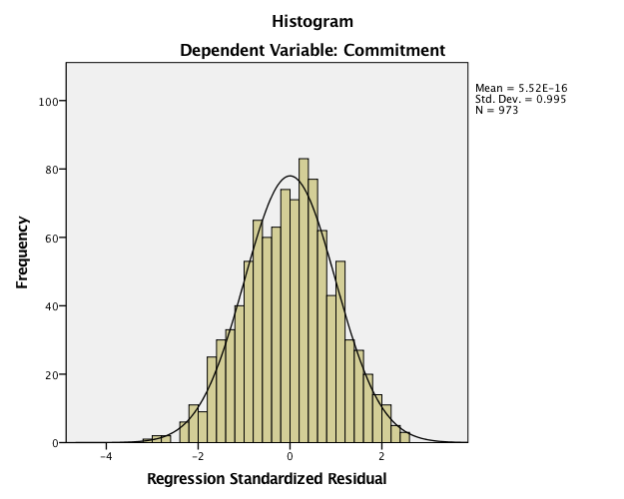
Regression Analysis Example using SPSS
No clear funnel shape
The expected mean error of the regression model is zero.
No reason to assume we do not meet this assumption.
The variance of the errors is constant (homoskedasticity).
Save the errors and plot these against the dependent variable and eyeball for a funnel-like shape.
The errors are independent (no autocorrelation) as there is no time component.
(optional): errors are normally distributed.
Seems normally distributed, which a separate Shapiro-Wilk test confirms

Slide 28
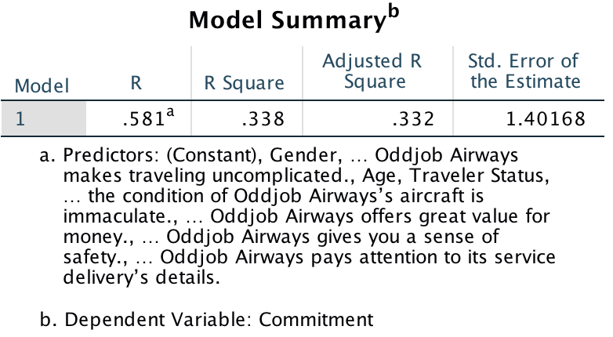
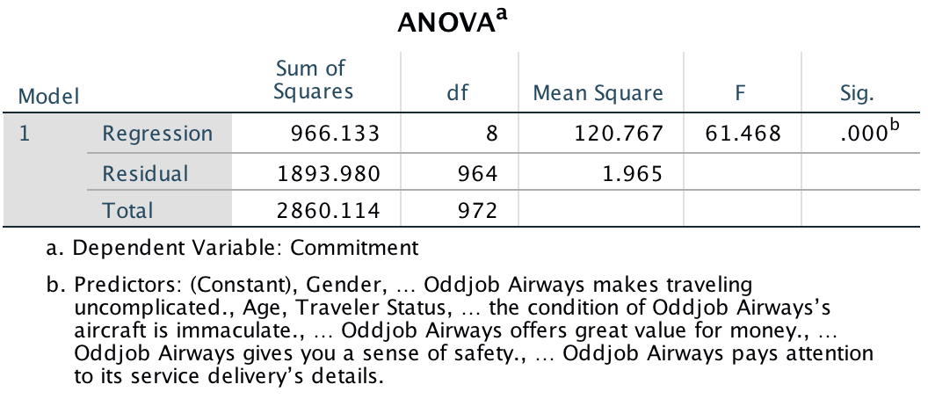
Regression Analysis Interpret the Regression Model
For comparing different models
33.2% of variance are explained
Significant F-value which suggests a significant model.
Notes:
For example, in longitudinal studies R²’s of .90 and over are common. In cross-sectional designs, values of around .30 are common while for exploratory research values of .10 are common.

Slide 29
Regression Analysis Interpret the Regression Model
If the answer to this item were one higher, commitment is expected to increase by .05
Oddjob Airways makes travelling uncomplicated has the largest influence
Oddjob Airways pays attention to its service delivery details has a significant influence
(p<0.05), as do the next variables
Notes:
For example, in longitudinal studies R²’s of .90 and over are common. In cross-sectional designs, values of around .30 are common while for exploratory research values of .10 are common.

Slide 30
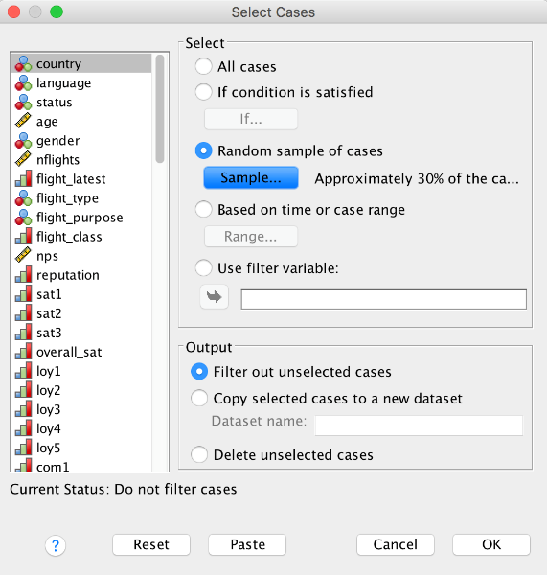
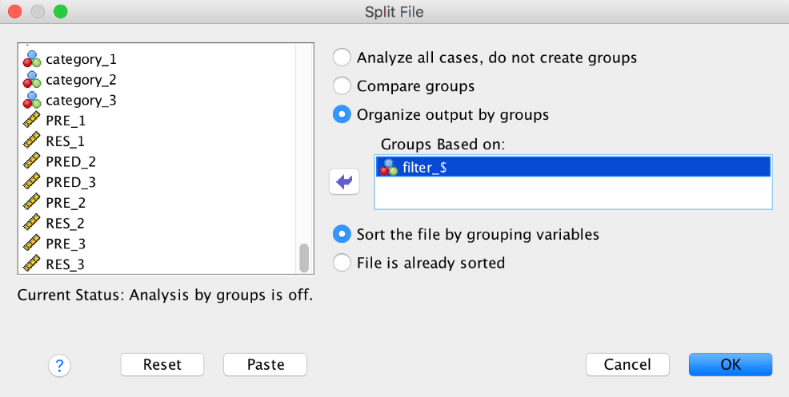
Regression Analysis Validation
Validation: select a 70% estimation sample and a 30% holdout sample and filter out the cases not needed.
May add additional regressors (e.g. income if available)

Slide 31
Regression Analysis Summary
Regression analysis is one of the most important methods in empirical economic research.
The regression analysis puts an optimal line through the observed points
Assumptions influence the regression results in mostly unexpected ways. We should check if
The regression model can be expressed in a linear way.
The expected mean error of the regression model is zero.
The variance of the errors is constant (homoskedasticity).
The errors are independent (no autocorrelation).
Interpretation of results: consider model fit and the effects of individual variables.

