Slide 1
Tic-Tac-Toe via Reinforcement Learning
A Galvanize Capstone Project
Chase Middleman
github.com/cmiddleman/capstone2

Slide 2
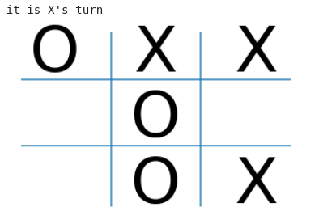
The Environment
A 3x3 board; each square can contain an ‘X’ an ‘O’ or be empty.

Slide 3
The Environment
A 3x3 board; each square can contain an ‘X’ an ‘O’ or be empty.
One possible state of the environment.

Slide 4
The Data
Generated through self-play only.
Episodes broken up and stored as experience tuples.
  (state, action, reward, next_state, terminal).

Slide 5
  (state, action, reward, next_state, terminal)

Slide 6
  (state, action, reward, next_state, terminal)

Slide 7
  (state, action, reward, next_state, terminal)

Slide 8
  (state, action, reward, next_state, terminal)
Actions encoded as integers 0-8
In this state, if we want to win as X, we should play in the right-middle square (a.k.a 5)

Slide 9
  (state, action, reward, next_state, terminal)
5

Slide 10
  (state, action, reward, next_state, terminal)
5

Slide 11
  (state, action, reward, next_state, terminal)
Reward given after each action taken.
  Non-zero rewards only at the end of each game.
    +1 for winning
    -1 for losing
    0 for tie

Slide 12
  (state, action, reward, next_state, terminal)
5
+1

Slide 13
  (state, action, reward, next_state, terminal)
5
+1

Slide 14
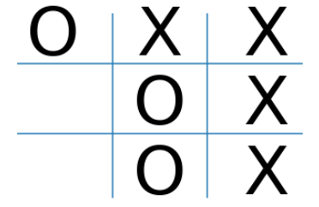
  (state, action, reward, next_state, terminal)
5
+1

Slide 15
  (state, action, reward, next_state, terminal)
5
+1

Slide 16
  (state, action, reward, next_state, terminal)
5
+1
True

Slide 17
  (state, action, reward, next_state, terminal)
(
)
,
6
,
+1
,
,
True

Slide 18
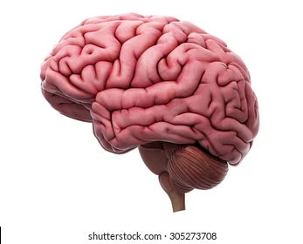
  (state, action, reward, next_state, terminal)
(
)
,
6
,
+1
,
,
True
*

Slide 19
  (state, action, reward, next_state, terminal)
(
)
,
6
,
+1
,
,
True
*
(de)queue with fixed
maximum size.

Slide 20
The Agent
DQN agent
  Epsilon-greedy policy.
  Uses Q-learning, a form of reinforcement learning.
  Approximates Q-table via neural network.
    Two hidden layers, each 128 in size.
    Linear output.

Slide 21
The Agent
States get encoded as a ‘one-hot-state’ for the model.

Slide 22
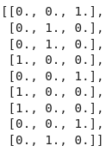
The Agent
States get encoded as a ‘one-hot-state’ for the model.
Empty
Opponent
Agent

Slide 23
The Environment
States get encoded as a ‘one-hot-state’ for the model.
Empty
Opponent
Agent

Slide 24
Training Techniques
Training concurrent with data gathering.
Target network stabilization.
Exploration rate (epsilon) decay.
Learning rate decay.
Fixed size experience replay buffer.
Prioritized replay for terminal states.
Agent corpus.

Slide 25
Results
“Reinforcement Learning is notoriously difficult… You will need time, patience, perseverance, and perhaps a bit of luck too.” - Aurélien Géron

Slide 26
Results
Performance metric:

Slide 27
Results
Performance metric: every 1,000 games, play a series of games against an agent that moves randomly.

Slide 28
Results
Performance metric: every 1,000 games, play a series of games against an agent that moves randomly.

Slide 29
DEMO

