Slide 1
311
CITY OF EDMONTON · 311 AND CUSTOMER ACCESS · EXECUTIVE BRIEFING
311
ONE SMALL DECISION · ONE SIMPLE ALGORITHM
Referral Check
Before a 311 referral goes out, a 20-second check on the one in ten that end with nothing for the City to do
TICKET · SEM 620 FINAL PRESENTATION · 25%
Dollar figures are the mean of 50,000 Monte Carlo draws on the team's own cost ranges, trained on 2025 tickets and tested on 2026. The share of empty visits the check avoids (35%) is our assumption; the pilot measures it.
Team 2 · Lauren Lonsberry · Nav Sekhon · Rick Auger · Curtis Middleton
Session 11 · Monday, December 7, 2026 · 15 minutes + Q&A
$375K A YEAR OF FIELD AND DESK CAPACITY · P10-P90 $171K-$622K · CAPACITY, NOT CASH
Notes:
Cover. Open on the decision, not the agenda: one 311 agent, one code, 20 seconds, and whether a City officer drives across town. Referral Check is the algorithm that sits between the pick and the referral. Say up front: capacity, not cash; the 35% is ours to test.

Slide 2
311
TUE 10:12 · CALLER 7 ON THE LINE · THE SAME CALL, TWICE
02 / 16
THE DECISION, AS IT HAPPENS
One pick on one call decides whether an officer drives out. 12,583 times in 2025 the officer arrived and found nothing to act on.
TODAY · THE CALL AS IT RUNS
WITH REFERRAL CHECK · 20 SECONDS ADDED
10:12
Caller 7: "The yard next door is full of junk again."
10:12
Same call, same words.
10:13
Agent searches "untidy", picks Complaint Registered - Untidy Property, refers to Municipal Enforcement. Clock: 120-second answer target.
10:13
Agent picks the same code. The screen shows RED: 28% of these referrals end with nothing to act on, and two screening questions written by Municipal Enforcement.
Thu
A peace officer drives out. Ordinary household items, nothing that meets the bylaw standard.
10:13
"Is it visible from the street or a neighbour's yard? More than ordinary household items?" Caller: "Just bins and a bike." Agent gives the bylaw information; caller can still insist on a referral.
Thu
Closed: Does Not Meet Bylaw Offence Standards. 1,350 of 4,877 such phone referrals ended this way in 2026 (28%).
Thu
No officer dispatched. If the referral had gone out, the officer's closure reason would return to the agent within a day.
Later
Nothing goes back to the agent. The scorecard counts the ticket as resolved on first contact.
Weekly
The code's risk table updates. Codes that stay red go to a fix queue 311 reviews with the area.
1 in 17
1 in 10
150 codes
$375K / yr
phone referrals ends in an empty field visit (5.9%, 2026)
ends in any wasted outcome, desk or field (10.1%)
carry 65% of the empty visits (18% of calls)
field and desk capacity freed, mean; P10-P90 $171K-$622K
CONCEPTS USED
BRIEF · ONE CONCRETE SITUATION
S7 · ROUTINE AS PERFORMED
S3 · FEEDBACK LINKS ACTION TO RESULT
TEAM 2 · REFERRAL CHECK · EDMONTON 311
311 Requests open data (q7ua-agfg), 2023 to Nov 6, 2026, re-run on the team's six-part export. Caller 7 is illustrative; every code, count and closure label is real. 2025: 191,521 phone referrals; 12,583 closed with a field outcome of nothing to act on (Does Not Meet Bylaw Offence Standards, Assessed - No Action Required, Unable to Locate Animal, Location Not Found, Unable to Contact Complainant). 2026 to Nov 6: 179,139 and 10,609.
2
Notes:
The hook. Caller 4 told you about bounces in October; Caller 7 is the bigger cost. Illustrative dialogue; real code (Complaint Registered - Untidy Property), real counts. The screening questions are examples of what the area would write; the area owns them. Key line: the caller can always insist on a referral. The algorithm never says no.

Slide 3
311
TUE 10:13 · THE PICK · WHAT DECISION ARE WE IMPROVING?
03 / 16
THE CORE ANALYTIC DECISION · RESTATED, REFINED
Same 20-second pick as October. The refinement: the code chooses whether the work goes out, not only where.
OCTOBER · DIAGNOSIS
FIVE-PART TEST | FINDING | SOURCE
Who makes it, how often | A 311 agent, live, once per phone referral: 191,521 in 2025, about one every 100 seconds the line is open | open data
Inputs used now | Caller's words and address, a code search, 900 area scripts, experience. Nothing on screen says how a code usually ends | OCA 2023; CSD03148
Options | Resolve on the call, refer under one of 1,917 codes, or ask one more question first | team deck, Oct 26
Bad instance x frequency | Empty visit $22 / $84 / $280 (team ranges) x 12,583 a year; bounce $36 x 1,062; days residents wait in the wrong queue | stake model
Could an algorithm make it? | Not the pick: only the agent hears the caller. But a lookup can say, before the referral, how often this code ends with nothing | this proposal
WHY THE DIAGNOSIS MOVED
Which service code does a new 311 phone ticket get?
Agent picks 1 of 1,917 codes. A wrong code bounces between areas: 1,062 phone-referral bounces in 2025, about $100K a year, 98.9% of referrals land first time.
1 The pick is right for routing
98.9% of 2026 phone referrals did not bounce. Fixing bounces alone frees $7K to $17K a year.
2 The bigger loss is the referral that should not have gone
5.9% of phone referrals end in a field visit with nothing to act on; 10.1% in some wasted outcome. Each visit costs far more than a bounce.
3 Grain size
One agent, one code, 20 seconds, 190,000 times a year. One level narrower than "intake", as the brief asks. McGarry's board was replaced; this agent is not.
DECEMBER · THE DECISION WE DESIGN FOR
On each phone referral: route on the code as picked, or check first whether the referral should go out at all?
The code sets resolve-or-refer on 99.4% of tickets. 1,062 bounced; 12,583 went out and found nothing. Same pick, same screen, a bigger loss.
CONCEPTS USED
BRIEF · FIVE-PART TEST
BRIEF · GRAIN SIZE
S7 · McGARRY BENCHMARK
S2 · IS THIS THE DECISION WE FACE?
TEAM 2 · REFERRAL CHECK · EDMONTON 311
311 Requests open data (q7ua-agfg), 2023 to Nov 6, 2026, re-run on the team's six-part export. October figures from the team's Oct 26 Strategic Analytics Initiative deck. Five-part test and grain-size rule from the SEM 620 Group Project brief; McGarry (ready-mix dispatcher) is the brief's benchmark for a decision an algorithm can take.
3
Notes:
Restate, then refine. The October decision stands; the diagnosis moved because the open data showed the pick is almost always right for routing, while one referral in ten ends with nothing for the City to do. Name the change openly: October's alternatives slide ranked complaint-intake screening sixth; the data moved it up.

Slide 4
311
THU · THE OFFICER FINDS NOTHING · WHY DOES IT KEEP HAPPENING?
04 / 16
PROBLEM TREE · WHY, IN ONE CALL
Empty referrals start before the call, are picked during it, and after it no one is told, so no one learns.
ROOT QUESTION
Why do one in ten phone referrals end with nothing for the City to do, and why does no one learn from them?
BEFORE THE CALL · THE CODE SET
DURING THE CALL · THE PICK
AFTER THE CALL · NO LEARNING
Codes name an owner, not a standard
The bylaw criteria live in 900 scripts the areas sign off; the code itself carries none of them.
The words do not say whether the standard is met
"Junk in the yard" fits the code; whether an officer can act is a second question nobody asks.
No count on the scorecard
"Resolved on Initial Contact" 98.7% counts an empty visit nobody chased as resolved.
ASSUMED, STATED
An empty visit is treated as avoidable at intake. Some are not: the condition changed, or the caller was right and the officer could not see it.
VERIFIED
INFERRED
ABSENCE
Ownership follows the asset
One garbage can, four codes, four owners. The caller's words rarely name the owner.
Speed is what is measured
120-second answer target; script AI framed around shorter calls. The first code that fits saves time.
No word back
No process we found returns the closure reason to the agent who picked the code.
THREE REAL EVENTS, ONE BRANCH EACH
Garbage-can bounce (4 codes, 4 owners): BEFORE. Untidy yard, no offence: DURING. 2026 bounce rise, 39% from new recording: AFTER.
VERIFIED
VERIFIED
ABSENCE
Risk is invisible
No published rate per code. Untidy Property: 28% empty; the average referral: 5.9%.
System 1 picks, System 2 defends
A familiar phrase calls up a familiar code; the search then confirms it. No feedback ever arrives to retrain the intuition.
Labels are built differently by area
Eight areas began recording bounces only in 2026; closure reasons vary by area. The measure moves when recording moves.
VERIFIED
HYPOTHESIS
VERIFIED
CONCEPTS USED
S2 · PROBLEM TREE
S2 · MECE BY STAGE
S2 · EXPLANATION AS HYPOTHESIS
S3 · SYSTEM 1 / SYSTEM 2
S6 · METRIC BUILT SLIGHTLY WRONG
S5 · WHAT THE DATA CANNOT SHOW
TEAM 2 · REFERRAL CHECK · EDMONTON 311
Problem tree after Glaser, Analytic Trees pp. 5-10: a root sentence with a result and a puzzle, branches by stage of one call (MECE by time), evidence marked on every leaf. 311 Requests open data (q7ua-agfg), 2023 to Nov 6, 2026, re-run on the team's six-part export; OCA 2023 pp. 3, 16, 19, 20; CSD03148 (Sep 2, 2026) p. 2, Att. 2.
4
Notes:
The October problem tree, widened from bounces to every referral that ends with nothing to do. Root is a sentence with a result and a puzzle. Branches are MECE by stage of one call. Each leaf carries its evidence grade. The assumption is on the slide: not every empty visit is an intake error. Three real events each land in exactly one branch, the test the reading prescribes. The design on slide 6 answers one leaf per branch: show the risk (before), ask the standard (during), send the reason back (after).

Slide 5
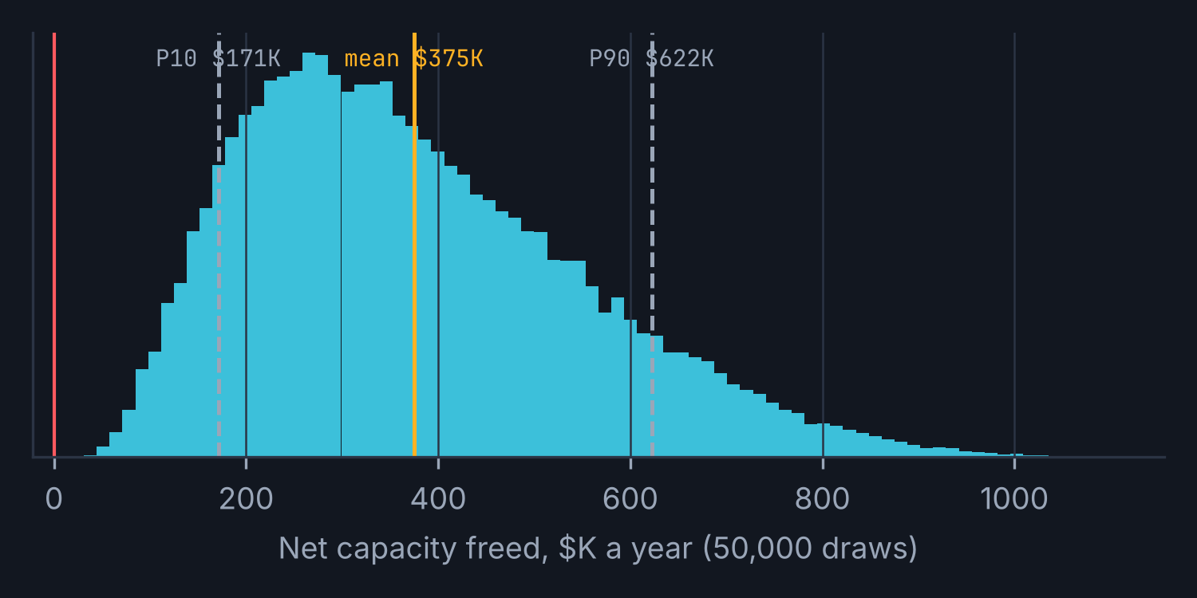
311
THU · WHAT THE EMPTY VISIT COST · THE STAKE AS A TREE
05 / 16
PROFIT TREE · CAPACITY AT STAKE
Checking the 150 riskiest codes frees about $375K a year of officer and desk time. Capacity, not cash: no budget line moves.
GROSS TIME FREED
FIELD VISITS AVOIDED
VISITS REACHED
x AVOIDED
x COST PER VISIT
$405K
$389K
8,100
x
35%
x
$137
field visits avoided + desk work avoided
2,835 visits x $137 (visit + desk)
65% of 12,480 empty visits a year sit in the 150 flagged codes
assumed 20 / 35 / 50%; the pilot measures it
$22 / $84 / $280 + desk
NET CAPACITY FREED, A YEAR
DESK WORK AVOIDED
$375K
$16K
mean of 50,000 draws; median $347K; every draw above zero
P10-P90 $171K-$622K
1,195 desk closures x $12.60
COST OF THE CHECK
SENSITIVITY
-$30K
Break-even if the check avoids only 2.6% of flagged empty visits. Halve the visit cost: $190K. Agent-time pricing only: $355K. Count desk closures out: $360K.
MIX EFFECT
The City-wide rate (5.9%) hides codes at 28%, 43%, 62%. Judge the pilot inside flagged codes, never on the average, or a change in call mix will read as a result.
38,245 flagged calls x $0.78 of agent time (20 s)
What the dollars leave out: residents' days in the wrong queue (16,987 in 2025 on bounces alone), hazard tickets delayed, and the officer's time spent on calls that could have been served. Reconciles with October's $100K bounce stake, which sits inside the desk row.
CONCEPTS USED
S2 · PROFIT TREE RECONCILES
S2 · EXPECTED VALUE IS NOT A FORECAST
S2 · MIX EFFECT
S2 · SENSITIVITY
S5 · DISAGGREGATE
DECK STD · UNITS, SOURCE, ASSUMPTIONS
TEAM 2 · REFERRAL CHECK · EDMONTON 311
Profit tree after Glaser, Analytic Trees Fig 2.1: each box is the sum or product of the boxes to its right and the tree reconciles. Triangular inputs (min / likely / max): field visit $22 / $84 / $280 and desk time 5 / 10 / 20 min at $36.93-$52.09 an hour (team's Oct 26 ranges, CSU 52 rates); avoided share 20 / 35 / 50% (assumed); check 20 s at $0.30-$1.02 (agent time only to average cost per contact, $16.29 per contact from the $14.66M budget). 50,000 draws, seed 20261110. Volumes: 2026 to Nov 6, annualised x 12/10.2.
5
Notes:
The stake as a profit tree: children multiply to the parent, the tree reconciles to $375K. Every input is a range with a source or a stated assumption; the one that matters most, the 35% avoided, is ours, and the pilot measures it. Say 'capacity, not cash' before anyone asks: officers freed for calls that need them; no budget line moves and no position is cut. The Monte Carlo spread is wide because visit cost is wide ($22 to $280).

Slide 6
311
TUE 10:13 · THE PICK IS SCORED · ONE RATIO PER CODE
06 / 16
THE ALGORITHM · SIMPLE ON PURPOSE
The algorithm is one number per code: how often it ended with nothing last year. A rule turns it into three colours; the agent does the rest.
RULE
THE WHOLE MODEL · EXPLAINABLE IN ONE SENTENCE
AGENT SEES
AGENT DOES
WHAT THE RULE PUTS OUT · THREE TIERS
risk(code) = (empty outcomes + 10 x 5.9%) / (referrals + 10)
GREEN
risk under 20%
82% of referrals
Nothing. Route as today.
ROUTE
Counted over the last 12 months of closed phone referrals, refreshed weekly. "This code ended with nothing to act on 1,350 of 4,877 times last year" is the whole explanation an agent needs. Rare codes are pulled toward the average so a code used five times cannot go red on one closure. New codes sit amber for 90 days.
AMBER
risk 20% to 30%
7%
The code's rate and the area's screening questions, one click to confirm.
CONFIRM OR SWITCH
WHAT KIND OF SYSTEM, AND THE QUESTION EACH KIND RAISES
RED
risk over 30%
11% of referrals, 65% of empty visits
Rate, two screening questions to ask, and the alternatives (information, self-serve, report again if it persists).
ASK, THEN DECIDE
KIND (SESSION 1) | IN REFERRAL CHECK | THE QUESTION TO ASK, AND OUR ANSWER
Learns a predictive pattern | The ratio per code, from past closures | How were the examples labelled? By the receiving area's closure reason, so the label is the area's verdict. Build a required reason field; audit a sample.
Applies an explicit rule | 20% and 30% cut-offs; amber for new codes | Who set the conditions and exceptions? 311 with the three pilot areas and CSU 52; reviewed at the gate.
Generates content | Nothing. No text is written or read by a model in phase one | Is it faithful to the source? Not triggered until phase two, when the Generative AI Standard's human-review rule applies.
WHY 20%, WHEN THE DECISION TREE SAYS 2%
Rolled back right to left, a 20-second check pays whenever a code's risk is above about 2%: $1.02 against 35% of a $137 visit. That is most referrals. Attention does not scale like expected value: a prompt on every second call becomes wallpaper. So the cut-off is set by the agent's attention, not the arithmetic: flag about one call in five and still reach 65% of the empty visits. The 2% line is the floor; the gate tests the 20% line.
CONCEPTS USED
S1 · THREE KINDS OF SYSTEM
S1 · HOW WERE EXAMPLES LABELLED
S2 · DECISION TREE THRESHOLD
S2 · SENSITIVITY
S3 · ATTENTION NEEDS ONE QUESTION
S1 · PREDICTION MACHINE
TEAM 2 · REFERRAL CHECK · EDMONTON 311
Risk score: last 12 months' empty outcomes per referral for the code, shrunk toward the City average with a prior of about 10 tickets (empirical Bayes), refreshed weekly from CRM closures. Trained on 2025, tested on Jan-Nov 2026. Shares of 2026 phone referrals: green 81.9%, amber 6.6%, red 11.5%. Threshold maths: ask cost $1.02 / (35% x $137) = 2.2% (0.6% at agent-time pricing). 311 Requests open data (q7ua-agfg), 2023 to Nov 6, 2026, re-run on the team's six-part export.
6
Notes:
The algorithm is deliberately the simplest thing that works: a shrunk ratio per code, a rule, three colours. Session 1's three kinds of system each raise a question; answer all three on the slide. The rational threshold (2%) and the psychological constraint (attention) disagree; the design sides with attention and says so. A logistic model with more features did worse out of time (AUC 0.69 vs 0.82 on bounces).

Slide 7
311
TUE 10:13 · THE CHECK · WHO DOES WHAT, IN ORDER
07 / 16
THE ROUTINE · INPUTS, OUTPUTS, WHO ACTS
Four actors, one new artifact. The algorithm scores; the agent asks; the area closes with a reason; the reason comes back.
DURING THE CALL
THE PICK (20 s)
THE CHECK (+20 s)
ROUTE
AFTER (DAYS)
LEARN (WEEKLY)
RESIDENT
"The yard next door is full of junk." Gives the address.
Answers two questions. Can always insist on a referral.
Hears the outcome once, with the reason, by text or email (phase 2).
311 AGENT
Listens; searches the code list under a 120-s answer target.
Picks Complaint Registered - Untidy Property.
Reads the tier; asks the area's two questions; chooses: refer with answers attached, or give information.
Final call on the referral stays here.
Sees the closure reason in a daily digest to the team lead. Coaching only.
REFERRAL CHECK
Looks up the code's risk and tier. Takes in: code, risk table, screening set.
Puts out: tier, rate, questions, alternatives. Logs tier, answers and the agent's choice.
Recomputes every code's ratio; drift alerts; codes that stay red go to the fix queue.
RECEIVING AREA
Receives the ticket with the two answers attached.
Officer attends; closes with a required reason (one of five).
Owns the screening questions and the fix queue with 311: retire, merge, reword, re-script.
OSTENSIVE · THE STEPS AS UNDERSTOOD
PERFORMATIVE · AS CARRIED OUT
ARTIFACTS · OLD AND NEW
Find the right code; resolve or refer. Unchanged. We add one step inside it: on risky codes, ask the standard before referring.
Search a phrase, pick the first fit, refer, next call. Where judgment moves: the "can an officer act?" question moves from the curb on Thursday to the line on Tuesday. The pick itself does not move.
Old: 1,917-code list, 900 scripts, CRM status field. New: the tier on the pick screen, the screening card, a required closure reason, the weekly fix queue. Ironstone's lesson: before we add the card, ask senior agents what they already ask.
CONCEPTS USED
S7 · OSTENSIVE / PERFORMATIVE / ARTIFACT
S7 · IRONSTONE · TACIT WORK
S7 · WHERE JUDGMENT MOVES
BRIEF · IN, OUT, WHO ACTS
S1 · AGENCY IN THE ASSEMBLAGE
TEAM 2 · REFERRAL CHECK · EDMONTON 311
Routine decomposed after Feldman and Pentland (2003): ostensive (the steps as understood), performative (as carried out), artifacts (screens, lists, fields). Ironstone Ready-Mix (Session 7): the scheduling system removed the afternoon readiness calls nobody had written down. OCA 2023 p. 19: agents are expected to ask clarifying questions.
7
Notes:
The brief's four questions in one picture: what goes in (the code, the risk table, the area's screening set), what comes out (tier, rate, questions, alternatives, a log), who acts (agent decides, area closes with a reason, 311 and the area run the fix queue), and the loop back. Session 7 decomposition at the bottom: the ostensive routine barely changes; the performative one gains one question; the artifacts are where the algorithm lives. Ironstone: co-design with senior agents so we do not pave over what they already ask.

Slide 8
311
TUE 10:14 · THE AGENT OVERRIDES · WHO DECIDES WHAT, AND WHAT IF IT IS WRONG
08 / 16
AUTOMATE VS LEAVE TO A PERSON · AND WHEN IT IS WRONG
Automate the counting and the reminder. Never the decision to refer, close or decline: those stay with people who can be asked why.
STEP | AUTOMATED | A PERSON | WHY
Score and tier every pick | Yes: one ratio, one rule, weekly | Sets the thresholds; reviews at the gate | Counting is what machines do well; the cut-off is a value choice
Show the screening questions | Yes: the card appears on amber and red | The area writes them; the agent asks them | Only the agent hears the caller (Northfield: the interface shapes the outcome)
Decide to refer, inform or switch code | No | The agent, every time; one-click override, logged | Decision authority stays where the information is; overrides are a signal, not a fault
Close a ticket or declare no offence | No, ever | The receiving area | Accountability sits with the area that must explain the result
Retire, merge or reword a code | No: the queue is automatic, the decision is not | 311 knowledge team with the owning area | Political, not statistical: areas sign off scripts today
Coach an agent | No: the digest is coaching material only | Team lead | Feedback works from a person the agent trusts; agreed in writing with CSU 52
WHEN IT IS WRONG · FIVE WAYS, FIVE ANSWERS
FALSE ALARM
A red flag on a real offence costs 20 to 40 seconds and one click. The override feeds the table; a code that is overridden 80% of the time is noise and goes green.
MISSED ONE
A green code sends an officer to nothing: the same as today. The closure reason now returns within a day and the code's ratio moves.
DRIFT
An area changes how it closes tickets (eight began recording bounces in 2026). Track recording rate by area; judge the pilot only against its control group.
RUBBER STAMP
Agents accept every prompt: audit a sample when acceptance passes 95%. Answer-first design: the questions, never a pre-selected outcome.
FOUR QUESTIONS FOR ANY AGENT · ACCESS · CHANGE · STOP · CORRECT
TURNED INTO A GATE
The Robodebt failure: a proxy becomes a reason to refuse service and the burden shifts to the resident. Rule: the algorithm never declines a referral; the caller can always insist; "referrals declined without consent" is measured and must read zero.
Access: code, closure and referral tables in the CRM; no caller notes, no names. Change: nothing; it displays and logs. Stop: tiers fall back to green if override rate passes 80%, recording drops in a pilot area, or the service is down; agents route as today. Correct: the weekly fix queue, owned jointly; an agent can flag a wrong tier from the card.
CONCEPTS USED
S1 · THREE ELEMENTS OF AGENCY
S1 · FOUR AGENT QUESTIONS
S1 · NORTHFIELD
S10 · WHAT TO REFUSE TO AUTOMATE
S9 · ROBODEBT · BURDEN OF PROOF
TEAM 2 · REFERRAL CHECK · EDMONTON 311
Three elements of agency and the four agent questions: Session 1 (Reassembly of Agency); Northfield Credit Union case (score, 1-in-20 override, throughput metric). Robodebt and proxy drift: Session 9, Lindebaum et al. (2022). Refusals: Session 10 brief. Green (2022): oversight people cannot perform is not oversight; Bucinca et al. (2021): answer-first designs cut over-reliance.
8
Notes:
Be explicit, as the brief asks. Influence: the card changes what gets asked. Decision authority: agent recommends and executes the referral; area approves the outcome; 311 and the area revise codes. Accountability: whoever must explain the result keeps the decision. Zuboff's worry (people who depend on the machine and lose the knowledge) is answered by keeping the ask with the agent and returning the outcome to them; Davenport's promise (strip bias, automate the structured part) is kept to the counting. Robodebt is the Q&A trap: say the refusal rule before anyone asks.

Slide 9
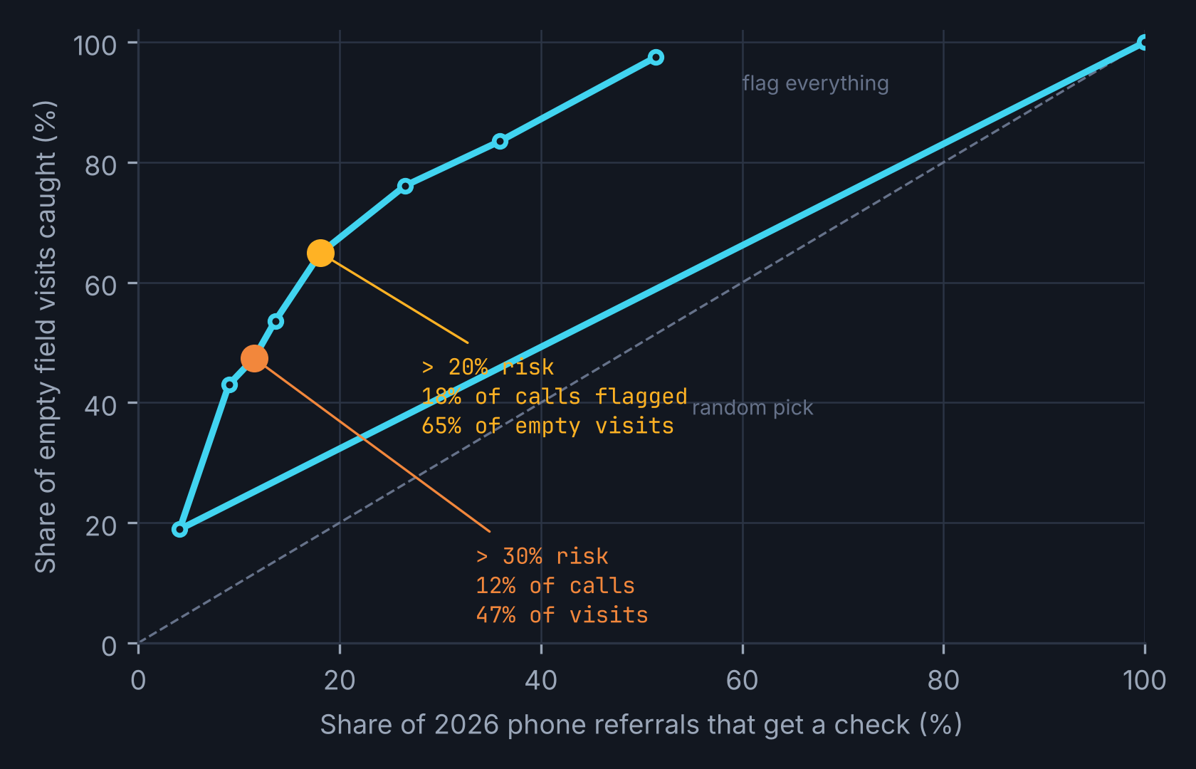
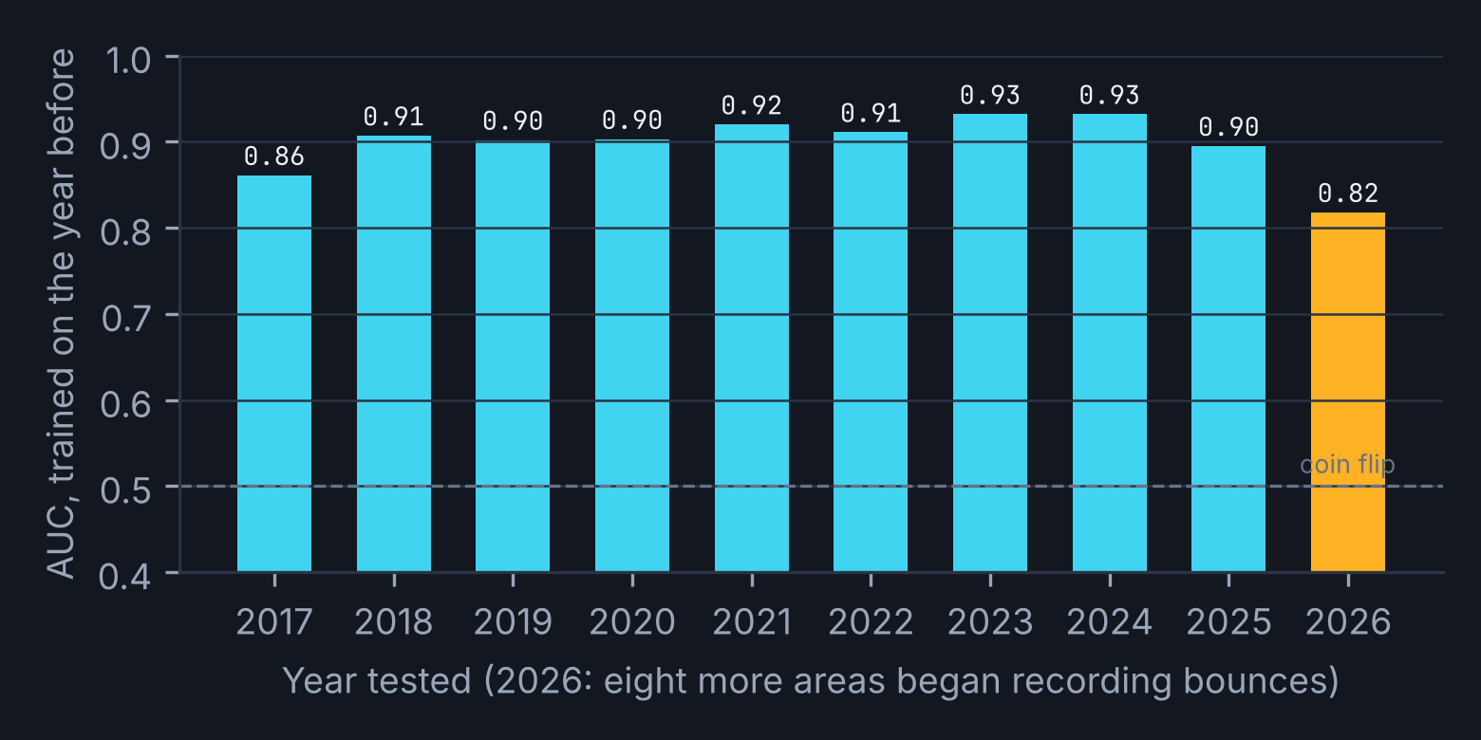
311
WOULD THE RED FLAG HAVE BEEN RIGHT? · 2025 PREDICTS 2026
09 / 16
EVIDENCE · OUT-OF-TIME BACKTEST
Last year's ratio picks this year's empty visits: 18% of calls, 65% of the waste. The same score has ranked bounces every year since 2016.
WHAT THIS DATA CANNOT SHOW · SAID BEFORE ANYONE ASKS
0.82
30%
r 0.74
8%
Why the officer found nothing (the resident was wrong, or the condition changed). Whether the first code differed from the final one: no re-route link exists. Which agent picked. Quiet misroutes an area fixes without a label. Peers measure what we cannot: Winnipeg publishes returns due to agent error (1.62%, 2024); Madrid's receiving units validated 79% of 38,221 AI routings. The 90-day data set (slide 12) is built to close these gaps.
AUC, 2026 bounces, lookup
logistic model with more features: 0.69
of flagged referrals end in waste
vs 10% of all referrals
code rate, 2024 vs 2025
402 codes with 30+ referrals
of 2026 bounces on codes new since 2025
hence amber for new codes
CONCEPTS USED
S3 · OVERFITTING TRAP · TEST ON UNSEEN CASES
S5 · DISAGGREGATE BEFORE YOU CONCLUDE
S4 · DATA LIMITS · WHAT NO PHOTO SHOWS
S4 · ADVISERS WHO KNOW YOUR ANSWER
TEAM 2 · REFERRAL CHECK · EDMONTON 311
311 Requests open data (q7ua-agfg), 2023 to Nov 6, 2026, re-run on the team's six-part export. Score trained on 2025 closures only and tested on 179,139 phone referrals from Jan 1 to Nov 6, 2026 (10,609 empty field visits). Bounce-score AUC by year from the City's yearly 311 datasets 2016-2022 and the current dataset 2023-2026 (yearly_2016_2026.csv, stability_backtest_2017_2026.csv). Peer results: team research, Nov 1 report (city self-reports; vendor claims excluded).
9
Notes:
Evidence slide. The test was specified before the 2026 data was scored: trained on 2025, scored on 2026, so the overfitting trap is addressed. The coverage curve is the design choice made visible: pick any point; we picked 18% of calls for 65% of empty visits. Ten years of the bounce score show the ratio is not fitted to one odd year; 2026 is weakest because eight areas started recording. Then say what the data cannot show, before the executive does.

Slide 10



311
THE SHIFT DEBRIEF · THREE LENSES ON THE SAME DESIGN
10 / 16
THE LENS · RATIONAL, PSYCHOLOGICAL, POLITICAL
Each lens changes one design choice: the rational lens sets the floor, the psychological lens sets the cut-off, the political lens sets the order of asking.
LOGICAL LAUREN · RATIONAL
NEURO NAV · PSYCHOLOGICAL
RULING RICK · POLITICAL
The arithmetic says check almost everything. I set the floor, not the ceiling.
Agents do not need to be more careful. They need one concrete question and to hear how it turned out.
The ratio is harmless. Publishing it is political: it makes the areas' closures visible for the first time.
EXPECTED VALUE
A 20-second check pays above about 2% risk; rolled back, $375K a year across the 150 flagged codes. An average, not a forecast.
ATTENTION
"Be more thoughtful" does nothing on a 120-second clock. The card gives one manageable question on one call in five, and the clock pauses for flagged calls.
THE PLAYERS
311 owns the pick; areas own the outcome labels and sign off scripts; CSU 52 represents the agents; Council asked for closure and duplicate numbers, not misroutes; the Auditor closed all five recommendations.
LOSS BESIDE THE AVERAGE
P10 is $171K; no draw is negative. The loss case is not money, it is 20 seconds on 38,000 calls and a prompt agents stop reading.
FEEDBACK FOR INTUITION
Kahneman and Klein: intuition needs feedback that links action to result. Today a closure reason never reaches the agent; the digest returns it within a day.
WHERE YOU STAND
An area may read a published empty-visit rate as an audit of its officers. Mirror imaging: do not assume they want it counted. So the area writes the questions and co-owns the queue.
OPTION VALUE OF WAITING
Waiting for the 2030 CRM costs three years of freed capacity (about $1.1M) and arrives with no labelled data. Waiting has a price; we state it.
ANCHORING
A suggested outcome would anchor. The card shows the rate and the questions, never a pre-selected answer; the agent writes the answer.
SEDIMENTED ASSUMPTION
"98.7% resolved on initial contact" and "efficiently routed" have been repeated to Council since 2023. Nobody in the room is lying; nobody is counting.
DOING NOTHING, STAGED OPTIONS
The base case is on slide 14. The pilot is the small, staged option; phase two and three are bought only if the gate passes.
GAIN, LOSS, REFERENCE POINT
Reference point is speed. Frame what agents gain (officers not sent to nothing, a fair measure) and name the loss (20 seconds). Calling concern "resistance" answers nothing.
STRATEGIC FORESIGHT
Future to now: the 2030 CRM replacement will inherit whatever labels exist. Now to future: every pilot field is written as a requirement for it.
CONCEPTS USED
S2 · EV · OPTION VALUE · LOSS
S3 · ATTENTION · FEEDBACK · ANCHORING · FRAMING
S4 · PLAYERS · WHERE YOU SIT · MIRROR IMAGING · FORESIGHT
S3 · ETHICS TEST
TEAM 2 · REFERRAL CHECK · EDMONTON 311
Rational: Glaser, Analytic Trees (threshold p. 20; option value of waiting; loss beside the average p. 21). Psychological: Glaser, The Psychological Perspective (3.2 attention, 3.3 feedback, 3.6 reference point); Kahneman and Klein (2009). Political: Session 4 (the political game; Allison: where you stand depends on where you sit; mirror imaging; sedimented assumptions; strategic foresight). CSD03148 p. 2: areas assume full ownership after routing; OCA 2023 p. 20: areas sign off scripts.
10
Notes:
The three characters from October assess the proposal. Rational: EV, loss beside the average, option value of waiting, staged options. Psychological: attention needs a concrete question (3.2), feedback for intuition (3.3, Kahneman and Klein), anchoring, gain/loss framing (3.6), and the ethics test: we use what we know about agents to help them see the 20 seconds, never to hide it. Political: the game's five questions (full table in Appendix A6), where you stand, mirror imaging, sedimentation, foresight both directions. Each lens changes a design choice; say which.

Slide 11
311
WED · THE TEAM CHAT · "WHY DIDN'T WE CATCH IT?" · THE BIASES, AND OURS
11 / 16
BIASES · SAY WHAT HAPPENED BEFORE NAMING ONE
Ten biases from the course, each with the situation first, and the design choice that answers it. Two of them are ours.
BIAS | WHAT HAPPENS (THE SITUATION) | WHAT IS NEGLECTED | WHAT THE DESIGN DOES
Availability | A memorable empty visit (or a memorable real offence) stands in for how often each happens | The ordinary, unmemorable cases: 4,877 untidy-property referrals a year | The ratio counts every case; the card shows the rate, not an anecdote
Confirmation | System 2 searches the code list to confirm the code System 1 offered | Evidence the standard is not met | The screening questions ask the other way round: what would make this not an offence?
Anchoring | A ranked suggestion on screen becomes the answer | The caller's actual words | No pre-selected outcome; the agent records the answers and decides
Overconfidence | "99% of referrals land correctly" reads as "the pick is fine" | Overprecision: the 99% is routing, not usefulness | Report precision per code (28%, 43%, 62%), never a city-wide average
Framing | "98.7% resolved on initial contact" vs "1 in 10 referrals ends with nothing to do" | The same facts, said the other way | The scorecard carries both lines
Loss aversion | Agents' reference point is the 120-second clock; areas' is control of their closures | What each side experiences as lost | Pause the clock on flagged calls; areas write the questions and co-own the queue
Sunk cost | "Wait for the 2030 CRM" or "we already built the script search" | What can still change now at low cost | A lookup table and a card; every field doubles as a CRM requirement
Jumping to conclusions | "Agents are careless" is a coherent story | The code set and the labels are built by the system, not the agent | The problem tree names nine causes; the agent is one leaf
Illusory truth | "Efficiently routed to the appropriate department" repeated in reports since 2023 | Where the claim originated: no routing measure exists | Put a measured rate beside the repeated phrase
Overfitting | A model that explains 2025 perfectly | Whether it predicts cases not yet seen | Trained on 2025, tested on 2026; one ratio, not a feature-rich model (AUC 0.82 vs 0.69)
OUR OWN · DECLARED BEFORE Q&A
CONFIRMATION
We went looking for a bigger dollar case after the bounce case came in at $7K to $17K. We found one. The test: the same score, specified before scoring 2026, out of time. It held.
OVERCONFIDENCE
The 35% avoided share has no source; it is a team judgment with a 20% to 50% range. The case holds down to 2.6%. The pilot replaces the assumption with a measurement.
PROMPT FRAMING
Asking an AI for "the most savings" produces savings. We asked the loss side separately: who pays for the 20 seconds, and who could be refused service.
HEURISTIC OR BIAS?
"Untidy yard means the untidy-property code" is a useful shortcut. It becomes a bias only under one condition: no feedback. The design changes the condition, not the person.
CONCEPTS USED
S3 · TEN BIASES
S3 · SITUATION, TENDENCY, NEGLECTED
S3 · HEURISTIC VS BIAS
S3 · PROMPT FRAMING MOVES THE ANSWER
S2 · SIX QUESTIONS FOR AN ANALYSIS
TEAM 2 · REFERRAL CHECK · EDMONTON 311
Biases as taught in Session 3 (Glaser, The Psychological Perspective; Tversky and Kahneman 1974, 1981; Nickerson 1998; Moore and Healy 2008; Kahneman and Tversky 1979; Arkes and Blumer 1985; Fazio et al. 2015; MacGarvie and McElheran 2018). Method rule: say what happened, then the tendency, then what is neglected; a heuristic is a shortcut, a bias is a systematic distortion under particular conditions.
11
Notes:
Each row follows the method rule: the situation, then the tendency, then what is neglected, then the design answer. Keep the agents out of the dock: the biases live in the system (no feedback, a speed clock, a label built by the area). Own ours in the room before the examiner finds them: confirmation (we wanted a dollar case), overconfidence (35%), framing of our own prompts.

Slide 12
311
THU · THE AREA CLOSES THE TICKET · WHAT RECORD DOES THAT LEAVE?
12 / 16
DATA · CONSTRUCTED, THEN LEVERAGED
The ratio needs five fields the City already has. Learning needs a data set that does not exist yet: we build it in the first 90 days.
DATA | HAVE IT? | FORM | USED FOR | WHO MUST CHANGE BEHAVIOUR
Code, area, channel, referral type, closure label, dates | Yes, public | Structured, batch | The ratio, the tiers, the backtest | No one
Ticket address, agent ID, handle time | Yes, in the CRM (inferred; not public) | Structured, real-time | Digest routing, handle-time guardrail, phase-two owner lookup | CRM owner: a data agreement with 311
Closure reason, consistent across areas | Partly: eight areas began recording in 2026 | Structured, batch | The label every ratio learns from | Receiving areas: a required reason on every closure
Screening answers on flagged calls | No | Structured, real-time (two fields) | The 90-day data set; answer-level risk in phase two | Agents: record two answers; CSU 52 agreement
Agent's choice after the card (refer / inform / caller insisted) | No | Structured, real-time | Override rate, consent guardrail, training label | Comes free with the card
Link from a referred ticket to its final code (re-route) | No; cannot be rebuilt from open data | Structured, batch | Whether the picked code was the right code | Area dispatch clerks: one field on reassignment
Accuracy of codes on calls resolved on the phone (473,564) | No | Sampled QA | Replaces the stake's biggest unknown | 311 QA: about 200 calls a month
THE 90-DAY DATA SET · BUILT SO THE ALGORITHM CAN LEARN
One row per flagged phone referral, from day 31:
code picked · tier and rate shown · the two answers · agent's choice · caller insisted (y/n) · days to closure · closure reason · reassigned to (final code) · re-contact within 30 days
SIZE BY DAY 90
About 6,400 flagged referrals logged (30 days shadow, 60 days pilot); about 4,800 with a closure reason; about 1,000 empty visits labelled. Enough to re-estimate every pilot code's ratio from its own 2026 closures.
WHAT IT LETS THE ALGORITHM LEARN
1 Whether the two answers predict an empty visit better than the code alone (answer-level risk, phase two).
2 Whether the picked code and the final code differ: the first ground truth for "coded correctly" the City will ever have.
3 Which codes are confusing versus which standards are unclear: two different fixes.
RULES FOR THE SET
No caller names or notes. Agent ID held by 311 QA only, never in the digest. Held out by time before any model is trained on it. Every field written as a requirement for the 2030 CRM.
Data is built. The label we learn from is the receiving area's verdict, written under its own incentives. A measure constructed slightly wrong rewards the wrong thing: an empty-visit rate on its own rewards areas for closing "no action" less often, whatever happened at the curb. So every rate is paired with resident re-contact within 30 days, and the labels are audited by sample.
CONCEPTS USED
S6 · DATA IS BUILT
S6 · INVENTORY COLUMNS
S6 · SBS · REPLY IS NOT FIX
S1 · HOW EXAMPLES WERE LABELLED
S1 · DATA STRUCTURE IS A CHOICE
S5 · WHAT IT CANNOT SHOW
TEAM 2 · REFERRAL CHECK · EDMONTON 311
Inventory columns after the Session 6 exercise (Scandinavian Building Services, Ivey W35309): have it, structured or not, real-time or batch, decision it serves, gap. SBS lesson: the 10-1-24 figure measured the reply, not the fix. Session 1: how the examples were labelled. Volumes: about 3,200 flagged phone referrals a month at the 20% cut-off (2026 pace).
12
Notes:
This is the 30% criterion. Left: the inventory in the Session 6 columns, with the behaviour change each gap needs. Right: the data set the City does not have and the pilot creates: one row per flagged call with the answers, the agent's choice, the outcome and the re-route. By day 90 it is large enough to re-estimate pilot codes from their own closures and to test whether answers beat codes. Labels are the area's verdict: audit them, pair them with re-contact.

Slide 13
311
THE PLAN · FIRST 90 DAYS, THE GATE, THEN PHASES TWO AND THREE
13 / 16
INTEGRATION · PHASED, GATED
Ninety days inside 311's own authority, three areas, half the teams. Phase two is bought only if the gate passes.
DAYS 1-30 · BUILD, NO SCREEN CHANGE
DAYS 31-60 · SHADOW MODE
DAYS 61-90 · PILOT
THE GATE · DAY 120 READ-OUT · ALL MUST BE TRUE
311
Re-run the backtest on internal closures; pick the three pilot areas (Municipal Enforcement, Peace Officers, Parking: 3 of every 4 flagged empty visits).
311
Score every pick, show nothing. Confirm 18% would be flagged and the mix matches the backtest.
311
Card on for half the teams, chosen by team-week at random; the other half is the control. Clock paused on flagged calls.
□
Empty-visit rate on flagged codes, pilot teams vs control: down 20% or more
□
Referrals a caller wanted and did not get: zero
□
Handle time on flagged calls: up 15 seconds or less; 120-s answer target still met
311 + AGENTS + CSU 52
Co-design the card with senior agents: what do they already ask? Agree in writing: digest is coaching only, no individual ranking.
DATA SET STARTS
Log tier, outcome, reason and re-route for every flagged referral. Daily digest and weekly fix queue begin.
DATA SET FILLS
Two answers and the agent's choice logged on every flagged call; QA samples 200 resolved calls a month.
□
Override rate between 20% and 80%
□
Closure reason present on 80%+ of flagged referrals in all three areas
NEEDS OTHERS
Data agreement with the CRM owner; required closure reason and a reassignment field in the three areas; each area writes its two screening questions.
NEEDS OTHERS
Areas close with a reason on 80% or more of flagged referrals, or the pilot waits.
NEEDS OTHERS
Weekly fix queue with the three areas: retire, merge, reword, re-script. Union walkthrough at day 75.
□
Data set: 5,000+ labelled flagged calls
□
Three areas and CSU 52 sign the phase-two scope
PHASE TWO · MONTHS 5-12 · IF THE GATE PASSES
PHASE THREE · 2027 ON · OPTIONS WITH A START CONDITION
All teams and all areas. Retrain the ratio on the 90-day set; test answer-level risk in shadow first. Then the text suggestion on the agent's typed notes (top three codes, never pre-selected), reusing the City's app AI of July 2026: Generative AI Standard human review, a privacy impact assessment, 85% top-three accuracy offline before it is shown. Resident sees the closure reason by text or email.
Every pilot field becomes a requirement for the 2030 CRM replacement (future to now). The shared app and web intake platform the team debated starts only if the phone pilot passes and app bounce rates move after the City's own AI suggestion (no visible fall in three months so far). Full automatic routing is not on the roadmap: no accuracy test, no stop rule, and the Standard requires review.
CONCEPTS USED
DECK STD · WITHIN CONTROL VS NEEDS OTHERS
S4 · STRATEGIC FORESIGHT
S2 · STAGED OPTIONS
S7 · DASHBOARD SIM · WHAT THE SYSTEM MAKES INVISIBLE
S10 · GOVERNANCE
TEAM 2 · REFERRAL CHECK · EDMONTON 311
Split after the course's consulting-deck standard (USPS 2010): what 311 can do within its own authority vs what needs others. Pilot by team-week randomisation, half the teams; at about 3,200 flagged calls a month a 20% relative drop reads out in about six weeks (80% power, 5% two-sided; team-week clustering makes this a minimum). Strategic foresight: Session 4. Generative AI Standard (Jul 2024, s. 3.2 Jul 2025) and the Privacy Impact Assessment standard (May 2026) apply from phase two.
13
Notes:
Ninety days in three columns, each split into what 311 controls and what needs others. The gate is numeric and complete: every line must be true. Phase two is where the AI assistant from the team's plan enters, gated and in shadow first. Phase three carries the CRM requirements and the platform option with its start condition. Pilot length: six weeks of pilot reads out a 20% drop; the day-120 gate leaves room for team-week clustering.

Slide 14
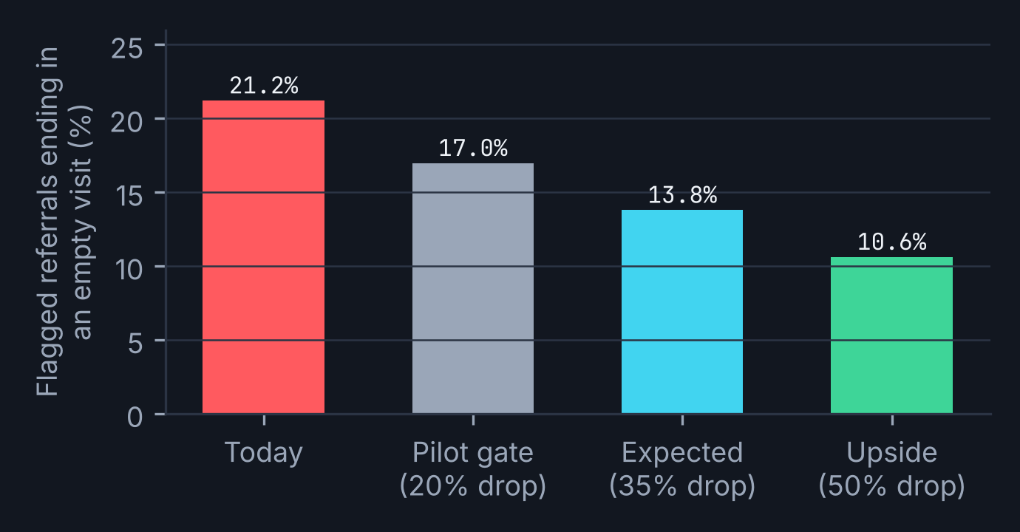
311
THE DEBRIEF · HOW WILL 311 KNOW IT WORKED?
14 / 16
HOW THE CITY WOULD KNOW · MEASURES CHOSEN BEFORE LAUNCH
One primary measure, paired with the thing it could corrupt. Containment and handle time are guardrails, never targets.
MEASURE | BASELINE | GATE / TARGET | TYPE | WHAT IT COULD REWARD BY MISTAKE, AND THE PAIR
Empty-visit rate on flagged codes, pilot vs control | 21.2% (2026) | down 20%+ at the gate; 35% expected | Primary | Areas closing "no action" less often on paper: paired with the re-contact line below
Resident re-contact within 30 days on flagged calls | to be measured in shadow | no rise | Resident-facing | Catches a check that talks residents out of real problems
Referrals a caller wanted and did not get | none today | zero | Guardrail (Robodebt) | The algorithm becoming a gate; burden shifting to the resident
Median days in the wrong queue per bounce | 2.0 days (2026 phone) | down | Resident-facing | Kept from October; bounces still matter for hazards
Closure reason back to the agent within 24 h | none today | 90% | Learning loop | A digest nobody opens: track opens, not sends
Codes cleared from the fix queue per quarter | none today | rising, then falling | Learning loop | Clearing codes by deleting them: pair with re-contact
Average handle time on flagged calls | from 311 | +15 s or less | Guardrail | Never a target: a target here recreates the speed incentive
Override rate | none today | 20% to 80% | Guardrail | Below 20%: rubber stamp. Above 80%: the tier is noise
Recording rate by area | varies | stable | Data health | Judge the model only where recording is stable
WHAT WOULD CHANGE OUR MINDS
Shadow mode flags 30%+ of calls rather than 18%: raise the cut-off before any agent sees it.
Re-contact rises on flagged calls: the check is talking residents out of real problems; stop and redesign the questions.
Empty-visit rate falls in the control group too: a recording change, not us; extend the pilot.
Handle time rises more than 15 s: the card is too long; cut to one question.
Values we refuse to trade: no resident is refused a referral; no agent is ranked by the digest.
CONCEPTS USED
S9 · PROXY DRIFT · VALUES WITHER
S9 · MEASURES BEFORE LAUNCH
S6 · EVERY MEASURE REWARDS SOMETHING
S2 · WHAT FLIPS THE RECOMMENDATION
DECK STD · BASE CASE FIRST
TEAM 2 · REFERRAL CHECK · EDMONTON 311
Measures chosen before launch (Session 9: proxies drift from what they stand for; values wither when nothing measures them). Base case: 21.2% of flagged referrals ended in an empty visit in 2026. Weekly City-wide phone-referral bounce rates ran 0.79% to 2.05% between April and October 2026, so the City-wide average cannot be the test. Robodebt: the burden of proof must stay with the City.
14
Notes:
Session 9 applied to ourselves. The primary measure (empty-visit rate on flagged codes) could be gamed by areas closing differently, so it is paired with resident re-contact. The Robodebt guardrail is explicit: referrals a caller wanted and did not get must be zero. Handle time and containment stay guardrails, not targets, or the routine recreates the speed incentive the problem tree found. 'What would change our minds' pre-empts the Q&A.

Slide 15
311
THE ASK · THREE DECISIONS FOR THIS ROOM
15 / 16
RECOMMENDATION
Approve a 90-day pilot in three areas and decide again at day 120 with the numbers on the previous slide.
1
APPROVE THE PILOT
2
SIGN THE DATA AGREEMENT
3
SET THE TERMS WITH CSU 52
Referral Check on the 150 codes above 20% risk, three areas, half the teams by team-week. One-time configuration estimated at $10K to $150K (assumed; no City quote); running cost about $30K a year of agent time, inside the $375K it frees.
Two CRM fields (closure reason, reassignment) in Municipal Enforcement, Peace Officers and Parking Enforcement, and 311's access to internal closures. This is the step that needs people outside 311.
Coaching only, no individual ranking, the clock paused on flagged calls, and a walkthrough at day 75. Agreed before any agent sees a card.
PREMORTEM · IT IS DECEMBER 2027 AND IT FAILED. WHY?
UPSIDE AND DOWNSIDE
WHAT OTHER CITIES TEACH
THE RATE FELL ON PAPER
Areas closed fewer tickets as "no action" and more as "resolved". Residents re-contacted more. Answer: the paired re-contact measure, label audits by sample.
UPSIDE
P90 $622K; answer-level risk in phase two reaches the 35% of empty visits in green codes; residents hear the reason.
DOWNSIDE
P10 $171K; 20 seconds on 38,000 calls a year; a published rate the areas resent. Nothing in the pilot is hard to undo: turn the card off and the fields remain useful.
Winnipeg already publishes returns due to agent error (1.62% in 2024): measuring misroutes is normal.
Madrid: rules first, then AI; the receiving unit validated 79% of 38,221 routings and rejections retrain the model.
Amsterdam (Signalen, live since 2022): a model suggests the category, anything under 40% confidence goes to a human desk, staff corrections retrain it. The closest precedent for a human-in-the-loop check.
Denver: a chatbot paired with cuts; Council voted 9 to 3 against a US$3.9M extension. A tool plus job cuts invites a fight. Ours cuts no position.
AGENTS CLICKED THROUGH
The card became wallpaper; override rate sat at 5%. Answer: the 20% to 80% guardrail, one question not two, coaching from a team lead who sees the digest.
THE SIGNAL DROWNED
Two more areas changed recording mid-pilot and the control group moved too. Answer: judge pilot against control, by area, never on the City-wide rate.
A REASON NOT ON THE TREE
The CRM vendor could not add two fields before 2028. Answer: the shadow phase and the data set run on exports; the card waits.
CONCEPTS USED
S2 · PREMORTEM
S2 · DOING NOTHING · STAGED OPTIONS
DECK STD · RISKS BESIDE THE FORECAST
S4 · THE POLITICAL GAME · WHO SAYS YES, IN ORDER
BRIEF · NOT ALREADY DOING IT
TEAM 2 · REFERRAL CHECK · EDMONTON 311
Premortem after Klein (2007). Peer evidence: team research Nov 1 and Nov 11 reports (Amsterdam Signalen, Dutch algorithm register gm0363; Winnipeg 311 budget presentation Dec 9, 2025 p. 6; Madrid SyRCI-IA, Interoperable Europe listing; Denver Council record 26-1373 and Auditor report Aug 2025; Toronto 'Simplifying the 311 Intake Experience' Apr 30, 2026). One-time cost is a team estimate with no City quote: a lookup table, one card and two CRM fields, not a platform.
15
Notes:
Close on the decision the room can take today. Three asks, in the order the political game requires: 311 approves, the CRM owner and three areas sign, the union agrees the terms. Premortem (Klein): four failure stories, each with the answer already in the design; the fourth is the reason not on the tree. Upside and downside beside the forecast, as the consulting standard asks. Peers: measuring misroutes is ordinary (Winnipeg); humans validate AI routing (Madrid); tools paired with cuts fail politically (Denver).

Slide 16
311
AI PROCESS REFLECTION · HOW WE WORKED, WHERE THE AI WAS WRONG
16 / 16
REQUIRED SLIDE
AI Process Reflection
TOOLS, AND THE KIND OF TASK EACH DID
TWO CRUX MOVES
• Analyst: Claude with Python and DuckDB over 3.5 million open-data rows (the backtest, the ten-year check, the Monte Carlo). Source-grounded, re-runnable scripts in the project folder.
• Assistant: first drafts of slide text, the swim lane and this deck's build script; the team rewrote every slide in its own words.
• Coach: AI played the skeptical 311 director ("why fix something 99% right?", "is this cash?") and the CSU 52 representative before each team meeting.
• Fact-checkers: separate AI agents checked the Nov 1 research report against its sources: 610 rows, 369 verified, 208 corrected, 25 unverified, 8 wrong.
• The AI argued against our own AI idea. Asked to validate an AI code suggester trained on past tickets, it showed the training labels are agents' own picks (errors included) and that LLM-written test tickets would be circular. We kept the suggester, but as a gated phase two behind a human-built data set.
• "Give me the most savings" moved the decision. The first routine (bounces only) came back at $7K to $17K a year. Directed to find the larger loss, the analysis found 12,583 empty field visits. Re-running it showed the flagged codes are bylaw complaints, so the question on the card changed from "who owns it?" to "does it meet the standard?".
HOW WE VALIDATED
WHERE THE AI WAS WRONG, AND WHAT WE DID
• Two independent pulls: the City's API and the team's own six-part CSV export; counts matched (191,521 phone referrals 2025; 179,139 in 2026).
• Every model was trained on one year and tested on the next; a richer model that scored better in-sample scored worse out of time and was dropped.
• Every figure on a slide has a source or is labelled assumed; where a citation could not be opened, it was dropped.
• Framing test: the same question asked gain-first and loss-first; the loss-first run produced the refusal rule and the re-contact pairing.
• It counted 1,930 phone codes where the team's deck said 1,917: a definition difference (area + category + description). We footnoted it rather than pick a winner.
• It proposed the 35% avoided share with confidence and no source. We kept it only as a labelled assumption with a range, and built the pilot to replace it.
• Its first pilot design needed 3.6 months to read out; a power calculation on the right outcome (empty visits, not bounces) cut that to six weeks.
• It drafted fluent slide prose that read as our own. The syllabus says the final writing must be ours; we rewrote, and kept a log of what changed.
CONCEPTS USED
S8 · DIRECT, DON'T PROMPT
S1 · ASSISTANT / ANALYST / COACH
S1 · MOLLICK · HUMAN IN THE LOOP
S3 · PROMPT FRAMING
BRIEF · TOOLS · CRUX · VALIDATION · ERRORS
TEAM 2 · REFERRAL CHECK · EDMONTON 311
Sloan and Glaser (2026), Stop Prompting AI, Start Directing It; Glaser, Sloan and Knight (2025): assistant, analyst, coach; Mollick (2024) four rules; AI Literacy Exercise brief: tools, crux moves, validation, errors. All analysis and final writing are the team's own; AI drafts were rewritten and every figure re-derived from the open data by a team member.
16
Notes:
Draft only: the team must write this slide in its own voice and with its own log. The four quadrants follow the brief: tools by kind of task, one or two crux moves, how outputs were validated, and what happened when the AI was wrong. 'A reflection that reports only successes has not been written honestly.' The figures in the fact-check line come from the Nov 1 team report.

Slide 17
311
APPENDIX A1 · HOW THE RISK SCORE IS BUILT
APPENDIX
APPENDIX A1
The score is a shrunk ratio per code, computed from fields the City already publishes.
DEFINITIONS
CUT-OFF | CODES | 2026 REFERRALS FLAGGED | EMPTY VISITS CAUGHT | DESK WASTE CAUGHT | WASTE RATE IN FLAGGED SET
> 10% | 425 | 35.9% | 83.5% |  | 22.1%
> 15% | 215 | 26.5% | 76.1% |  | 26.8%
> 20% (chosen) | 150 | 18.1% | 64.9% | 38.5% | 30.1%
> 25% | 99 | 13.6% | 53.6% |  | 32.0%
> 30% | 72 | 11.5% | 47.4% | 26.0% | 34.0%
> 40% | 34 | 9.0% | 43.0% |  | 38.1%
> 50% | 14 | 4.1% | 18.9% |  | 38.5%
Code = service area + category + description (1,930 phone codes in 2025).
Empty field outcome = closure label in {Does Not Meet Bylaw Offence Standards, Assessed - No Action Required, Unable to Locate Animal, Location Not Found, Unable to Contact Complainant}.
Wasted desk outcome = {311 Redirecting to Other Business Area (a bounce), Non-City Service or Location, Duplicate Request (three labels), File Already under Investigation, Reported on same day}.
Left out: Parking "Vehicle Gone Upon Arrival" (4,886 in 2025) because it depends on dispatch speed (9.7% when closed within an hour vs 44.2% at 3-12 hours), not on intake.
Score = (empty + prior mean x 10) / (referrals + 10), separately for field and desk outcomes, then summed. Prior means 2025: field 6.6%, desk 4.1%.
Refresh: weekly, rolling 12 months. New codes: amber for 90 days, then scored. Three years of history did no better than one (AUC within 0.01).
Route Check lives inside Referral Check: the bounce ratio is one of the two terms, so the October design is a special case of this one.
Base rates, 2026 to Nov 6: 5.9% of phone referrals ended in an empty field visit, 4.2% in a wasted desk outcome, 10.1% in either. 2025: 12,583 field, 7,815 desk, of 191,521 referrals.
Precision reads: a red code at 30%+ means three in ten of its referrals end in some wasted outcome; the card says so in words.
TEAM 2 · REFERRAL CHECK · EDMONTON 311
311 Requests open data (q7ua-agfg), 2023 to Nov 6, 2026, re-run on the team's six-part export. Scripts: edmonton-311-analysis/scripts/s1b.py (Referral Check), a1-a4.py (Route Check), code_risk_table_2025.csv, sibling_codes_2025.csv.
A1

Slide 18
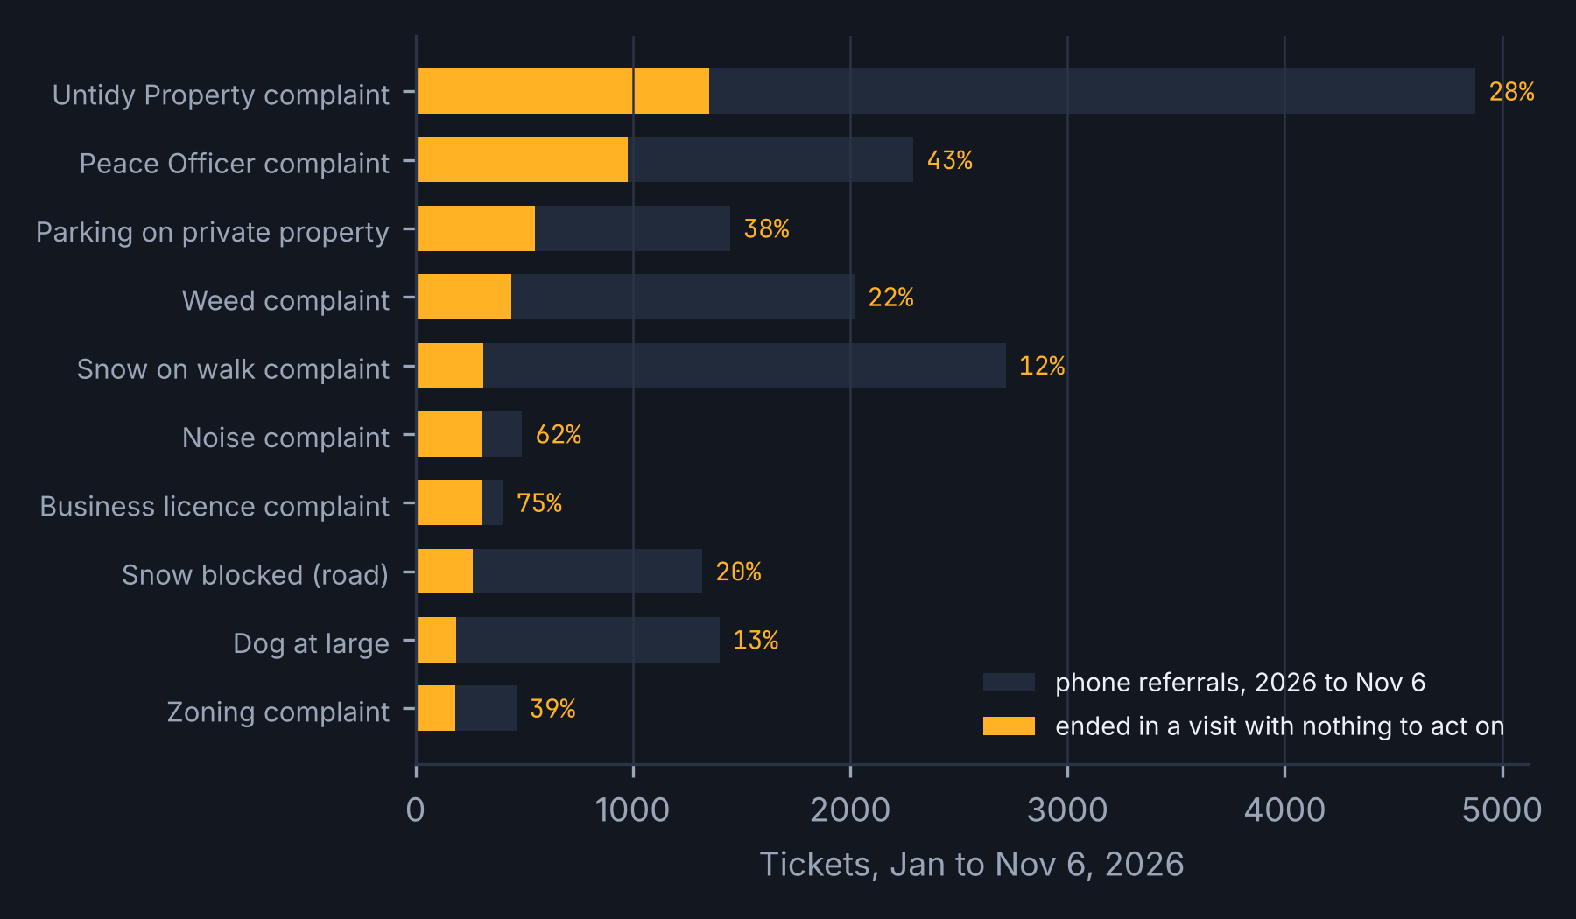
311
APPENDIX A2 · THE CODES BEHIND THE EMPTY VISITS
APPENDIX
APPENDIX A2
Ten codes carry most of the flagged empty visits, and three areas carry three in four.
AREA | FLAGGED REFERRALS | EMPTY VISITS | SHARE OF FLAGGED EMPTY VISITS
Community Standards - Municipal Enforcement | 10,937 | 2,812 | 41%
Roadway Maintenance | 10,808 | 1,519 | 22%
Community Standards - Peace Officers | 3,218 | 1,446 | 21%
Parking Enforcement | 2,385 | 625 | 9%
Animal Control | 2,210 | 225 | 3%
Park Rangers | 1,560 | 123 | 2%
All other | 1,390 | 135 | 2%
Why the question changed: the flagged codes are complaints where an officer must judge a standard (untidy, noise, weeds, parking on private property), not assets with an ambiguous owner. Municipal Enforcement, Peace Officers and Parking are the three pilot areas. Roadway Maintenance (snow) is seasonal and depends on timing; it joins in phase two.
TEAM 2 · REFERRAL CHECK · EDMONTON 311
311 Requests open data (q7ua-agfg), 2023 to Nov 6, 2026, re-run on the team's six-part export, phone referrals, Jan 1 to Nov 6, 2026. Flagged set = 150 codes above 20% 2025 risk.
A2

Slide 19
311
APPENDIX A3 · TEN-YEAR CHECK OF THE BOUNCE SCORE
APPENDIX
APPENDIX A3
The same lookup has ranked next year's bounces every year since 2016; the step-ups track recording, not coding.
YEAR | PHONE REFERRALS | BOUNCES | RATE | AREAS RECORDING | AUC (PRIOR YEAR) | CAUGHT AT 2% FLAG | BOUNCES ON NEW CODES
2026 (to Nov 6) | 179,139 | 1,930 | 1.08% | 31 | 0.82 | 41% | 8.4%
2025 | 191,521 | 1,062 | 0.55% | 24 | 0.90 | 56% | 1.2%
2024 | 188,003 | 874 | 0.46% | 20 | 0.93 | 64% | 7.6%
2023 | 193,077 | 1,062 | 0.55% | 23 | 0.93 | 58% | 1.4%
2022 | 223,944 | 1,205 | 0.54% | 20 | 0.91 | 43% | 2.7%
2021 | 225,435 | 584 | 0.26% | 17 | 0.92 | 33% | 22.1%
2020 | 200,313 | 562 | 0.28% | 17 | 0.90 | 36% | 2.1%
2019 | 254,693 | 566 | 0.22% | 19 | 0.90 | 44% | 4.4%
2018 | 261,243 | 649 | 0.25% | 14 | 0.91 | 35% | 20.5%
2017 | 259,028 | 585 | 0.23% | 20 | 0.86 | 28% | 6.2%
WHAT THE HISTORY ADDS
The bounce rate stepped up in 2022 and 2026; both steps line up with more areas recording (all-channel bounces 2,162 in 2021 to 4,515 in 2022). The count tracks recording as much as coding.
Phone volume fell by two thirds (1.83M phone tickets in 2016 to 0.67M in 2025) while phone codes grew from 1,701 to 1,930: less practice per code each year, which is the Kahneman and Klein condition eroding.
One-year rolling history is enough and adapts faster to recording changes.
TEAM 2 · REFERRAL CHECK · EDMONTON 311
City of Edmonton yearly 311 datasets 2016-2022 (deduplicated by Row ID) and the current dataset 2023-2026. Score trained on the prior year, tested on the year shown; flag = 2% bounce risk.
A3

Slide 20
311
APPENDIX A4 · MONTE CARLO INPUTS AND SENSITIVITY
APPENDIX
APPENDIX A4
Every input is a range with a source or a flag; the one that moves the answer most is ours.
INPUT | MIN / LIKELY / MAX | SOURCE OR STATUS
Empty field visits a year in flagged codes | 8,100 (counted) | Open data, 2026 annualised
Wasted desk closures a year in flagged codes | 3,414 (counted) | Open data, 2026 annualised
Flagged referrals a year | 38,245 (counted) | Open data, 2026 annualised
Cost of a field visit | $22 / $84 / $280 | Team's Oct 26 stake model ranges; no City figure
Desk time per closure | 5 / 10 / 20 min at $36.93 / $41.99 / $52.09 an hour | CSU 52 collective agreement rates
Share of flagged empty visits avoided by the check | 20% / 35% / 50% | ASSUMED; the pilot measures it; break-even 2.6%
Agent time per flagged call (20 s) | $0.30 / $1.02 / $1.02 | Agent-only to average cost per contact ($16.29 per contact, $14.66M budget / 900K contacts)
311 re-handling share on desk waste | 25% x $16.29 | Team judgment
SIX QUESTIONS FOR REVIEWING THIS ANALYSIS
Is this the decision we face? Yes: the pick on a phone referral, as in October, with its consequence widened.
What is missing, overlapping, dependent? Vehicle Gone is left out; bounces sit inside desk waste, so October's $100K is not added twice.
Observed vs estimated? Volumes observed; costs are team ranges; the avoided share is assumed.
Does it account for what averages hide? Rates are per code; the pilot is judged inside flagged codes.
What flips it? Avoided share under 2.6%, or a visit cost under about $10. Neither is plausible; both are tested.
What could we lose that the numbers leave out? Agent trust if the card is noise; area goodwill if the rate is published as a league table.
Results: net mean $375K; median $347K; P10 $171K; P90 $622K; no draw below zero. Gross $405K; check cost $30K. Halve visit cost: about $190K. Agent-time pricing only: about $355K. At the 30% cut-off: $276K (P10-P90 $127K-$457K).
TEAM 2 · REFERRAL CHECK · EDMONTON 311
Triangular distributions (min / most likely / max), 50,000 draws, seed 20261110, independent draws. Volumes annualised from Jan 1 to Nov 6, 2026 (x 12 / 10.2). Six questions for reviewing an analysis: Session 2.
A4

Slide 21
311
APPENDIX A5 · HOW LONG THE PILOT MUST RUN
APPENDIX
APPENDIX A5
Because the outcome is common (one in five flagged referrals), the pilot reads out in weeks, not quarters.
DROP TO DETECT | FLAGGED REFERRALS PER ARM | MONTHS OF PILOT (50/50 SPLIT)
20% relative (21.2% to 17.0%) | 1,347 | 0.85
35% relative (21.2% to 13.8%) | 408 | 0.26
At the 30% cut-off, 20% drop (24.5% to 19.6%) | 1,120 | 1.1
For comparison, Route Check (bounces, 7.0% base), 30% drop | about 2,000 | 3.6
GATE ARITHMETIC
Baseline inside flagged codes: 21.2% empty field visits (6,885 of 32,508 in 2026 to Nov 6).
Gate: 17.0% or lower in pilot teams while control stays near 21%.
Expected: 13.8% (35% avoided). Upside: 10.6% (50%).
Dollar read-across at the gate: 20% avoided is about $200K a year; 35% is $375K; 50% is about $550K.
Design: half the teams see the card in a given week, chosen at random by team-week; the other half is the control. Both halves log the two answers only when the card is shown, so the control measures today's routine. The gate decision is set at day 120 (60 days of pilot) to allow for clustering and for the areas' closure lag (most field outcomes close within three weeks).
TEAM 2 · REFERRAL CHECK · EDMONTON 311
Two-proportion test, 80% power, 5% two-sided significance; baseline 21.2% of flagged referrals ending in an empty visit; about 3,200 flagged phone referrals a month at the 20% cut-off, split 50/50 by team-week. Clustering by team-week adds a design effect: treat the figures as minimums.
A5

Slide 22
311
APPENDIX A6 · THE POLITICAL GAME · PLAYERS, GOALS, MOVES
APPENDIX
APPENDIX A6
Who must say yes, in what order, and what each stands to lose.
PLAYER | MEASURED ON TODAY | GOAL | MOVES OPEN | WHAT IS AT STAKE (HYPOTHESIS) | LIKELY MOVE, AND OUR ANSWER
311 and Customer Access | 98.7% resolved on initial contact; 120-s answer | Fewer repeat calls; a defensible scorecard | Approve the pilot; publish or not | A new line on its own scorecard that can go down | Approves if the measure is paired and framed as capacity: it is
Receiving areas (3 pilot) | Closed within timelines (81%); audit compliance | Officers on real work; control of outcome labels | Write the questions; record reasons; sign or stall | A published empty-visit rate read as an audit of officers | Stall unless they own the questions and the queue: they do
Agents and CSU 52 | Answer speed; Art. 11.03 on technological change | No hidden ranking; no job loss; less rework | Accept, bargain, grieve | 20 s per flagged call; a digest that could become a performance file | Accept with coaching-only terms and a paused clock, agreed in writing first
CRM owner / IT | Uptime; 2030 replacement scope | No scope creep on a dying system | Add two fields, or export instead | Effort on a platform being replaced | Two fields, or exports in the shadow phase; every field a 2030 requirement
Council and Auditor | Closures, duplicates, compliance (July 2025 motion) | Residents served; audit findings closed | Ask for a routing measure | A number that was never reported before | Welcome a measure that is already in open data
Residents | Nothing | One call, the right outcome, a reason | Call again or give up | Being talked out of a real problem | The consent rule: a referral on request, always
TEAM 2 · REFERRAL CHECK · EDMONTON 311
Session 4: who are the players, what are their goals, what actions can they take, which maximise their benefit, what are they likely to do. CSD03148 (Sep 2, 2026); OCA 2023; CSU 52 collective agreement Art. 11.03 (technological change). 'At stake' cells are hypotheses to test in the day 1-30 interviews, not findings.
A6

Slide 23
311
APPENDIX A7 · EVERY COURSE CONCEPT, AND THE DESIGN CHOICE IT CHANGED (1 OF 2)
APPENDIX
APPENDIX A7
Sessions 1 to 3: each concept, where it appears, and what it changed.
SESSION · CONCEPT | WHERE | THE DESIGN CHOICE IT CHANGED
S1 · AI as prediction machine; three kinds of system and their questions | 6 | A learned ratio plus an explicit rule, no generative step in phase one; the labelling question answered on the slide
S1 · Four agent questions (access, change, stop, correct) | 8 | Read-only access, no caller text, a kill switch to green, a joint fix queue
S1 · Three elements of agency; Organizations as Algorithms | 7, 8 | Authority stays with the agent; accountability with the area; data categories named as choices
S1 · Northfield Credit Union | 8 | The interface and the metric shape the outcome: no pre-selected answer, no throughput target
S1 · Assistant, analyst, coach; Mollick's rules; Zuboff vs Davenport | 16, 8 | AI used in three roles; the human keeps the knowledge by asking the question
S2 · Problem tree, MECE, explanation as hypothesis | 4 | Branches by stage of one call; the agent is one leaf of nine
S2 · Profit tree that reconciles; EV; mix effect; sensitivity | 5 | Capacity case with ranges; judge inside flagged codes; break-even stated
S2 · Decision tree threshold; option value of waiting; staged options; premortem; six questions | 6, 10, 13, 15, A4 | 2% floor, 20% cut-off; cost of waiting for 2030 stated; pilot as the small option; four failure stories
S3 · System 1 / 2; attention needs one concrete question | 4, 6, 10 | One question, one call in five, clock paused
S3 · Kahneman and Klein: feedback for intuition | 10, 12 | Closure reason back to the agent within a day
S3 · Ten biases; situation before tendency; heuristic vs bias; prompt framing; ethics test | 11, 16 | Answer-first card, paired measures, our own biases declared
TEAM 2 · REFERRAL CHECK · EDMONTON 311
A concept earns its place only if it changed a design choice (Group Project brief: not a tour of the syllabus).
A7

Slide 24
311
APPENDIX A7 · EVERY COURSE CONCEPT, AND THE DESIGN CHOICE IT CHANGED (2 OF 2)
APPENDIX
APPENDIX A7 (CONTINUED)
Sessions 4 to 10, the brief and the consulting standard.
SESSION · CONCEPT | WHERE | THE DESIGN CHOICE IT CHANGED
S4 · The political game; where you stand; mirror imaging; sedimented assumptions | 10, A6 | Areas write the questions and co-own the queue; asks ordered 311, areas, union
S4 · Strategic foresight (now to future, future to now); data limits; advisers who know your answer | 13, 9, 16 | Every field a 2030 requirement; what the data cannot show said first; test specified before scoring
S5 · Garneau: disaggregate; what the data structurally cannot show | 5, 9, 12 | Per-code rates; the gaps listed; the 90-day set built to close them
S6 · Data is built; inventory columns; a metric constructed slightly wrong; SBS reply-not-fix | 12, 14 | Required closure reason; label audits; re-contact paired with the primary measure
S7 · Ostensive / performative / artifact; McGarry; Ironstone tacit work; dashboard-sim questions | 3, 7, 13 | The algorithm as a new artifact; co-design with senior agents; what the system makes invisible
S8 · Direct AI, don't prompt it (Sloan and Glaser 2026) | 16 | Roles assigned to AI; loss-first and gain-first runs compared
S9 · Proxy drift; values wither; measures before launch; Robodebt burden of proof | 8, 14 | Zero declined referrals; consent rule; guardrails never targets
S10 · What to refuse to automate | 8 | Closing, declining, deciding an offence, hazard routing: never automated
Brief · Five-part test; grain size; not already doing it; one concrete situation | 2, 3, 15 | Caller 7; the pick, not intake; checked against the City's July 2026 app AI and script search
Consulting standard · takeaway titles; base case; within control vs needs others; risks beside forecast | all, 13, 14, 15 | Every title a sentence; 90 days split by authority; upside and downside shown
TEAM 2 · REFERRAL CHECK · EDMONTON 311
Sessions 8 to 10 entries follow the syllabus; the team will update them after those sessions (Nov 16, 23, 30).
A8

Slide 25
311
APPENDIX A8 · SOURCES
APPENDIX
APPENDIX A8
Sources.
City of Edmonton, 311 Requests open data (q7ua-agfg), accessed Nov 6-10, 2026, and yearly datasets 2016-2022. https://data.edmonton.ca/d/q7ua-agfg
City of Edmonton, CSD03148 (Sep 2, 2026) and Attachments 1-2; Office of the City Auditor, City's Response to 311 Requests (Nov 2023); FCS02139 (Nov 30, 2023).
City of Edmonton, Generative Artificial Intelligence Standard (Jul 25, 2024; s. 3.2 Jul 29, 2025); Administrative Standard on Privacy Impact Assessments (May 13, 2026); CSU 52 collective agreement 2024-2027, Art. 11.03.
City of Edmonton operating budget: 311 and Customer Access $14.66M (2026). Toronto 311 cost per call $11-16 (Global News, Jan 19, 2024).
Winnipeg 311 budget presentation (Dec 9, 2025) p. 6; Madrid SyRCI-IA (Interoperable Europe); Amsterdam Signalen (algoritmes.overheid.nl, gm0363); Dallas Auditor 311 SLA audit (Apr 2026); Denver Auditor (Aug 2025) and Council record 26-1373; Toronto, Simplifying the 311 Intake Experience (Apr 30, 2026).
Glaser, V. L. (2026a) Analytic Trees; (2026b) The Psychological Perspective; Session 1 and 4 decks. Glaser, Sloan and Gehman (2024) Organizations as Algorithms, JMS 61(6). Glaser, Sloan and Knight (2025) FFI Practitioner. Sloan and Glaser (2026) Stop Prompting AI, MIT SMR.
Kahneman and Klein (2009) Am. Psychologist 64(6); Klein (2007) HBR; Feldman and Pentland (2003) ASQ 48(1); Lindebaum, Glaser, Moser and Ashraf (2022) MIT SMR; Mollick (2024) Co-Intelligence; Tversky and Kahneman (1974, 1981); Moore and Healy (2008); Allison (2016).
Green, B. (2022) The flaws of policies requiring human oversight of government algorithms; Bucinca et al. (2021) To trust or to think; Alon-Barkat and Busuioc (2023) Human-AI interactions in public sector decision making.
Team materials: Strategic Analytics Initiative deck (Oct 26, 2026); Team research report (Nov 1, 2026); Final presentation plan (Nov 10, 2026); analysis scripts and tables in the project folder.
TEAM 2 · REFERRAL CHECK · EDMONTON 311
Full references in the team's Oct 26 deck appendices and the Nov 1 research report (Appendix D).
A9

