Slide 1
Regular Expressions Library Carpentry
https://librarycarpentry.org/lc-data-intro/

Slide 2
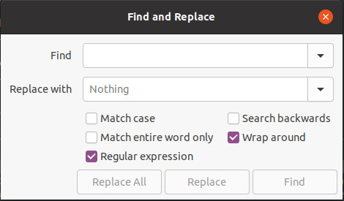
Regular Expressions (regex)
How much do you know about regular expressions a.k.a. regex?
- no idea?
- a vague idea?
- know what they are?
https://librarycarpentry.org/lc-data-intro/

Slide 3
Regular Expressions (regex)
A sequence of characters that define a pattern for matching strings (rather than only matching an exact string)
Used to match/find/replace patterns of text
Example use: find email addresses or phone numbers in text
Regular expressions can match a string of zero length or many lines of text
Used in programming languages, “find and replace” functionality in text editors, OpenRefine, Google Sheets, grep at the commandline etc.
https://librarycarpentry.org/lc-data-intro/

Slide 4
Regular Expressions (regex)
Match by types of characters (e.g. upper case letters, digits, spaces, etc.)
Match patterns that repeat any number of times
Capture the parts of the original string that match your pattern (can be used in replacement)
Consist of literal characters (“a” to match the letter “a”) and metacharacters (“.” to match a non-specific single character)
Backlash “\” is used to escape (make the literal character of a metacharacter)
- “\.” matches a period instead of any single character
https://librarycarpentry.org/lc-data-intro/

Slide 5
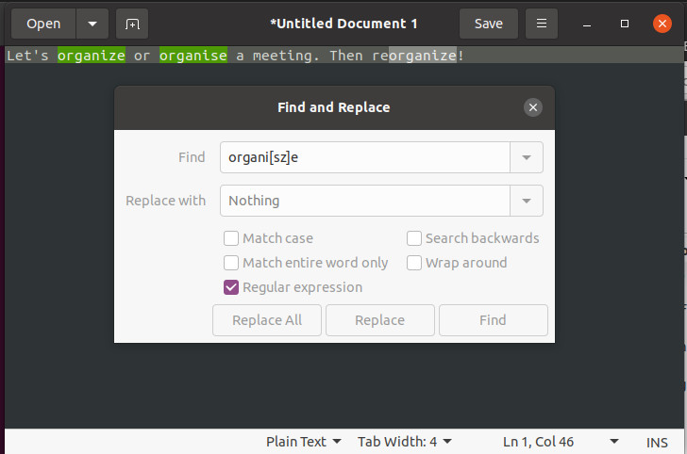
Regex use case
Find multiple spellings of same word:
organi[sz]e matches both organise and organize (even if part of the words reorganise, reorganize, organises, organizes, organised, organized, etc.)
https://librarycarpentry.org/lc-data-intro/

Slide 6
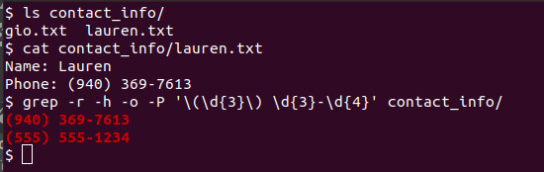
Regex use case
Pull all of the phone numbers out of a directory of files
grep is a commandline program for printing matches found in files
options used:
- r recursively search files in the directory
- h don’t print filenames before match
- o only print matching part of line
- P use Perl-compatible regex
https://librarycarpentry.org/lc-data-intro/

Slide 7
Regular Expression Syntax
Use literal characters to match exactly
- a matches “a”; 1 matches “1”; , matches “,”
. matches any single character
- .ow matches “tow”, “cow”, “low”
\ escapes the following special character
- \.com matches “.com”; .com matches “.com” or “bcom” or “4com” etc.
* matches the preceding element zero or more times
- ab*c matches “ac”, “abc”, “abbbc”
+ matches the preceding element one or more times
- ab+c matches “abc”, “abbbc” but not “ac”
? matches when the preceding character appears zero or one time
- cows? matches “cow” or “cows”
https://librarycarpentry.org/lc-data-intro/

Slide 8
Regex Syntax – specific count
{VALUE} matches the preceding character the number of times defined by VALUE
- a{5}bc matches “aaaaabc”
{VALUE,VALUE} matches the preceding character a number of times given in the range of values
- 0{1,9}33 matches between one and nine zeroes in length, i.e. “000033”
https://librarycarpentry.org/lc-data-intro/

Slide 9
Regex Syntax - Opposites
\d matches any single digit
- \d matches “9” or “0”
\D matches a non-digit (opposite of \d)
- \D matches “a” or “,”
\w matches any word character (equivalent to [A-Za-z0-9_])
- \w matches “A”, “8”, “_”
\W matches any non-word character (opposite of \w)
- \W matches “-” or “ “
\s matches any space, tab, or newline
- \s matches “ “
\S matches a character that is not a space, tab, nor newline (opposite of \s)
- \S matches “a”
https://librarycarpentry.org/lc-data-intro/

Slide 10
Regex Syntax - Positions
^ indicates a position at the start of the line. What you put after the caret only matches if it starts the line.
- ^the day matches “the day” but not “on the day”
$ indicates a position at the end of the line. What you put before it only matches if it ends the line.
- good luck$ matches “it’s good luck” but not “good luck you”
\b asserts the pattern matches at a word boundary. Putting this either side of an expression stops it matching longer variants of words.
- mark will match “mark”, “marking”, “market”, ”unremarkable”
- \bword matches “word”, “wordless”, and “wordlessly”
- comb\b matches “comb” and “honeycomb” but not “combine”
- \brespect\b will match respect but not respectable or disrespectful
https://librarycarpentry.org/lc-data-intro/

Slide 11
Regex Syntax - Brackets
Square brackets can be used to define a list or range of characters to be found
[ABC] matches A or B or C
[A-Z] matches any upper case letter
[A-Za-z] matches any upper or lower case letter
[A-Za-z0-9] matches any upper or lower case letter or any digit
https://librarycarpentry.org/lc-data-intro/

Slide 12
Regex Syntax - Misc
(...) matches the expression inside the parentheses, defining a group that can later be retrieved, such as for use with replacement, using a \number reference (backlash followed by group number)
- (\d{3}-){2}\d{4} matches “940-565-3000”
- ark:.67531.(metapth\d+) matches “ark:/67531/metapth213” creating a group that can be referenced by \1 which gives the value “metapth213”
| means or
- (help|youth)ful matches “helpful” or “youthful”
/i renders an expression case-insensitive (equivalent to [A-Za-z]), though this varies by implementation
https://librarycarpentry.org/lc-data-intro/

Slide 13
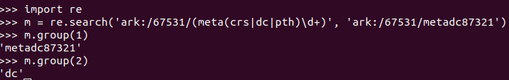
Regex in Python
https://librarycarpentry.org/lc-data-intro/

Slide 14
Regex Use Case
How do you see yourself using regular expressions?
https://librarycarpentry.org/lc-data-intro/

Slide 15
Regex in Practice
What will the regular expression ^[Oo]rgani.e\w* match?
https://librarycarpentry.org/lc-data-intro/

Slide 16
Regex in Practice
What will the regular expression ^[Oo]rgani.e\w* match?
organise
Organize
organifer
Organi2ed111
https://librarycarpentry.org/lc-data-intro/

Slide 17
Regex in Practice
What will the regular expression [Oo]rgani.e\w+$ match?
https://librarycarpentry.org/lc-data-intro/

Slide 18
Regex in Practice
What will the regular expression [Oo]rgani.e\w+$ match?
organiser
Organized
organifer
Organi2ed111
https://librarycarpentry.org/lc-data-intro/

Slide 19
Regex in Practice
What will the regular expression ^[Oo]rgani.e\w?$ match?
https://librarycarpentry.org/lc-data-intro/

Slide 20
Regex in Practice
What will the regular expression ^[Oo]rgani.e\w?$ match?
organise
Organized
organifer
Organi2ek
https://librarycarpentry.org/lc-data-intro/

Slide 21
Regex in Practice
What will the regular expression \b[Oo]rgani.e\w{2}\b match?
https://librarycarpentry.org/lc-data-intro/

Slide 22
Regex in Practice
What will the regular expression \b[Oo]rgani.e\w{2}\b match?
organisers
Organizers
organifers
Organi2ek1
https://librarycarpentry.org/lc-data-intro/

Slide 23
Regex in Practice
What will the regular expression
\b[Oo]rgani.e\b|\b[Oo]rgani.e\w{1}\b
match?
https://librarycarpentry.org/lc-data-intro/

Slide 24
Regex in Practice
What will the regular expression
\b[Oo]rgani.e\b|\b[Oo]rgani.e\w{1}\b
match?
organise
Organi1e
Organizer
organifed
https://librarycarpentry.org/lc-data-intro/

Slide 25
Regex in Practice
Let’s do the exercises at
https://ldko.github.io/lc-data-intro/04-exercises/index.html
https://librarycarpentry.org/lc-data-intro/

Slide 26
Regex in Practice
Regex in Google Sheets:
1. Export and unzip the 2017 Public Library Survey (https://github.com/LibraryCarpentry/lc-data-intro/blob/gh-pages/files/PLS_FY17.zip) as a CSV file.
2. Upload the CSV file to Google Sheets and open as a Google Sheet if it doesn’t do this by default.
3. Look in the ADDRESS column and notice that the values contain the latitude and longitude in parentheses after the library address.
4 . Construct a regular expression to match and extract the latitude and longitude into a new column named ‘LATLONG’. HINT: Look up the function REGEXEXTRACT in Google Sheets. That function expects the first argument to be a string (a cell in ADDRESS column) and a quoted regular expression in the second.
https://librarycarpentry.org/lc-data-intro/

