Slide 1
Data Axle
Overview
Processing and Storage

Slide 2


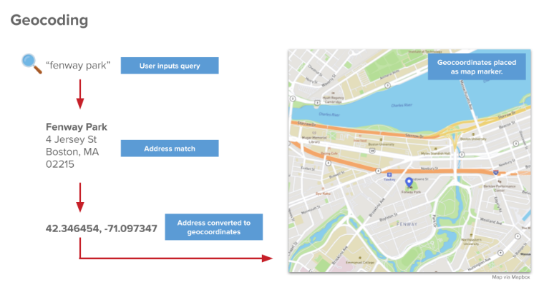
What is Data Axle?
Data Axle (formerly Reference USA) is a data source that contains information for over 61 U.S. business.
Businesses are organized by North American Industry Classification System (NAICS) and Standard Industrial Classification (SIC) codes
One primary NAICS code
One primary and five additional SIC codes
Codes are selected by businesses
Businesses have a unique identifier that can be traced over time (ABI)
Businesses are linked to address, latitude/longitude

Slide 3
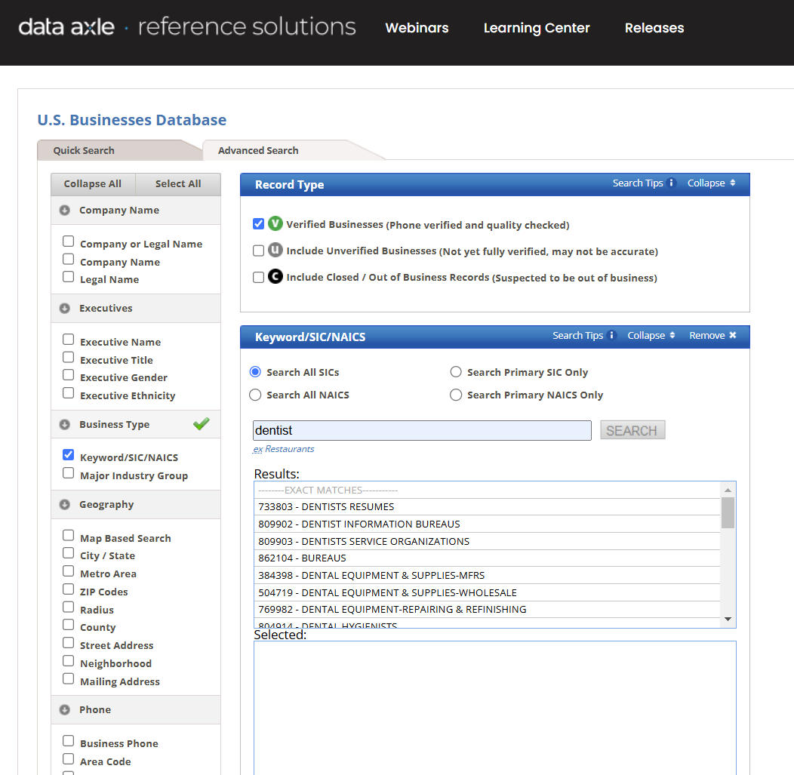
Who has access to these data?
Search tool available through BU Libraries
BEDAC owns flat files (1997-2026)
Files 2016-2022 are fully geocoded
Files 2024-2026 not yet available

Slide 4
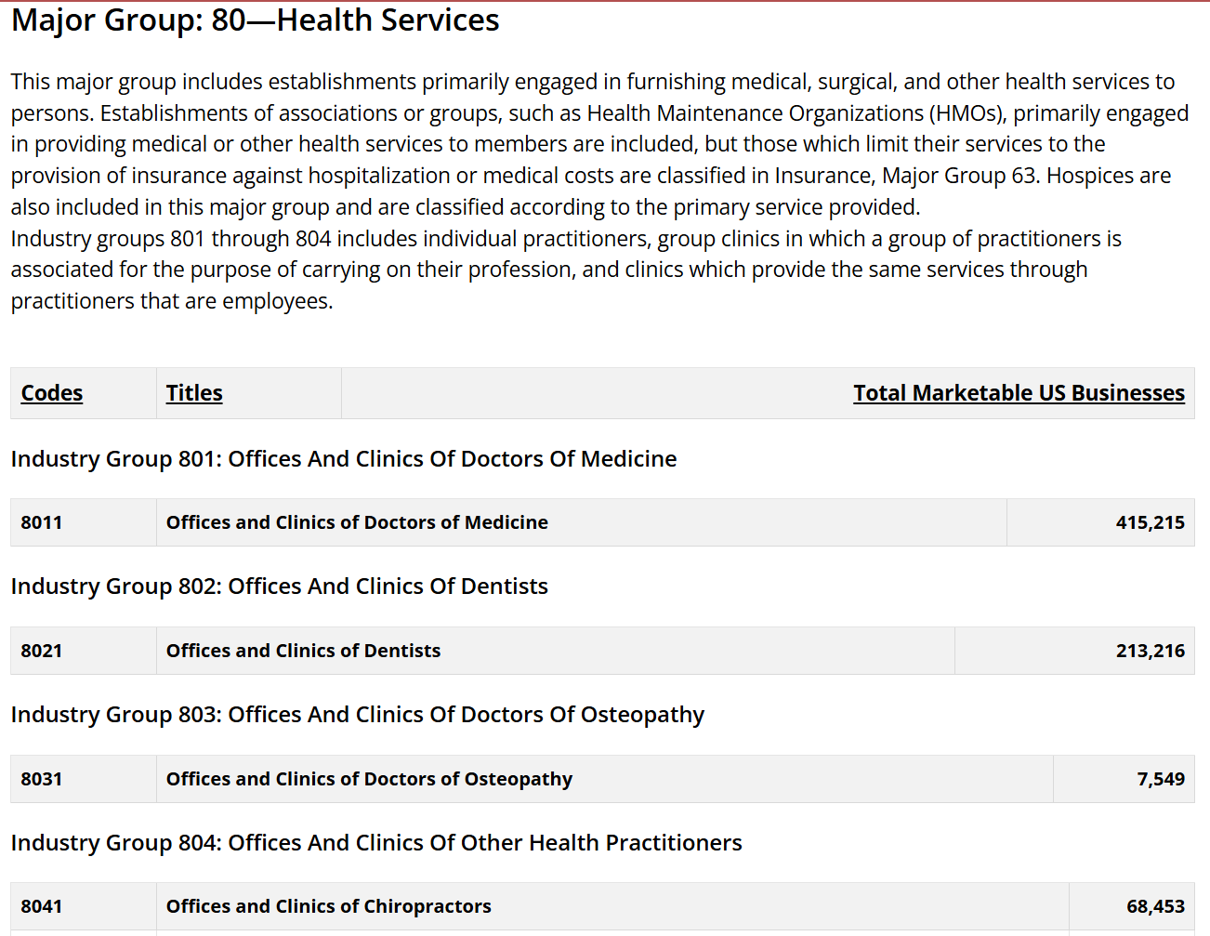
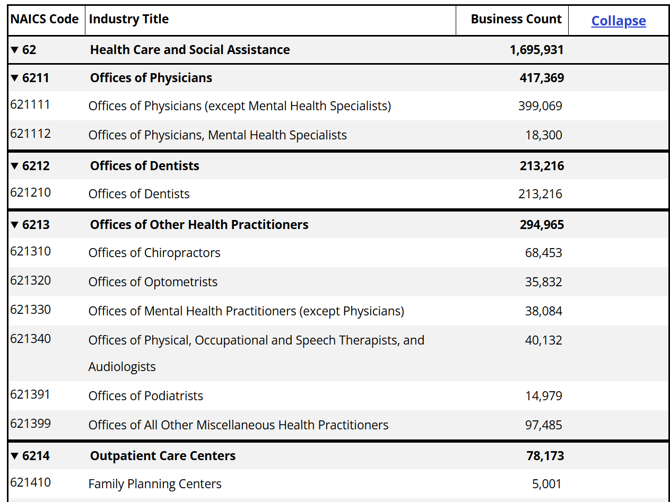
What are NAICS and SIC codes?
SIC codes (6 digits)
NAICS codes (up to 8 digits)
Specificity increases as you add digits.
Similar groups of industries are captured by both.

Slide 5
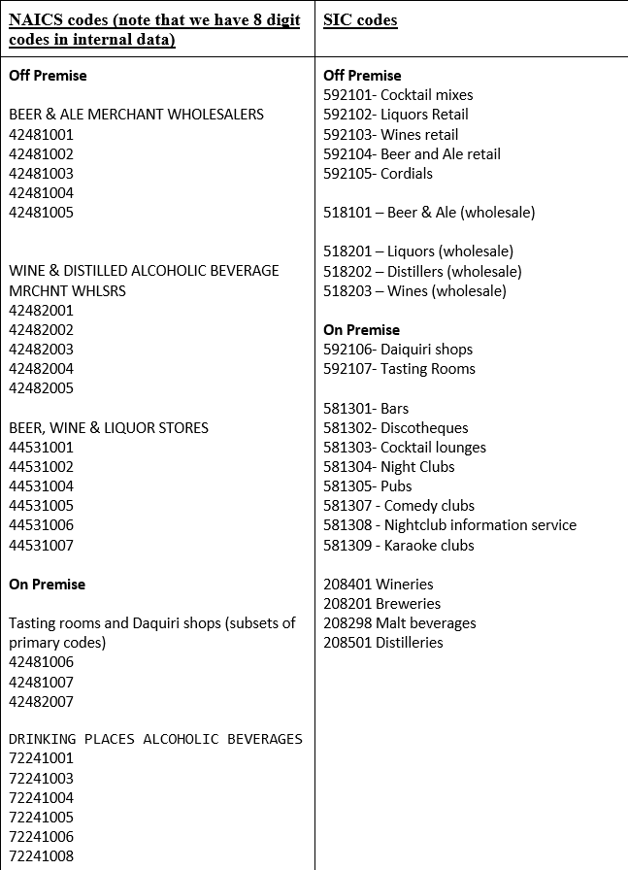
How do I pick the right NAICS/SIC codes?
Some pulls are minimally complicated
Dental offices:
SIC 802101 (dentists)
SIC 802103 (dental technicians)
NAICS 62121003 (dentists)
NAICS 62121002 (dental technicians)
62121001 (dental mechanics)
Some pulls require additional investigation and nuance (alcohol retailers – displayed on right)

Slide 6
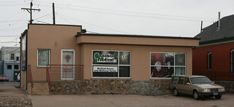
Exercise: Selecting NAICS/SIC codes
Using online resources (NAICS website, BU Libraries Data Axle), determine the feasibility of identifying cannabis retailers.
What codes did you end up selecting?
Are there gray areas? How might you handle these?
This Photo by Unknown Author is licensed under CC BY-SA

Slide 7
Where does BEDAC’s data live?
Location on SCC:
Project: /restricted/project/bedac-dataaxle
Files delivered annually from Data Axle
Stored here: /restricted/project/bedac-dataaxle/08Data/01External_Data
Dictionary in DCC folder:
"\\ad.bu.edu\bumcfiles\SPH\DCC\Dept\BEDAC_DataHub\05Data_Management\02Data_Definition\Historical Business Full File Layout 2020.xlsx"

Slide 8

Do we need to pre-process the data?
Data received from Data Axle sometimes have missing or incomplete geographic information.
To manage this, we need to bulk geocode using ArcGIS
Instructions for bulk geocoding here
We will discuss later!
Location of geocoded data: /restricted/project/bedac-dataaxle/08Data/01External_Data/Geocoded
We will pull from this folder

Slide 9
How do we pull information?
Two pathways for data collection
Extraction using NAICS/SIC code lists
A simpler system
Can subset on SIC/NAICS only
Extraction using a REDCap request system
Requires REDCap entry
Incorporates additional metadata in the request
We’ll use this for our example

Slide 10
Creating a pull using a set of NAICS/SIC lists
If you’re only pulling based on NAICS/SIC codes we pulled requests manually based on identified SIC/NAICS codes.
Data are stored in source-specific folders: /restricted/project/bedac-dataaxle/09Programming/01Dataset_Creation/02Data_Processing
Code files to review:
/restricted/project/bedac-dataaxle/09Programming/01Dataset_Creation/02Data_Processing/
Extract_TEMPLATE.R
You will modify this based on the SIC/NAICS codes requested
/restricted/project/bedac-dataaxle/09Programming/01Dataset_Creation/02Data_Processing/
Extract_TEMPLATE.sh
You will modify this to point toward your R extraction code
^We will walk through this together on the SCC

Slide 11

Extracting data using REDCap Request System
REDCap request system includes:
[NAICS code(s)]
[SIC code(s)]
[start_year]
[end_year]
Ability to add additional parameters to query where necessary. • [variable]/[values] (for as many additional variables as needed)
Request parameters stored: /restricted/project/bedac-dataaxle/08Data/01External_Data/request_forms
Code that formats requests, checks for duplicates, and pulls based on new criteria: /restricted/project/bedac-dataaxle/09Programming/01Dataset_Creation/02Data_Processing/REDCap_Request_System/QuerySystem.R
This code loads and uses R dependencies, located in the same folder.
We will walk through this together on the SCC
Notes:
We will walk through this code together

Slide 12

Do I have to clean the extracted data?
Once files are extracted, pull to the Y drive to clean:
Download here: \SPH\DCC\Dept\BEDAC_DataHub\08Data\02Raw_Data\06Reference_USA_BU
Clean programming: \SPH\DCC\Dept\BEDAC_DataHub\08Data\03Clean_Data\Reference_USA_BU
Clean output: \SPH\DCC\Dept\BEDAC_DataHub\09Programming\01Dataset_Creation\02Data_Processing\Reference_USA_BU
Data Axle business listings often contain mis-classified listings.
There is no automated way to complete this cleaning. Some tips:
Do not replicate last year’s cleaning code directly.
Manually tabulate, sort and check SIC/NAICS codes
Spot-check small locations (e.g. zip codes you can lookup or are familiar with).
Check business-specific cleaning instructions here.

Slide 13
What happens next?
We should end up with:
1 file per measure (e.g. dentists) per year
Each file contains one row per business
After the data are cleaned, the geospatial team will use these files to create access buffers.
You’ll learn more about this in the next set of tutorials…

