Slide 1
Data Axle
Overview
Processing and Storage

Slide 2


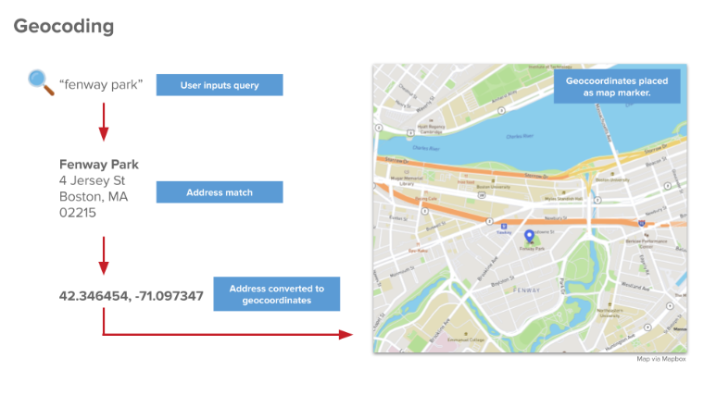
What is Data Axle?
Data Axle (formerly Reference USA) is a data source that contains information for over 61 U.S. business.
Businesses are organized by North American Industry Classification System (NAICS) and Standard Industrial Classification (SIC) codes
One primary NAICS code
One primary and five additional SIC codes
Codes are selected by businesses
Businesses have a unique identifier that can be traced over time (ABI)
Businesses are linked to address, latitude/longitude

Slide 3
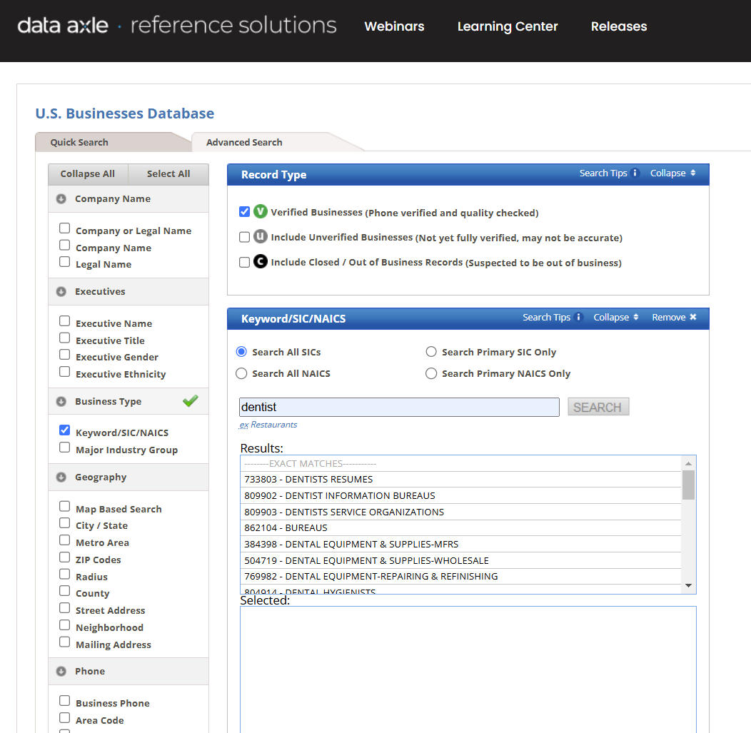
Who has access to these data?
Search tool available through BU Libraries
BEDAC owns flat files (1997-2026)

Slide 4
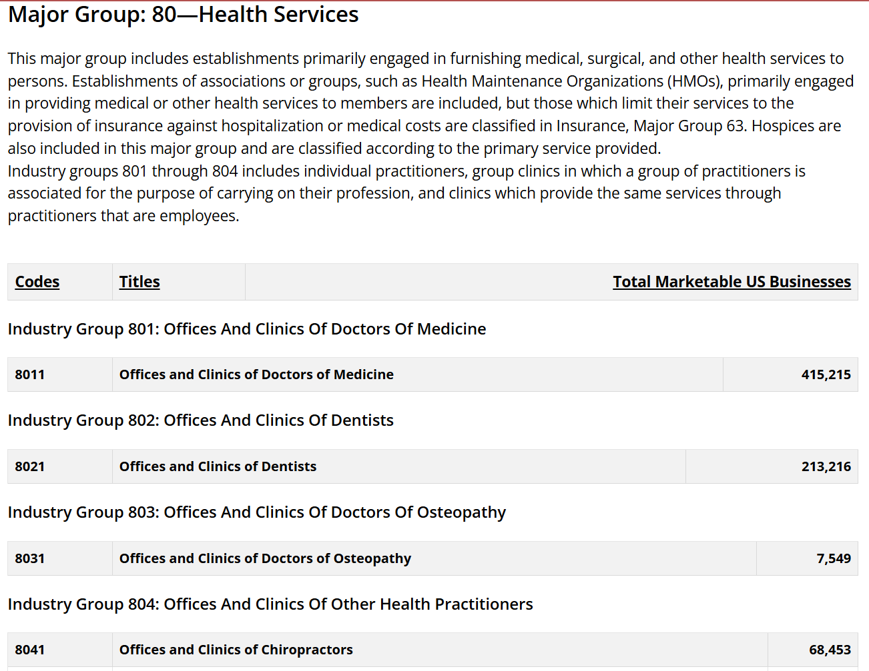
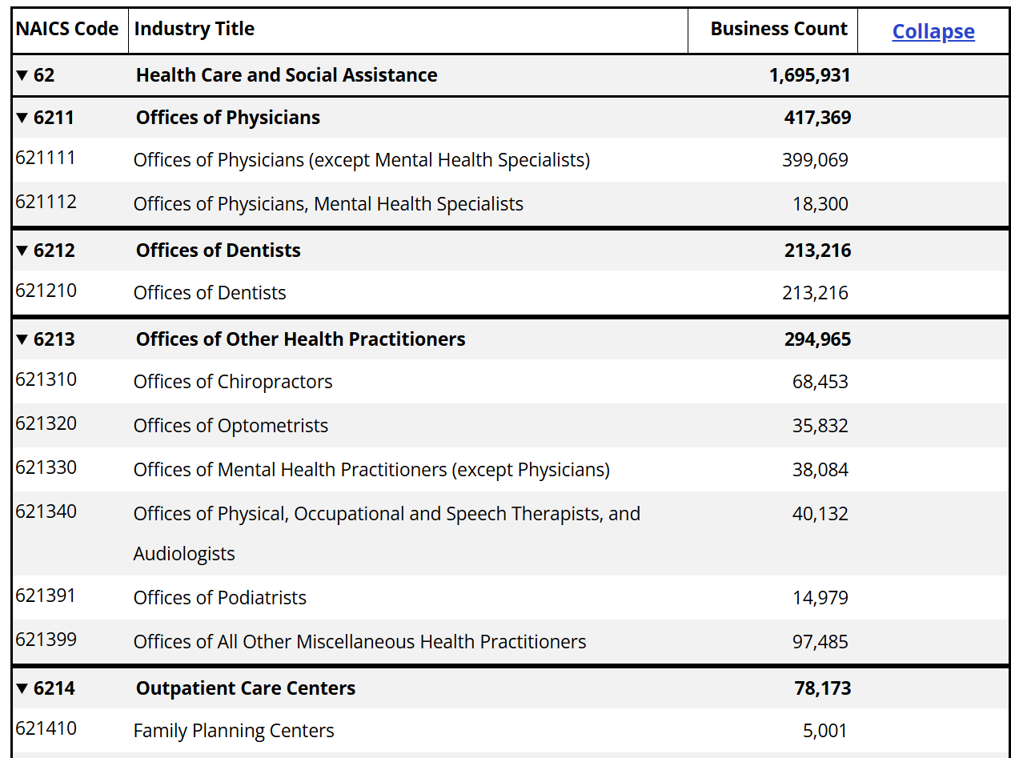
What are NAICS and SIC codes?
SIC codes (6 digits)
NAICS codes (up to 8 digits)
Specificity increases as you add digits.
Similar groups of industries are captured by both.

Slide 5
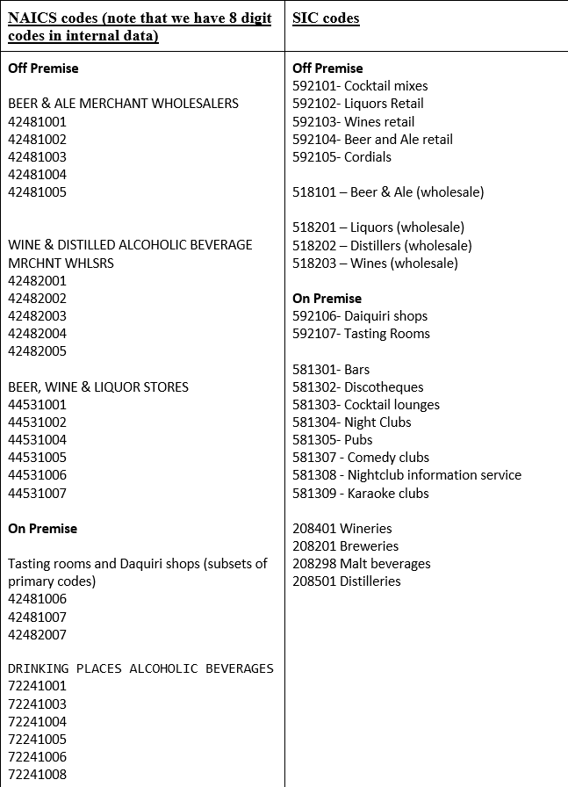
How do I pick the right NAICS/SIC codes?
Some pulls are minimally complicated
Dental offices:
SIC 802101 (dentists)
SIC 802103 (dental technicians)
NAICS 62121003 (dentists)
NAICS 62121002 (dental technicians)
62121001 (dental mechanics)
Some pulls require additional investigation and nuance (alcohol retailers – displayed on right)

Slide 6

Do we need to pre-process the data?
Data received from Data Axle sometimes have missing or incomplete geographic information.
To manage this, we bulk geocode using ArcGIS

Slide 7
How does BEDAC pull information?
Two pathways for data collection
Extraction using NAICS/SIC code lists
A simpler system
Can subset on SIC/NAICS only
Extraction using a REDCap request system
Requires REDCap entry
Incorporates additional metadata in the request

Slide 8
What happens next?
Each pull yields:
1 file per measure (e.g. dentists) per year
Each file contains one row per business
After the data are cleaned, the geospatial team will use these files to create access buffers.

