Slide 1
SHRI Locate
Chad Milando
6.21.2024

Slide 2
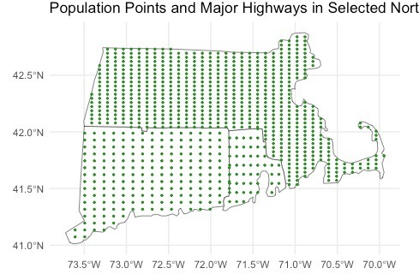
Estimate population location
* But this could also be house locations, or any way to make point estimates of population and related variables

Slide 3
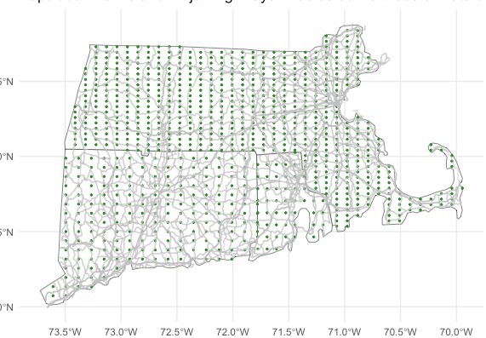
The road network determines potential locations for new or existing toilets

Slide 4
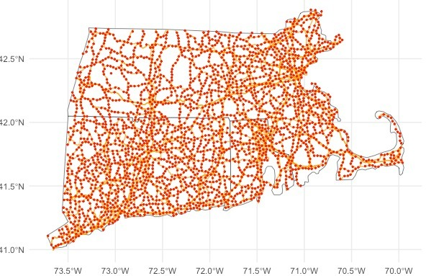
IF you are looking for new locations, you can space out potential locations every 20 miles or so, otherwise you can skip to this step if you are looking to prioritize existing sites.

Slide 5
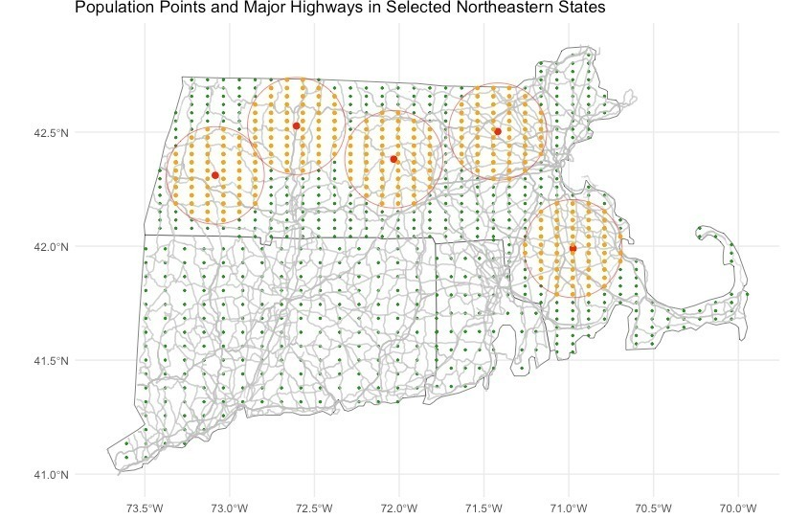
Then run a simulated annealing process to find the N=5 sites with the highest *SCORE, which is the sum of Weights * population data
(so b1 * z-population + b2 * metric1 + ….)

Slide 6
Next steps
Probably radius is not the best way to do this, likely you need the first step to be a network analysis like Keith did in his paper.
But for short distances this is probably fine.

