Slide 1


New User Bookings
Where will a new guest book their first travel experience?
W207 Final Project
2018 December 12th
Authors: Christian Millsop, Chris Ventura, Stanley Ye
Notes:
Hi Everyone, my name is Stanley Ye, and my teammates are Christian Millsop and Chris Ventura.
For our final project, we chose the Kaggle Competition: Airbnb New User Bookings.
---
10
[Citations]
(Pic) Travel Booking - https://www.google.com/imgres?imgurl=https%3A%2F%2Fownerupdate.bluegreenvacations.com%2Fwp-content%2Fuploads%2FTravel-booking-online-Time-to-Travel-OU2.jpg&imgrefurl=https%3A%2F%2Fownerupdate.bluegreenvacations.com%2Ftravel-services%2Fbook-cruises-hotels-flights-car-rentals-online&docid=jIpBCVuiLI-7rM&tbnid=IpG97NGEWwoU8M%3A&vet=10ahUKEwjL6LKi6pjfAhWO11QKHfQHBbgQMwhkKAowCg..i&w=1140&h=550&safe=off&bih=832&biw=1536&q=travel%20booking&ved=0ahUKEwjL6LKi6pjfAhWO11QKHfQHBbgQMwhkKAowCg&iact=mrc&uact=8

Slide 2
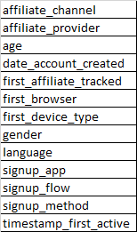



Aim
Goals:
Airbnb: Predict destination countries and send targeted content to reduce average time to first booking and forecast demand.
Us: Get acquainted with Kaggle and practice our ML techniques.
Research Question:
How does a user’s profile and online activity relate to the country of first booking?
Notes:
For the Aim, there are a couple goals to mention.
First, Airbnb’s goal was to anticipate travel destinations for new customers, so that they could send personalized content to encourage first time bookings.
[T] Second, our main objective was to become familiar with Kaggle and to practice our Machine Learning skillset.
[T] Our reseach question was to figure out the relationship between a user’s profile [T] and online activity [T] to their first booking destination [T].
---
28
[Citations]
(Pic) Travel directions - https://www.faminternational.com/wp-content/uploads/p_shop_country.jpg

Slide 3
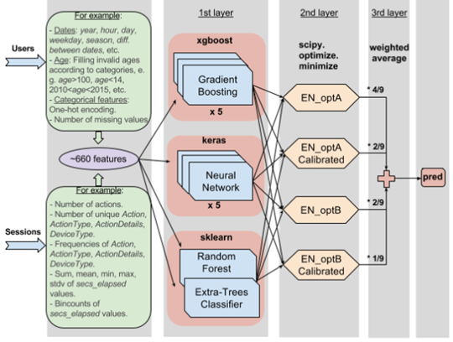
Background
Closed Competition → Insights from Top Finishers
Data Balancing
Unbalanced classes
Feature Engineering
Limited raw features
Classifiers
Ensemble Learning
3rd Place Winner
Notes:
Since this Kaggle competition has already concluded, we were able to learn from the insights shared by the top finishers.
[T] Here we have the flowchart of the 3rd place winner’s solution, which is representative of other Kaggle submissions that were publicly shared.
The typical components of Kaggle submissions include:
[T] Data Balancing, in order to address the unbalanced samples for each class.
[T] Feature engineering to expand on the dozen or so raw features.
[T] Selection of classifiers to best fit the given dataset.
[T] And, ensemble learning to combine the results of the different classiers.
Next, Christian will go over the methodology behind our project.
---
32
[Citations]
(Pic) 3rd Place Winner - http://blog.kaggle.com/2016/03/07/airbnb-new-user-bookings-winners-interview-3rd-place-sandro-vega-pons/

Slide 4
Methodology

Slide 5
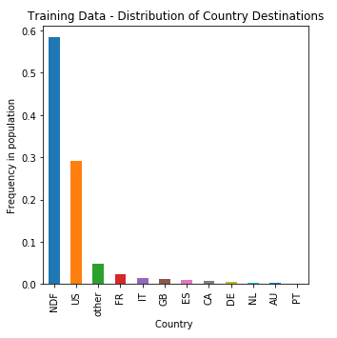
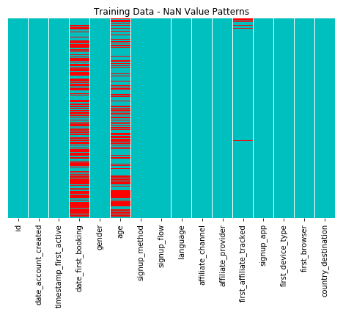
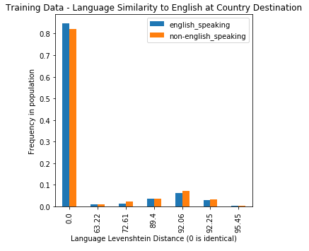
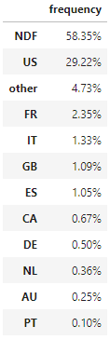
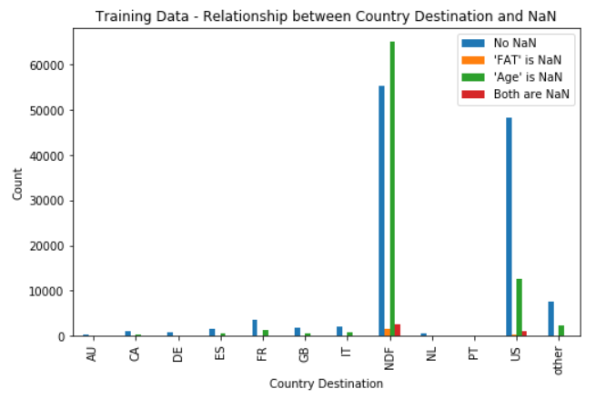
Methodology – EDA
Notes:
The first step is exploratory data analysis. The attribute that we are trying to predict is the country destination, so that seemed a good place to start.
[Transition]
We can see that the training data is heavily imbalanced. Most of the samples belong to this No Destination Found class, indicating that the user did not make a reservation. The second highest represented group is US, indicating that typical first-time users are domestic.
[Transition]
Sometimes looking for patterns of NaN values in a dataset can be insightful. In the training data set, we have many age and date_first_booking NaN’s and then a some in first_affiliate_tracked. We should ignore date_first_booking, since that actually comes with the country_destination, which is absent in the test set. Exploring the relationship between the two remaining NaN attributes to the outcome variable yields this:
[Transition]
The blue bars have no NaN samples. The green bar however, is when age is NaN. This condition is over-represented in the NDF group, so it will be a good feature to train on. We can’t really say anything about the first_affiliate_tracked attribute based upon this data though.
[Transition]
Moving on to the Country data set, this chart illustrates the language Levenshtein distance, which is the degree of similarity between two languages. A value of 0 in this data indicates that the language at the country destination is English.
The date_first_booking NaN samples are exclusively in the NDF class, which is reasonable since all of the bookings should have an associated date. This is an important feature to train on. The age variable though has NaN’s distributed throughout all of the classes.

Slide 6
Methodology – Model Generation
Preprocessing Pipeline
Data Selection
5%: Training
95%: Development
Imbalanced Classes
Over-sampling
Boosting
Weighting
Model Selection
Bernoulli Naïve Bayes
Logistic Regression
Random Forest
XGBoost
Voting Classifier Ensemble
Data Cleaning
Feature Engineering
One Hot Encoding
Notes:
Our model generation was divided into three main areas of concern.
[Transition]
The first of these is the pre-processing pipeline. Since we knew that we would be evaluating many models, it was important for us to standardize how data was processed. Light data cleaning was required, mostly in regards to handling NaN’s in the data. Feature engineering was applied to bucket the user age data and to transform dates into seasons. Since all of our data turned out to be categorical, we exclusively used One Hot Encoding to transform the categories to binomial True/False features.
[Transition]
Data selection turned out to be very challenging for this data set. We found that using 5% of the 213 thousand training samples yielded equivalent results to using 80 or 90%. We suspect that this is due to the there not being enough differentiation among features learned.
[Transition]
We evaluated three different methods to account for the imbalanced classes.
Over-sampling: We generated a more balanced training set by replicating instances of minority classes.
Boosting: We tried a classifier that specifically accommodate for imbalanced data by using ensembles of weak classifiers.
Weighting: We tried classifiers that weight the learned features by the class distribution.
[Transition]
Then for model selection, we used two general groups of classifiers. The first, Bernoulli Naïve Bayes and Logistic Regression were evaluated as a general baseline. The second group is more specifically targeted at working through the imbalanced data issue. XGBoost is a boosting algorithm that is similar to a random forest, however rather than growing Decision trees in parallel, XGBoost iteratively grows trees based upon the outcome of the prior tree. In the voting classifier ensemble, we combined all of the above classifiers into a single ensemble. The goal there was to see whether we could combine the strengths of the individual classifiers.

Slide 7
Results and Conclusion

Slide 8
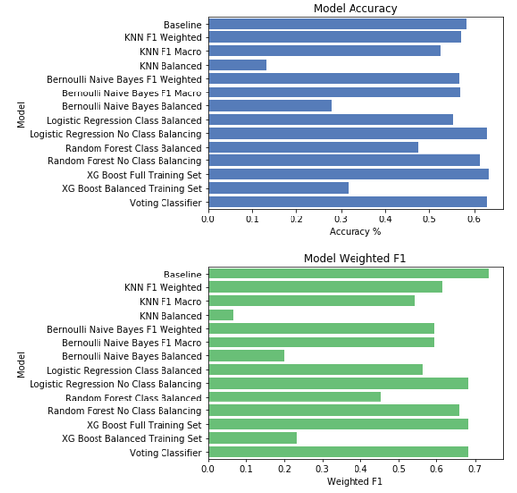
Results
Top Performers:
XGBoost
Logistic Regression
Voting Classifier
Key Themes:
Modest improvement over baseline
Attempts at class balancing proved futile
Notes:
As Christian just walked you through, we implemented a variety of models to try to predict destination countries. [As we stated earlier}, the classes we are trying to predict are heavily imbalanced, so most of our models were selected after reading literature on classifying imbalanced data, or models commonly used by the top competition performers.
On the right are two graphs showing accuracy scores and weighted F1 scores. For those that might not be familiar, weighted F1 scores are weighted averages of each class F1 score.
As a point of comparison, we also provide a baseline score, which is the accuracy and F1 if we simply defaulted all predictions to “NDF” - no destination found, the most common class.
What you’ll probably notice is that most of our model scores hover right around the baseline accuracy, with only a few doing better than the baseline.
Furthermore, the models where we attempted to apply class balancing, a technique to improve machine learning results for imbalanced classes, actually did worse. In fact, the more we attempted to correct for the class imbalance, the worse the models typically did. We will get to why in a second, but I also want to point out that the model that did the best overall was simply a regularized logistic regression.

Slide 9
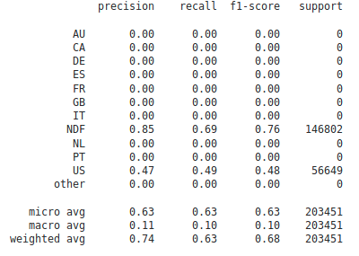
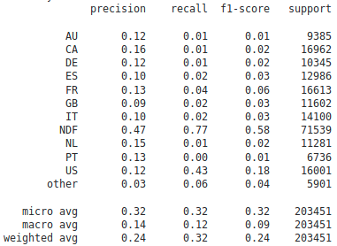
Results
XGBoost: No Class Balancing
XGBoost: Class Balancing
Notes:
As I mentioned before, we tried several techniques to account for the class imbalance, all of which had significant downside.
To illustrate this, I’ve provided the classification reports from our two XGBoost models. As you can see, the model on the left, our top performing model, simply predicts the top two classes of “NDF” and “US”.
The model on the right, which was trained after class balancing the data, returns much more frequent predictions for the uncommon classes, but at the cost of significantly reduced accuracy and weighted F1.
We believe this is because the uncommon classes don’t really look all that different from the common classes.
If you look at the data, there are very few records on destinations outside of the top two, and there are no clear delineation in the demographic data between users that chose those destinations and users that chose more common destinations (or no destinations). Therefore, the model is unlikely to predict those classes, and even if it does, unlikely to do so accurately.
This is further proven out by our voting classifier, which combines multiple models. This model combination did not improve accuracy over our XGBoost and Logistic Regression models, suggesting that the models were largely returning the same predictions, and thus learning the same patterns.

Slide 10
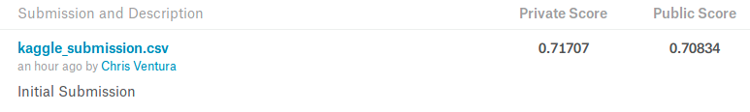
Conclusion
Modest improvement over baseline
Able to predict most common classes moderately accurately
Additional demographic and user activity data would help
Notes:
So I don’t mean to make it sound like our effort was a total failure! We actually were able to beat the baseline by five percentage points, and feel like we did quite well given the data that we had. While we focused on optimizing single predictions, the competition actually allows users to submit ranked predictions of up to five destinations, with penalties for each additional wrong submission.
See Kaggle submission output.
We were able to do ok at the submission, but didn’t focus on optimizing there like many of the other teams did - basically a trail and error approach while we focused on the upfront machine learning.
Ultimately, we think to radically improve the predictions would require additional demographic data or additional web sessions data. They provided borderline useless web sessions data from which you could really only derive quantity of activity. For example, it says “search” but not the actual search query. If we had information like that, as well as perhaps user location, we think we could easily improve our predictions. Otherwise we are mostly stuck with age, sex, signup method, etc.
That concludes our presentation, any questions?

