Slide 1

TIME SERIES IN FINANCE
The Barney Stinson’s 3 Day Rule
VICTOR ANTON
CHRIS IMHOLZ

Slide 2
Introduction
Timing is key in both love and stock trading.
Inspired by Barney Stinson’s 3-Day Rule (wait 3 days before calling a girl), we tested it on stocks to see if waiting after a market drop leads to a better decision.
We incorporated ARIMA forecasting to help predict stock movements.

Slide 3
Objectives
Identify Price Drops: Recognizing stock price drops of ≥ 5%.
3-Day Rule: Buy stock 3 days after a significant drop to mitigate immediate market reactions.
Evaluate Performance: Measure returns and Cumulative Returns.
Benchmark with Buy-and-Hold (SMI): Compare performance against a passive strategy holding SMI Index.

Slide 4


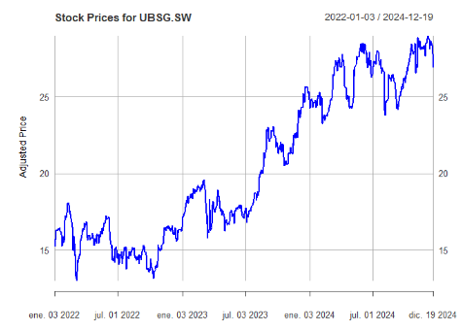
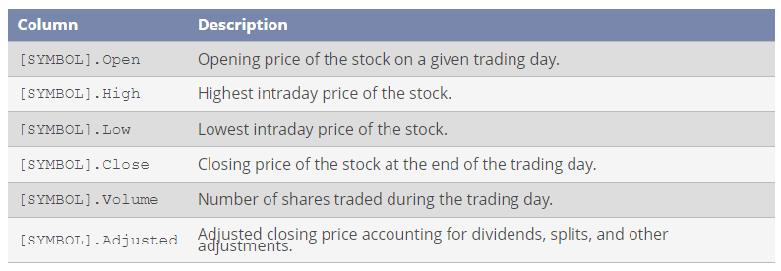
Starting Point

Slide 5

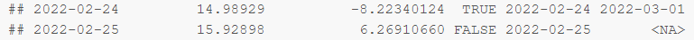
Implementation of the Strategy
Identification of Events: Significant events are identified as price changes of 5% or more in the adjusted closing price.
Stock Purchase: Stocks are purchased three trading days after a significant event to mitigate overreaction.
Holding Period: The stocks are held for 30 trading days, allowing for potential recovery.

Slide 6
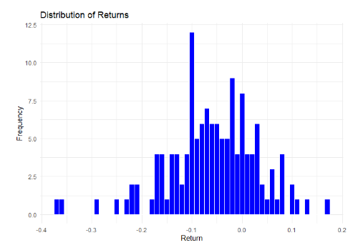
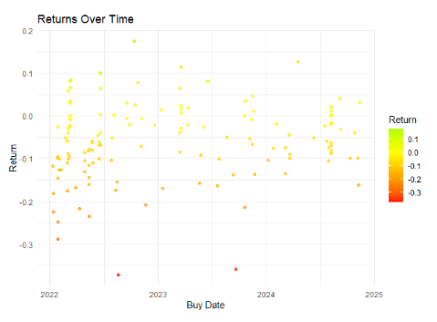
Strategy Performance I

Slide 7
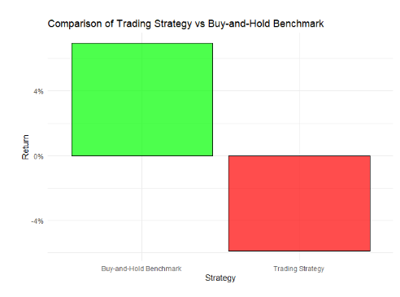
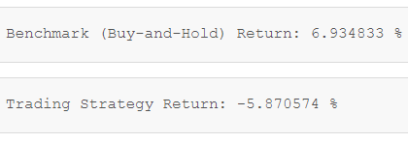
Strategy Performance II

Slide 8
Re-Implementation of the Strategy - ARIMA
Identification of Events: Significant events are identified as price changes of 5% or more in the adjusted closing price.
ARIMA is used to predict stock price movements following an event. A Buy Decision is made if the model predicts a 0.05-1% increase in stock price within a given period (typically post-event recovery).
Stock Purchase: Stocks are purchased 3 trading days after a significant price drop, only if ARIMA's Buy Decision is TRUE.
Holding Period: The stocks are held for 30 trading days, allowing for potential recovery.

Slide 9
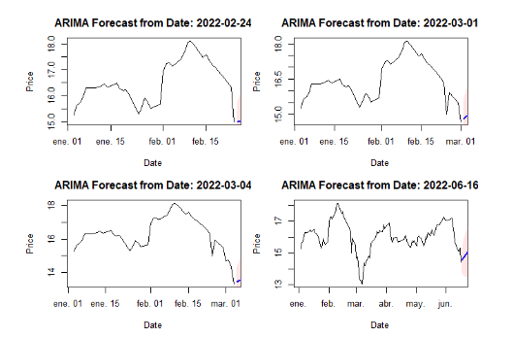
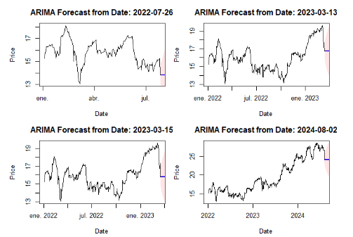
ARIMA Forecast on 5% drops

Slide 10
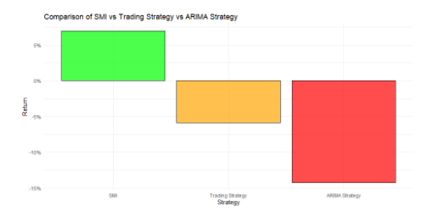
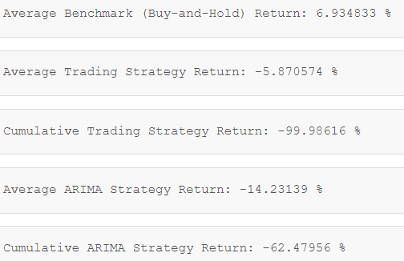
Strategy Performance

Slide 11
Conclusion
SMI (Buy-and-Hold) Strategy outperformed active strategies, highlighting the value of long-term, passive investing.
Trading Strategy and ARIMA Model both struggled with negative returns, showing that short-term, reactive strategies might fail to capture market trends effectively.
ARIMA Model lacked the predictive accuracy needed for consistent profitability, suggesting the need for better models.
Barney’s 3-Day Rule, although fun, requires adjustments in trading strategies, and longer-term decision-making is often more effective in stock trading.

Slide 12

THANK YOU!
Q&A

