Slide 1
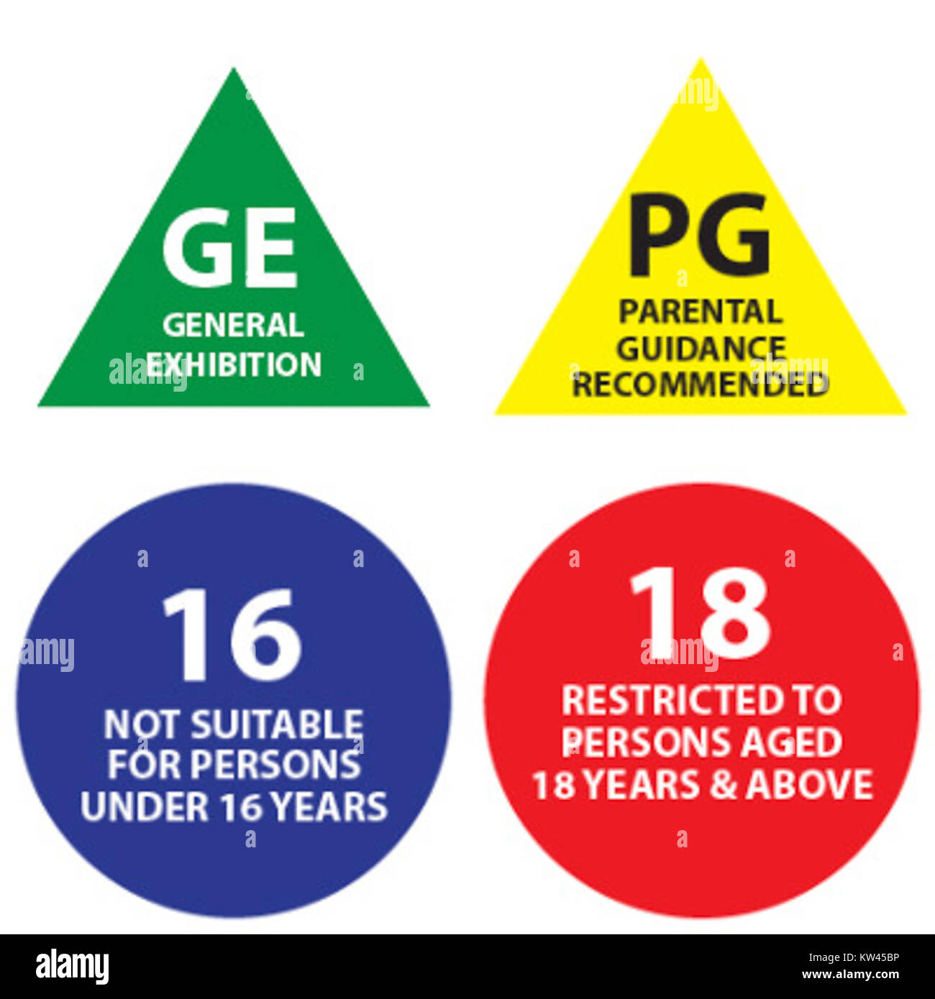
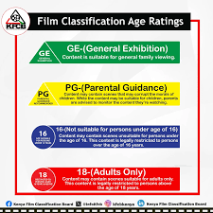
Automating Classification of Audio-Visual Content and Rating for Regulation and Personal Use
DSC-PT-10
Authors:
Gibson Ngetich
Cindy Minyade
Ayaya Vincent
Maryan Daud
Edwin Korir
Margaret Njoroge
July 25th, 2025

Slide 2
PROJECT OVERVIEW
Develop a machine learning model to automate film classification based on genre, synopsis, platform, and other metadata.
Enhance regulatory efficiency by providing intelligent rating suggestions aligned with Kenya’s classification guidelines.
Support parental control tools and age-based content filtering for safer content consumption.
Promote discoverability and categorization of local content to increase visibility of Kenyan productions.

Slide 3
Objectives
This project is aimed at assisting the regulator in automating the classification of audiovisual content in Kenya.
Automate film classification using machine learning to predict appropriate age ratings.
Improve regulatory efficiency by providing AI-based rating suggestions.
Support parental controls through age-based content filtering tools.
Promote and recommend local content through enhanced categorization and discoverability.

Slide 4
DATA USED
The data used for this project was collected by the Kenya Film Classification Board (KFCB) between July 2022 and June 2025.
It was sourced from official classification records containing film metadata and regulatory decisions across different platforms (cinema, TV, online streaming). For purposes of this study, the data was consolidated and structured as follows:
A unified dataset comprising 2,574 film records with 15 key attributes, including film title, genre, classification, synopsis, rating, and origin. The data was cleaned and standardized to support analysis of content patterns, classification trends, and audience suitability.

Slide 5
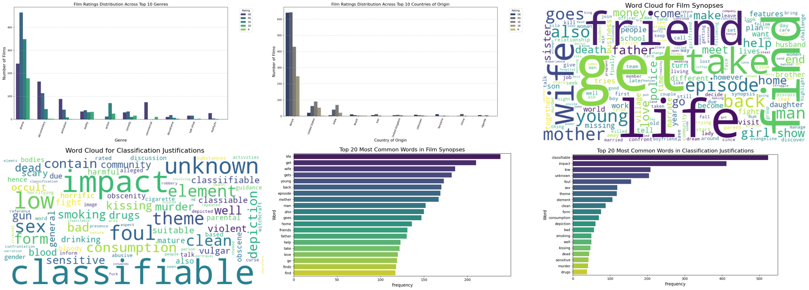
EDA Summary

Slide 6
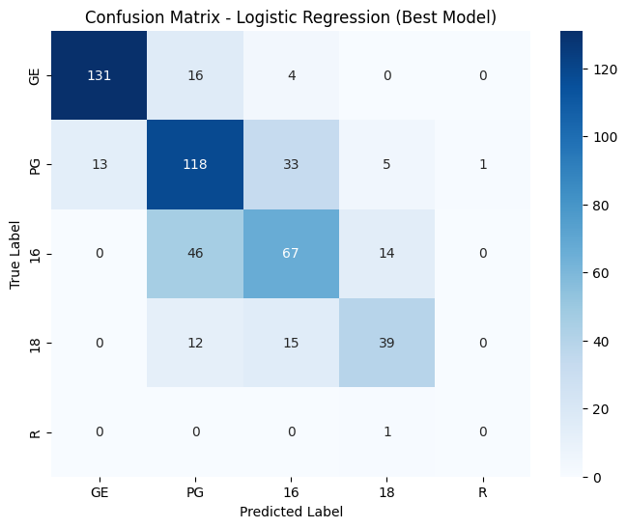
MODELLING
Logistic Regression Model(Baseline)
1. Logistic Regression
- Best Parameters: `C=1`, `solver='lbfgs’`
- Accuracy: 0.69
- Best F1-Weighted Score (CV): 0.69
- Notes: Serves as a solid baseline with decent precision for 'GE' and 'PG' classes. Underperforms for rare classes like 'R'.
The model performs well in predicting GE ratings, with minimal misclassifications. However, PG, 16, and 18 show significant overlap many PG films are misclassified as 16, and vice versa suggesting feature similarity in borderline content. The model struggles to correctly classify Restricted films due to the very limited training data in that class. Improving class balance and incorporating more discriminative features could enhance overall rating accuracy.

Slide 7
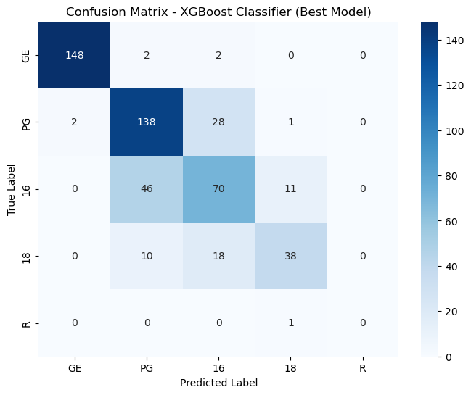
MODELLING
XGBoost Classifier
Best Model
XGBoost Classifier
- Accuracy: 77.48%
- F1-Weighted Score (Cross-Validation): 0.76
- Excellent balance between performance and interpretability
- Robust against overfitting and handles both categorical and numerical features effectively
High True Positives across major classes like "PG" and "GE", indicating strong classification performance on the most frequent categories.
- Misclassifications are more common between similar or adjacent rating classes (e.g., "16" misclassified as "18"), suggesting overlap in content characteristics.
- The "R" and "18" classes, which are less represented, show slightly lower recall—typical in imbalanced datasets.

Slide 8
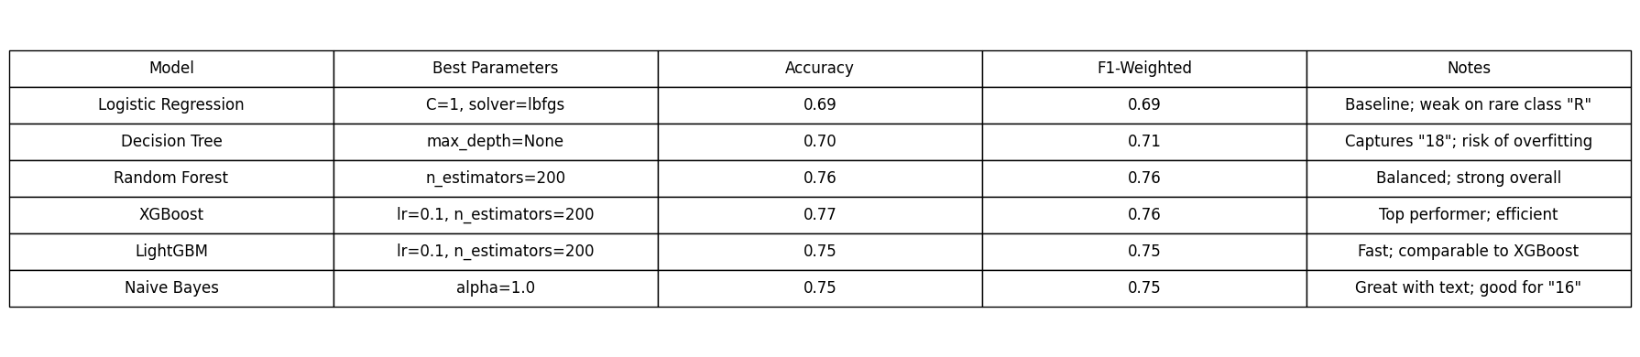
MODEL EVALUATION SUMMARY
MODELS EVALUATION TABLE

Slide 9
CONCLUSION
Successfully built a machine learning model to classify films based on age-appropriateness using KFCB guidelines.
XG Boost classifier performed best (Accuracy: 77.48%, F1: 0.772).
Text features like synopses and justifications were key in improving prediction.
EDA revealed rating patterns across genres, platforms, and countries.
The solution supports regulators, parents, and content platforms in faster, scalable, and objective classification.

Slide 10
Project Challenges
Missing Data: Key columns like VENUE and CONTACT had many null values.
Data Cleaning: Inconsistent formats in fields like DURATION(MINS) required extensive preprocessing.
Class Imbalance: Rare ratings like 'R' had very few samples, hurting model recall.
Similar Class Overlap: Models confused PG, 16, and 18 due to feature similarity.
Text Feature Complexity: High-dimensional TF-IDF features from SYNOPSIS increased model complexity.
Evaluation Limitation: Low support for rare classes affected confusion matrix reliability.

Slide 11
RECOMMENDATIONS
Use the ML model as a pre-screening tool for faster content review.
Integrate API with KFCB or streaming platforms for real-time classification.
Switch to transformer models (e.g., BERT) for better text analysis.
Apply SMOTE or class weighting to handle rating imbalance.
Add human-in-the-loop feedback to improve accuracy over time.
Build a parental control app to help filter content by rating.
Include image/audio features for richer content classification.
Perform regular audits to detect and correct model bias.

Slide 13

🙏 Thank You
Thank you for your time and attention. We appreciate your support and interest in our project.
— The Team
🙏 Thank You
We sincerely appreciate your time and attention.
Thank you for engaging with our project on Automating the Classification of Audio-Visual Content. We hope our work contributes to safer, smarter, and more efficient content regulation in the digital age.
— The Data Science Team Gibson Ngetich · Cindy Minyade · Ayaya Vincent · Maryan Daud · Edwin Korir · Sarah Njoroge

