Slide 1

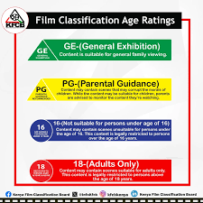
Automating Classification of Audio-Visual Content and Rating for Regulation and Personal Use
DSC-PT-10
Authors:
July 25th, 2025
Classifiable Elements
Age Appropriateness
Gibson Ngetich
Horror
16
Cindy Minyade
Ayaya Vincent
GE
Ohc
Maryan Daud
Rating
Consumer Advisory Index
Edwin Korir
Margaret Njoroge

Slide 2


PROJECT OVERVIEW
The project builds a machine learning and natural language processing pipeline to automatically classify audiovisual content and predict its rating based on the official rating (GE, PG, 16, 18, Restricted) in Kenya. It aims to support regulatory bodies, parents, educators, and streaming platforms by enhancing the speed, accuracy, and scalability of content classification.

Slide 3


PROBLEM STATEMENT
As digital content explodes across platforms like YouTube, TikTok, and local streaming services, the manual task of classifying each piece of content for age-appropriateness becomes impractical.
This poses a challenge for the regulator to serve clients by setting standards.

Slide 4
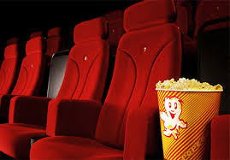
OBJECTIVES
Automate film classification using machine learning to predict appropriate age ratings
Improve regulatory efficiency by providing AI-based rating suggestions
Support parental controls through age-based content filtering tools.
Promote and recommend local content through enhanced categorization and discoverability.

Slide 5

DATA USED
From the country’s regulator
FY 2022/2023 to FY 2024/2025
Three(3) years data
Film title
Genre
Classification
Synopsis
Rating, and
Country of origin
Film classification data
From Which Period?
Composition of the Data
2,574 Film Records
15 key Attributes
Data was cleaned and standardized

Slide 6
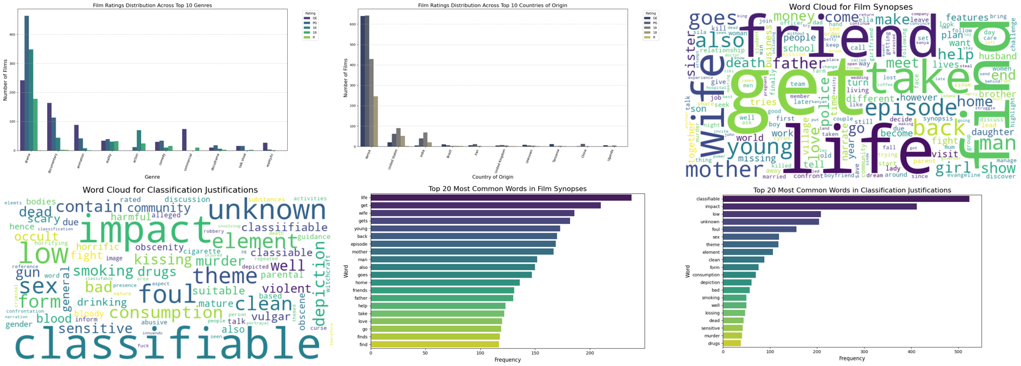
EDA Summary

Slide 7
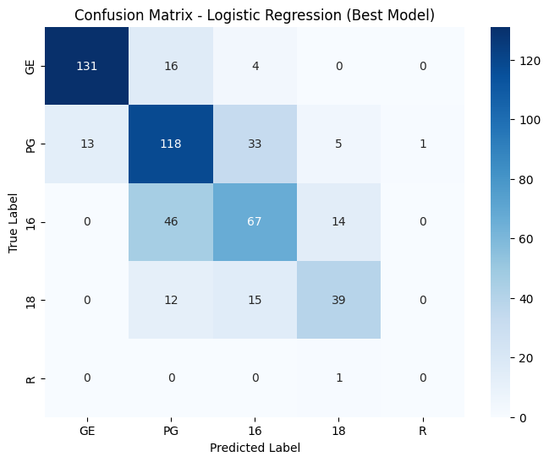
MODELLING
Logistic Regression Model(Baseline)
1. Logistic Regression
- Best Parameters: `C=1`, `solver='lbfgs’`
- Accuracy: 0.69
- Best F1-Weighted Score (CV): 0.69
- Notes: Serves as a solid baseline with decent precision for 'GE' and 'PG' classes. Underperforms for rare classes like 'R'.
The model performs well in predicting GE ratings, with minimal misclassifications. However, PG, 16, and 18 show significant overlap many PG films are misclassified as 16, and vice versa suggesting feature similarity in borderline content. The model struggles to correctly classify Restricted films due to the very limited training data in that class. Improving class balance and incorporating more discriminative features could enhance overall rating accuracy.

Slide 8
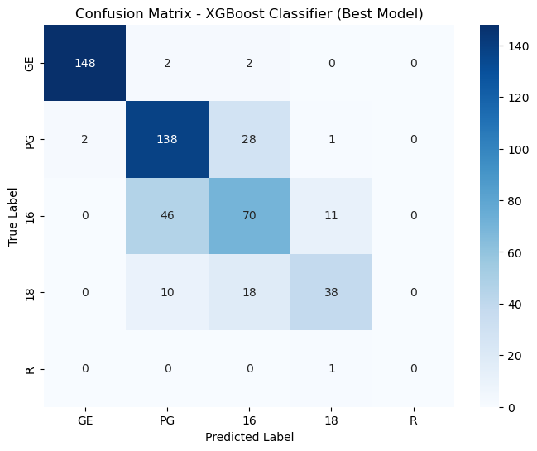
MODELLING
Best Model : XGBoost Classifier
XGBoost Classifier
- Accuracy: 0.77
- F1-Weighted Score (Cross-Validation): 0.76
- Excellent balance between performance and interpretability
- Robust against overfitting and handles both categorical and numerical features effectively
High True Positives across major classes like "PG" and "GE", indicating strong classification performance on the most frequent categories.
- Misclassifications are more common between similar or adjacent rating classes (e.g., "16" misclassified as "18"), suggesting overlap in content characteristics.
- The "R" and "18" classes, which are less represented, show slightly lower recall , typical in imbalanced datasets.

Slide 9
MODEL EVALUATION SUMMARY
Model | Best Parameters | Accuracy | F1-Weighted | Notes
Logistic Regression | C=1, solver=lbfgs | 0.69 | 0.69 | Baseline; weak on rare class "R"
Decision Tree | max_depth=None | 0.70 | 0.71 | Captures "18"; risk of overfitting
Random Forest | n_estimators=200 | 0.76 | 0.76 | Balanced; strong overall
XGBoost | lr=0.1, n_estimators=200 | 0.77 | 0.76 | Top performer; efficient
LightGBM | lr=0.1, n_estimators=200 | 0.75 | 0.75 | Fast; comparable to XGBoost
Naive Bayes | alpha=1.0 | 0.75 | 0.75 | Great with text; good for "16"

Slide 10
CONCLUSION
1.
Built a machine learning model to classify films based on age-appropriateness using the regulators' guidelines
2.
XGBoost classifier performed best (Accuracy: 0.77, F1: 0.76).
3.
Text features like synopses and justifications were key in improving prediction.

Slide 11
CONCLUSION
4.
BEDA revealed rating patterns across genres, platforms, and countries
5.
The solution supports regulators, parents, and content platforms in faster, scalable, and objective classification.
6.
The solution can assist the regulator on time taken to classify content.

Slide 12
Project Challenges
Missing Data: Key columns like VENUE and CONTACT had many null values.
Data Cleaning: Inconsistent formats in fields like DURATION(MINS) required extensive preprocessing
Class Imbalance: Rare ratings like 'R' had very few samples, hurting model recall.
Similar Class Overlap: Models confused PG, 16, and 18 due to feature similarity.
Text Feature Complexity: High-dimensional TF-IDF features from SYNOPSIS increased model complexity.
Evaluation Limitation: Low support for rare classes affected confusion matrix reliability

Slide 13
RECOMMENDATIONS
Use the ML model as a pre-screening tool for faster content review
Integrate API with the regulator or streaming platforms for real-time classification.
Switch to transformer models (e.g., BERT) for better text analysis.

Slide 14
RECOMMENDATIONS
Apply SMOTE or class weighting to handle rating imbalance.
Add human-in-the-loop feedback to improve accuracy over time.
Build a parental control app to help filter content by rating.

Slide 15
RECOMMENDATIONS
Include image/audio features for richer content classification.
Perform regular audits to detect and correct model bias.

Slide 16

NEXT STEPS
Advanced NLP: Use BERT/RoBERTa for better text understanding
Multimodal: Add image/audio features
API & Dashboard: Deploy for real-time use
Bias Audit: Fix class imbalance, monitor fairness
Human Feedback: Improve model via user input
Scaling: Localize for other countries/languages

Slide 17

🙏 Thank You
Thank you for your time and attention. We appreciate your support and interest in our project.
— The Team
🙏 Thank You
We sincerely appreciate your time and attention.
Thank you for engaging with our project on Automating the Classification of Audio-Visual Content. We hope our work contributes to safer, smarter, and more efficient content regulation in the digital age.
— The Data Science Team Gibson Ngetich · Cindy Minyade · Ayaya Vincent · Maryan Daud · Edwin Korir · Sarah Njoroge

