Slide 1
Presidential Topics over Time
A topical analysis visualization tool for time-sensitive inquiries
By Chetan Mishra

Slide 2
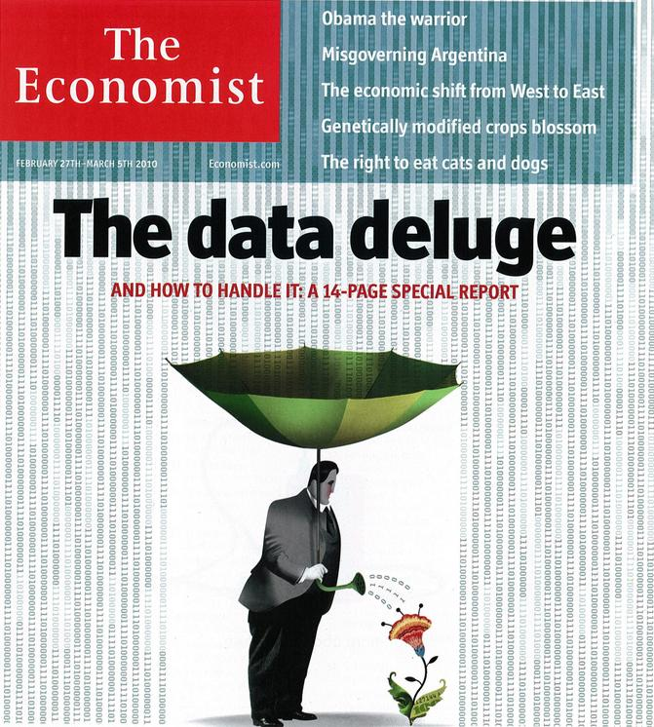
The Problem: there’s too much data
Our society today stores nearly everything written on a digital device (Facebook posts, tweets, emails)
Unstructured data specifically is exploding (most common on the internet). Chief on this list is text.

Slide 3
The Problem: old tools don’t work (especially in the humanities)
Studies of text are traditionally done slowly or by sampling (read the most promising 5%)
This in becoming less feasible. With exponentially growing data, the time required to comb through everything will also grow exponentially. Sampling will decrease in power (as 5% shrinks to 0.5% and 0.05%)
Solution: To answer humanities questions with statistical methods/tools

Slide 4
A question: Was the Afghan War ‘forgotten’?
Many commented on how the Afghan war was ignored in the media 2004-2008
Did this happen when it came to presidential attention? Let’s test the following statement:
There is no evidence to suggest that increasing presidential attention to Iraq during the height of the conflict in that country (2004-2008) traded off with presidential attention upon the Afghanistan during the ongoing Afghan war.

Slide 5
The Data: Public Papers of the Presidents (Bush & Clinton)
The Public Papers of the President contain the speeches, and press interactions of US Presidents and the dates of those interactions
Data was
tokenized (content transformed into arrays of words)
Normalized (lowercased, punctuation removed)
Filtered for stopwords (like ‘a’, ‘the’, ‘like’)

Slide 6
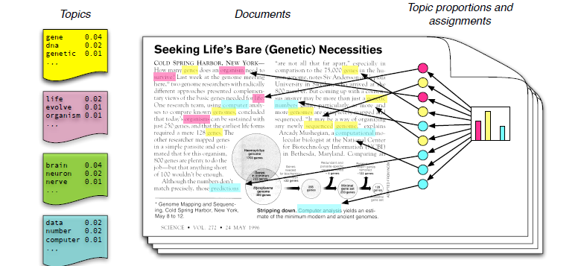
The Statistical Method: Latent Dirichlet Allocation (picture)

Slide 7
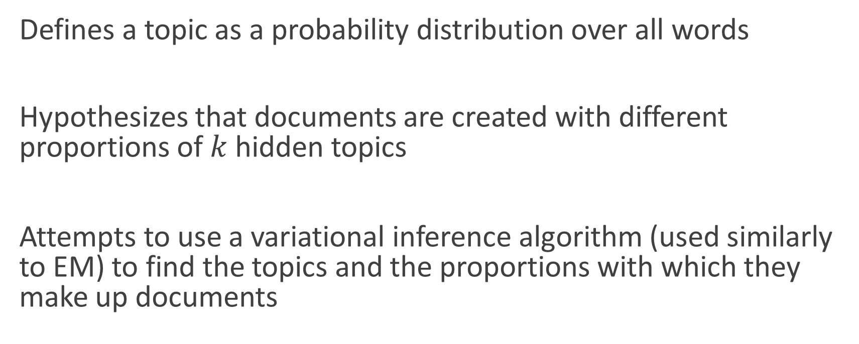
The Statistical Method: Latent Dirichlet Allocation (theory)
Defines a topic as a probability distribution over all words
Hypothesizes that documents are created with different proportions of $k$ hidden topics
Attempts to use a variational inference algorithm (used similarly to EM) to find the topics and the proportions with which they make up documents

Slide 8

Fitting an LDA model
Lots of parameters to vary, we’ll focus on 2: $α, k$
$k$ is the number of topics
$α$ is the initial value of the Dirichlet parameter

Slide 9
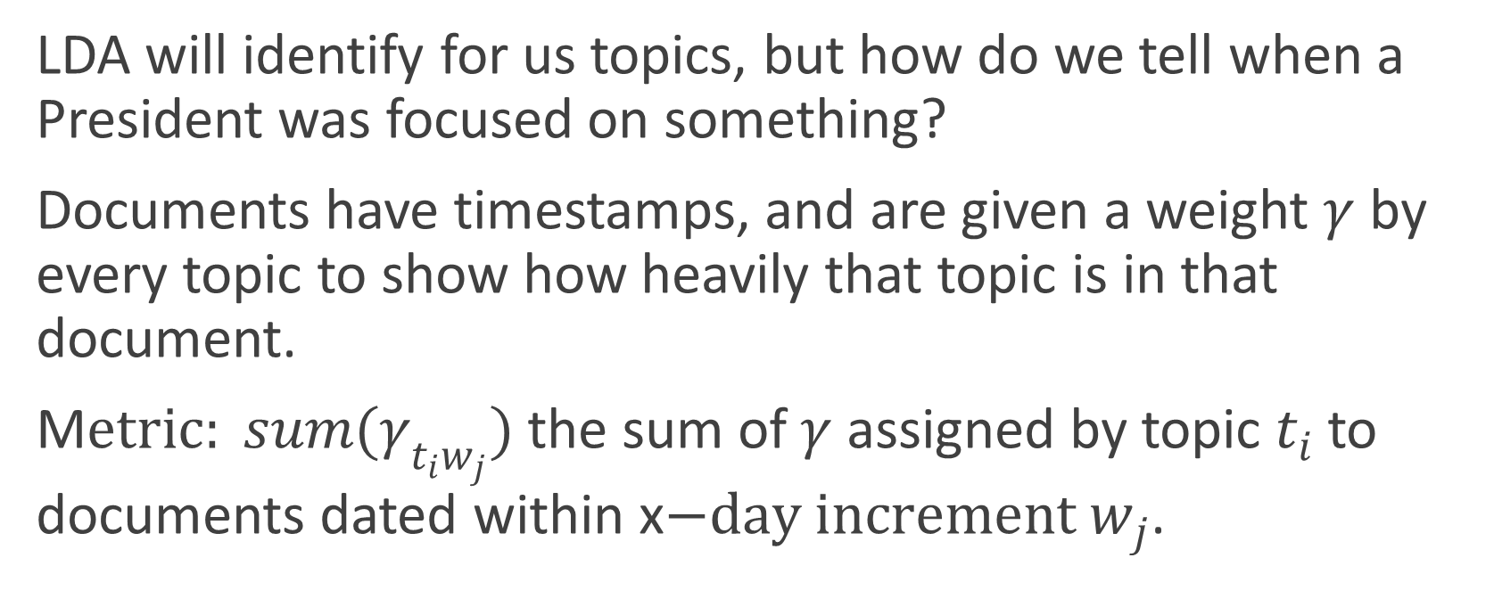
The Tool: A tool to show topics rise/fall
LDA will identify for us topics, but how do we tell when a President was focused on something?
Documents have timestamps, and are given a weight $γ$ by every topic to show how heavily that topic is in that document.
M$etric: sum(γ_{t_{i}w_{j}})$ the sum of $γ$assigned by topic $t_{i}$ to documents dated within x$−day increment w_{j}$.

Slide 10

Answer to the question: Was the Afghan War ‘forgotten’?
cmishra.shinyapps.io/visualization

Slide 11
A tool mostly designed to show a strategy
Does this tool solve all the problems highlighted initially? Of course not.
It shows a strategy to solve it in nearly every domain and successfully implements this strategy with regards to a specific class of hypothesis

Slide 12
Future Work
Experience – “the thing you get after you most needed it”
Use Hierarchical Latent Dirichlet Allocation(so you can ‘zoom in’ and ‘zoom out’ of topics)
Plot with tweets at @TheWhiteHouse to see correlation between public and administration
Automated google search when you click on a topic model’s line (restricted to news from that specific week)
Automated content printing when a topic model’s line is clicked (to explore ‘why’ a peak occurs more easily)

Slide 13

Questions?

Slide 14
References

