Slide 1
Book1
File created on: 10/22/19 4:34:56 PM MDT

Slide 2
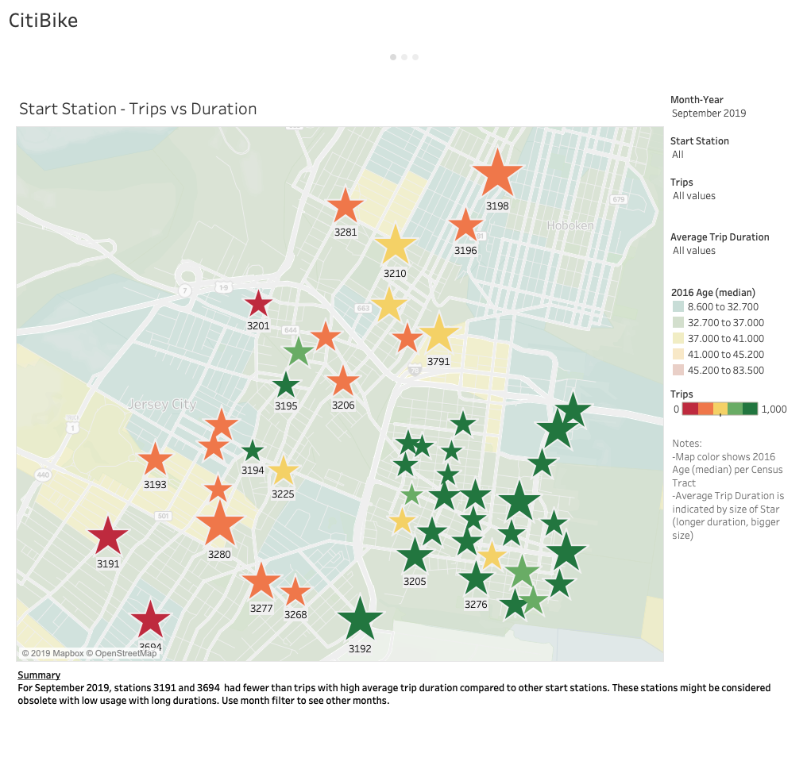

Slide 3
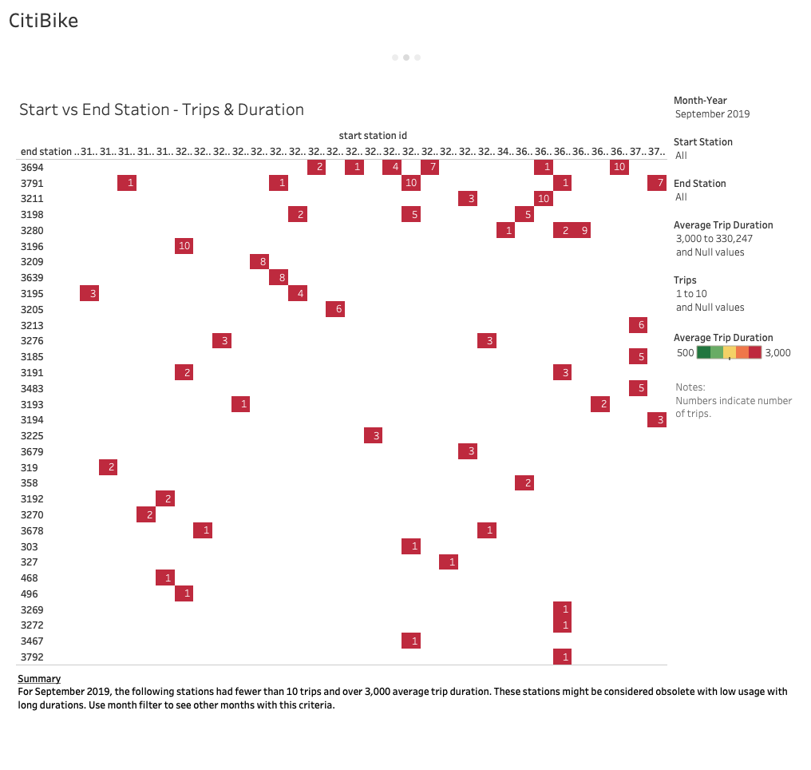

Slide 4
