Slide 1

Overview
What does it solve?
Difficulty finding relevant guidance and using it where internet access is unreliable.
What does it do?
Provides access to published clinical guidelines and reference tools on web and mobile.
How does it solve it?
Searchable content, supported offline downloads and a controlled clinical review process.
Intended audience
Clinicians and other health workers, clinical reviewers and programme teams.
01
Notes:
Sources: /Users/jaba/Documents/projects/web/mediguide-pos/README.md
/Users/jaba/Documents/projects/web/mediguide-pos/docs/content-hub-and-document-publishing-workflow.md
/Users/jaba/Documents/projects/web/mediguide-pos/docs/guideline-collections.md
MediGuide supports public reading, an offline-first clinician application, and a staff publishing dashboard. AI requires service access and readers must verify citations. Conceptual illustration created with built-in imagegen, not a photograph.

Slide 2
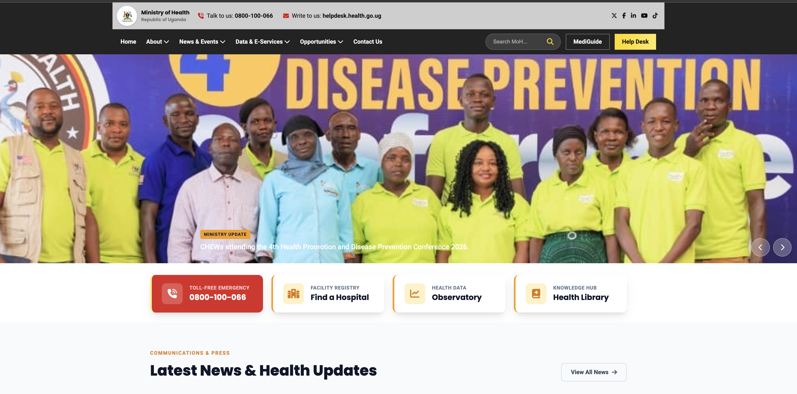
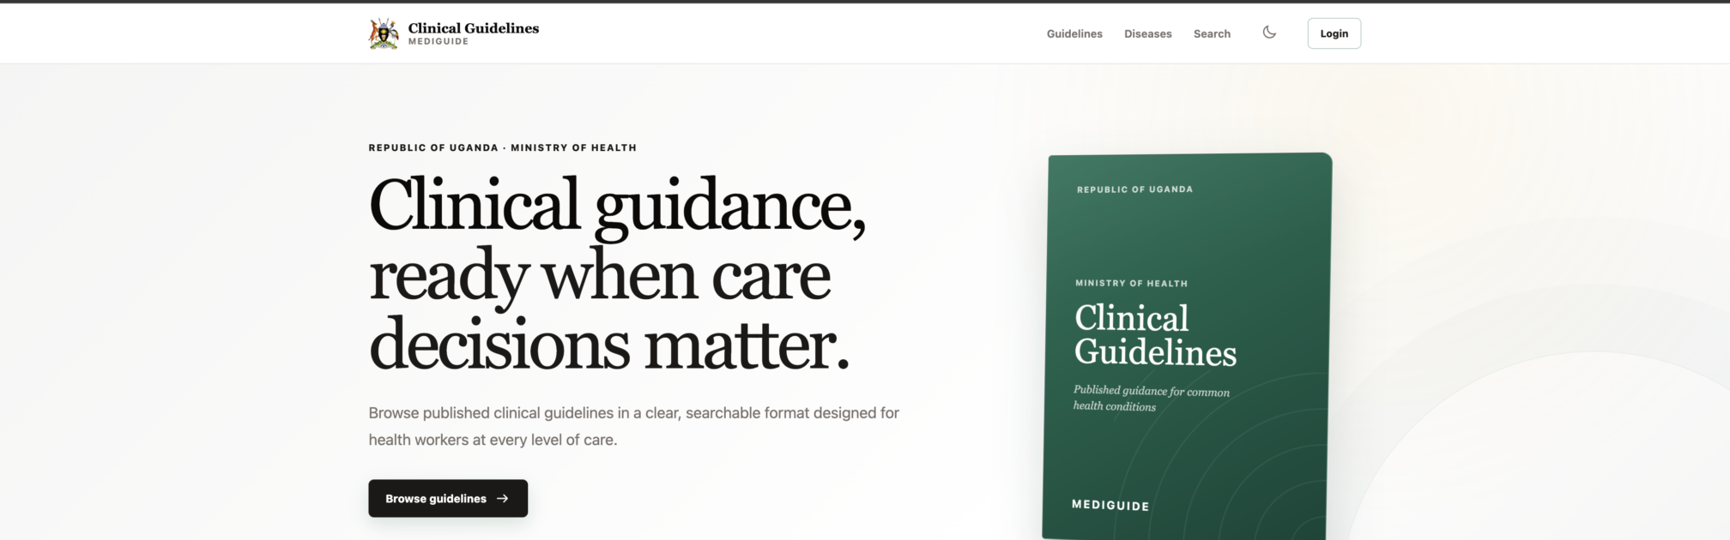
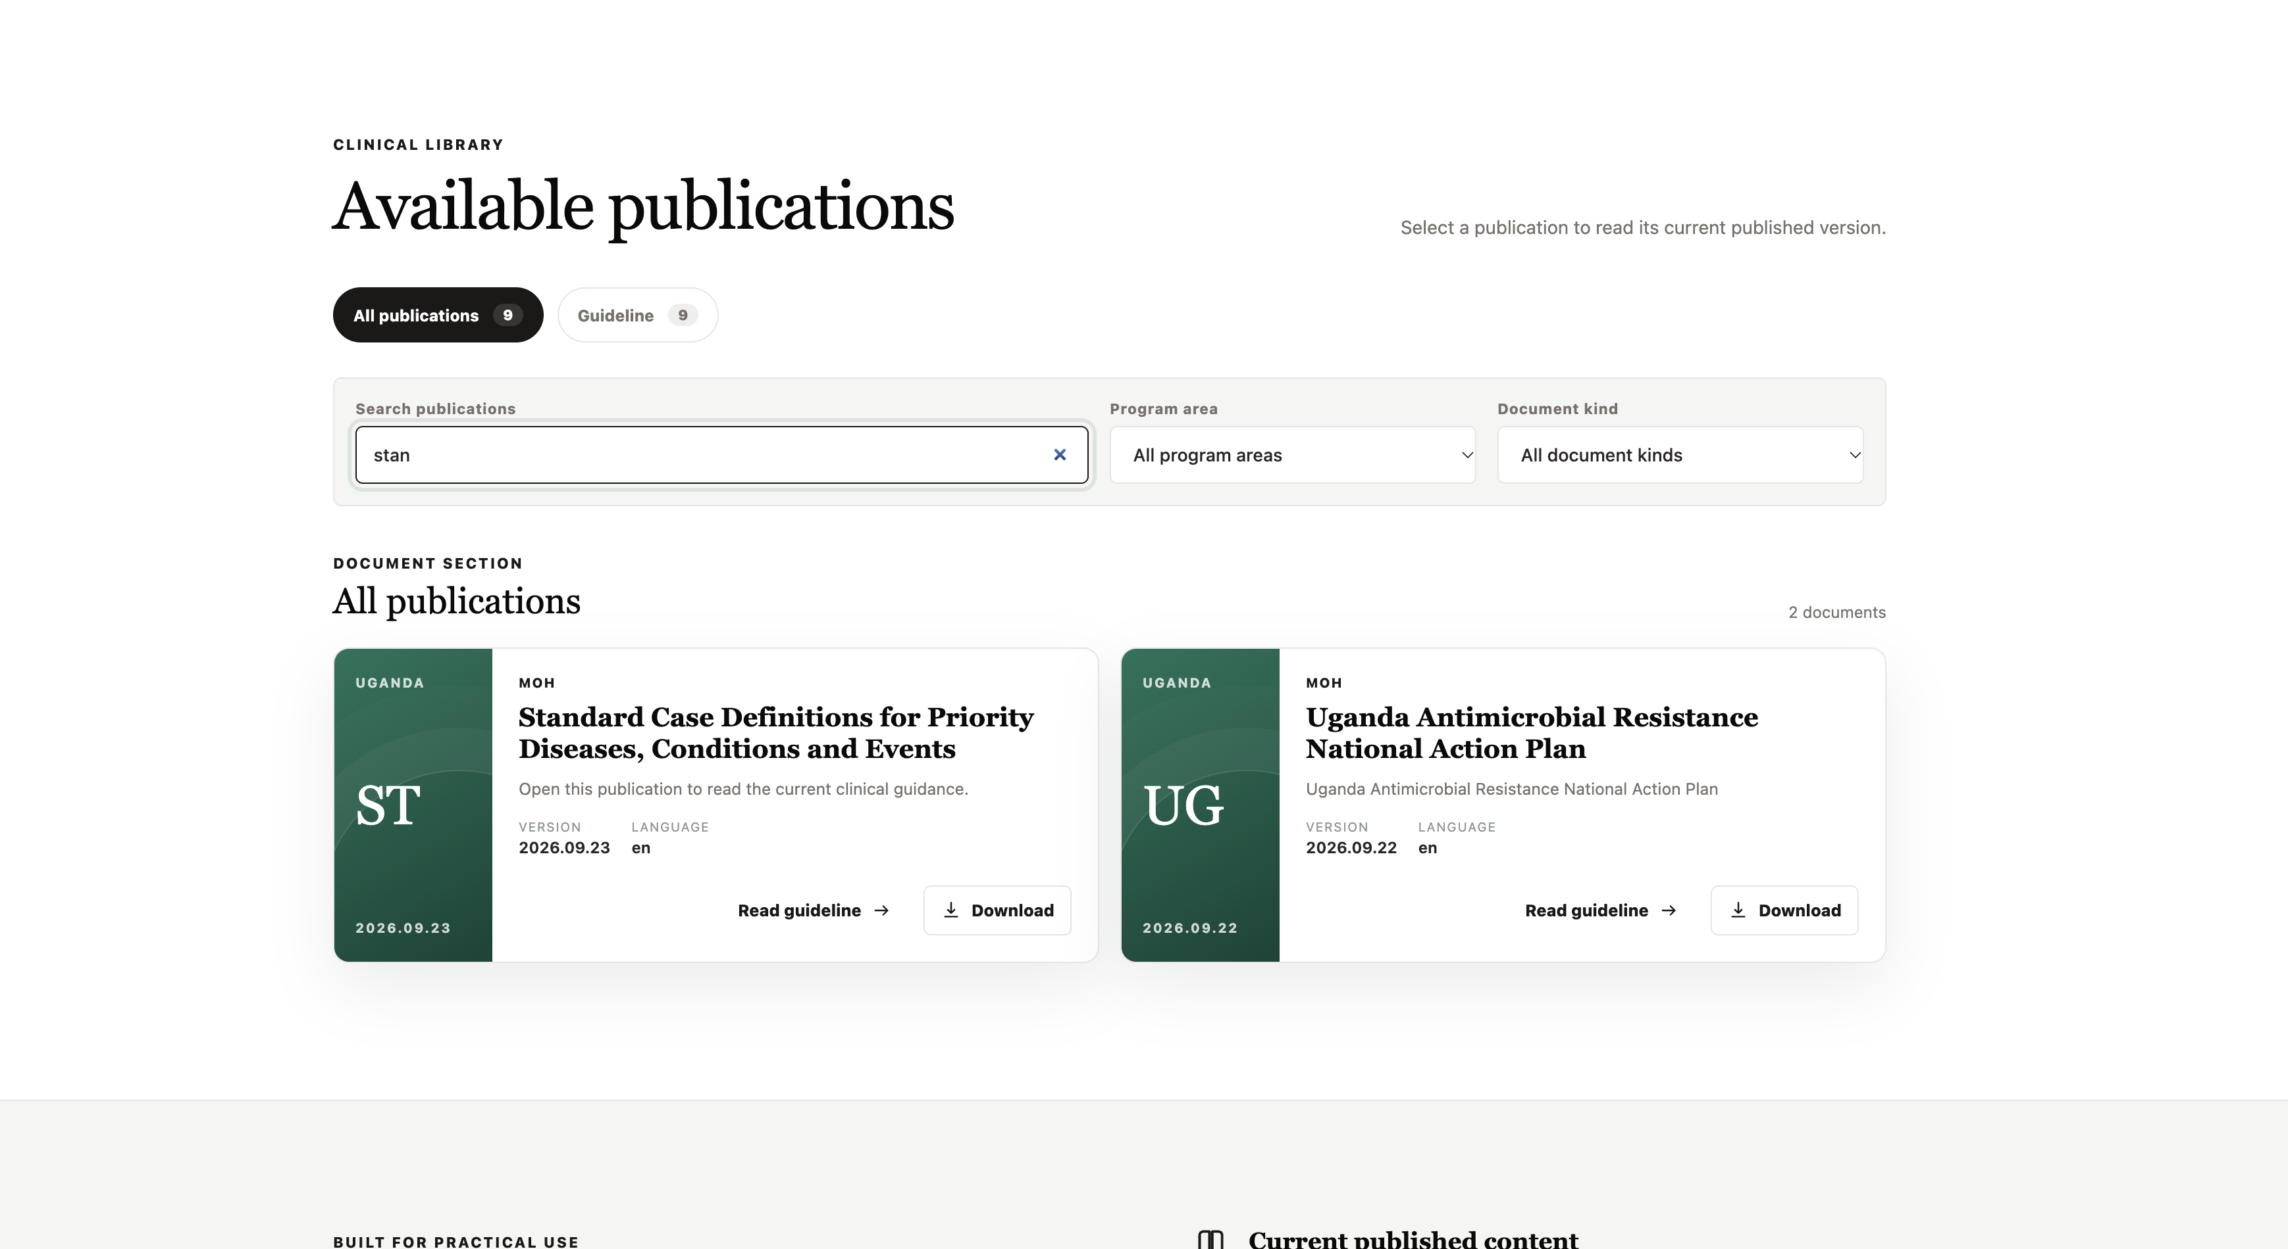
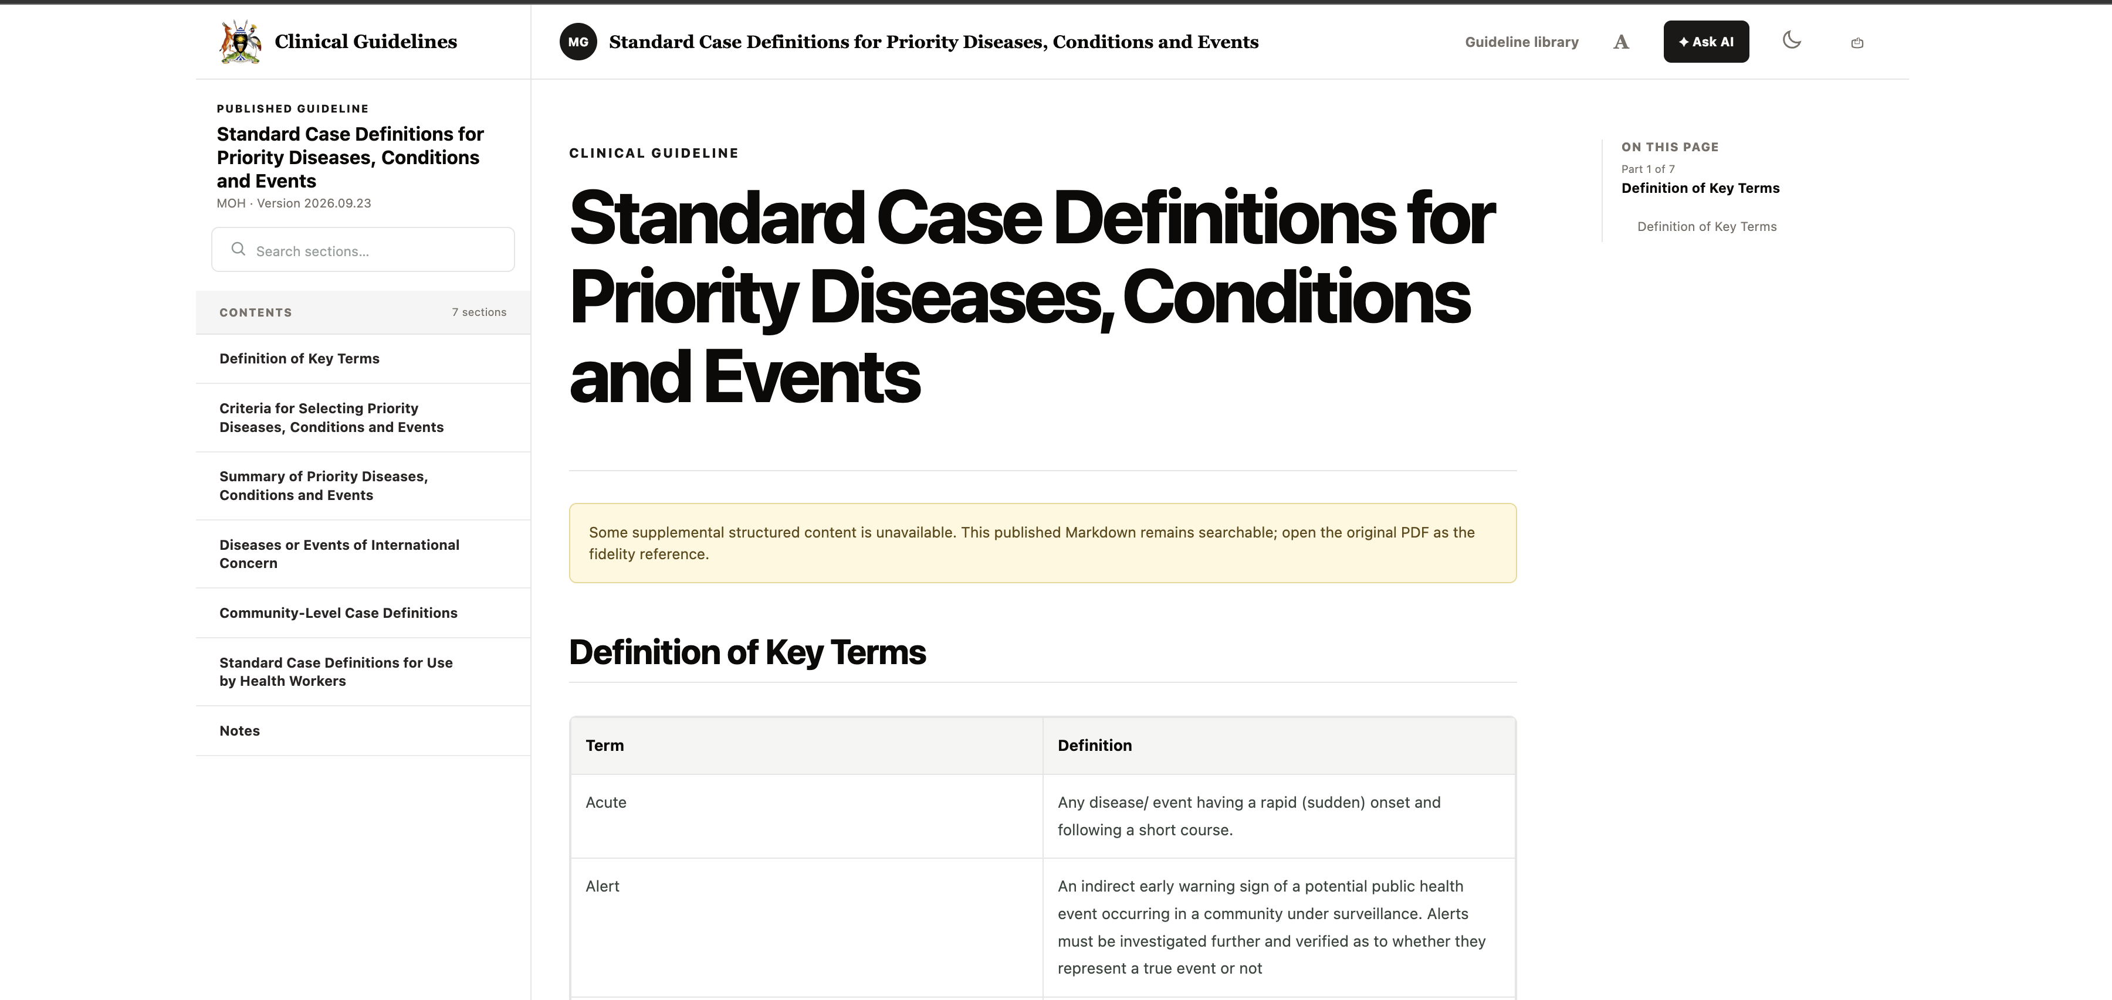
How it works
02
1 Visit the MoH website
2 Open MediGuide
Open https://health.go.ug and select MediGuide.
Select Browse guidelines to reach the library.
3 Search for a guideline
4 Open and read
Search “stan” for Standard Case Definitions.
Click Read guideline and navigate its sections.
Notes:
Reader journey based on the four screenshots supplied by the user. 1. Open https://health.go.ug and select MediGuide in the top navigation. 2. The MediGuide platform opens at https://mediguide.health.go.ug. Select Browse guidelines to reach Available publications. 3. In Search publications type a title, source or topic. The supplied example types stan and shows Standard Case Definitions for Priority Diseases, Conditions and Events. 4. Click Read guideline on the desired publication. Read the content and use the contents menu or Search sections to navigate. The supplied reader includes an availability notice and advises using the original PDF as the fidelity reference when supplemental structured content is unavailable. Source guidance is already MoH-approved before its digital preparation and publication. Screenshots are presentation evidence, not live embedded pages.

Slide 3
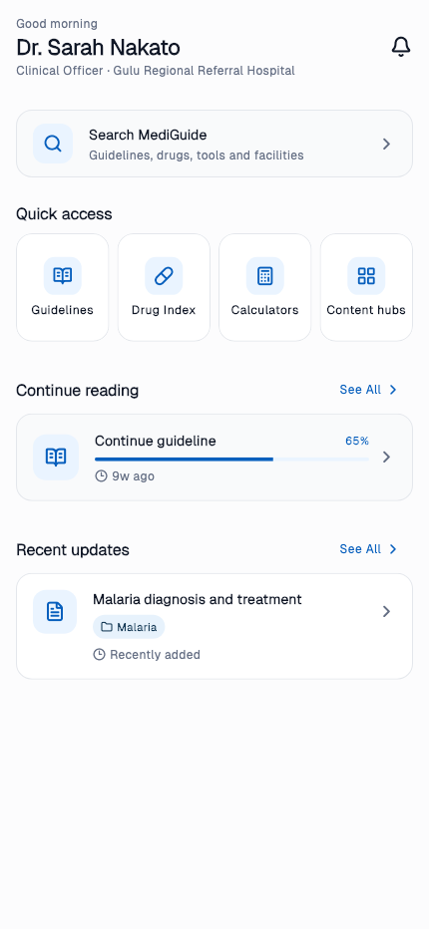
How to access
Public website
https://mediguide.health.go.ug
Browse published clinical guidelines.
Administration and content creation
https://mediguide.health.go.ug/admin
For administrators, content creators and reviewers.
Google Play download
https://play.google.com/store/apps/details?id=com.mediguide.ug
Download the MediGuide Android app.
App screen with sample content
03
Notes:
Access URLs supplied by the user: https://mediguide.health.go.ug ; https://mediguide.health.go.ug/admin ; https://play.google.com/store/apps/details?id=com.mediguide.ug . App screenshot uses synthetic test fixtures. Sources: /Users/jaba/Documents/projects/web/mediguide-pos/guidelines-platform/README.md
/Users/jaba/Documents/projects/web/mediguide-pos/user_app/test/full_screen_golden_matrix_test.dart

Slide 4

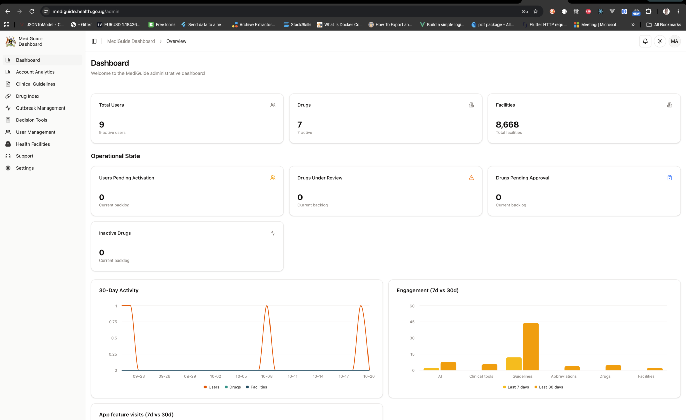
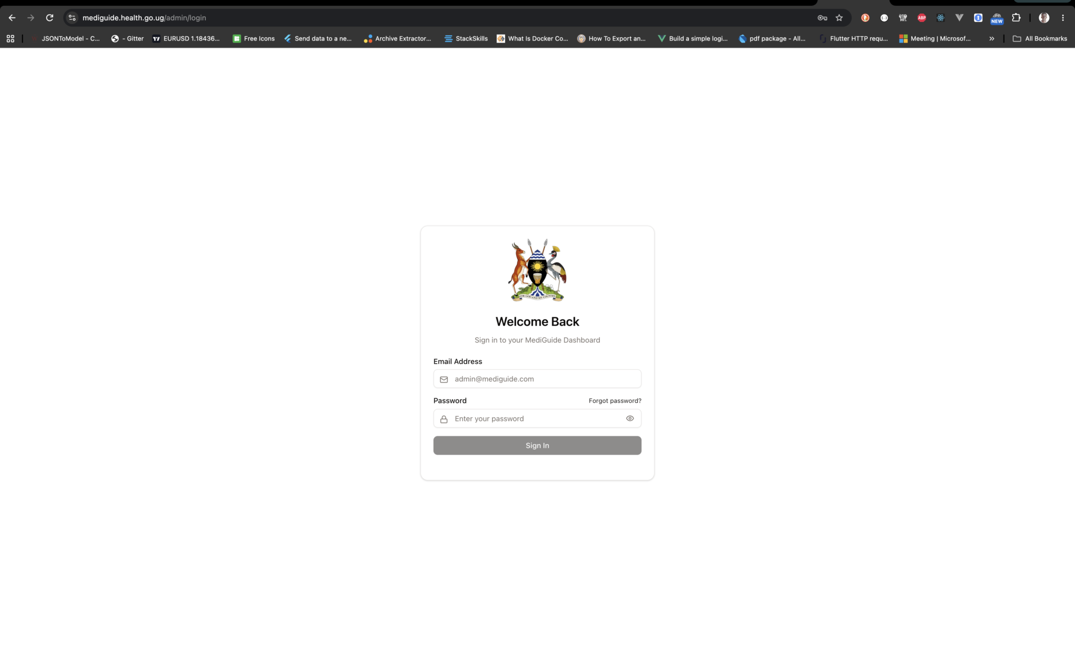
Demo
Public website
Mobile app
Staff dashboard
Browse and read published clinical guidance.
Sign in to manage and publish content.
Sample app content
04
Notes:
Public website, staff login and dashboard screenshots supplied by the user. These are screenshots, not live embedded applications. Dashboard counts reflect the supplied image only. Mobile screenshot rendered from the actual Flutter app with synthetic sample content. Demo: browse the public library, open the clinician app, then show staff sign-in and the publishing workspace. Sources: /Users/jaba/Documents/projects/web/mediguide-pos/user_app/test/full_screen_golden_matrix_test.dart

Slide 5
Next steps
Drive sensitization
Improve the AI implementation
Run demonstrations and orientation sessions.
Equip facility champions with user guides.
Collect feedback and track adoption.
Broader evidence
Add more reviewed MoH guidance to AI retrieval.
More relevant answers
Expand MoH-approved content
Improve retrieval and links to source sections and versions.
Clinical evaluation
Maternal, newborn and child health
HIV, TB, malaria and other disease guidance
NCD and mental health
Emergency care and referral protocols
Drug references and treatment algorithms
IPC, laboratory and outbreak resources
Test answers with clinician-reviewed questions and feedback.
Quality and reliability
Monitor errors and response time. State when evidence is insufficient.
05
Notes:
Proposed plan for discussion, not completed work or measured outcomes. Preserve sensitization and content expansion priorities. AI improvements build on the existing retrieval-augmented generation implementation: broaden reviewed sources, improve retrieval and source/version citations, evaluate on clinician-authored questions, record feedback and monitor response quality and latency. Design the assistant to state when evidence is insufficient. Agree target metrics, owners and release gates before implementation. Content priorities require an inventory check with MoH programme owners and approved source documents. Sources: /Users/jaba/Documents/projects/web/mediguide-pos/ai-worker/README.md
/Users/jaba/Documents/projects/web/mediguide-pos/docs/content-hub-and-document-publishing-workflow.md
/Users/jaba/Documents/projects/web/mediguide-pos/docs/guideline-authoring-and-publication-workflow.md

