Slide 1
Customer Churn Prediction (Telco)
Kaggle Dataset

Slide 2
Data Exploration
Data Set (rows=7043, columns=21)
Features:
customerID
gender
SeniorCitizen
Partner
Dependents
tenure
...

Slide 3
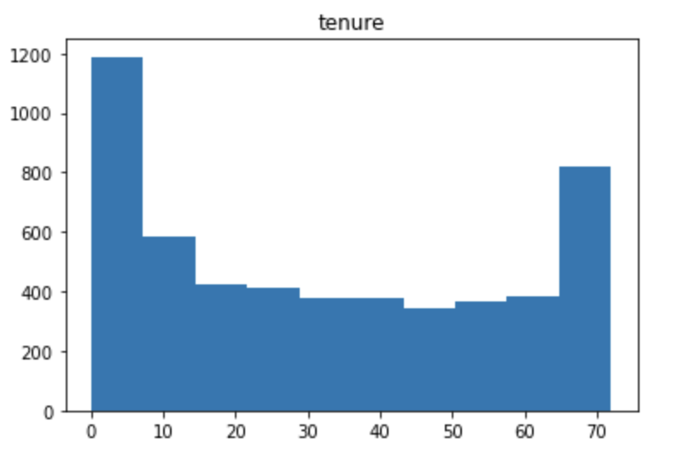
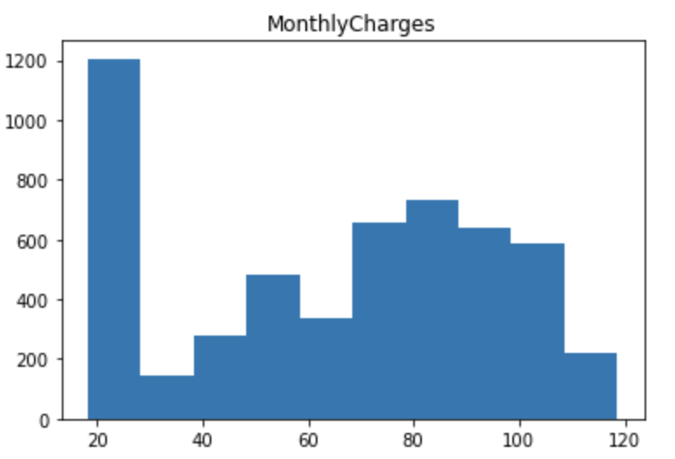
Numerical Features (EDA)
Tenure
Monthly Charges

Slide 4
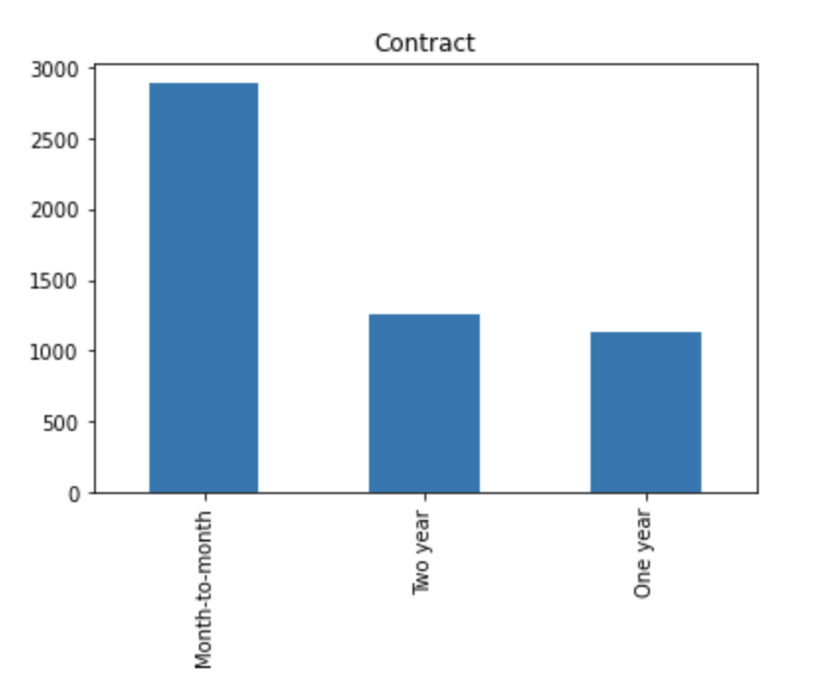
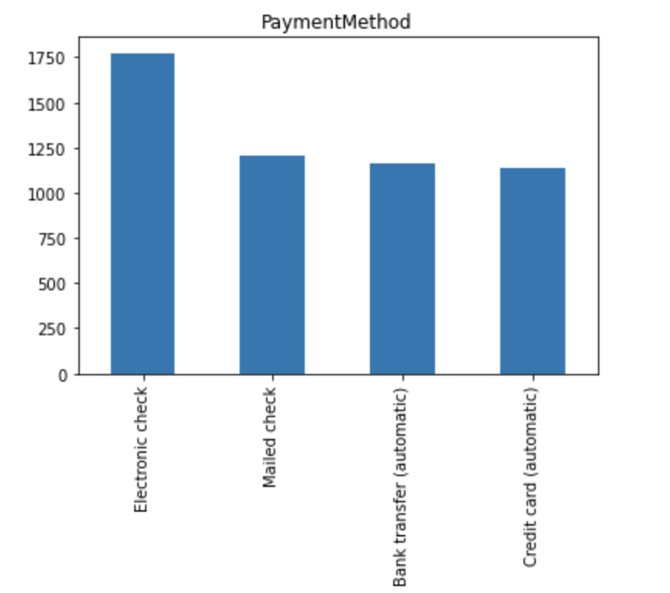
Categorical Features (EDA)
Contract
Payment Method

Slide 5
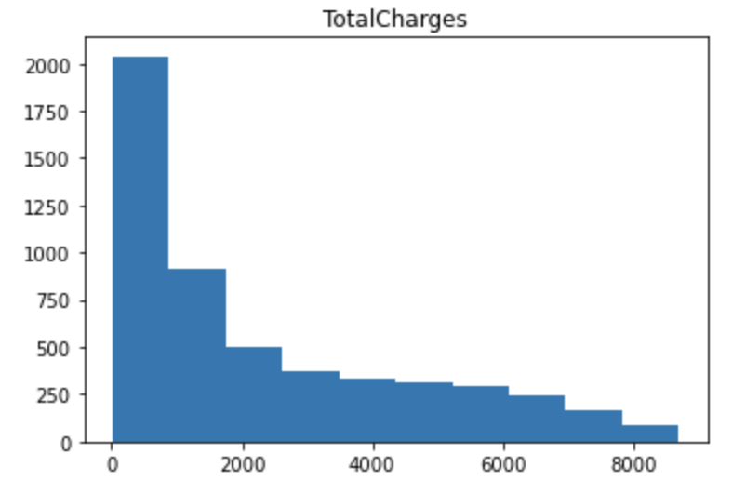
Handling NULL/Missing values
To fill missing values in Total Charges I used value 20 since the distribution was skewed instead of using mean value.

Slide 6
Multicollinearity
Dropping Columns with VIF value greater than 10.
InternetService_No
OnlineSecurity_No internet service
OnlineBackup_No internet service
DeviceProtection_No internet service
TechSupport_No internet service
StreamingTV_No internet service
PhoneService
MonthlyCharges
TotalCharges

Slide 7
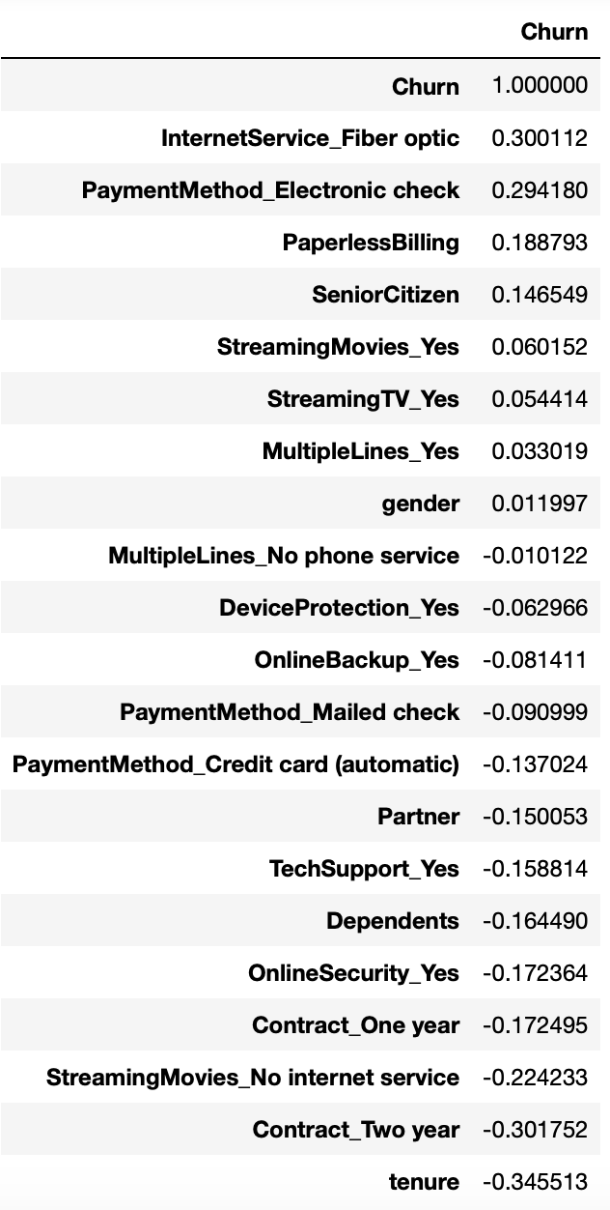
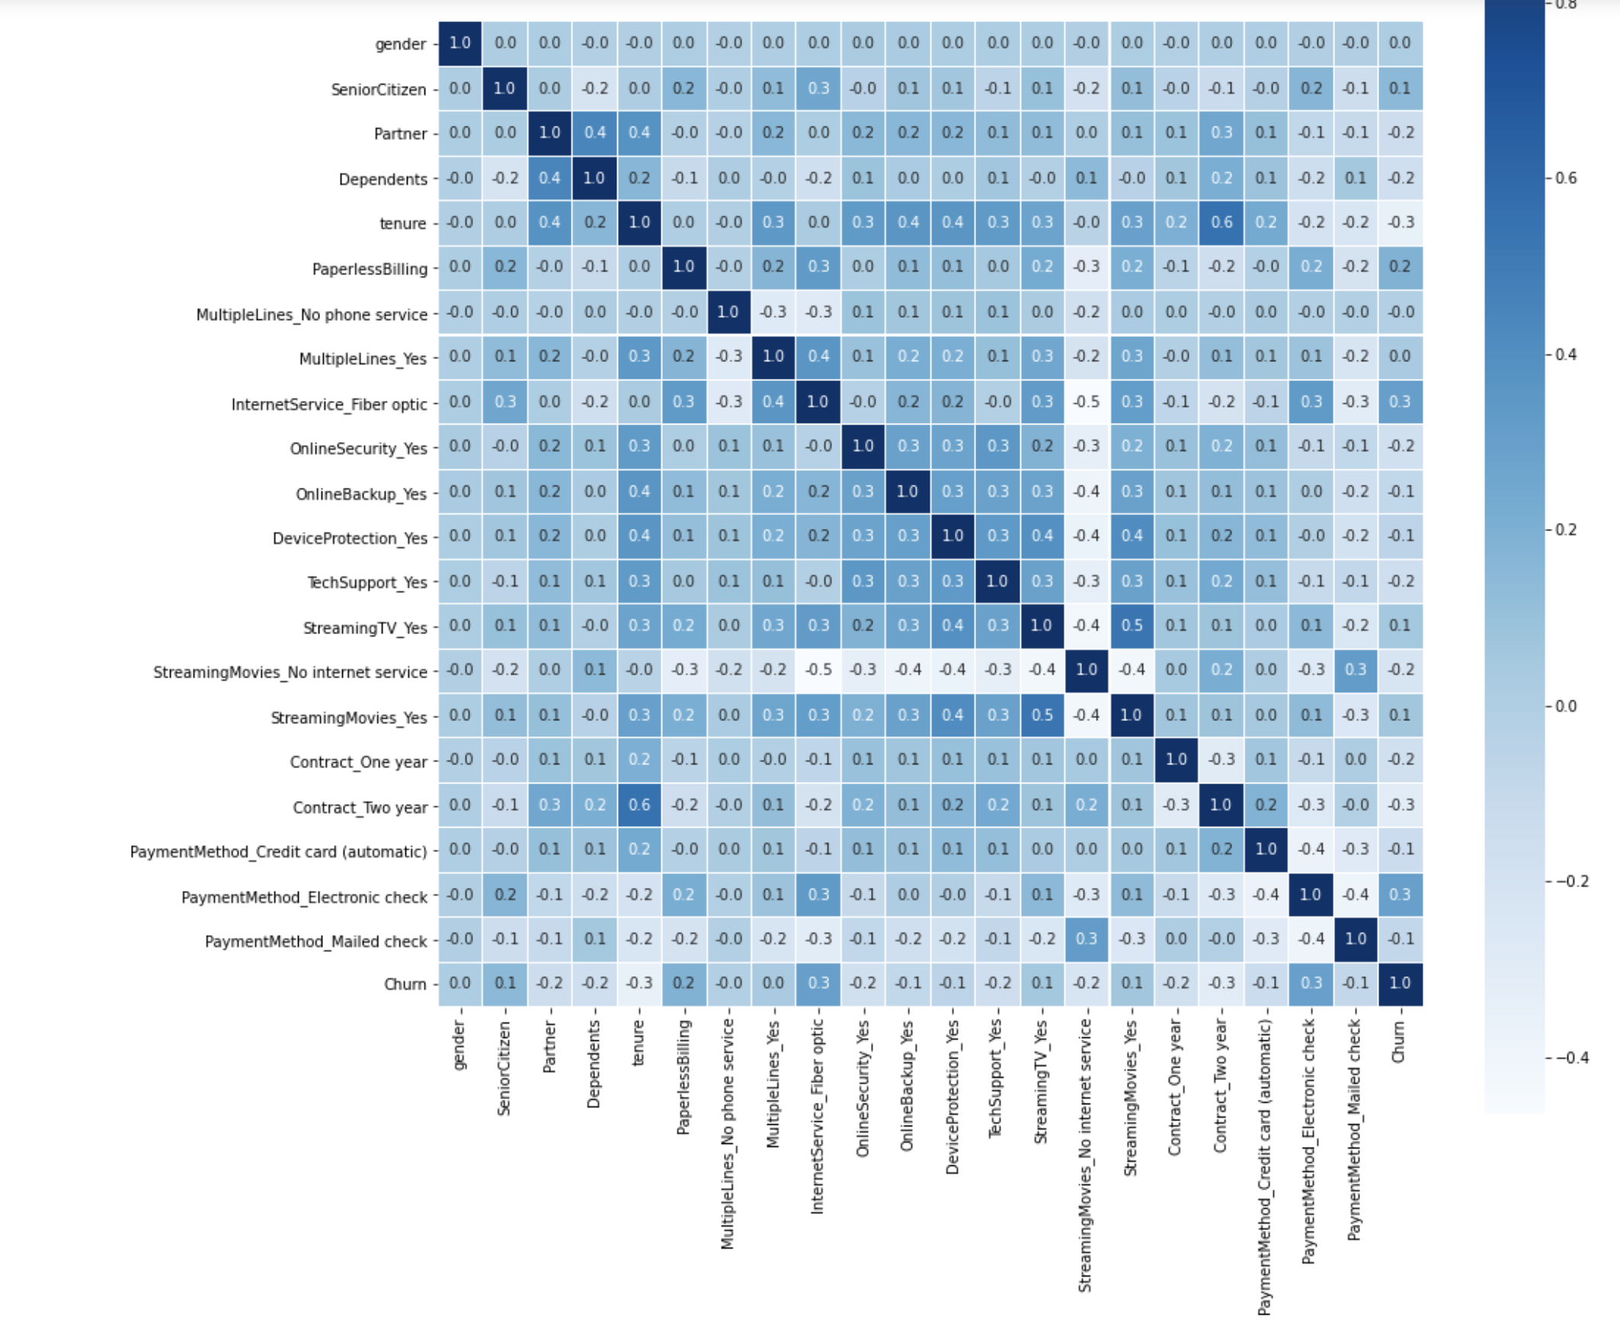
Correlation Heat Map

Slide 8
Model Fitting
Logistic Regression
Decision Tree Classifier
AdaBoostClassifier
GradientBoostingClassifier
RandomForestClassifier

Slide 9
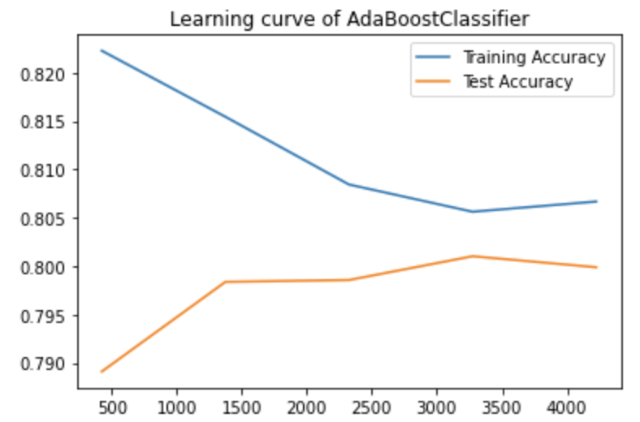
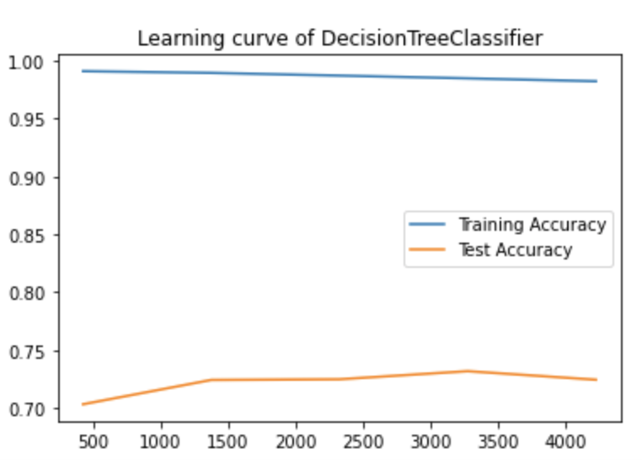
Learning Curve of Different Models
AdaBoostClassifier
DecisionTreeClassifier

Slide 10
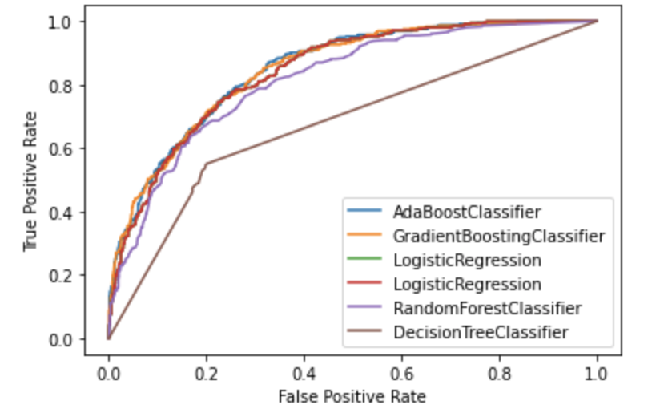
ROC Curve
ROC AUC Score for different Models
ROC curve for Different Models
AdaBoostClassifier - 0.844914
GradientBoostingClassifier - 0.844507
LogisticRegression - 0.838888
RandomForestClassifier - 0.810109
DecisionTreeClassifier - 0.660533

Slide 11
Few Important features
Tenure
MultipleLines_Yes (pos)
StreamingMovies_Yes (pos)
Contract_One year (neg)
OnlineSecurity_Yes (neg)

Slide 12
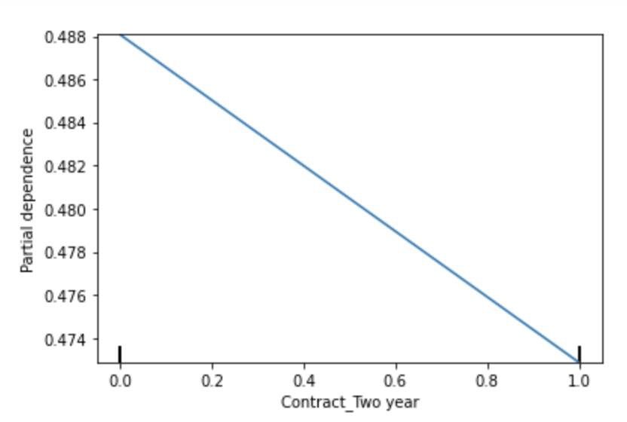
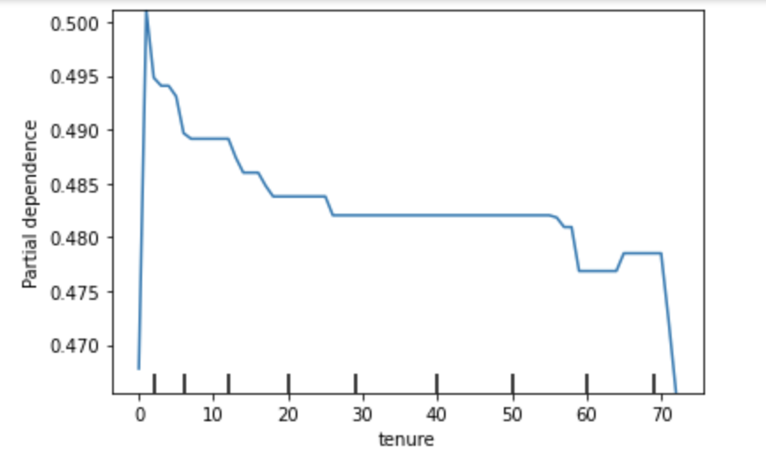
Interpreting Model Features
Tenure
Contract

Slide 13
Best Model Score
Train Data Set → 0.846463
Test Data Set → 0.861353

Slide 14
Thank You

