Slide 1
House Prices Prediction (Ames, Iowa, USA)
Kaggle Dataset

Slide 2
Data Exploration
Train Set (rows=1460, columns=81)
Test Set (rows=1459, columns=80)
Features:
GrLivArea
TotalBsmtSF
Street
Alley
RoofStyle
YearBuilt
...

Slide 3
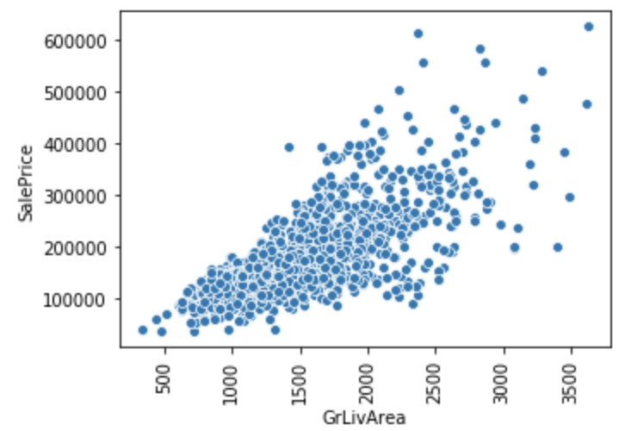
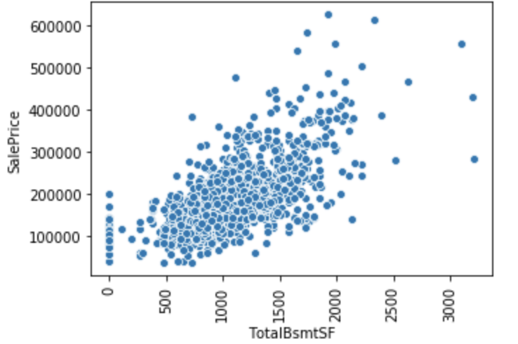
Numerical Features (EDA)
GrLivArea [Correlation (0.7)]
TotalBsmtSF [Correlation (0.6)]

Slide 4
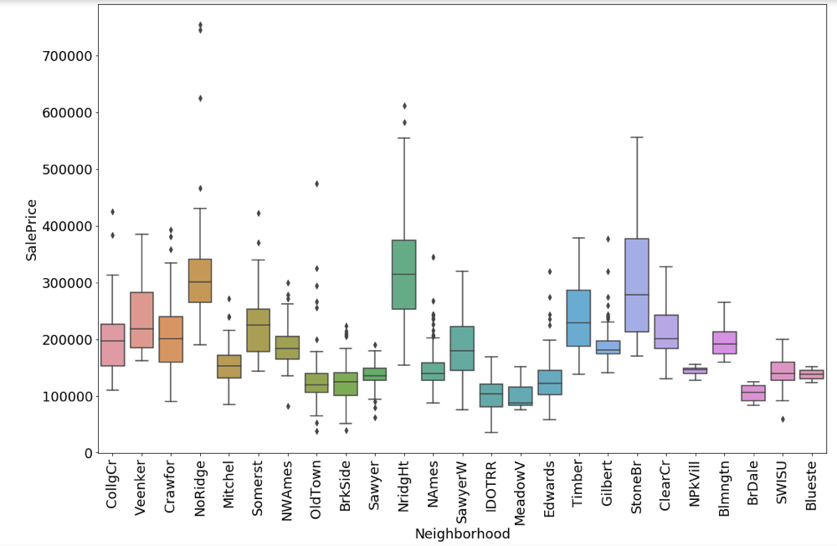
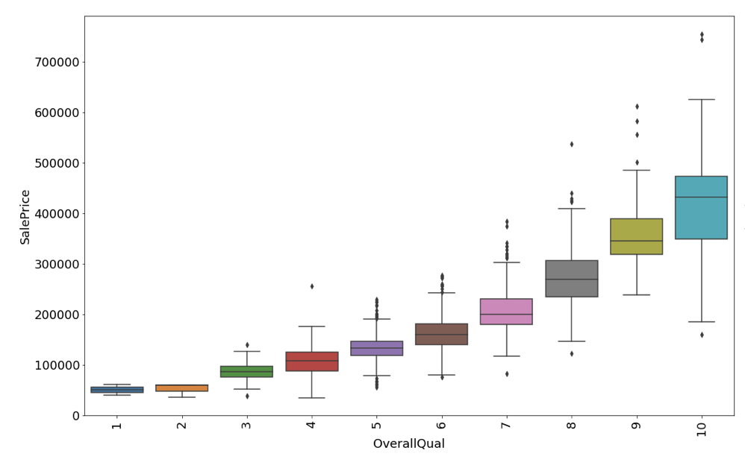
Categorical Features (EDA)
Neighborhood
OverallQual

Slide 5
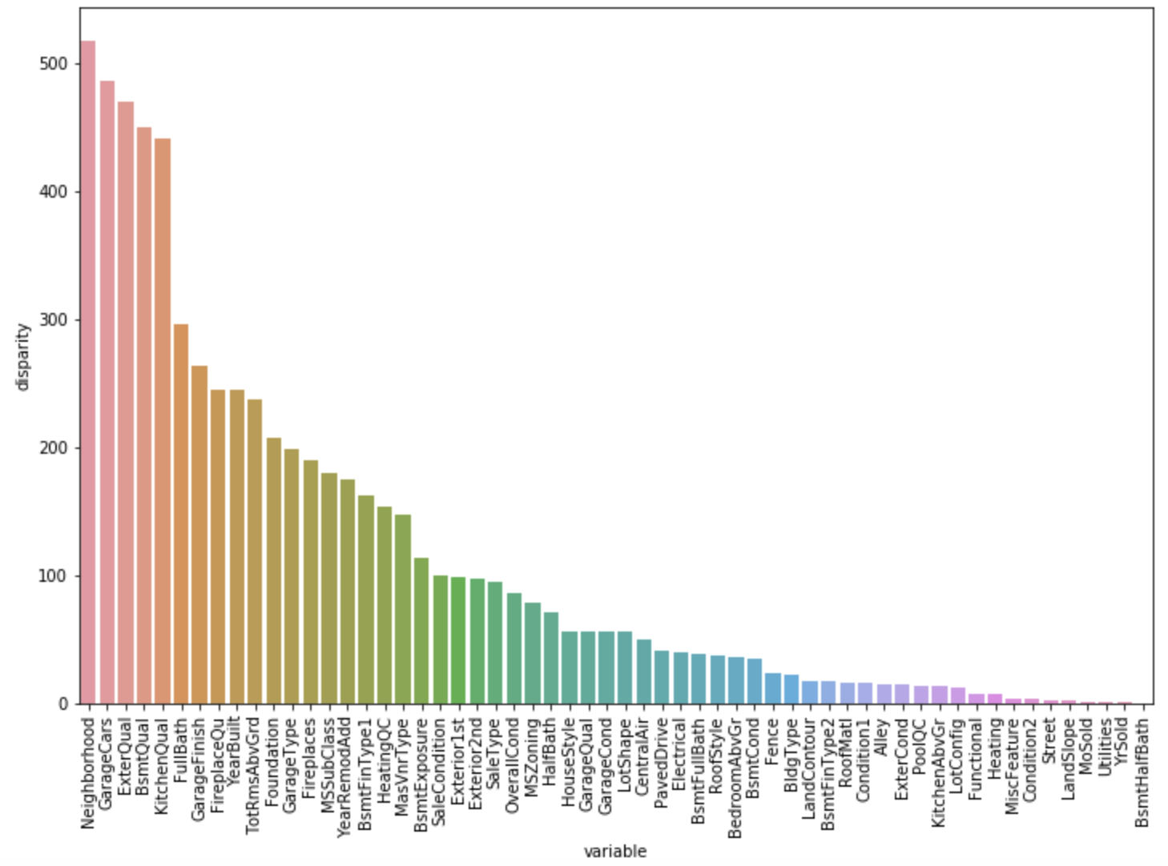
Is there significance between Groups [ANOVA]?
H0 (Null Hypothesis) - There exists no significant difference between the groups.
Ha (Alternate Hypothesis) - There exists a significant difference between the groups.

Slide 6
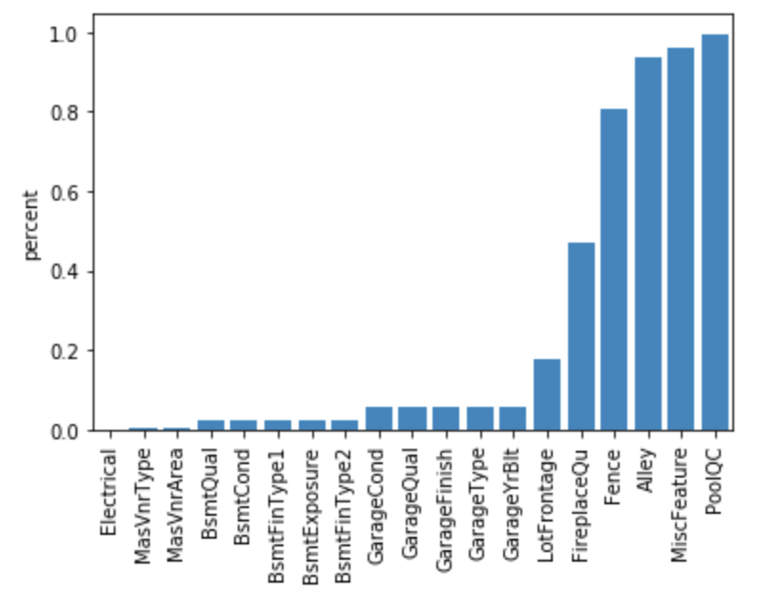
Handling NULL/Missing values
The Feature description shows NAs values are to indicate that particular house does not have that feature.

Slide 7
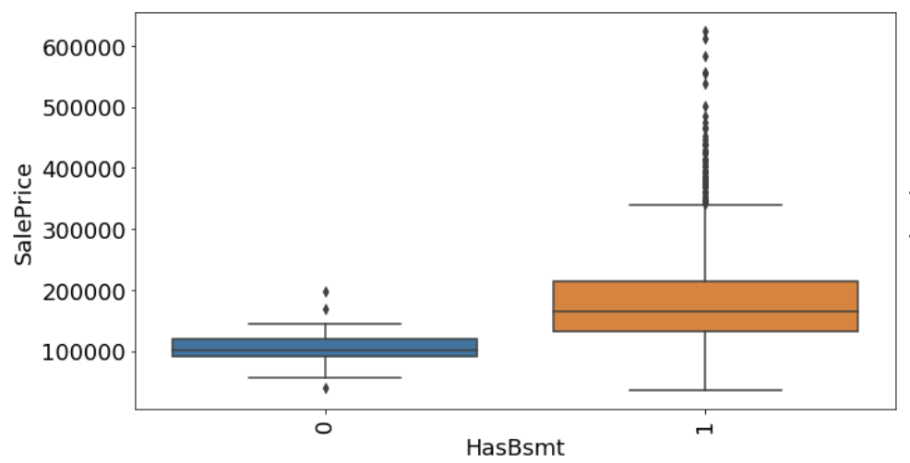
Feature Engineering
Numerical:
TotalArea1st2nd = 1stFlrSF + 2ndFlrSF
TotalBath= BsmtFullBath + BsmtHalfBath+ FullBath + HalfBath
Categorical:
HasBsmt = TotalBsmtSF > 0
HasPool = PoolArea > 0
HasFirePlace = FirePlace > 0
HasGarage = Garage > 0

Slide 8
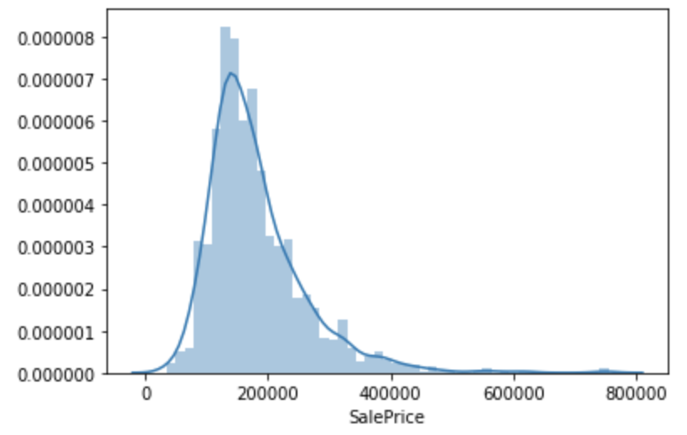
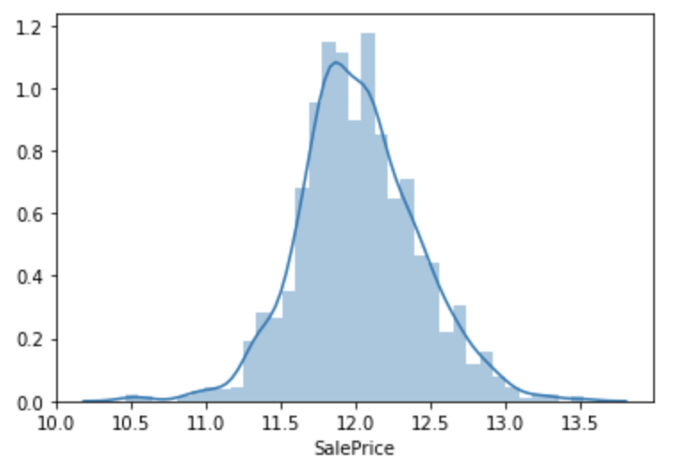
Normalizing Target (SalePrice) Variable
Before taking log
After taking log

Slide 9
Model Fitting
Linear Regression
Ridge Regression
XGBoost
Light Gradient Boosting
Stacking models
Blended models

Slide 10
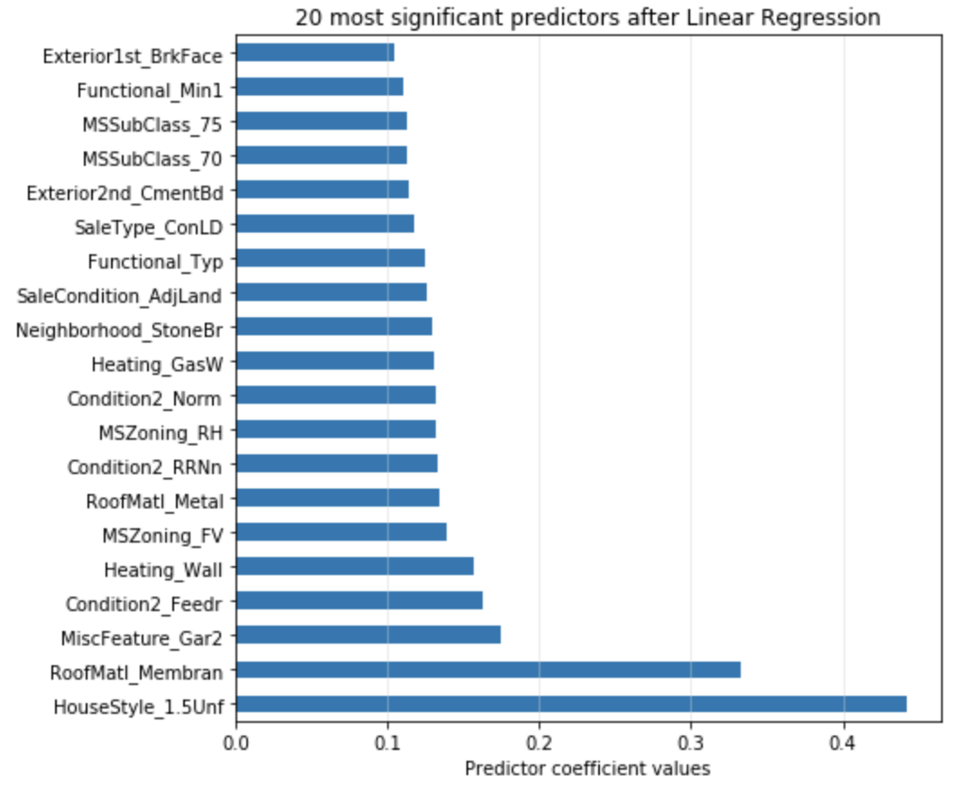
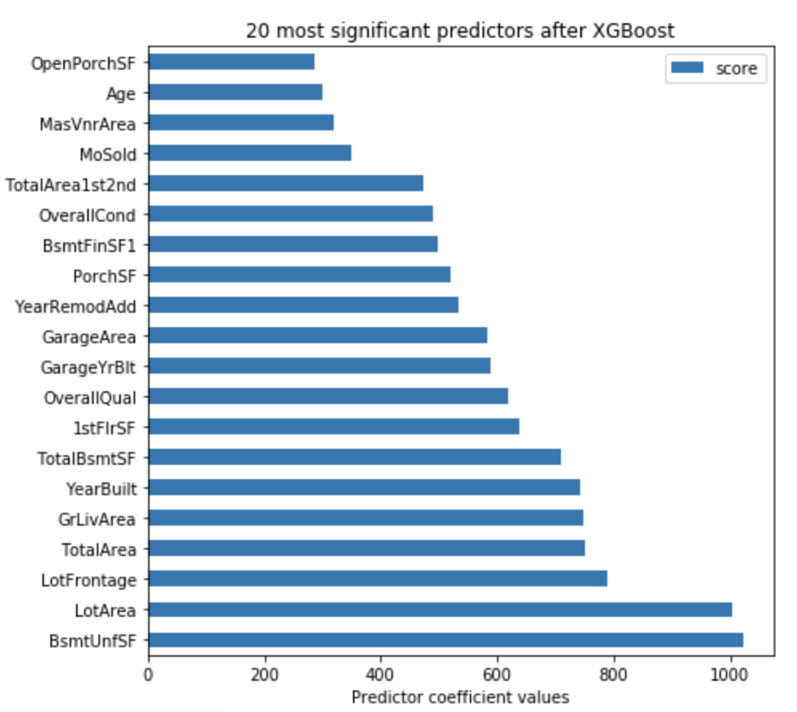
Important Features
Linear
XGBoost

Slide 11
Few Important features from different model
Surface Area (TotalBsmtSF, GarageArea, ...)
Neighborhood
YearBuilt
HouseStyle
MSZoning

Slide 12
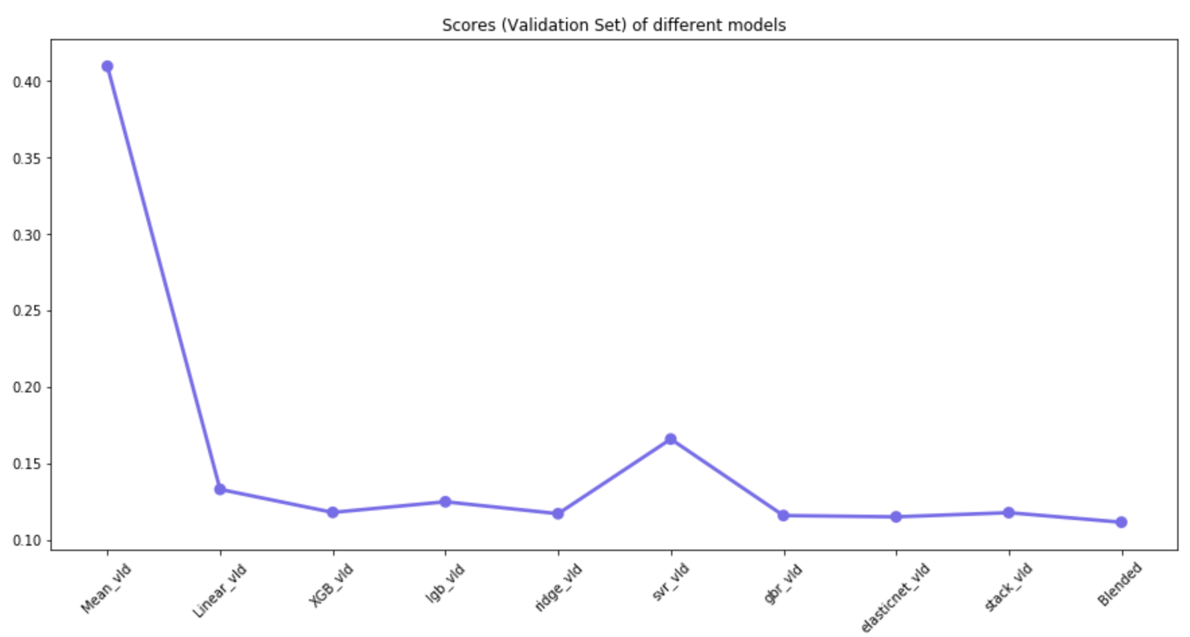
Model RMSE Score

Slide 13
Best Model Score
Train Data Set → 0.11141
Test Data Set → 0.12372 (Kaggle Score)

Slide 14
Thank You

