Slide 1

OpenMC Neutronics Analysis of an ABR-1000 Reactor Core
Cal Kaufman
NERS 590 – Advanced Reactor Design

Slide 2

Contents
Introduction to the ABR-1000
Core Design Description
Approximations
Modeling Methodology
BOC Performance
Depletion Evolution
TRU & Actinide Evolution
Power Distribution
Discussion & Conclusion

Slide 3
Introduction to the ABR-1000
What is it?
Why it matters
SFRs efficiently fission transuranic (TRU) isotopes from LWR spent fuel, reducing long-term radiotoxicity and heat load of nuclear waste.
Target Performance
Closed fuel cycle with recycled metallic U-TRU-Zr fuel and a target TRU conversion ratio of ~0.7 over a 328.5 EFPD cycle.
1000 MWt pool-type sodium-cooled fast reactor (SFR) developed by Argonne National Laboratory under the GNEP program.

Slide 4
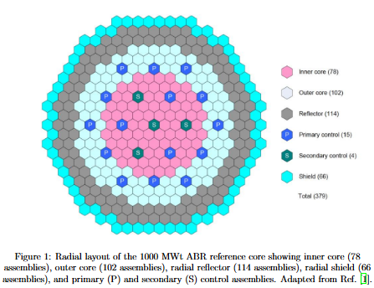
Core Design Description
379-Assembly Hexagonal Core
78 inner-core + 102 outer-core driver fuel assemblies
114 radial reflector + 66 radial shield assemblies
19 control assemblies (15 primary, 4 secondary)
Assembly pitch: 16.142 cm; 271 pins per assembly
Fuel: U-TRU-10wt%Zr metallic alloy, HT9 cladding
Active core height: 85.82 cm; fuel volume fraction: 39%

Slide 5
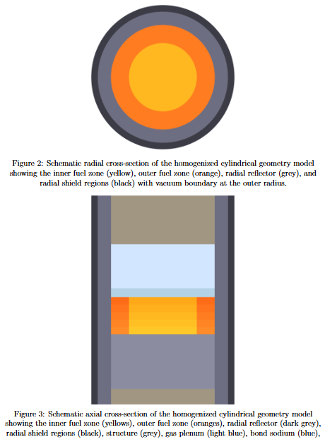
Approximations
Cylindrical Homogenization: 4 annular regions of equivalent area
The hexagonal core is collapsed into concentric annuli of equivalent area. Radial boundaries: R_{inner} = 78.14 cm, R_{outer} = 119.56 cm, R_{refl} = 149.94 cm, R_{shield} = 164.99 cm. Vacuum boundary conditions applied on all outer surfaces. Five axial composition zones represent the burnup-dependent gradient at BOEC.

Slide 6
Modeling Methodology
Nuclear Data
ENDF/B-VIII.0 continuous-energy cross sections;
Transport Settings
60 batches (20 inactive),
Tallies
8 tallies:
T_{fuel} = 807 K,
T_{cool/struct} = 706 K
Depletion Scheme
CECM predictor-corrector integrator via openmc.deplete;
12 geometric timesteps spanning 328.5 EFPD;
20,000 particles per batch;
20×20×20 Shannon entropy mesh for convergence.
total/zone power,
neutron balance,
system leakage,
and 33-group spectral flux.
SFR transmutation chain.

Slide 7
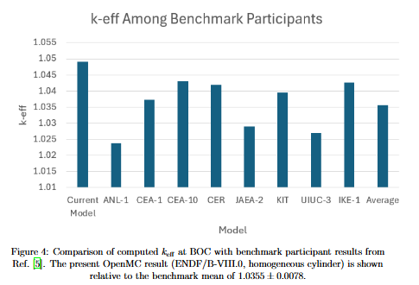
Beginning of Cycle Performance
BOC k_{eff} = 1.04916 ± 0.00070
Benchmark mean: 1.0355 ± 0.0078; deviation of ~1258 pcm, well within the known spread attributable to library differences and geometric modeling.
Competing biases: cylindrical homogenization increases leakage (negative bias), while ENDF/B-VIII.0 and no explicit fission products introduce positive bias.

Slide 8
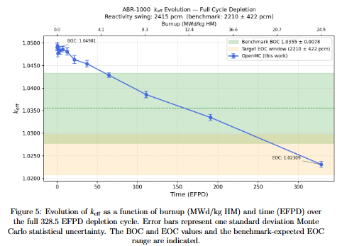
K_{eff} Evolution
Reactivity Swing:
Δρ_{cycle} = −2415 pcm
Benchmark: −2210 ± 422 pcm
Monotonic decrease driven by ²³⁹Pu and ²⁴¹Pu depletion and accumulation of higher actinide absorbers (²⁴⁰Pu, ²⁴⁴Cm).
EOC k_{eff}= 1.02309 ± 0.00066

Slide 9
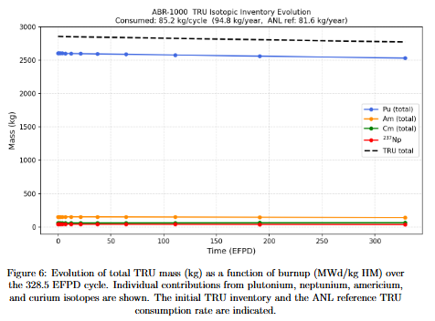
TRU Evolution
85.2
kg/cycle
TRU destroyed
94.8
kg/year
TRU consumed
2859.4 kg → 2774.2 kg
ANL reference: 81.6 kg/year (~16% elevated due to positive k-eff bias)

Slide 10
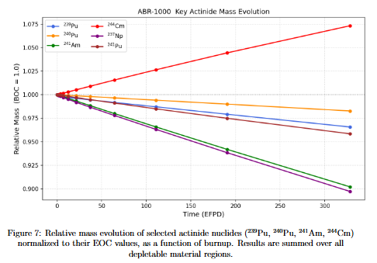
Actinide Evolution
The depletion of ²³⁹Pu is dominant transmutation pathway.
Increases in higher actinide masses, particularly ²⁴⁰Pu, ²⁴⁴Cm, reflect fast neutron capture chains.
Fission exceeds 238U capture production, enabling sustained actinide burning, with a TRU conversion ratio of ~ 0.7

Slide 11
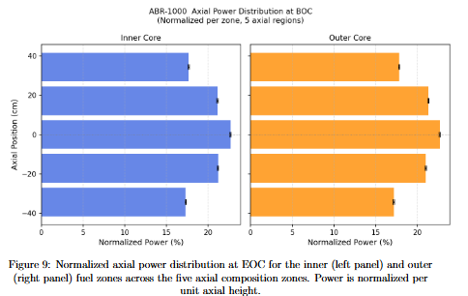
Power Distribution
Outer core exhibits higher local power density due to higher TRU enrichment
Axially, the power distribution peaks near the core midplane
Inner Core Power: 48.08%
Outer Core Power: 51.92%

Slide 12
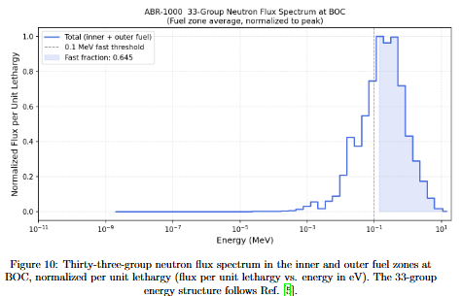
Neutron Spectrum
Fast flux fraction (>0.1 MeV): 0.645 (ANL ref: 0.68)
System leakage: L ≈ 1.13%
(n,2n) on ²³⁸U contributes 0.19% of total neutron production
Characteristic of fast-spectrum systems.

Slide 13
Discussion & Conclusions
Validation
BOC k-eff = 1.04916 (within benchmark spread); reactivity swing = −2415 pcm vs. −2210 ± 422 pcm benchmark mean; TRU consumption = 94.8 kg/year.
Biases
Cylindrical homogenization, ENDF / B-VIII.0 vs. JEFF-3.1 / ENDF / B-VII.0 library differences, and natural Mo pseudo-fission product surrogate.
Next Steps
Full hexagonal lattice; explicit fission product chain; multi-cycle equilibrium analysis; increased particle statistics (≥100,000/step).

Slide 14
References
C. Grandy et al. Advanced Burner Reactor 1000 MWth reference concept. Technical Report ANL-AFCI-202, Argonne National Laboratory, September 2007. Prepared for the U.S. Department of Energy under Contract No. DE-AC02-06-CH11357.
T. K. Kim et al. Numerical benchmark results for 1000 MWth sodium-cooled fast reactor. In Second Meeting of the SFR Benchmark Task Force of the Working Party on Scientific Issues of Reactor Systems (WPRS), OECD/NEA, Paris, France, February 2012
Md. Hasebul Hasan Niloy et al. Neutronic analysis of ABR-1000 sodium cooled fast reactor with radially and axially heterogeneous core configurations. Annals of Nuclear Energy, 193:110022, 2023.
Paul K. Romano et al. OpenMC: A state-of-the-art Monte Carlo code for research and development. Annals of Nuclear Energy, 82:90–97, 2015.
N. E. Stauff et al. Benchmark for neutronic analysis of sodium-cooled fast reactor cores with various fuel types and core sizes. Technical Report NEA/NSC/R(2015)9,OECD Nuclear Energy Agency, February 2016.
Nicolas Stauff et al. Argonne neutronic assessment of ABR-1000.Technical Report CRADA 2021-21076, Argonne National Laboratory, May 2022.

