Slide 1
2012-10-08 Event CIMI+BATS Simulation Update
Colin Komar
Alex Glocer, Mei-Ching Fok, Dan Welling
Modeling Thrust
November 18, 2021

Slide 2
Overview
Simulation Tuning Parameters & Definitions
Dst comparisons of 5 select simulations
Results are… Interesting…
Summary
Next steps

Slide 3
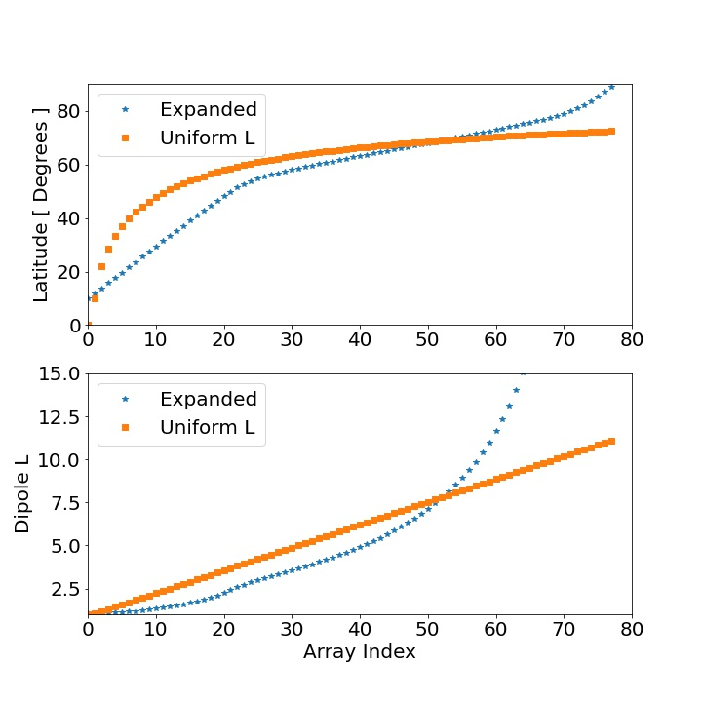
Simulation Tuning Parameters & Definitions
BATSRUS Grid | CCMC grid 2M cells 0.25 R_{E} (figures next page) | “CUSIA” grid 11M cells 1/16 R_{E}: |x, y, z| < 4 1/8 R_{E}: |x, y, z| < 10 | “Komar” grid* 30M cells 1/8 R_{E} -16 < x < 32 |y, z| < 16 | SWPC Test 2M cells 0.25 R_{E} -20 < x < 8, |y, z| < 8
BATSRUS Inner Boundary (IB) | n = 28 amu/cm⁻³ T = 25,000 K |  | n = 500 amu/cm⁻³ T = 4,300 K
CIMI Grid 48 points Azim. 76 points rad. | Uniform L 0.5 MLT resolution 1.03 < 1/cos²(λ) < 11 |  | Expanded 0.5 MLT resolution 10 < λ < 89
CIMI H+/O+ Composition | 80/20 |  | 70/30
*Komar grid reused from previous ULF wave study [Komar et al., 2017]
Changed simulation parameters are highlighted. There are other less important changes than I detail here.

Slide 4
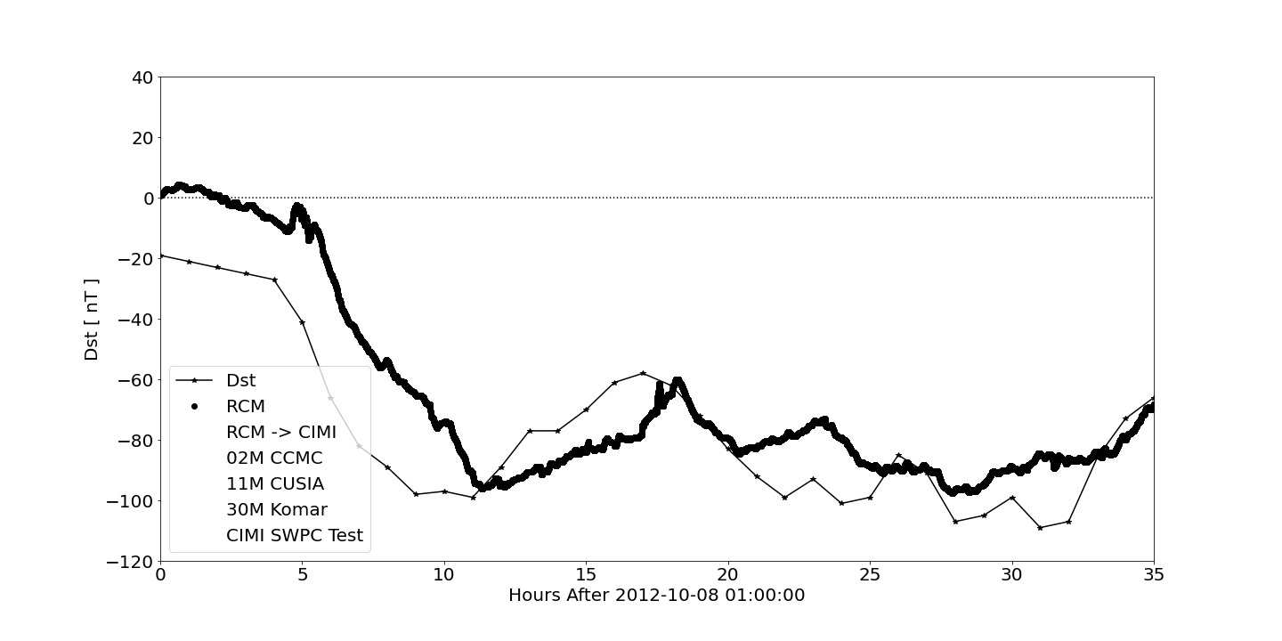
Control: RCM+BATSRUS v. Observations
BATS Grid: 11M cell CUSIA grid. BATS IB: n = 28 amu/cm⁻³; T = 25,000 K CIMI: 80/20 H+/O+ ratio; Default RCM Grid

Slide 5
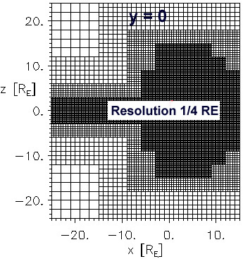
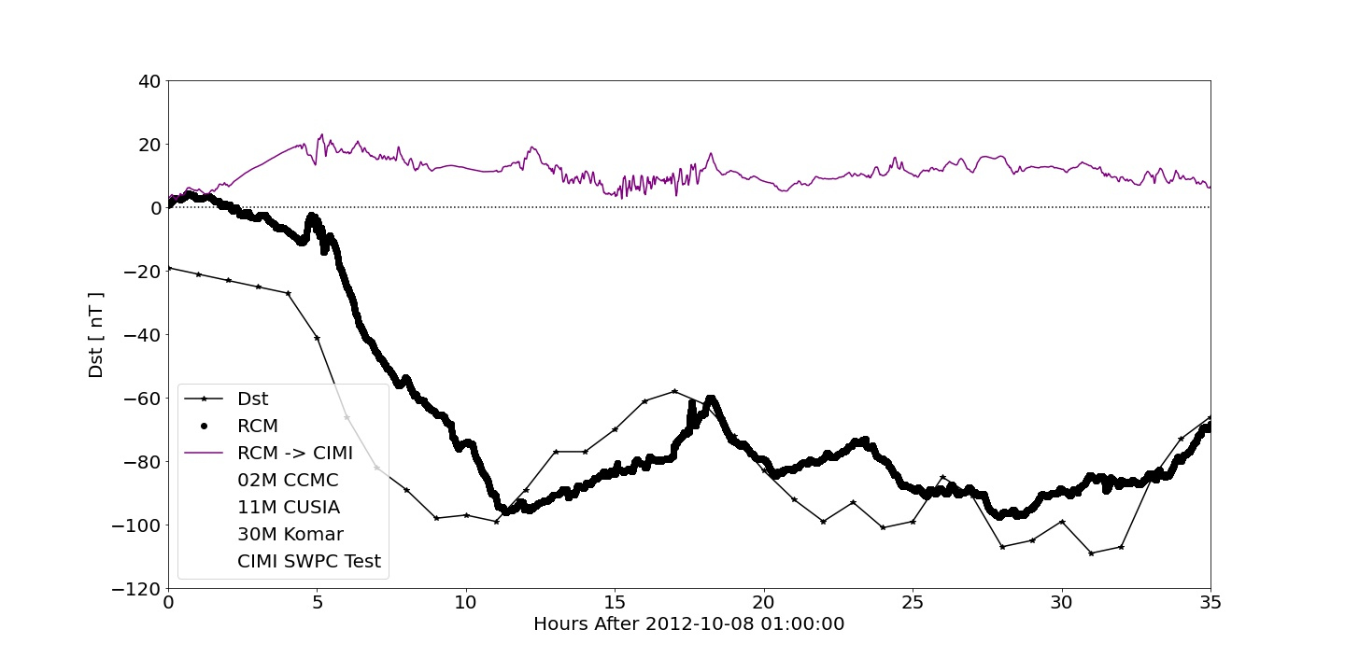
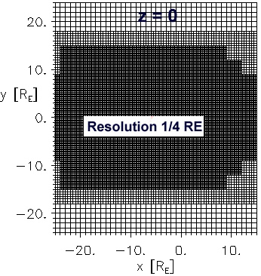
Subbing CIMI for RCM: Using 2M cell CCMC Grid
BATS Grid: 2M cell CCMC grid. Only change output frequency and file types. BATS IB: n = 28 amu/cm⁻³; T = 25,000 K CIMI: 80/20 H+/O+ ratio; Uniform L Grid

Slide 6
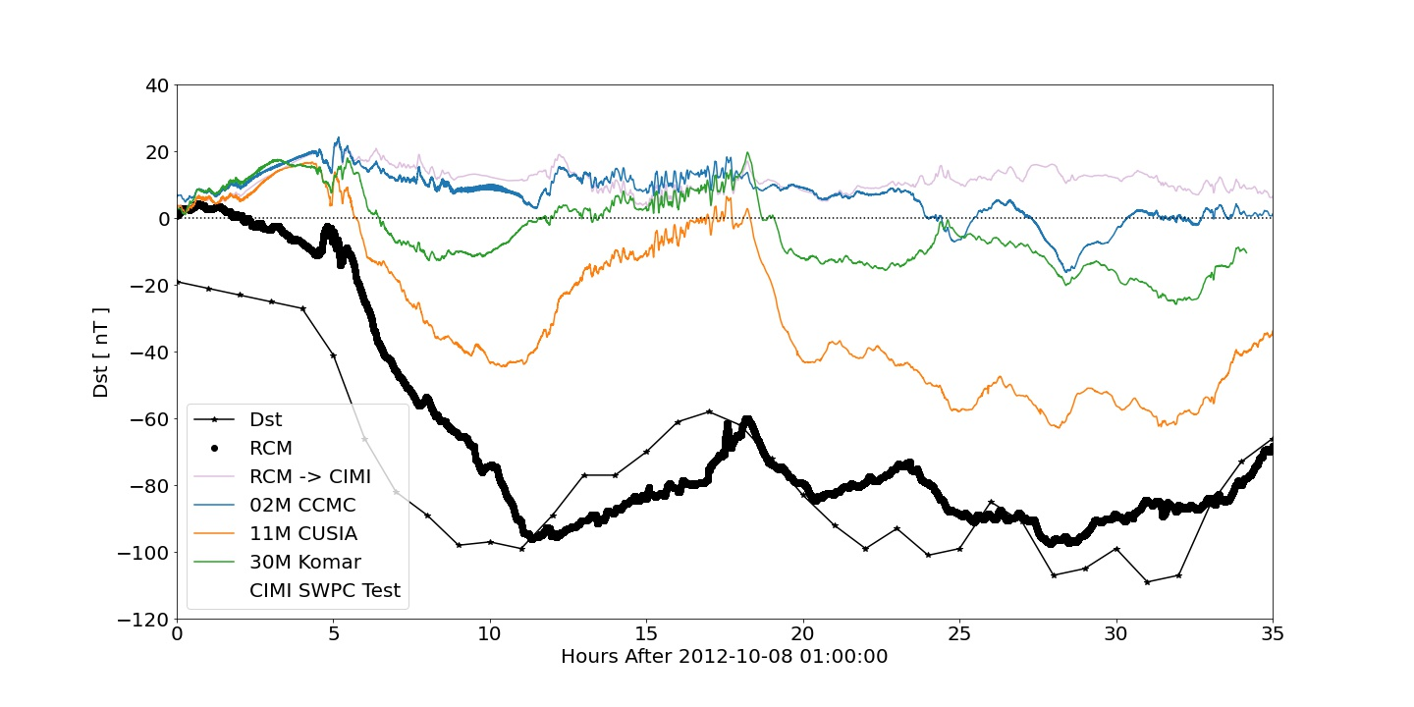
Changing Multiple Parameters
BATS Grid: 2M cell CCMC, 11M cell CUSIA, 30M cell Komar grids BATS IB: n = 500 amu/cm⁻³; T = 4,300 K CIMI: 80/20 H+/O+ ratio, Uniform L grid

Slide 7
Changing Multiple Parameters
Dst response independent of Inner Boundary Condition for CCMC grid (CIMI initialized from BATS’ density/pressure
BATS Grid: 2M cell CCMC, 11M cell CUSIA, 30M cell Komar grids BATS IB: n = 500 amu/cm⁻³; T = 4,300 K CIMI: 80/20 H+/O+ ratio, Uniform L grid

Slide 8
Changing Multiple Parameters
Storm-time onset and recovery similarities improves as grid resolution increases… (1/4 -> 1/16 R_{E})
BATS Grid: 2M cell CCMC, 11M cell CUSIA, 30M cell Komar grids BATS IB: n = 500 amu/cm⁻³; T = 4,300 K CIMI: 80/20 H+/O+ ratio, Uniform L grid

Slide 9
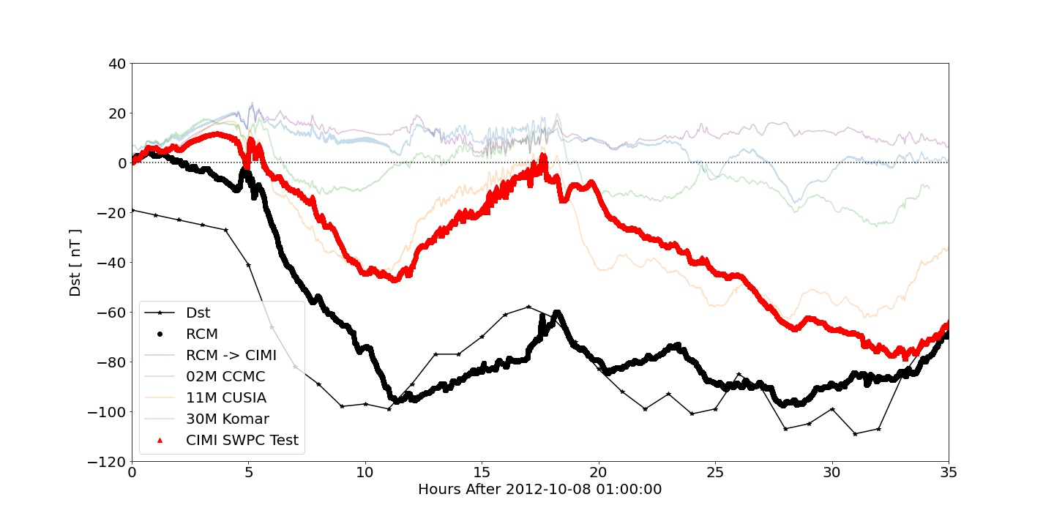
Taking a step back: SWPC Test grid
Much better Dst comparison.
Similar trends to observations
and RCM simulation.
Many differences between the SWPC test setup and CUSIA.
BATS Grid: SWPC Test Grid changing the date to 2012-10-08 BATS IB: n = 28 amu/cm⁻³; T = 25,000 K CIMI: 70/30 H+/O+ ratio; Expanded grid

Slide 10
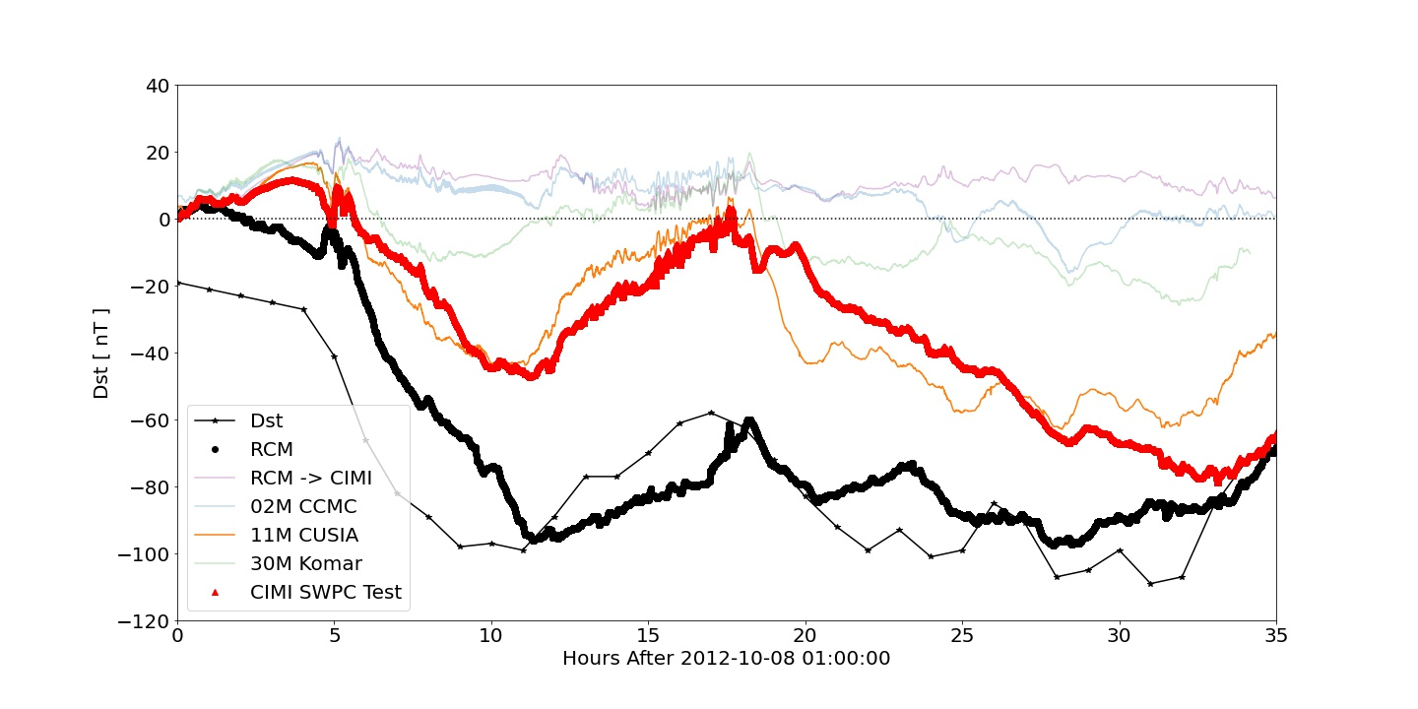
Comparing SWPC Test to CUSIA results
Much better Dst comparison.
Similar trends to observations
and RCM simulation.
Many differences between the SWPC test setup and CUSIA.
Even more surprising is that similar results can be seen in Dst for 1/5th simulation cost
(11M -> 2M cells)

Slide 11
Summary
Dst agreement is perplexing
Dst response independent of Inner Boundary conditions
Better storm-time onset and recovery as grid resolution increases (Numerical effects?)
Have updated existing setup files for CIMI compatibility
These have been uploaded to Dan’s github repository: https://github.com/spacecataz
Next steps:
Ongoing internal testing and debugging of CIMI
Starting to compare other parameters (densities, pressures, etc.)
Simulation underway using the SWPC Test setup and CUSIA grid
What are differences between SWPC test and CUSIA setup files?
Once we have a handle on these issues:
Update setup files on github
Perform flipped By simulation

