Slide 1
INSTANCE SELECTION AND FEATURE SELECTION USING
GREY WOLF OPTIMIZATION
C.MONISH KUMAR REDDY

Slide 2
OUTLINE
Feature and Instance Selection
Grey wolf optimizer (GWO)
Social hierarchy of grey wolf
Grey wolf encircling prey
Grey wolf Hunting
Attacking prey (exploitation)
Search for prey (exploration)
GWO algorithm
References

Slide 3
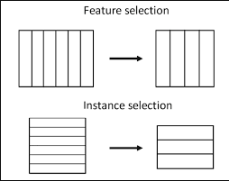
Feature Selection
What is Feature Selection :
Feature selection is a process where you automatically select those features in output in which you are interested.
Feature Selection is also called ‘Variable Selection’
There are three general classes of feature selection algorithms
◦ Filter Method
◦ Wrapper Method
◦ Embedded Method

Slide 4
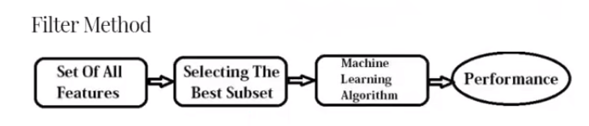
Filter Method :
Filter methods are generally used as a preprocessing step. The selection of features is independent of any machine learning algorithms. Instead, features are selected on the basis of their scores in various statistical tests for their correlation with the outcome variable

Slide 5
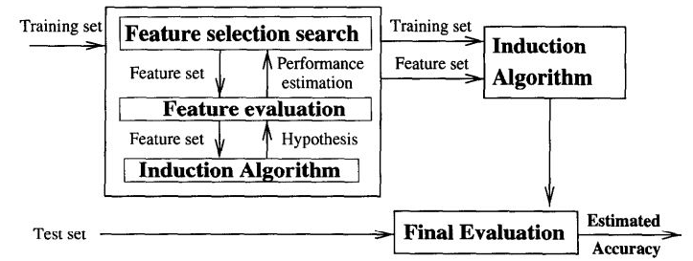
Wrapper Method :
Wrapper methods work by evaluating a subset of features using a machine learning algorithm (by using Pandas) that employs search strategy and space of possible feature subsets, evaluating each subset based on the quality of the performance of a given algorithm

Slide 6
Wrapper Method :
There are three types of feature selection techniques in Wrapper Method
Forward selection
Backward elimination
Bi-directional elimination
Forward Selection: Forward selection is an iterative method in which we start with having no feature in the model. In each iteration, we keep adding the feature which best improves our model till an addition of a new variable does not improve the performance of the model.

Slide 7
Wrapper Method :
Backward Elimination: In backward elimination, we start with all the features and removes the least significant feature at each iteration which improves the performance of the model. We repeat this until no improvement is observed on removal of features.
Bi-directional elimination: It is a greedy optimization algorithm which aims to find the best performing feature subset. It repeatedly creates models and keeps aside the best or the worst performing feature at each iteration. It constructs the next model with the left features until all the features are exhausted. It then ranks the features based on the order of their elimination.

Slide 8
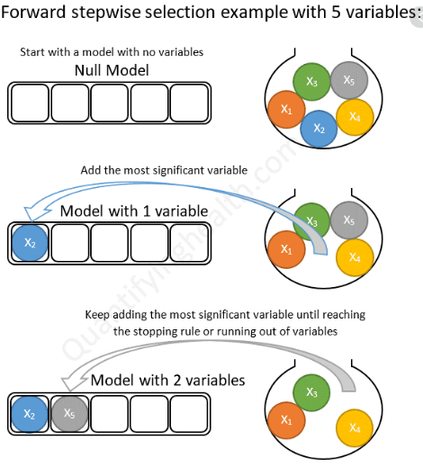
Wrapper Method :
Forward selection is an iterative method in which we start with having no feature in the model

Slide 9
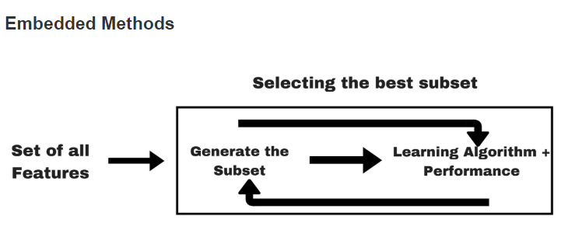
Embedded Method :
They take into consideration the interaction of features like wrapper methods do They are faster like filter methods they are more accurate than Wrapper methods.
First, these methods train a machine learning model ( it do combination )
Finally, they remove non-important features using the derived feature importance.

Slide 10
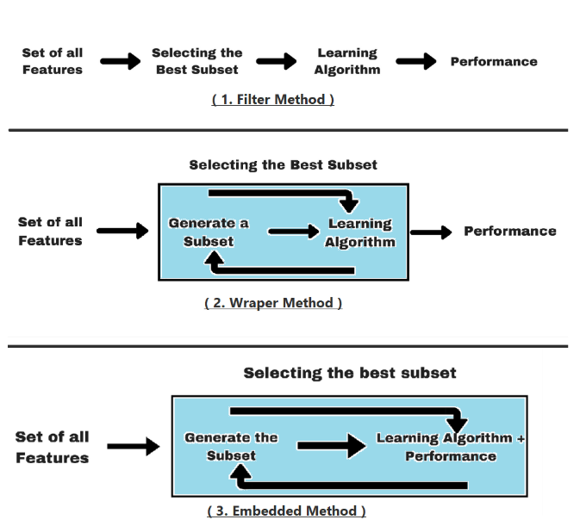
Filter,Wrapper,Embedded Method :

Slide 11
Instance Selection :
Instance Selection is Selection process on rows
It is a family of learning algorithms that , instead of performing explicit generalization compares new problem instances with instances seen in training , which have seen stored in memory.
Sometimes it is also called ‘memory-based learning’.
Instance based methods are sometime referred to as ‘lazy learning’ methods because they delay processing until a new instance must be classified.

Slide 12
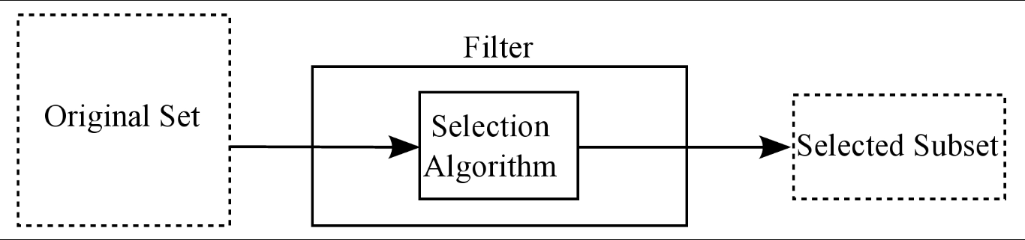
Advantages Instance Selection :
It has ability to adapt its model to previously unseen data.
It use specific instances rather than pre-compiled abstraction during prediction tasks.
These algorithms can also describe probabilistic concepts because they use similarity functions to yield graded matches between instances.

Slide 13
Disadvantages of Instance Selection :
Computational load of performing the classification can be high.
It may often not be possible to create complex models because of the computational requirements.
In some cases, this may lead to oversimplification.
Increase risk of supply interruption for some specific products
High cost of purchasing organization greater number of Orders telephone calls, records and so on

Slide 14
Grey Wolf Optimization(GWO)
GWO is nature inspired mathematically algorithm . The leadership hierarchy and hunting behavior of the grey wolves is explained in GWO
It Was proposed by Mirjalili in 2014
Grey wolves are considered as apex predators , which they are at the top of the food chain.
Grey wolves prefer to live in a groups (packs),each group contains 5-12 members on average.
All the members in the group have a very strict social dominant hierarchy as shown in the following figure.

Slide 15
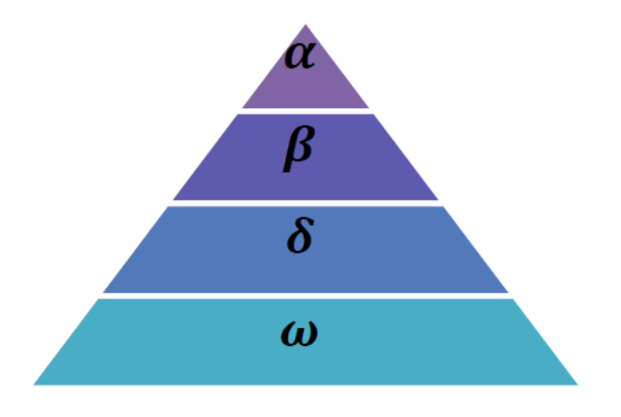
SOCIAL HIERARCHY OF GREY WOLF

Slide 16
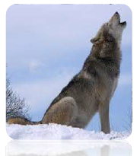
Alpha(𝛼)
The social hierarchy consists of four levels as follow.
The first level is called Alpha (𝛼). The alpha wolves are the leaders of the pack and they area male and a female.
They are responsible for making decisions about hunting, time to walk, sleeping place and so on.
The pack members have to dictate the alpha decisions and they acknowledge the alpha by holding their tails down.
The alpha wolf is considered the dominant wolf in the pack and all his/her orders should be followed by the pack members.

Slide 17
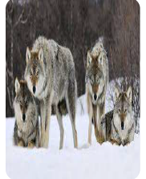
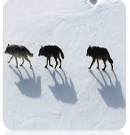
Beta(𝛽)
The second level is called Beta (𝛽).
The betas are subordinate wolves, which help the alpha in decision making.
The beta wolf can be either male or female and it consider the best candidate to be the alpha when the alpha passes away or becomes very old.
The beta reinforce the alpha's commands throughout the pack and gives the feedback to alpha

Slide 18
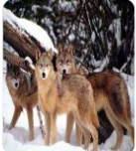
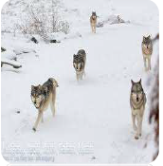
Delta(𝛿)
The third level is called Delta (𝛿)
The delta wolves are not alpha or beta wolves and they are called subordinates.
Delta wolves have to submit to the alpha and beta but they dominate the omega (the lowest level in wolves social hierarchy).

Slide 19
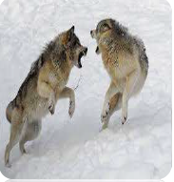
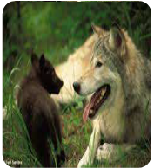
Omega(𝜔)
The fourth (lowest) level is called Omega (𝜔)
The omega wolves are considered the scapegoat in the pack, they have to submit to all the other dominant wolves.
They may seem are not important individuals in the pack and they are the last allowed wolves to eat.
The whole pack are fighting in case of losing the omega.

Slide 20
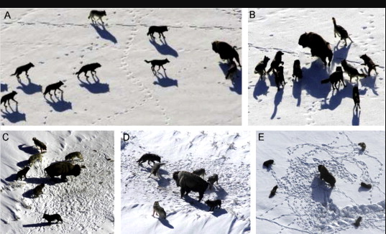
Social Hierarchy Of Grey Wolf
In the grey wolf optimizer (GWO), we consider the fittest solution as the alpha , and the second and the third fittest solutions are named beta and delta , respectively.
The rest of the solutions are considered omega
In GWO algorithm, the hunting is guided by 𝛼,𝛽 and 𝛿
The 𝜔 solutions follow these three wolves.
Tracking, chasing, and approaching the prey.
Pursuing, encircling, and harassing the
prey until it stops moving.
Attack towards the prey.

Slide 21
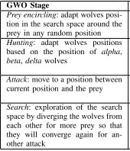
4 SATGES OF ATTACKING PREY
There are 4 stages for Attacking prey
Prey encircling
Hunting Prey
Attack Prey
Search for Prey

Slide 22
Grey Wolves Encircle Prey
During the hunting, the grey wolves encircle prey.
The mathematical model of the encircling behavior is presented in the following equations.
Where t is the current iteration, A and C are coefficient vectors, Xp is the position vector of the prey, and X indicates the position vector of a grey wolf.

Slide 23
The vectors A and C are calculated as follows:
Where components of a are linearly decreased from 2 to 0 over the course of iterations and r1, r2 are random vectors in [0, 1].
The following mathematical formulas are used to re-adjust positions of the wolf omega. The conceptual model that wolf update its position.

Slide 24
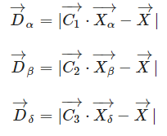
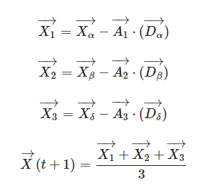
where Xα,Xβ and Xδ are the position vector of alpha, beta, and delta respectively. C1 ,C2, C3 are randomly generated vectors.
X represents the position vector of current individual.
The above equations respectively calculate the distances between the position of current individual and that of individual alpha, beta, and delta. So the final position vectors of the current individual are calculated by

Slide 25
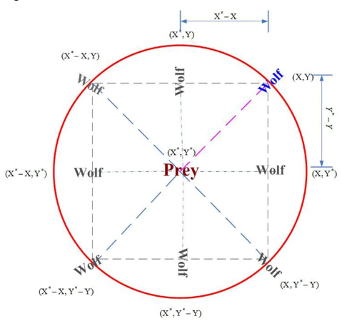
Where A1,A2,A3 are randomly generated vectors, and t represents the number of iterations.

Slide 26
Attacking Prey
The grey wolf finish the hunt by attacking the prey when it stop moving.
The vector A is a random value in interval [-2a, 2a], where a is decreased from 2 to 0 over the course of iterations.
When |A| < 1, the wolves attack towards the prey, which represents an exploitation process.

Slide 27
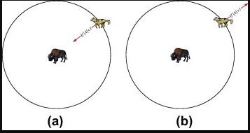
Attacking Prey
With the operators proposed so far, the GWO algorithm allows its search agents to update their position based on the location of the alpha, beta, and delta; and attack towards the prey.

Slide 28
Search For Prey
The exploration process in GWO is applied according to the position , and , that diverge from each other to search for prey and converge to attack prey.
The exploration process modeled mathematically by utilizing A with random values greater than 1 or less than -1 to oblige the search agent to diverge from the prey.
When |A| > 1, the wolves are forced to diverge from the prey to fined a fitter prey

Slide 29
Pseudo Code
Initialize the population X_{i} ( i = 1, 2, … n) of GWO
Initialize GWO parameters (a, A, C)
Calculate the individual fitness value in the population
Record the best individual, second best individual and third best individual as Xα ,Xβ and Xδ
While (t< maximum iteration number)
For each individual
Update the position of current individual by equations
End for
Update a, A, C
Calculate the fitness value of all individual in the population
Update Xα ,Xβ Xδ
t = t + 1
End While
Return Xα

Slide 30
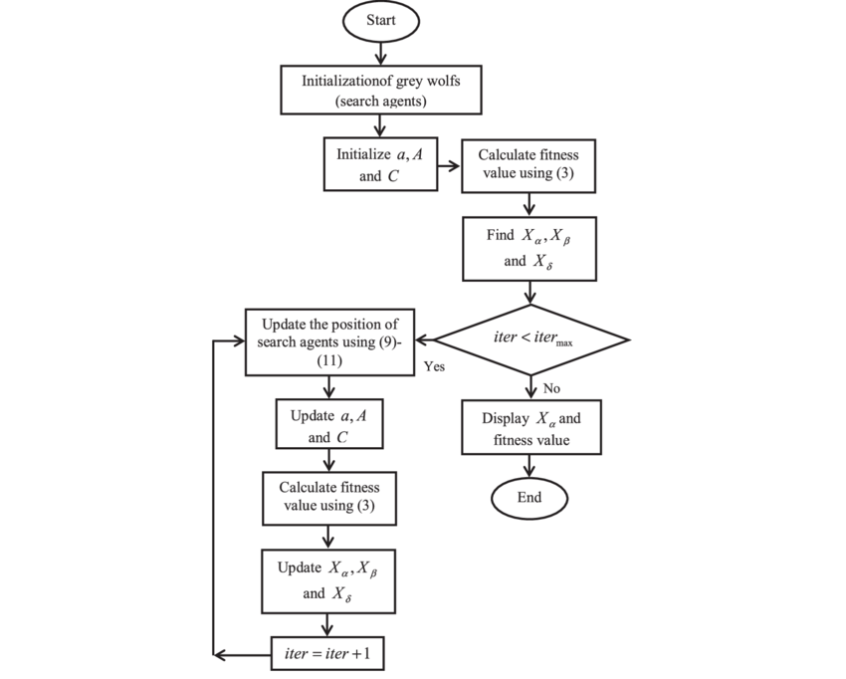

Slide 31
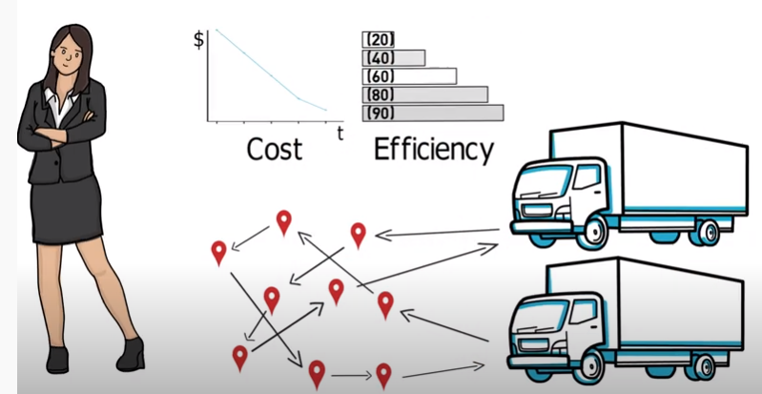
Real Time Example of GWO : Vehicle Routing Problem
The vehicle routing problem (VRP) is about designing the least cost delivery route to deliver the goods and services to customers in different locations, given a fleet of vehicles and other constraints.

Slide 32
Real Time Example of GWO : Vehicle Routing Problem
For this it should has Minimize Cost and same time Maximize Efficacy
Problems:
1. Number of vehicles
2.Vehicals Capacity
3.Time Window of Stores
4.Number of Depot's
5. Split Delivery
6.Human Resources
7.Traffic & Road Condition

Slide 33
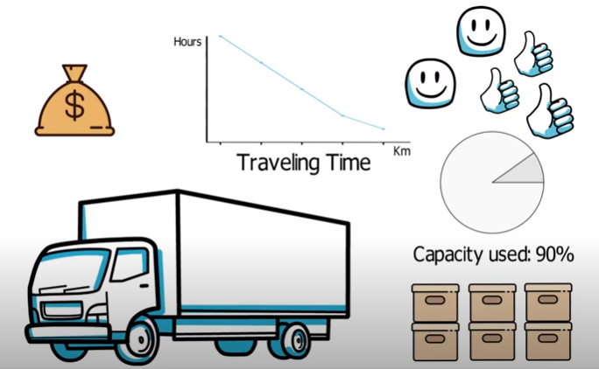
Real Time Example of GWO : Vehicle Routing Problem
By using GWO it gets best Efficient way of Solution and Provides best Rotes (Shortest Path First )for the Stores

Slide 34
Reference
S. Mirjalili, S. M. Mirjalili, and A. Lewis, "Grey Wolf
Optimizer," Advances in Engineering Software,
vol. 69,pp.46-61, 2014

Slide 35
THANK YOU

