Slide 1
KDD Cup 2014 - Predicting Excitement at DonorsChoose.org
CS5228 Project by Group 8
Raymond
Muthu Kumar Chandrasekaran
Peter

Slide 2



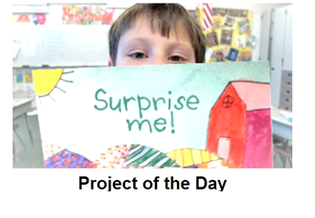
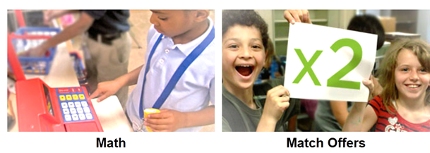

Slide 3


Donors need to evaluate every project to recommend for funding

Slide 4
Outline
Problem Statement
Data
Data preprocessing
Predictive Model
Features
Learning algorithm: Max-Ent
Experiments and Results
Conclusions

Slide 5
Problem: Predict “exciting” vs “not exciting”

Slide 6
Ours is the 7th best Solution

Slide 7
Data provisioned by Kaggle

Slide 8
Too much history is useless!

Slide 9
Outline
Problem Statement
Data
Data preprocessing
Predictive Model
Features
Learning algorithm: Max-Ent
Experiments and Results
Conclusions

Slide 10
Features
Binary
Categorical
Numeric

Slide 11
Learning Algorithm: Max-Ent
a.k.a Logistic regression (Logit)

Slide 12
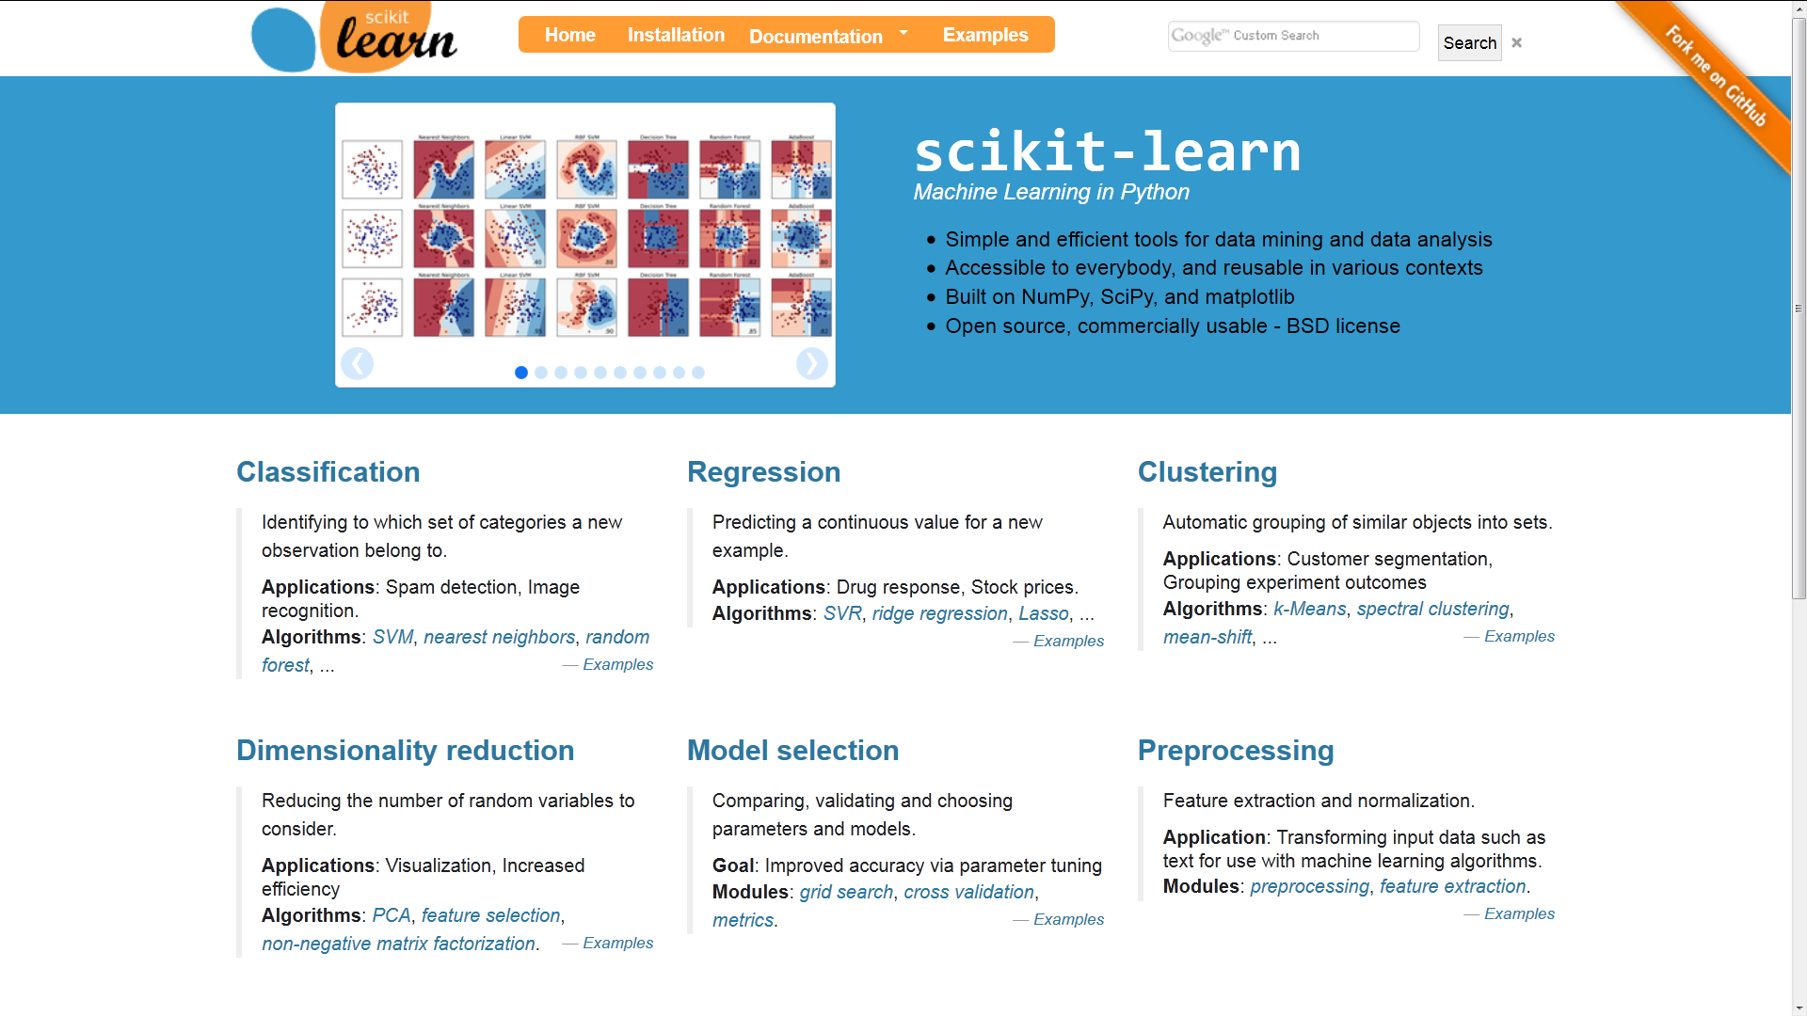

Slide 13
Outline
Problem Statement
Data
Data preprocessing
Predictive Model
Features
Learning algorithm: Max-Ent
Experiments and Results
Conclusions

