Slide 1
KDD Cup 2014 - Predicting Excitement at DonorsChoose.org
CS5228 Project by Group 8
Raymond Hendy Susanto
Muthu Kumar Chandrasekaran
Peter Phandi

Slide 2





Image credits: Donorschoose.org website

Slide 3


Donors need to evaluate every project to recommend for funding

Slide 4
Outline
Problem Statement
Data
Data preprocessing
Predictive Model
Features
Learning algorithm: Max-Ent
Experiments and Results
Conclusions

Slide 5
Problem: Predict “exciting” vs “not exciting”
Train a supervised classifier C to predict if a new proposed project is exciting or not.
The task is a binary classification problem.

Slide 6
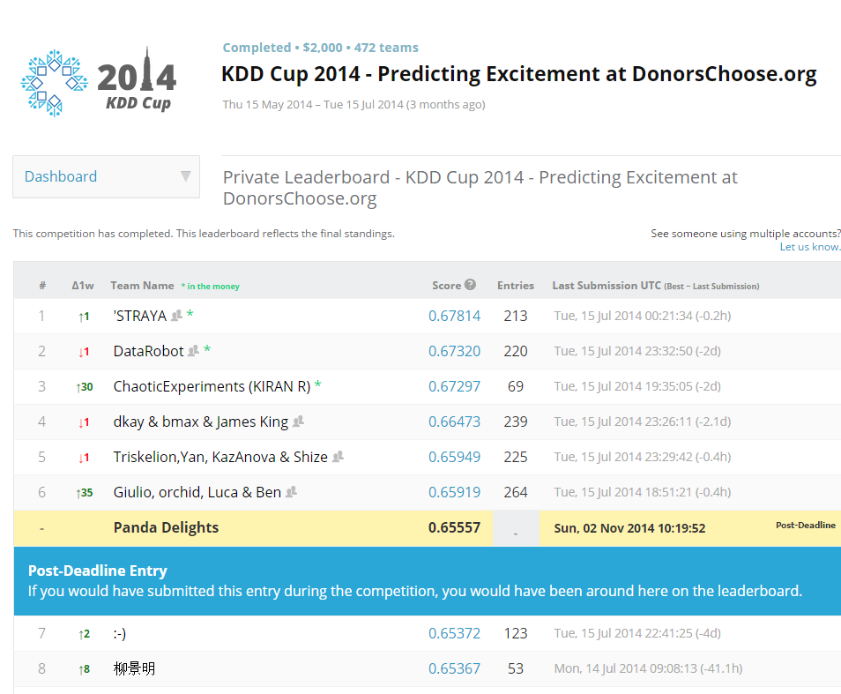
Ours is the 7th best Solution

Slide 7
Data provisioned by Kaggle
Training + Test
projects.csv
essays.csv
resources.csv
Training only
donations.csv
outcomes.csv

Slide 8
Data provisioned by Kaggle
Training:
< 1 January 2014
Test:
>= 1 January 2014

Slide 9
Too much history is useless!
Training set Start date | Training Set Size (# projects) | 3-fold CV Over Training Data | Kaggle public leaderboard score | Kaggle private leaderboard score
All | 619,326 | 0.76894 | 0.58110 | 0.63825
January 2012 | 248,955 | 0.67067 | 0.60727 | 0.65418
July 2012 | 196,770 | 0.65882 | 0.60818 | 0.65557
January 2013 | 131,329 | 0.64538 | 0.60417 | 0.63495

Slide 10
Class Imbalance
Class | # instances
Positive instances (exciting) | 18,670 (~ 9%)
Negative instances (not exciting) | 178,100 (~ 91%)

Slide 11
Outline
Problem Statement
Data
Data preprocessing
Predictive Model
Features
Learning algorithm: Max-Ent
Experiments and Results
Conclusions

Slide 12
Binary Features
School_charter | N
School_magnet | Y
School_year_round | Y
School_nlns | N
School_kipp | Y
School_charter_ready_promise | Y
Teacher_teach_for_america | Y
Teacher_ny_teaching_fellow | N
Eligible_double_your_impact_match | N

Slide 13
Numeric Features
Cost of implementation
e.g., cost of fulfillment
Projected project impact
e.g., number of students impacted by a project

Slide 14
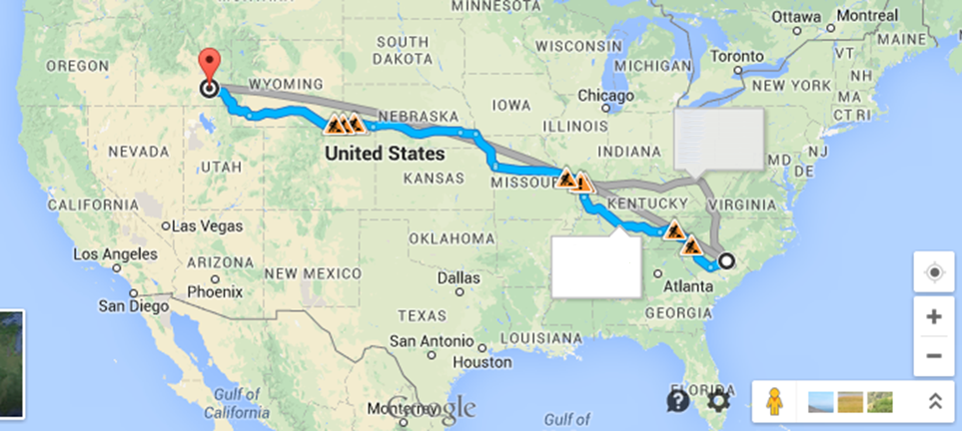
Categorical Features
42.820593, -112.409161
+ve
- ve
34.361999,
-80.063582
It’s all about location, location, location!

Slide 15

Bag of Words from the essay- Unigrams

Slide 16
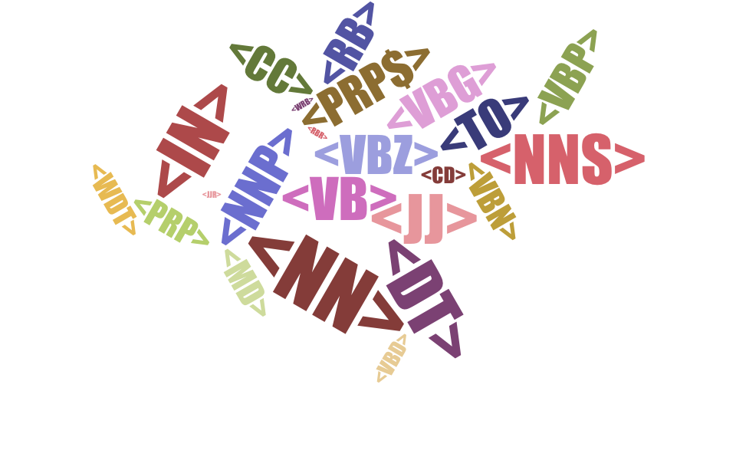
Bag of Words from the essay –
Part Of Speech Tags

Slide 17

Learning Algorithm: Max-Ent
A.K.A Logistic regression (Logit)
L2­regularized Max­Ent model
Regularisation
Max-Ent Model

Slide 18


Slide 19
Ensemble Classifier
Output
Average
Max-Ent 1
Max-Ent 2
Text Classifier
Project meta-data

Slide 20
Outline
Problem Statement
Data
Data preprocessing
Predictive Model
Features
Learning algorithm: Max-Ent
Experiments and Results
Conclusions

Slide 21
Why are we ranked 7th?
Features | 3-fold CV Over Training Data | Kaggle Public Leaderboard Score | Kaggle Private Leaderboard Score
boolean features | 0.55554 | 0.58706 | 0.62673
numerical features | 0.56524 | 0.58742 | 0.62393
categorical features | 0.65185 | 0.60136 | 0.64924
essay | 0.65856 | 0.60812 | 0.65551
pos | 0.65882 | 0.60818 | 0.65557

Slide 22
Late submission has low impact*
12 May
2014
2012
2013
2014
15 May
2014
Training Data
Test Data
Too late!
*Based on clue from Kaggle forum

Slide 23
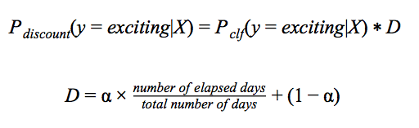
Late submission has low impact : Discount Function

Slide 24
Late submission has low impact*
12 May
2014
2012
2013
2014
15 May
2014
Training Data – No discounts applied
Test Data –Discounted from 10 Feb 2014 onwards
*Based on clue from Kaggle forum

Slide 25
Late submission has low impact
Test Data Type | Kaggle Public Leaderboard Score | Kaggle Private Leaderboard Score
Without discounting | 0.59803 | 0.60173
With discounting | 0.60818 | 0.65557

Slide 26
Discounted vs Not dicounted
Features | 3-fold CV Over Training Data | Kaggle Public Leaderboard Score | Kaggle Private Leaderboard Score
boolean features | 0.55554 | 0.58706 | 0.62673
numerical features | 0.56524 | 0.58742 | 0.62393
categorical features | 0.65185 | 0.60136 | 0.64924
essay | 0.65856 | 0.60812 | 0.65551
pos | 0.65882 | 0.60818 | 0.65557

Slide 27

Ours is the 7th best Solution
Thank you! Questions?
Photo credits : Kooroshication @flickr

