Slide 1
KDD Cup 2014 - Predicting Excitement at DonorsChoose.org
CS5228 Project by Group 8
Raymond
Muthu Kumar Chandrasekaran
Peter

Slide 2






Slide 3


Donors need to evaluate every project to recommend for funding

Slide 4
Outline
Problem Statement
Data
Data preprocessing
Predictive Model
Features
Learning algorithm: Max-Ent
Experiments and Results
Conclusions

Slide 5
Problem: Predict “exciting” vs “not exciting”
Train a supervised classifier C to predict if a new proposed project is exciting or not.
The task is a binary classification problem.

Slide 6
Ours is the 7th best Solution

Slide 7
Data provisioned by Kaggle
Training + Test
projects.csv
essays.csv
resources.csv
Training only
donations.csv
outcomes.csv

Slide 8
Data provisioned by Kaggle
Training: < 1 January 2014
Test: >= 1 January 2014

Slide 9
Too much history is useless!
Training set Start date | Training Set Size (# projects) | 3-fold CV Over Training Data | Kaggle public leaderboard score | Kaggle private leaderboard score
All | 619,326 | 0.76894 | 0.58110 | 0.63825
January 2012 | 248,955 | 0.67067 | 0.60727 | 0.65418
July 2012 | 196,770 | 0.65882 | 0.60818 | 0.65557
January 2013 | 131,329 | 0.64538 | 0.60417 | 0.63495

Slide 10
Class Imbalance
Positive instances (exciting) | 18,670 (~ 9%)
Negative instances (not exciting) | 178,100 (~ 91%)

Slide 11
Outline
Problem Statement
Data
Data preprocessing
Predictive Model
Features
Learning algorithm: Max-Ent
Experiments and Results
Conclusions

Slide 12
Binary Features
school_charter | N
school_magnet | Y
school_year_round | Y
school_nlns | N
school_kipp | Y
school_charter_ready_promise | Y
teacher_teach_for_america | Y
teacher_ny_teaching_fellow | N
eligible_double_your_impact_match | N

Slide 13
Numeric Features
Cost of implementation
e.g., cost of fulfillment
Projected project impact
e.g., number of students impacted by a project

Slide 14
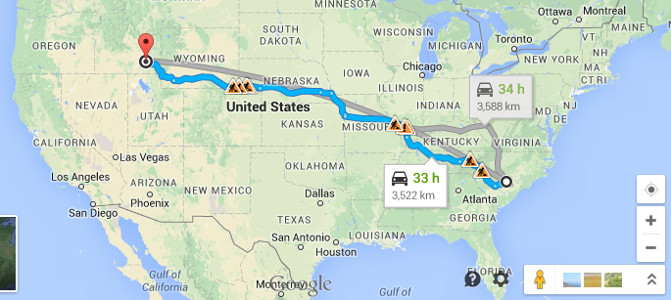
Categorical Features
42.820593,-112.409161
34.361999,-80.063582
It’s all about location, location, location!

Slide 15


Slide 16
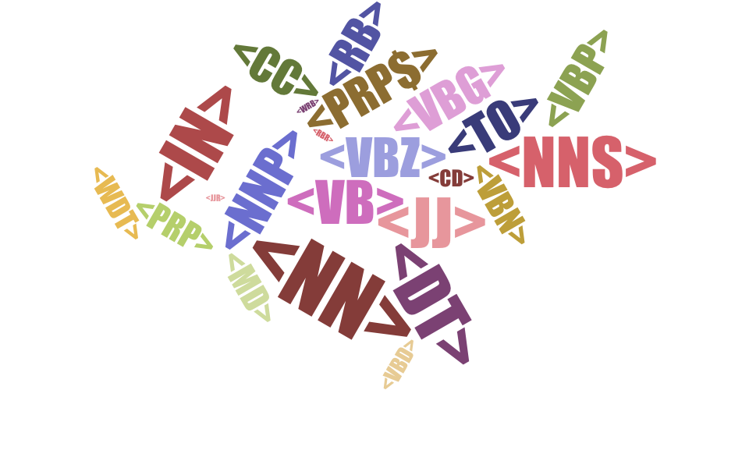

Slide 17

Learning Algorithm: Max-Ent
a.k.a Logistic regression (Logit)
L2­regularized Max­Ent model

Slide 18


Slide 19
Ensemble Classifier
Output
Average
Text
Project

Slide 20
Late submission has low impact
15 May 2014
2012
2013
2014
12 May 2014
Based on clue from Kaggle forum

Slide 21
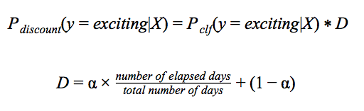

Slide 22
Test Data Type | Kaggle Public Leaderboard Score | Kaggle Private Leaderboard Score
without discounting | 0.59803 | 0.60173
with discounting | 0.60818 | 0.65557

Slide 23
Outline
Problem Statement
Data
Data preprocessing
Predictive Model
Features
Learning algorithm: Max-Ent
Experiments and Results
Conclusions

Slide 24
Why are we ranked 7th?
Features | 3-fold CV Over Training Data | Kaggle Public Leaderboard Score | Kaggle Private Leaderboard Score
boolean features | 0.55554 | 0.58706 | 0.62673
numerical features | 0.56524 | 0.58742 | 0.62393
categorical features | 0.65185 | 0.60136 | 0.64924
essay | 0.65856 | 0.60812 | 0.65551
pos | 0.65882 | 0.60818 | 0.65557

