Slide 1
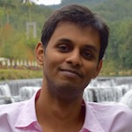
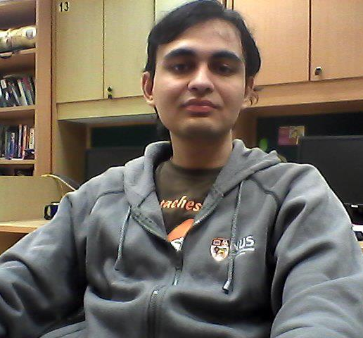
Basics of Deep Learning
Workshop on Educational and Social Science Technologies (WESST 2017, 19—21 July)
Animesh Prasad
Muthu Kumar Chandrasekaran

