Slide 1
CONDITION BRIEFING ENGINE
Evidence-grounded medical briefings—that show their work
Facts first
Every fact is pulled from ClinicalTrials.gov, PubMed, NIH and FDA registries before any AI writes a word.
A strategy team asks about a medical condition—current standard of care, treatments coming down the pipeline, who's building them. Generic AI tools answer fluently and occasionally invent a clinical trial number that doesn't exist. This system is built so that cannot happen.
Cited, not claimed
Every sentence links back to the exact source document it came from—one click to verify.
Checked by machine
Automated checks confirm every citation, trial number, and drug name is real before a briefing ships.
Condition Briefing Engine · Overview
Confidential — prepared for stakeholder review

Slide 2
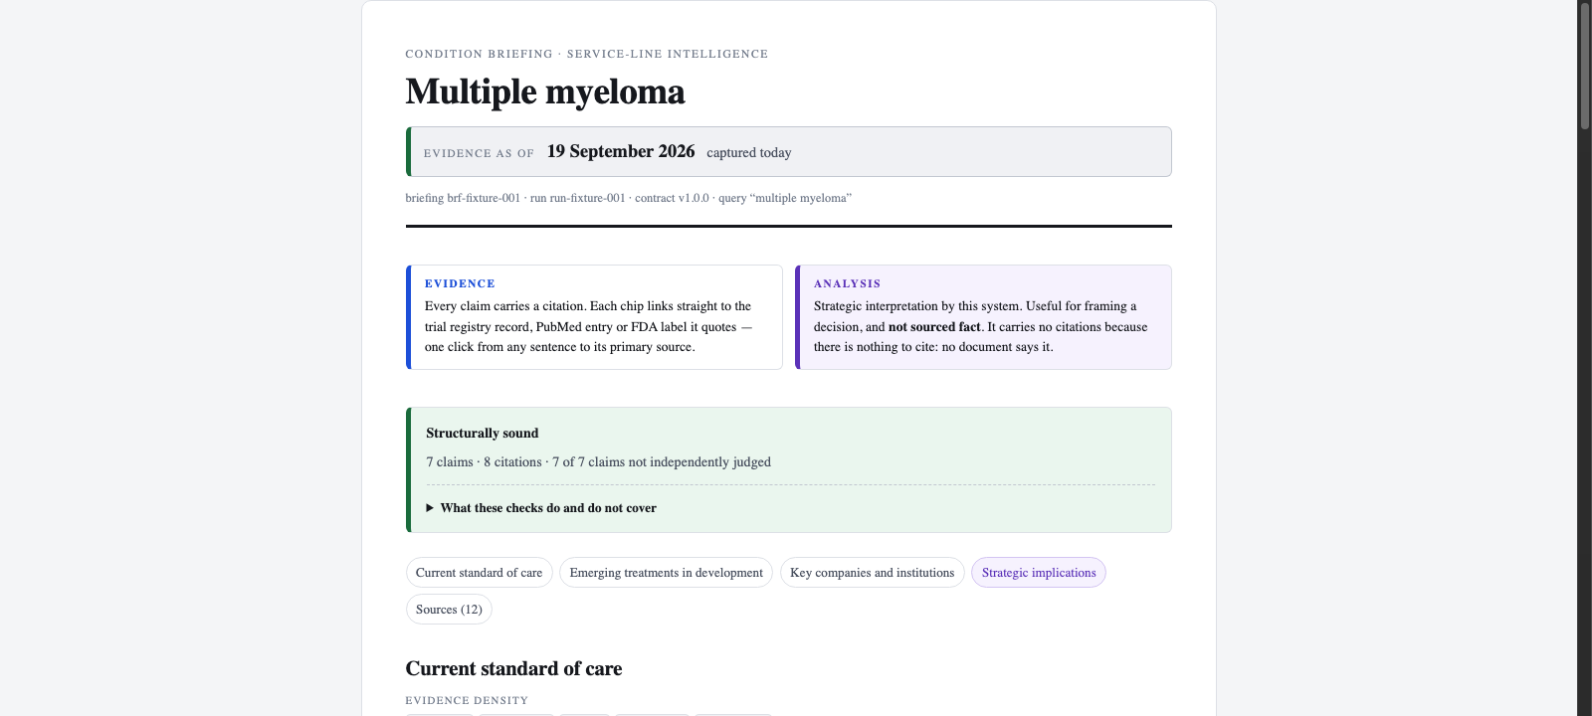
Two kinds of answer, never blurred together
Every briefing separates documented fact from strategic interpretation—visually and structurally—so a reader always knows which is which.
EVIDENCE
Every claim carries a citation—linked straight to the trial registry, journal article, or FDA label it came from.
ANALYSIS
Clearly labeled strategic interpretation—useful for framing a decision, and never presented as if it were a sourced fact.
Live output — multiple myeloma briefing, generated by the system
Checked automatically before publish:
Every citation traced to a real source · every trial ID verified to exist · every drug and company name confirmed in the underlying evidence
Condition Briefing Engine · How it works
Confidential — prepared for stakeholder review

Slide 3
Where things stand
Built to be defensible, not just fast—and built to scale to any condition.
SOURCED
IN PROGRESS
WORKING DEMO
Retrieval
Synthesis & scoring
Presentation & proof
Pulls directly from ClinicalTrials.gov, PubMed, NIH, and FDA—the same registries clinicians use.
No web search, no guessing: only what these official sources actually say.
Ranks evidence by credibility and recency, tuned per condition—fast-moving oncology vs. stable chronic disease.
Writes the briefing constrained to only quote what the sources contain.
The clickable briefing view shown on this deck is live today.
Automated scoring plus clinician spot-checks validate quality before wider rollout.
Not a diagnostic tool.
This system informs strategy and planning conversations. It is not clinical decision support, not a medical device, and it never touches patient data.
Condition Briefing Engine · Status & guardrails
Confidential — prepared for stakeholder review

