Slide 1
Group 04 : The League of Extraordinary Programmers
Jason Knight
Colin Larson
Jiayuan Hu
Luke Robinson

Slide 2
What is Nextbooks?
Today everything is digital. Books, movies, music, and games are some of the things that can be distributed and consumed solely using digital means. We think textbooks are long overdue to be added to that list and it is for this reason that we decided to create Nextbooks.
Nextbooks is a digital platform that aims to centralize all textbook related activities of students, and facilitate ease of access to materials that would otherwise be difficult to have on hand at all times.
Nextbook users will be able to search for, rent, and access their textbooks from any internet capable computer. Rental periods will correspond to the length of the course for which the book is required.

Slide 3
Why make a digital textbook rental service?
Several reasons why students would prefer a digital platform for their textbook access and rental activities.
Almost all students carry a laptop while on campus.
Students dislike carrying multiple heavy textbooks around all day.
Buying textbooks at the campus bookstore has several inconveniences.
  Long Lines
  Needed books may not be in stock
Rentals are less expensive then purchasing a physical copy.
Several reasons why lower priced textbooks will still be a good business model.
No manufacturing required, costs of production, including materials and labour, are negated.
No shipping, costs of shipping and handling negated.
No lost sales due to reselling of physical copy.
Lower store markup as digital store has a substantially lower cost of upkeep and fewer staff.

Slide 4
Features of Nextbooks
Each student will have an individual account page presented to them as they log in, from this page several actions are possible.
Search
Students will be able to search the book catalogue for a textbook, searches can be made by author, title, ISBN, and also by the course that the textbook is required for.
Rent
A student can select a book from a search and purchase it to add it to his account for the rental period (1-2 terms, course dependant).
Read
A student can select a textbook from his/her library of current rentals and access it using the e-book reader built into the Nextbooks platform.
Administrator profiles also have the options to add/remove books from the catalogue, and add/remove users from the system.

Slide 5
Use Case Diagram

Slide 6
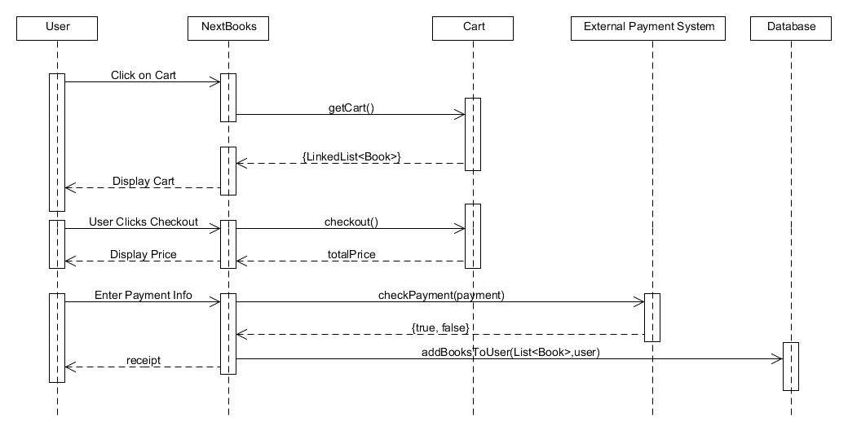
System Seq. Diagram : Purchase a Book

Slide 7
Class Diagram

Slide 8
7. What have you achieved so far? (Screen shots of the projects are allowed): 2-4 slides

Slide 9
Challenges & Experience
Originally we had planned several features that were cut due to time constraints, these features included profile pictures, book reviews, and page notes.

Slide 10
Conclusion
Nextbooks was an attempt to create a platform that could replace traditional bookstores as a way for students to acquire their textbooks. While also providing an easy way to access their textbooks without the hassle of lugging heavy physical copies of the books around campus.
We feel we were ultimately successful in the execution of our original design sans some minor details that were cut for various reasons.

