Slide 1

Reusing Conceptual Models with CML
Quenio Cesar Machado dos Santos & Raul Sidnei Wazlawick
Computer Sciences | Universidade Federal de Santa Catarina | Brazil

Slide 2

CML
Textual Modeling Language
  Think of Light-UML + OCL in One Language
  Concepts
  Generalization / Specialization
  Associations
  Derived Attributes & Associations
  Functions
Extensible Compiler
  Supports Modules
  Extensible Templates
  Targets Any Programming Language / Technology

Slide 3
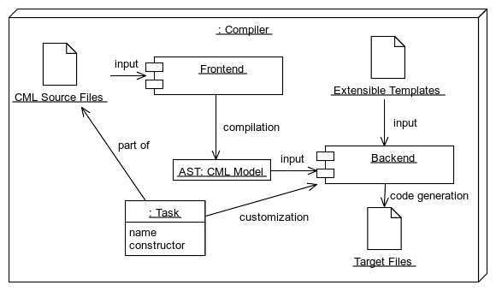
Overall Architecture

Slide 4
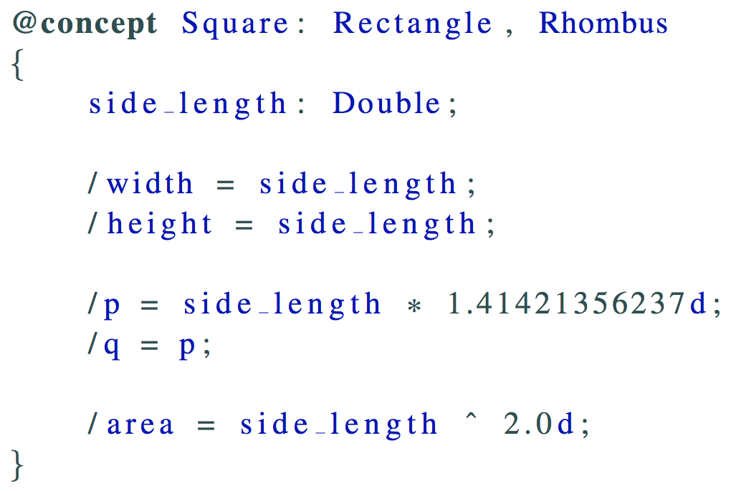
Generalization / Specialization

Slide 5
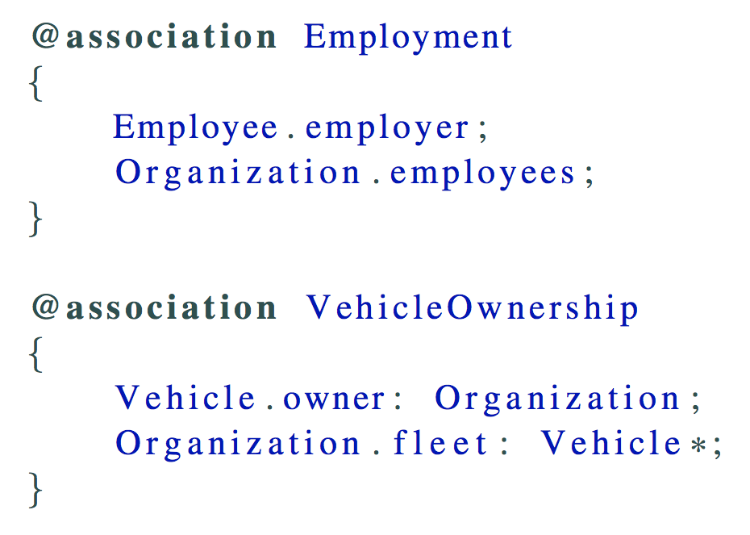
Associations

Slide 6
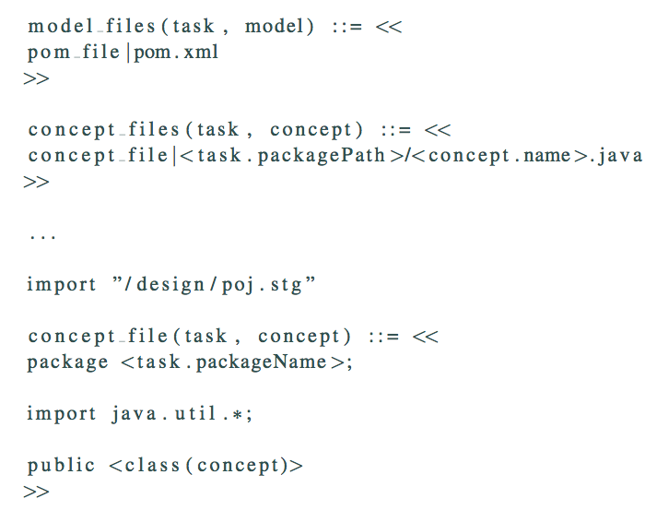
Extensible Templates

Slide 7
Development Status
Compiler: Very Early Alpha Version
But Supports
Generalization / Specialization
Associations
Derived Attributes / Associations
Bootstrapped: Metamodel being modeled in CML
Language: Specification In Progress
Very Detailed
  Metamodel
  Model Synthesis
  Model Validation
  Type Inference / Conformance
  Model Translation

Slide 8
Would you like to see more?
Quenio
quenio.santos@grad.ufsc.br

