Slide 1




CENG EDITOR
Project-III
Computer Engineering
CME1252
Project Based Learning - II
By
Dilara Karacan
Qusai Almoqadam
Cemil Dalar
2019510047
2020510120
2019510025

Slide 2
PRESENTATION OUTLINE:
Introduction
Progress Summary
Requirements
Task Schedule
Task Sharing
Completed Tasks
Incomplete Tasks, Reasons and Explanations.
Additional Improvements
Problems Encountered
Algorithms And Solution Strategies.
Screenshots
Conclusion
References.

Slide 3
INTRODUCTION!
The goal of the project is to develop a simplified console editor.

Slide 4
PROGRESS SUMMARY
Requirements:
Java knowledge
OOP knowledge
Java knowledge
Mll knowledge
Integrated Development Environment
Adobe illustrator
PowerPoint

Slide 5
Task Schedule
01
02
First Week:
Discussing and designing solution alternatives. Creating the necessary variables, structures. Screen.
01
Second Week:
Load/save. Cursor movement. Entering and deleting characters/words.
Third Week:
03
Insert/overwrite modes. Special keys.

Slide 6
Task Schedule
Fourth Week:
Selection. Cut/copy/paste. Find, replace.
04
Fifth Week:
05
Alignment. Remaining parts of the program, testing/debugging.

Slide 7
TASK SHARING
Dilara Karacan
Qusai Almoqadam
Cemil Dalar
Selection part.
Copy/ Cut/ paste.
Find/ Replace.
Special keys.
Creating the necessary variables, structures. Screen.
Load /save.
Find part.
Presentation.
Poster.
Mll class.
Entering and deleting characters/words.
Back space and delete keys.

Slide 8
COMPLETED TASKS
Cursor movement and screen.
Load and save.
Insert/Overwrite modes.
Special keys.
Selection.
Cut/Copy/Paste.
Find/ Replace.
Alignment.

Slide 9
INCOMPLETE TASKS
There is not incomplete tasks

Slide 10
ADDITIONAL IMPROVEMENTS
-Paragraphs are automatically capitalized.
-When something is deleted in the remove function, the position of the following lines also changes properly

Slide 11
PROBLEMS ENCOUNTERED
Null pointer exception error.
Wrong character deletion error.
Adding to wrong location is in add function.
pasting in wrong place.
Mll methods errors.

Slide 12
SOLUTION STRATEGIES
Whenever the team had
problems, we solved it by
Consulting with the professor
Using breakpoints
Using
debugging tool
Researching online

Slide 13
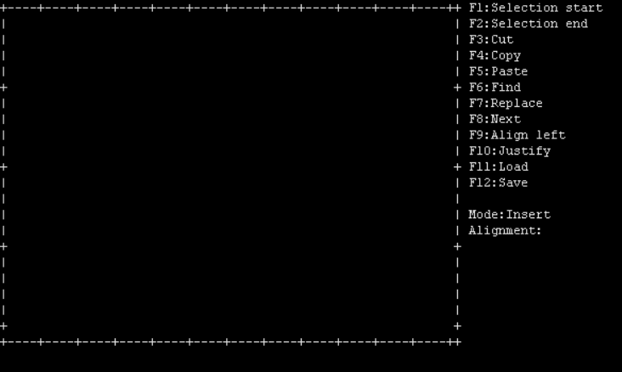
SCREENSHOTS

Slide 14
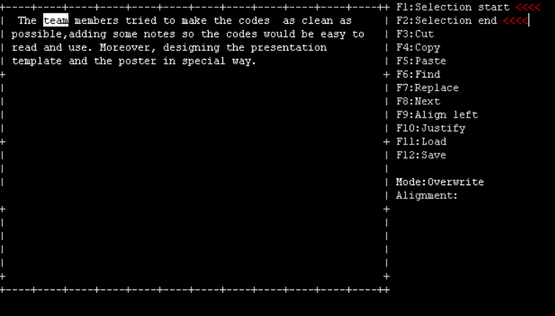
SCREENSHOTS

Slide 15
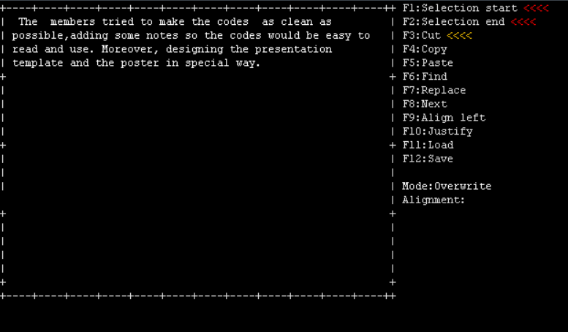
SCREENSHOTS

Slide 16

SCREENSHOTS

Slide 17
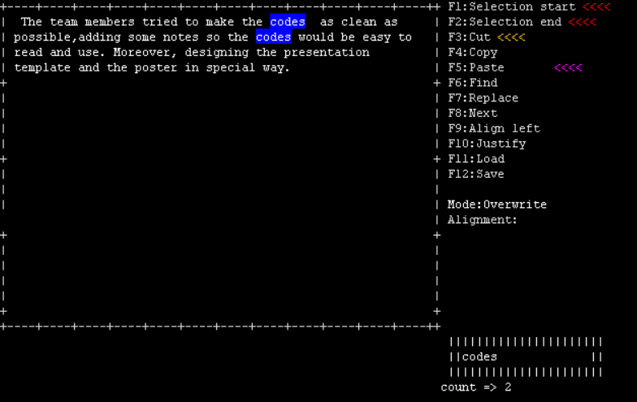
SCREENSHOTS

Slide 18
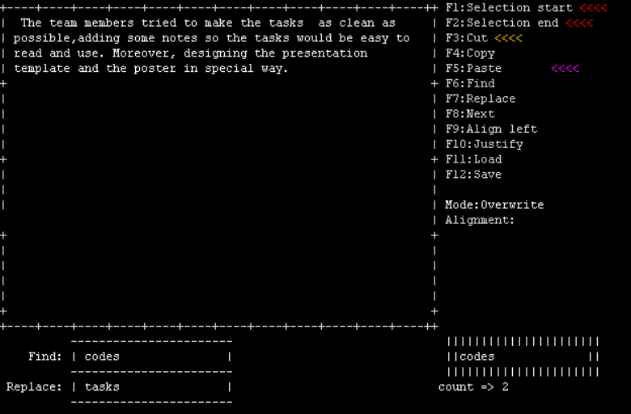
SCREENSHOTS

Slide 19
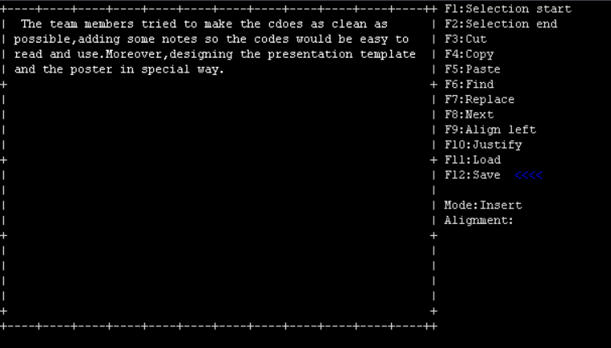
SCREENSHOTS

Slide 20
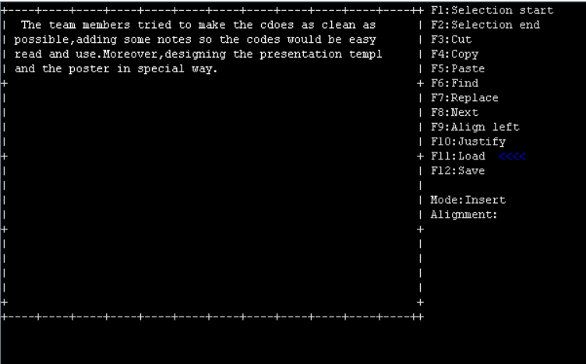
SCREENSHOTS

Slide 21
CONCLUSION
The team members tried to make the codes as clean as possible, adding some notes so the codes would be easy to read and use. Moreover, designing the presentation template and the poster in special way. Also, The team members have worked together as a professional team and learn many skills like time managing and dividing tasks. In conclusion, the assignment took five weeks to be finished, All member of the team worked so hard in order to provide the best version possible.

Slide 22
REFERENCES:
An Introduction to Object-Oriented Programming with Java, 5th Edition, McGraw-Hill, 2009.
Michael T. Goodrich, Roberto Tamassia, Data Structures and Algorithms in Java, Wiley.
https://www.geeksforgeeks.org
https://stackoverflow.com

Slide 23
THANKS

