Slide 1



Project Car Rental
CME 1252 PROJECT BASED LEARNING 2
Prepared by:
2019510075 Alptuğ TOPALHAN
2019510063 Sıla İdil MURAT
2019510025 Cemil DALAR

Slide 2

OUTLINE
INTRODUCTION
PROGRESS SUMmary
Requirements
Task Sharing
Scheduling
Completed Tasks
Incomplete Tasks: Reasons, Explanations
Additional Improvements
PROBLEMS ENCOUNTERED
ALGORITHMS AND SOLUTION STRATEGIES
SCREENSHOTS
conclusıon
REFERENCES

Slide 3


INTRODUCTION
The aim of this project is to manage a car rental system that works stably for a car rental company.
The company can see the daily income-expense, profit-loss amount and statistics for the last 10 days.
The company can update workers, cars, offices.

Slide 4

PROGRESS SUMMARY
Requirements
Task Sharing
Scheduling
Completed Tasks
Incomplete Tasks: Reasons, Explanations
Additional Improvements

Slide 5
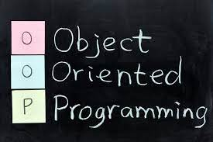


REQUIREMENTS
Object oriented programming
Eclipse
Teamwork
Canva

Slide 6
Task SHARING
Alptuğ TOPALHAN | Cemil DALAR | Sıla İdil MURAT
Creating office class ,customer class ,car and class employee class. | Creating date class ,carrequest class and contract class. | Improvement methods to employee class ,car class and office class.
Getting input from the user. Creating class methods | Making CarRequest commands. Making contracts. Creating class methods | Making system recommendations Creating class methods
Making nextday operations(office profits and statistics) | Making randomcarrequest methods | Making deleteemployee and deleteoffice methods
Test and debugging | Test and debugging | Test and debugging

Slide 7
SCHEDULING
FIRST WEEK | SECOND WEEK | THIRD WEEK | FOURTH WEEK | FIFTH WEEK
Discussing and designing solution alternatives. Creating the necessary variables, structures. Screen. | Class designs. Attributes/methods. Add and list commands for office/employee. | Add and list commands for car/customer. Delete commands for office/employee. | Add and list for CarRequest commands. Making contracts. listContract command. | Command nextday operations (Office profits, statistics and system recommendations). Remaining parts of the application. Testing/Debugging.

Slide 8

COMPLETED TASKS
Attributes,constructors and methods of classes
Add,list and delete commands
Random request for car
Systems recommendations,office profits and statistics.
Getting inputs from the user
Reading text file operations

Slide 9

INCOMPLETE TASKS: REASONS, EXPLANATIONS
There is no incompleted tasks, all the tasks assigned to us were completed on time.

Slide 10
ADDITIONAL IMPROVEMENTS
Understandable codes with comment lines and meaningful variables.

Slide 11


PROBLEMS ENCOUNTERED
Null errors
Controlling availability of car and employee for contract
Calculation error of the bonus given to the employee
Invalid date errors
Delete office error

Slide 12
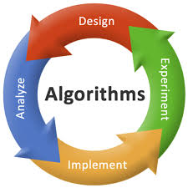
ALGORITHMS AND SOLUTION STRATEGIES
Error messages were shown on console easily by using Boolean variables.
Shifting method are used to delete employee and office.

Slide 13
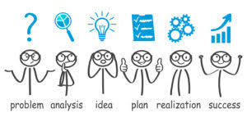
Think:
Analyze the problem
Restate the problem
Write out examples of input and output
Breake the problem into its component parts
We discussed how to convert samples to code
Execute:
Code it up
Step through our example data with our code
Test your solution against our examples
Find the errors
Fixing the errors we find

Slide 14
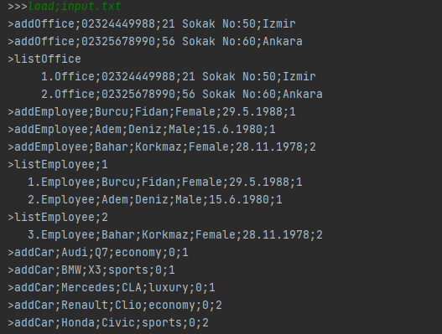
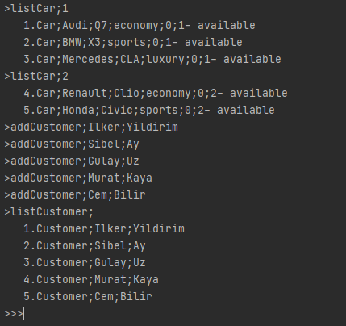
SCREENSHOTS

Slide 15
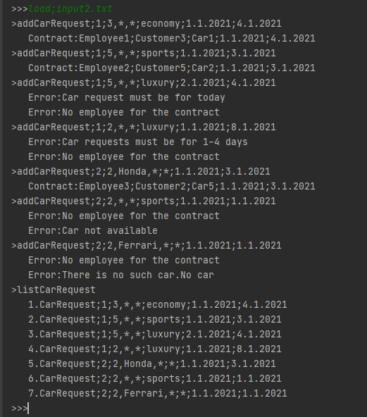

Slide 16
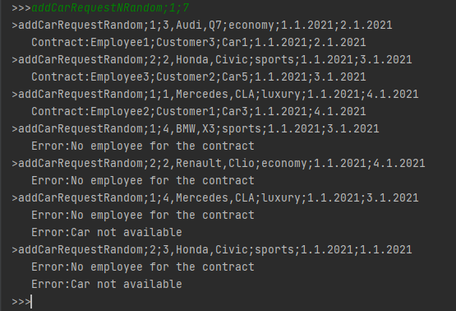
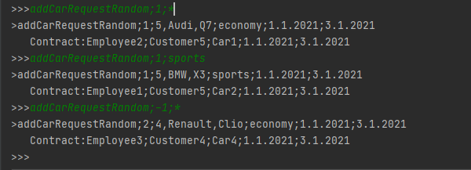

Slide 17
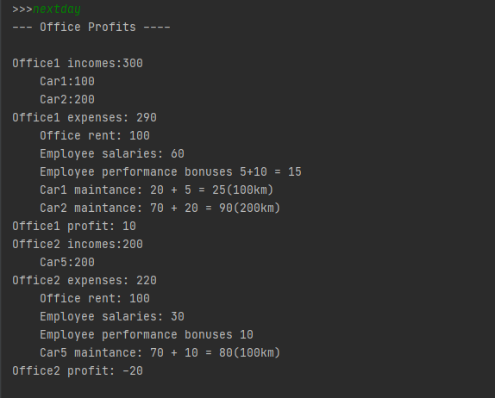

Slide 18
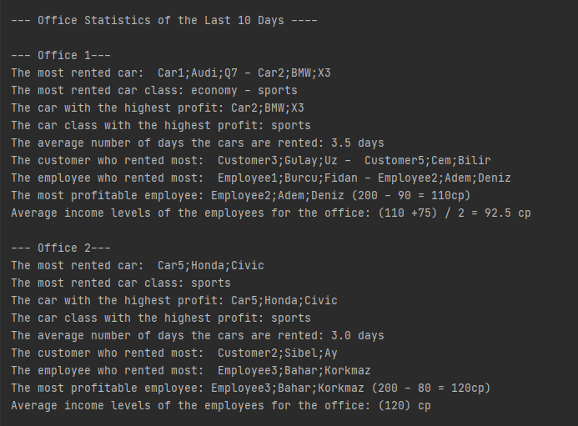
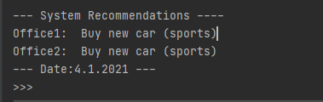

Slide 19

conclusıon
Task sharing
Take responsibility
Solving problems
Find and fix errors
Finding something new and using them
Present to other people

Slide 20

REFERENCES
CME1212 ALGORITHMS AND PROGRAMMİNG 2 RESOURCES
https://www.javatpoint.com/object-and-class-in-java
https://stackoverflow.com/questions/7970857/java-shifting-elements-in-an-array
https://docs.oracle.com/javase/tutorial /

