Slide 1
Deep Neural Networks
Janghun Jo
Computer Graphics Lab.
jhjo432@postech.ac.kr
1
Notes:
1

Slide 2
Contents
Classification
XOR problem
Regression
Non-linear regression with DNN
Robust regression
1

Slide 3
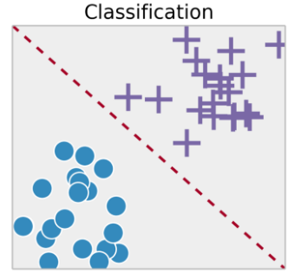
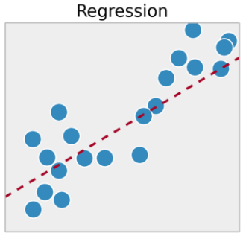
Classification and Regression
Machine learning tasks have two types
Classification : predict class with categorical data
Regression : predict continuous value
1
Notes:
1

Slide 4
Classification
Classification: predict class with categorical data
Logistic regression
Single layer
Sigmoid activation function
Softmax regression (for multi class Classification)
Single layer
Softmax activation function
DNN classifier
Note: Logistic regression and Softmax regression are not regression algorithms.
1

Slide 5
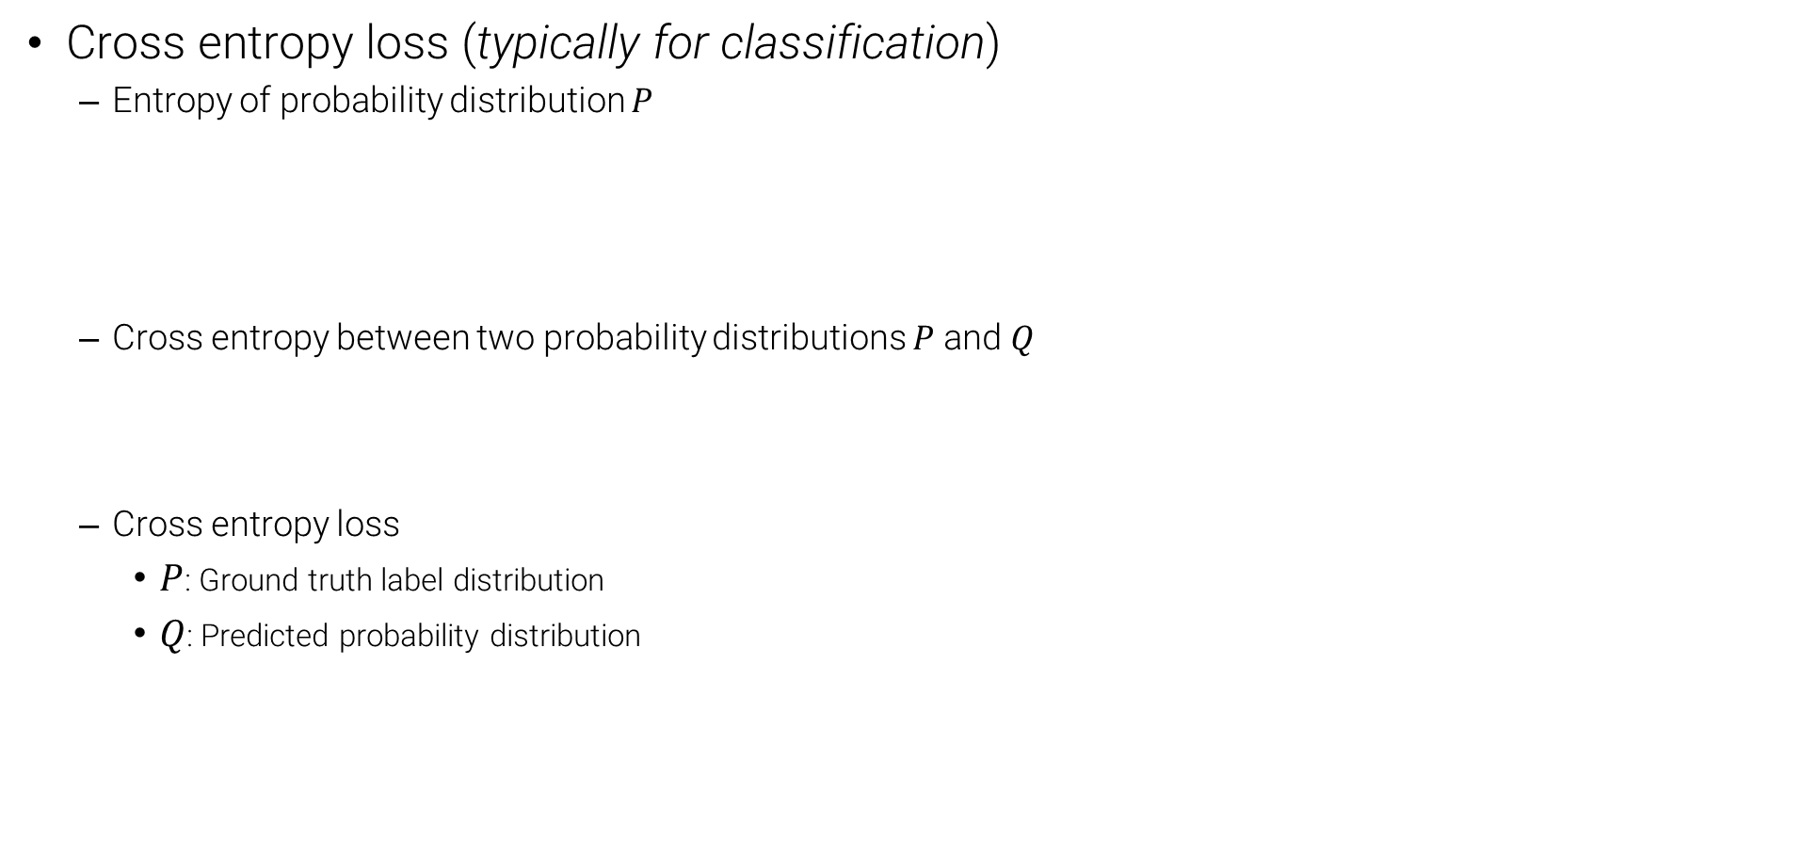
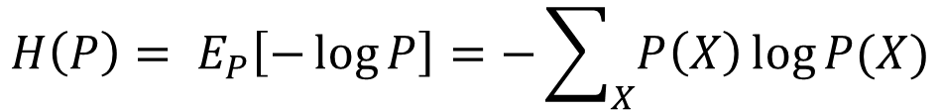
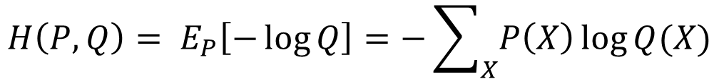
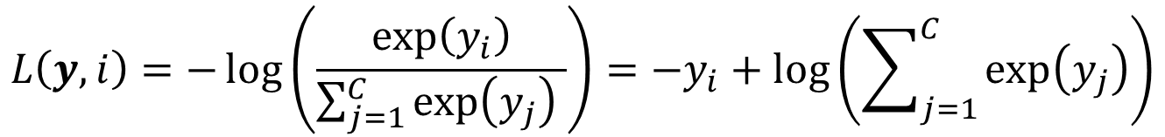
Loss function for Classification
1
Notes:
Entropy: a function of probability distribution (function of function = functional)
<number>

Slide 6











Multilayer Perceptron
Stacking layers of multiple perceptrons
Advantages
Nonlinear classification: More complex decision boundary can be defined using multiple layers.
Typically achieves better performance.
$W_{1}$
$W_{2}$
$W_{3}$
$x_{1}$
$x_{2}$
$x_{d}$
1

Slide 7





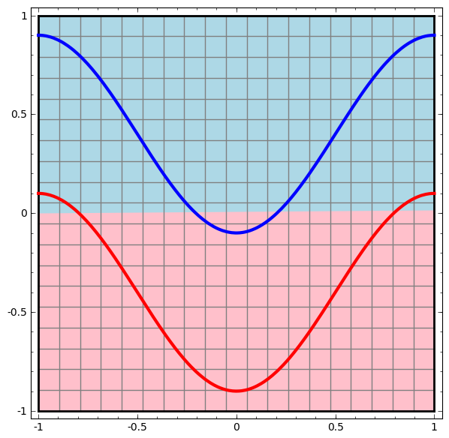
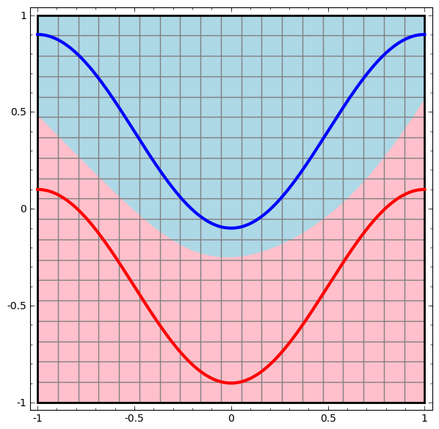
Multilayer Perceptron
Single Perceptron
Multi-layer perceptron
$x_{1}$
$x_{1}$
$x_{2}$
$x_{2}$
Data transformation
A new representation
1

Slide 8
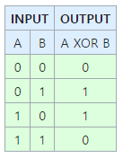
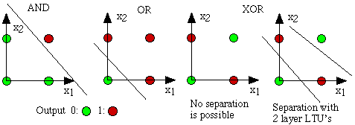
XOR Problem
What is the XOR operation?
Exclusive OR
XOR gives a True output when the number of True inputs is odd.
XOR problem: predict output of XOR operation using a neural network.
Single layer neural networks cannot solve the XOR problem
Data points are not linearly separable.
Deep Neural Networks can solve the XOR problem.
1

Slide 9
Quiz 1. Solving XOR problem
XOR 데이터 셋 구현
Network 구현
single layer network구현
Fully connected layer - in_features: 2, out_features: 1
DNN 구현
Fully connected layer - in_features: 2, out_features: 20
Fully connected layer - in_features: 20, out_features: 20
Fully connected layer - in_features: 84, out_features: 1
Note
Apply ReLU activation function for hidden layers.
Apply Sigmoid activation function for output layers.
Define a Loss function and optimizer
Cross-Entropy loss
SGD with learning rate 0.01 and momentum 0.5
Train the network on the training data
Test the network on the test data
1
Notes:
<number>

Slide 10
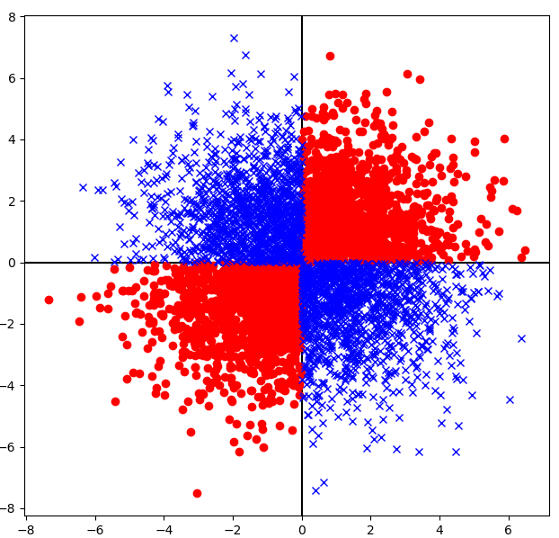
Creating XOR Dataset
We can make XOR dataset using torch.randn function
Generate random (x, y) using torch.randn function
if x * y < 0 then label should be 0
else (x * y >= 0) then label should be 1
1

Slide 11
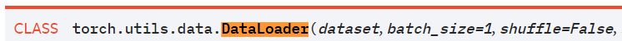
Recap: How to make datasets?
All datasets are subclass of torch.utils.data.Dataset
Make new class and inherit torch.utils.Dataset
It should have __len__(self) method and __getitem__(self, idx) method
__len__(self): returns size of dataset
__getitem__(self, idx): returns (idx)th data sample in Dataset
torch.utils.data.DataLoader reads datasets and make the batch
dataset – dataset from which to load the data. (torch.utils.data.Dataset)
batch_size – how many samples per batch to load (default: 1)
shuffle – set to True to have the data reshuffled at every epoch (default: False).
Usage: for batch_idx, data, label in enumerate(trainloader)
1

