Slide 1
Some observations of DLM performance from empirical cdfs
Liz Brooks
29 sept 2021

Slide 2
Interpreting colors/line types of legend
Color spectrum = retro source (green/blue Catch retro; red/orange M retro)
Line type = fishing history (solid is F1; dashed is F2)
Intensity = ACL scalar (Dark is 1; light is 0.75)
Color = selectivity blocks (green & red is 1 block; blue and pink is 2 blocks)
Selectivity doesn’t have huge impact so could collapse this factor
Plots can be read like this
The intersection of any ecdf line and the grey polygon tells you the median for that method/scenario (read intersection point down to x-axis)
The intersection of any ecdf and a vertical reference line (at 0.5 and 1.0) tells you what proportion of the distribution is above or below that reference (read intersection point across to y-axis)
Example (on slide 4): for DLM method, short term SSB for the scenario in light blue dashed line, the median SSB/SSBmsy is just above 0.5 and there is about a 12.5% probability that SSB/SSBmsy is >1

Slide 3
Take homes (focused on DLM, PBS, SCAA which seem to be top performers)
Now that full SCAA runs completed, our previous statement that it did as well or better than DLM methods is not quite accurate
Short-term catch has tendency to be overestimated for SCAA, specifically for scenarios with catch as source of retro (ehhh… red flag for this region??), although long-term catch appears appropriate [slide 6]
Some short-term overfishing in DLM and PBS when fishing history = F2, but that is resolved in long-term summaries, and it occurs for fewer scenarios than SCAA and those instances are far less egregious [slide 5]
Short-term, there were fewer scenarios resulting in overfished condition for DLM and PBS compared to SCAA; long-term, both DLM and PBS achieve rebuilding for all scenarios while SCAA still has a few scenarios with median SSB/SSBmsy < 0.5 (so still overfished) [slide 4]

Slide 4
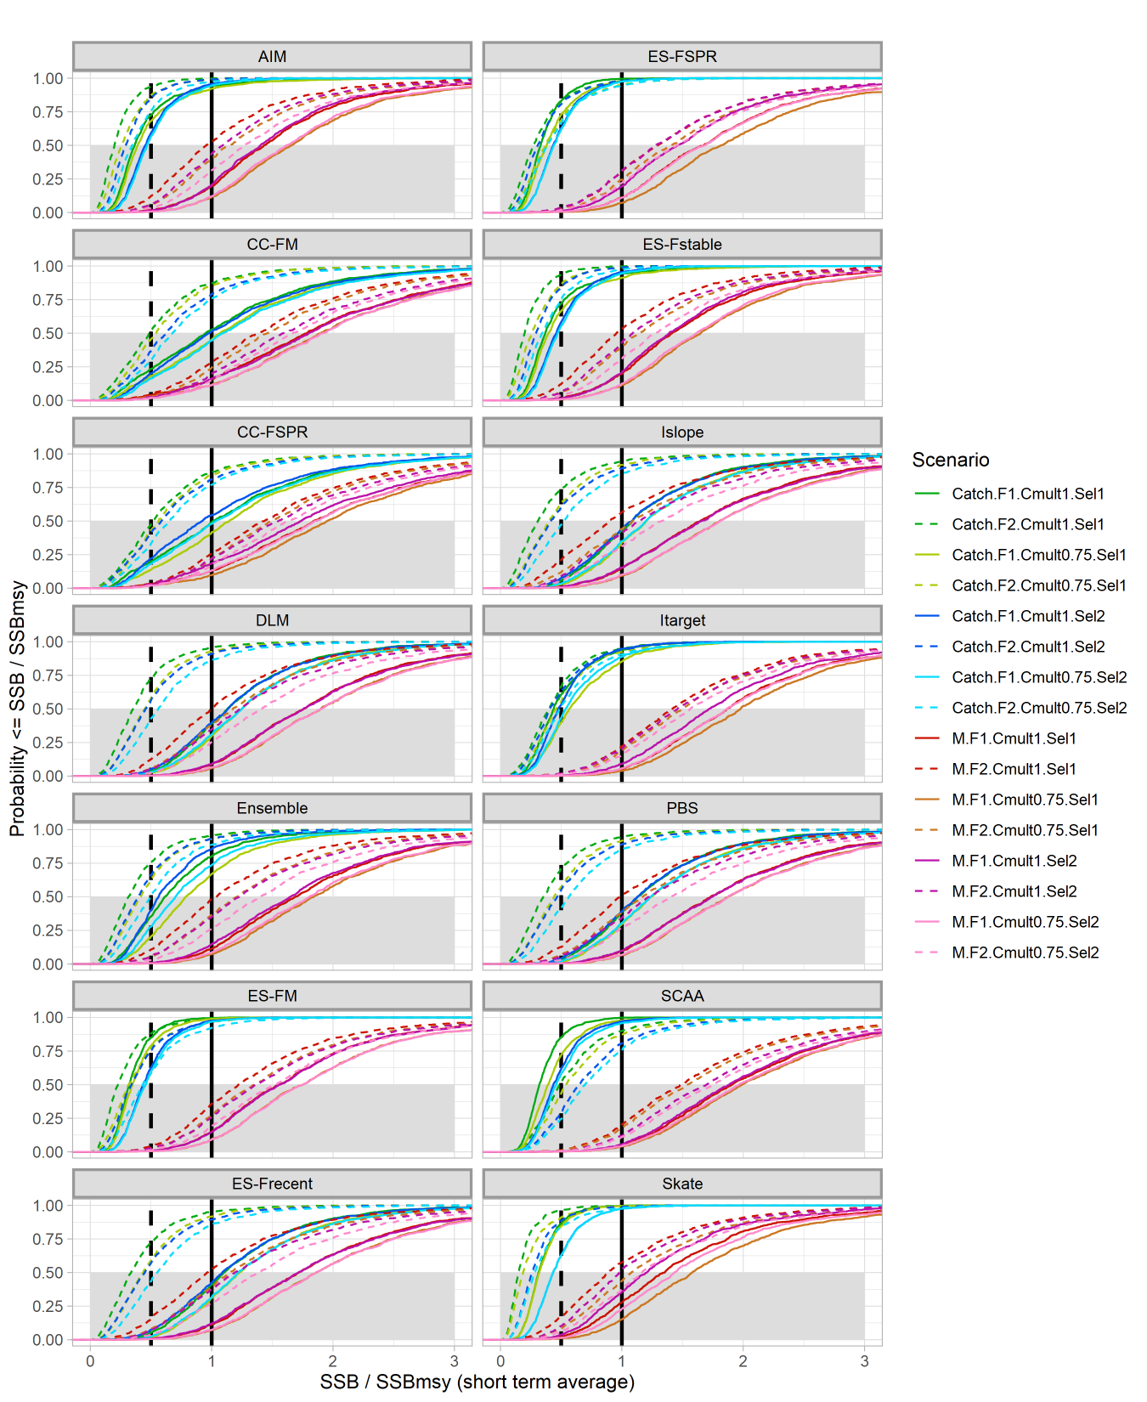
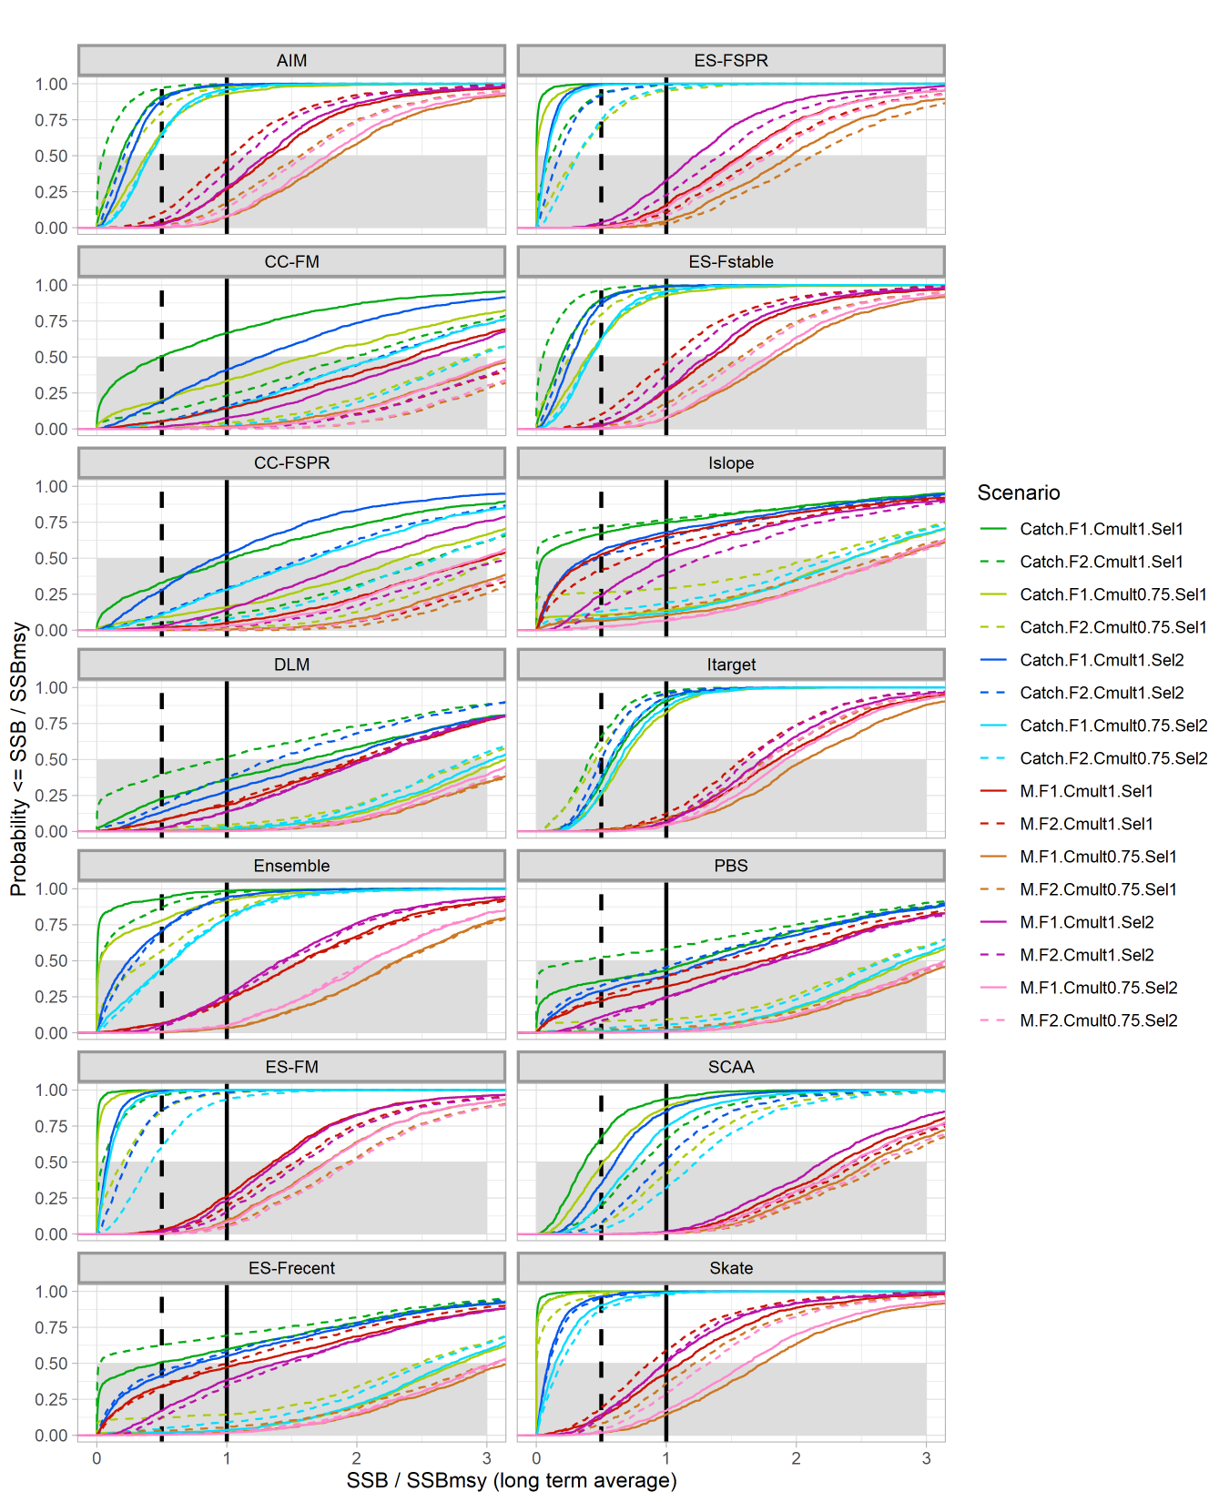
Short-term
Long-term
Notes:
Generally, we want to see more of the distribution above 0.5 (overfished limit, vertical dashed line) and closer to 1 (target, vertical solid line)
All methods perform well when M is the source of the retro (red/orange/pink/violet); *nice result when using data-poor method and M is unknown (~always the case); true for short and long term
Many methods resulted in short-term overfished when catch was source of retro (green/blue); some achieved rebuilding while others did not; most challenging rebuilding was the F2 scenario for catch-retro (dashed green and dashed blue)
DLM and PBS has less overfished scenarios, both short and long-term, than SCAA;
AIM, ES-FSPR, ES-Fstable, Itarget, Ensemble, ES-FM, and Skate should not be used if catch is suspected to be source of retro (though they perform fine if M is the source)
Islope had mixed results

Slide 5
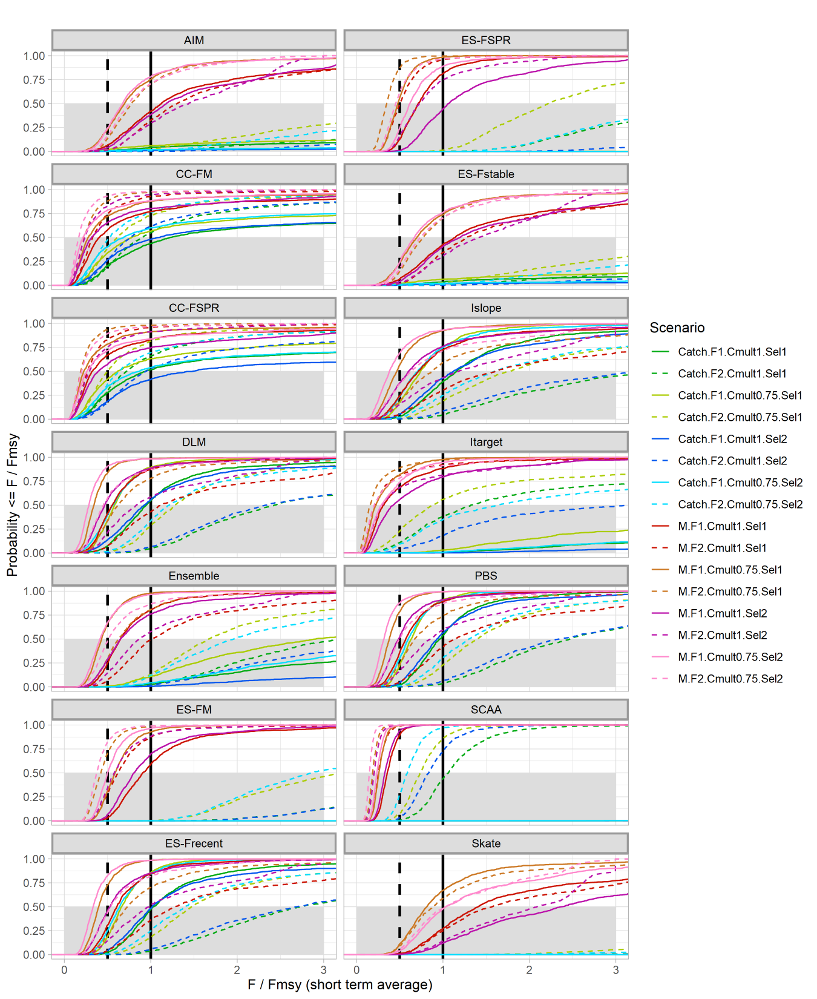
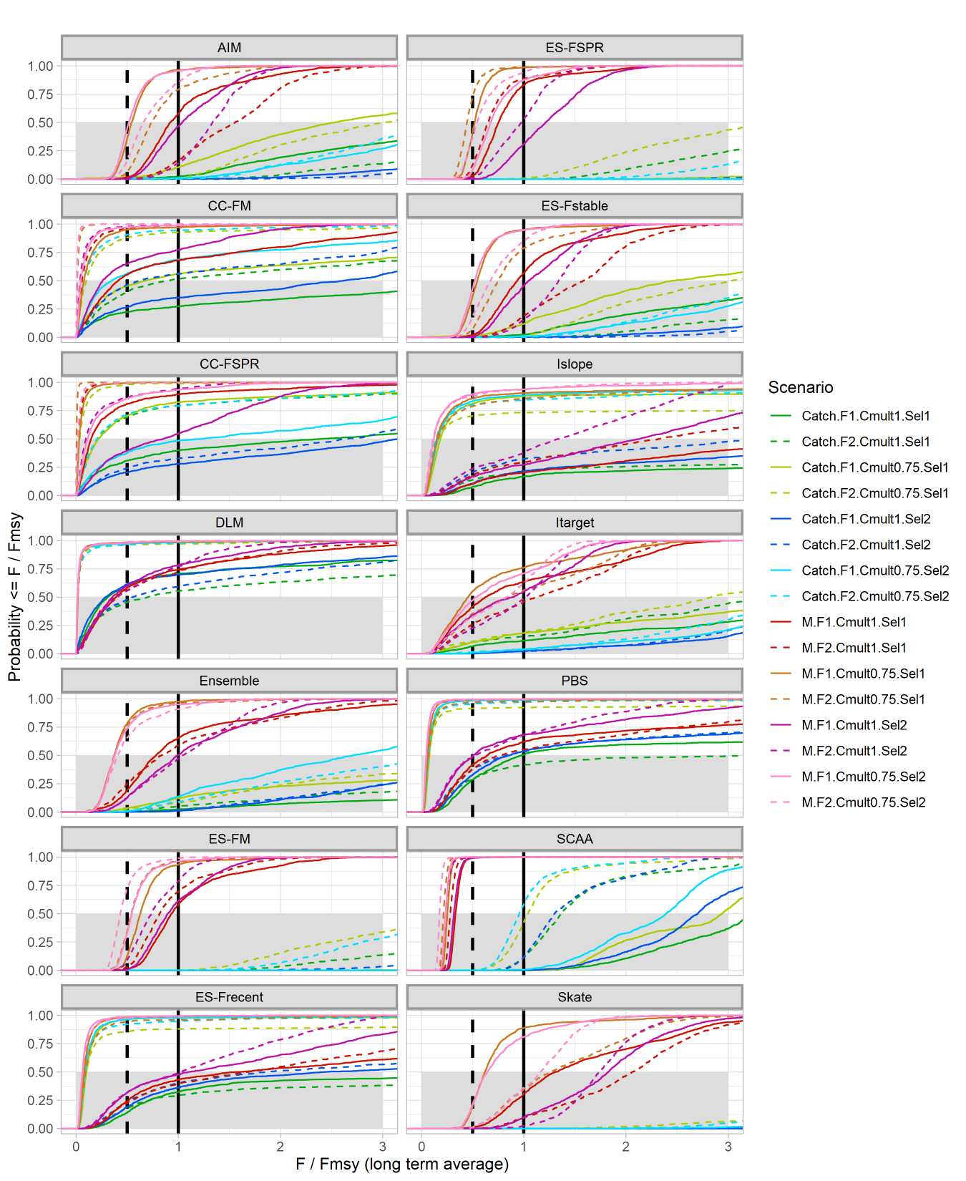
Short-term
Long-term
Omg!
Notes:
Generally, we want to see more of the distribution below 1 (overfishing limit); I’m not sure 0.5 has meaning, but there is a vertical dashed line there anyway
All methods perform well when M is the source of the retro (red/orange/pink/violet); true for short and long term, where >=50% of the distribution is less than 1 for most methods/scenarios; a few show F/Fmsy>1 more than 50% of the time (skate, ES-Fstable, ES-FSPR) but these also seem to have SSB>>SSBmsy (I feel like we explored this apparent paradox before, though I can’t recall the explanation)
Many methods resulted in short-term overfishing when catch was source of retro (green/blue), with F/Fmsy>>>1 (some of the cdfs are on the x-axis!); some methods ended overfishing while others did not; most challenging scenarios were for catch-retro (green and blue, both dashed and solid)
DLM and PBS has less overfishing scenarios, both short and long-term, than SCAA (especially note the SCAA cdfs that are on the x-axis!); long term results are not great for SCAA and actually get worse for a couple catch-retro scenarios
AIM, ES-FSPR, ES-Fstable, Itarget, Ensemble, ES-FM, and Skate should not be used if catch is suspected to be source of retro (though they mostly perform fine if M is the source)

Slide 6
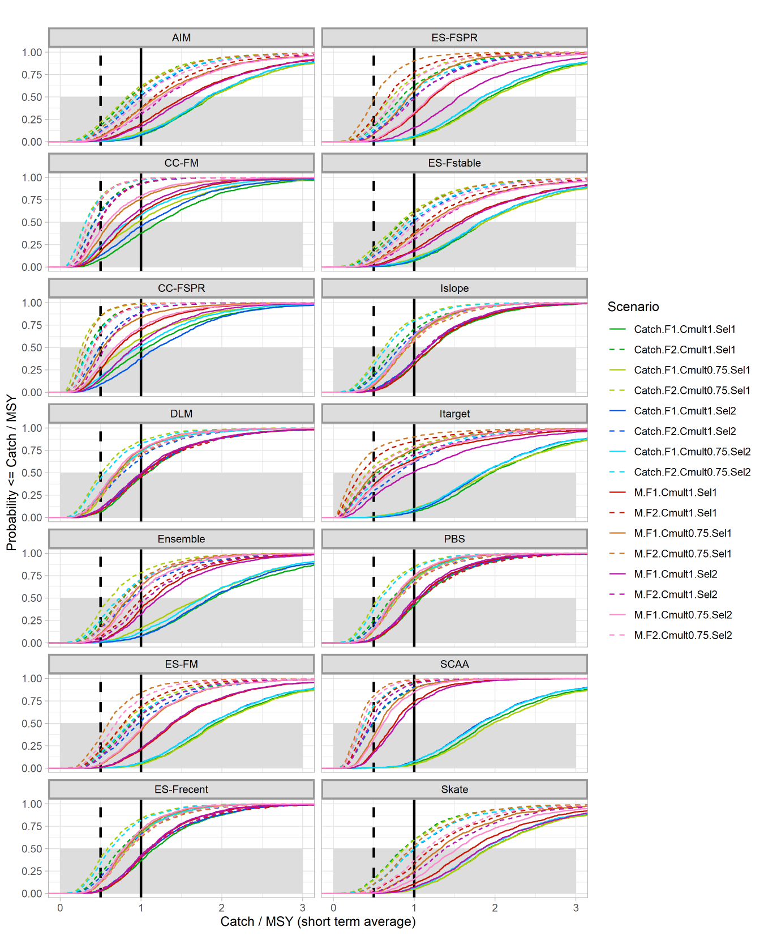
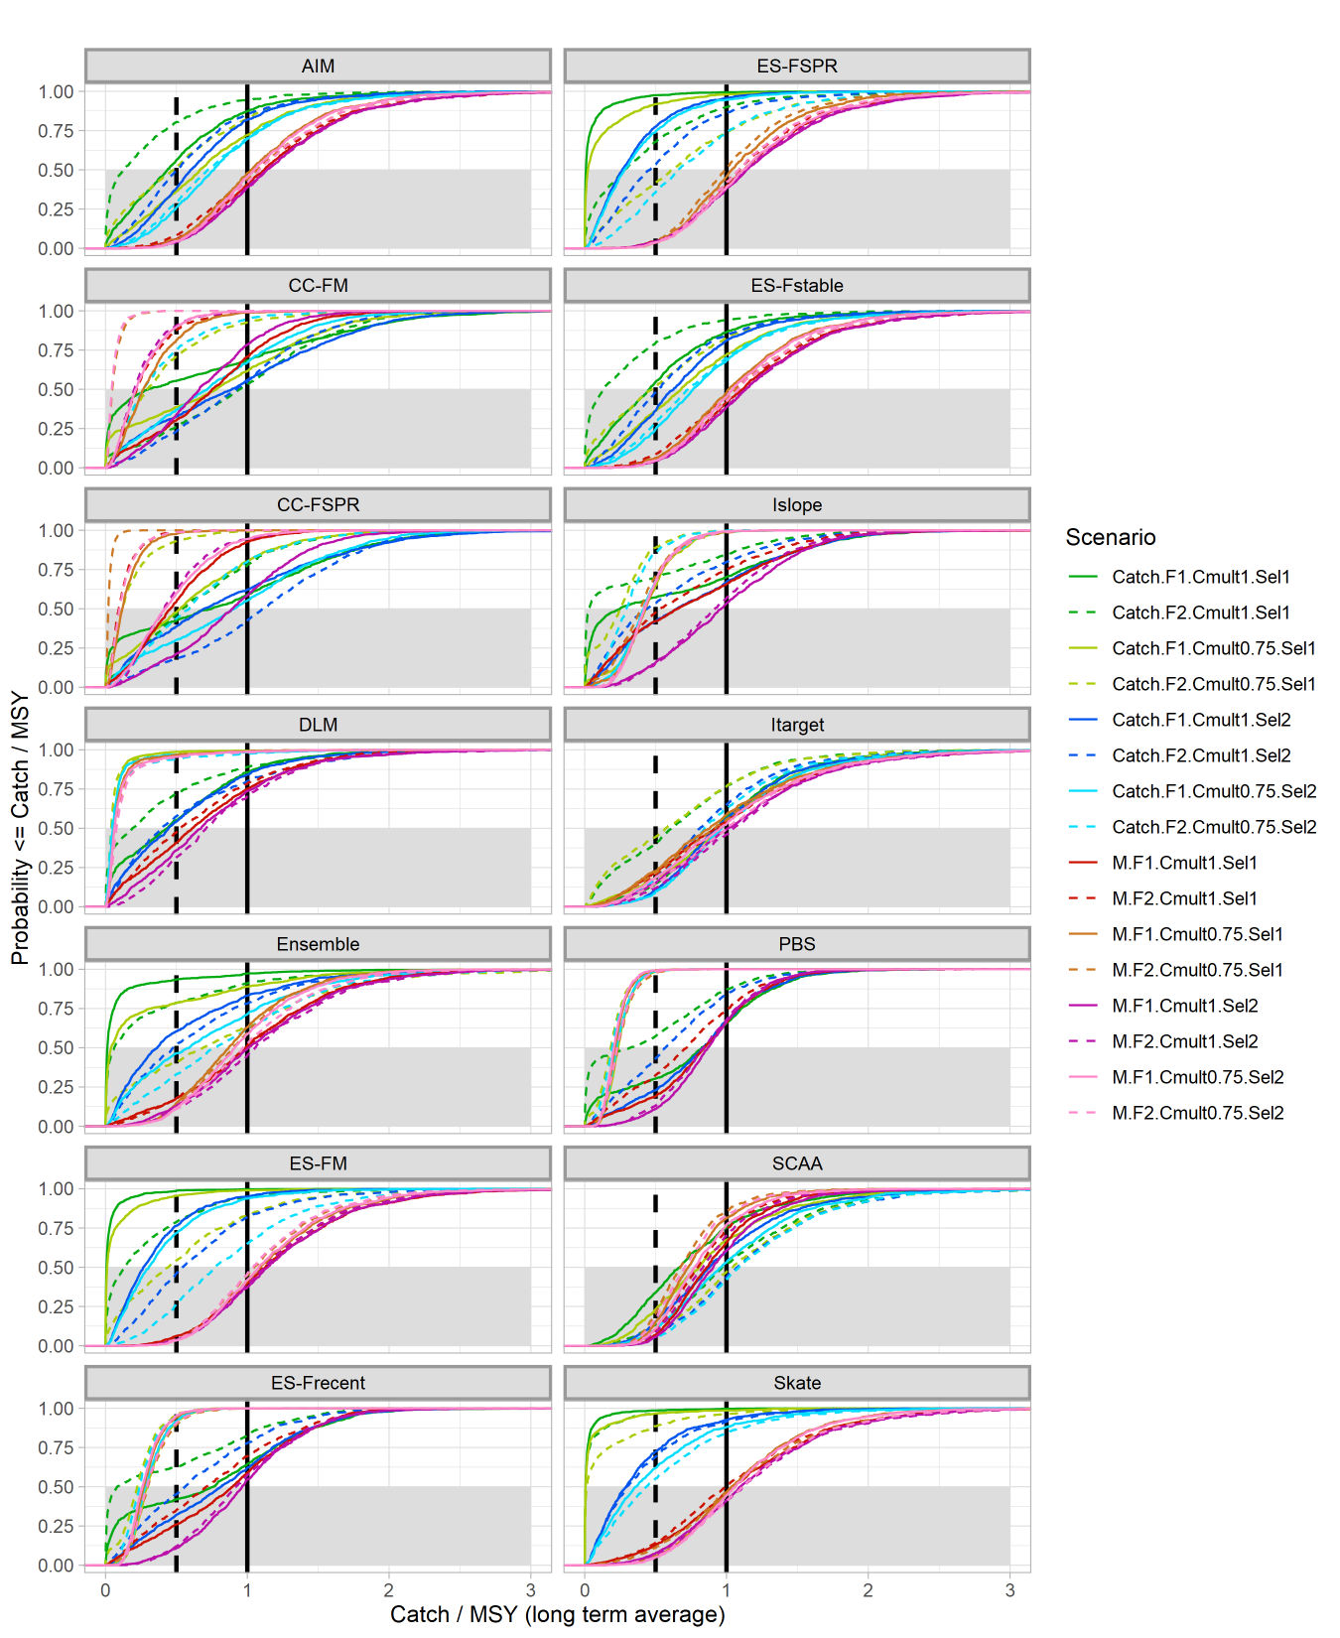
Short-term
Long-term
Notes:
Generally, we want to see don’t want to set catch>MSY, so a good result should have the median around 1 or even slightly below 1 for a buffer
All methods perform well when M is the source of the retro (red/orange/pink/violet); true for short and long term
When catch was source of retro, some methods set catch>MSY (green/blue); some methods with appropriate short-term catch when the retro source was missing catch ended up with long-term catch advice that was <<MSY (this seems to be due to the population crashing rather than just severe penalty on catch with a healthy population – compare with SSB plots on slide 4)
DLM and PBS has appropriate distributions of catch for scenarios in the short term, while SCAA overestimated catch for most catch-retro scenarios; long-term, it seems like SCAA dialed in the appropriate catch, while some DLM and PBS scenarios set catch too low (DLM seemed to slightly overpenalize to a greater extent than PBS)
AIM, ES-FSPR, ES-Fstable, Itarget, Ensemble, ES-FM, and Skate should not be used if catch is suspected to be source of retro (though they perform fine if M is the source)
Some of the previously identified poor performers tended to have short-term catch >MSY; long-term catch then looks very small for some scenarios due to the population having crashed

