Slide 1
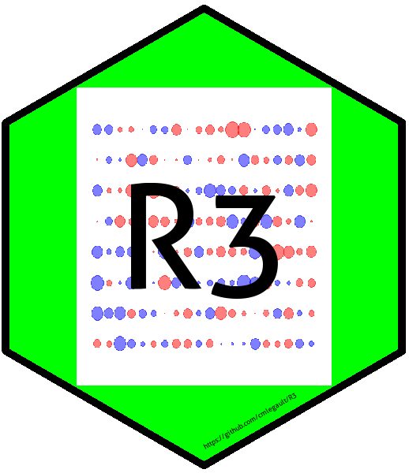
Recognizing Random Residuals, the game
Chris Legault
Population Dynamics Branch
READ Speed Talks 12 December 2019

Slide 2
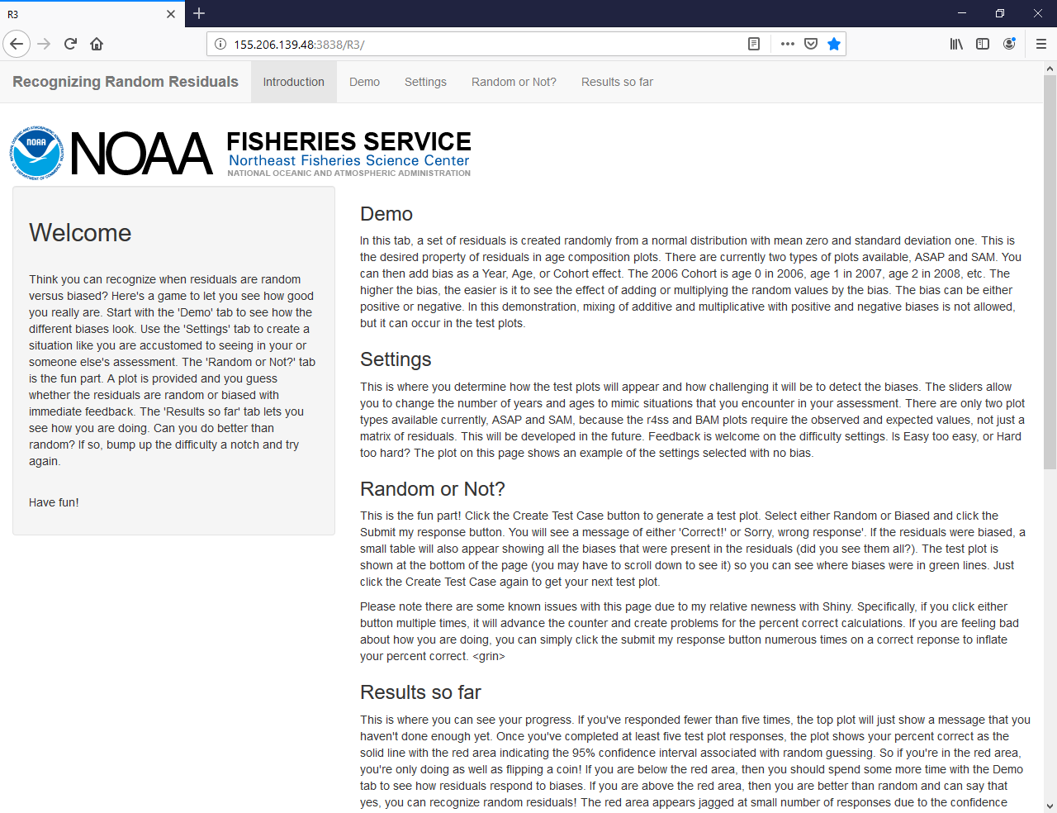
Notes:
Highlight this game is available on our Shiny1 server.
Point out tabs and the descriptions of what is in each tab.

Slide 3
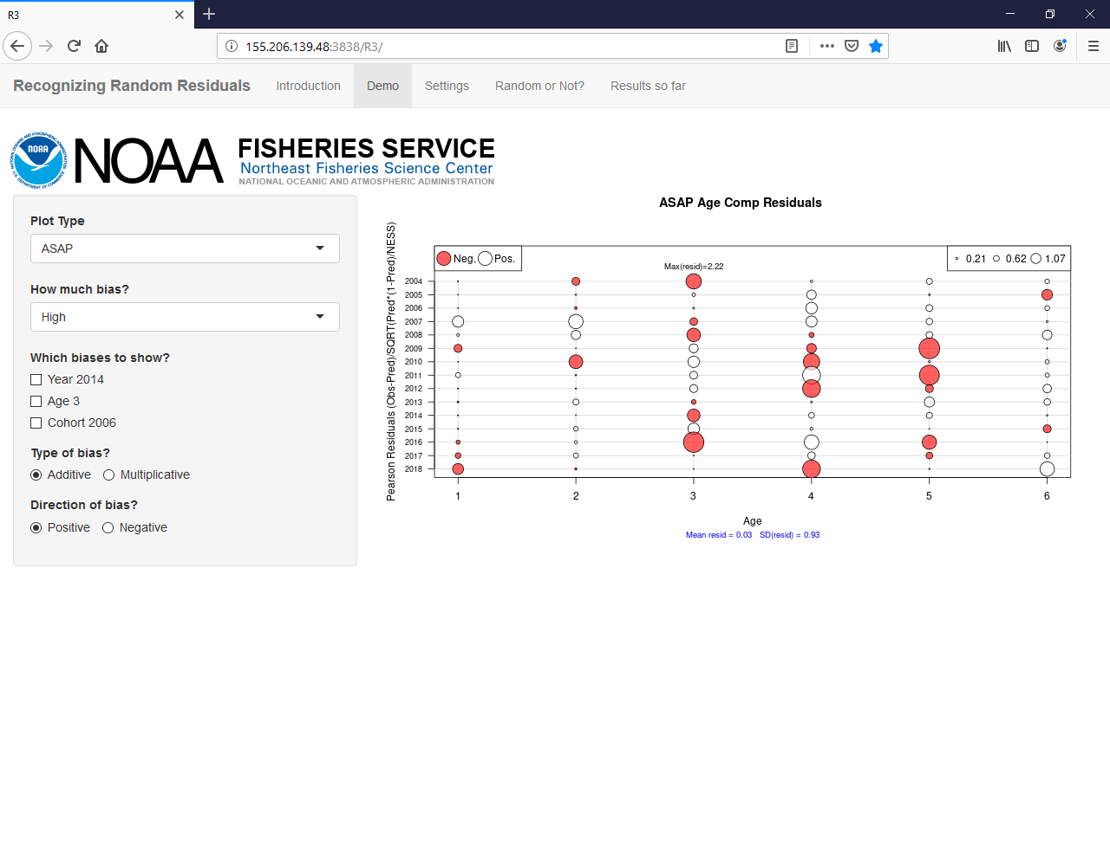
Notes:
Describe in words what a residual is.
Note that this page initially shows random residuals using plotting for ASAP model by ASAPplots (available on my github site).

Slide 4

Notes:
Click the Cohort 2006 box and Negative button to produce this plot showing biased residuals.
A cohort is like a class in school that sticks together through time (age 1 in 2007, age 2 in 2008, age 3, in 2009, etc)

Slide 5
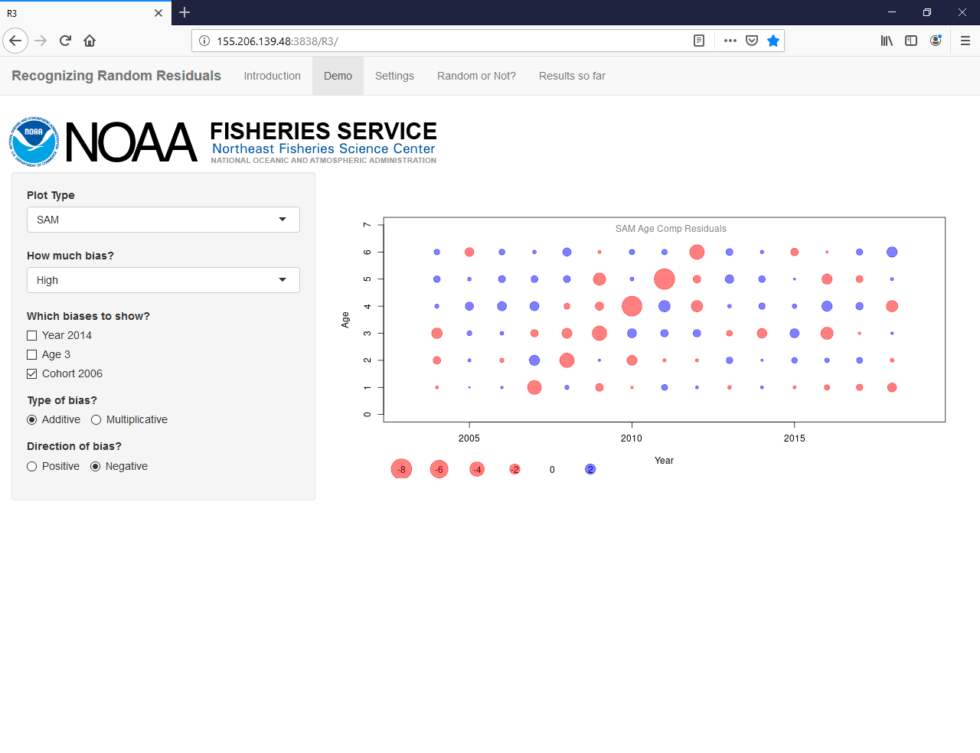
Notes:
Same plot as previous page, but now in SAM (another stock assessment model) plotting.
Note cohorts now go other direction because year and age axes flipped and both increase.

Slide 6
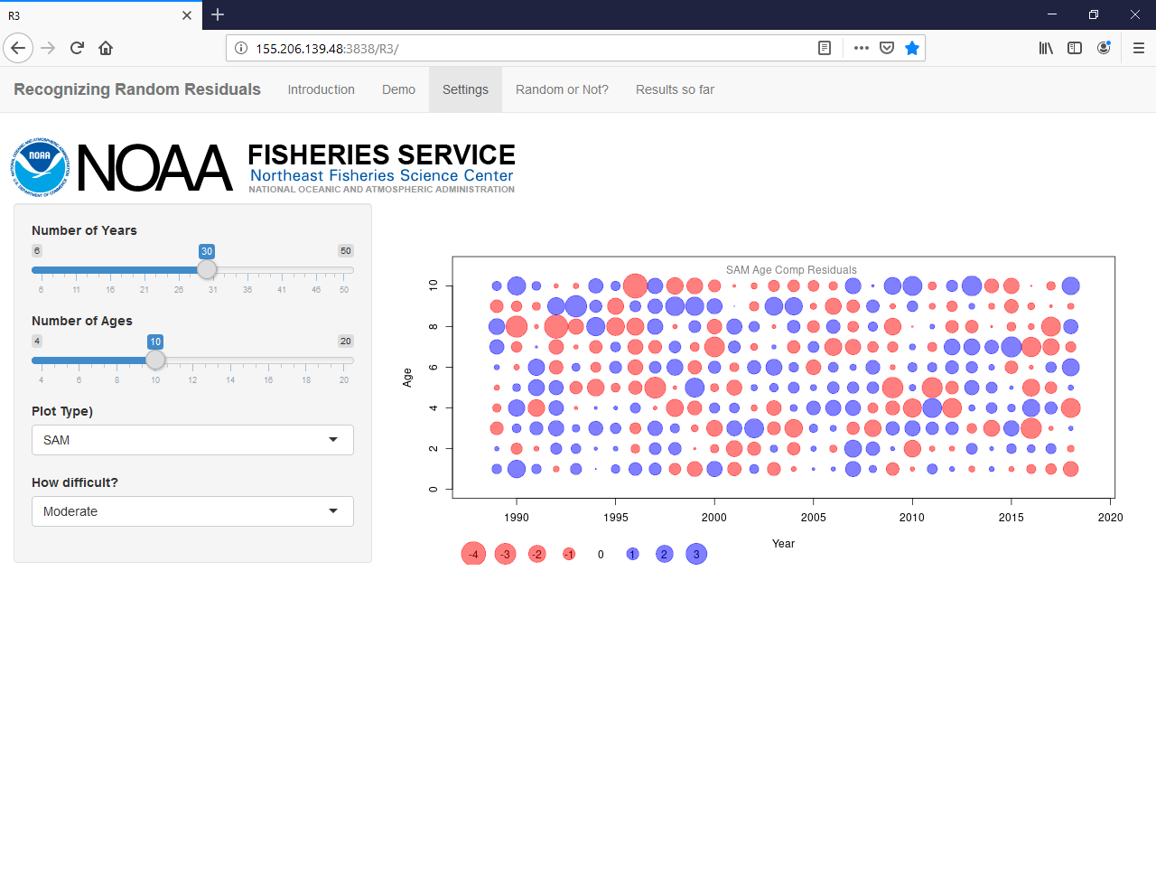
Notes:
Now pick settings to match your favorite stock assessment: 30 years, 10 ages, SAM, and moderate difficulty in this case.
Plot shows an example of random residuals for your selected settings.

Slide 7
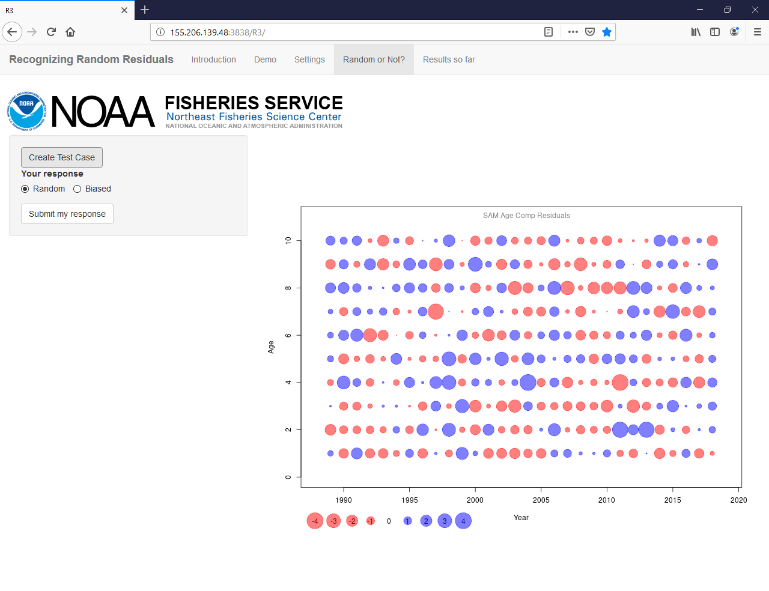
Random or Not? tab
Notes:
Click the Create Test Case button to get started.
So what do you think – is it random or not?

Slide 8
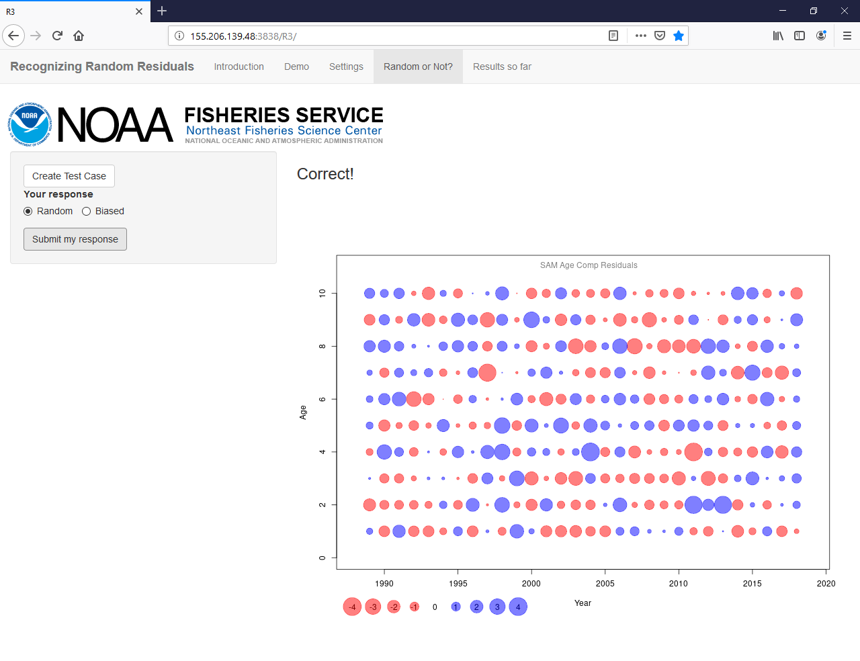
Notes:
You were right!

Slide 9
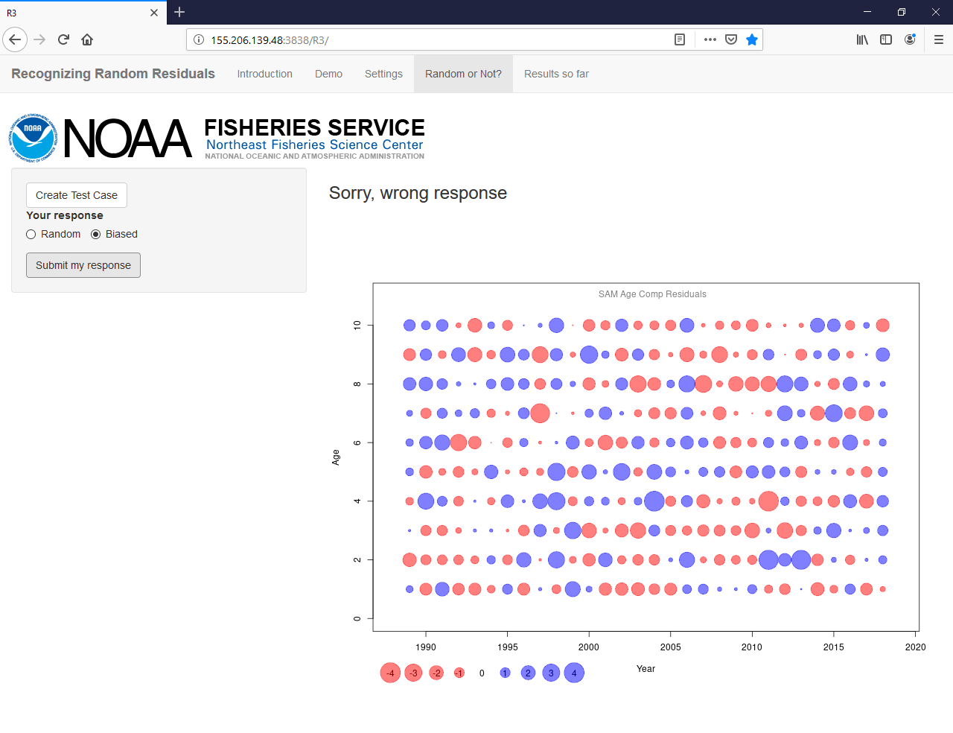
Notes:
Oops, sorry, wrong answer.
Note, that if you click submit my response button multiple times you can cheat on the Results so far tab

Slide 10
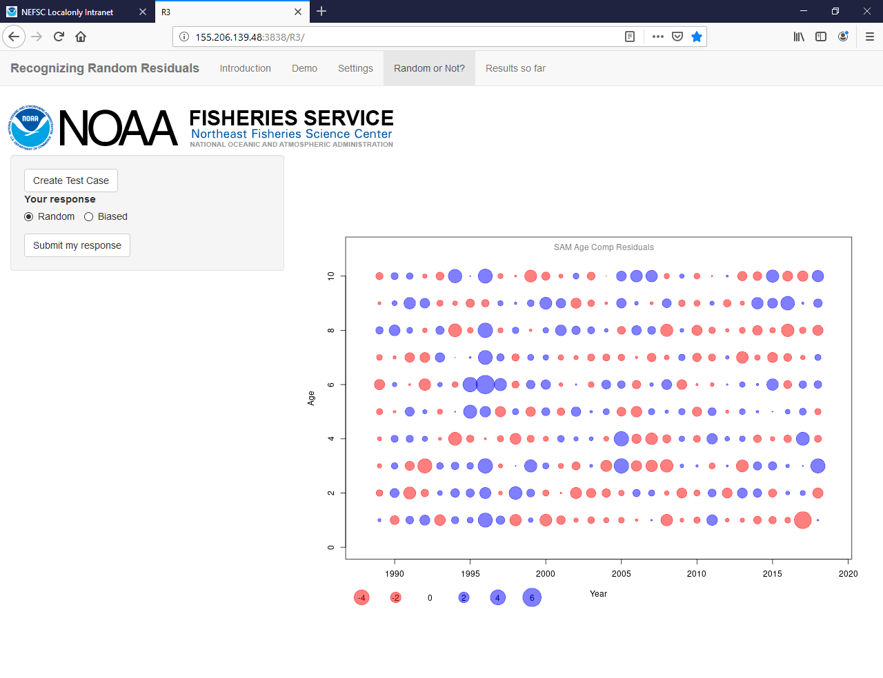
Notes:
How about this one. Is it random or not?

Slide 11
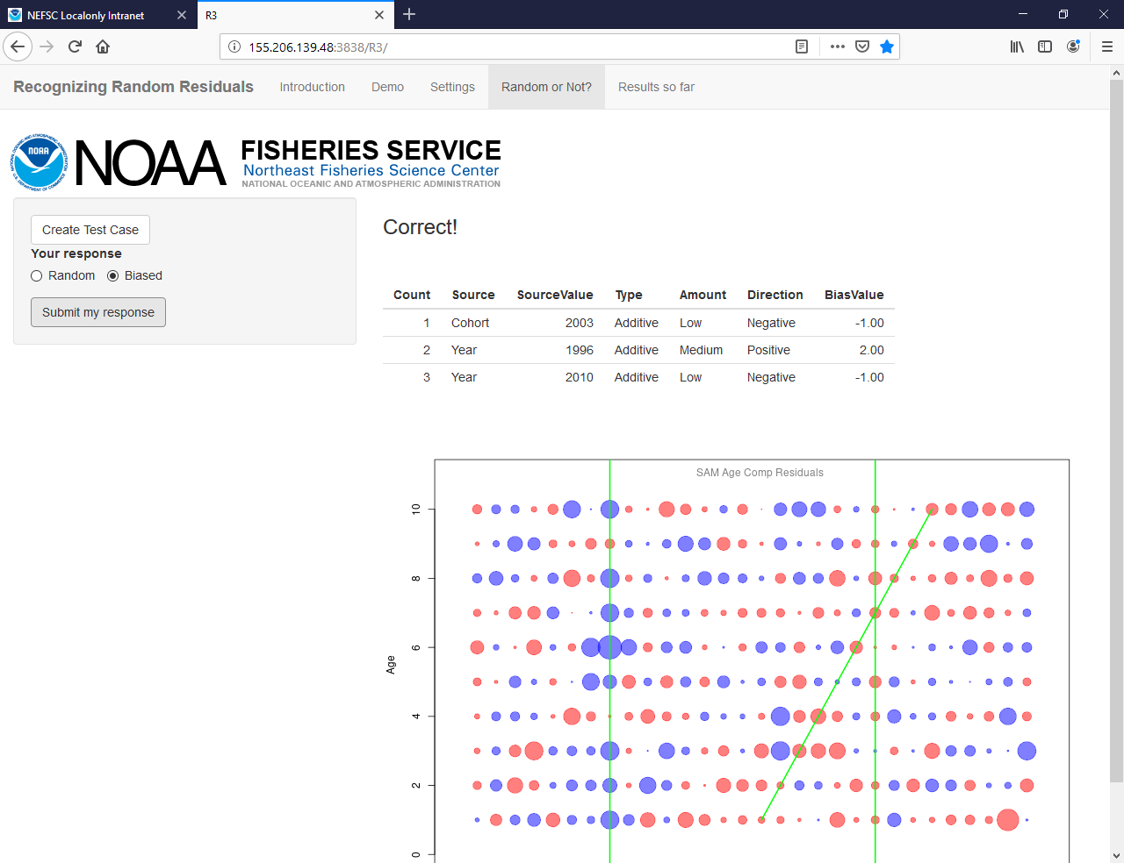
Notes:
Did you see all three biases?

Slide 12
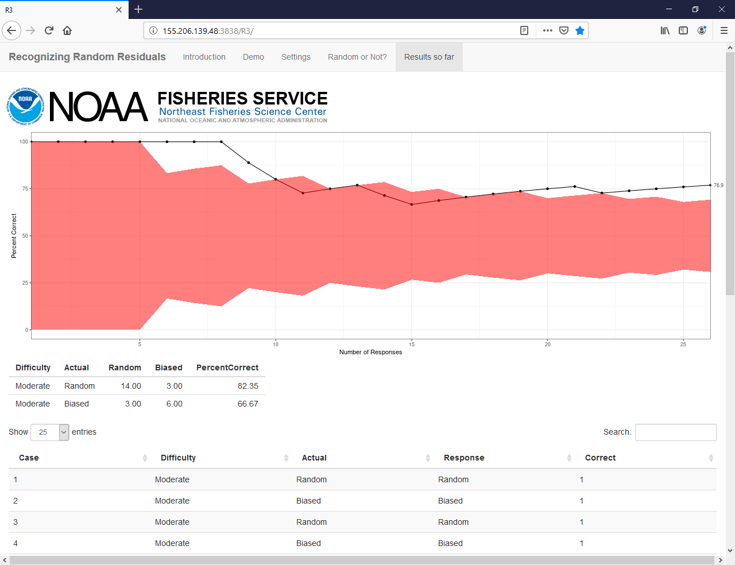
Results so far tab
Notes:
Once you have more than 10 responses you can see if you are better than random guessing (the red shaded area).
This plot shows that I started strong with 8 correct in a row, then got three wrong, two right, two wrong, another good streak of 6 right, a wrong, and 4 right to get out of the red shaded area (better than random guessing).
The table below shows the crosswise table to see if you are better are recognizing random or biased patterns.
Individual results are shown below in a table that can be sorted.

Slide 13
How to play
Point your browser to http://155.206.139.48:3838/R3/
R users who want a peek under the hood can find the code at https://github.com/cmlegault/R3
Notes:
No results are saved, no merchandise is available.
I welcome feedback – thanks!

