Slide 1
BSIMM
Building Security In Maturity Model
christian.Heinrich@cmlh.id.au
Notes:
BSIMM explores “What is a Successful Software Security Initiative (SSI) from a Scientific Sample?”
Forked from OpenSAMM Beta i.e. http://www.opensamm.org/
Further information is available from http://www.bsimm2.com/

Slide 2






BSIMM - Sample Size - USA
Total of Nine (9) with Two (2) Unnamed out of 25 Most Advanced SSI
Notes:
Financial Services (two (2) declined to be named): The Depository Trust and Clearing Corporation (DTCC)
Wells FargoIndependent Software Vendors: Adobe
Microsoft
QualcommTechnology Firms: Google
EMC
Quoted from p2 or p5 (PDF Page Numbering) of BSIMM v1.5

Slide 3




BSIMM - Sample Size - Europe
Total of Nine (9) with Four (4) Unnamed out of 56 Most Advanced SSI
Notes:
The bottom row of logos is two companies i.e. total of five (5).
Financial Services
Standard Life
SWIFT
Media and Telecommunications
Nokia
Thomson Reuters
Telecom Italia
Quoted from BSIMM v1.5 p51 or p54 (PDF Page Numbering)

Slide 4





BSIMM2 - Sample Size
Total of 30
Notes:
Financial Services
Bank of America
Capital One
SallieMae
Independent Software Vendors
VMWare
Intel
Intuit
Symantec
Quoted from p4 or p7 (PDF Page Numbering) of BSIMM2

Slide 5
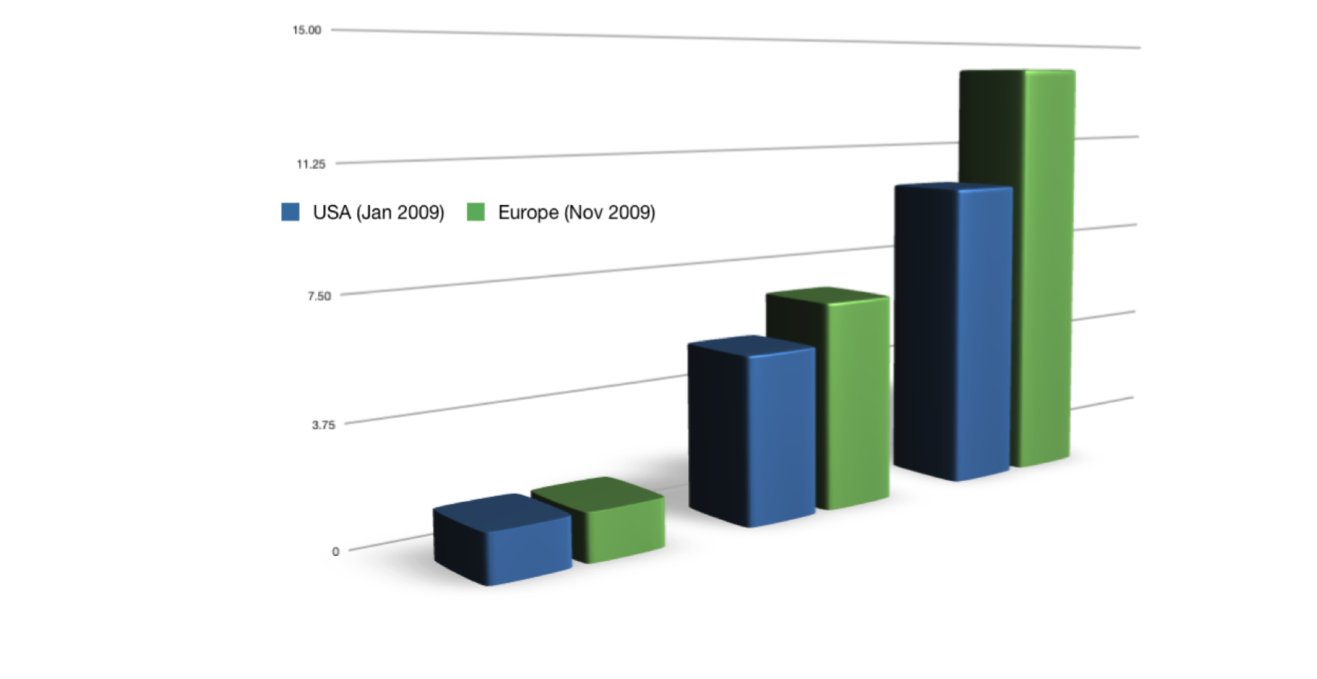
BSIMM - SSI Duration - Global
Oldest
Average
Newest
Notes:
USA - 1 (year) 1/2 (6 months), 5 (years) 1/3 (4 months), 10 (years)
USA Data Quoted from BSIMM v1.5 pp2 and 3 (same as PDF Page Number)
European - 1 1/2 (6 months), 6 2/3 (8 months), 14 (years)
European Data Quoted from BSIMM v1.5 p51 or p54 (PDF Page Numbering)
BSIMM2 - 1/4 (3 months), 4 5/12 (5 Months), 14 Years - September 2009
BSIMM2 is *not* included in the above graph due to similar values with BSIMM (Europe) Quoted from BSIMM2 p4 or p7 (PDF Page Numbering)

Slide 6
BSIMM - Resourcing - Global
USA - Jan 2009
 | Developer | Satellite | SSG
Median | 5000 | 20 | 20
Average | 7550 | 79 | 41
Largest | 30000 | 300 | 100
Smallest | 450 | 0 | 12
Europe - Nov 2009
 | Developer | Satellite | SSG
Median | 5000 | 0 | 11.5
Average | 4664 | 29 | 16
Largest | 12000 | 140 | 50
Smallest | 400 | 0 | 1
Notes:
Colours used in table signify:
Pink -> Average
Blue -> Less
Purple -> More
Europe has a significant lower number of resources within their SSG compared to the USA. Yet their (European) SSI has been executing for a longer duration.
“Satellite” are professionals outside of the SSG who have an interest in software security” as per the definition quoted from p6 or p9 (PDF Page Numbering) of BSIMM v1.5

Slide 7
BSIMM2 - Resourcing - Global
May 2010
 | Developer | Satellite | SSG
Median | 3000 | 11 | 13
Average | 5061 | 39.7 | 21.9
Largest | 30000 | 300 | 100
Smallest | 40 | 0 | 0.5
Notes:
Major variances from BSIMM are highlighted in green
Quoted from BSIMM2 p4 or p7 (PDF Page Numbering)

Slide 8
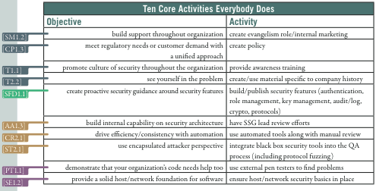
BSIMM - Top Ten - USA
Notes:
“3 out of 12 Practices are not implemented i.e. “Attack Models”
“Standards and Requirements”
“Configuration and Vulnerability Management”
Quoted from BSIMM v1.5 p47/p50 (PDF Page Numbering)
Within the “Governance” Domain:
SM is “Strategy and Metrics” Practice
CP is “Compliance and Policy” Practice
Within the “Intelligence” Domain:
SFP is “Security Features and Design” Practice
Within the “SDL Touchpoints” Domain:
AA is “Architectural Analysis” Practice
CR is “Code Review” Practice
ST is “Security Testing” Practice
Within the “Deployment” Domain:
PT is “Penetration Testing” Practice
SE is “Software Environment” Practice

Slide 9
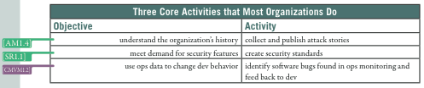
BSIMM - Top 11 to 13 - USA
Notes:
Within the “Intelligence” Domain:
AM is “Attack Models” Practice
SR is “Standards and Requirements” Practice
Within the “Deployment” Domain:
CMVM is “Configuration Management Vulnerability Management” Practice
Table above quoted from BSIMM v1.5 p47/p50 (PDF Page Numbering)

Slide 10
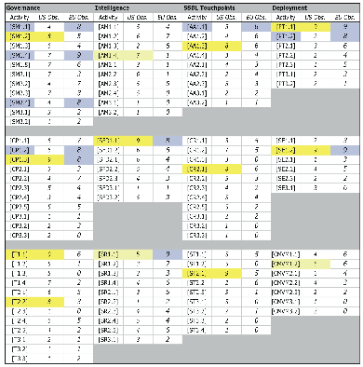
BSIMM - Activities - Global
Notes:
Yellow - 8 out of 9 USA
Yellow/Blue - More common to USA
Blue - 8 out of 9 Europe
Table quoted from p53 or p56 (PDF Page Numbering) of BSIMM v1.5
SM is “Strategy and Metrics”
CP is “Compliance and Policy”
T is “Training”
AM is “Attack Models”
SFD is “Security Features and Design”
SR is “Standards and Requirements”
AA is “Architecture Analysis”
CR is “Code Review”
ST is “Security Testing”
PT is “Penetration Testing”
SE is “Software Environment”
CMWM is “Configuration Management and Vulnerability Management”

Slide 11
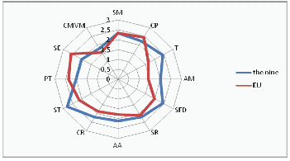
BSIMM - Average - Global
Notes:
“The largest deltas appear in the Training and Security Testing practices.
There are three practices where the European companies show evidence of more activity: Compliance and Policy, Penetration Testing, and Software Environment.
When it comes to Strategy and Metrics, the averages are exactly the same.
In general, this reflects a European situation that is more process and compliance driven (including privacy compliance) and more driven to measurement.
However, the Europeans tend to carry out fewer assurance activities (for example, reviewing source code to look for bugs) and instead focus more energy getting a handle on the problem and meeting compliance criteria through penetration testing.”
Graph quoted from BSIMM v1.5 p52/p55 (PDF Page Numbering)
SM is “Strategy and Metrics”
CP is “Compliance and Policy”
T is “Training”
AM is “Attack Models”
SFD is “Security Features and Design”
SR is “Standards and Requirements”
AA is “Architecture Analysis”
CR is “Code Review”
ST is “Security Testing”
PT is “Penetration Testing”
SE is “Software Environment”
CMWM is “Configuration Management and Vulnerability Management”

Slide 12
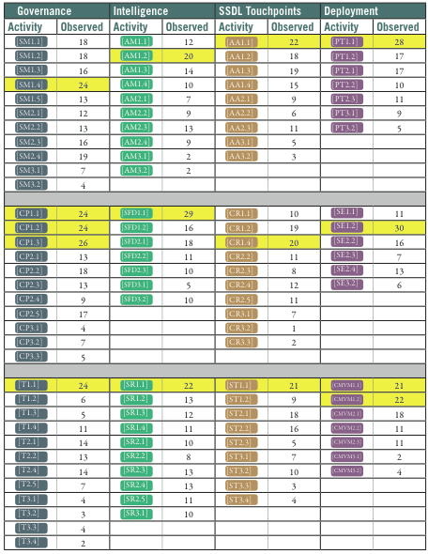
BSIMM2 - Activities
Notes:
Fifteen (15) core activities are highlighted in yellow
Quoted from p50 or p53 (PDF Page Numbering) from BSIMM2
SM is “Strategy and Metrics”
CP is “Compliance and Policy”
T is “Training”
AM is “Attack Models”
SFD is “Security Features and Design”
SR is “Standards and Requirements”
AA is “Architecture Analysis”
CR is “Code Review”
ST is “Security Testing”
PT is “Penetration Testing”
SE is “Software Environment”
CMWM is “Configuration Management and Vulnerability Management”

Slide 13
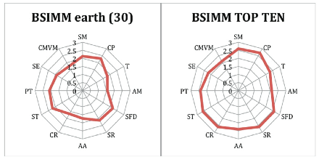
BSIMM2 - Average
Notes:
Quoted from p9 or p12 (PDF Page Numbering) from BSIMM2
SM is “Strategy and Metrics”
CP is “Compliance and Policy”
T is “Training”
AM is “Attack Models”
SFD is “Security Features and Design”
SR is “Standards and Requirements”
AA is “Architecture Analysis”
CR is “Code Review”
ST is “Security Testing”
PT is “Penetration Testing”
SE is “Software Environment”
CMWM is “Configuration Management and Vulnerability Management”

Slide 14
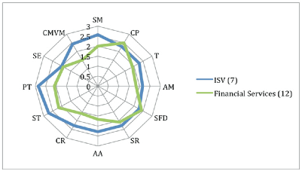
BSIMM2 - Average
Notes:
ISV is “Independent Software Vendors” i.e. including Adobe, Microsoft, etc
Quoted from p10 or p13 (PDF Page Numbering) from BSIMM2
SM is “Strategy and Metrics”
CP is “Compliance and Policy”
T is “Training”
AM is “Attack Models”
SFD is “Security Features and Design”
SR is “Standards and Requirements”
AA is “Architecture Analysis”
CR is “Code Review”
ST is “Security Testing”
PT is “Penetration Testing”
SE is “Software Environment”
CMWM is “Configuration Management and Vulnerability Management”

Slide 15
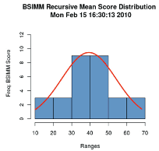
BSIMM2 - Average
Notes:
Quoted from p10 or p13 (PDF Page Numbering) from BSIMM2

Slide 16


In Closing
Thanks Ricardo, Chris, Audrey and Keith of AISA
Next Presentation at ISACA
12PM - 2PM Wed 17 Nov @ Telstra
Slides are published on
  http://www.slideshare.net/cmlh
Slides can be downloaded from
  http://github.com/cmlh/

