Slide 1

Maltego “Have I Been Pwned?”
Christian Heinrich
DEFCON China [Beta] (2018)
“Demo Labs” and “Recon Village”

Slide 2
Latest Slides
https://www.slideshare.net/cmlh/maltego-have-i-been-pwned
https://speakerdeck.com/cmlh/maltego-have-i-been-pwned
https://github.com/cmlh/Maltego-haveibeenpwned/tree/master/Presentation
Don’t forget to look at each Slide Note.

Slide 3
$ whoami
https://www.linkedin.com/in/ChristianHeinrich
Developer of Local and Remote Maltego Transforms for:
@Facebook
@Instagram
@Gravatar
@RecordedFuture
@TAIA Global REDACT™
@VirusTotal
@FullContact
Python Modules from @CanariProject and @Paterva
https://github.com/search?q=user%3Acmlh+Maltego

Slide 4
Agenda
Integration of the API [v1 and v2], including “Pwned Passwords”
Configuration of Maltego:
Import configuration file
“Transform Hub”
Case Studies
Penetration Tester
Incident Responder

Slide 5
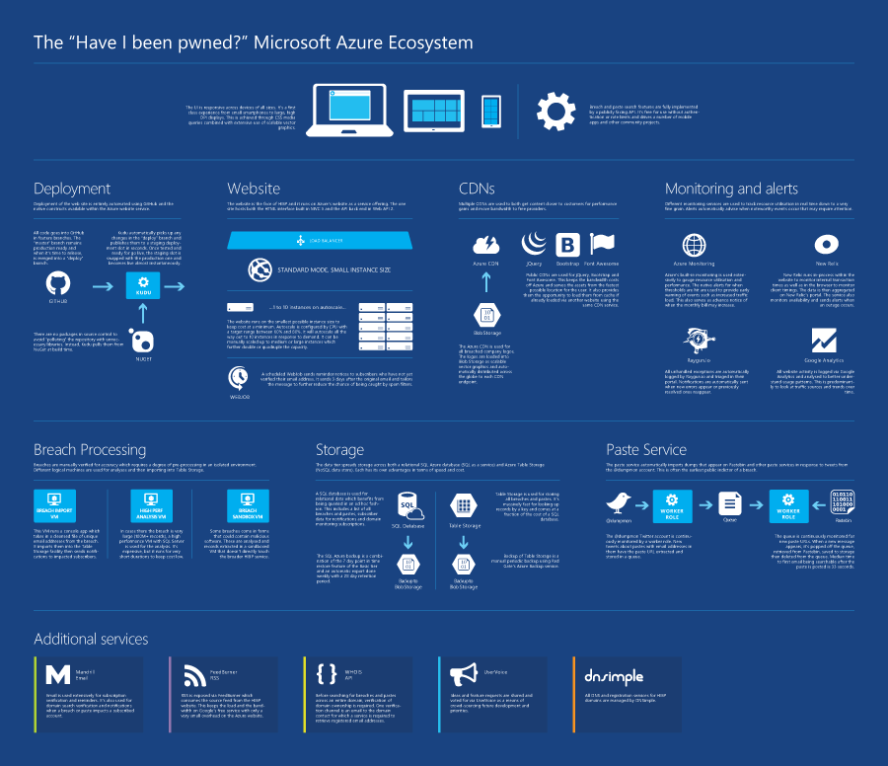
“Have I Been Pwned?”
Notes:
https://haveibeenpwned.com/ecosystem.pdf

Slide 6
@haveibeenpwned – API v1
Integrated Single API v1 Endpoint.
Supports all API v1 HTTP Status Codes i.e. 200, 400 and 404.
Notes:
https://haveibeenpwned.com/API/v1
HTTP Status Codes
200 Ok — everything worked and there's a string array of pwned sites for the account
400 Bad request — the account does not comply with an acceptable format (i.e. it's an empty string)
404 Not found — the account could not be found and has therefore not been pwned

Slide 7
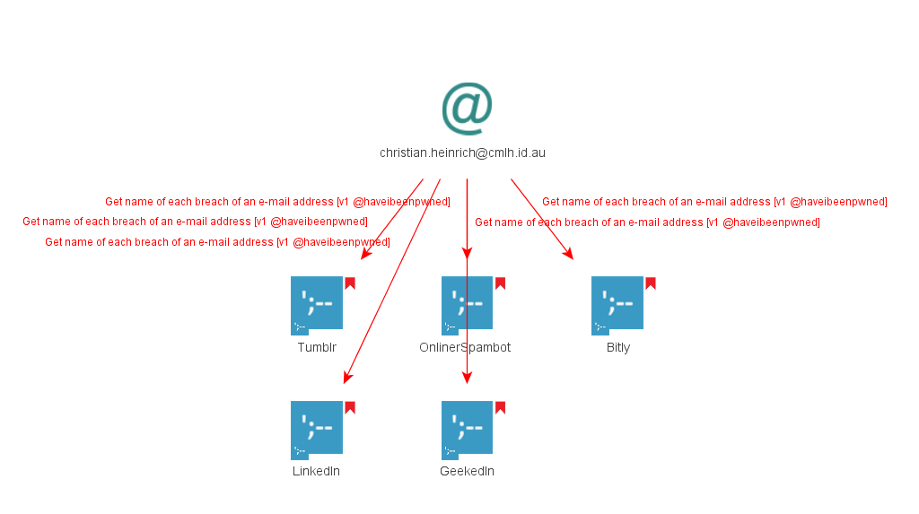
@haveibeenpwned – API v1

Slide 8
@haveibeenpwned – API v2
Integrated API v2 Endpoints:
Getting all breaches for an account
Getting all pastes for an account
Getting all breached sites in the system
Getting a single breached site
Notes:
https://haveibeenpwned.com/API/v2

Slide 9
@haveibeenpwned – API v2 – Rate Limit
Supports all APIv2 HTTP Status Codes i.e. 200, 400, 403, 404 and 429.
Rate Limit
All breaches for an account i.e. e-mail address and alias.
All pastes for an e-mail address
Notes:
https://haveibeenpwned.com/API/v2#RateLimiting
HTTP Status Codes
200 Ok — everything worked and there's a string array of pwned sites for the account
400 Bad request — the account does not comply with an acceptable format (i.e. it's an empty string)
403 Forbidden — no user agent has been specified in the request
404 Not found — the account could not be found and has therefore not been pwned
429 Too many requests — the rate limit has been exceeded
https://github.com/cmlh/Maltego-haveibeenpwned/wiki#rate-limit

Slide 10
“Pwned Passwords” – API v1
Integrated Single API v1 Endpoint.
Supports all API v1 HTTP Status Codes i.e. 200 and 404.
Notes:
https://github.com/cmlh/Maltego-haveibeenpwned/wiki#api-v1-1
HTTP Status Codes
200 Ok — the password was found in the Pwned Passwords repository
404 Not found — the password was not found in the Pwned Passwords repository

Slide 11
“Pwned Passwords” – API v2
Integrated API v2 Endpoints:
Searching by Password
Searching by Range
Supports all API v1 HTTP Status Codes i.e. 200 and 404.
Notes:
https://haveibeenpwned.com/API/v2#SearchingPwnedPasswordsByPassword
HTTP Status Codes
200 Ok — the password was found in the Pwned Passwords repository
404 Not found — the password was not found in the Pwned Passwords repository

Slide 12
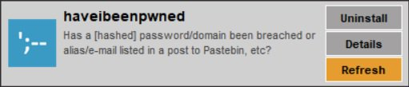
Installation
Notes:
https://github.com/cmlh/Maltego-haveibeenpwned/wiki

Slide 13
@haveibeenpwned – Maltego Input Entities
“Account”
maltego.EmailAddress
maltego.Alias
“Site”
maltego.Domain
Maltego.Phrase

Slide 14
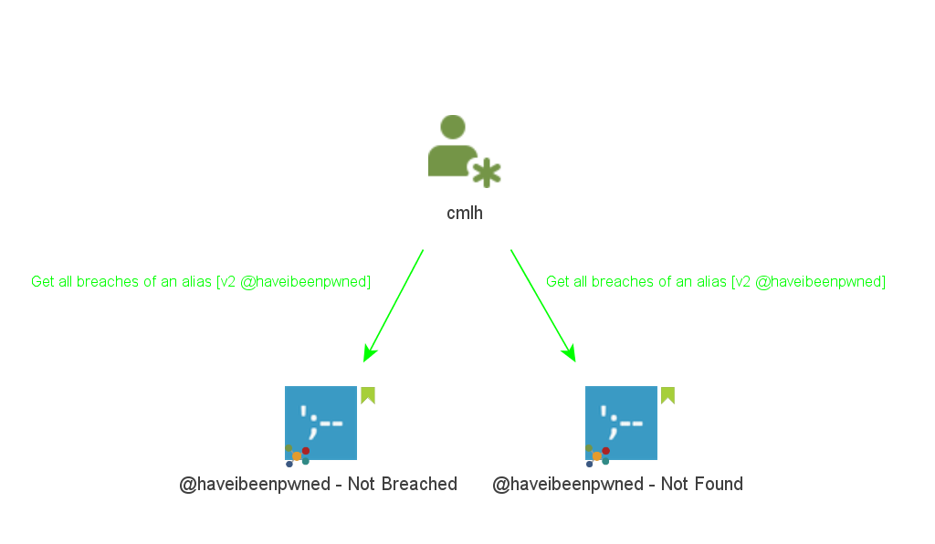
@haveibeenpwned – maltego.Alias Entity
Notes:
Green Bookmark

Slide 15
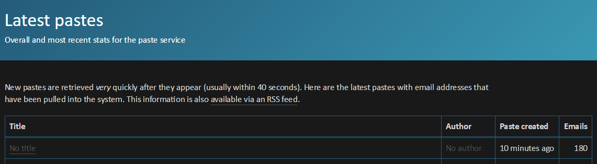
@haveibeenpwned - Paste
Notes:
https://haveibeenpwned.com/Pastes/Latest
Slide hidden due to https://www.troyhunt.com/pastes-on-have-i-been-pwned-are-no-longer-publicly-listed/

Slide 16
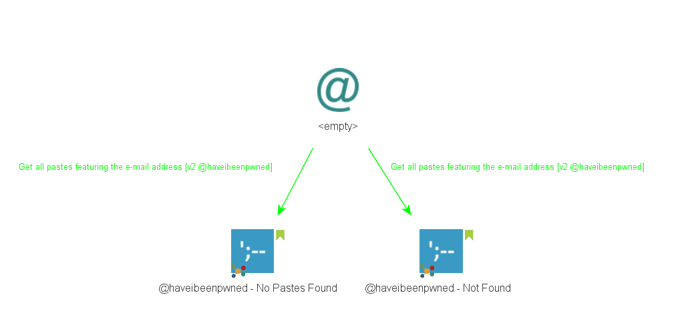
@haveibeenpwned - Paste
Notes:
Green Bookmark

Slide 17
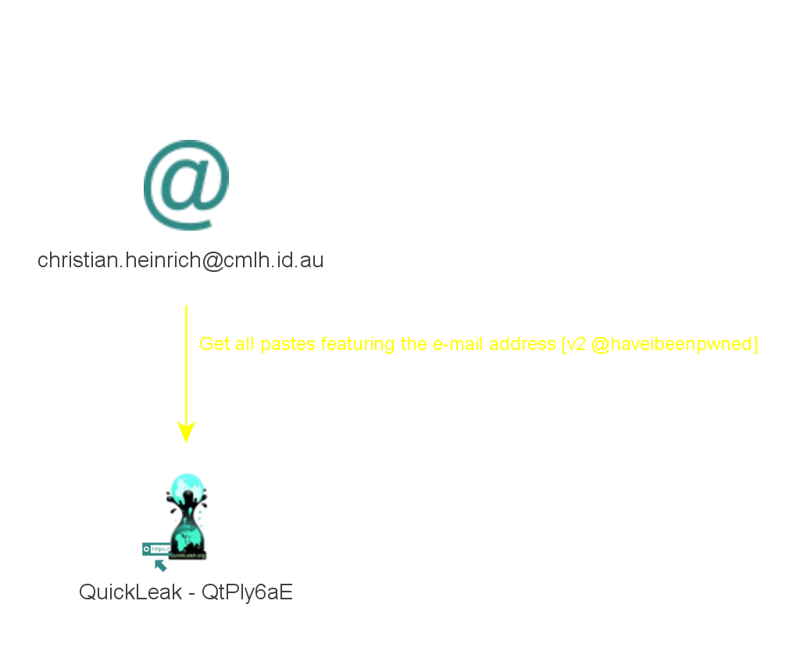
@haveibeenpwned - Paste
Notes:
Yellow Link

Slide 18
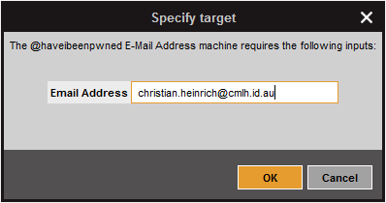
@haveibeenpwned – Maltego Machines

Slide 19
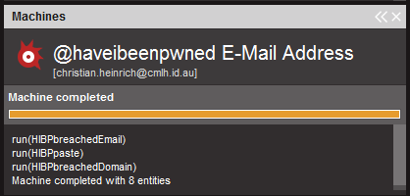
@haveibeenpwned – Maltego Machines

Slide 20
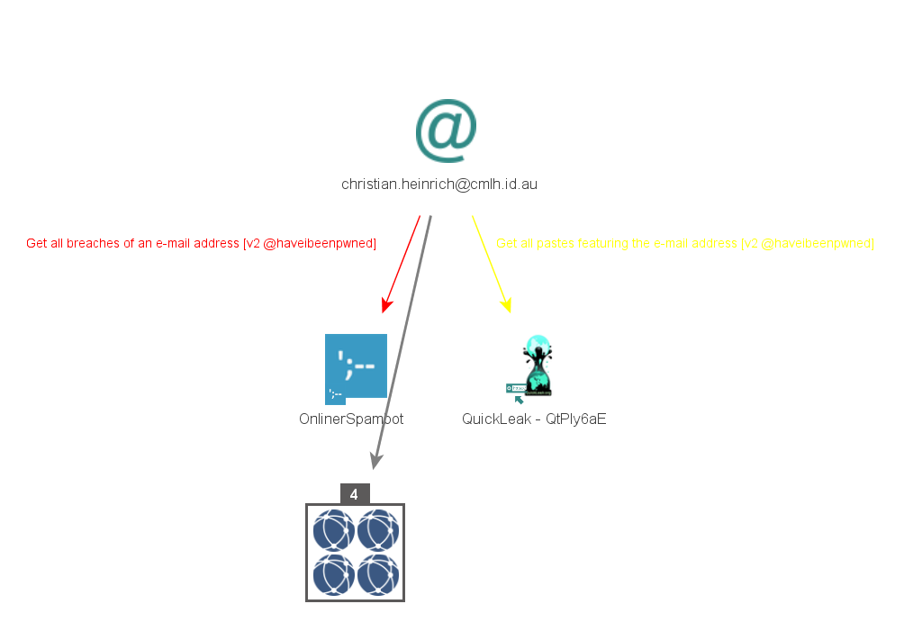
@haveibeenpwned – Maltego Machines
Notes:
Collections

Slide 21
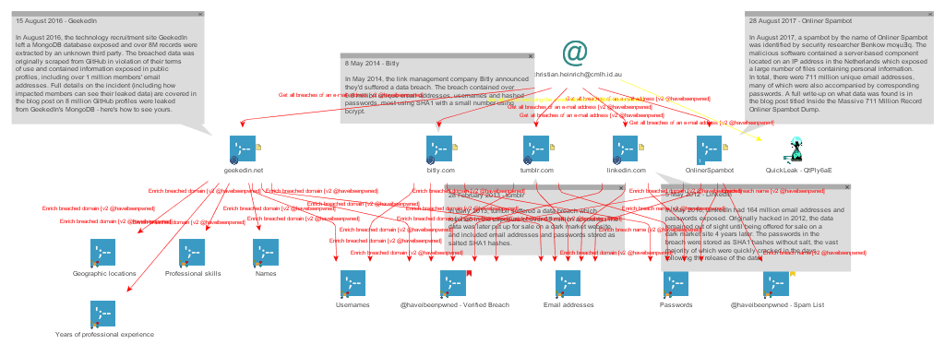
@haveibeenpwned – Maltego Machines
Notes:
Collections Disabled
Domains and Breach Names Link colour changed to red

Slide 22
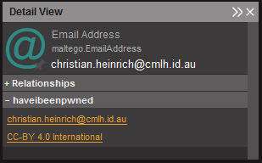
@haveibeenpwned – <DisplayInformation>
Notes:
https://haveibeenpwned.com/account/christian.heinrich@cmlh.id.au

Slide 23
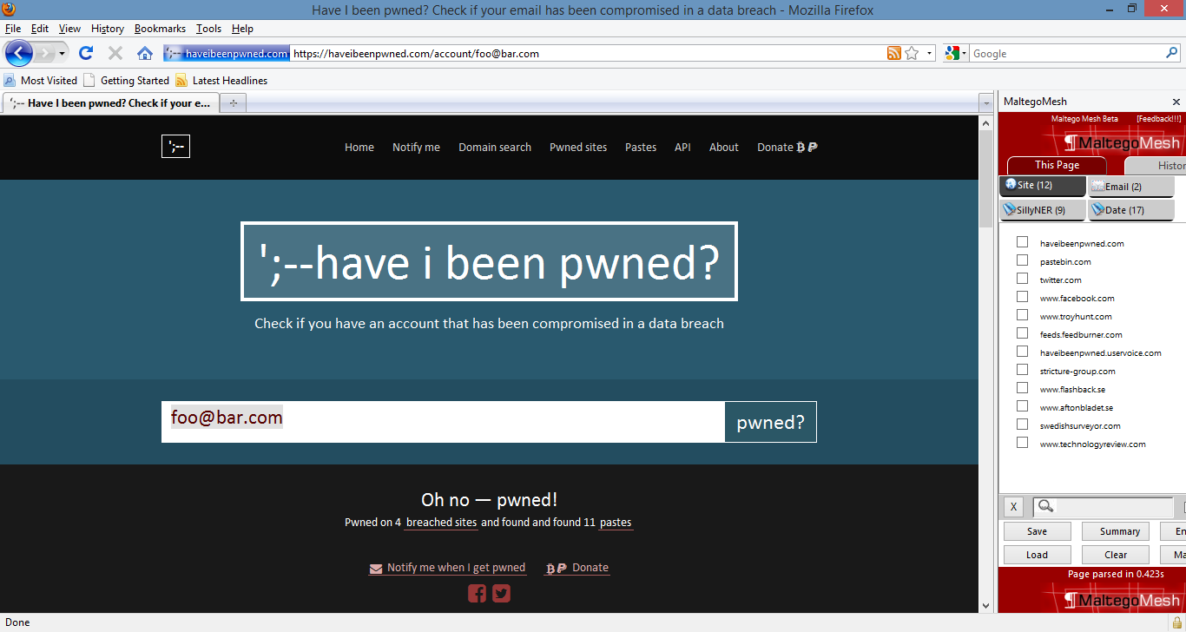
@haveibeenpwned – <DisplayInformation>
Notes:
foo@bar.com from https://haveibeenpwned.com/API/v2#BreachesForAccount
https://haveibeenpwned.com/account/foo@bar.com

Slide 24
“Pwned Passwords” API v2 – Input Entities
haveibeenpwned.Password
Inherits from maltego.Phrase
maltego.Hash

Slide 25
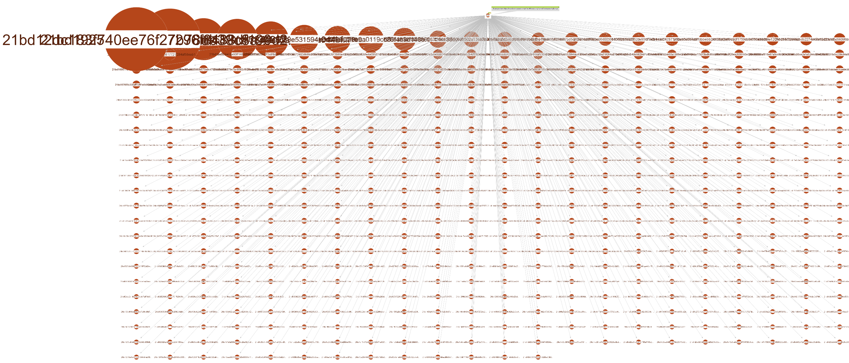
“Pwned Passwords” API v2 – Range
Notes:
Weighting

Slide 26
Thanks
@troyhunt of @haveibeenpwned
@SudhanshuC of the forked Maltego local transforms
@RoelofTemmingh, @AndrewMohawk and @paulRchds of @Paterva
@NoobieDog, @glennzw and @charlvdwalt of @SensePost
@dcuthbert
Notes:
http://maltego.blogspot.com.au/2017/12/time-to-say-goodbye.html

Slide 27
Maltego “Have I been pwned?”
Christian Heinrich
Follow me on Twitter at @cmlh
christian.heinrich@cmlh.id.au
Latest Slides
https://www.slideshare.net/cmlh/maltego-have-i-been-pwned
https://speakerdeck.com/cmlh/maltego-have-i-been-pwned
https://github.com/cmlh/Maltego-haveibeenpwned/tree/master/Presentation
Notes:
https://twitter.com/cmlh

