Slide 1

Movie Recommendations
Cristian M. Luna

Slide 3





Slide 4
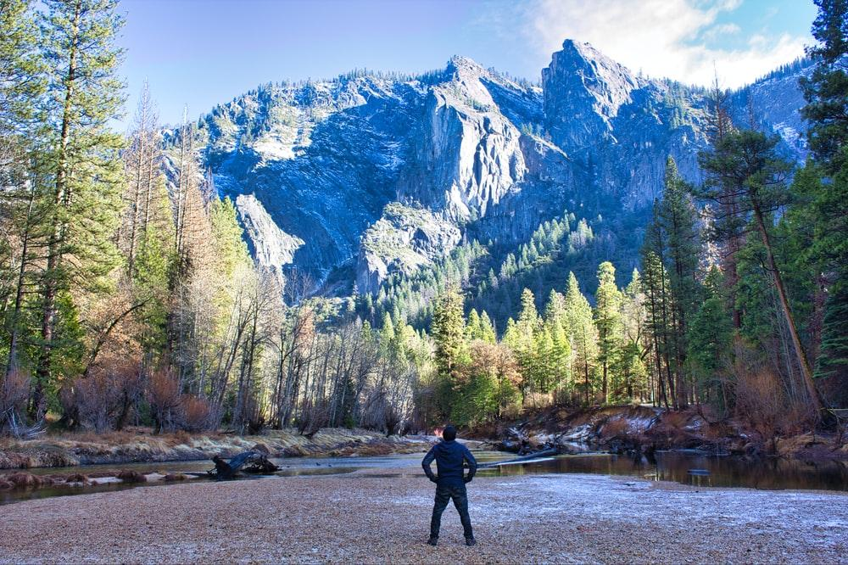

Slide 5


Create an App!

Slide 6
Data

Slide 7
Data
GroupLens
MovieLens

Slide 8
Data
GroupLens
MovieLens
2 Sets

Slide 9
Data
GroupLens
MovieLens
2 Sets
‘Small’

Slide 10
Data
GroupLens
MovieLens
2 Sets
‘Small’
100,000 Ratings 600 Users

Slide 11
Data
GroupLens
MovieLens
2 Sets
‘Small’
100,000 Ratings 600 Users
Movie, User ID, Tags, Ratings, etc

Slide 12

Exploratory Data Analysis

Slide 13
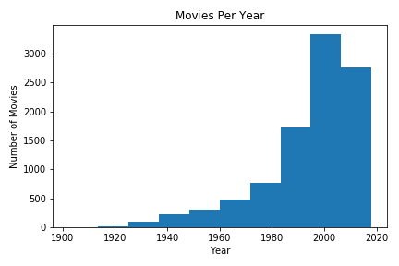
Movies per Year

Slide 14
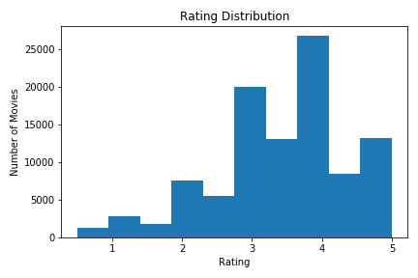
Ratings

Slide 15
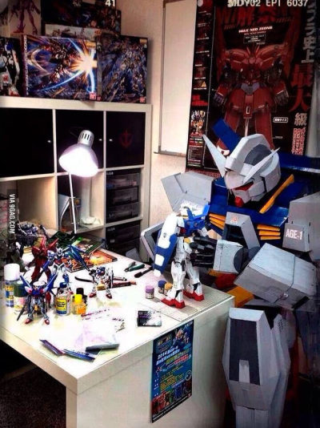
Model Building

Slide 16
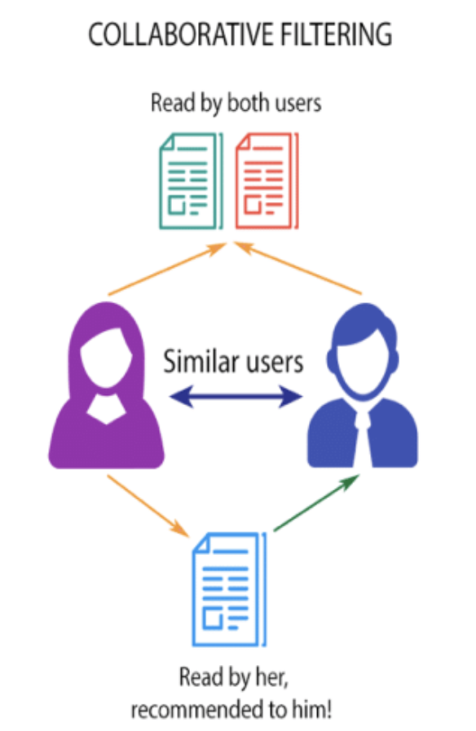
Collaborative Filtering

Slide 17
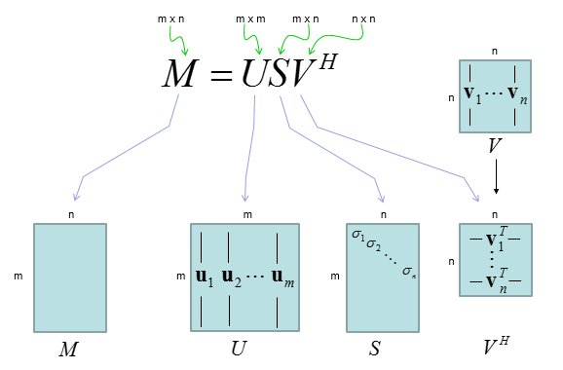
SVD ++

Slide 18
SVD ++
RMSE: 0.4991

Slide 19
SVD ++
RMSE: 0.4991
User ID | Movie ID | Rating
1 | 5 | 5.0
1 | 1337 | 3.5
2 | 501 | 2.0
3 | 2913 | 4.5
3 | 127 | 4.0

Slide 20
User: John Doe

Slide 21
User: John Doe
Top 5 Rated

Slide 22
User: John Doe
Top 5 Rated
Seven; Hulu
Usual Suspects; Amazon
Taxi Driver; Amazon
Before Sunrise; Netflix
Natural Born Killer; Amazon

Slide 23
User: John Doe
Top 5 Rated
Seven; Hulu
Usual Suspects; Amazon
Taxi Driver; Amazon
Before Sunrise; Netflix
Natural Born Killer; Amazon
Top 5 Recommended

Slide 24
User: John Doe
Top 5 Rated
Seven; Hulu
Usual Suspects; Amazon
Taxi Driver; Amazon
Before Sunrise; Netflix
Natural Born Killer; Amazon
Top 5 Recommended
Wild Tales; Hulu
Singin’ in the Rain; Hulu
Lawrence of Arabia; Amazon
Rosemary’s Baby; Netflix
The Hustler; Netflix

Slide 25
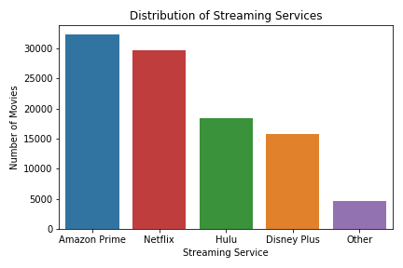
Streaming Services

Slide 26
Recommendations

Slide 27
Recommendations
Phone App.

Slide 28
Recommendations
Phone App.
Current Movies

Slide 29
Recommendations
Phone App.
Current Movies
Run Ads

Slide 30
Recommendations
Phone App.
Current Movies
Run Ads
Incorporate User Data

Slide 31

Pitfalls

Slide 32
Pitfalls
User Dependent

Slide 33
Pitfalls
User Dependent
Constant Updating

Slide 34

Next Steps

Slide 35
Next Steps
Encode Genres and Tags

Slide 36
Next Steps
Encode Genres and Tags
Streaming Service Tag

Slide 37
Next Steps
Encode Genres and Tags
Streaming Service Tag
User Search Customization

Slide 38
Next Steps
Encode Genres and Tags
Streaming Service Tag
User Search Customization
By Service

Slide 39
Next Steps
Encode Genres and Tags
Streaming Service Tag
User Search Customization
By Service
By Genre

Slide 40
Next Steps
Encode Genres and Tags
Streaming Service Tag
User Search Customization
By Service
By Genre
Year
Etc.

Slide 41
Next Steps
Encode Genres and Tags
Streaming Service Tag
User Search Customization
By Service
By Genre
Year
Etc.
Use ‘Large’ Set

Slide 42
Thank You!
Email: cmluna2913@gmail.com
Github: github.com/cmluna2913
LinkedIn: linkedin.com/in/cmluna2913/

