Slide 1


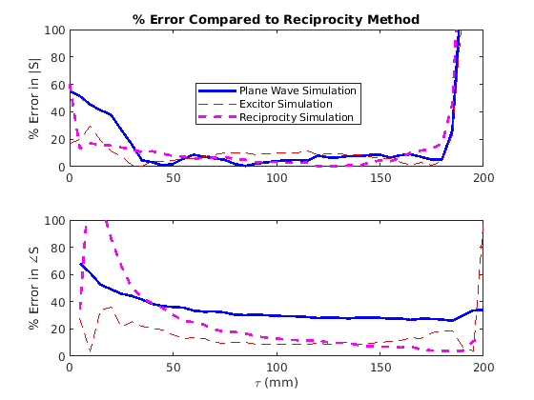
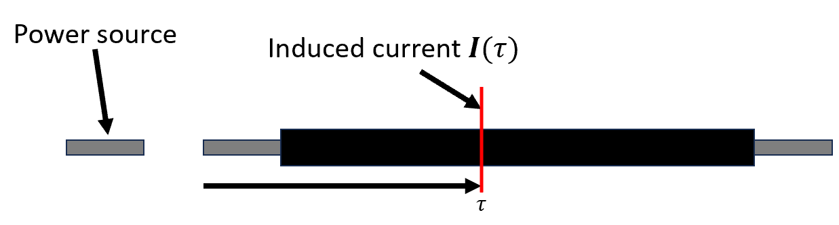
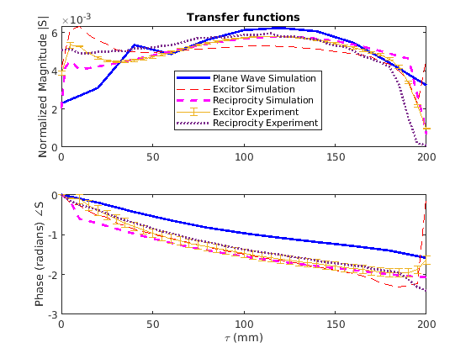
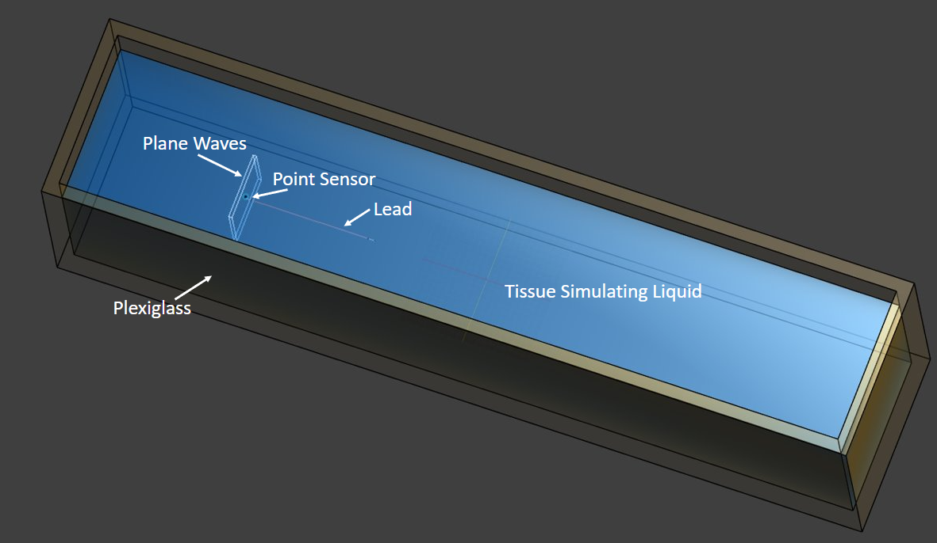
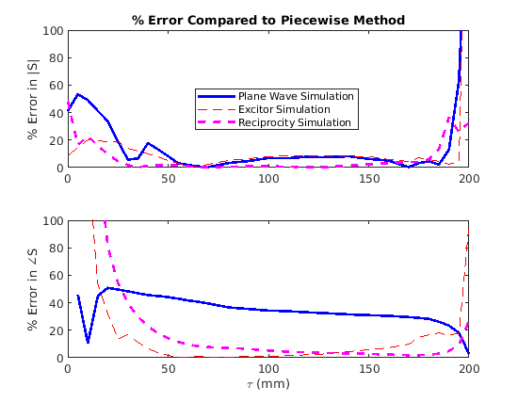
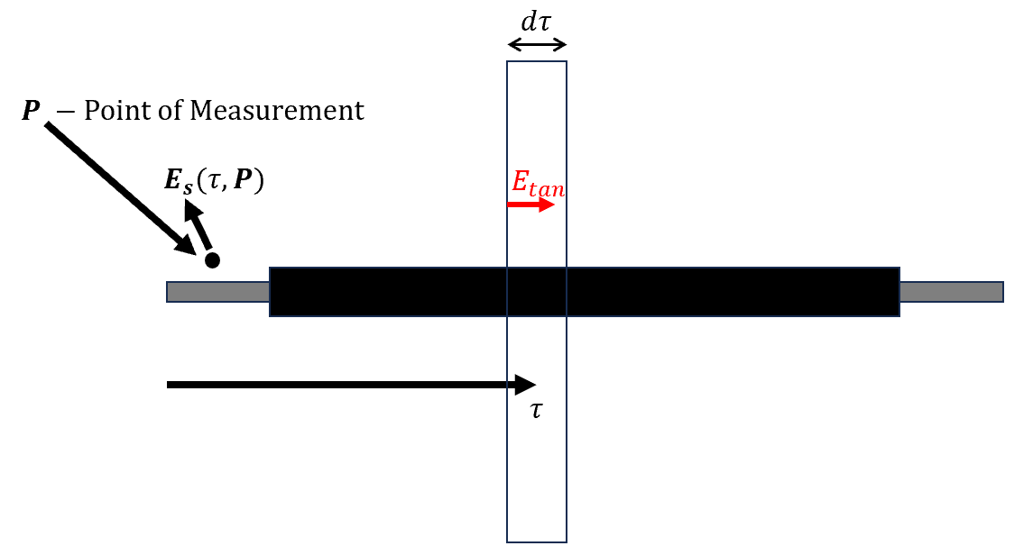
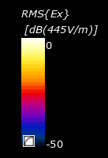
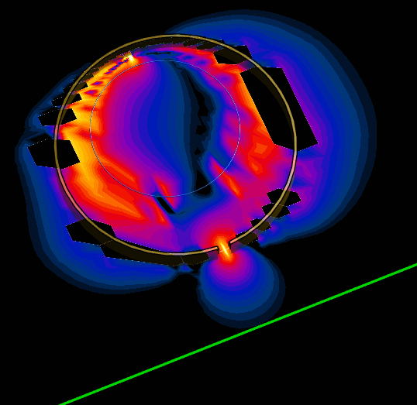

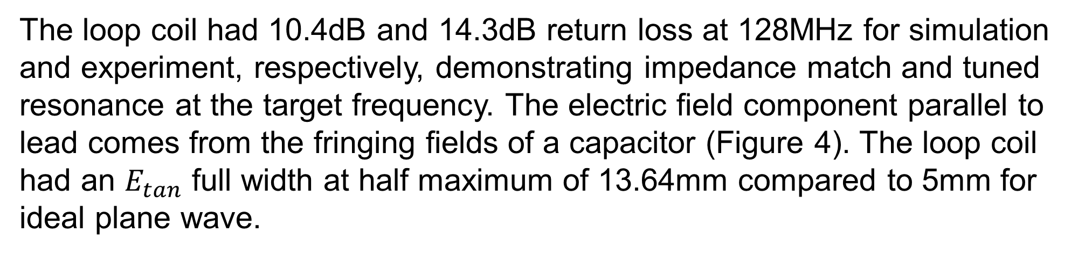
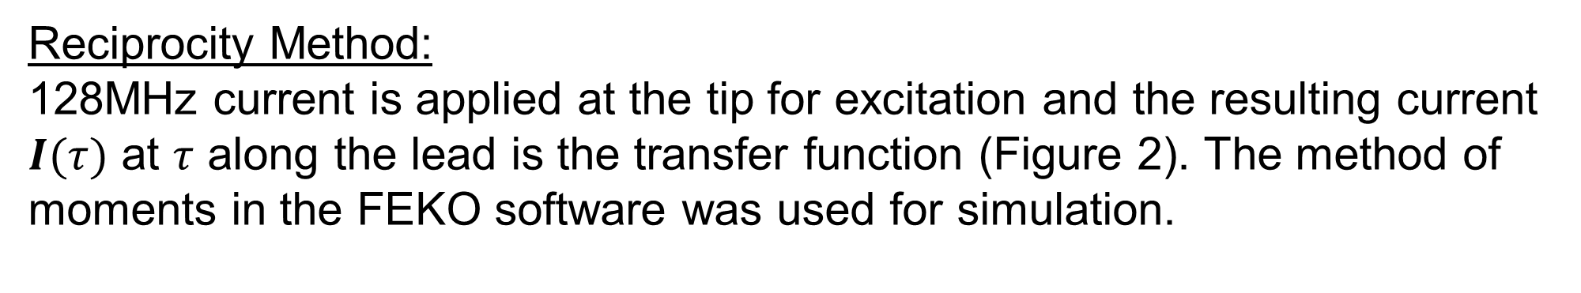
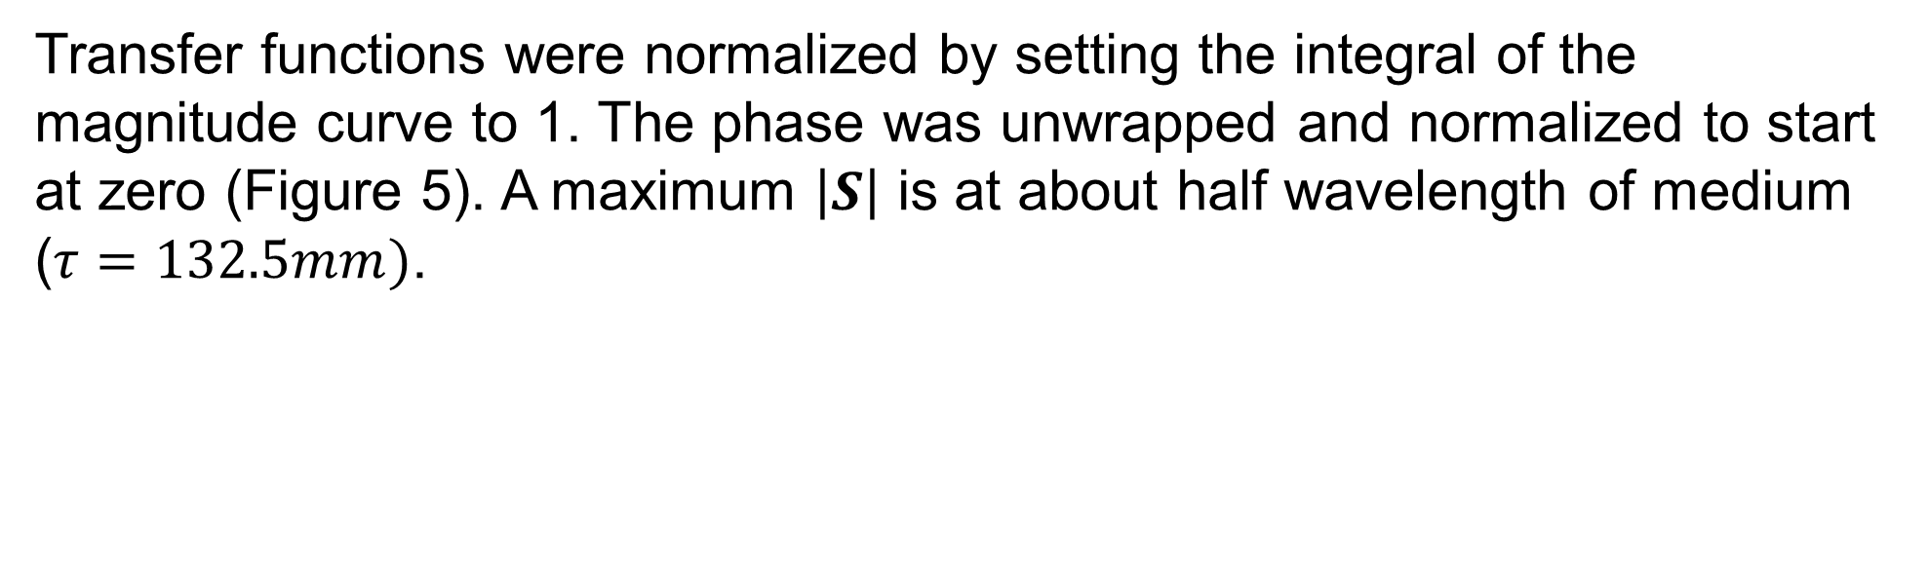
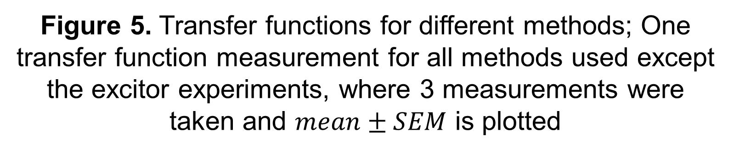
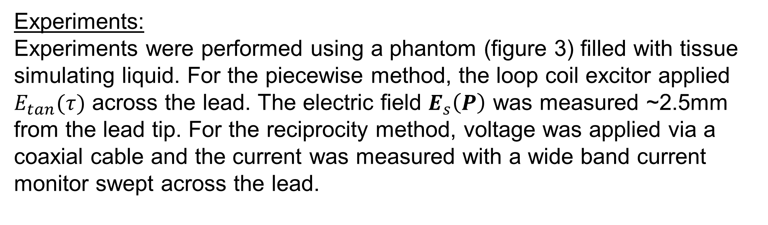
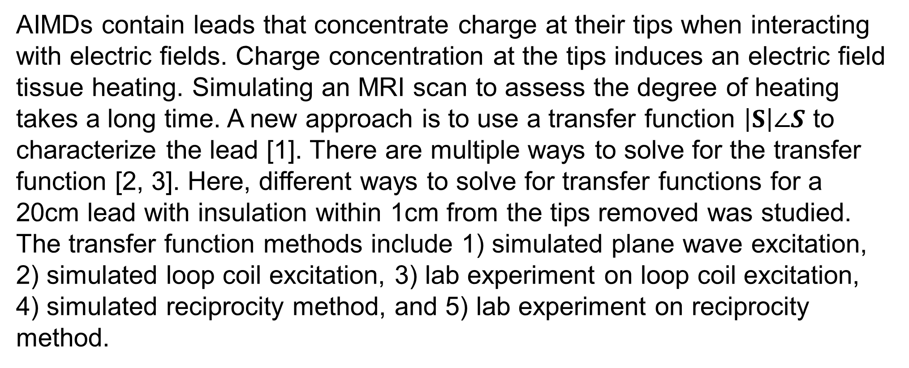
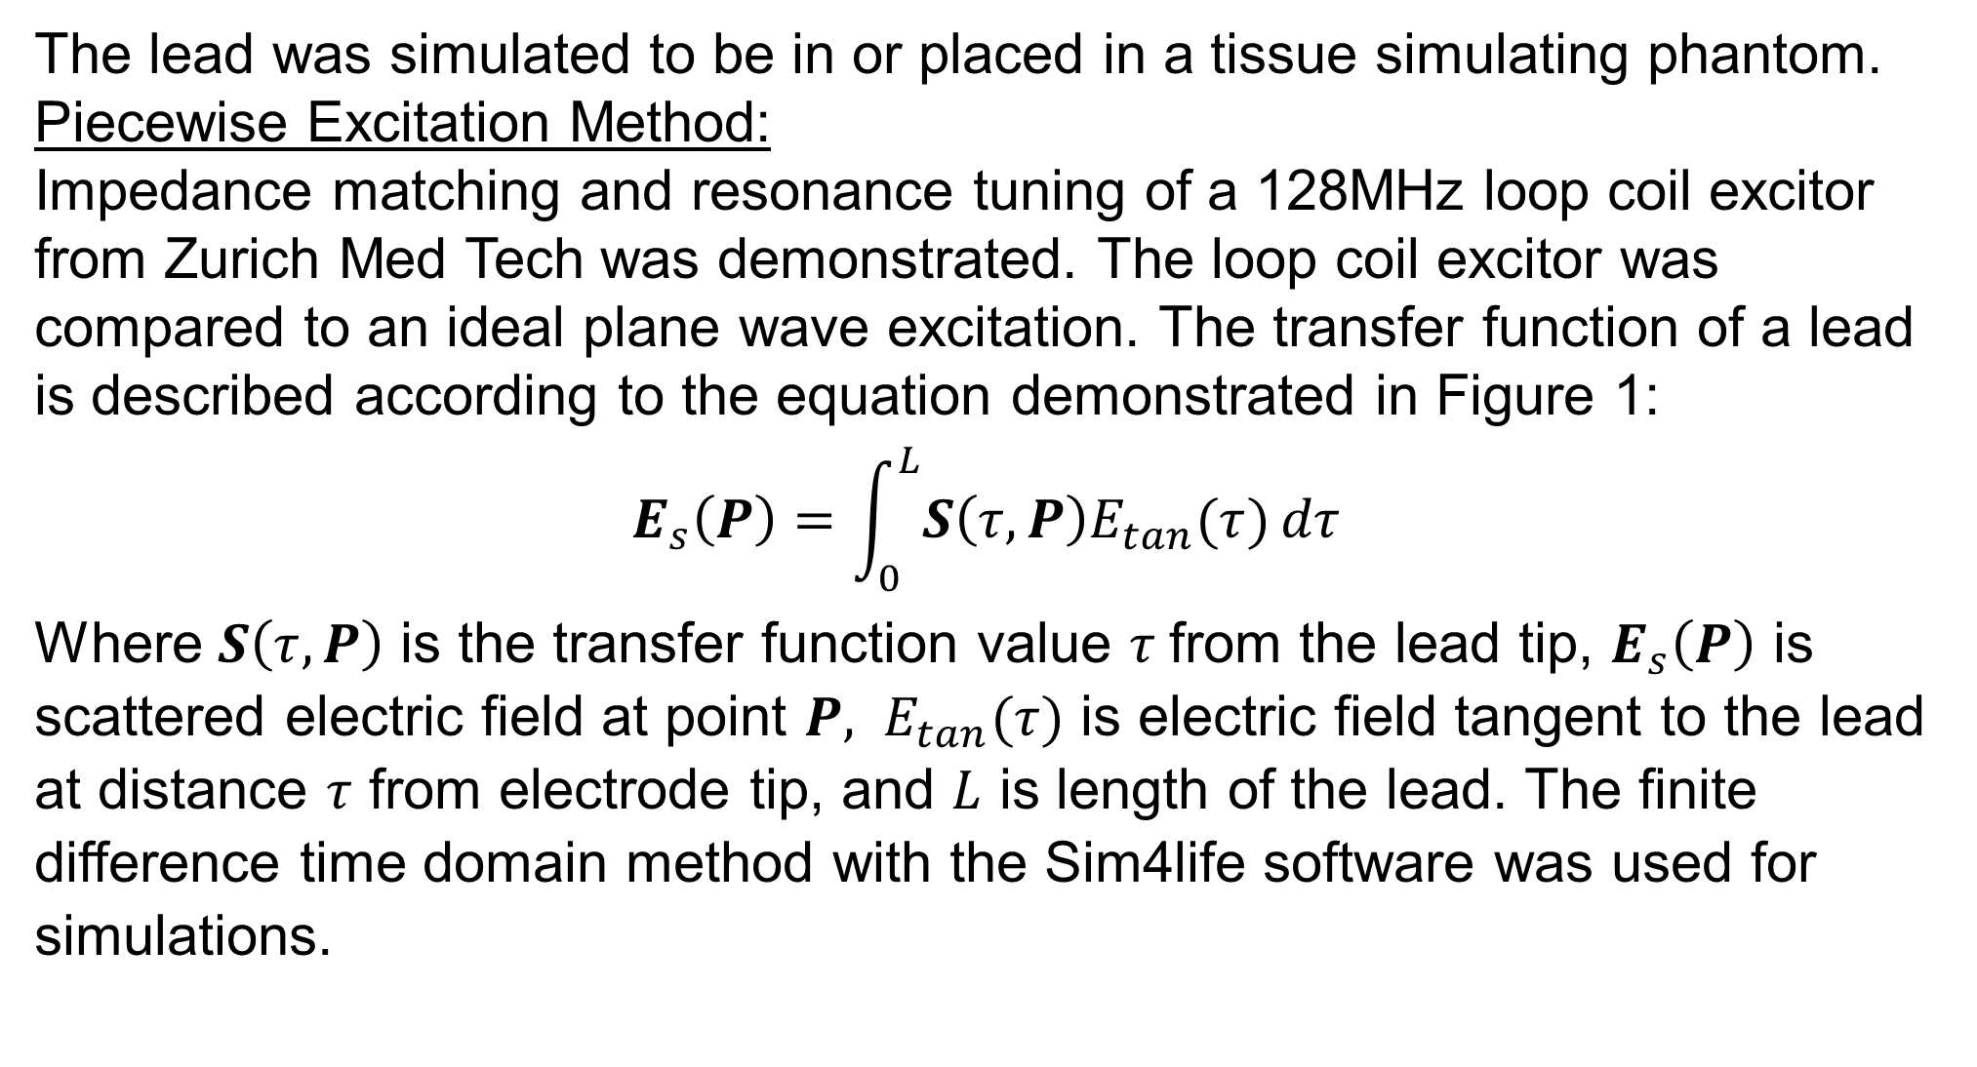
Evaluating Transfer Function Methods and Exciter Probes Used for Evaluation of MR Safety for Active Implantable Medical Devices
Charles Marchini^{1,2} , Hongbae Jeong¹, and Ananda Kumar¹
1 - Division of Biomedical Physics, Food and Drug Administration, Silver Spring, Maryland
2 - Bioengineering, University of Illinois Urbana-Champaign, Urbana, Illinois
Abstract
Reciprocity Method:
128MHz current is applied at the tip for excitation and the resulting current $I(τ)$ at $τ$ along the lead is the transfer function (Figure 2). The method of moments in the FEKO software was used for simulation.
Transfer functions were normalized by setting the integral of the magnitude curve to 1. The phase was unwrapped and normalized to start at zero (Figure 5). A maximum $\left|S\right|$ is at about half wavelength of medium ($τ=132.5mm)$.
Active implantable medical devices (AIMDs) interact with the electric field during MRI scans which may cause burns. A transfer function approach has previously been developed that can drastically decrease simulation times to predict heating. Different transfer function methods were compared and showed agreement for transfer function values away from lead tips and had larger errors near the lead tips.
Introduction
Figure 2. The reciprocity method of measuring the transfer function [2]
Experiments:
Experiments were performed using a phantom (figure 3) filled with tissue simulating liquid. For the piecewise method, the loop coil excitor applied $E_{tan}(τ)$ across the lead. The electric field $E_{s}\left(P\right)$ was measured ~2.5mm from the lead tip. For the reciprocity method, voltage was applied via a coaxial cable and the current was measured with a wide band current monitor swept across the lead.
AIMDs contain leads that concentrate charge at their tips when interacting with electric fields. Charge concentration at the tips induces an electric field tissue heating. Simulating an MRI scan to assess the degree of heating takes a long time. A new approach is to use a transfer function $\left|S\right|∠S$ to characterize the lead [1]. There are multiple ways to solve for the transfer function [2, 3]. Here, different ways to solve for transfer functions for a 20cm lead with insulation within 1cm from the tips removed was studied. The transfer function methods include 1) simulated plane wave excitation, 2) simulated loop coil excitation, 3) lab experiment on loop coil excitation, 4) simulated reciprocity method, and 5) lab experiment on reciprocity method.
Figure 7. Percent errors when comparing simulation to the reciprocity method experiments
Figure 5. Transfer functions for different methods; One transfer function measurement for all methods used except the excitor experiments, where 3 measurements were taken and $mean±SEM$ is plotted
The highest percent error was ~4000% between the excitor simulation and reciprocity method magnitudes at the lead edge. High errors at the lead edge were likely a consequence of low resolution for the FDTD simulation (0.2x0.2x2mm), the current monitor touching the uninsulated lead tip during measurement, and a rubber band wrapped at the lead tip to hold it in place for the reciprocity experiment. Also, the current in experiment measured at the lead tip was small, causing a large percent error for a small absolute error.
Materials and Methods
The lead was simulated to be in or placed in a tissue simulating phantom.
Piecewise Excitation Method:
Impedance matching and resonance tuning of a 128MHz loop coil excitor from Zurich Med Tech was demonstrated. The loop coil excitor was compared to an ideal plane wave excitation. The transfer function of a lead is described according to the equation demonstrated in Figure 1:
$$E_{s}\left(P\right)=\int_{0}^{L}{S\left(τ,P\right)E_{tan}(τ)}dτ$$
Where $S\left(τ,P\right)$ is the transfer function value $τ$from the lead tip, $E_{s}\left(P\right)$ is scattered electric field at point $P, E_{tan}(τ)$ is electric field tangent to the lead at distance $τ$ from electrode tip, and $L$ is length of the lead. The finite difference time domain method with the Sim4life software was used for simulations.
The percent error in simulation was highest near the tips of the leads. Some of the errors were over 100% and are off the graphs in figures 6 and 7. Errors comparing the piecewise method and reciprocity method experiments were lower in insulated regions. Considering only insulated regions, the largest average percent error was 36%, which was between the piecewise lab experiment and plane wave simulation.
Figure 3. The phantom model used in simulations and experiments
Results and Discussion
The loop coil had 10.4dB and 14.3dB return loss at 128MHz for simulation and experiment, respectively, demonstrating impedance match and tuned resonance at the target frequency. The electric field component parallel to lead comes from the fringing fields of a capacitor (Figure 4). The loop coil had an $E_{tan}$ full width at half maximum of 13.64mm compared to 5mm for ideal plane wave.
Conclusion
The loop coil excitor approximates a plane wave source. The transfer functions show good agreement with each other in the insulated regions although in the uninsulated regions there may be large errors.
References
[1] Park et al. “Calculation of MRI-induced heating of an implanted medical lead wire with an electric field transfer function”, Journal of Magnetic Resonance Imaging, 2007.
[2] Feng et al. “A Technique to Evaluate MRI-Induced Electric Fields at the Ends of Practical Implanted Lead”, IEEE TRANSACTIONS ON MICROWAVE THEORY AND TECHNIQUES, 2015.
[3] Tokaya et al., “MRI-based transfer function determination for the assessment of implant safety”, Mag Res Med, 2017.
Acknowledgements
This work was partially supported by the Miniature Brain Machinery Fellowship, training grant number NSF 1735252. Also, thanks to Josh Guag for helping set up the lab experiments.
Disclaimer
Figure 1. Visualization of piecewise excitation transfer function method [1, 3]
Figure 4. Simulated loop coil used for piecewise excitation in lab experiments; Electric field shown as a colormap; Lead is placed at green line below excitor
Figure 6. Percent errors when comparing simulation to the piecewise excitation experiments.
The mention of commercial products, their sources, or their use in connection with material reported herein is not to be construed as either an actual or implied endorsement of such products by the Department of Health and Human Services. This presentation reflects the views of the author and should not be construed to represent FDA’s views or policies.

