Slide 1
PLEASE FILL IN THIS → side of the classroom first!
Check in with Paul (by the doors)
If you are using one of the Gilman desktops…
Sign in on a desktop
Double click the desktop folder “SSH & Secure File Transfer”
Double click on “putty.exe”
Sign into the server
Chill
If you need help, raise your hand or put an ORANGE sticky note on your monitor

Slide 2
Advanced UNIX
BCBGSO Workshop
March 3rd, 2018
Presenter: Carla Mann

Slide 3
Thanks!
BIG thanks to Jennifer Chang for inspiration for slides and materials
Organizers: Urminder Singh and Paul Villanueva
Funding/Support/Volunteers: BCBGSO
Tech support: Biology IT, especially Levi Baber
Our many, MANY volunteers:
Ashish Jain Bekah Starks Sagnik Banerjee
Sharmistha Chakrabortty Yulu Chen Basil Khuder
Avani Khadilkar Weija Su Hylia Gao
Alvin Chon

Slide 4
Materials
All exercise activities from this workshop are available at:
https://github.com/cmmann/20180302-unix-adv
Supporting materials are available at:
https://github.com/cmmann/20180302-UNIX-ADV-MATERIALS/
You can download this PowerPoint and follow along on your computer.
You will probably benefit quite a bit from downloading (and using) the cheat sheet!

Slide 5
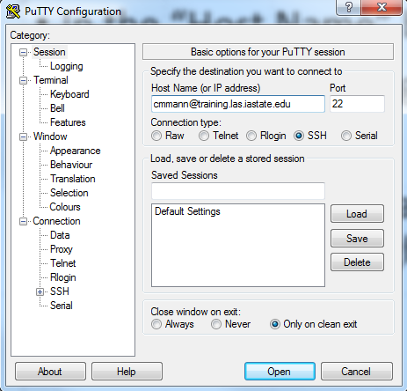
Set-Up
Mac/Linux:
Open terminal
ssh <your-netid>@training.las.iastate.edu
Windows:
Open Putty.exe
Enter
<your-netid>@training.las.iastate.edu into the Host Name box

Slide 6
Overview
Lesson 0: Quick Review of Basic UNIX
Lesson 0.5: Setup
Lesson 1: Text Editing with nano
Lesson 2: Shell Scripting
Lesson 3: Condo and Slurm
Lesson 4: Data Exploration with grep
Lesson 5: Regular Expressions (if we get to it)

Slide 7
Lesson 0: Quick Review
When describing a path to an/application:
this/is/path/to/the/file.txt
For our purposes:
“folder” and “directory” refer to the same thing
“terminal”, “console”, and “console window” all refer to the place you will type commands
In PowerPoint, commands you will type in the terminal will look like this
Keys you press will look like this: [Ctrl] or [command]
If you should press keys at the same time: [Ctrl] + [C]
A name or value that is user-dependent or variable will look <like this>
Don’t use spaces in names; use dashes [-] instead
cd: change directory
ls: list directory contents
man <command>: show manual page for command

Slide 8
Lesson 0.5: Setup
Once logged in, use this command to clone the materials into your workspace:
git clone https://github.com/cmmann/20180303-unix-adv.git
If you are prompted for a username/password, check to make sure you typed the URL correctly!

Slide 9
Lesson 1: Text Editing
Overview:
Lesson 1.1: Text Editors in UNIX
Lesson 1.2: nano

Slide 10
Lesson 1.1: Text Editors in UNIX
Multiple ways of editing text in files in UNIX
Vim is a VERY powerful text editor, but has a steep learning curve
Very worthwhile to learn, but we could spend an entire workshop on it, so we’re not going to mess with it today
“Friendliest” Unix text editor is nano
*If you already know how to use Vim, feel free to use it!

Slide 11
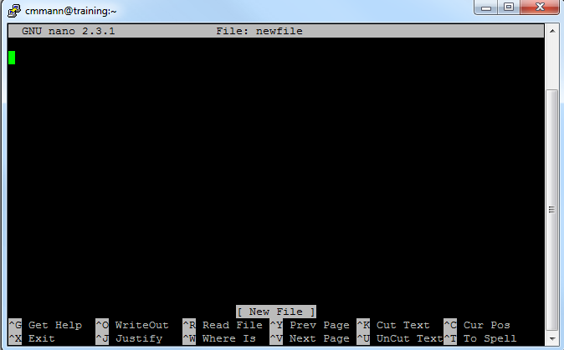

Lesson 1.2: Text Editing with nano
Command:
nano <filename>
What it does:
If <filename> exists, nano will open the file and you can read and manipulate it
If <filename> does not exist, nano will create a new file called <filename> and open it for you

Slide 12
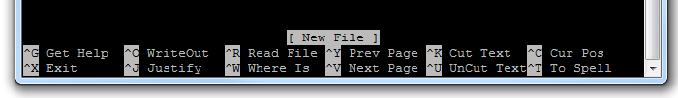
Lesson 1.2: Text Editing with nano
nano is kind enough to give you a list of controls at the bottom of the editing window
You can easily type in the nano window just as you would in Notepad, TextEdit, or any other text editor
To exit out of a nano window, type [Ctrl]+[x]
nano will ask if you want to save changes; type [y] or [n]

Slide 13
Exercise 1:
Goals:
Navigate to adv-unix/exercise1/
Use nano to open “exercise1.txt”
Edit the text of “3. What is the capital of Assyria?” to read “3. What is your favorite color?”
Answer the questions in the file (the answers don’t really matter, just your ability to edit the file)
Exit (save when prompted)

Slide 14
Exercise 1:
Goals:
Navigate to adv-unix/exercise1/ cd adv-unix/exercise1
Use nano to open “exercise1.txt”
Edit the text of “3. What is the capital of Assyria?” to read “3. What is your favorite color?”
Answer the questions in the file (the answers don’t really matter, just your ability to edit the file)
Exit (save when prompted)

Slide 15
Exercise 1:
Goals:
Navigate to adv-unix/exercise1/ cd adv-unix/exercise1
Use nano to open “exercise1.txt” nano exercise1.txt
Edit the text of “3. What is the capital of Assyria?” to read “3. What is your favorite color?”
Answer the questions in the file (the answers don’t really matter, just your ability to edit the file)
Exit (save when prompted)

Slide 16
Exercise 1:
Goals:
Navigate to adv-unix/exercise1/ cd adv-unix/exercise1
Use nano to open “exercise1.txt” nano exercise1.txt
Edit the text of “3. What is the capital of Assyria?” to read “3. What is your favorite color?”
Answer the questions in the file (the answers don’t really matter, just your ability to edit the file) Carla I seek the Holy Grail Blue An African or European swallow? 42
Exit (save when prompted)

Slide 17
Exercise 1:
Goals:
Navigate to adv-unix/exercise1/ cd adv-unix/exercise1
Use nano to open “exercise1.txt” nano exercise1.txt
Edit the text of “3. What is the capital of Assyria?” to read “3. What is your favorite color?”
Answer the questions in the file (the answers don’t really matter, just your ability to edit the file) Carla I seek the Holy Grail Blue An African or European swallow? 42
Exit (save when prompted) [Ctrl]+[x] [y]

Slide 18
Lesson 2: Shell Scripting
Overview:
Lesson 2.0: What is a shell?
Lesson 2.1: Creating a shell script
Lesson 2.3: Executing a shell script
Exercise 2: Completed throughout the lesson

Slide 19


Lesson 2.0: What is a shell?
A shell is an interface for accessing an operating system’s services
Shells can be GUIs (graphical user interface)
or CLIs (command-line interface)

Slide 20

Lesson 2.0: What is a shell?
There are multiple ‘flavors’ of command-line interfaces:
DOS, POSIX, CMD.EXE, many others
We are going to use a command-line shell called Bash:
To enable Bash scripting on your terminal, enter:
bash
And as simply as that, the server now knows what to use to interpret commands

Slide 21
Lesson 2.0: Shell Scripting
Every command you type into your terminal can be saved into a file
This file is called a shell script
That file can then be executed, or run, from the terminal
The commands in the file will be read line-by-line and executed, as if you had typed them in the terminal

Slide 22
Lesson 2.1: Creating a Shell Script
When creating a shell script, we first need to create a file
This file should end in “.sh”, which signifies that it is a shell script
Note that the computer doesn’t require the “.sh” extension to recognize this (it uses something different) – this is a human convention so you know the file contains a shell script
Exercise 2:
Create a file, using nano, called “hello.sh”

Slide 23
Lesson 2.1: Creating a Shell Script
WE know the script should be executed with bash – Unix doesn’t.
How do we tell UNIX what tools to use?
By starting off the file with a hashbang and a file path! This tells UNIX to use certain a certain shell to run the script
#!<path/to/program>
In our case, we’re using bash. So the first line of hello.sh, and EVERY SHELL SCRIPT YOU WRITE (that will be interpreted with bash), will be:
#!/bin/bash
Exercise 2: Go ahead and add this header to hello.sh

Slide 24
Lesson 2.1: Comments
Scripts can be complicated
Keep track of what scripts are doing with comments
In .sh files, any text following ‘#’ is ignored by bash
#So this is ignored
But only #this last bit is ignored
Exercise 2:
#Using a comment, add your name and the date to your hello.sh script

Slide 25


Lesson 2.1: Comments
It is good practice to comment your scripts well
Will you still know what your script is doing 6 months from now?

Slide 26
Lesson 2.1: Creating a Shell Script
We are going to create a simple script within hello.sh that prints “hello” to the console upon execution.
You can print to the console using the command “echo”:
echo “what you want to say”

Slide 27
Lesson 2.1: Creating a Shell Script
You can do the same thing, within the script
Exercise 2:
In your hello.sh file, type:
echo “hello world!”
or
echo “Hello, world!”
(if you want to be grammatically correct)
Then exit and save the file.

Slide 28
Lesson 2.2: Executing a Shell Script
You can execute scripts you’ve written (that are in your present working directory) by typing:
./scriptname.sh
This tells the server the path to the command it’s executing
But we execute other commands by typing just ls or cd or echo
Why can’t we just execute the file by typing it’s name?

Slide 29
Lesson 2.2: Executing a Shell Script
Security.
What happens if somebody comes into your directory and creates an executable file called ls that contains:
#!/bin/bash
echo “sucks to be you”
rm –rf /
(Don’t create this file or run rm –rf /)

Slide 30
Lesson 2.2: Executing a Shell Script
Security.
What happens if somebody comes into your directory and creates an executable file called ls that contains:
#! /bin/bash
echo “sucks to be you”
rm –rf /
This way, you can be sure that you’re using the genuine ls command.

Slide 31
Lesson 2.2: Executing a Shell Script
So how do we execute hello.sh?

Slide 32
Lesson 2.2: Executing a Shell Script
So how do we execute hello.sh?
./hello.sh
What happens when you run the script?

Slide 33
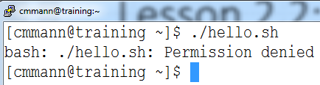
Lesson 2.2: Executing a Shell Script
So how do we execute hello.sh?
./hello.sh
What happens when you run the script?

Slide 34
Lesson 2.2: Executing a Shell Script
See what happens with:
bash hello.sh

Slide 35
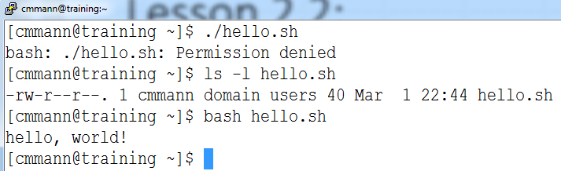
Lesson 2.2: Executing a Shell Script
Why is the script executing, even though we don’t have permission!?!?

Slide 36
Lesson 2.3: Executing a Shell Script
Fun fact: The execute permission is not a security feature – instead, it’s a flag to the system that a script is executable, and the system now knows to look for a #! header line to know what program to use to interpret the instructions in your script.
So when we run a script with ./hello.sh, we are executing hello.sh, which the system does not recognize as executable
When we run the script with bash hello.sh, we are executing bash, which is reading hello.sh and then executing the commands it has read

Slide 37

Lesson 2.3: Executing a Shell Script
The difference between the two:
In scenario 1, hello.sh is telling the system what to do.
In scenario 2, bash is reading hello.sh, and then bash is telling the system what to do.
bash has executable permissions, so it can ‘boss’ the system around, but hello.sh currently doesn’t, so it can’t.

Slide 38
Lesson 2.3: Executing a Shell Script
Try changing the permissions on hello.sh to make it executable for you, the owner
How would you change the Execute permission for hello.sh?
chmod ??? hello.sh
Remember: read = 4, write = 2, execute = 1

Slide 39
Lesson 2.3: Executing a Shell Script
Exercise 2:
Try changing the permissions on hello.sh to make it executable for you, the owner
How would you change the execute permission for hello.sh?
chmod ??? hello.sh
Remember: read = 4, write = 2, execute = 1
chmod 755 hello.sh
Alternate shortcut:
chmod u+x hello.sh

Slide 40
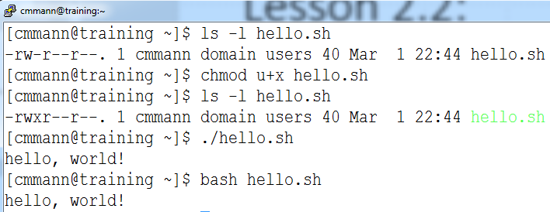
Lesson 2.3: Executing a Shell Script
Try executing the script now:
./hello.sh

Slide 41
Lesson 2.3: Executing a Shell Script
If Execute permission isn’t providing security, then what is?

Slide 42
Lesson 2.3: Executing a Shell Script
If Execute permission isn’t providing security, then what is?
Read and Write permissions!
Try changing permission of hello.sh so that you have Write and Execute, but not Read:

Slide 43
Lesson 2.3: Executing a Shell Script
If Execute permission isn’t providing security, then what is?
Read and Write permissions!
Try changing permission of hello.sh so that you have Write and Execute, but not Read:
chmod 344 hello.sh

Slide 44
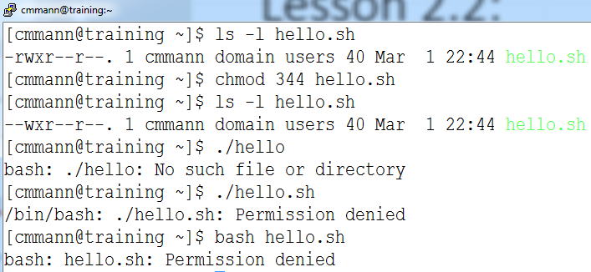
Lesson 2.3: Executing a Shell Script

Slide 45
Lesson 2.3: Executing a Shell Script
Why don’t they work?

Slide 46
Lesson 2.3: Executing a Shell Script
Why don’t they work?
Because without Read permission, the system can’t read the commands in the file, regardless of how it’s called!
So Read (and to a lesser extent, Write) permissions are the true ‘security’ features of permissions

Slide 47
Exercise 2:
Goal:
1. Execute hello.sh by calling
./hello.sh

Slide 48
Lesson 3: Condo and Slurm
Overview:
Lesson 3.1: High Performance Computing
Lesson 3.2: Condo
Lesson 3.3: Slurm
Lesson 3.4: Slurm Job Script generation
Lesson 3.5: Slurm commands

Slide 49
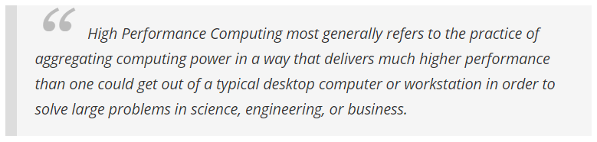

Lesson 3.1: High Performance Computing
Also known simply as “HPC”
https://insidehpc.com/hpc-basic-training/what-is-hpc/
Typically, an HPC resource consists of a “cluster” of computational nodes, so sometimes you will hear HPC referred to as a “cluster”
http://www.ticra.com/products/software/grasp/mpi-hpc-linux-cluster

Slide 50
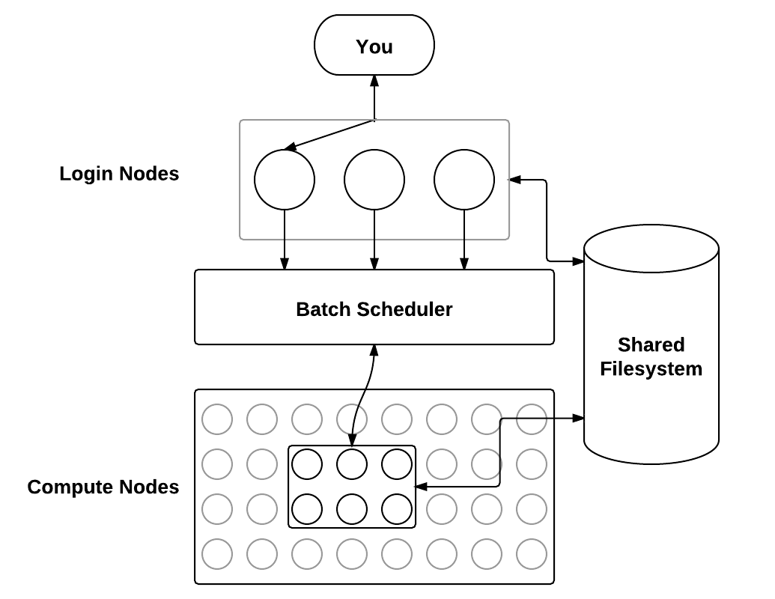
Lesson 3.1: High Performance Computing
Many people can simultaneously use an HPC cluster
An HPC resources can perform several computationally intensive jobs at once by distributing those jobs across several computational nodes

Slide 51
Lesson 3.1: High Performance Computing
Users communicate with the server through SSH, and connect to a “head” or “login” node

Slide 52
Lesson 3.1: High Performance Computing
The user submits a job through the head node to a “scheduler”

Slide 53
Lesson 3.1: High Performance Computing
The scheduler distributes jobs across the “compute” nodes in the cluster, so that jobs can be performed as efficiently as possible

Slide 54
Lesson 3.1: High Performance Computing
Once the compute nodes have finished performing a job, the results are stored where the user can access them

Slide 55
Lesson 3.2: Condo
Condo is one of ISU’s frequently utilized HPC resources
Further information: https://www.hpc.iastate.edu/guides/condo-2017
ITS has very good guides on IT resources

Slide 56
Lesson 3.2: Condo
NEVER DO LARGE OPERATIONS DIRECTLY IN YOUR CONSOLE/ON THE HEAD NODE
This means you shouldn’t run large jobs directly in your terminal when connected to an HPC cluster
When SSH’d into the HPC cluster, the environment you’re in is only meant to handle task scheduling
You submit jobs to the compute nodes through Slurm scripts

Slide 57


Lesson 3.3: Slurm
Simple Linux Utility for Resource Management
The name is indeed referencing Slurm “soda” from the TV show Futurama

Slide 58

Lesson 3.3: Slurm
Slurm is the batch scheduler that ISU uses for distributing jobs on our HPC resources

Slide 59
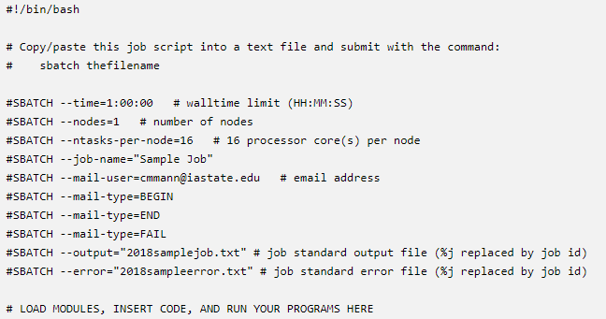
Lesson 3.3: Slurm
HPC jobs are submitted through the console, in the form of scripts
Each of these scripts will have special instructions for Slurm, and Slurm will handle them appropriately

Slide 60
Lesson 3.4: Slurm Job Script Generation
ITS has set up a wonderful tool for automatically generating Slurm scripts
https://www.hpc.iastate.edu/guides/condo-2017/slurm-job-script-generator-for-condo
We will be able to use Slurm on our training server; you can get access to condo through your lab:
https://www.hpc.iastate.edu/guides/condo-2017/who-can-use-condo

Slide 61
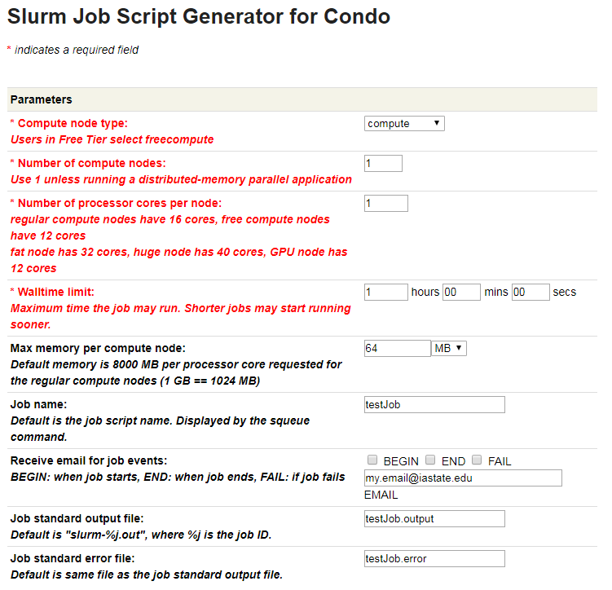
Lesson 3.4: Slurm Job Script Generation

Slide 62
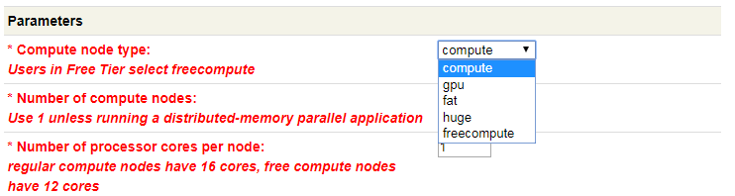
Lesson 3.4: Slurm Job Script Generation
Compute node type:
Allows you to select the node type for your job
You will mostly use “compute” or “freecompute”; gpu, fat, and huge are more expensive and for processing truly ridiculous amounts of information (like TB, as opposed to GB)

Slide 63
Lesson 3.4: Slurm Job Script Generation
Number of compute nodes:
Allows you to select how many nodes will process your job
More nodes = faster completion = more $

Slide 64
Lesson 3.4: Slurm Job Script Generation
Number of processor cores per node:
Allows you to select how many processors in each node will be utilized
More processors = faster completion = more $

Slide 65
Lesson 3.4: Slurm Job Script Generation
Walltime limit:
Limits how long a job will run
A job will immediately be canceled if it runs into its walltime limit
Shorter walltimes tend to be prioritized (to finish as many jobs as quickly as possible)

Slide 66
Lesson 3.4: Slurm Job Script Generation
Pro-tip (Thanks, Sagnik!):
If you’re running a script for the first time, allocate 1-2min of walltime, instead of several hours or days
Check to make sure your script actually runs before requesting more than a few minutes of HPC time!

Slide 67
Lesson 3.4: Slurm Job Script Generation
Max memory per compute node:
Limits how much memory each node you are utilizing will use
More memory = faster completion = more $

Slide 68
Lesson 3.4: Slurm Job Script Generation
Job name:
A name you can provide to more easily identify your jobs

Slide 69
Lesson 3.4: Slurm Job Script Generation
Receive email for job events:
You can provide an email address to optionally receive emails to inform you when your job starts, when it ends, and if it fails due to an error of some kind

Slide 70
Lesson 3.4: Slurm Job Script Generation
Job standard output file:
If your job would output information to the console, this is the name of the file it will output to

Slide 71
Lesson 3.4: Slurm Job Script Generation
Job standard error file:
If your job fails due to an error, the error message/log will be output to this file

Slide 72
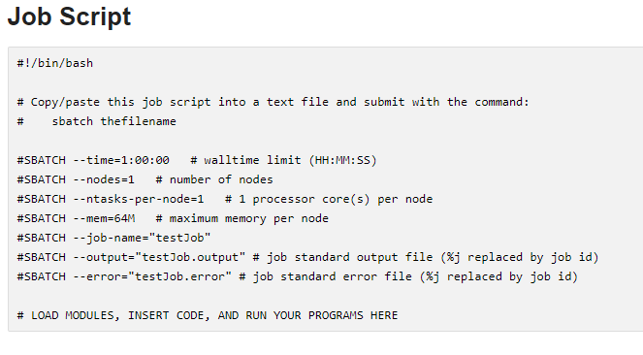
Lesson 3.4: Slurm Job Script Generation
As you specify options, the page will dynamically generate a script header containing your parameters
Below this section, you can write code to execute some function/run a program

Slide 73
Lesson 3.4: Slurm Job Script Generation
When creating Slurm commands, you can:
Open your script file with nano
Copy the header script to your clipboard ([Ctrl] + [c] or [command] + [c])
Then Left click or [command] + click to paste the header directly into the console

Slide 74
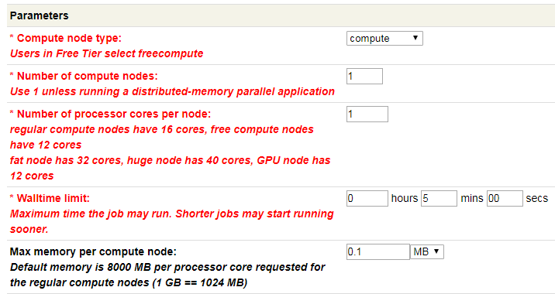
Lesson 3.4: Slurm Job Script Generation
We are not on condo
We are on a training server
Use these settings for Slurm jobs on training server:

Slide 75
Exercise 3 Prelude
Use https://www.hpc.iastate.edu/guides/condo-2017/slurm-job-script-generator-for-condo to generate Slurm headers for your file
Name a standard output file and a standard error
Copy the Job Script
Create a copy of the file called slurm-test.sh; call this copy <yourname>-slurm-test.sh
Open <yourname>-slurm-test.sh and paste your Slurm Job Script header above the code in <yourname>-slurm-test.sh
Change “0.1M” to “1K”

Slide 76
Lesson 3.5: Slurm Commands
3.51: Submit a Slurm script
3.52: Check the job queue
3.53: Cancel a Slurm job
3.54: Check job stats

Slide 77

Lesson 3.51: Submit a Slurm script
Command: sbatch <slurmscript.sh>
What it does:
sbatch submits a script to Slurm, which reads the parameters in the #SBATCH lines and then allocates resources and distributes jobs accordingly
Your job will be assigned a job ID; you can use this job ID to check job stats, cancel jobs, etc.

Slide 78

Lesson 3.52: Check the job queue
Command: squeue -options
What it does:
View information on jobs in the Slurm queue
Options:
-u <user>: View information only on jobs submitted by a particular user

Slide 79
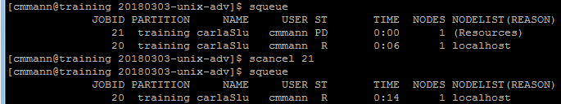
Lesson 3.53: Cancel a Slurm job
Command: scancel <jobid>
What it does:
Immediately stops running <jobid>, or removes <jobid> from the Slurm queue

Slide 80
Exercise 3
1. Submit <yourname>-slurm-test.sh to Slurm for processing. The code should take exactly 30 seconds to run, once it reaches the head of the queue.
2. Use squeue to view the Slurm queue
3. Try to cancel SOMEONE ELSE’s job. What happens?
4. View your output file. What did the code in <yourname>-slurm-test.sh do?

Slide 81
Lesson 4:
Overview:
Lesson 4.0: Review Text Output
Lesson 4.1: Word Count
Lesson 4.2: Piping
Lesson 4.3: Sort
Lesson 4.4: Uniq
Lesson 4.5: Grep
Exercise 4: Hello

Slide 82
Lesson 4.0: Text Output
Commands:
cat <filename.txt>
head <filename.txt>
tail <filename.txt>
less <filename.txt>
What they do:
cat outputs the entirety of <filename.txt> to the console (don’t try this with large files!!)
head outputs the first 10 lines of the file
tail outputs the last 10 lines of the file
less lets you scroll around a file

Slide 83
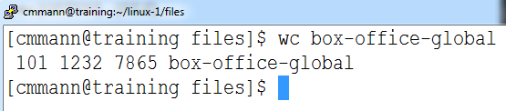
Lesson 4.1: Word Count
Command:
wc <filename>
What it does:
Outputs the number of:
lines words bytes filename

Slide 84
Lesson 4.1: Word Count
Options:
-l : output ONLY the number of LINES and filename
-w : output ONLY the number of WORDS and filename
-m : print the number of characters in the file and filename

Slide 85
Lesson 4.1: Word Count
So that’s cool, but these options all put out the filename as well
How do we get around that?
Many, many possible ways, but we’re going to use piping for now

Slide 86

Lesson 4.2: Piping
We can take the output of one command, and directly feed it to another command – all in one line, using the [|] key (this is generally directly below the backspace key)
command1 | command2
Example:
cat bill-of-rights | wc -l

Slide 87
Lesson 4.3: sort
Command:
sort <file>
What it does:
Sorts <file> alphabetically by line
Options:
-n : sort numerically (if there are no numbers, it will default to alphabetic sort
-r : sort in reverse alphabetical order
-u : sort only unique items

Slide 88
Lesson 4.4: uniq
Command:
uniq
What it does:
Finds unique occurrences of text input
Options:
-c : count the occurrences of each line
-d : print only duplicated lines
-u : print only unique lines

Slide 89
Lesson 4.4: uniq
uniq must be called on something that is already sorted!
It works by comparing adjacent items in a list and discarding if they are identical.
Generally called after sort:
cat hello.txt | sort | uniq

Slide 90
Lesson 4.5: Grep
Stands for “Global Regular Expression Print”
EXTREMELY POWERFUL search tool
Finds text matching highly variable criteria and prints the lines containing that text
Can search multiple files, and find the files that match

Slide 91
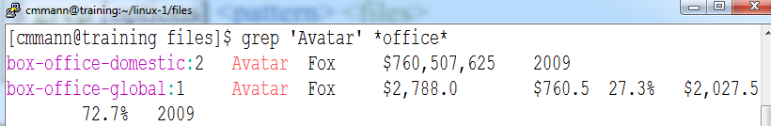
Lesson 4.5: Grep
Command:
grep –options <pattern> <files>
What it does:
grep searches <files> for content matching <pattern>

Slide 92
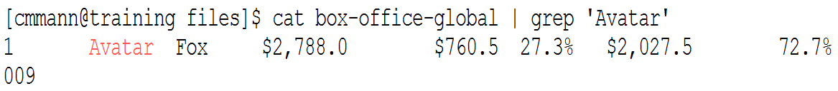
Lesson 4.6: Piping and Grep
We can also feed text directly to grep, and have it search that:
Command:
<intext> | grep –options <pattern>
What it does:
grep searches <intext> for content matching <pattern>

Slide 93
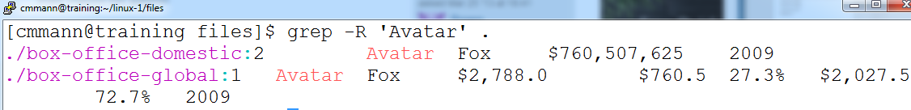
Lesson 4.7: Grep All Files in A Directory
We can also search for content within a directory:
grep –R <pattern> <directoryname/>
For this, we have to use the –R Recursive option!

Slide 94
Lesson 4.8: Grep Options
Grep has many, many options:
-c : count how many LINES on which the pattern occurs
-o : show only the part of a line that matches a pattern; this will show all matches in the line
-v : invert match – so select things that DON’T match <pattern>
-i : case insensitive matching
-l : list the files with a match
-L : list the files that don’t have a match

Slide 95
Exercise 4: Hello
1. Navigate to ~/20180303-adv-unix/exercise4/
2. Open “exercise4.sh”
3. Edit the file to perform the exercises.
4. Execute the file!
Hint:
If you aren’t sure if you’re getting the correct answers, you can run exercise4answers.sh.

Slide 96
Lesson 5: Regular Expressions
Overview:
Lesson 5.1: What are Regular Expressions?
Lesson 5.2: egrep
Lesson 5.3: Matching words with egrep
Lesson 5.4: Fuzzy Matching
Lesson 5.5: Number Matching
Lesson 5.6: Operators
Lesson 5.7: Matching X Letters
Lesson 5.8: Example
Lesson 5.9: Continuing Education

Slide 97
Lesson 5.1: Regular Expressions
Also called ‘regex’ or ‘regexp’
UNBELIEVABLY POWERFUL tool for defining search patterns
Consists of ‘codes’ that denote various conditions
These conditions can be used to very narrowly find things, or very, very broadly find things

Slide 98
Lesson 5.2: Regular Expressions
In UNIX, frequently used with grep
grep -E <‘regexppattern’> <file>
The option “-E” tells grep that the pattern is a regular expression! It is very important that you remember the “-E” option, otherwise grep will try to match your exact pattern, instead of what it represents.

Slide 99
Lesson 5.2: egrep
Alternatively, you can use egrep:
egrep <‘regexppattern’> <file>
This behaves exactly as “grep –E”, and will be used through the rest of the slides.

Slide 100
Lesson 5.3: Matching Words
We can still match words while grepping regular expressions:
egrep ‘cat’ <file>
will still find any instance of the letters ‘cat’ in a file
But grep allows us to search for words similar to ‘cat’…

Slide 101
Lesson 5.4: Fuzzy Matching
The regexp to find words containing ‘cat’ or ‘cot’ would be:
‘[c][ao][t]’
The brackets encase ‘character’ slots
What would ‘[fw][i][s][h]’ match?

Slide 102
Lesson 5.4: Fuzzy Matching
The regexp to find words containing ‘cat’ or ‘cot’ would be:
‘[c][ao][t]’
The brackets encase ‘character’ slots
What would ‘[fw][i][s][h]’ match?
fish, lungfish, fishing, wish, wishing, swish, etc.

Slide 103
Lesson 5.4: Fuzzy Matching
If we only wanted to match the ‘word’ cat or cot, and not , we can bracket ‘[c][ao][t]’ with spaces:
‘[ ][c][ao][t][ ]’
Note that many, many systems use Regular Expressions, and some have slightly different usage. For many systems, you can specify a match to ‘whitespace’ (spaces and tabs) using “\s”, but this does not work in bash.

Slide 104
Lesson 5.4: Fuzzy Matching
This bracket system, though, is rather cumbersome. Instead, we could specify:
‘\b[c][ao][t]’
In this context, ‘\b’ means to match the beginning of a word.
The ‘\’ before the ‘b’ is an escape character – it signals that we don’t want to literally match the letter ‘b’, but the condition that ‘b’ represents.

Slide 105
Lesson 5.4: Fuzzy Matching
We can use a ‘-’ to represent a span of characters:
‘[a-c][o][g]’ would recognize ‘aog’, ‘bog’, ‘cog’
‘[l-z][o][g]’ would only recognize ‘log’, ‘mog’, ‘nog’ etc.

Slide 106
Lesson 5.5: Number Matching
We can also match numbers:
What number(s) will the following match?
‘[0-3][5-8][345]’

Slide 107
Lesson 5.5: Number Matching
We can also match numbers:
What number(s) will the following match?
‘[0-3][5-8][345]’
053, 153, 374, etc.

Slide 108
Lesson 5.6: Operators
‘[cd][ao][tg]’ would match ‘cat’ or ‘dog’
(But also ‘cag’, ‘dat’, and any combination of those letters)
What regular expression would you use to find words containing “trap” or “tarp”?

Slide 109
Lesson 5.6: Operators
‘[cd][ao][tg]’ would match ‘cat’ or ‘dog’
(But also ‘cag’, ‘dat’, and any combination of those letters)
What regular expression would you use to find words containing “trap” or “tarp”?
‘[t][ar][ar][p]’

Slide 110
Lesson 5.6: Operators
But what if we wanted to match ‘trap’ or ‘tarp’, but not ‘trrp’ or ‘taap’?
We can use operators to specify this!

Slide 111
Lesson 5.6: Operators
If you want to match this OR that:
egrep ‘this|that’ <file>
When using regular expressions, grep understands that “|” means “OR”
If you to find things that are NOT something, you use:
egrep –v ‘something’ <file>

Slide 112
Lesson 5.6: Operators
What if you want to match the character ‘|’?
We use escape characters again!
egrep ‘\|’

Slide 113
Lesson 5.7: Matching X Letters
What if we want to find something more complicated, like a zip code?
What is the form of a zip code?
5 numbers
How could we potentially match that?
‘[0-9][0-9][0-9][0-9][0-9]’

Slide 114
Lesson 5.7: Matching X Letters
But that’s rather cumbersome. Instead, we can specify a specific number of times to look for a set of characters:
egrep ‘[0-9]{5}’ <file>
In regexp, you can use a number in brackets AFTER the thing that you want to repeat

Slide 115
Lesson 5.7: Matching X Letters
We can put more than just a number in there:
a{n,} : will match the letter ‘a’ n OR MORE times
What will ‘a{2,}’ match?
aardvark, armadillo, aaaah

Slide 116
Lesson 5.7: Matching X Letters
We can put more than just a number in there:
a{n,} : will match the letter ‘a’ n OR MORE times
What will ‘a{2,}’ match?
aardvark, armadillo, aaaah

Slide 117
Lesson 5.7: Matching X Letters
We can also specify a range of times to match:
a{n, m} : will match ‘a’ at least n times, but not more than m times.
What will ‘a{2, 3}’ match?
aardvark, armadillo, aaaah

Slide 118
Lesson 5.7: Matching X Letters
We can also specify a range of times to match:
a{n, m} : will match ‘a’ at least n times, but not more than m times.
What will ‘a{2, 3}’ match?
aardvark, armadillo, aaaah

Slide 119
Lesson 5.7: Matching X Letters
We can also specify more matches:
a* : match ‘a’ 0 or more times
a+ : match ‘a’ 1 or more times
a? : match ‘a’ once if it happens, but matching it is optional

Slide 120
Lesson 5.8: Example
We can match EXTREMELY complicated things
Real world example: PDB files
In my day job, I want to find the coordinates of atoms in PDB files.
These lines take the form:

Slide 121
Lesson 5.8: Example
So these lines look similarly, but they have different numbers and characters spaced differently.
And the rest of the file looks NOTHING like this.
How could I pull out ONLY these lines?

Slide 122

Lesson 5.8: Example
We could try:
egrep ‘ATOM’ 1R2X.pdb, but…

Slide 123
Lesson 5.8: Example
We can specify that we only want to match ‘ATOM’ if it starts at the beginning of the line:
egrep ‘^ATOM’ 1R2X.pdb
The character ‘^’ is a special character called an ‘anchor’ that means to match the beginning of the line

Slide 124
Lesson 5.8: Example
But what if I ONLY want the protein atom coordinates?

Slide 125
Lesson 5.8: Example
We make a really complicated regexp:
egrep ‘^ATOM[ ]*[0-9]+[ ]*[A-Z]+[ ]*[A-Z]{3}’

Slide 126
Lesson 5.8: Example
What is this doing?
‘^ATOM[ ]*[0-9]+[ ]*[A-Z]+[ ]*
[A-Z]{3}’
Match ATOM at the beginning of the line
Match at least one letter
Match at least one digit
Match any number of spaces
Match exactly 3 letters

Slide 127
Lesson 5.9: Regexp Continuing Education
There are many, many more options available to use with regexp in bash
We could spend an entire workshop on this alone. (We’re not going to today, though.)
If you want to learn more, visit:
http://tldp.org/LDP/Bash-Beginners-Guide/html/sect_04_01.html#sect_04_01_02

Slide 128
Exercise 5: Real Life Stuff
1. Open and edit exercise5.sh
2. Complete the exercises within.
3. Run exercise5.sh

Slide 129
Closing
Thanks for coming!
Please take this survey so that we can improve the workshop for future attendees:
https://goo.gl/forms/cumiG8DvCOzOmDuC2

