Slide 1
PLEASE FILL IN THIS → side of the classroom first!
If you are using one of the Gilman desktops…
Sign in on a desktop
Double click on “Statistics (SAS)”
Hit [Ctrl]+[Alt]+[Del]
Double click the desktop folder “SSH & Secure File Transfer”
Double click on “putty.exe”
Sign into the server
Chill

Slide 2
Advanced UNIX
BCBGSO Workshop
March 2nd, 2017
Presenter: Carla Mann

Slide 3
Thanks!
BIG thanks to Jennifer Chang for inspiration for slides and materials
Organizers: Ashish Jain and Dan Kool
Funding/Support/Volunteers: BCBGSO
Tech support: Biology IT (Levi Baber)
Our many, MANY volunteers:
Dan Kool Ashish Jain David Hufnagel Xiyu Peng
Sagnik Banerjee Akshay Yadav Schuyler Smith Urminder Singh
Lindsay Rutter Alvin Chon Avani Khadilkar Kumar Ambuj
Nancy Machanda Cam Fay Sayane Shome Rebekah Starks
John Hsieh Ashley Zhu Gaurav Kandoi Michael Zeller

Slide 4
Materials
All materials (slides, cheat sheets, etc) available here:
https://github.com/cmmann/advanced-unix-workshop-materials.git

Slide 5
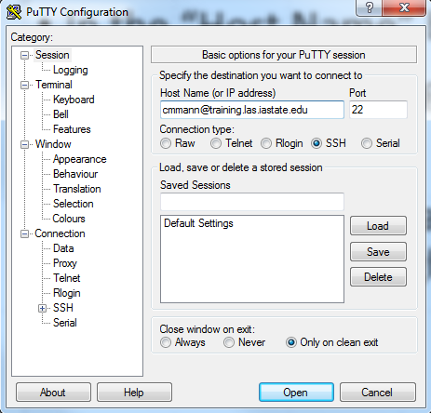
Set-Up
Mac/Linux:
Open terminal
ssh <your-netid>@training.las.iastate.edu
Windows:
Open Putty.exe
Enter
<your-netid>@training.las.iastate.edu into the Host Name box

Slide 6
Overview
Lesson 0: Quick Review of Basic UNIX
Lesson 0.5: Setup
Lesson 1: Text Editing with nano
Lesson 2: Shell Scripting; if and loop
Lesson 3: Data Exploration with wc and grep
Lesson 4: Regular Expressions
Lesson 5: Further Data Exploration with sort and uniq
Lesson 5: awk

Slide 7
Lesson 0: Quick Review
In PowerPoint, commands you will type will look like this
cd: change directory
ls: list directory contents
man <command>: show manual page for command

Slide 8
Lesson 0.5: Setup
Once logged in:
git clone https://github.com/cmmann/20170302-adv-unix.git

Slide 9
Lesson 1: Text Editing
Overview:
Lesson 1.1: Text Editors in UNIX
Lesson 1.2: Nano

Slide 10
Lesson 1.1: Text Editors in UNIX
Multiple ways of editing text in files in UNIX
Vim is a VERY powerful text editor, but has a steep learning curve
Very worthwhile to learn, but we could spend an entire workshop on it, so we’re not going to mess with it today
“Friendliest” is nano
*If you already know how to use Vim, go ahead and use it!

Slide 11
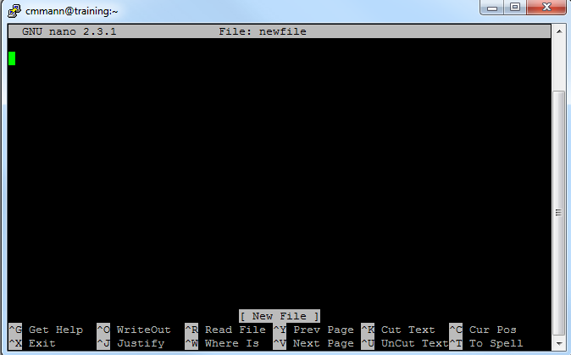

Lesson 1.2: Text Editing with nano
To use:
nano <filename>
If <filename> exists, nano will open the file and you can read and manipulate it
If <filename> does not exist, nano will create a new file called <filename> and open it for you

Slide 12
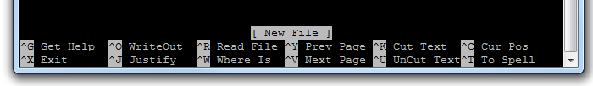
Lesson 1.2: Text Editing with nano
nano is kind enough to give you a list of controls at the bottom of the editing window
You can easily type in the nano window just as you would in notepad or another text editor
To exit out of a nano window, type [Ctrl]+[x]
nano will ask if you want to save changes; type [y] or [n]

Slide 13
Exercise 1:
Goals:
Navigate to adv-unix/exercise1
Use nano to open “exercise1.txt”
Edit the text of “3. What is the capital of Assyria?” to read “3. What is your favorite color?”
Answer the questions in the file (the answers don’t really matter, just your ability to edit the file)
Exit (save when prompted)

Slide 14
Exercise 1:
Goals:
Navigate to adv-unix/exercise1 cd adv-unix/exercise1
Use nano to open “exercise1.txt”
Edit the text of “3. What is the capital of Assyria?” to read “3. What is your favorite color?”
Answer the questions in the file (the answers don’t really matter, just your ability to edit the file)
Exit (save when prompted)

Slide 15
Exercise 1:
Goals:
Navigate to adv-unix/exercise1 cd adv-unix/exercise1
Use nano to open “exercise1.txt” nano exercise1.txt
Edit the text of “3. What is the capital of Assyria?” to read “3. What is your favorite color?”
Answer the questions in the file (the answers don’t really matter, just your ability to edit the file)
Exit (save when prompted)

Slide 16
Exercise 1:
Goals:
Navigate to adv-unix/exercise1 cd adv-unix/exercise1
Use nano to open “exercise1.txt” nano exercise1.txt
Edit the text of “3. What is the capital of Assyria?” to read “3. What is your favorite color?”
Answer the questions in the file (the answers don’t really matter, just your ability to edit the file) Carla I seek the Holy Grail Blue 42
Exit (save when prompted)

Slide 17
Exercise 1:
Goals:
Navigate to adv-unix/exercise1 cd adv-unix/exercise1
Use nano to open “exercise1.txt” nano exercise1.txt
Edit the text of “3. What is the capital of Assyria?” to read “3. What is your favorite color?”
Answer the questions in the file (the answers don’t really matter, just your ability to edit the file) Carla I seek the Holy Grail Blue 42
Exit (save when prompted) [Ctrl]+[x] [y]

Slide 18
Lesson 2: Shell Scripting
Overview:
Lesson 2.0: What is a shell?
Lesson 2.1: Creating a shell script
Lesson 2.3: Executing a shell script
Exercise 2: Completed throughout the lesson

Slide 19


Lesson 2.0: What is a shell?
A shell is an interface for accessing an operating system’s services
Shells can be GUIs (graphical user interface) or CLIs (command-line interface)

Slide 20

Lesson 2.0: What is a shell?
There are multiple ‘flavors’ of command-line interfaces:
DOS, POSIX, CMD.EXE, many others
We are going to use a command-line shell called Bash:
To enable Bash scripting on your terminal, enter:
bash
And as simply as that, the server now knows what to use to interpret commands

Slide 21
Lesson 2.0: Shell Scripting
Every command you type into your terminal can be pasted into a file
This file is called a shell script
That file can then be executed, or run, from the terminal
The commands in the file will be read line-by-line and executed, as if you had typed them in the terminal

Slide 22
Lesson 2.1: Creating a Shell Script
When creating a shell script, we first need to create a file
This file should end in “.sh”, which signifies that it is a shell script
Note that the computer doesn’t require the “.sh” extension to recognize this (it uses something different) – this is a human convention so you know the file contains a shell script
Create a file, using nano, called “hello.sh”

Slide 23
Lesson 2.1: Creating a Shell Script
WE know the script should be executed with bash
How do we tell UNIX what tools to use?
By starting off the file with a hashbang and a file path! This tells UNIX to use certain a certain shell to run the script
#! <path/to/program>
In our case, we’re using bash. So the first line of hello.sh, and EVERY SHELL SCRIPT YOU WRITE (that will be interpreted with bash), will be:
#! /bin/bash

Slide 24
Lesson 2.1: Comments
Scripts can be complicated
Keep track of what scripts are doing with comments
In .sh files, any text following ‘#’ is ignored
#So this is ignored
But only #this last bit is ignored
#Using a comment, add your name and the date to this script

Slide 25

Lesson 2.1: Comments
It is good practice to comment your scripts well
Will you still know what your script is doing 6 months from now?

Slide 26
Lesson 2.1: Creating a Shell Script
We are going to create a simple script within hello.sh that prints “hello” to the console upon execution.
You can print to the console using the command “echo”:
echo “what you want to say”

Slide 27
Lesson 2.1: Creating a Shell Script
You can do the same thing, within the script
In your hello.sh file, type:
echo “hello world!”
or
echo “hello, world!” if you want to be grammatically correct
Then exit and save the file

Slide 28
Lesson 2.2: Executing a Shell Script
You can execute scripts you’ve written (that are in your current directory) by typing:
./commandname
This tells the server the path to the command it’s executing
But we execute other commands by typing just ls or cd or echo
Why can’t we just execute the file by typing it’s name?

Slide 29
Lesson 2.2: Executing a Shell Script
Security.
What happens if somebody comes into your directory and creates an executable file called ls that contains:
#! /bin/bash
echo “sucks to be you”
rm –rf /

Slide 30
Lesson 2.2: Executing a Shell Script
Security.
What happens if somebody comes into your directory and creates an executable file called ls that contains:
#! /bin/bash
echo “sucks to be you”
rm –rf /
This way, you can be sure that you’re using the genuine ls command.

Slide 31
Lesson 2.2: Executing a Shell Script
So how do we execute hello.sh?

Slide 32
Lesson 2.2: Executing a Shell Script
So how do we execute hello.sh?
./hello.sh
What happens when you run the script?

Slide 33
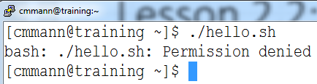
Lesson 2.2: Executing a Shell Script
So how do we execute hello.sh?
./hello.sh
What happens when you run the script?

Slide 34
Lesson 2.2: Executing a Shell Script
See what happens with:
bash hello.sh

Slide 35
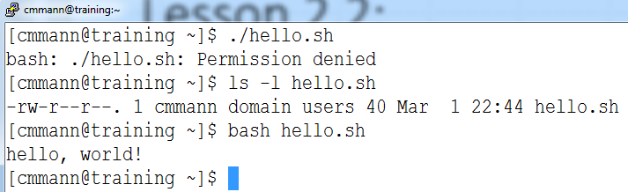
Lesson 2.2: Executing a Shell Script
Why is the script executing, even though we don’t have permission!?!?

Slide 36
Lesson 2.3: Executing a Shell Script
Fun fact: The execute permission is not a security feature – instead, it’s a flag to the system that a script is executable
So when we run a script with ./hello.sh, we are executing hello.sh, which the system does not recognize as executable
When we run the script with bash hello.sh, we are executing bash, which is reading the commands in hello.sh and then executing those commands

Slide 37

Lesson 2.3: Executing a Shell Script
The difference between the two:
In scenario 1, hello.sh is telling the system what to do.
In scenario 2, bash is reading hello.sh, and then bash is telling the system what to do.
Bash has executable permissions, so it can ‘boss’ the system around, but hello.sh currently doesn’t, so it can’t.

Slide 38
Lesson 2.3: Executing a Shell Script
Try changing the permissions on hello.sh to make it executable for you, the owner
How would you change the Execute permission for hello.sh?
chmod ??? hello.sh
Remember: read = 4, write = 2, execute = 1

Slide 39
Lesson 2.3: Executing a Shell Script
Try changing the permissions on hello.sh to make it executable for you, the owner
How would you change the execute permission for hello.sh?
chmod ??? hello.sh
Remember: read = 4, write = 2, execute = 1
chmod 755 hello.sh
Alternate shortcut:
chmod u+x hello.sh

Slide 40
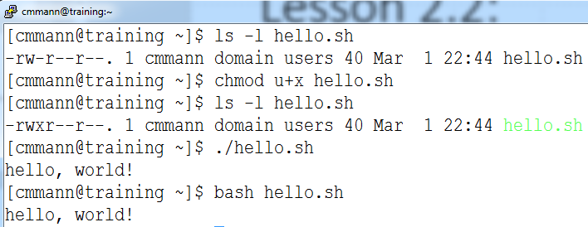
Lesson 2.3: Executing a Shell Script
Try executing the script now:
/.hello.sh

Slide 41
Lesson 2.3: Executing a Shell Script
If Execute permission isn’t providing security, then what is?

Slide 42
Lesson 2.3: Executing a Shell Script
If execute permission isn’t providing security, then what is?
Read and Write permissions!
Try changing permission of hello.sh so that you have Write and Execute, but not Read:

Slide 43
Lesson 2.3: Executing a Shell Script
If execute permission isn’t providing security, then what is?
Read and Write permissions!
Try changing permission of hello.sh so that you have Write and Execute, but not Read:
chmod 344 hello.sh

Slide 44
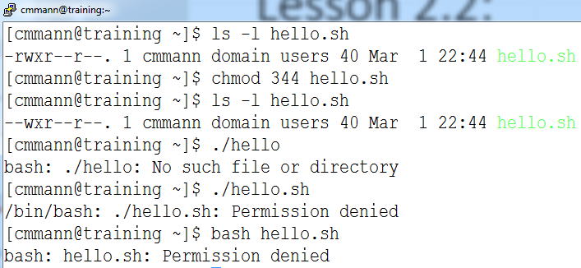
Lesson 2.3: Executing a Shell Script

Slide 45
Lesson 2.3: Executing a Shell Script
Why don’t they work?

Slide 46
Lesson 2.3: Executing a Shell Script
Why don’t they work?
Because without Read permission, the system can’t read the commands in the file, regardless of how it’s called!
So Read (and to a lesser extent, Write) permissions are the true ‘security’ features of permissions

Slide 47
Exercise 2:
Goal:
1. Execute hello.sh by calling ./hello.sh

Slide 48
Lesson 3:
Overview:
Lesson 3.0: Review Text Output
Lesson 3.1: Word Count
Lesson 3.2: Piping, overwriting, and appending
Lesson 3.3: Uniq
Lesson 3.4: Sort
Lesson 3.5: Grep
Exercise 3: Hello

Slide 49
Lesson 3.0: Text Output
Commands:
cat <filename.txt>
head <filename.txt>
tail <filename.txt>
less <filename.txt>
What they do:
cat outputs the entirety of <filename.txt> to the console (don’t try this with large files!!)
head outputs the first 10 lines of the file
tail outputs the last 10 lines of the file
less lets you scroll around a file

Slide 50
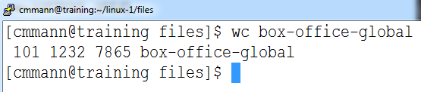
Lesson 3.1: Word Count
Command:
wc <filename>
What it does:
Outputs the number of:
lines words bytes filename

Slide 51
Lesson 3.1: Word Count
Options:
-l : output ONLY the number of LINES and filename
-w : output ONLY the number of WORDS and filename
-m : print the number of characters in the file and filename

Slide 52
Lesson 3.1: Word Count
So that’s cool, but these options all put out the filename as well
How do we get around that?
Many, many possible ways, but we’re going to use piping for now

Slide 53
Lesson 3.2: Piping
We can take the output of one command, and directly feed it to another command – all in one line, using the [|] key
command1 | command2
Example:
cat bill-of-rights | wc -l

Slide 54
Lesson 3.3: sort
Command:
sort <file>
What it does:
Sorts <file> alphabetically by line
Options:
-n : sort numerically (if there are no numbers, it will default to alphabetic sort
-r : sort in reverse alphabetical order
-u : sort only unique items

Slide 55
Lesson 3.4: uniq
Command:
uniq
What it does:
Finds unique occurrences of text input
Options:
-c : count the occurrences of each line
-d : print only duplicated lines
-u : print only unique lines

Slide 56
Lesson 3.4: uniq
uniq must be called on something that is already sorted!
It works by comparing adjacent items in a list and discarding if they are identical.
Generally called after sort:
cat hello.txt | sort | uniq

Slide 57
Lesson 3.5: Grep
Stands for “Global Regular Expression Print”
EXTREMELY POWERFUL search tool
Finds text matching highly variable criteria and prints the lines containing that text
Can search multiple files, and find the files that match

Slide 58
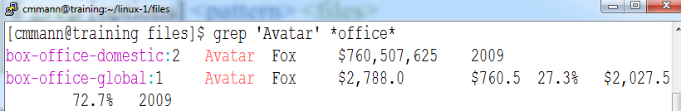
Lesson 3.5: Grep
Command:
grep –options <pattern> <files>
What it does:
grep searches <files> for content matching <pattern>

Slide 59
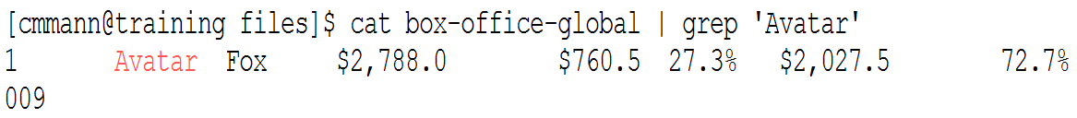
Lesson 3.6: Piping and Grep
We can also feed text directly to grep, and have it search that:
Command:
<intext> | grep –options <pattern>
What it does:
grep searches <intext> for content matching <pattern>

Slide 60
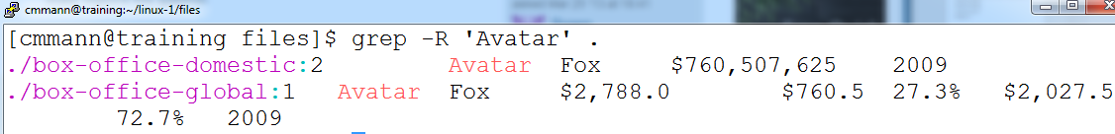
Lesson 3.7: Grep All Files in A Directory
We can also search for content within a directory:
grep –R <pattern> <directoryname/>
For this, we have to use the –R Recursive option!

Slide 61
Lesson 3.8: Grep Options
Grep has many, many options:
-c : count how many LINES on which the pattern occurs
-o : show only the part of a line that matches a pattern; this will show all matches in the line
-v : invert match – so select things that DON’T match <pattern>
-i : case insensitive matching
-l : list the files with a match
-L : list the files that don’t have a match

Slide 62
Exercise 3: Hello
Navigate to ~/20170302-adv-unix/exercise3/
Open “exercise3.sh”
Edit the file to perform the exercises.
Execute the file!

Slide 63
Lesson 4: Regular Expressions
Overview:
Lesson 4.1: What are Regular Expressions?
Lesson 4.2: egrep
Lesson 4.3: Matching words with egrep
Lesson 4.4: Fuzzy Matching
Lesson 4.5: Number Matching
Lesson 4.6: Operators
Lesson 4.7: Matching X Letters
Lesson 4.8: Example
Lesson 4.9: Continuing Education

Slide 64
Lesson 4.1: Regular Expressions
Also called ‘regex’ or ‘regexp’
UNBELIEVABLY POWERFUL tool for defining search patterns
Consists of ‘codes’ that denote various conditions
These conditions can be used to very narrowly find things, or very, very broadly find things

Slide 65
Lesson 4.2: Regular Expressions
In UNIX, frequently used with grep
grep -E <‘regexppattern’> <file>
The option “-E” tells grep that the pattern is a regular expression! It is very important that you remember the “-E” option, otherwise grep will try to match your exact pattern, instead of what it represents.

Slide 66
Lesson 4.2: egrep
Alternatively, you can use egrep:
egrep <‘regexppattern’> <file>
This behaves exactly as “grep –E”, and will be used through the rest of the slides.

Slide 67
Lesson 4.3: Matching Words
We can still match words while grepping regular expressions:
egrep ‘cat’ <file>
will still find any instance of the letters ‘cat’ in a file
But grep allows us to search for words similar to ‘cat’…

Slide 68
Lesson 4.4: Fuzzy Matching
The regexp to find words containing ‘cat’ or ‘cot’ would be:
‘[c][ao][t]’
The brackets encase ‘character’ slots
What would ‘[fw][i][s][h]’ match?

Slide 69
Lesson 4.4: Fuzzy Matching
The regexp to find words containing ‘cat’ or ‘cot’ would be:
‘[c][ao][t]’
The brackets encase ‘character’ slots
What would ‘[fw][i][s][h]’ match?
fish, lungfish, fishing, wish, wishing, swish, etc.

Slide 70
Lesson 4.4: Fuzzy Matching
If we only wanted to match the ‘word’ cat or cot, and not , we can bracket ‘[c][ao][t]’ with spaces:
‘[ ][c][ao][t][ ]’
Note that many, many systems use Regular Expressions, and some have slightly different usage. For many systems, you can specify a match to ‘whitespace’ (spaces and tabs) using “\s”, but this does not work in bash.

Slide 71
Lesson 4.4: Fuzzy Matching
This bracket system, though, is rather cumbersome. Instead, we could specify:
‘\b[c][ao][t]’
In this context, ‘\b’ means to match the beginning of a word.
The ‘\’ before the ‘b’ is an escape character – it signals that we don’t want to literally match the letter ‘b’, but the condition that ‘b’ represents.

Slide 72
Lesson 4.4: Fuzzy Matching
We can use a ‘-’ to represent a span of characters:
‘[a-c][o][g]’ would recognize ‘aog’, ‘bog’, ‘cog’
‘[l-z][o][g]’ would only recognize ‘log’, ‘mog’, ‘nog’ etc.

Slide 73
Lesson 4.5: Number Matching
We can also match numbers:
What number(s) will the following match?
‘[0-3][5-8][345]’

Slide 74
Lesson 4.5: Number Matching
We can also match numbers:
What number(s) will the following match?
‘[0-3][5-8][345]’
053, 153, 374, etc.

Slide 75
Lesson 4.6: Operators
‘[cd][ao][tg]’ would match ‘cat’ or ‘dog’
(But also ‘cag’, ‘dat’, and any combination of those letters)
What regular expression would you use to find words containing “trap” or “tarp”?

Slide 76
Lesson 4.6: Operators
‘[cd][ao][tg]’ would match ‘cat’ or ‘dog’
(But also ‘cag’, ‘dat’, and any combination of those letters)
What regular expression would you use to find words containing “trap” or “tarp”?
‘[t][ar][ar][p]’

Slide 77
Lesson 4.6: Operators
But what if we wanted to match ‘trap’ or ‘tarp’, but not ‘trrp’ or ‘taap’?

Slide 78
Lesson 4.6: Operators
But what if we wanted to match ‘trap’ or ‘tarp’, but not ‘trrp’ or ‘taap’?
We can use operators to specify this!

Slide 79
Lesson 4.6: Operators
If you want to match this OR that:
egrep ‘this|that’ <file>
When using regular expressions, grep understands that “|” means “OR”
If you to find things that are NOT something, you use:
egrep –v ‘something’ <file>

Slide 80
Lesson 4.6: Operators
What if you want to match the character ‘|’?
We use escape characters again!
egrep ‘\|’

Slide 81
Lesson 4.7: Matching X Letters
What if we want to find something more complicated, like a zip code?

Slide 82
Lesson 4.7: Matching X Letters
What if we want to find something more complicated, like a zip code?
What is the form of a zip code?

Slide 83
Lesson 4.7: Matching X Letters
What if we want to find something more complicated, like a zip code?
What is the form of a zip code?
5 numbers

Slide 84
Lesson 4.7: Matching X Letters
What if we want to find something more complicated, like a zip code?
What is the form of a zip code?
5 numbers
How could we potentially match that?

Slide 85
Lesson 4.7: Matching X Letters
What if we want to find something more complicated, like a zip code?
What is the form of a zip code?
5 numbers
How could we potentially match that?
‘[0-9][0-9][0-9][0-9][0-9]’

Slide 86
Lesson 4.7: Matching X Letters
But that’s rather cumbersome. Instead, we can specify a specific number of times to look for a set of characters:
egrep ‘[0-9]{5}’ <file>
In regexp, you can use a number in brackets AFTER the thing that you want to repeat

Slide 87
Lesson 4.7: Matching X Letters
We can put more than just a number in there:
a{n,} : will match the letter ‘a’ n OR MORE times
What will ‘a{2}’ match?
aardvark, armadillo, aaaah

Slide 88
Lesson 4.7: Matching X Letters
We can put more than just a number in there:
a{n,} : will match the letter ‘a’ n OR MORE times
What will ‘a{2}’ match?
aardvark, armadillo, aaaah

Slide 89
Lesson 4.7: Matching X Letters
We can also specify a range of times to match:
a{n, m} : will match ‘a’ at least n times, but not more than m times.
What will ‘a{2, 3}’ match?
aardvark, armadillo, aaaah

Slide 90
Lesson 4.7: Matching X Letters
We can also specify a range of times to match:
a{n, m} : will match ‘a’ at least n times, but not more than m times.
What will ‘a{2, 3}’ match?
aardvark, armadillo, aaaah

Slide 91
Lesson 4.7: Matching X Letters
We can also specify more matches:
a* : match ‘a’ 0 or more times
a+ : match ‘a’ 1 or more times
a? : match ‘a’ once if it happens, but matching it is optional

Slide 92
Lesson 4.8: Example
We can match EXTREMELY complicated things
Real world example: PDB files
In my day job, I want to find the coordinates of atoms in PDB files.
These lines take the form:

Slide 93
Lesson 4.8: Example
So these lines look similarly, but they have different numbers and characters spaced differently.
And the rest of the file looks NOTHING like this.
How could I pull out ONLY these lines?

Slide 94

Lesson 4.8: Example
We could try:
egrep ‘ATOM’ 1R2X.pdb, but…

Slide 95
Lesson 4.8: Example
We can specify that we only want to match ‘ATOM’ if it starts at the beginning of the line:
egrep ‘^ATOM’ 1R2X.pdb
The character ‘^’ is a special character that means to match the beginning of the line

Slide 96
Lesson 4.8: Example
But what if I ONLY want the protein atom coordinates?

Slide 97
Lesson 4.8: Example
We make a really complicated regexp:
egrep ‘^ATOM[ ]*[0-9]+[ ]*[A-Z]+[ ]*[A-Z]{3}’

Slide 98
Lesson 4.8: Example
What is this doing?
‘^ATOM[ ]*[0-9]+[ ]*[A-Z]+[ ]*
[A-Z]{3}’
Match ATOM at the beginning of the line
Match at least one letter
Match at least one digit
Match any number of spaces
Match exactly 3 letters

Slide 99
Lesson 4.9: Regexp Continuing Education
There are many, many more options available to use with regexp in bash
We could spend an entire workshop on this alone. (We’re not going to today, though.)
If you want to learn more, visit:
http://tldp.org/LDP/Bash-Beginners-Guide/html/sect_04_01.html#sect_04_01_02

Slide 100
Exercise 4: Real Life Stuff
Open and edit the file ‘exercise4.sh’
Complete the exercises within.
Then run it.

Slide 101
Lesson 5: Super-basic AWK
Overview:
Lesson 5.1: What is AWK?
Lesson 5.2: AWK Syntax

Slide 102
Lesson 5.1: What is AWK?
AWK is a programming language that we can use within bash to add extra power to our scripts
(“AWK” comes from the initials of its creators, Alfred Aho, Peter Weinberger, and Brian Kernighan, not awkward)
AWK is EXTREMELY complicated, so we are going to focus on a few VERY narrow uses, that will hopefully be helpful to some of you

Slide 103
Lesson 5.2: AWK Syntax
Basic syntax:
awk ‘condition {procedure}’
When condition is TRUE, do procedure
If condition is FALSE, don’t do that procedure
If you want to do a procedure regardless, then leave out condition
awk ‘{procedure}’

Slide 104
Lesson 5.3: AWK Field Separator
AWK has the ability to automatically break a line into separate columns (or ‘fields’)
By default, fields are separated by whitespaces – tabs, spaces, etc.
The separator or delimiter can be changed:
awk –F ’delimiter’ ‘condition {procedure}’ <filename>
If you want to separate on tabs only:
awk –F ‘\t’ ‘condition {procedure}’ <filename>

Slide 105
Lesson 5.4: Accessing AWK Fields
When AWK breaks up a line, each field gets its own number:
The quick brown fox jumped over the lazy dog.
$1 $2 $3 $4 $5 $6 $7 $8 $9
The ‘name’ of each column takes the form of $number
Each field can be accessed through its name!

Slide 106
Lesson 5.4: Accessing AWK Fields
Example:
Suppose we have the following sentence in a file called “sentence.txt”
The quick brown fox jumped over the lazy dog.
$1 $2 $3 $4 $5 $6 $7 $8 $9
We could access the third word via:
awk ‘{print $3}’ sentence.txt

Slide 107
Lesson 5.4: Accessing AWK Fields
With this method, we can actually access ‘columns’ in data:
Rank Title Studio Worldwide Domestic
1 Avatar Fox $2,788 $760.5
2 Titanic Par $2,186.8 $658.7
3 Star Wars: TFA BV $2,059.7 $932.3
We could output the Worldwide gross for each movie using:
awk –F ’\t’ ‘{print $4}’

Slide 108
Lesson 5.5: AWK Conditions
We can use ‘conditions’ to only access certain columns:
So let’s print the Worldwide gross ONLY for movies made after 2010:
Rank Title Studio Worldwide Domestic %
$1 $2 $3 $4 $5 $6
Overseas % Year
$7 $8 $9
awk –F $’\t’ ???

Slide 109
Lesson 5.5: AWK Conditions
We can use ‘conditions’ to only access certain columns:
So let’s print the Worldwide gross ONLY for movies made after 2010:
Rank Title Studio Worldwide Domestic %
$1 $2 $3 $4 $5 $6
Overseas % Year
$7 $8 $9
awk –F $’\t’ ‘$9 > 2010 {print $4}’

Slide 110
Exercise 5
Navigate to ~/20170302/exercise5
Move ‘exercise5.sh’ to ~/linux-1/files
Open ‘exercise5.sh’
Complete the instructions, and run the script

Slide 111
Lesson 5.6: AWK Continuing Education
We can do many, many, many more things with AWK
(Add rows and columns based on conditions, etc.)
It is EXTREMELY powerful, and can get extremely complicated
Hopefully, you now have enough to at least know what questions to ask
Further AWK learning:
https://www.gnu.org/software/gawk/manual/gawk.html

Slide 112
Closing
Thanks for coming!
Please take this survey so that we can improve the workshop for future attendees:

