Slide 1
Project by
Amnah Afzal and Catherine Maxwell

Slide 2
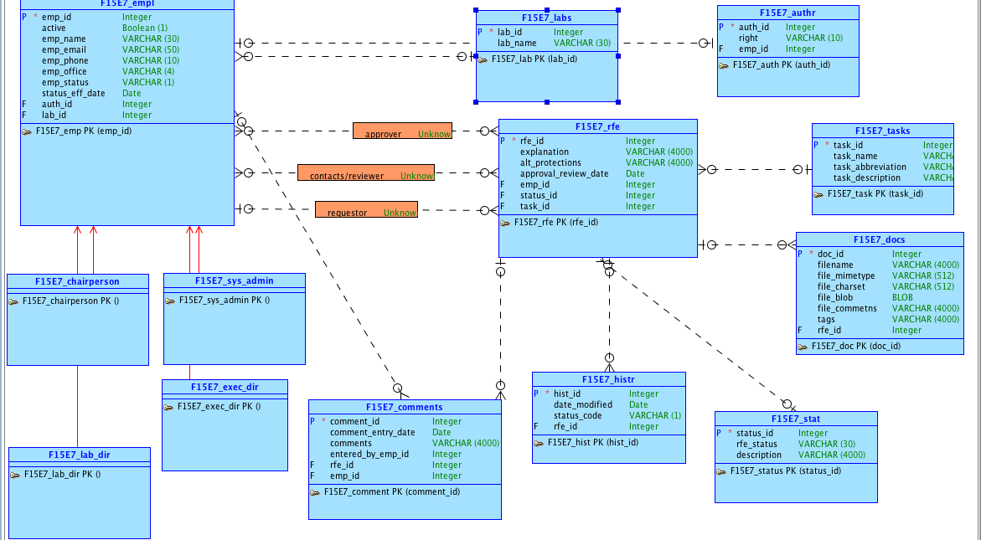
Conceptual Model

Slide 3
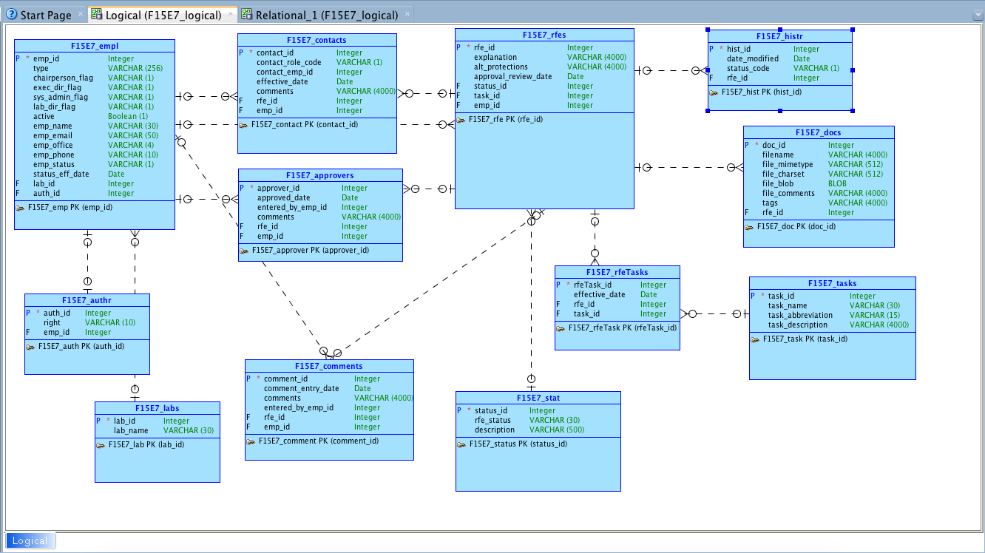
Logical Model

Slide 4
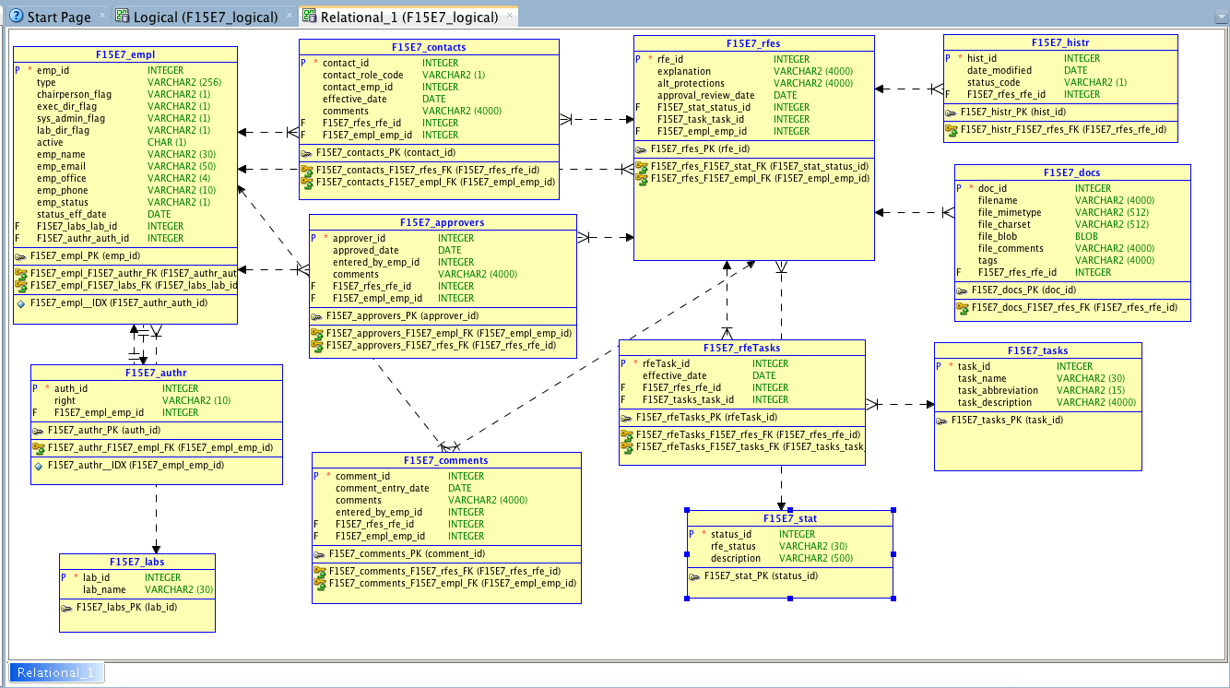
Relational Model

Slide 5
APEX application
https://apex.oracle.com/pls/apex/f?p=100176:2:2563830214797:::::

Slide 6
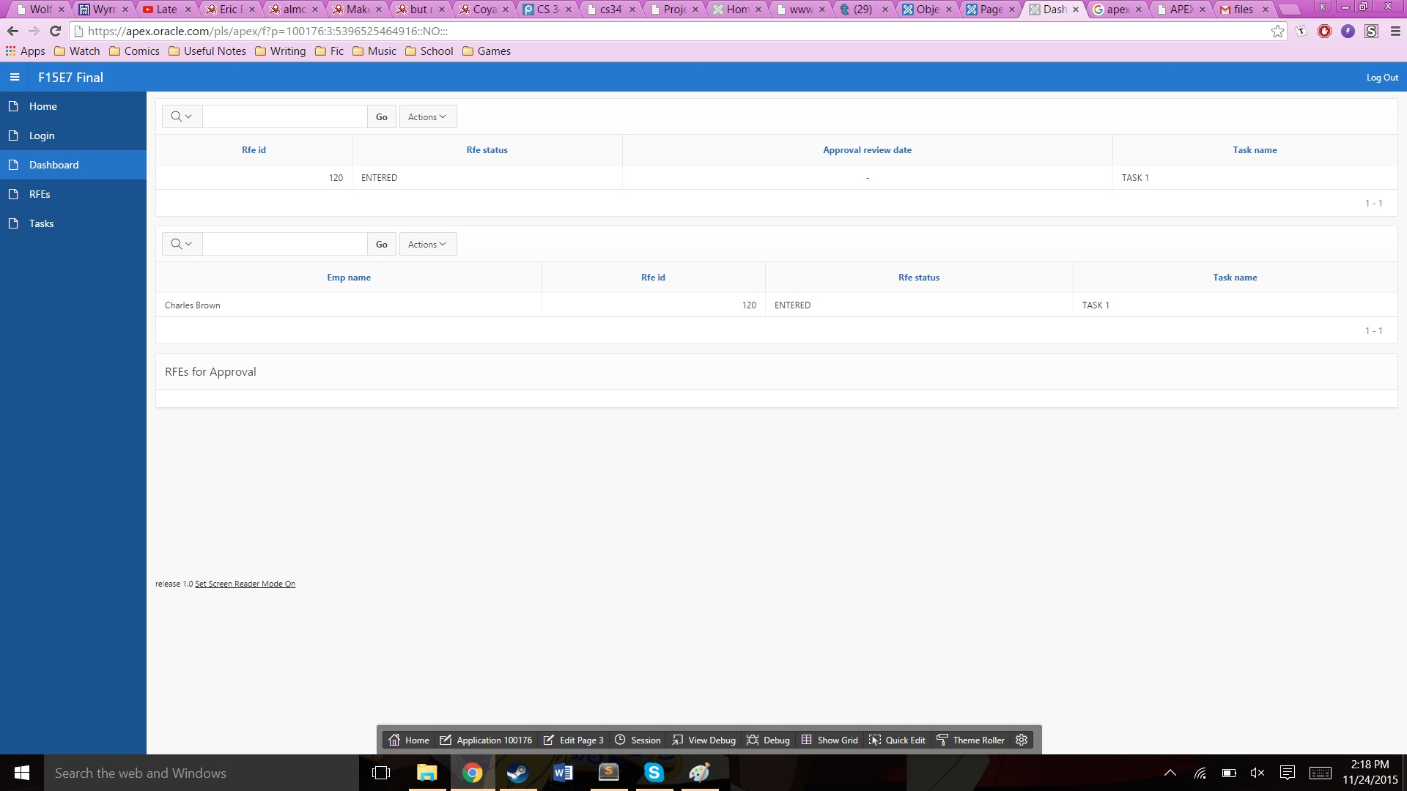
APEX snapshots

Slide 7
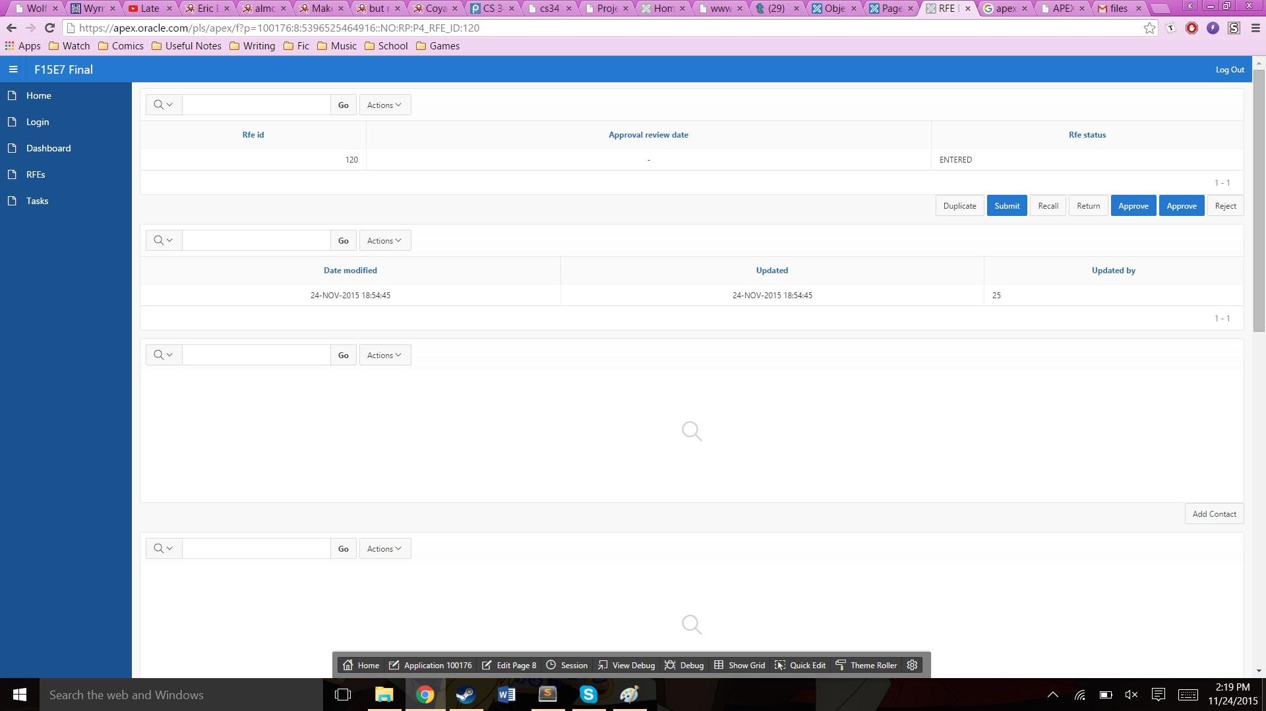
APEX snapshots

Slide 8
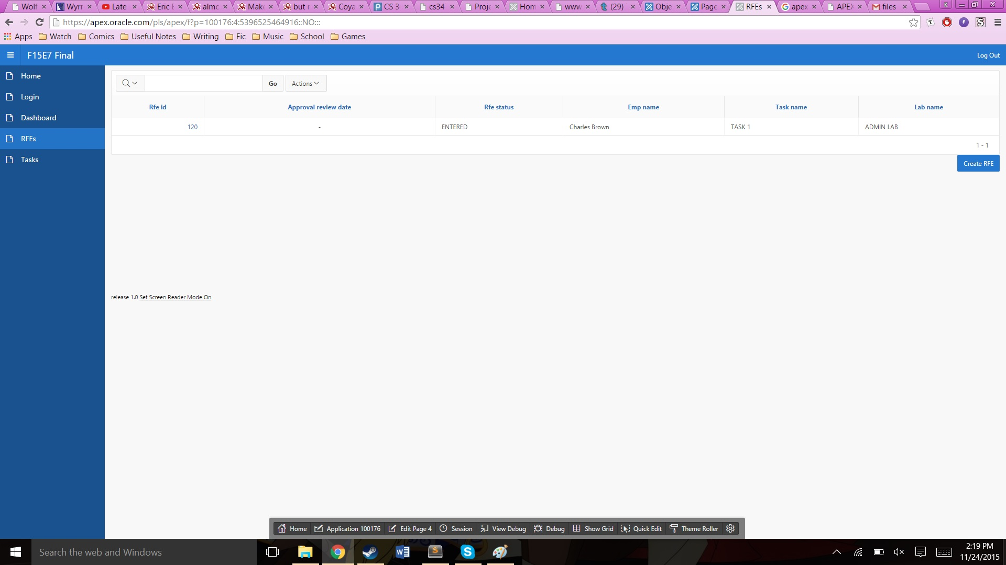
APEX snapshots

Slide 9
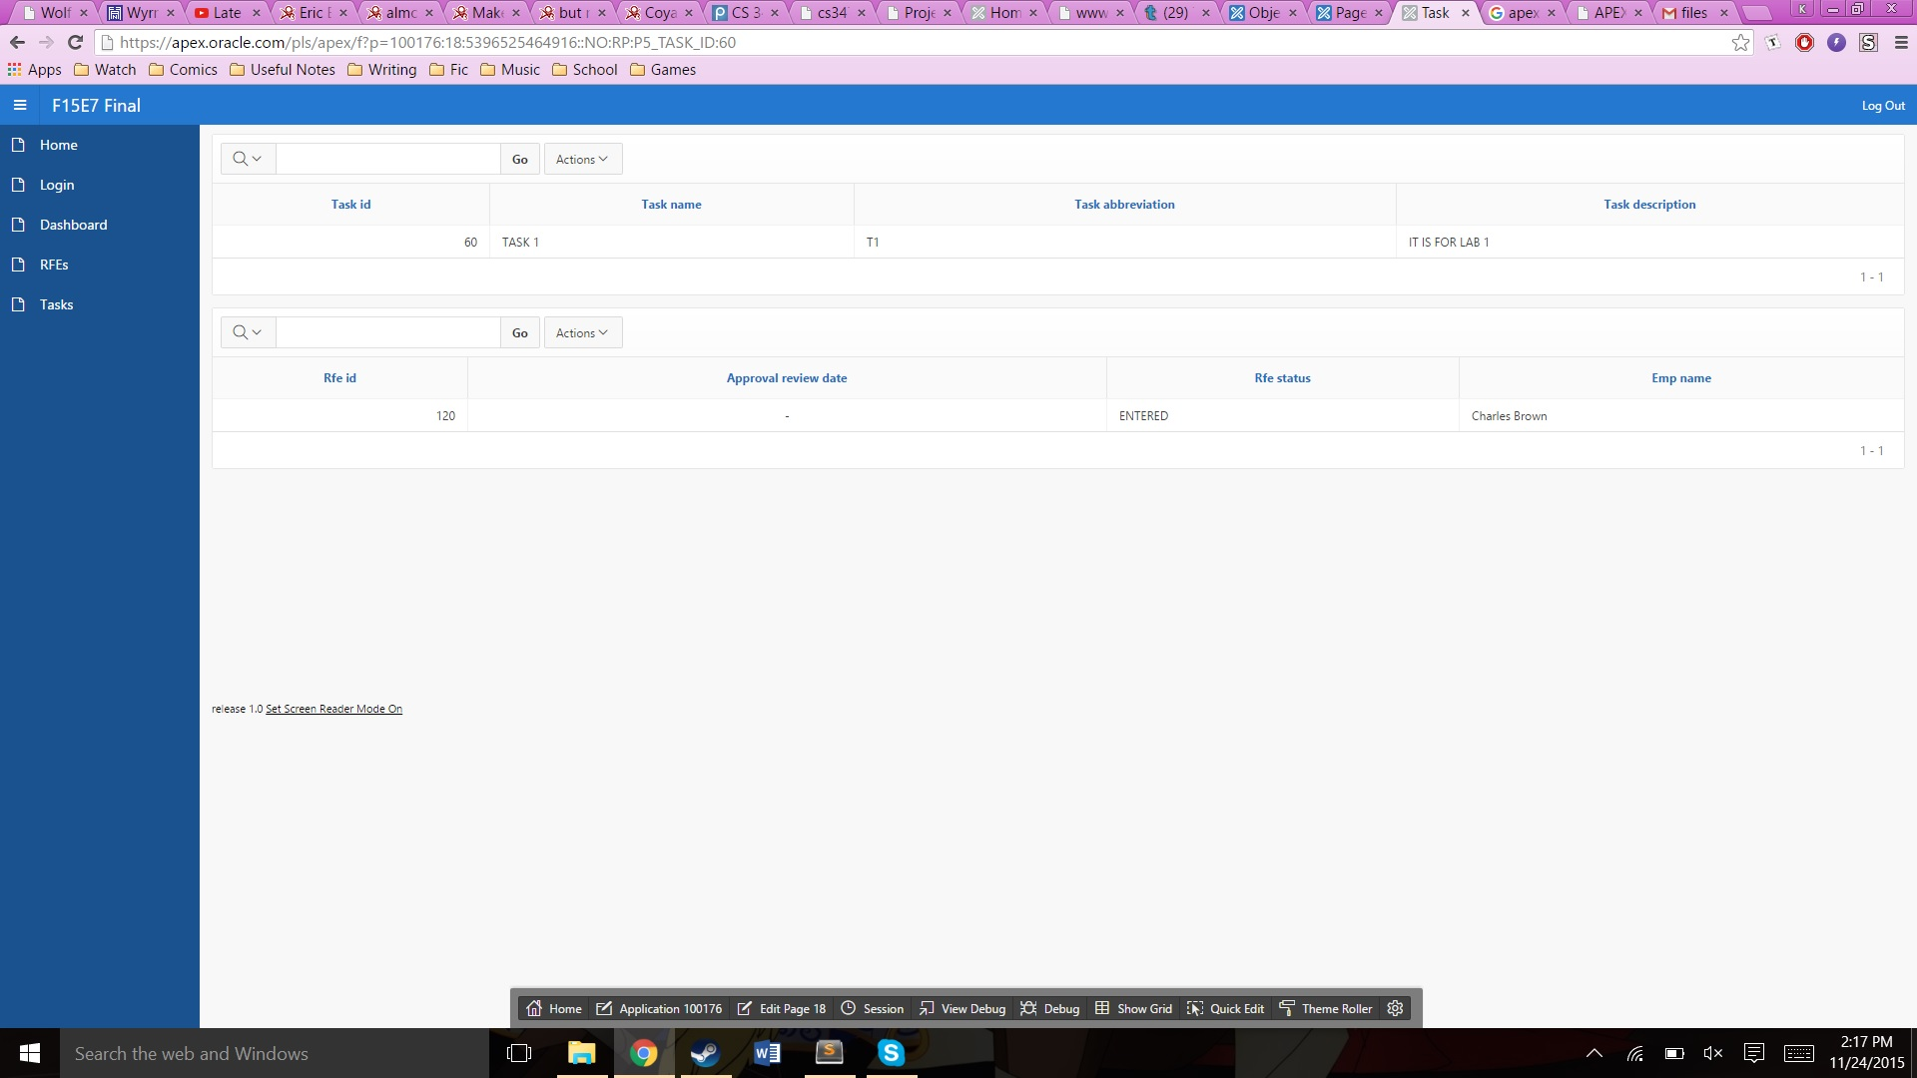
APEX snapshots

Slide 10
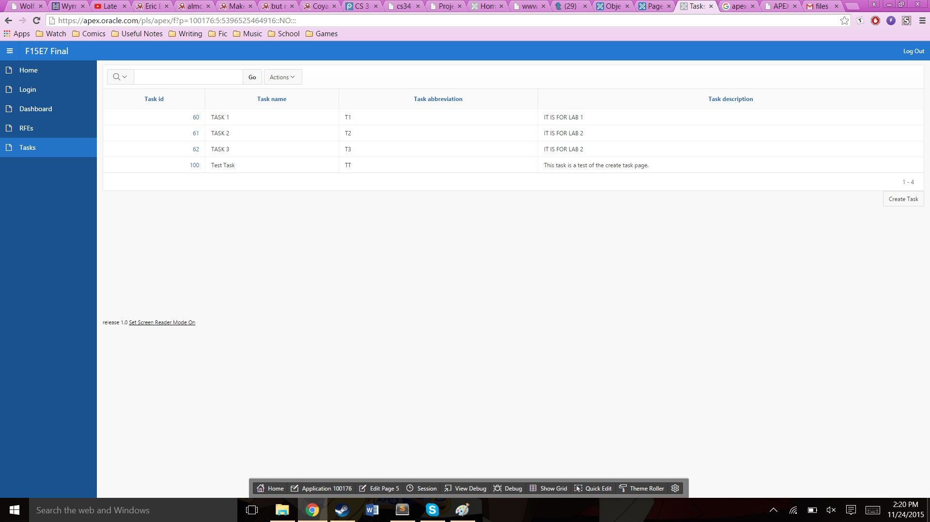
APEX snapshots

Slide 11
PART II
We tried to create the data with two entities doctors and patients with one to many relationship from doctor to patients.
Intention was to allow multiple patients to connect with the doctor specialized in their problem.

Slide 12
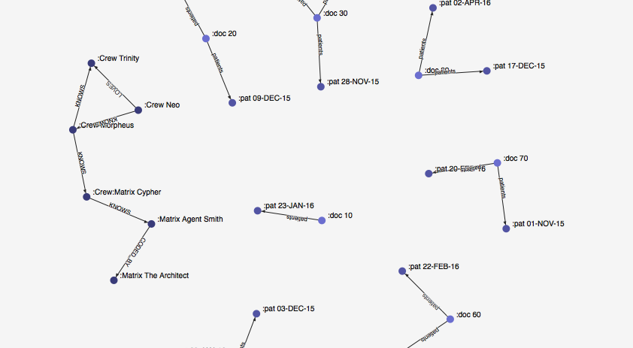
Conceptual Model Part II

Slide 13
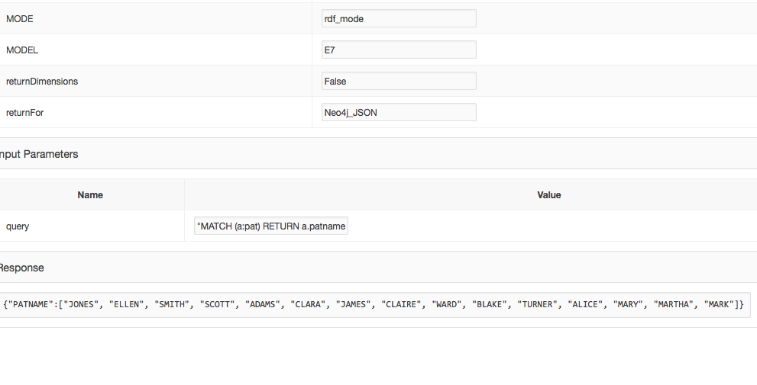
Testing

Slide 14
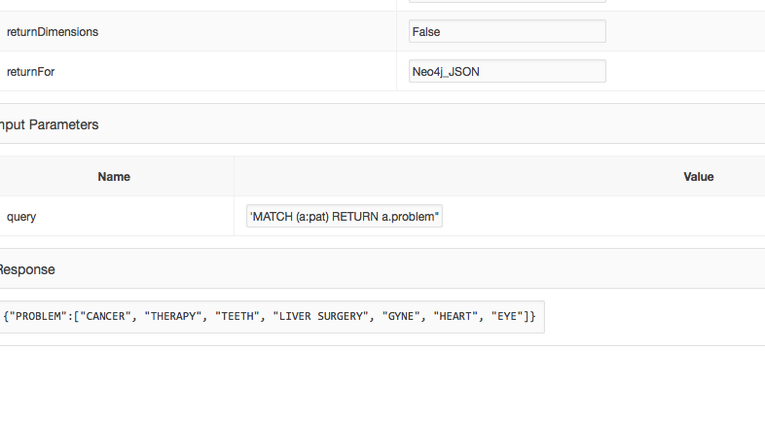

Slide 15
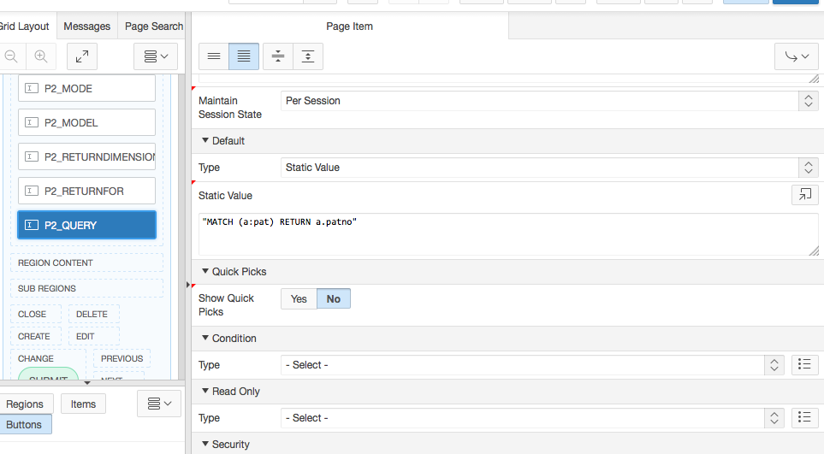

Slide 16
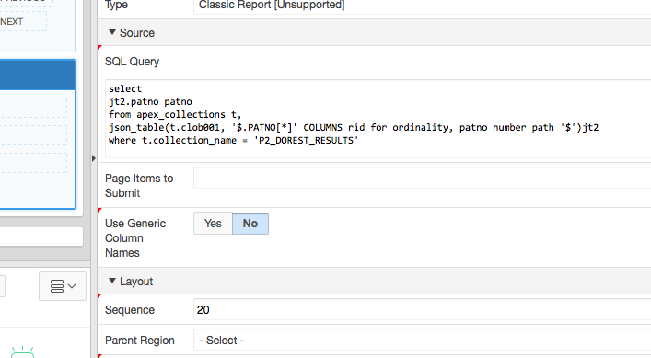
Report Query

Slide 17
Part 2
https://apex.oracle.com/pls/apex/f?p=93074:2:100388274222819:::::

Slide 18
