Slide 1
Project by
Amnah Afzal and Catherine Maxwell

Slide 2
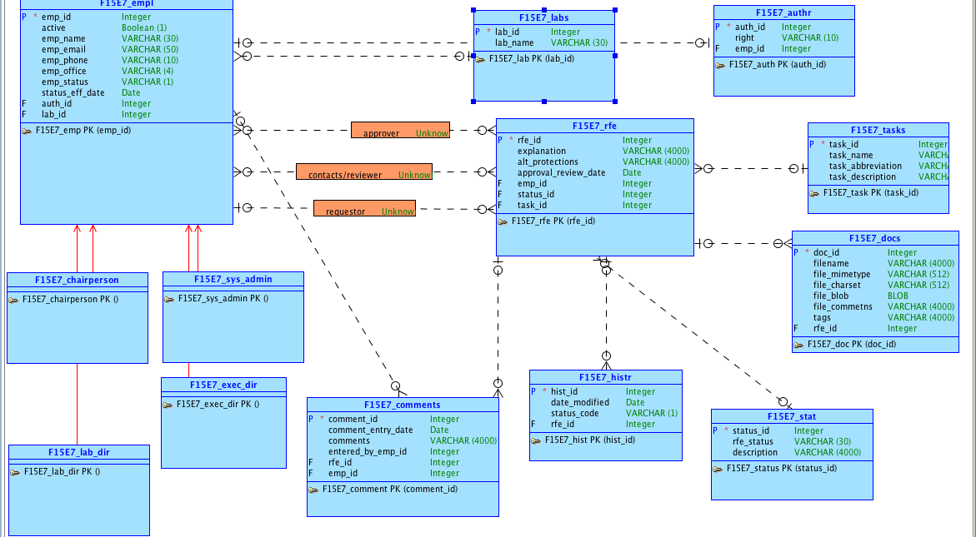
Conceptual Model

Slide 3
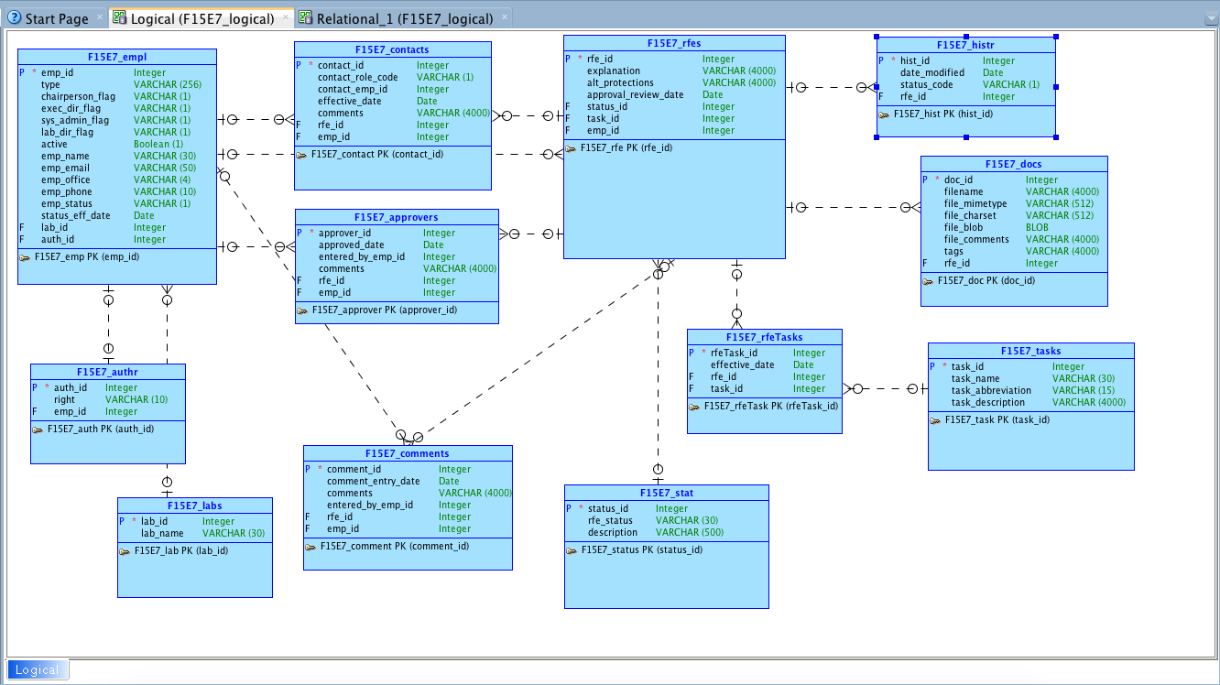
Logical Model

Slide 4
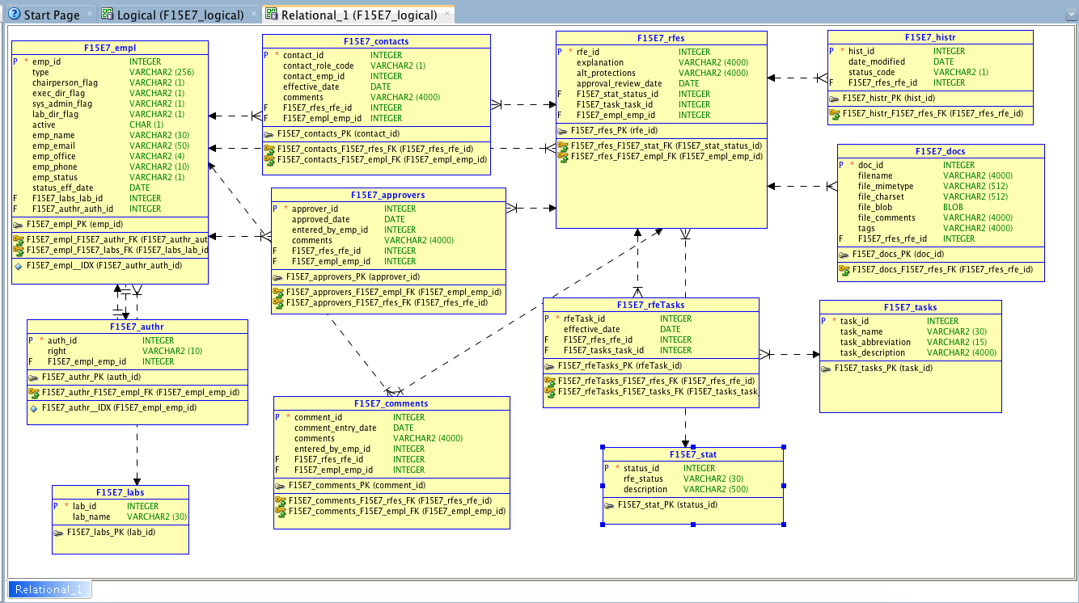
Relational Model

Slide 5
PART II
We created an app that allows patients and doctors to keep track of appointments and the visits.

Slide 6
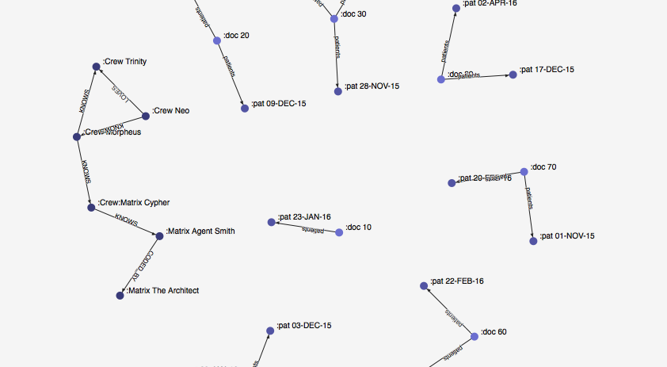
Conceptual Model Part II

Slide 7
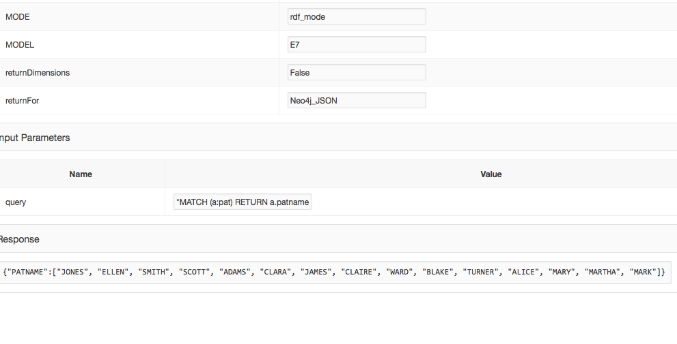

Slide 8
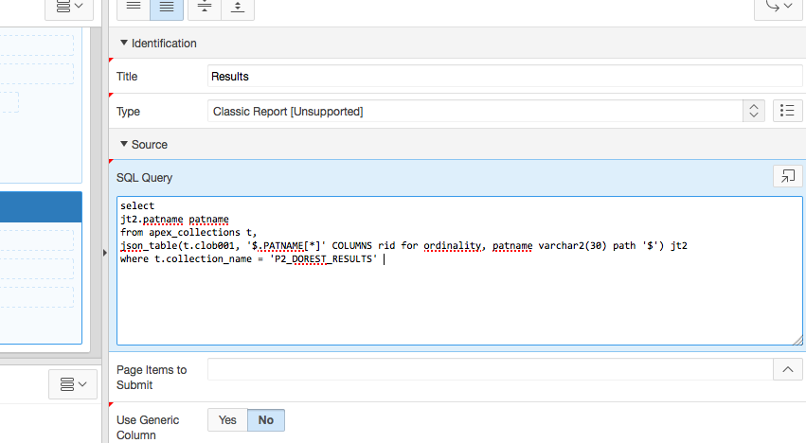

Slide 9
