Slide 1
Discrete-time deterministic models
Modern Techniques in Modelling

Slide 2
Introduction

Slide 3
Discrete-time deterministic models
Often we may want to model an epidemic in terms of a discrete time step, e.g. from one day or week to the next:
Susceptible = 99
Susceptible = 98
Susceptible = 97
Infected
= 1
Infected
= 2
Infected
= 2
Recovered
= 0
Recovered
= 0
Recovered
= 1
Day 1
Day 2
Day 3

Slide 4
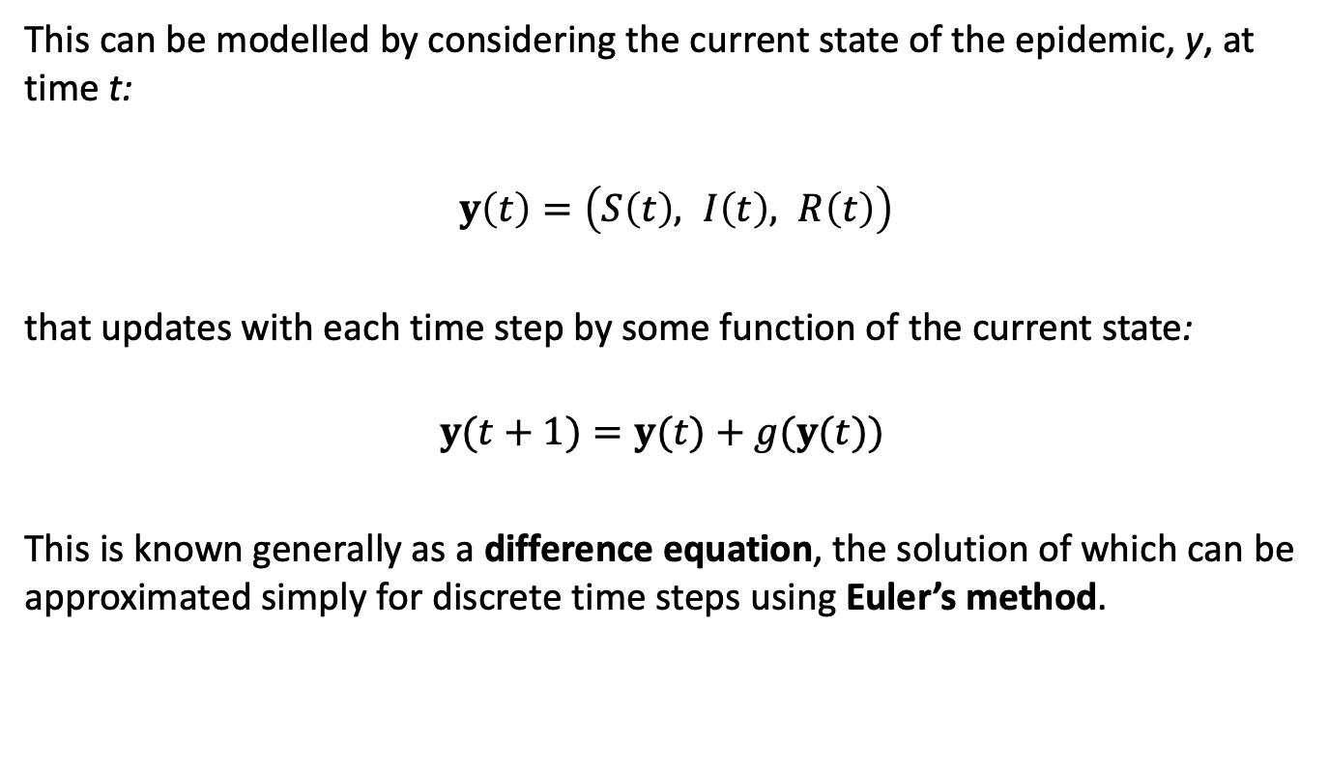
Discrete-time deterministic models
This can be modelled by considering the current state of the epidemic, y, at time t:
$y\left(t\right)=\left(S\left(t\right), I\left(t\right), R\left(t\right)\right)$
that updates with each time step by some function of the current state:
$$y(t+1)=y(t)+g(y(t))$$
This is known generally as a difference equation, the solution of which can be approximated simply for discrete time steps using Euler’s method.

Slide 5
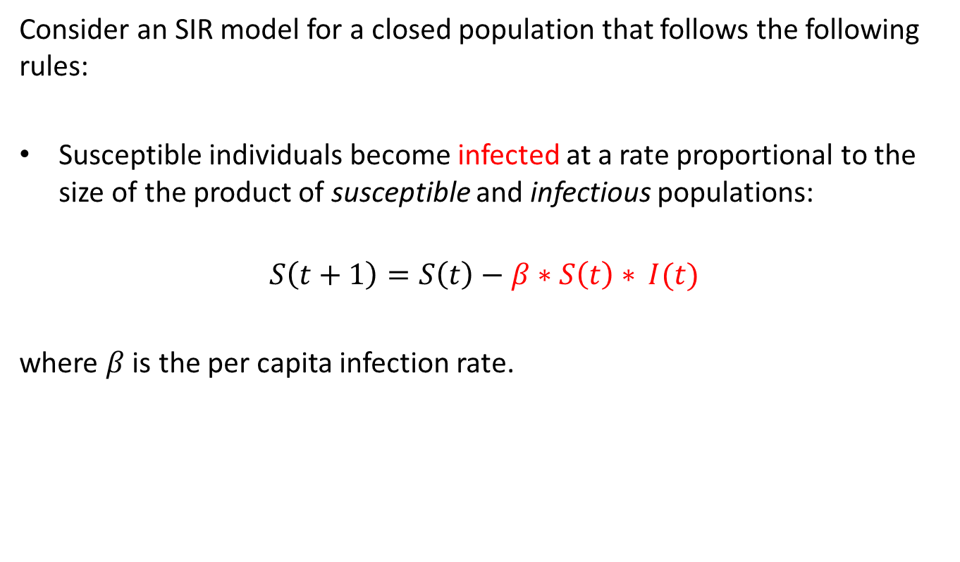
Discrete-time deterministic models
Consider an SIR model for a closed population that follows the following rules:
Susceptible individuals become infected at a rate proportional to the size of the product of susceptible and infectious populations:
$$S\left(t+1\right)=S\left(t\right)−β∗S\left(t\right)∗ I(t)$$
where $β$ is the per capita infection rate.

Slide 6

Discrete-time deterministic models
Recovery from infection grants life-long immunity
$$R\left(t+1\right)=R\left(t\right)+γ∗I(t)$$
Where γ is the recovery rate, and 1/γ is the mean time spent infectious (1/rate = duration).

Slide 7

Discrete-time deterministic models
The only transitions between states are infection and recovery
$$I\left(t+1\right)=I\left(t\right)+β∗S\left(t\right) ∗I\left(t\right)−γ∗I\left(t\right)$$
Which adds those being infected and subtracts those who recover

Slide 8
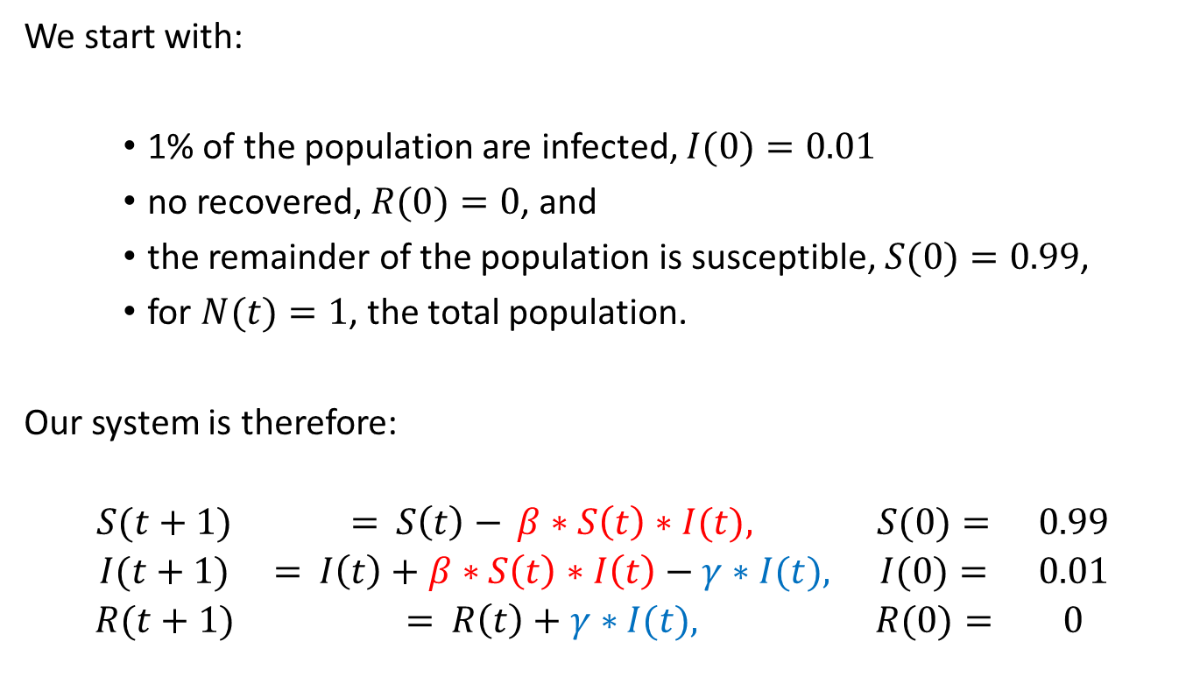
SIR example
We start with:
1% of the population are infected, $I(0)=0.01$
no recovered, $R(0)=0$, and
the remainder of the population is susceptible, $S(0)=0.99$,
for $N(t)=1$, the total population.
Our system is therefore:
$$\begin{matrix}S(t+1) & = S\left(t\right)− β∗S\left(t\right)∗I(t), & S(0)= & 0.99 \\ I(t+1) & = I\left(t\right)+β∗S\left(t\right)∗I\left(t\right)−γ∗I(t), & I(0)= & 0.01 \\ R(t+1) & = R\left(t\right)+γ∗I(t), & R(0)= & 0\end{matrix}$$

Slide 9

SIR example
This system can also be written in vector form as:
$${\left[\begin{matrix}S \\ I \\ R\end{matrix}\right]}_{t+1}={\left[\begin{matrix}S \\ I \\ R\end{matrix}\right]}_{t}+{\left[\begin{matrix}−βSI \\ βSI−γI \\ γI\end{matrix}\right]}_{t}$$
Here the subscript indicates the time value and the term on the right is our update vector

Slide 10
SIR example
In R, we can write a function to return our update vector with three elements:
update_sir <- function(t, y, parms){
S <- y[1]
I <- y[2]
R <- y[3]
beta <- parms['beta'] gamma <- parms['gamma'] out <- c(- beta*S*I,
+ beta*S*I - gamma*I,
+ gamma*I) return(out) }

Slide 11
Discrete-time deterministic SIR
parms_sir <- c(beta = 1.3, gamma = 0.23)
time_sir <- seq(0, 20, by = 1)
y_sir <- matrix(data = NA, nrow = length(time_sir), ncol = 3)
# initial values at t=0 y_sir[1, ] <- c(0.99, 0.01, 0) for (i in 1:(nrow(y_sir) - 1)){
y_sir[i + 1,] <- y_sir[i,] + update_sir(t = time_sir[i + 1], y = y_sir[i, ], parms = parms_sir) }

Slide 12
Discrete-time deterministic SIR
y_sir_df <- as.data.frame(y_sir) names(y_sir_df) <- c('Susceptible', 'Infectious', 'Recovered') y_sir_df <- cbind(time = time_sir, y_sir_df) head(y_sir_df)
## time Susceptible Infectious Recovered ## 1 0 0.9900000 0.01000000 0.00000000 ## 2 1 0.9771300 0.02057000 0.00230000 ## 3 2 0.9510006 0.04196833 0.00703110 ## 4 3 0.8991151 0.08420110 0.01668382 ## 5 4 0.8006967 0.16325327 0.03605007 ## 6 5 0.6307654 0.29563626 0.07359832

Slide 13
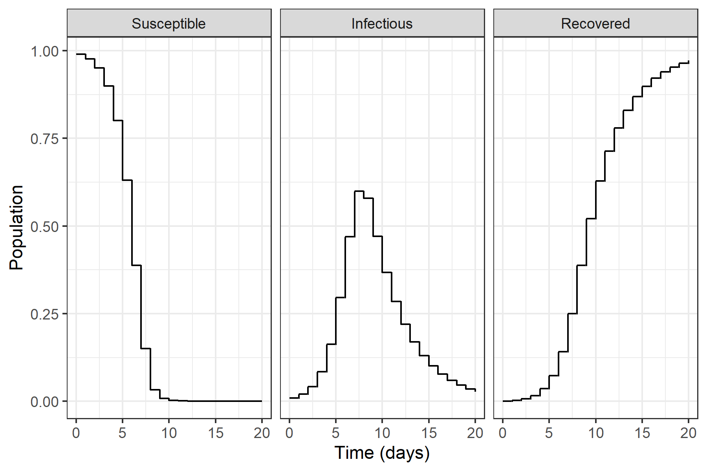
Discrete-time deterministic SIR

Slide 14

Discrete-time deterministic SIR
Our more general form of the update is
$$y(t+1)=f(t,y(t),θ(t))$$
…but parameters may or may not change with time t.

Slide 15
Summary

Slide 16
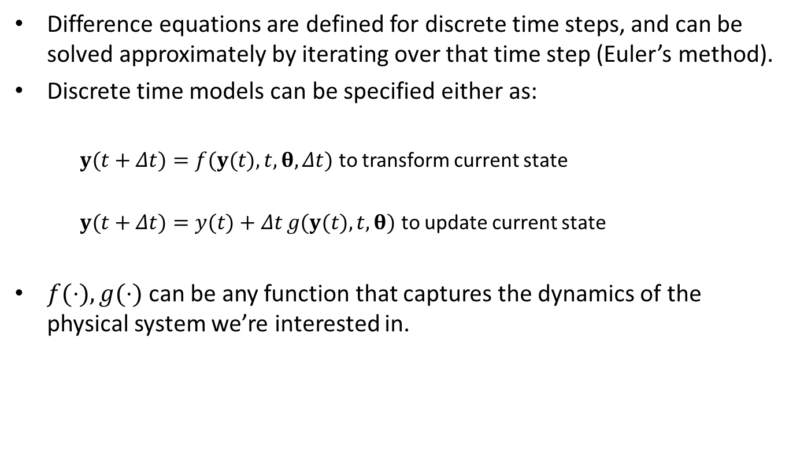
Summary
Difference equations are defined for discrete time steps, and can be solved approximately by iterating over that time step (Euler’s method).
Discrete time models can be specified either as:
$y(t+Δt)=f(y(t),t,θ,Δt)$ to transform current state
$y(t+Δt)=y(t)+Δt g(y(t),t,θ)$ to update current state
$f(⋅),g(⋅)$ can be any function that captures the dynamics of the physical system we’re interested in.

Slide 17
Looking forward
Later today you’ll start to learn about extending to continuous time models with differential equations.
Later in the week you’ll learn about update functions that model infection and recovery as probabilistic events.

Slide 18
Practical

