Slide 1
Ordinary Differential Equations
Modern Techniques in Modelling

Slide 2
Outline
Ordinary differential equations (ODEs)
How do we ‘solve’ ODE’s
integration
numerical integration
using the deSolve package
Using R package deSolve
SI, SIR, SEIR models in R
time dependent parameter changes
events based on numbers of infection

Slide 3
Ordinary differential equations

Slide 4
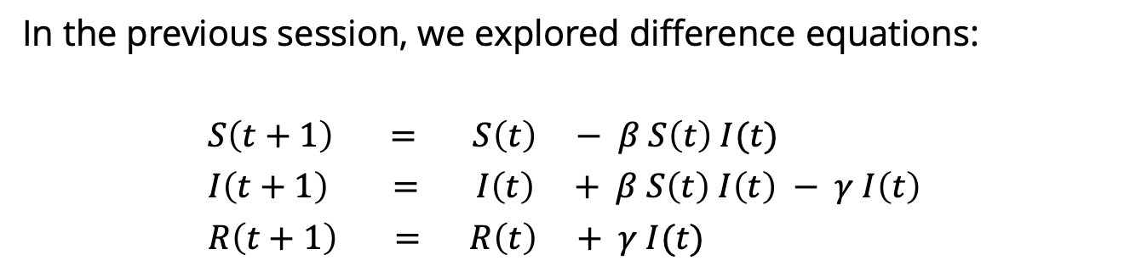
Reminder: Difference equations
In the previous session, we explored difference equations:
$S\left(t+1\right) = S\left(t\right) − β S\left(t\right) I(t)$
$I\left(t+1\right) = I\left(t\right) + β S\left(t\right) I\left(t\right) − γ I\left(t\right)$
$R\left(t+1\right) = R\left(t\right) + γ I(t)$
next
value
current
value
change
in value
=
+
These changes are the interesting part – they are what define the behaviour of the system.

Slide 5
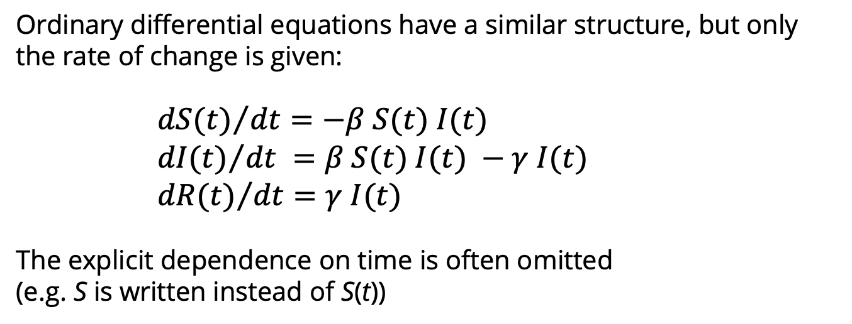
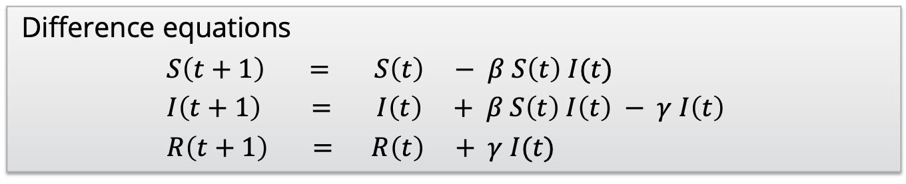
Ordinary differential equations
Difference equations
$S\left(t+1\right) = S\left(t\right) − β S\left(t\right) I(t)$
$I\left(t+1\right) = I\left(t\right) + β S\left(t\right) I\left(t\right) − γ I\left(t\right)$
$R\left(t+1\right) = R\left(t\right) + γ I(t)$
Ordinary differential equations have a similar structure, but only the rate of change is given:
${dS(t)}/{dt}=−β S(t) I(t)$
${dI(t)}/{dt} =β S(t) I(t) −γ I(t)$
${dR(t)}/{dt}=γ I(t)$
The explicit dependence on time is often omitted
(e.g. S is written instead of S(t))

Slide 6
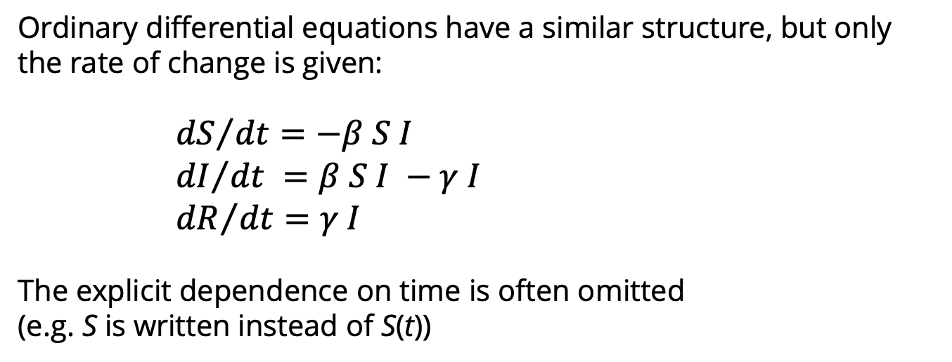
Ordinary differential equations
Difference equations
$S\left(t+1\right) = S\left(t\right) − β S\left(t\right) I(t)$
$I\left(t+1\right) = I\left(t\right) + β S\left(t\right) I\left(t\right) − γ I\left(t\right)$
$R\left(t+1\right) = R\left(t\right) + γ I(t)$
Ordinary differential equations have a similar structure, but only the rate of change is given:
${dS}/{dt}=−β S I$
${dI}/{dt} =β S I −γ I$
${dR}/{dt}=γ I$
The explicit dependence on time is often omitted
(e.g. S is written instead of S(t))

Slide 7
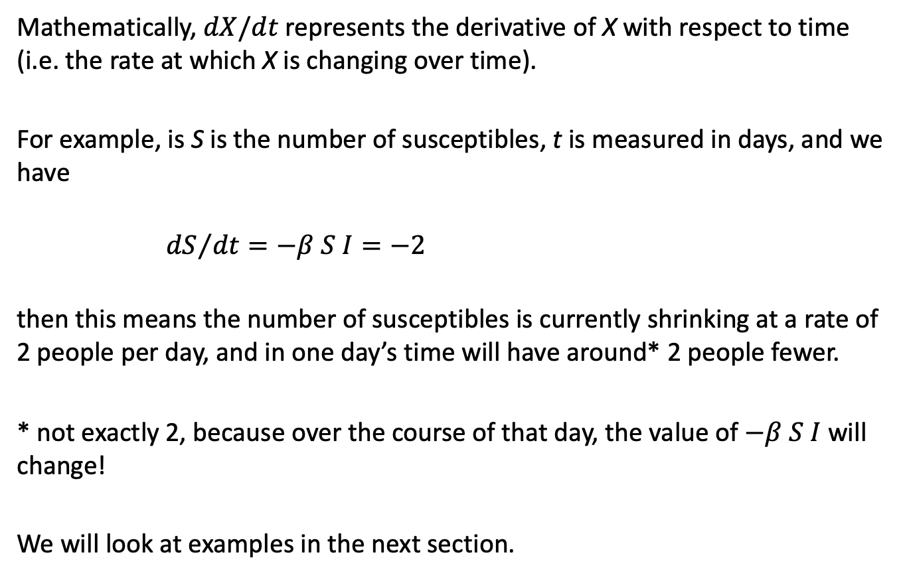
Ordinary differential equations
Mathematically, $dX/dt$ represents the derivative of X with respect to time (i.e. the rate at which X is changing over time).
For example, is S is the number of susceptibles, t is measured in days, and we have
${dS}/{dt}=−β S I=−2$
then this means the number of susceptibles is currently shrinking at a rate of 2 people per day, and in one day’s time will have around* 2 people fewer.
* not exactly 2, because over the course of that day, the value of $−β S I$ will change!
We will look at examples in the next section.

Slide 8
How do we ‘solve’ ODE’s

Slide 9

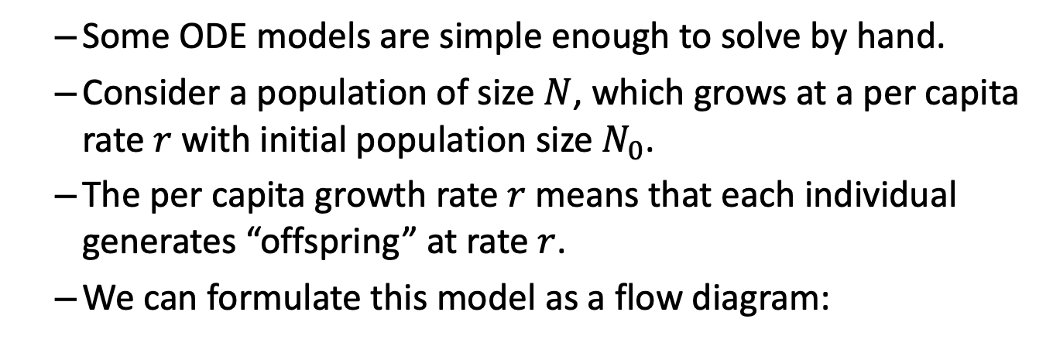
Population growth
Some ODE models are simple enough to solve by hand.
Consider a population of size $N$, which grows at a per capita rate $r$ with initial population size $N_{0}$.
The per capita growth rate $r$ means that each individual generates “offspring” at rate $r$.
We can formulate this model as a flow diagram:
N
$$r$$

Slide 10
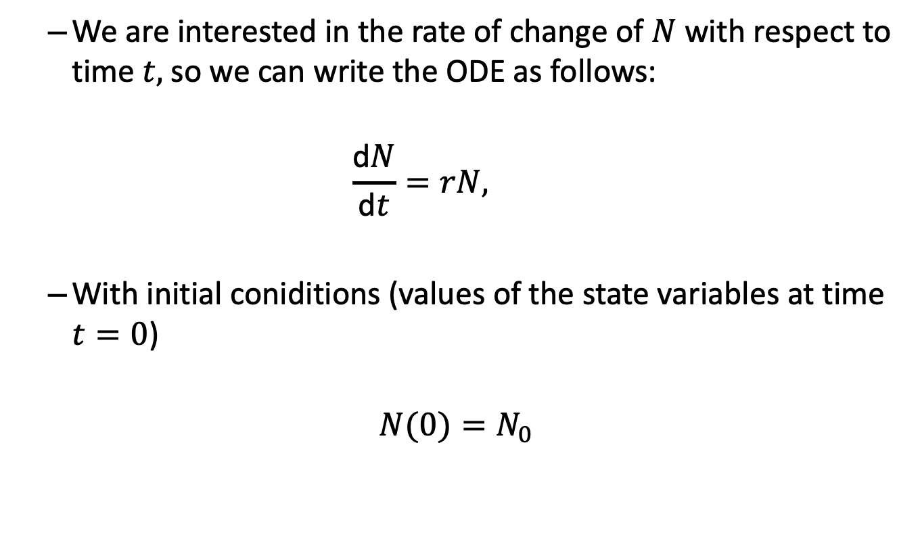
Population growth
We are interested in the rate of change of $N$ with respect to time $t,$so we can write the ODE as follows:
$$\frac{\text{d}N}{\text{d}t}=rN,$$
With initial coniditions (values of the state variables at time $t=0$)
$$N(0)=N_{0}$$

Slide 11
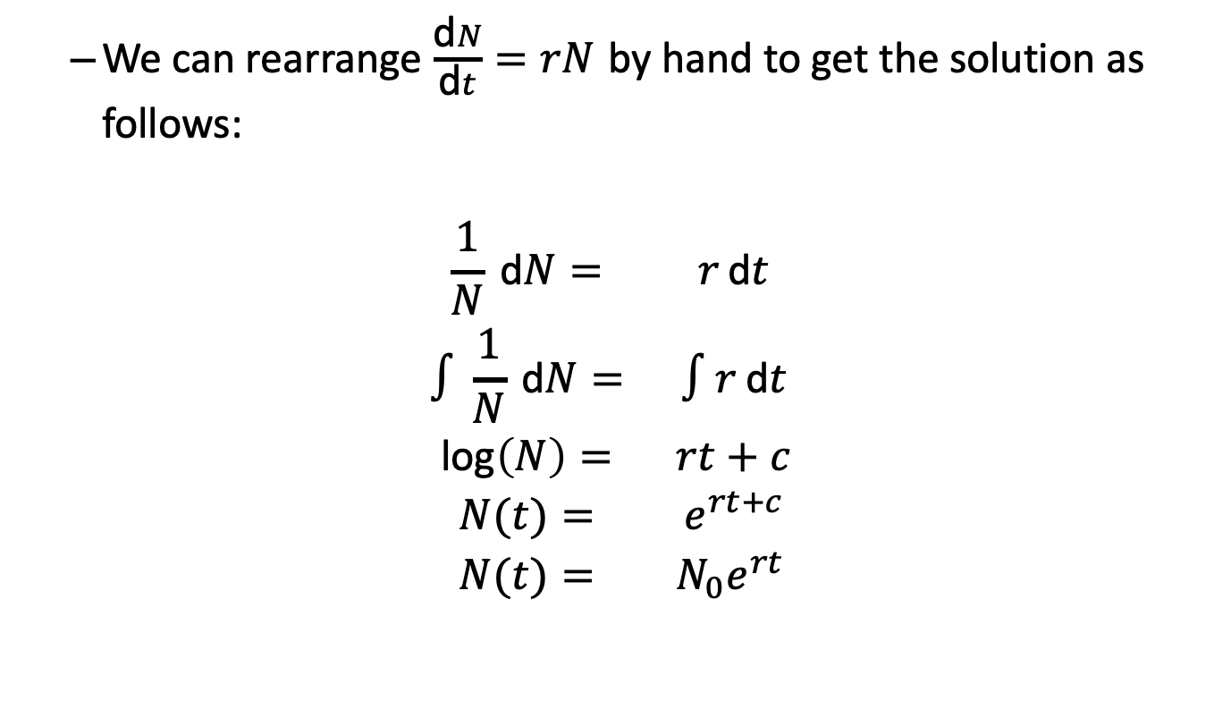
Population growth
We can rearrange $\frac{\text{d}N}{\text{d}t}=rN$ by hand to get the solution as follows:
$$\begin{matrix}\frac{1}{N} \text{d}N= & r \text{d}t \\ ∫\frac{1}{N} \text{d}N= & ∫r \text{d}t \\ \text{log}\left(N\right)= & rt+c \\ N(t)= & e^{rt+c} \\ N(t)= & N_{0}e^{rt}\end{matrix}$$

Slide 12
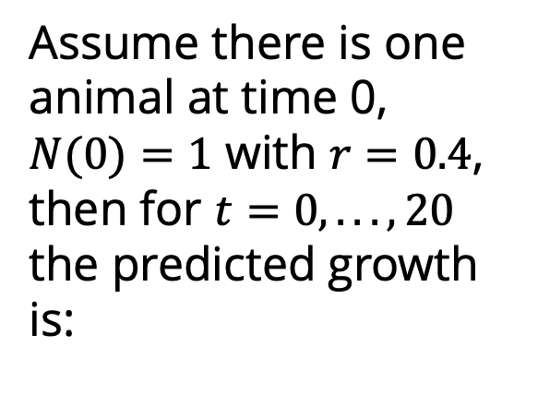
Population growth
Assume there is one animal at time 0, $N(0)=1$ with $r=0.4$, then for $t=0,...,20$ the predicted growth is:

Slide 13
Numerical solutions

Slide 14
Euler’s method
When you can’t find the solution by hand, numerical methods are required
Euler’s method finds numerical solutions using difference equations
This method approximates continuous time using discrete time steps

Slide 15
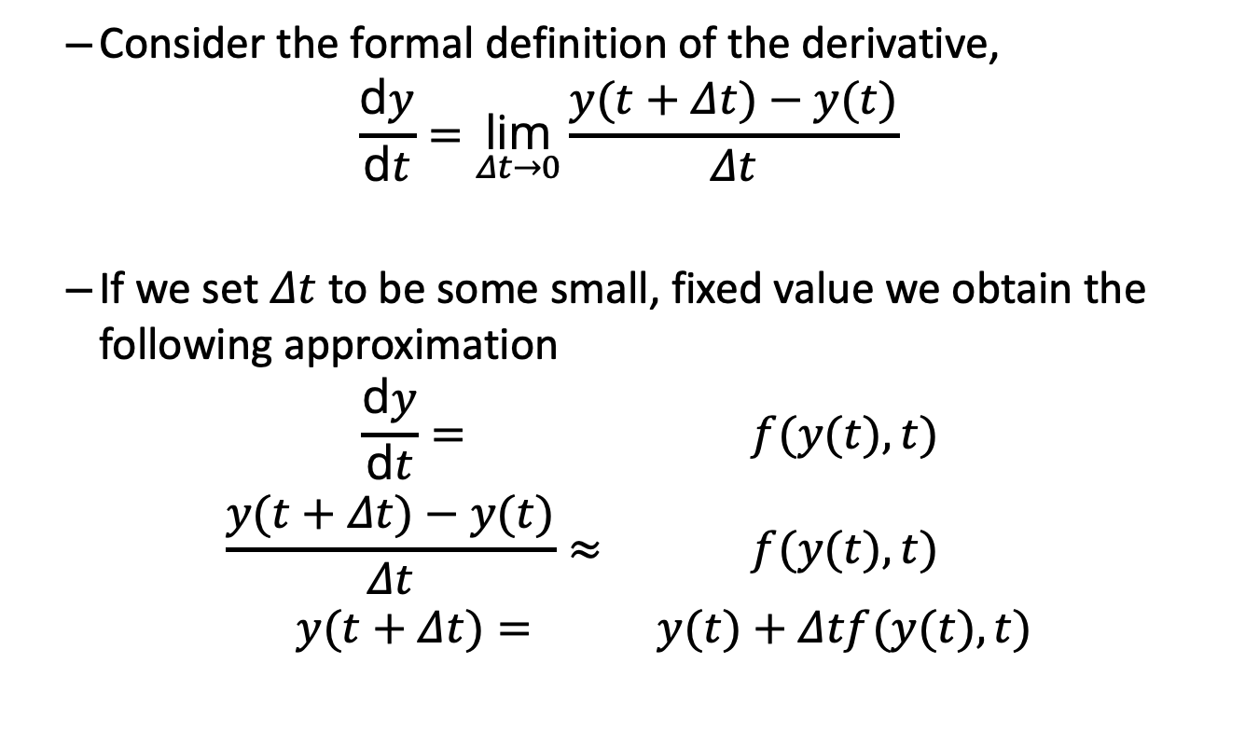
Euler’s method
Consider the formal definition of the derivative,
$$\frac{\text{d}y}{\text{d}t}=\underset{Δt→0}{\text{lim}}\frac{y(t+Δt)−y(t)}{Δt}$$
If we set $Δt$ to be some small, fixed value we obtain the following approximation
$$\begin{matrix}\frac{\text{d}y}{\text{d}t}= & f(y(t),t) \\ \frac{y(t+Δt)−y(t)}{Δt}≈ & f(y(t),t) \\ y(t+Δt)= & y(t)+Δtf(y(t),t)\end{matrix}$$

Slide 16
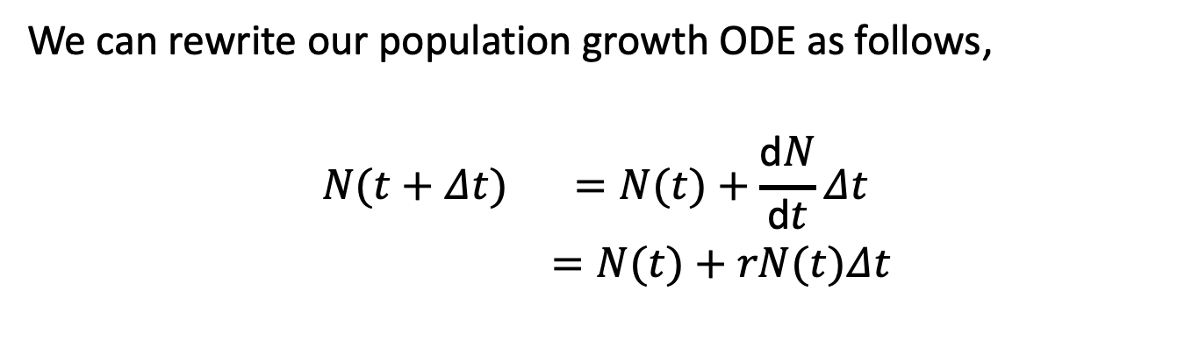
Euler’s method
We can rewrite our population growth ODE as follows,
$$\begin{matrix}N(t+Δt) & =N(t)+\frac{\text{d}N}{\text{d}t}Δt \\ & =N(t)+rN(t)Δt\end{matrix}$$

Slide 17
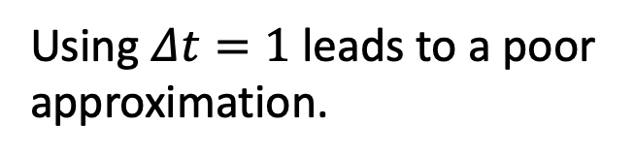
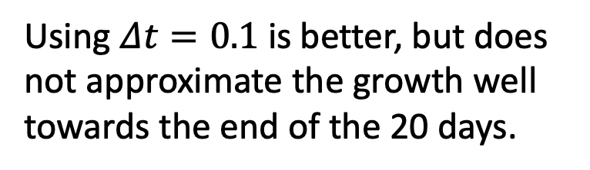
Euler’s method
Using $Δt=1$ leads to a poor approximation.
Using $Δt=0.1$ is better, but does not approximate the growth well towards the end of the 20 days.

Slide 18
What alternatives are there?
Runge-Kutta method
Commonly referred to as RK4
So called because it calculates 4 different increments in its approximation
We will implement this using the package deSolve

Slide 19
Using R package deSolve
R package which can numerically solve systems of differential equations using different integrators
Function ode() stands for ordinary differential equation
Inputs:
y, the initial conditions
times the time points to solve the ODE(s)
parms, a vector parameter values
func, a function describing the ODE(s)
Outputs:
a matrix consisting of the numerical solution to the equations and the times

Slide 20
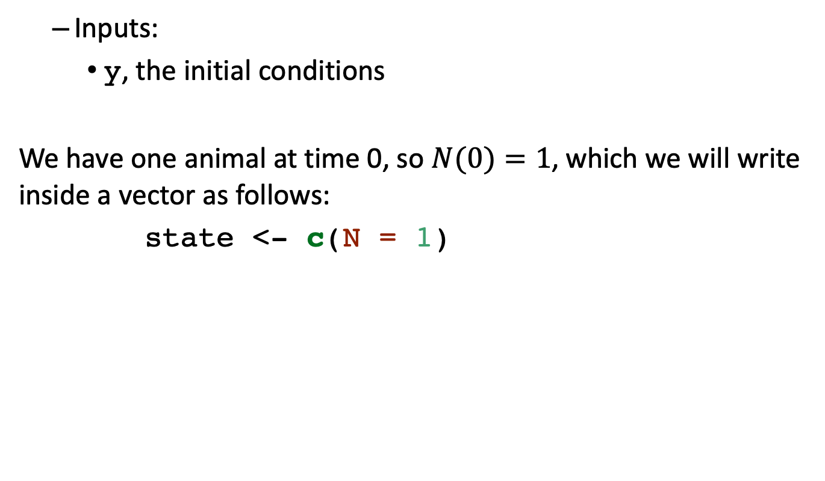
Solving the population growth model using deSolve
Inputs:
y, the initial conditions
We have one animal at time 0, so $N(0)=1$, which we will write inside a vector as follows:
state <- c(N = 1)

Slide 21
Solving the population growth model using deSolve
Inputs:
times the time points to solve the ODE(s)
Let’s solve the equation over a period of 20 days, which we will write inside a vector as follows:
times <- seq(from = 0, to = 20, by = 1)

Slide 22
Solving the population growth model using deSolve
Inputs:
parms, a vector parameter values
We have just one parameter, the growth rate:
parameters <- c(r = 0.4)

Slide 23
Solving the population growth model using deSolve
Inputs:
func, a function describing the ODE(s)
pop_model <- function(times, state, parms){ ## Define variables N <- state["N"] # Extract parameters r <- parms["r"] # Define differential equations dN <- r * N res <- list(c(dN)) return(res) }

Slide 24
Solving the population growth model using deSolve
# Solve equations output_raw <- ode(y = state, times = times, func = pop_model, parms = parameters, method = "euler") # Convert to data frame for easy extraction of columns output <- as.data.frame(output_raw) head(output)
## time N ## 1 0 1.00000 ## 2 1 1.40000 ## 3 2 1.96000 ## 4 3 2.74400 ## 5 4 3.84160 ## 6 5 5.37824

Slide 25
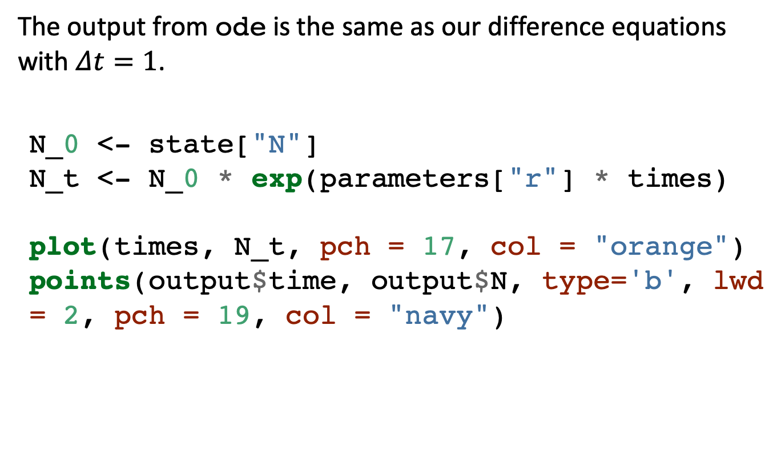
Solving the population growth model using deSolve
The output from ode is the same as our difference equations with $Δt=1$.
N_0 <- state["N"] N_t <- N_0 * exp(parameters["r"] * times) plot(times, N_t, pch = 17, col = "orange") points(output$time, output$N, type='b', lwd = 2, pch = 19, col = "navy")

Slide 26
Solving the population growth model using deSolve

Slide 27
Solving the population growth model using deSolve
output_raw_rk4 <- ode(y = state, times = times, func = pop_model, parms = parameters, method = "rk4") # Convert to data frame # for easy extraction of columns output_rk4 <- as.data.frame(output_raw_rk4) output_raw_euler <- ode(y = state, times = times, func = pop_model, parms = parameters, method = "euler") output_euler <- as.data.frame(output_raw_euler)

Slide 28
Solving the population growth model using deSolve
In the practical we will use RK4, BUT it will be up to you in your research to make sure that you know which method you are using and you why you are using it.

Slide 29
Susceptible Infected model

Slide 30
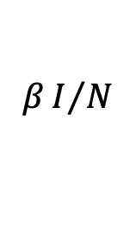

Susceptible Infected (SI) model
Individuals are either susceptible or infected
Susceptible individuals become infected via transmission rate $β$.
$$\begin{matrix}\frac{\text{d}S}{\text{d}t} & =−βSI/N \\ \frac{\text{d}I}{\text{d}t} & =βSI/N\end{matrix}$$
S
$$βI/N$$
I

Slide 31
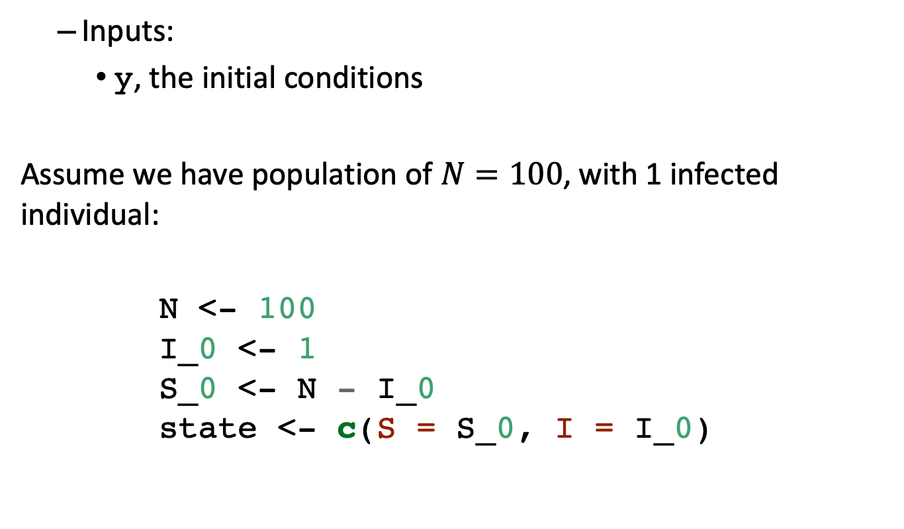
Solving SI model using deSolve
Inputs:
y, the initial conditions
Assume we have population of $N=100$, with 1 infected individual:
N <- 100 I_0 <- 1 S_0 <- N - I_0 state <- c(S = S_0, I = I_0)

Slide 32
Solving SI model using deSolve
Inputs:
times the time points to solve the ODE(s)
Let’s solve the equation over a period of 50 days, which we will write inside a vector as follows:
times <- seq(from = 0, to = 50, by = 1)

Slide 33
Solving SI model using deSolve
Inputs:
parms, a vector parameter values
We have just one parameter, the transmission rate:
parameters <- c(beta = 0.4)

Slide 34
Solving SI model using deSolve
Inputs:
func, a function describing the ODE(s)
SI_model <- function(times, state, parms){ ## Define variables S <- state["S"] I <- state["I"] N <- S + I # Extract parameters beta <- parms["beta"] # Define differential equations dS <- - (beta * S * I) / N dI <- (beta * S * I) / N res <- list(c(dS, dI)) return(res) }

Slide 35
Solving SI model using deSolve
# Solve equations output_raw <- ode(y = state, times = times, func = SI_model, parms = parameters, method = ”rk4") # Convert to data frame for easy extraction of columns output <- as.data.frame(output_raw) head(output)
## time S I ## 1 0 99.00000 1.000000 ## 2 1 98.60400 1.396000 ## 3 2 98.05340 1.946605 ## 4 3 97.28991 2.710090 ## 5 4 96.23525 3.764747 ## 6 5 94.78605 5.213953

Slide 36
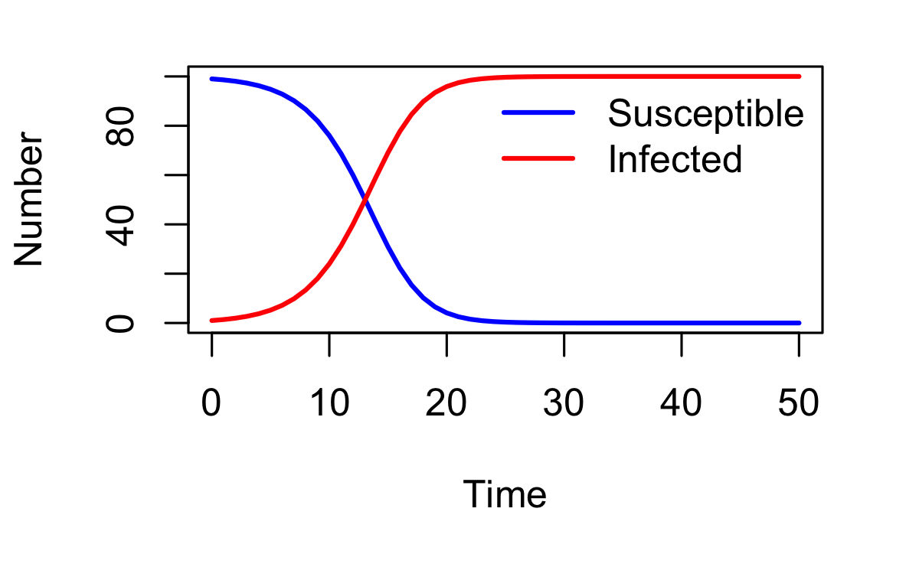
Solving SI model using deSolve

Slide 37
Practical part 1

Slide 38
Practical part 1
Open the file ‘04_ODEs/01_ODE_SIR.R’ and add your code to the existing script
Objective: Solve SI, SIR, SEIR models using deSolve
Answer questions 1, 2 and 3
Question 4 is optional

Slide 39
Practical part 1 - 04_ODEs/01_ODE_SIR.R
Around line 215…
# plot results
par(mfrow = c(1, 1))
plot(output$time, output$S, type = "l", col = "blue", lwd = 2, ylim = c(0, N),
xlab = "Time", ylab = "Number")
lines(output$time, output$I, lwd = 2, col = "red")
lines(output$time, output$R, lwd = 2, col = "green")
lines(output$time, output$E, lwd = 2, col = "cyan")
legend("topright",
legend = c("Susceptible", "Exposed", "Infected", "Recovered"),
lty = 1, col = c("blue", "red", "green", "cyan"), lwd = 2, bty = "n")
The four plot/lines commands should be:
plot(output$time, output$S, type = "l", col = "blue", lwd = 2, ylim = c(0, N),
xlab = "Time", ylab = "Number")
lines(output$time, output$E, lwd = 2, col = "red")
lines(output$time, output$I, lwd = 2, col = "green")
lines(output$time, output$R, lwd = 2, col = "cyan")

Slide 40
Part 1 summary
There is a defined list of outputs that you need to tailor to your model
Inputs:
y, the initial conditions
times the time points to solve the ODE(s)
parms, a vector parameter values
func, a function describing the ODE(s)
Be aware of what ‘method’ is being used to numerically solve your model

Slide 41
Advanced use of deSolve package

Slide 42
Advanced use of deSolve package
Speeding up code,
Using Rcpp
Different types of models,
Time dependent parameters
Using ‘events’ in deSolve
method ="lsoda"

Slide 43
Using Rcpp
Rcpp is a CRAN package that provides a interface between R and C++
The func input in ode can be written in Rcpp
Why? speed

Slide 44
Using Rcpp
#include <Rcpp.h> using namespace Rcpp; // [[Rcpp::export]] List SIR_cpp_model(NumericVector times,NumericVector state, NumericVector parms) { // Define variables double S = state["S"]; double I = state["I"]; double R = state["R"]; double N = S + I + R; // Extract parameters double beta = parms["beta"]; double gamma = parms["gamma"]; // Define differential equations double dS = - (beta * S * I) / N; double dI = (beta * S * I) / N - gamma * I; double dR = gamma * I; NumericVector res_vec = NumericVector::create(dS, dI, dR ); List res = List::create(res_vec); return(res); }

Slide 45

Time dependent parameters
Recall the SI model is written as follows:
$$\begin{matrix}\frac{\text{d}S}{\text{d}t} & =−βSI/N \\ \frac{\text{d}I}{\text{d}t} & =βSI/N\end{matrix}$$

Slide 46
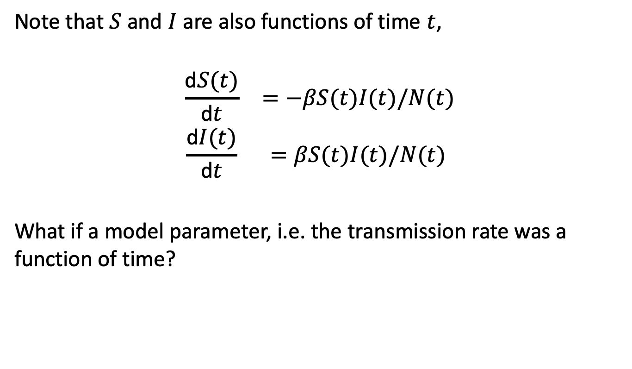
Time dependent parameters
Note that $S$ and $I$ are also functions of time $t$,
$$\begin{matrix}\frac{\text{d}S(t)}{\text{d}t} & =−βS(t)I(t)/N(t) \\ \frac{\text{d}I(t)}{\text{d}t} & =βS(t)I(t)/N(t)\end{matrix}$$
What if a model parameter, i.e. the transmission rate was a function of time?

Slide 47
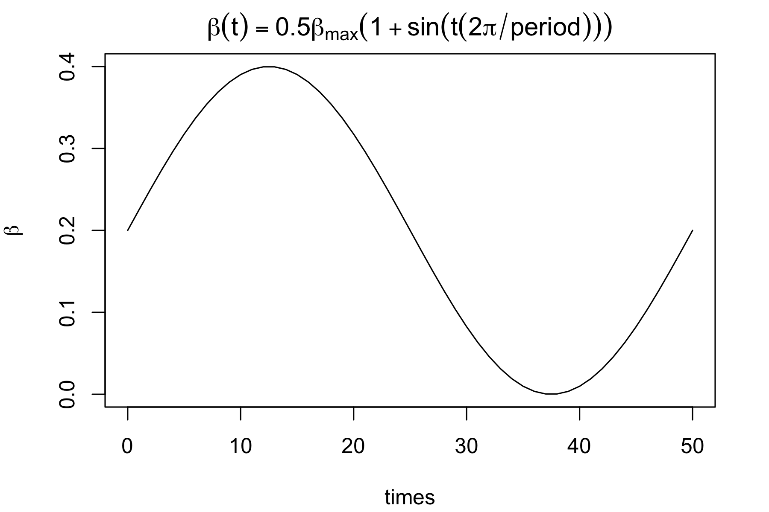
Time dependent parameters

Slide 48
Time dependent parameters
SI_seasonal_model <- function(times, state, parms){ ## Define variables S <- state["S"] I <- state["I"] N <- S + I # Extract parameters beta_max <- parms["beta_max"] period <- parms["period"] # Calculate time dependent transmission rate beta <- beta_max / 2 * (1 + sin(times * (2 * pi / period) ) ) # Define differential equations dS <- - (beta * S * I) / N dI <- (beta * S * I) / N res <- list(c(dS, dI)) return(res) }

Slide 49
method = "lsoda"
deSolve has a useful method option called lsoda
switches automatically between stiff and non-stiff methods
what is a stiff problem?
broadly, rapid changes in state variables
why is it a problem?
some numerical methods will lead to poor approximation
We will use this in events

Slide 50
Using ‘events’ in deSolve
deSolve has the capability to include ‘events’
This can be used when you want to change the value of a state variable based on some condition
Events can be specified as a data.frame, or in a function.
Events can also be triggered by a root function.
use a data.frame to specify times at which events occur
use root function to trigger an event based on some condition

Slide 51
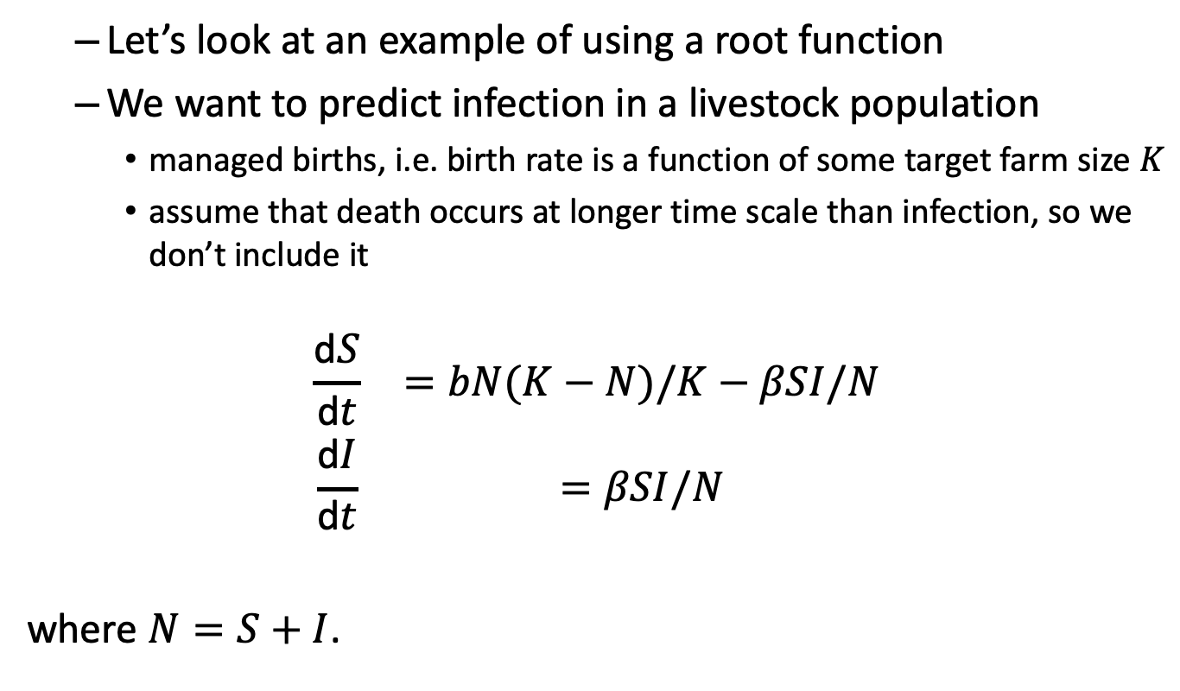
Using ‘events’ in deSolve
Let’s look at an example of using a root function
We want to predict infection in a livestock population
managed births, i.e. birth rate is a function of some target farm size $K$
assume that death occurs at longer time scale than infection, so we don’t include it
$$\begin{matrix}\frac{\text{d}S}{\text{d}t} & =bN(K−N)/K−βSI/N \\ \frac{\text{d}I}{\text{d}t} & =βSI/N\end{matrix}$$
where $N=S+I$.

Slide 52
Using ‘events’ in deSolve
We have our model function,
SI_open_model <- function(times, state, parms){ ## Define variables S <- state["S"] I <- state["I"] N <- S + I # Extract parameters beta <- parms["beta"] K <- parms["K"] b <- parms["b"] # Define differential equations dS <- b * N * (K - N) / K - ( beta * S * I) / N dI <- (beta * S * I) / N res <- list(c(dS, dI)) return(res) }

Slide 53
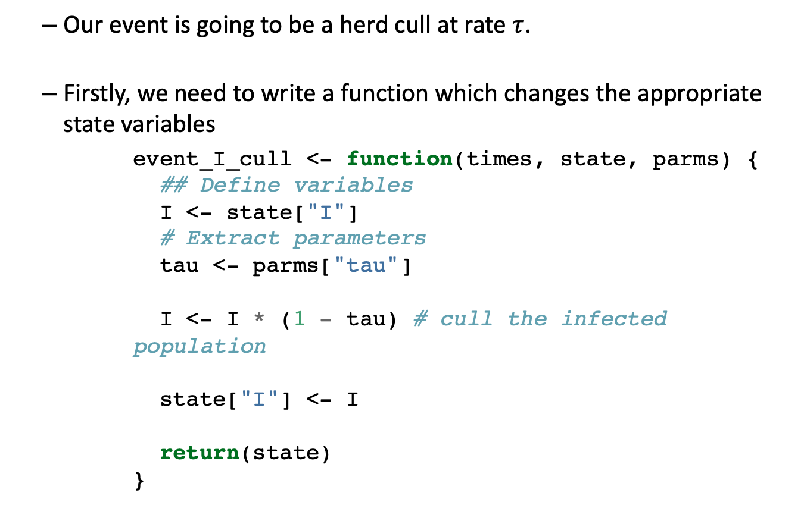
Using ‘events’ in deSolve
Our event is going to be a herd cull at rate $τ$.
Firstly, we need to write a function which changes the appropriate state variables
event_I_cull <- function(times, state, parms) { ## Define variables I <- state["I"] # Extract parameters tau <- parms["tau"] I <- I * (1 - tau) # cull the infected population state["I"] <- I return(state) }

Slide 54
Using ‘events’ in deSolve
Secondly, we need to write a function which triggers the event
root <- function(times, state, parms){ ## Define variables S <- state["S"] I <- state["I"] N <- S + I # Extract parameters K <- parms["K"] # Our condition is if more than half of the target herd size becomes infected condition <- !(I > K * 0.5) # This is a logical condition (TRUE/FALSE) return(as.numeric(condition)) # Make this numeric, event occurs if root==0 }

Slide 55
Using ‘events’ in deSolve
output_raw <- ode(y = state, times = times, func = SI_open_model, parms = parameters, method = "lsoda", events = list(func = event_I_cull, root = TRUE), rootfun = root)
What does the output look like?

Slide 56
Practical part 2

Slide 57
Practical part 2
Download the file ’04_ODEs/02_ODE_Extras.R’ and add your code to the existing script
Objective : implement SIR with time dependent transmission and use the events function in deSolve
Answer questions 1,2
Question 3 is optional

Slide 58
Summary
Baseline structure of `deSolve`
Be aware of what `method’ is being used to solve your ODEs
`deSolve` has many different types of extensions!
Soetaert, K., Petzoldt, T. & Setzer, R.W. (2010) Solving differential equations in R: Package deSolve. Journal of Statistical Software, 33, 1–25.

